Slide 1
Demo: Unified Data Catalog for Military Aircraft
Scenario 3: Extend Catalog to Data & AI Workbench
Frank Lee, Joanna Wong, Reginald D’Souza
https://github.com/drfranknlee/demo-udc-aircraft

Slide 2
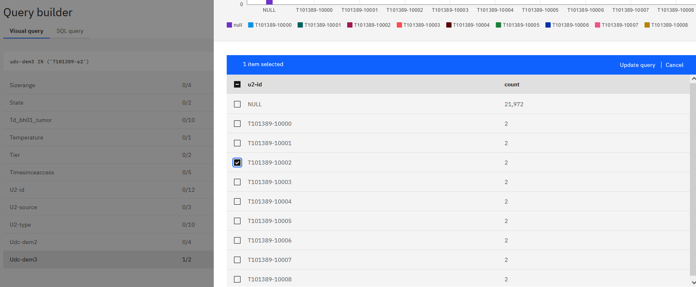
Use Visual Query to Browse and Search for Data with ImageID=T101389-10002

Slide 3
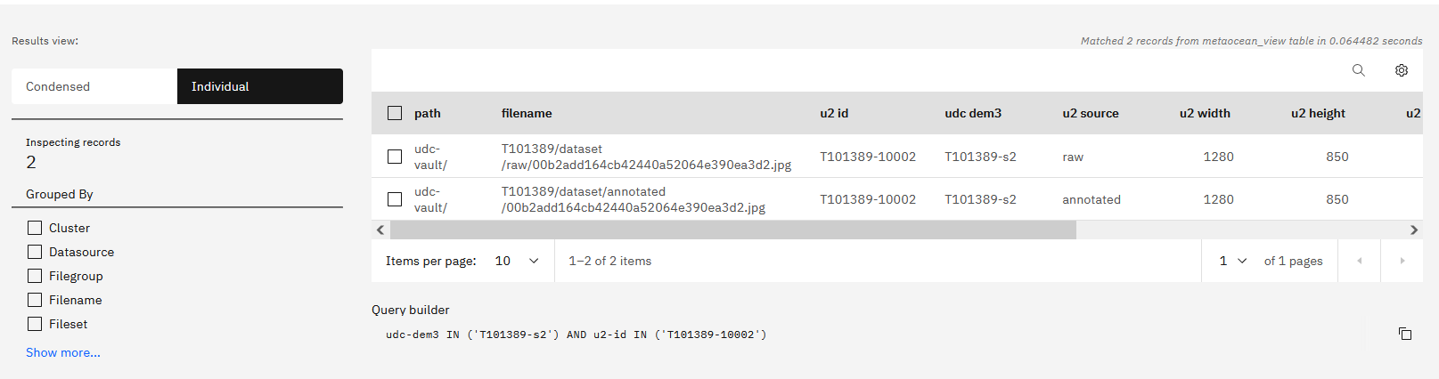
Use Visual Query to Browse and Search for Data with ImageID=T101389-10002: Result

Slide 4
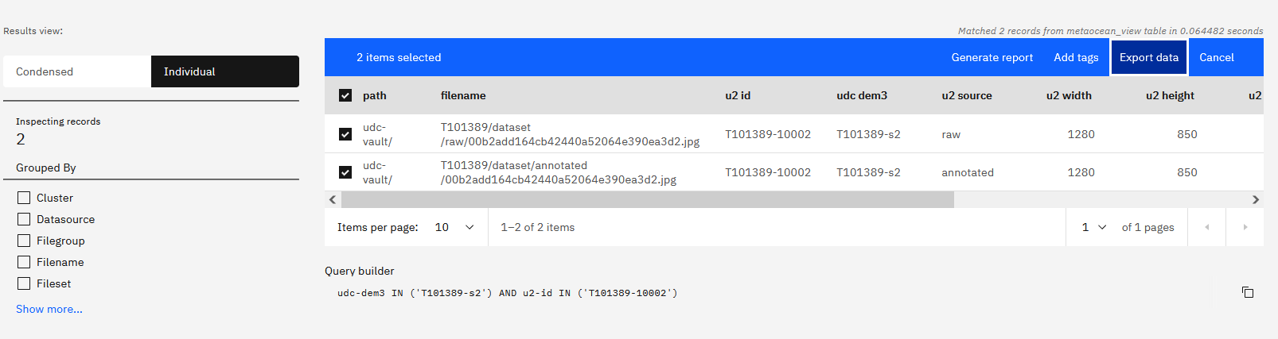
Select files to be Exported to Watson Knowledge Catalog (in Cloud Pak for Data)

Slide 5
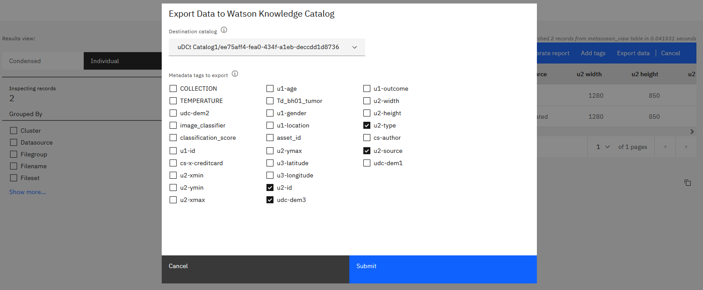
Select Metadata Tags to be Exported to Watson Knowledge Catalog “uDCt Catalog1”

Slide 6
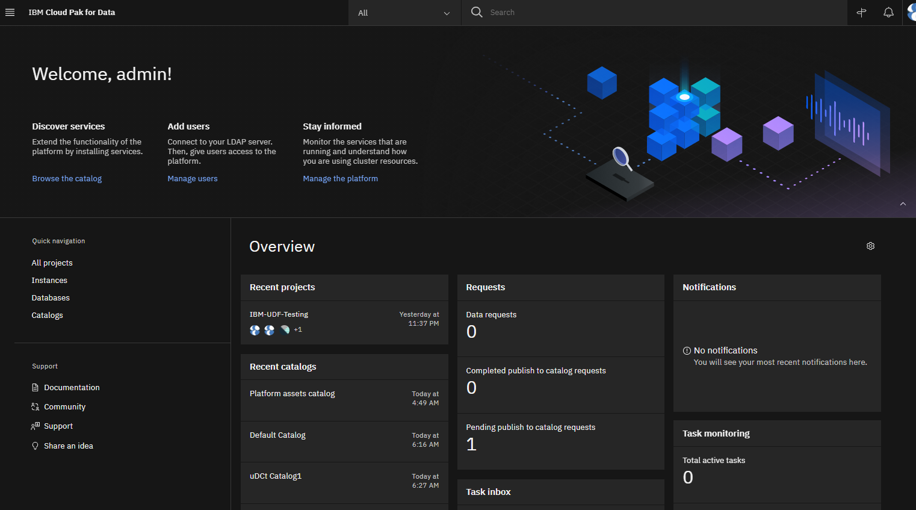

Slide 7
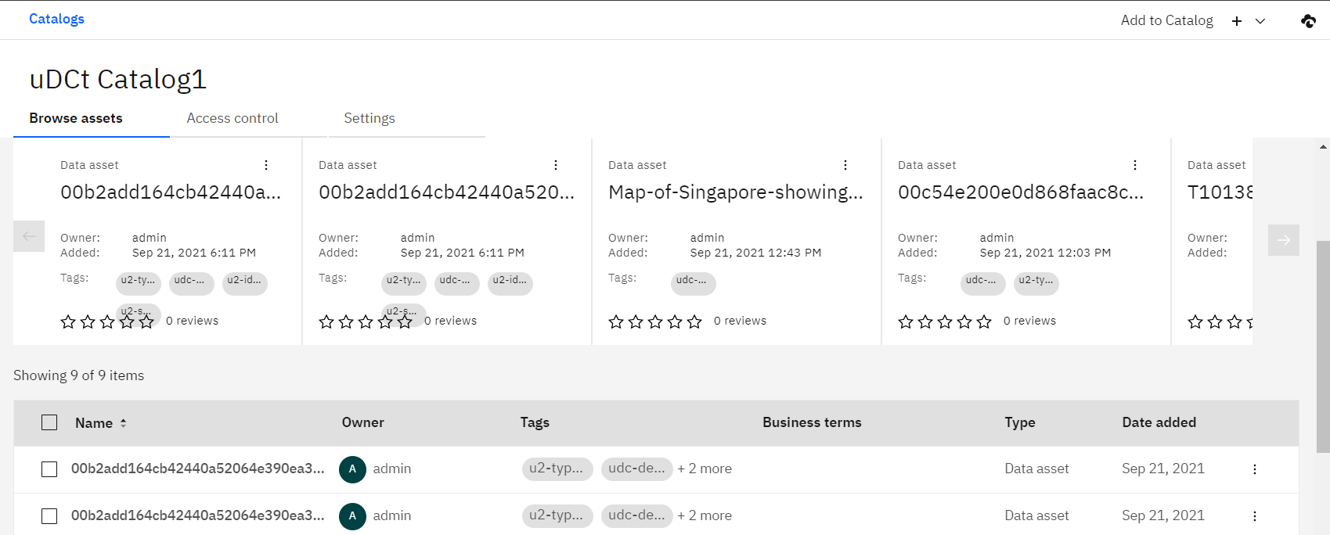
Watson Knowledge Catalog “uDCt Catalog1”

Slide 8
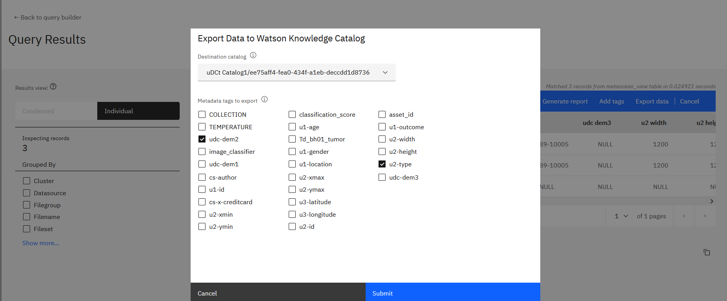
Export dataset to WKC Catalog1

Slide 9
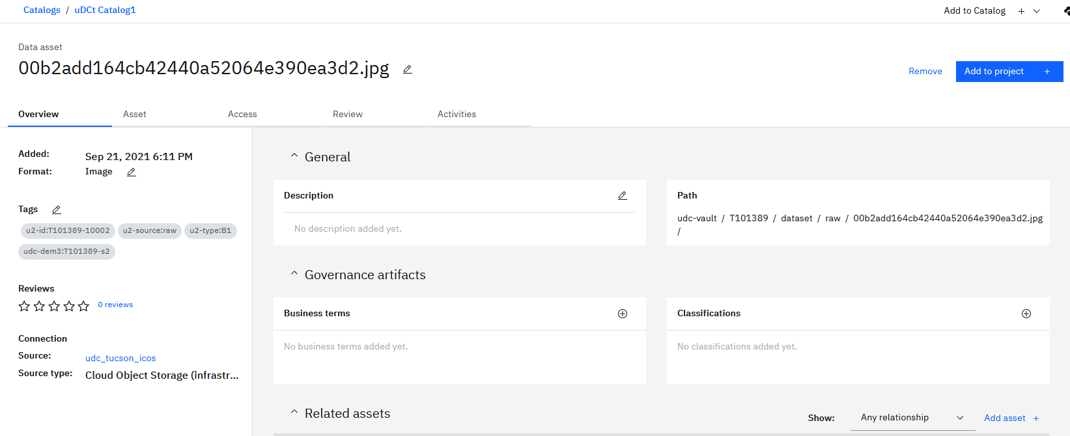
T101389-10002-Raw – Data Asset View

Slide 10
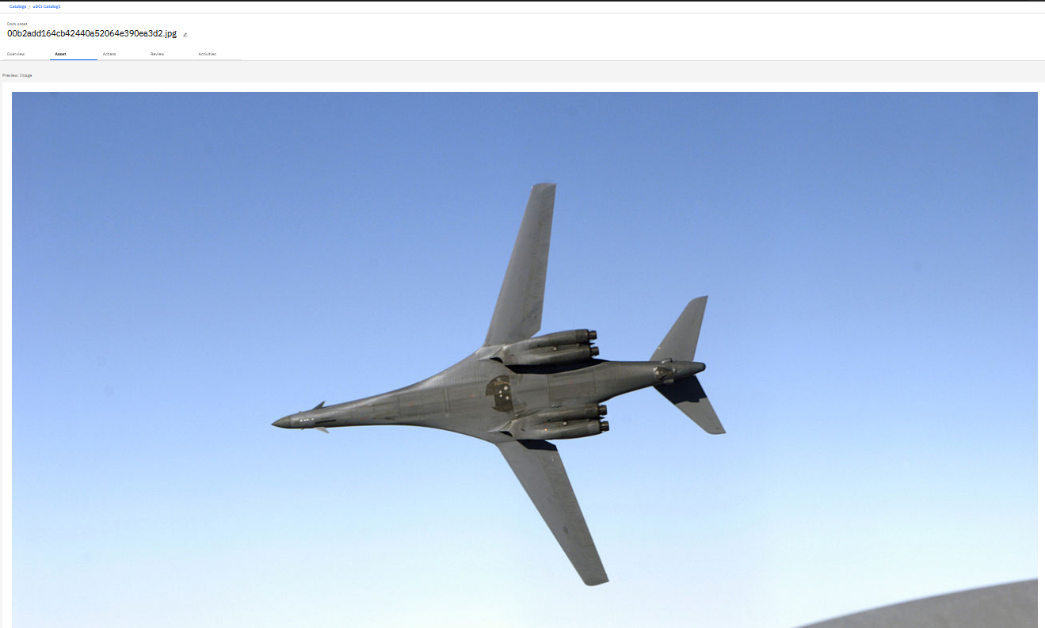
T101389-10002-Annotated – Data Asset View

Slide 11
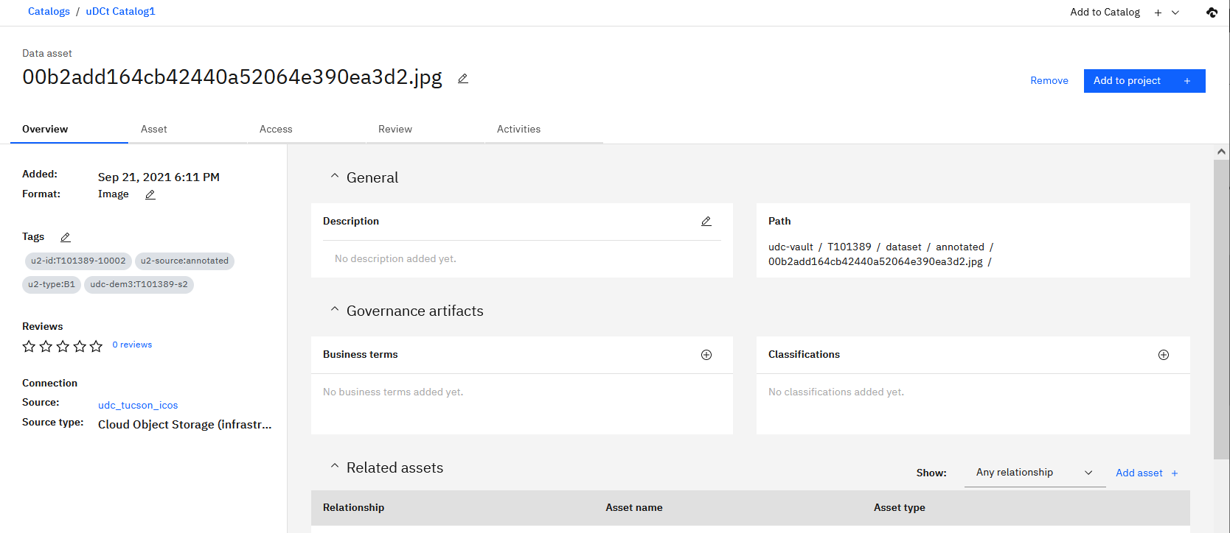
T101389-10002-Annotated – Data Asset View

Slide 12
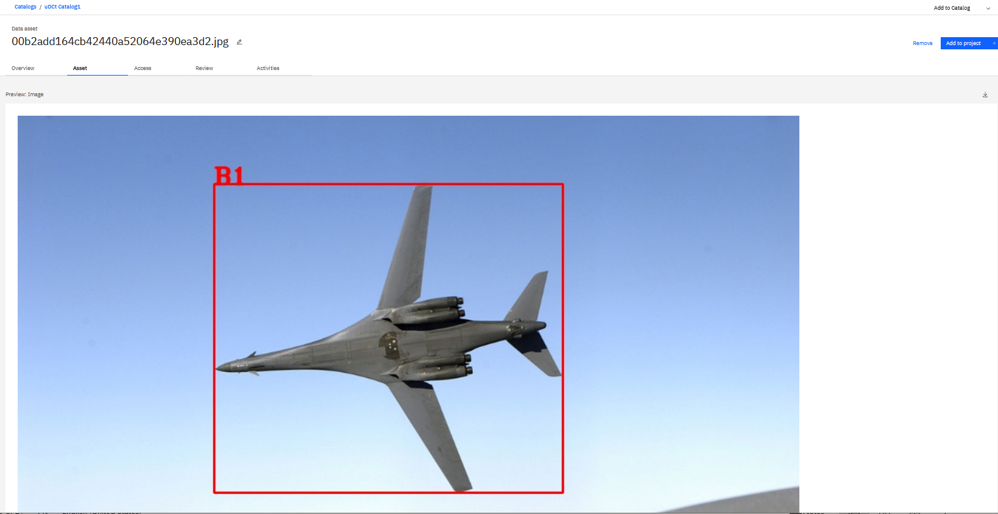
T101389-10002-Annotated – Data Asset View

Slide 13
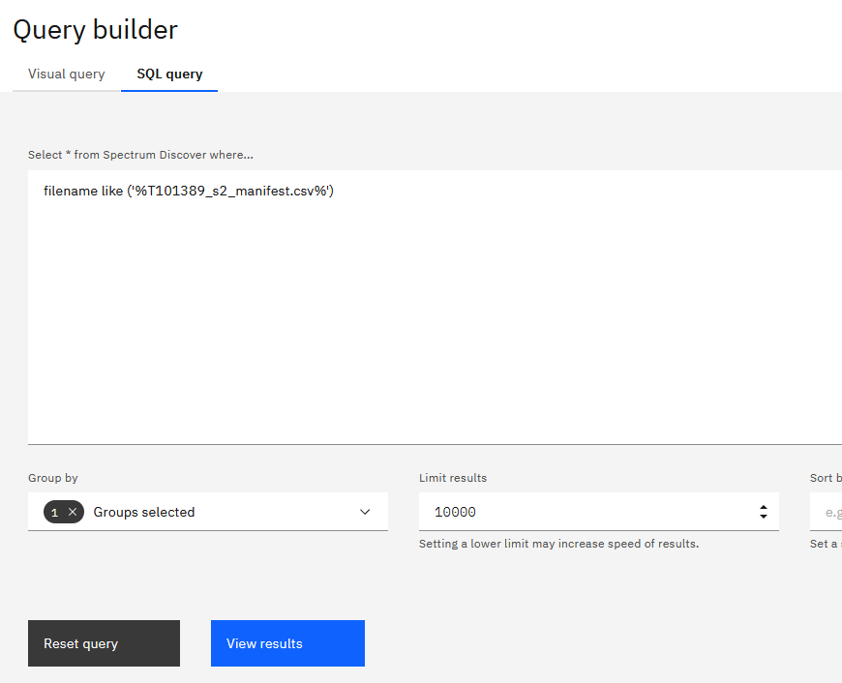
Find the T101389-s2 Master Manifest

Slide 14
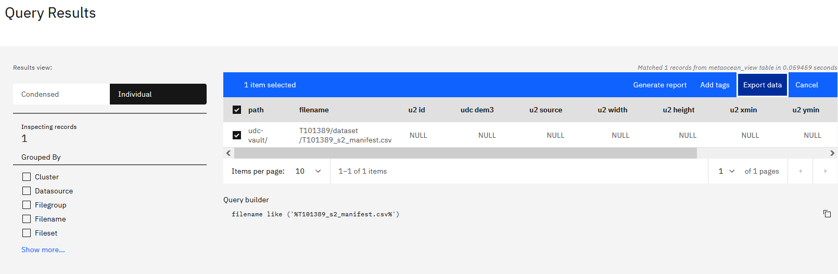
Find the T101389-s2 Master Manifest: Result

Slide 15
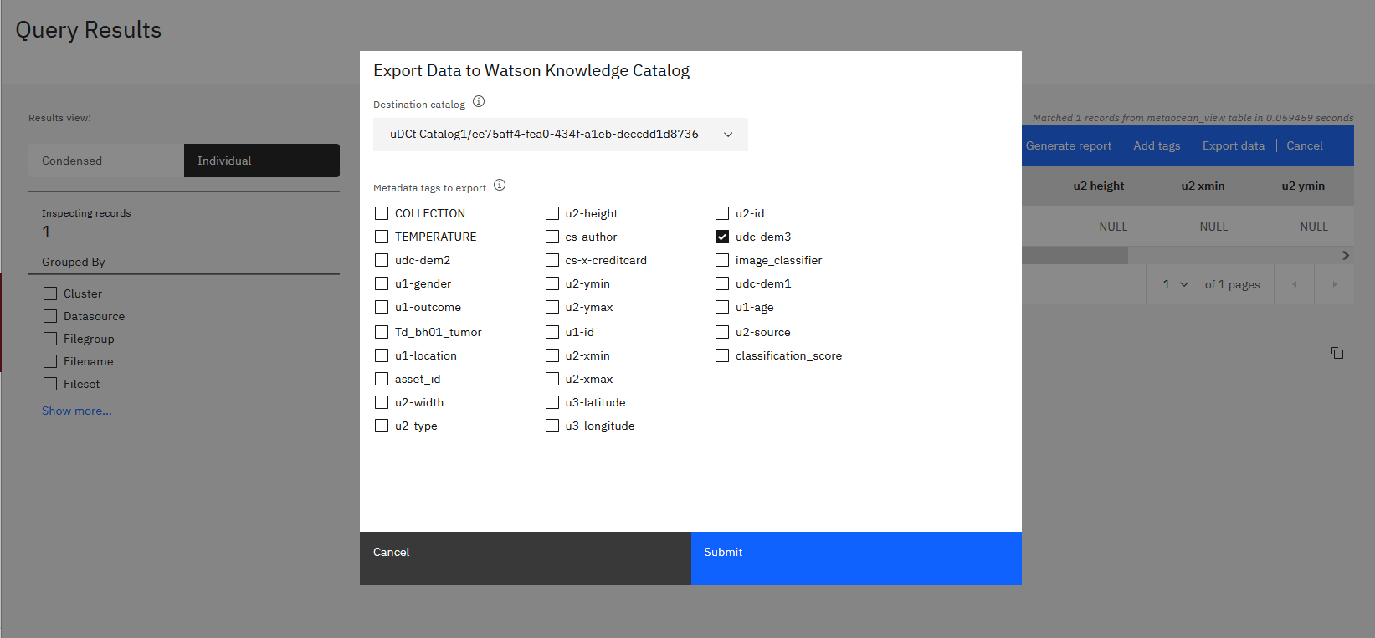
Export Manifest to WKC/CP4D

Slide 16
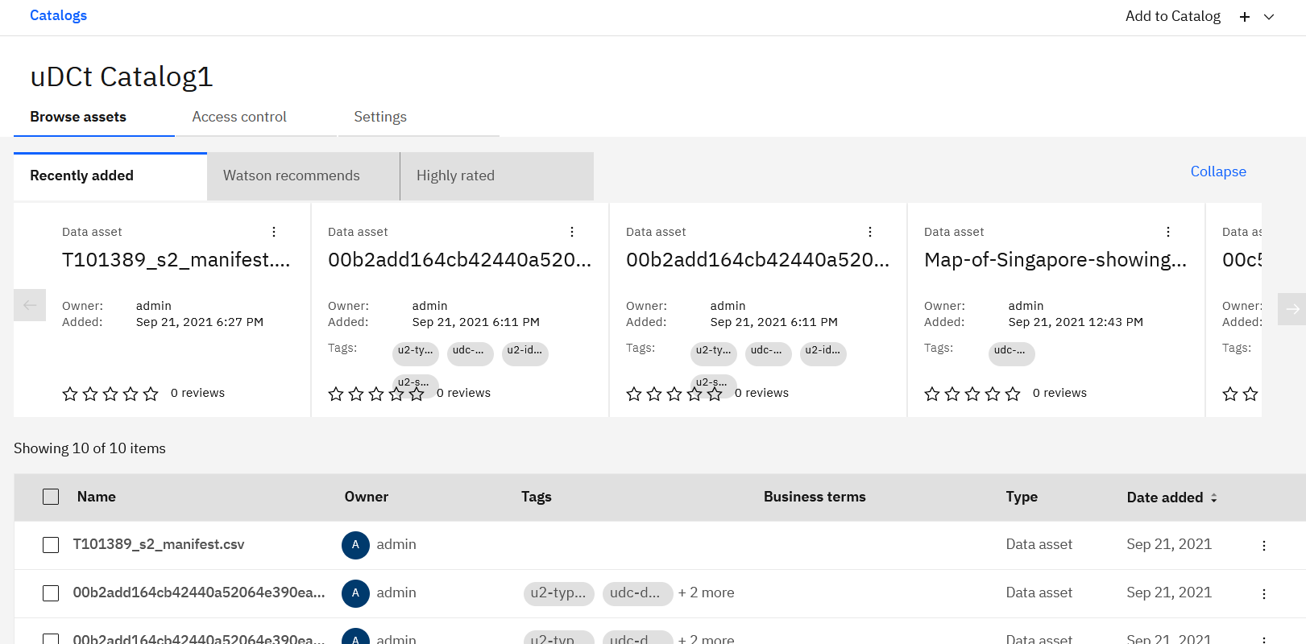
Manifest (T101389_s2_manifest.csv) Exported to WKC

Slide 17
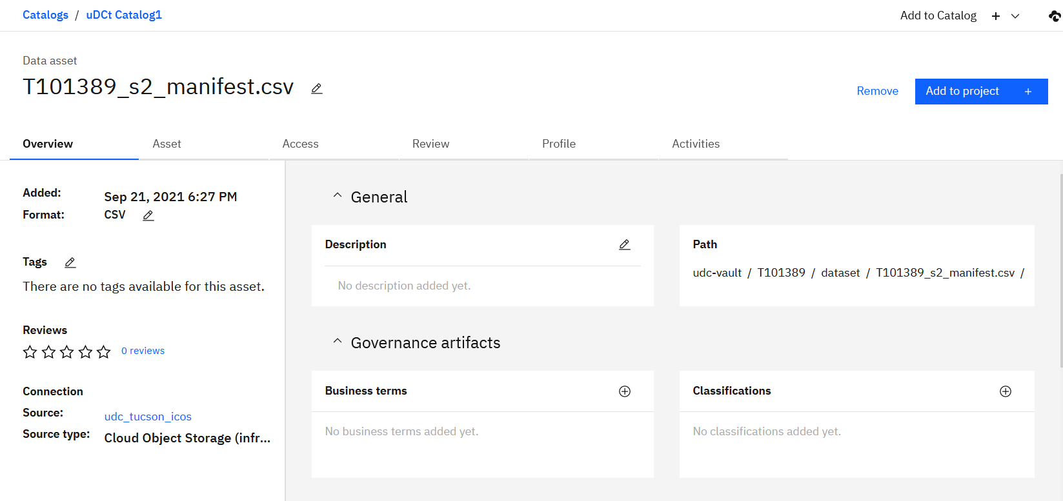
Working with the Manifest in WKC

Slide 18
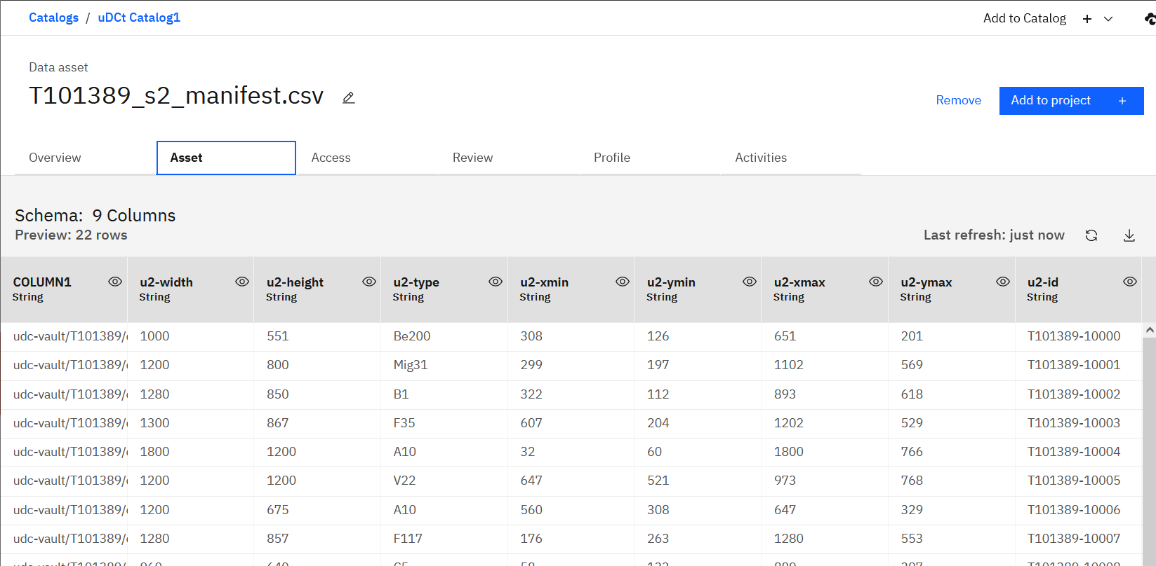
Working with the Manifest in WKC

Slide 19
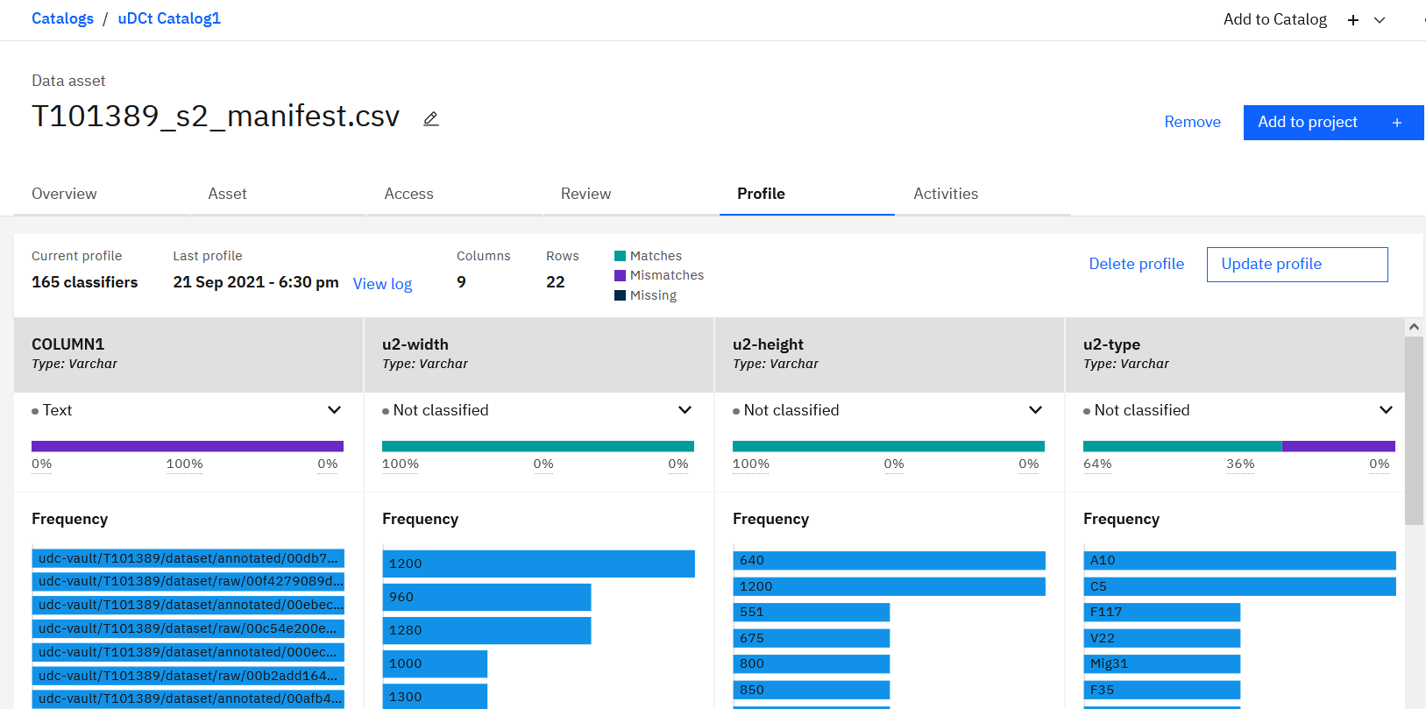
Working with the Manifest in WKC

Slide 20
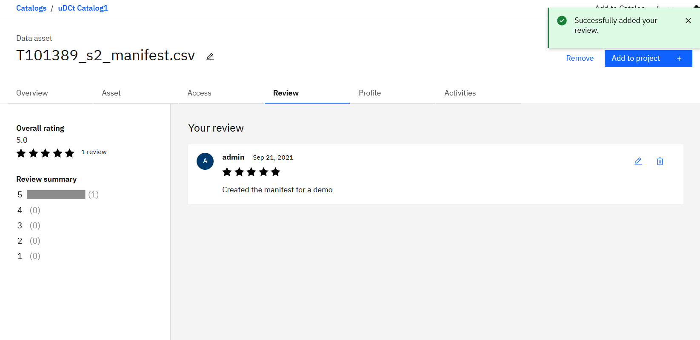
Working with the Manifest in WKC

Slide 21
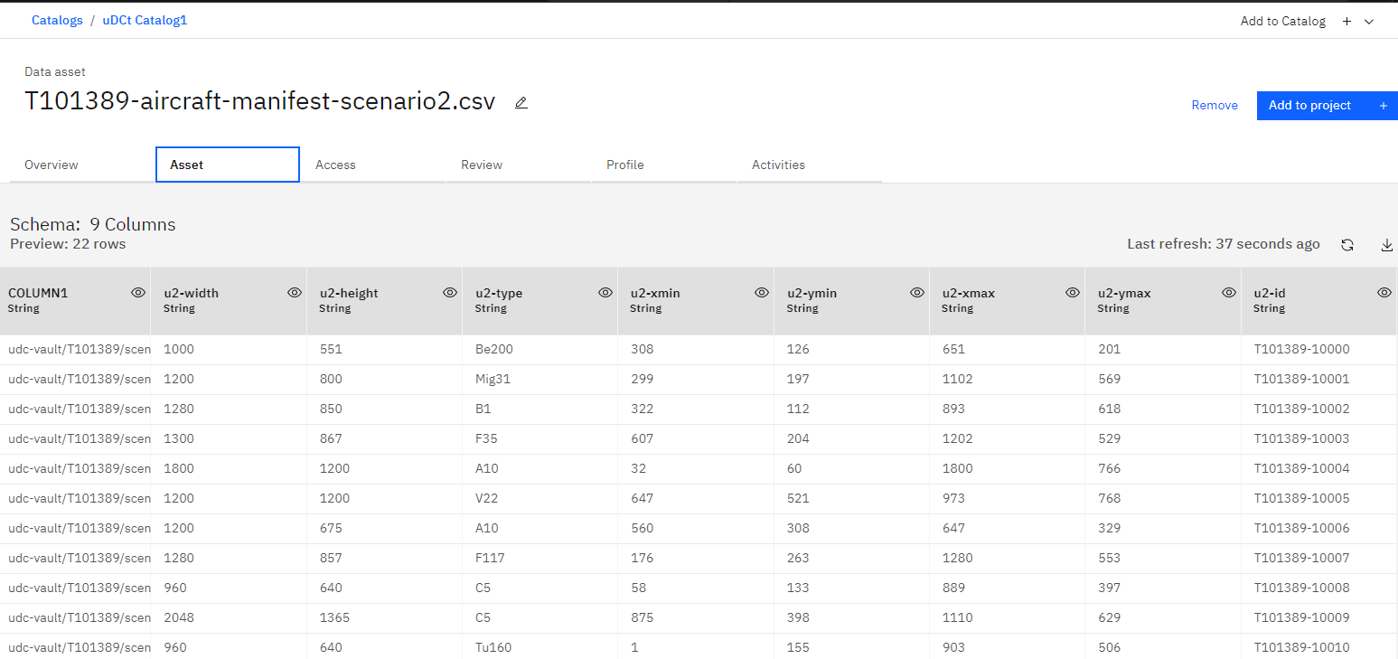
Working with the Manifest

Slide 22
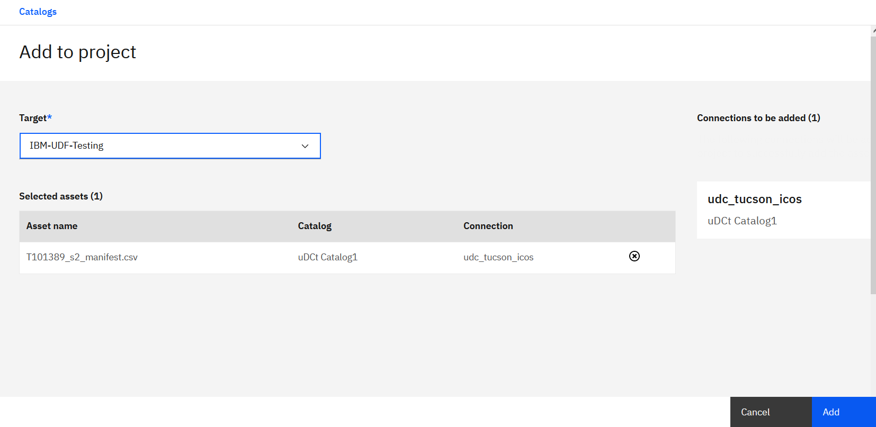
Add Manifest to Project “IBM-UDF-Testing”

Slide 23
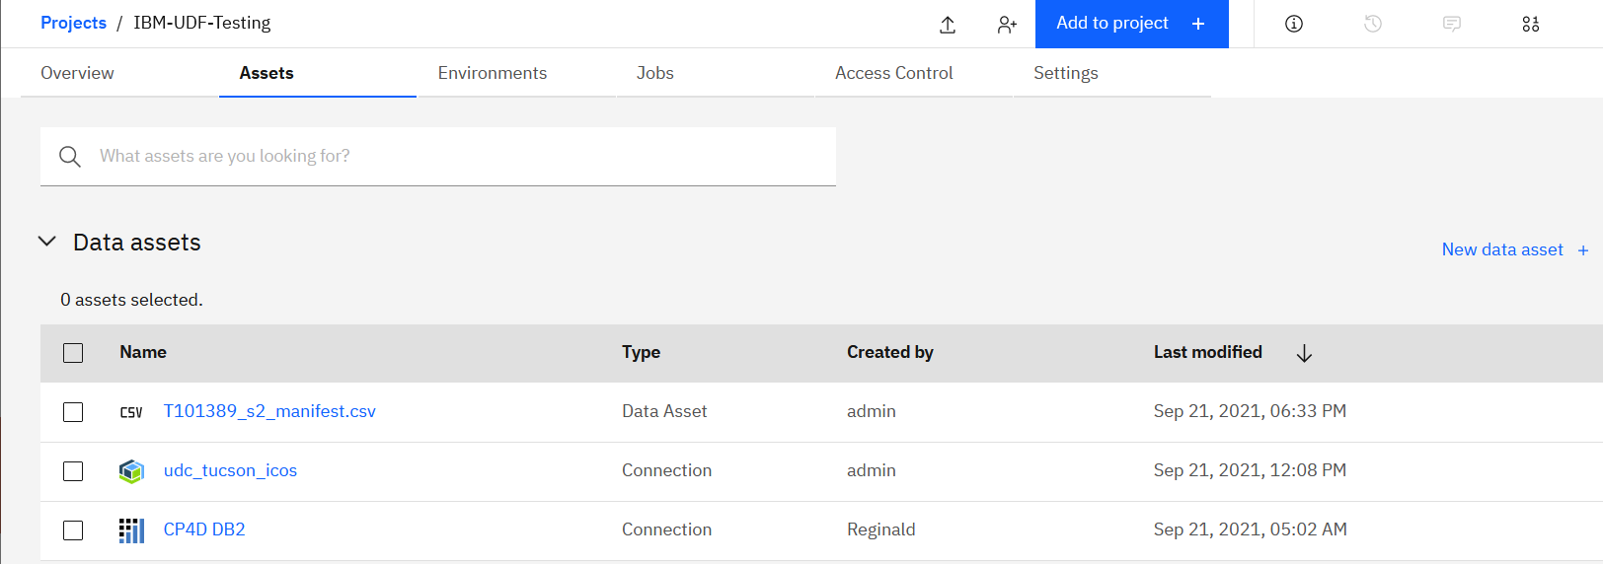
Manifest available as Data Asset in Project (Watson Studio)

Slide 24
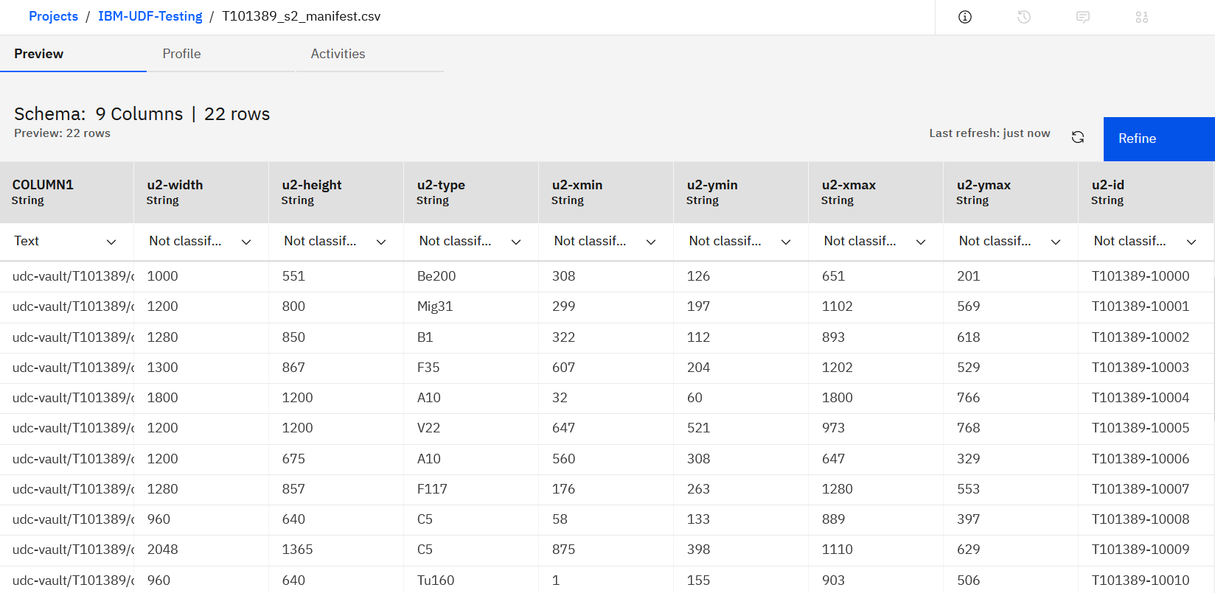
Working with the Manifest: Refine the Manifest in Data Refinery

Slide 25
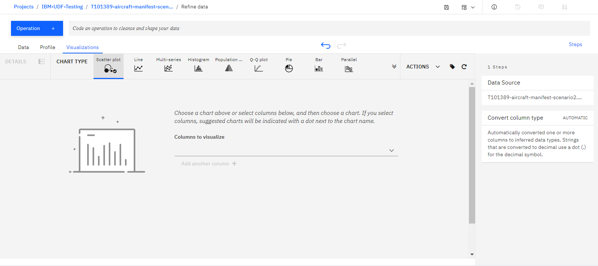
Working with the Manifest: Refine the Manifest in Data Refinery – Visualization

Slide 26
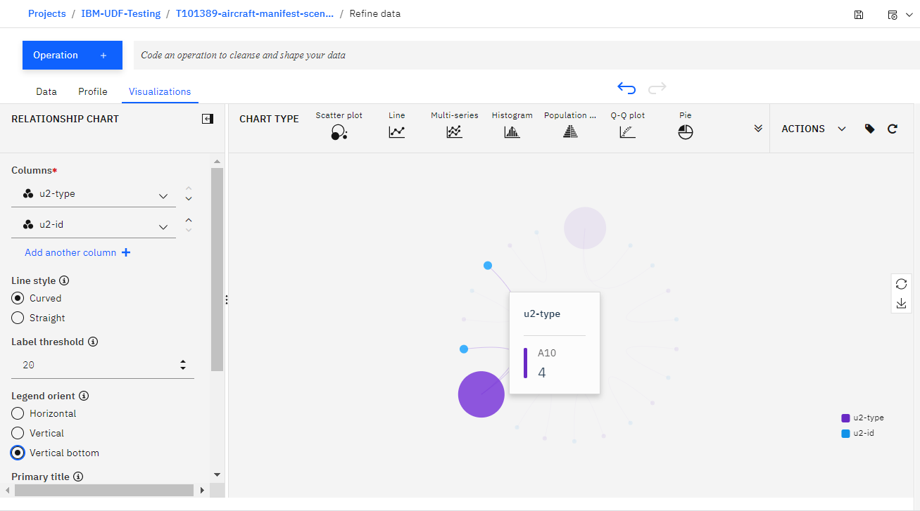
Working with the Manifest: Refine the Manifest in Data Refinery – Visualization

Slide 27
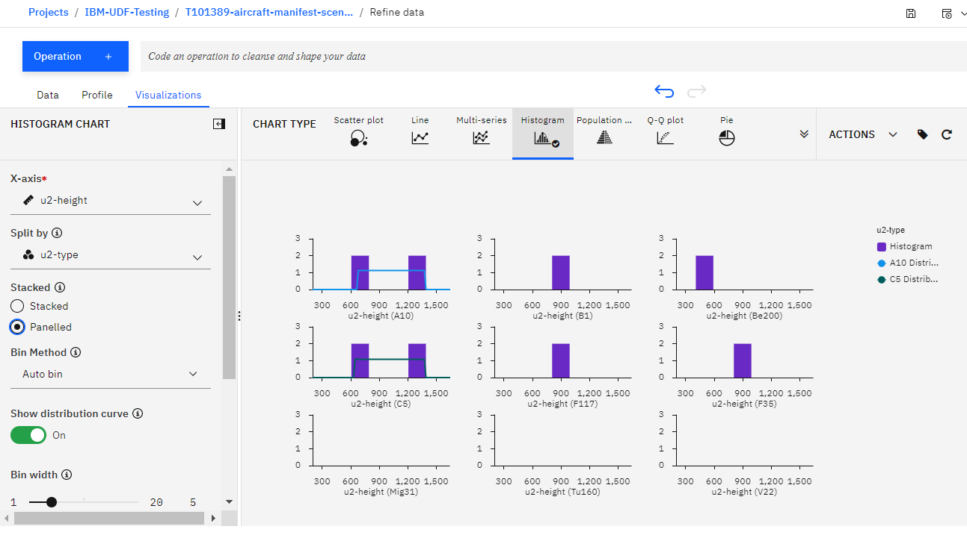
Working with the Manifest: Refine the Manifest in Data Refinery – Visualization

Slide 28
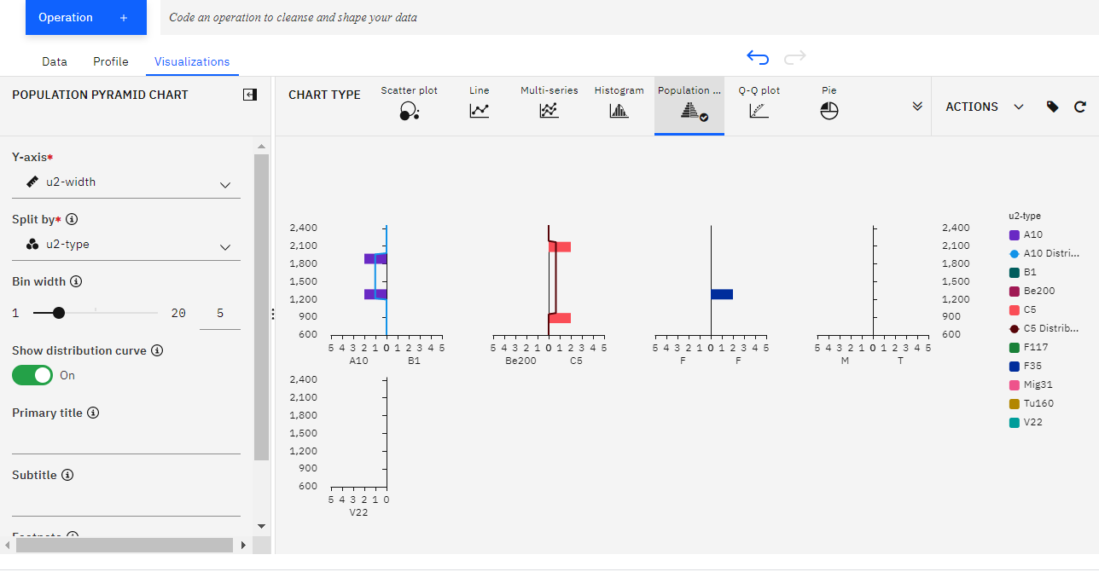
Working with the Manifest: Refine the Manifest in Data Refinery – Visualization

