Slide 1
Demo: Unified Data Catalog for Aircraft Images
Scenario 5: Extract Metadata with Deep-Inspection & AI Model
Frank Lee, Joe Dain
https://github.com/drfranknlee/demo-udc-aircraft

Slide 2
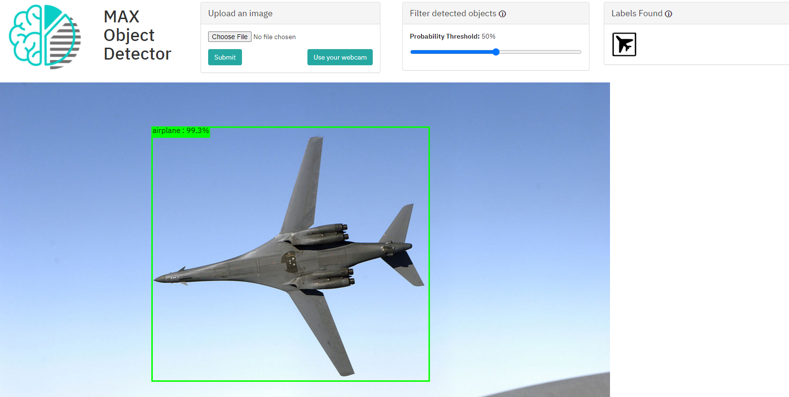

Slide 3
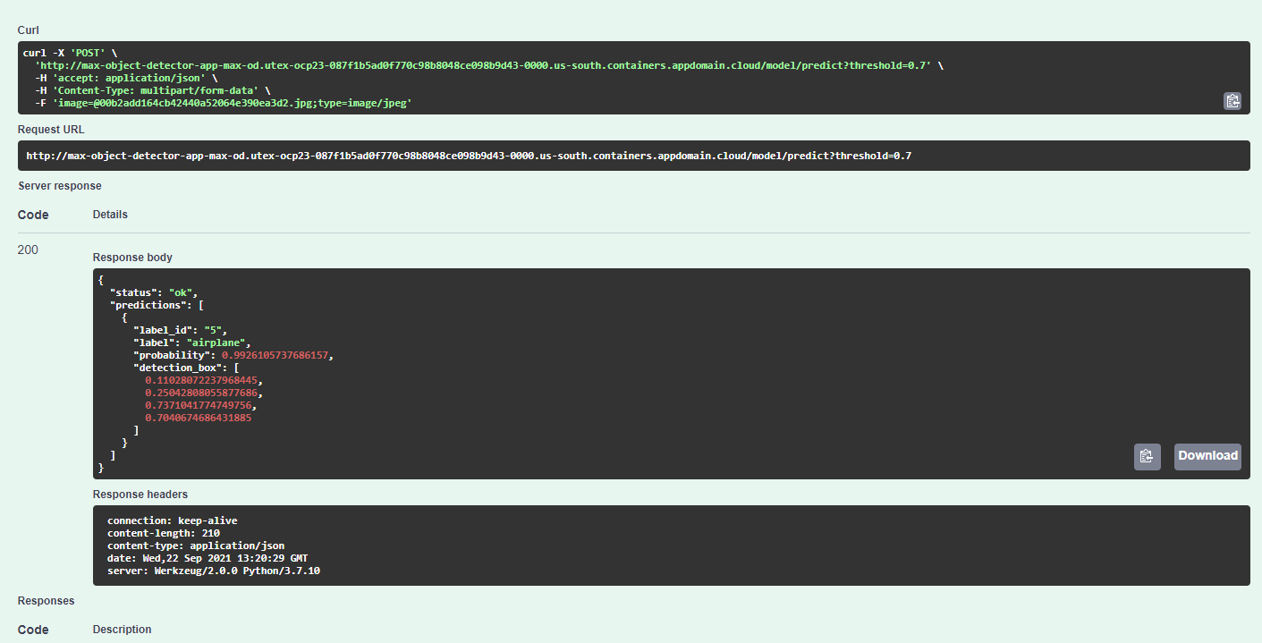
http://max-object-detector-app-max-od.utex-ocp23-087f1b5ad0f770c98b8048ce098b9d43-0000.us-south.containers.appdomain.cloud/

