Slide 1
Demo: Unified Data Catalog for Military Aircraft
Scenario 3: Extend Catalog to Data & AI Workbench
Frank Lee, Joanna Wong
https://github.com/drfranknlee/demo-udc-aircraft

Slide 2
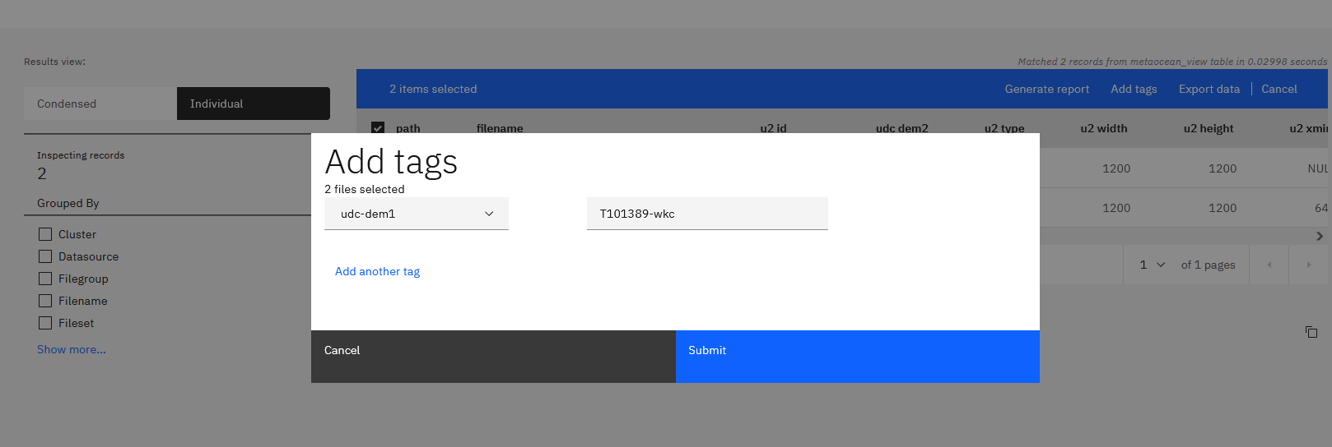
Identify Dataset to be Exported

Slide 3
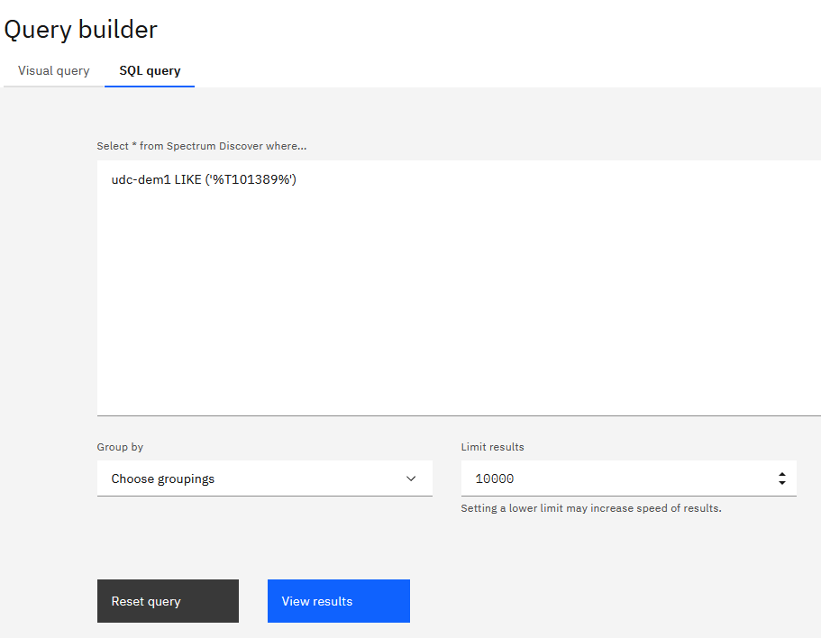
Find the new dataset using Query Builder
T101389-wkc

Slide 4
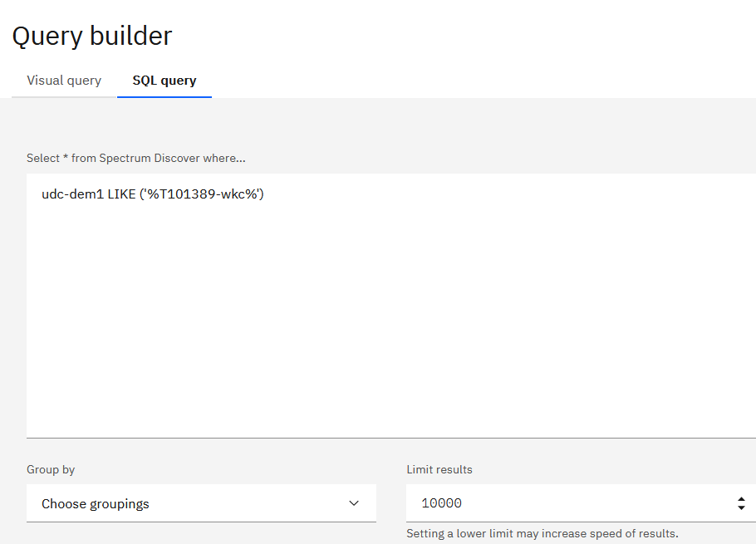
Search for Dataset and Manifest in Spectrum Discover Web Console

Slide 5
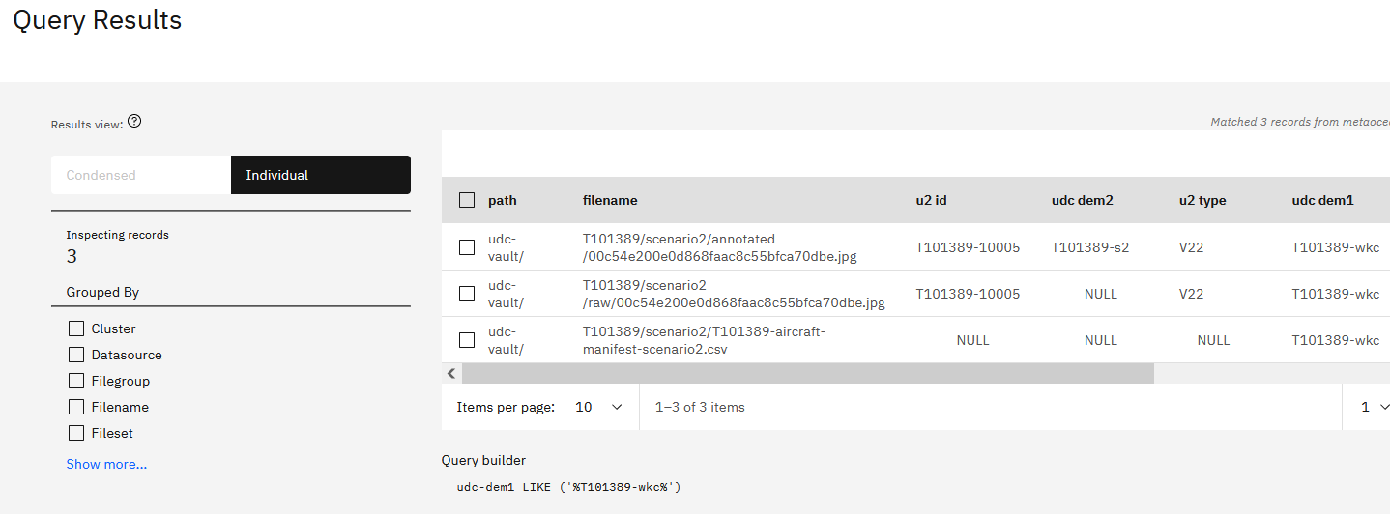
Search for Dataset and Manifest in Spectrum Discover Web Console: Results

Slide 6
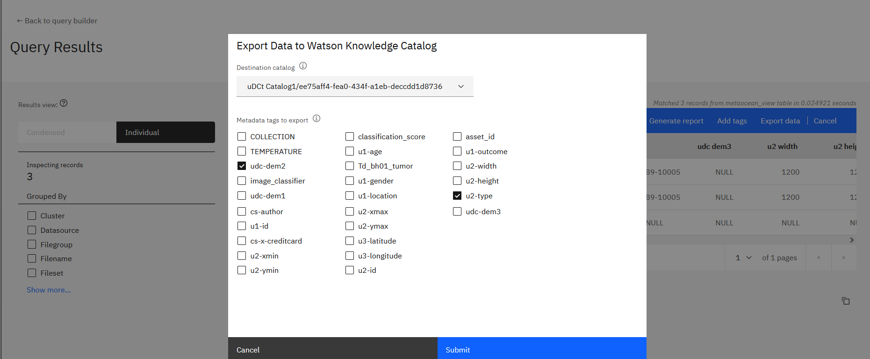
Export dataset to WKC Catalog1

Slide 7
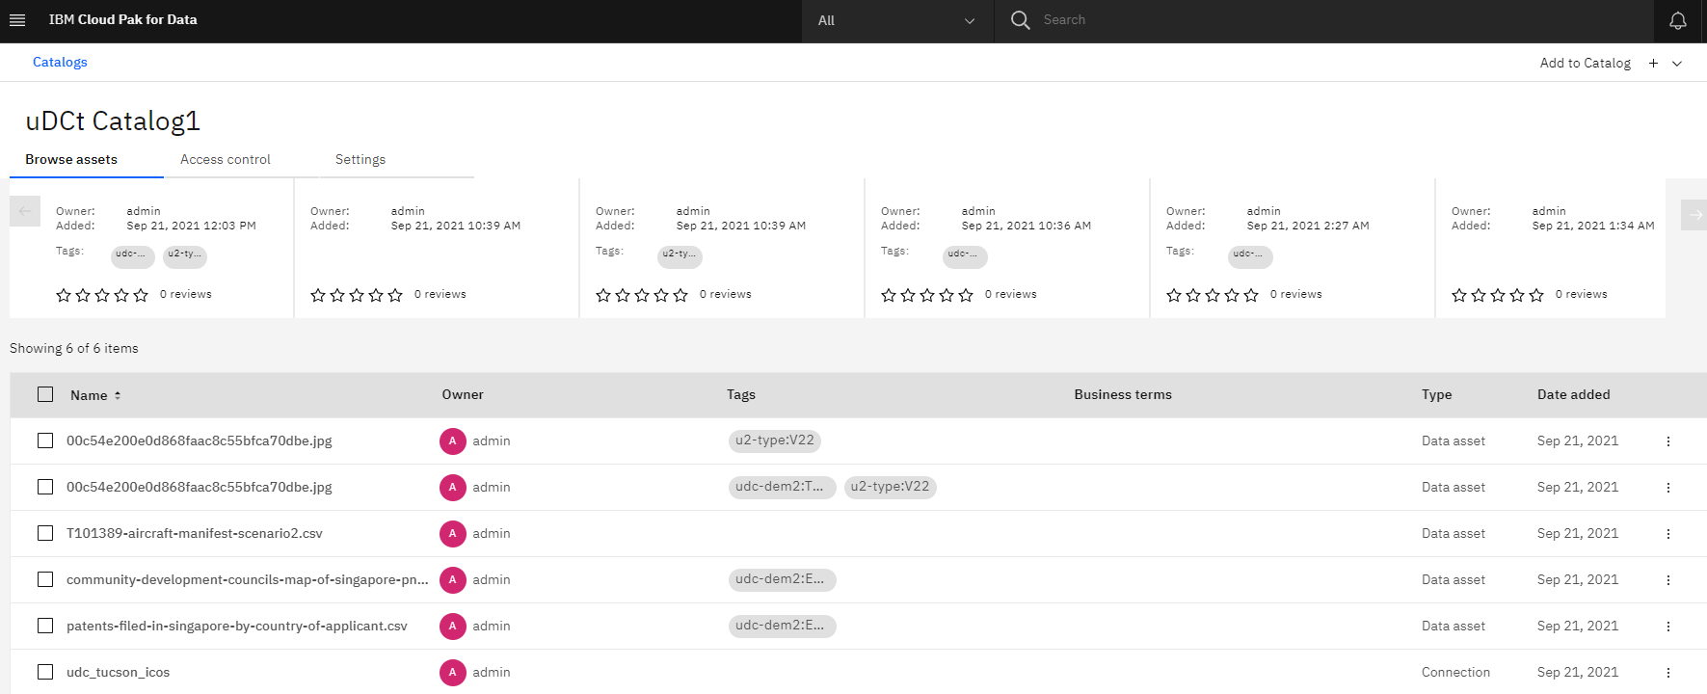
Export dataset to WKC Catalog1: Result from WKC-1

Slide 8
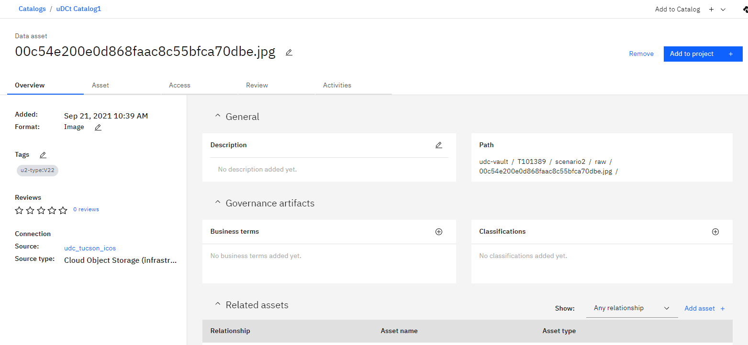
Export dataset to WKC Catalog1: Result from WKC-2

Slide 9
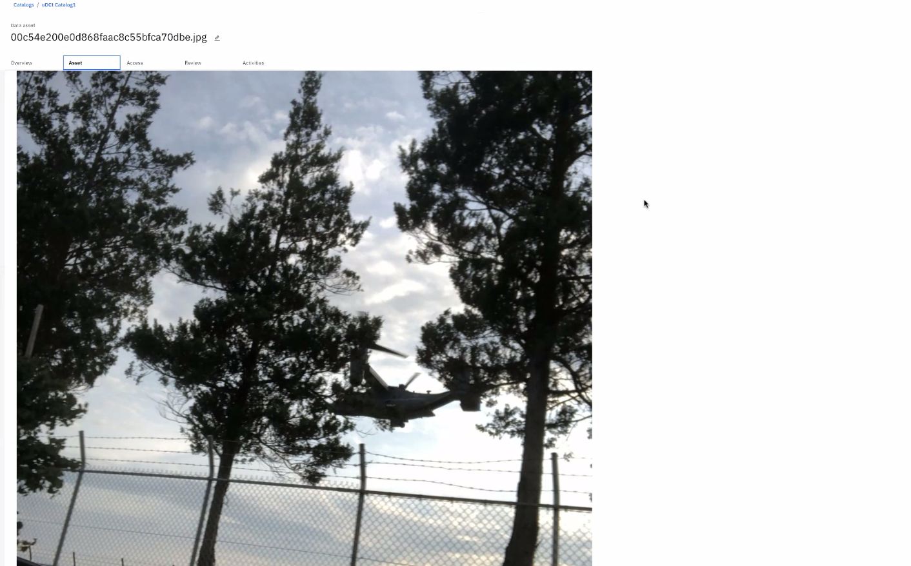
Export dataset to WKC Catalog1: Result from WKC-2

Slide 10
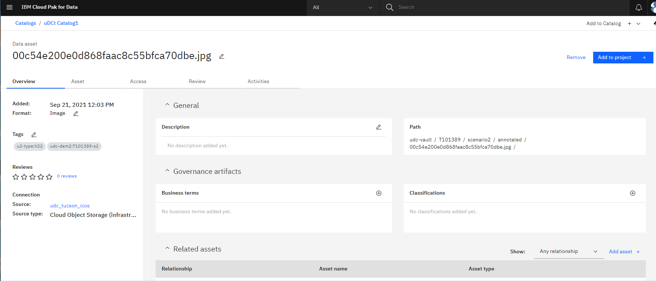
Export dataset to WKC Catalog1: Result from WKC-2

Slide 11
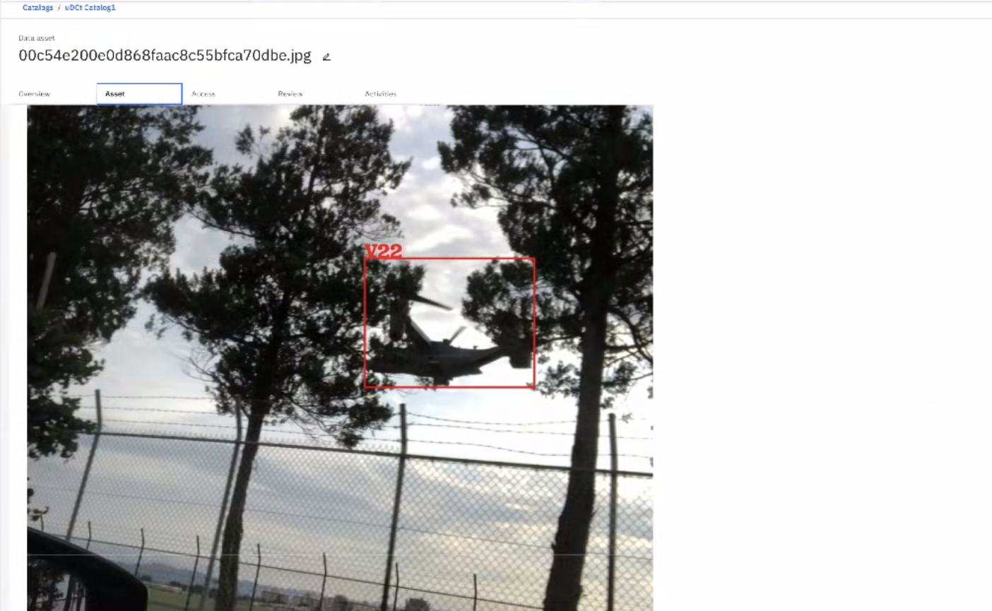
Export dataset to WKC Catalog1: Result from WKC-2

Slide 12
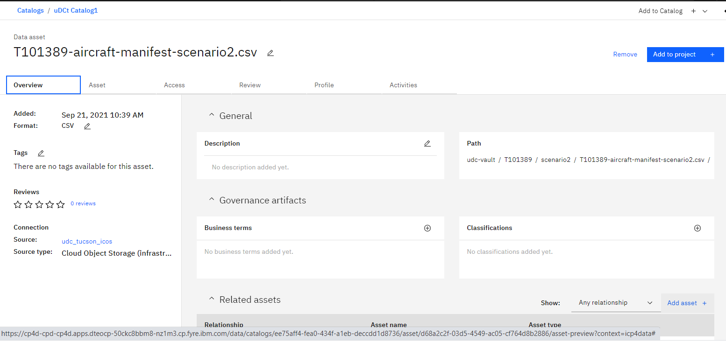
Working with the Manifest

Slide 13
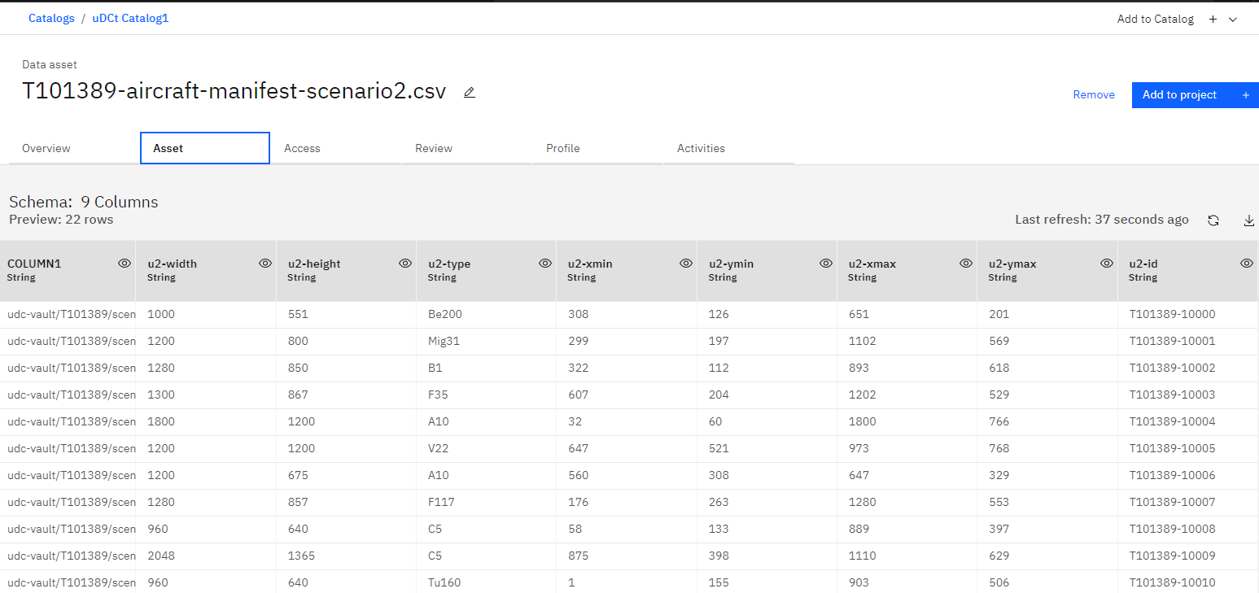
Working with the Manifest

Slide 14
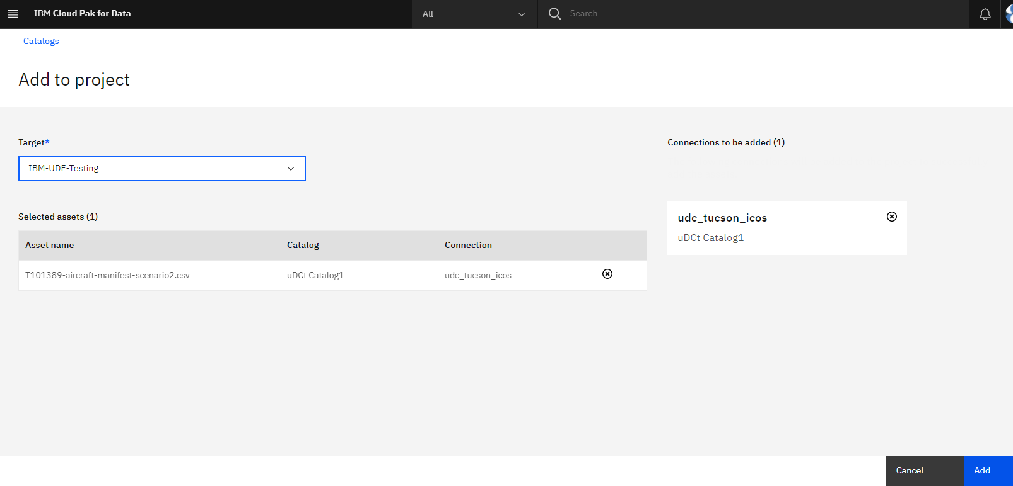
Working with the Manifest

Slide 15
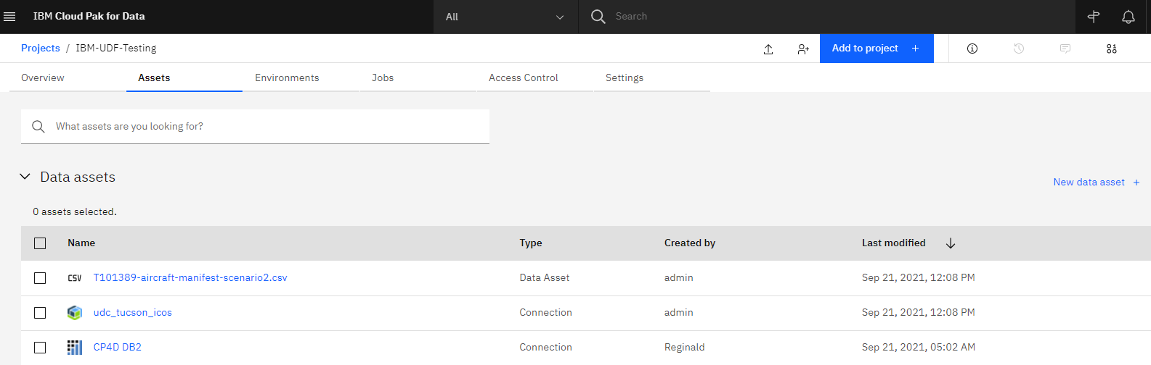
Working with the Manifest: Exported Data Asset to Watson Studio Project

Slide 16
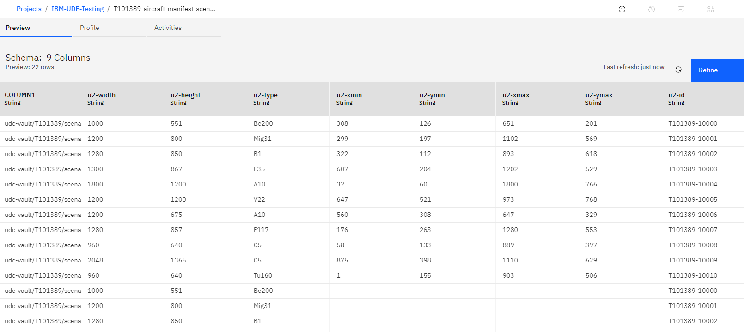
Working with the Manifest: Refine the Manifest in Data Refinery

Slide 17
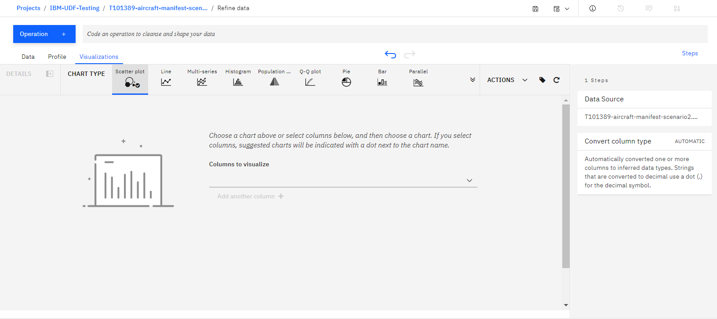
Working with the Manifest: Refine the Manifest in Data Refinery – Visualization

Slide 18
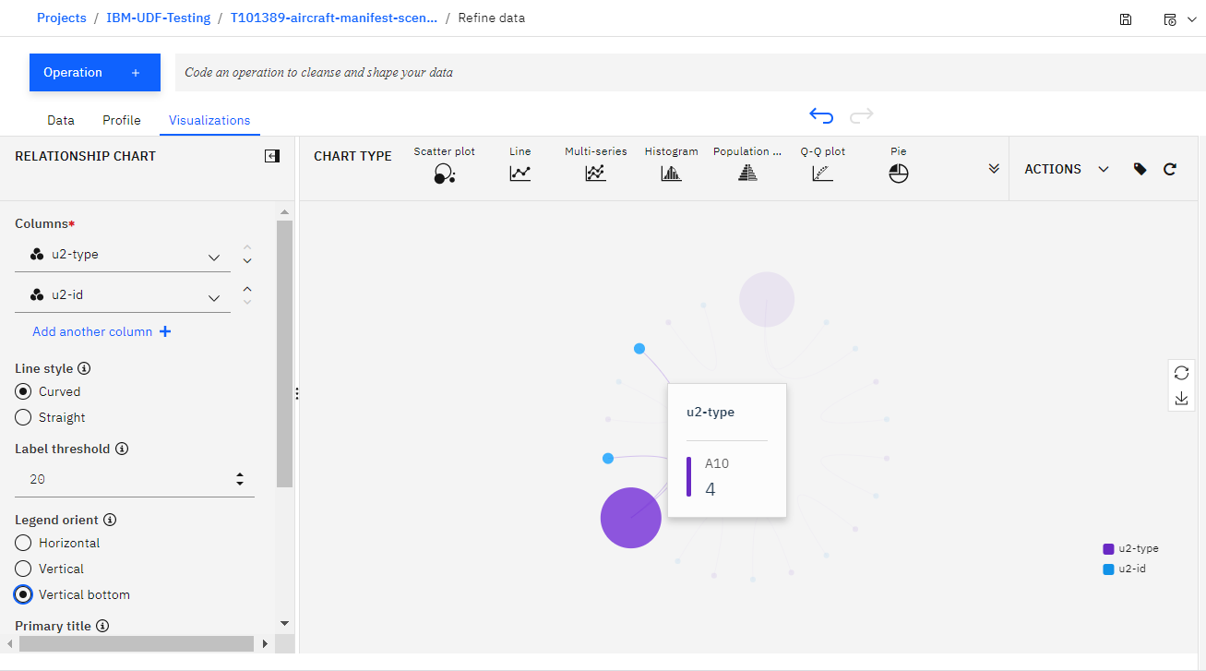
Working with the Manifest: Refine the Manifest in Data Refinery – Visualization

Slide 19
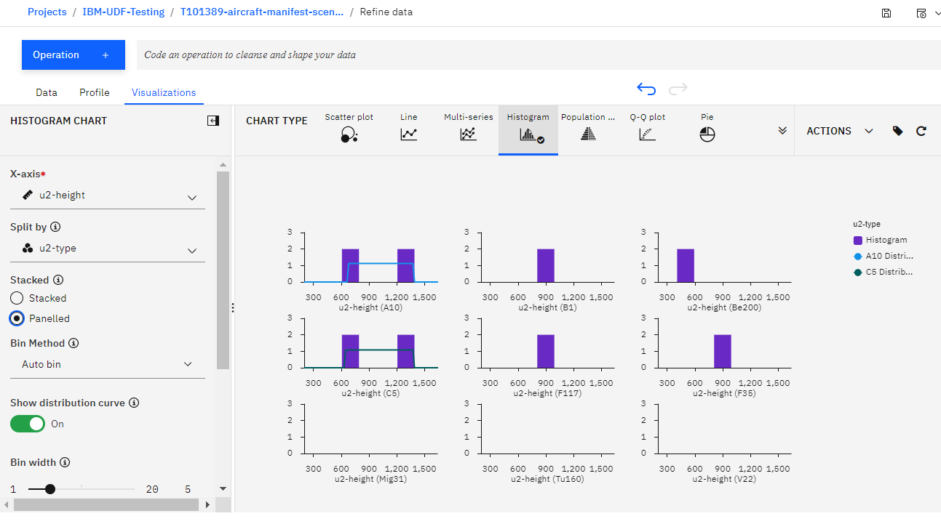
Working with the Manifest: Refine the Manifest in Data Refinery – Visualization

Slide 20
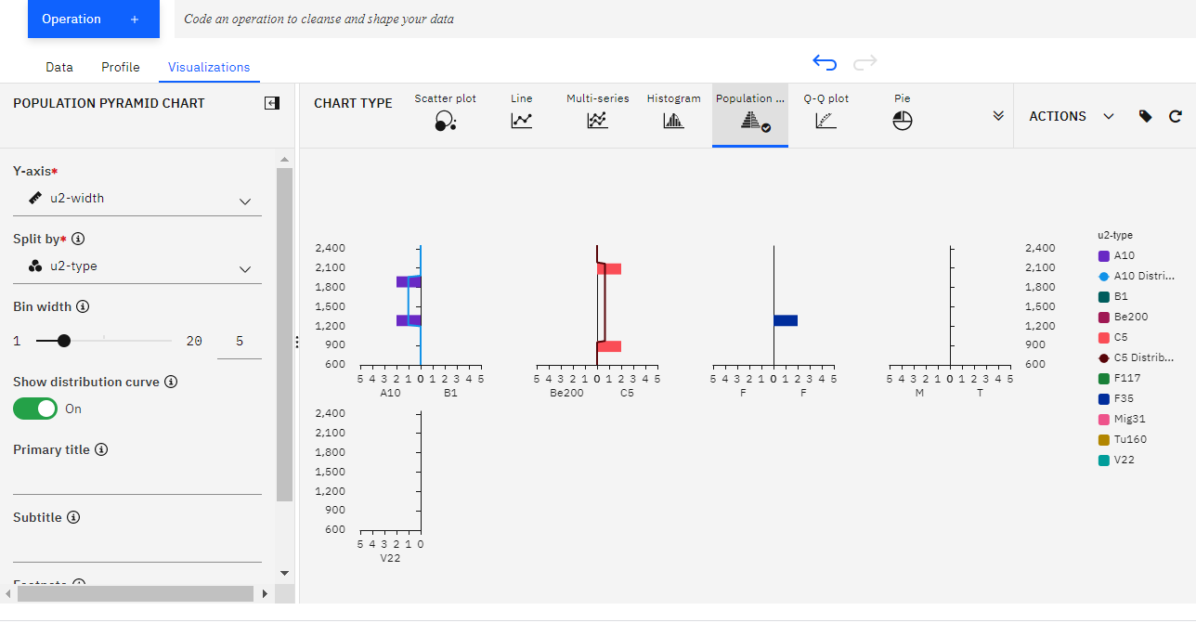
Working with the Manifest: Refine the Manifest in Data Refinery – Visualization

