Slide 1
Demo: Unified Data Catalog for Military Aircraft
Scenario 2: Index & Tag Multi-dimensional Dataset
Frank Lee
https://github.com/drfranknlee/demo-udc-aircraft

Slide 2
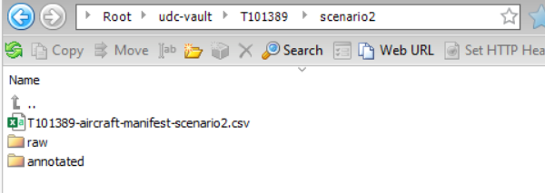
Upload Dataset to Cloud Object Storage Bucket

Slide 3
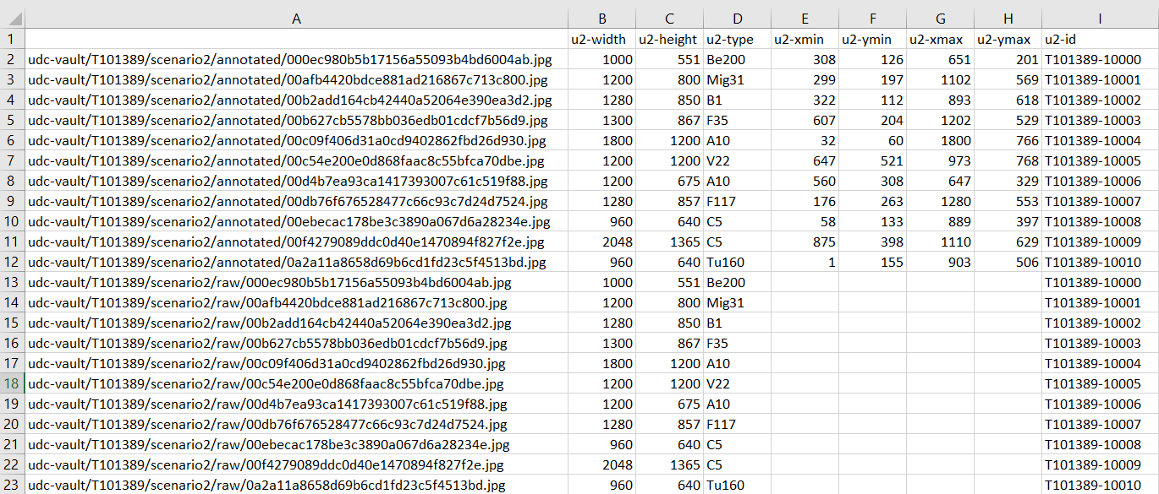
Upload Manifest to Cloud Object Storage Bucket

Slide 4
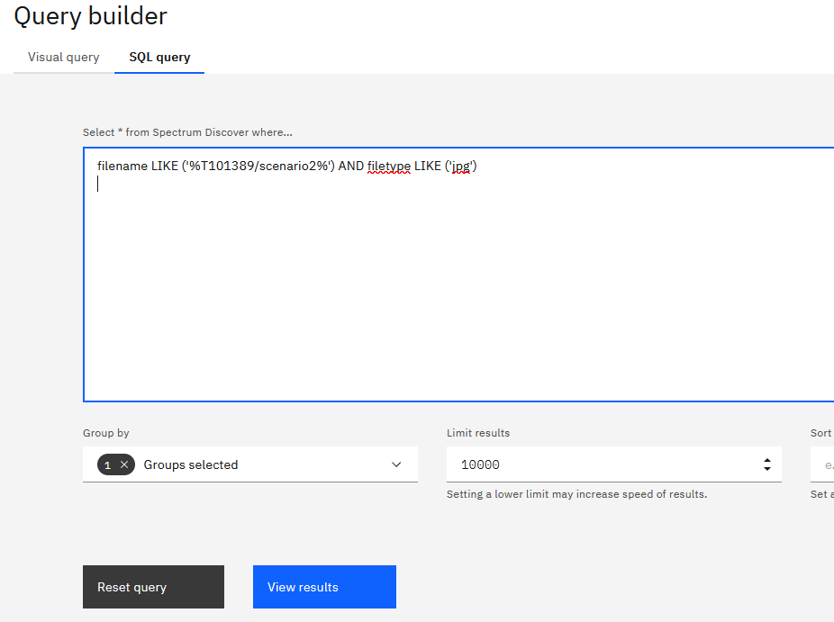
Search for Dataset and Manifest in Spectrum Discover Web Console

Slide 5
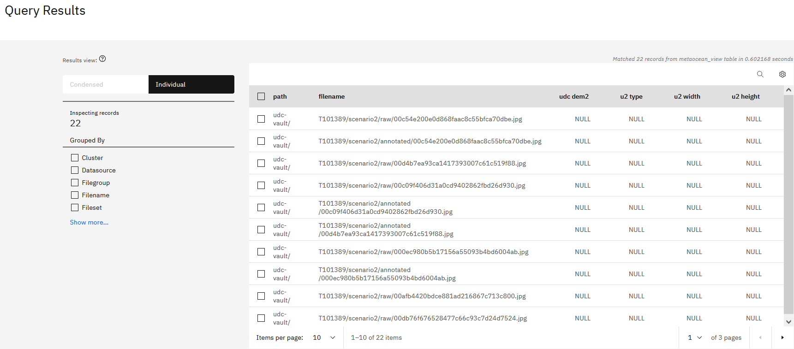
Search for Dataset and Manifest in Spectrum Discover Web Console: Results

Slide 6
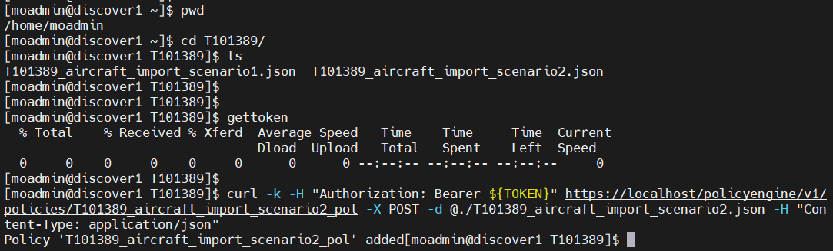
Create IMPORT_TAGS Policy

Slide 7
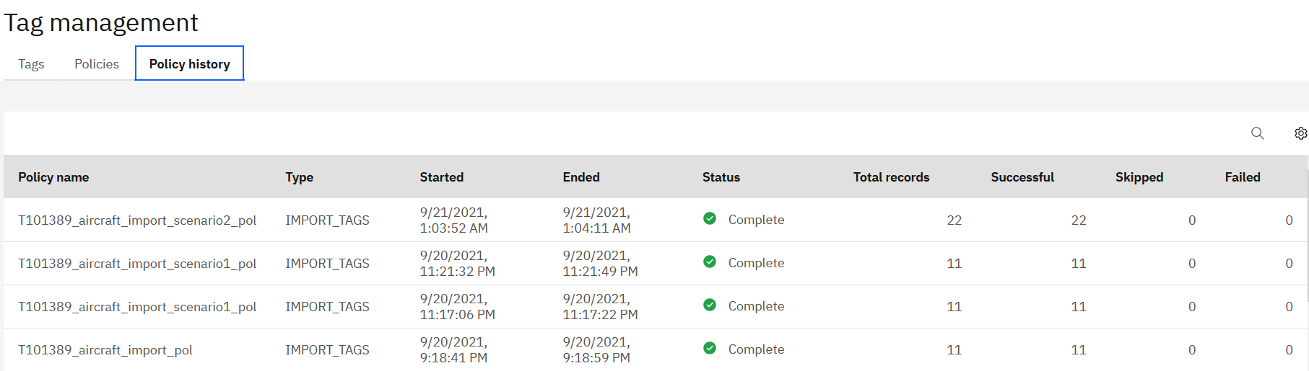
Create IMPORT_TAGS Policy: Result-2

Slide 8
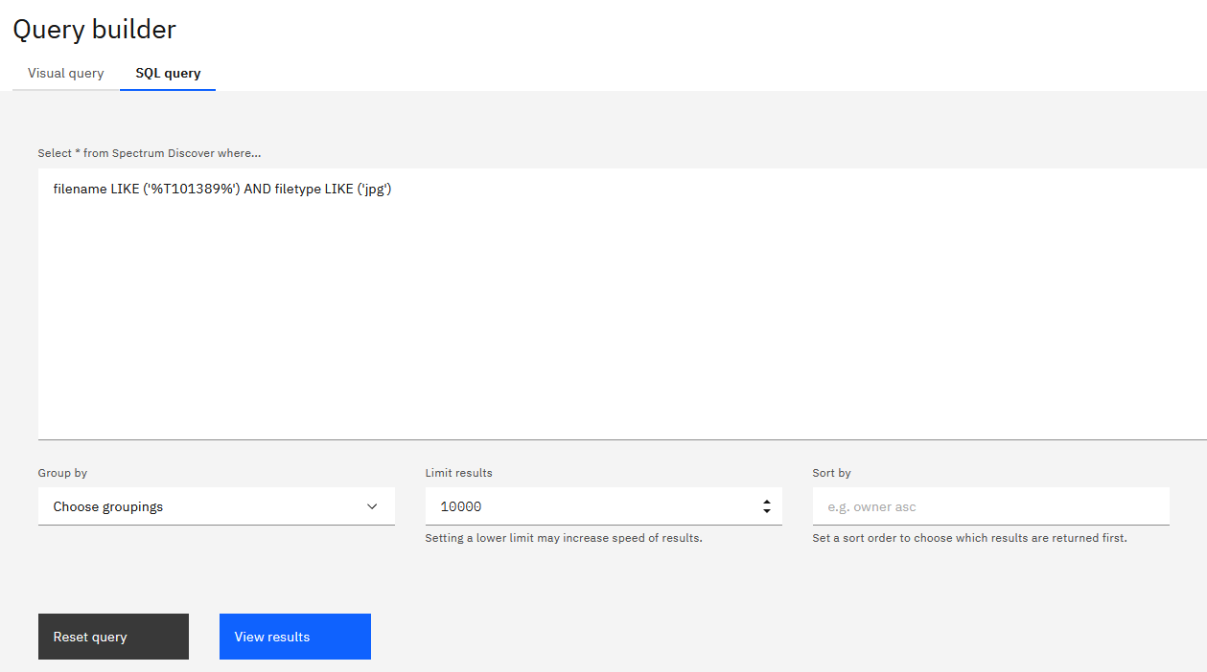
Find the Newly Tagged Dataset: Method-1 using SQL Query

Slide 9
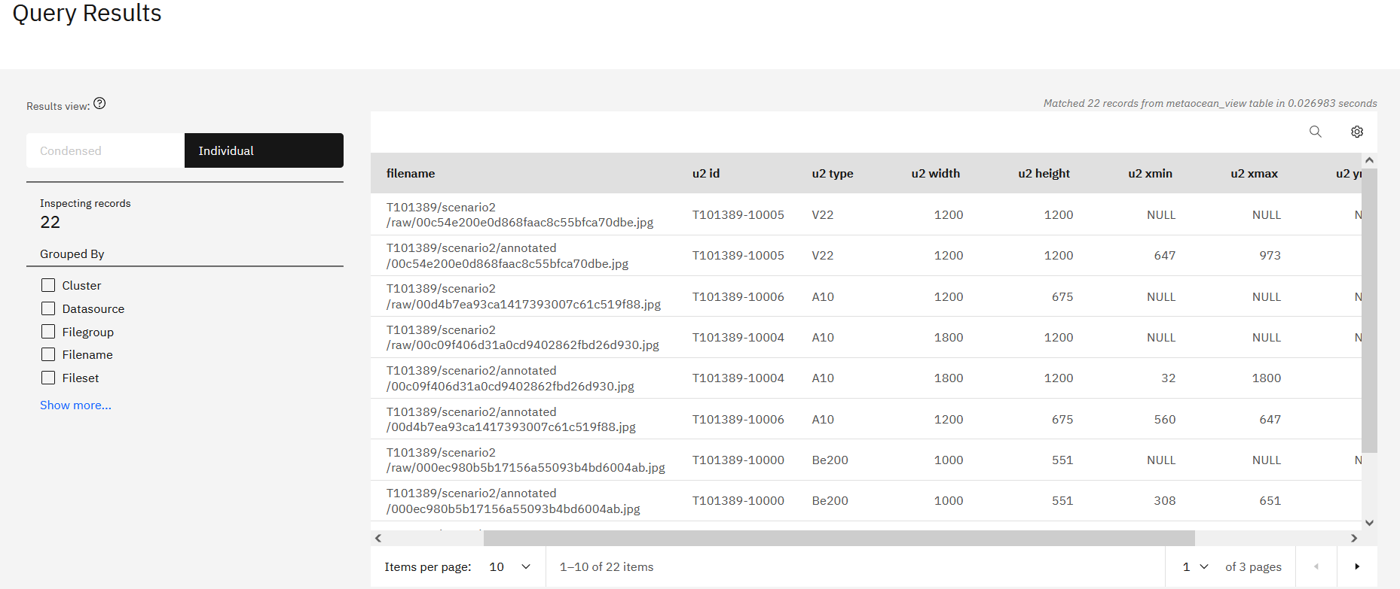
Create IMPORT_TAGS Policy: Result-1

Slide 10
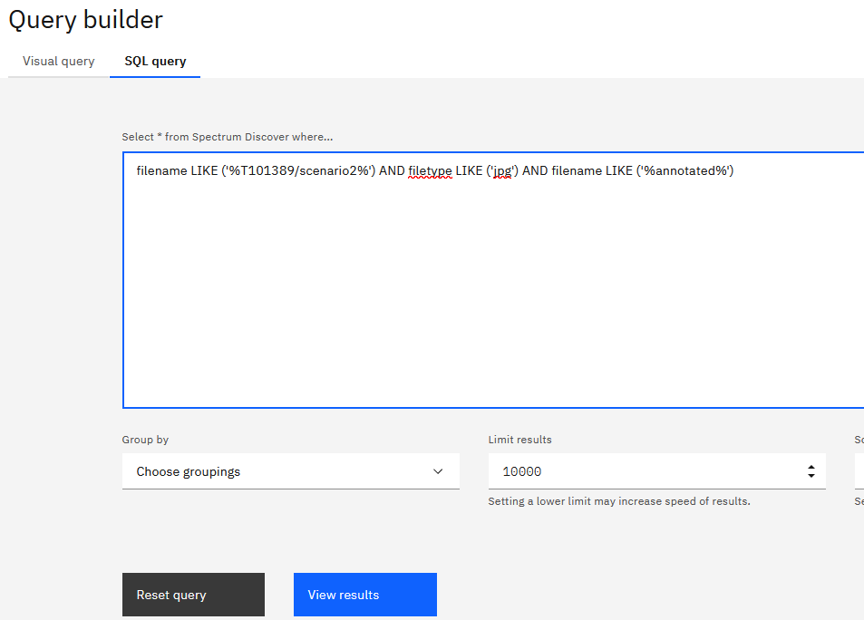
Custom-tag the Data that are annotated

Slide 11
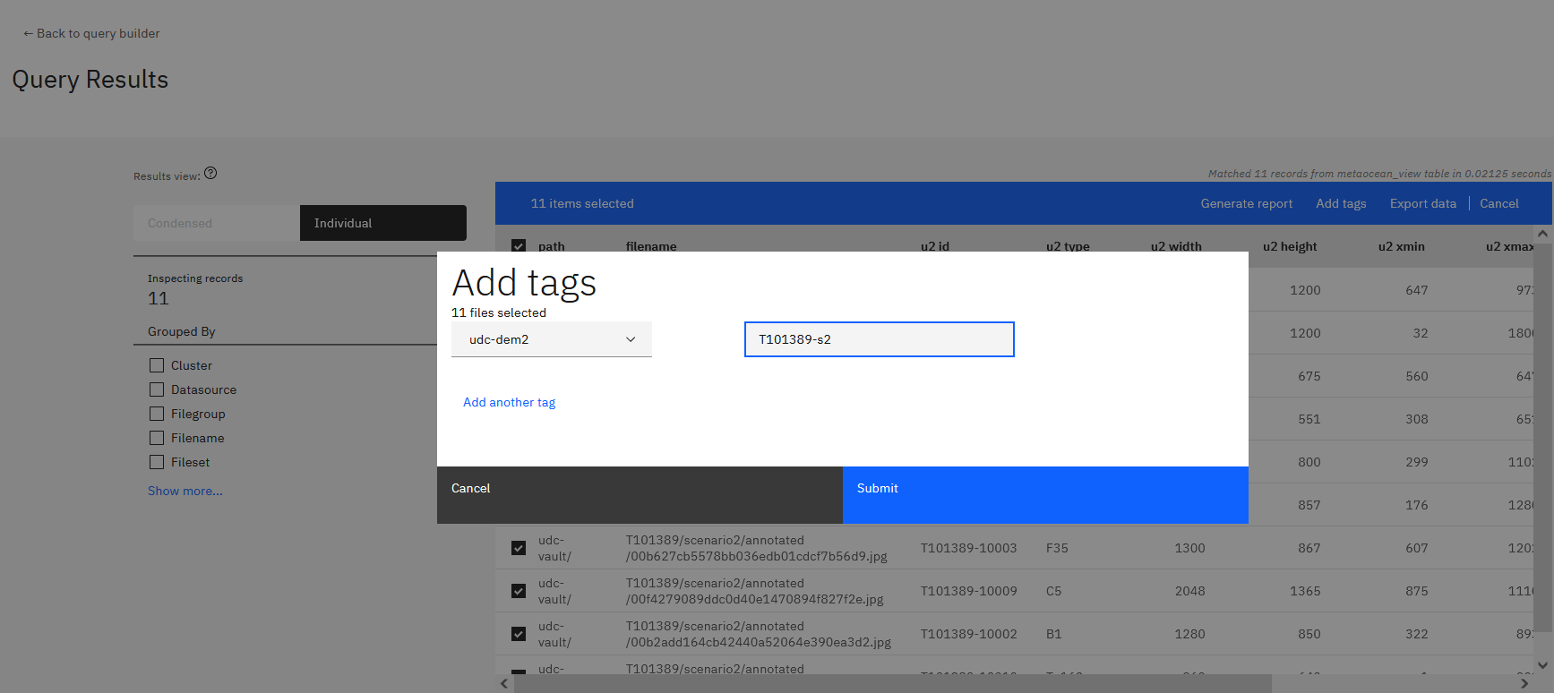
Custom-tag the Selected Data to create a New Dataset “T101389-s2”

Slide 12
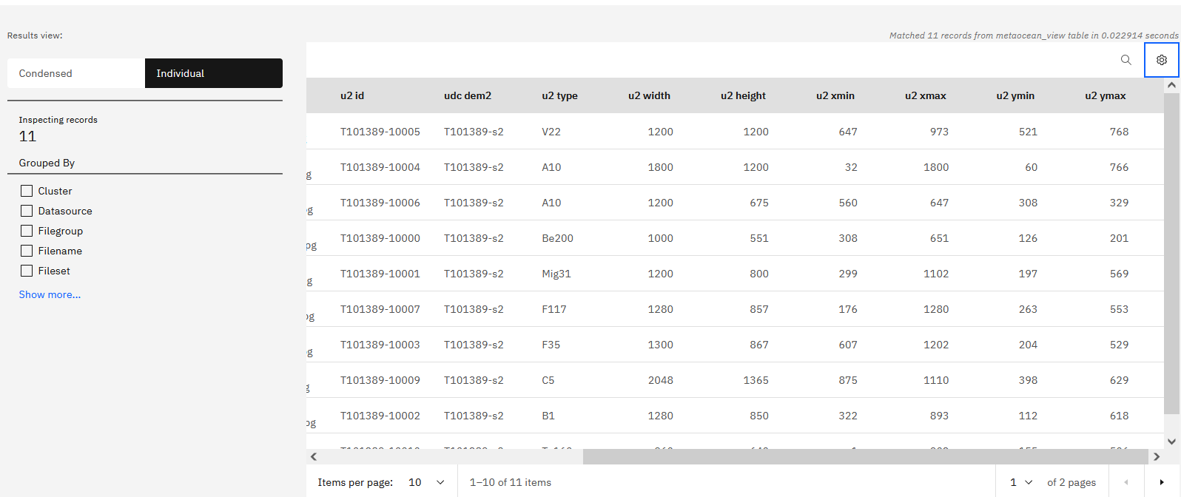
Custom-tag the Selected Data to create a New Dataset “T101389-s2”: Result

Slide 13
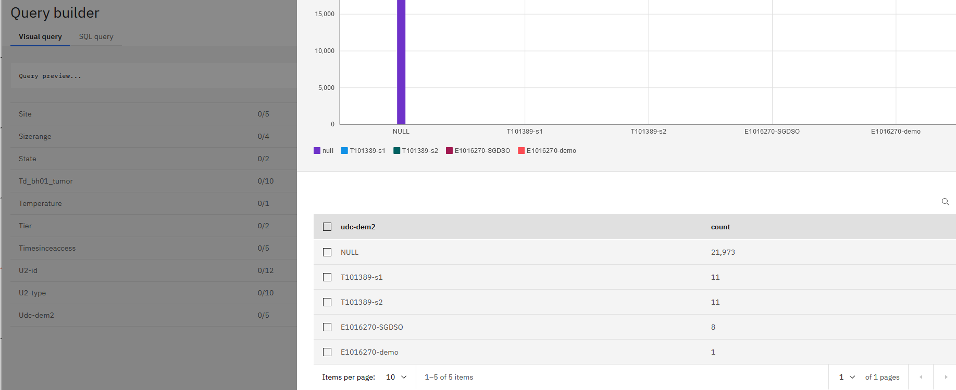
Find the Newly Tagged Dataset with Visual Query

Slide 14
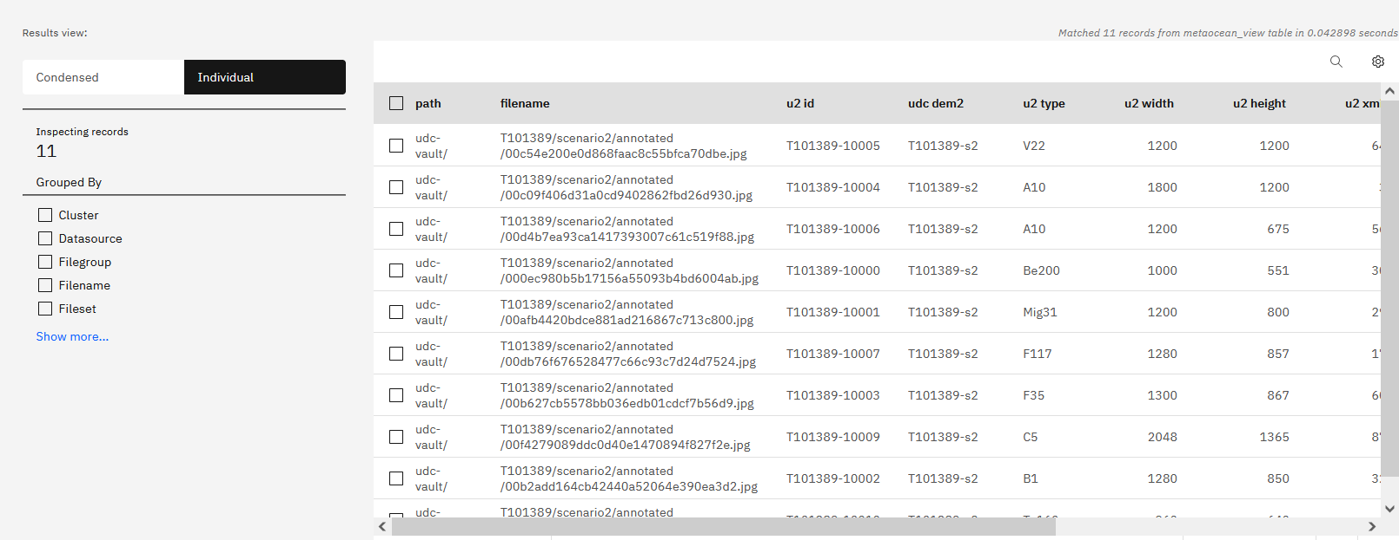
Find the Newly Tagged Dataset with Visual Query: Result

Slide 15
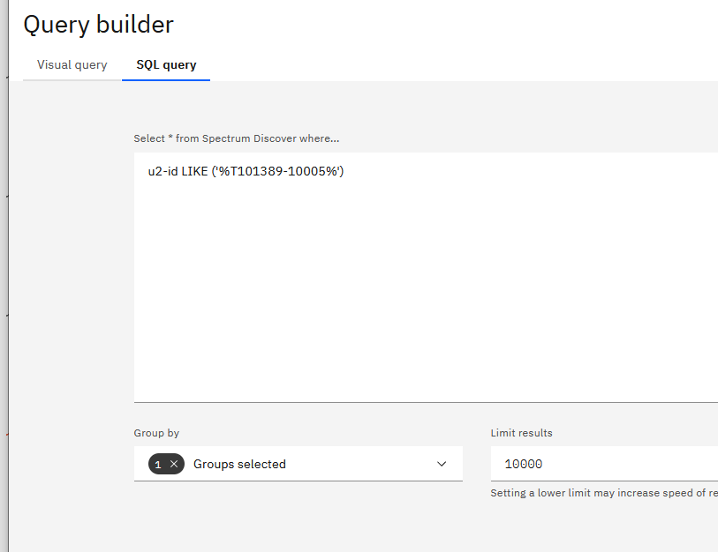
Find the Paring Data (raw-annotated) based on newly-crated file ID “u2-id”

Slide 16
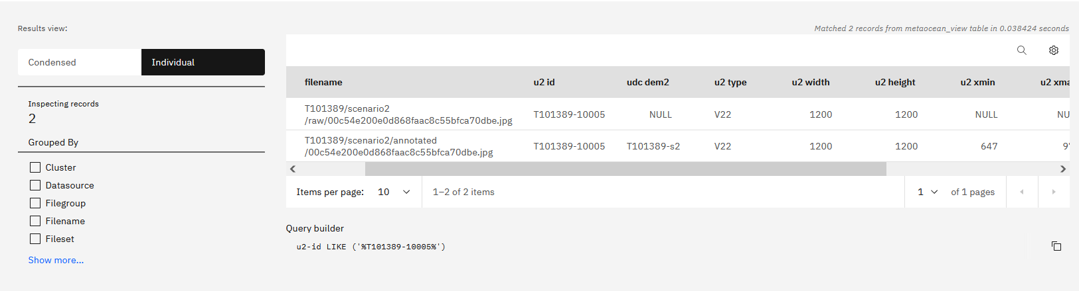
Find the Paring Data (raw-annotated) based on newly-crated file ID “u2-id”: result

Slide 17

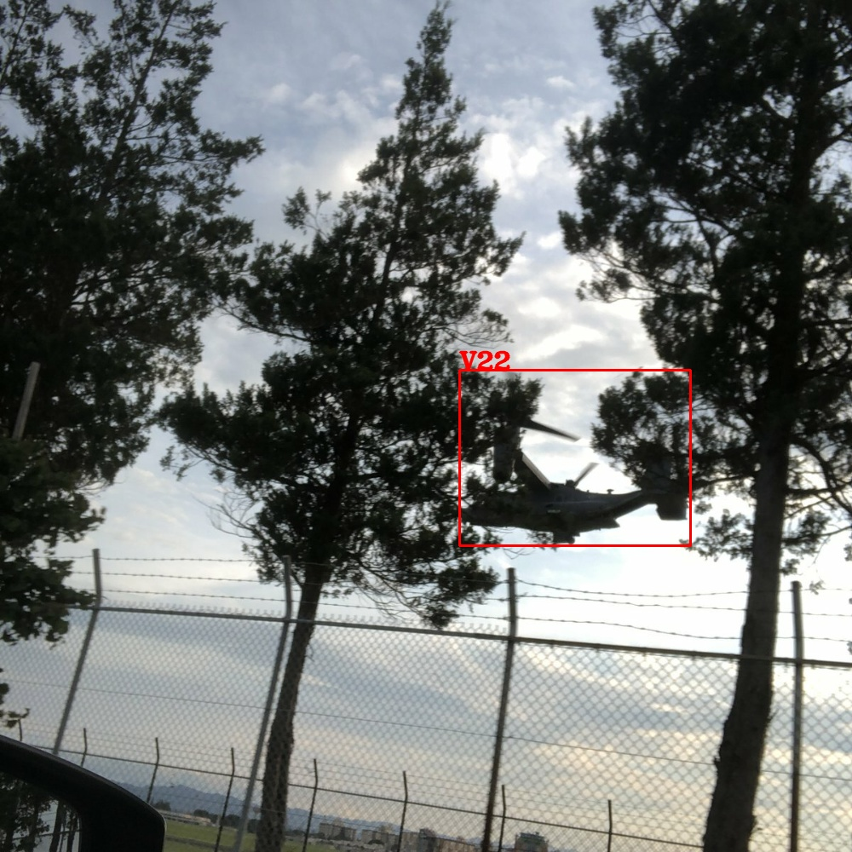
647, 768
973, 768
647, 521
973, 521
u2-id = T101389-10005: filename = 00c54e200e0d868faac8c55bfca70dbe.jpg

