Slide 1
Demo: Unified Data Catalog for Military Aircraft
Scenario 1: Initialize Catalog with Metadata
Frank Lee
https://github.com/drfranknlee/demo-udc-aircraft

Slide 2
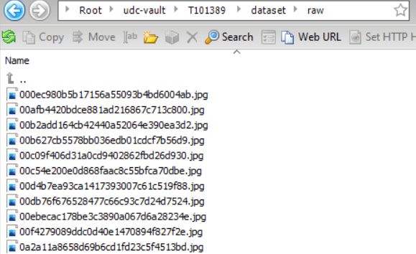
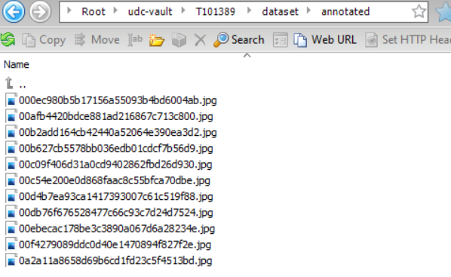
Upload Original Data to Cloud Object Storage Bucket

Slide 3
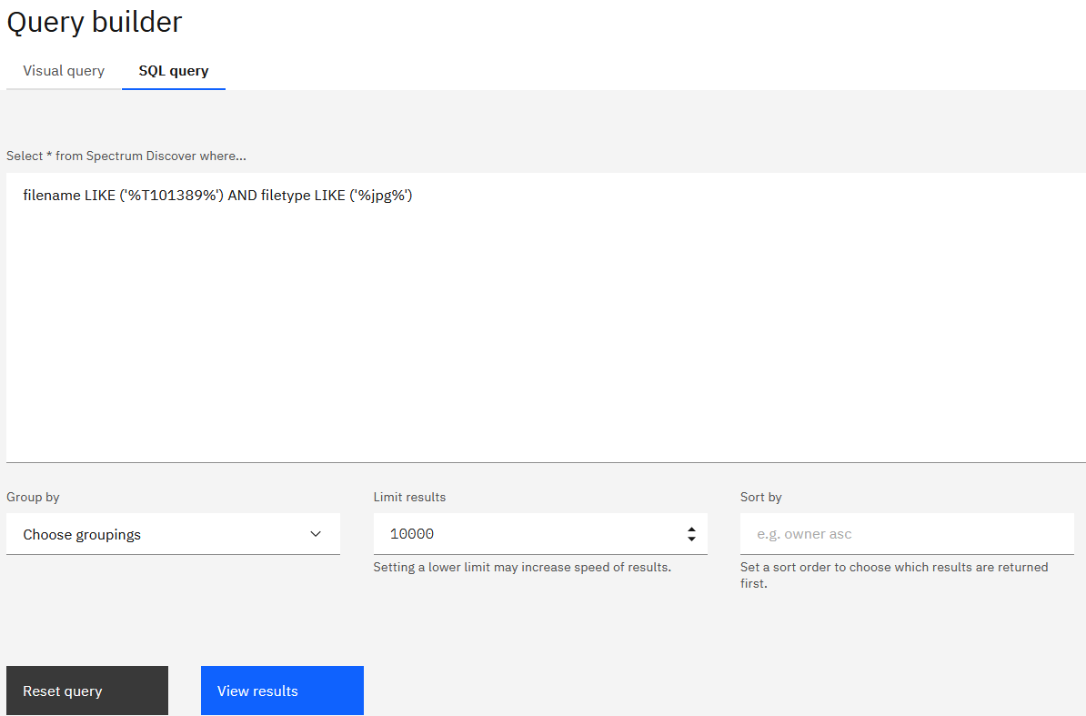
Search for Dataset using Query Builder

Slide 4
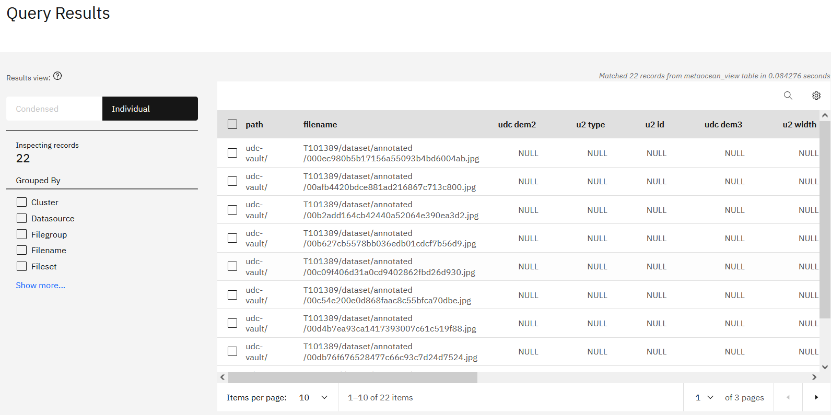
Search for Dataset using Query Builder: Results

Slide 5
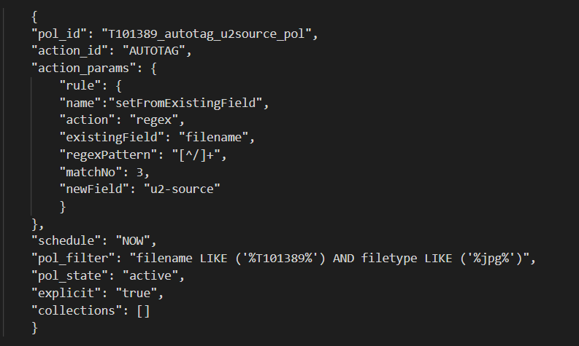
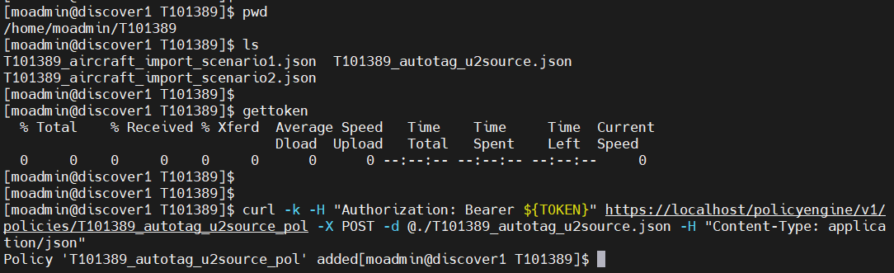
Create AutoTag Policy
Create the autotag policy in json
Execute the policy on server

Slide 6
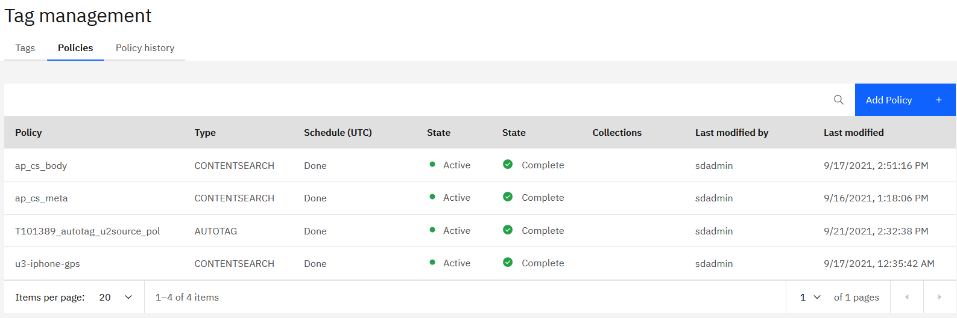
Create AutoTag Policy: Result

Slide 7
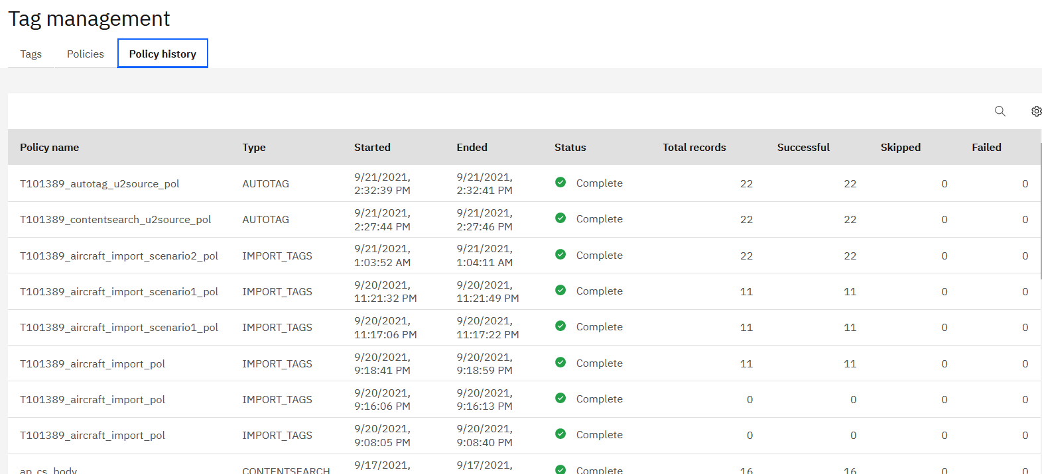
Create AutoTag Policy: Result

Slide 8
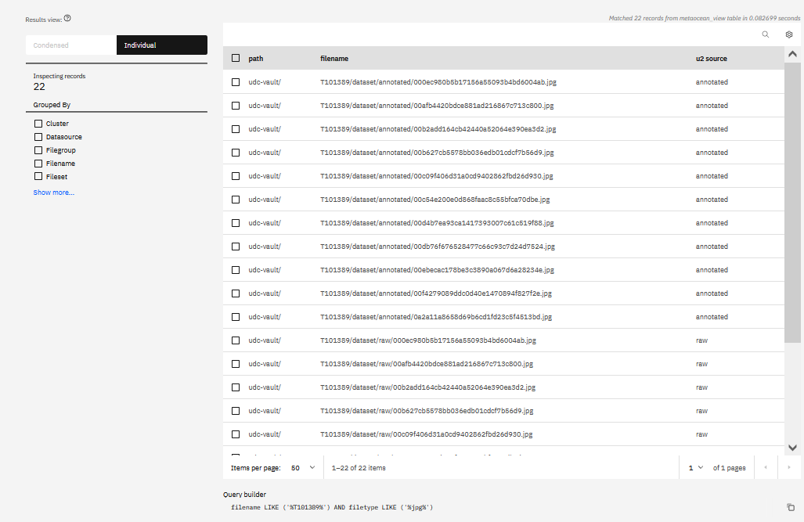
Create AutoTag Policy: Result

Slide 9
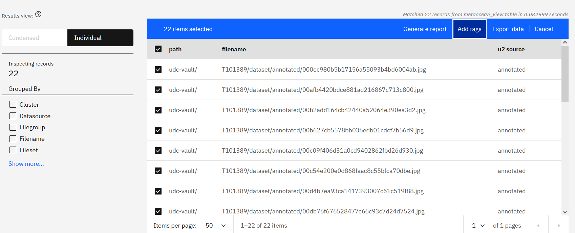
Custom-Tag Dataset

Slide 10
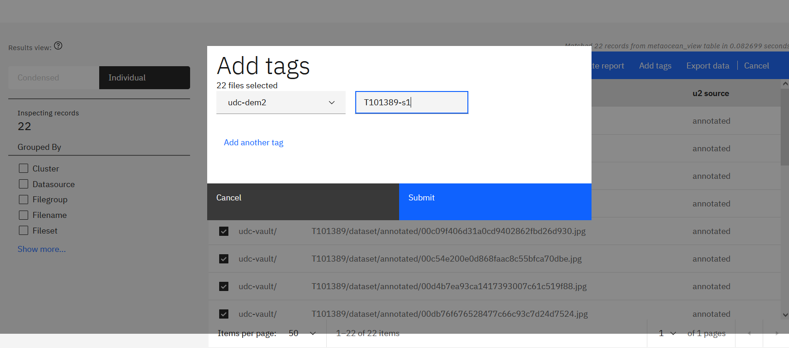
Custom-Tag Dataset

Slide 11
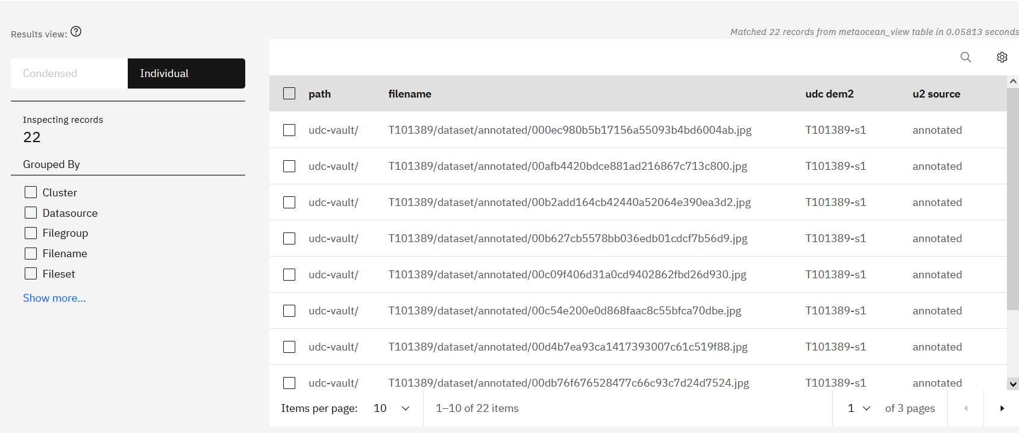
Custom-Tag Dataset with T101389-s1

Slide 12
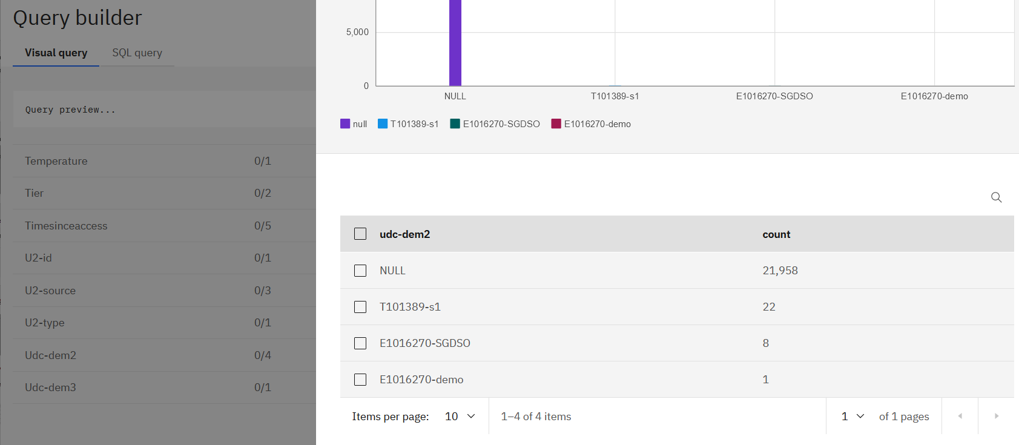
Find the Newly Tagged Dataset with Visual Query

Slide 13
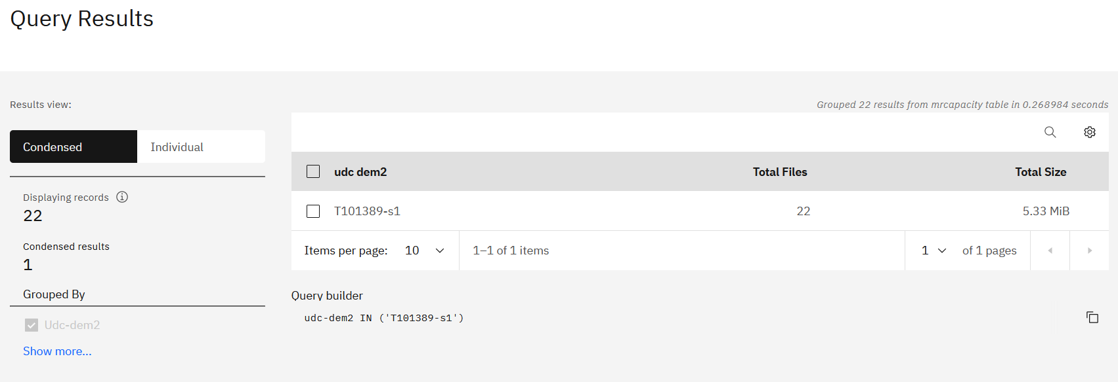
New Dataset (T101389-s1) Can be Found using a Single-query Search

Slide 14
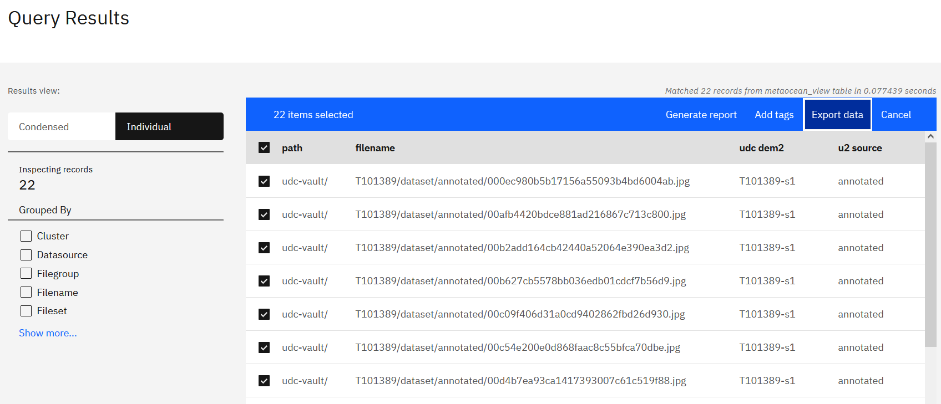
Export the New Dataset into a Manifest

Slide 15
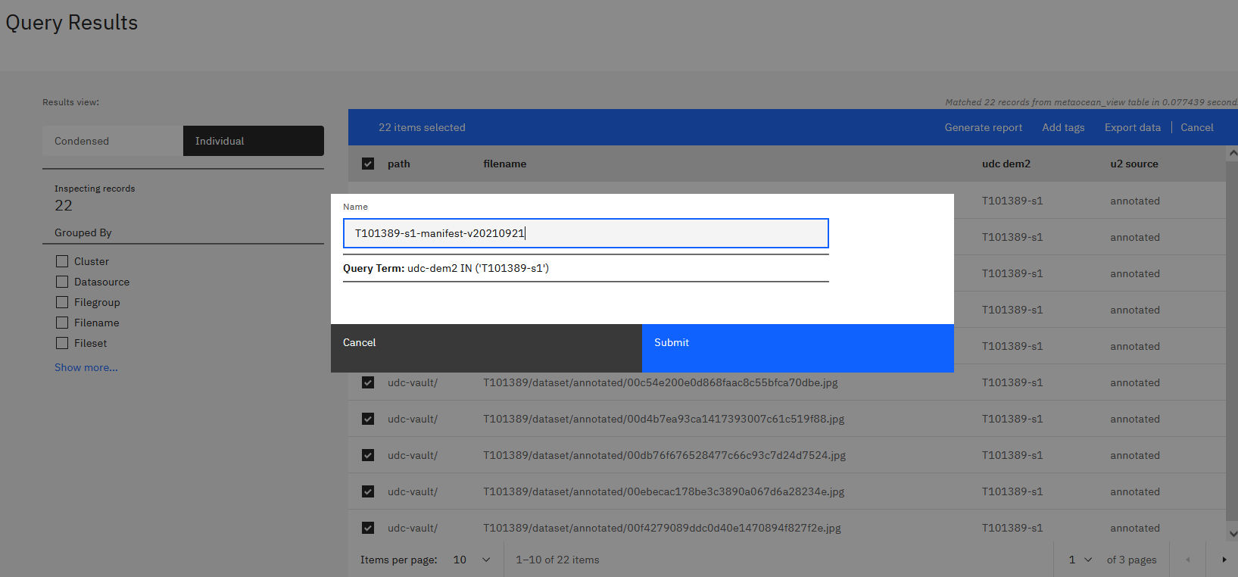
Export the New Dataset into a Manifest

Slide 16
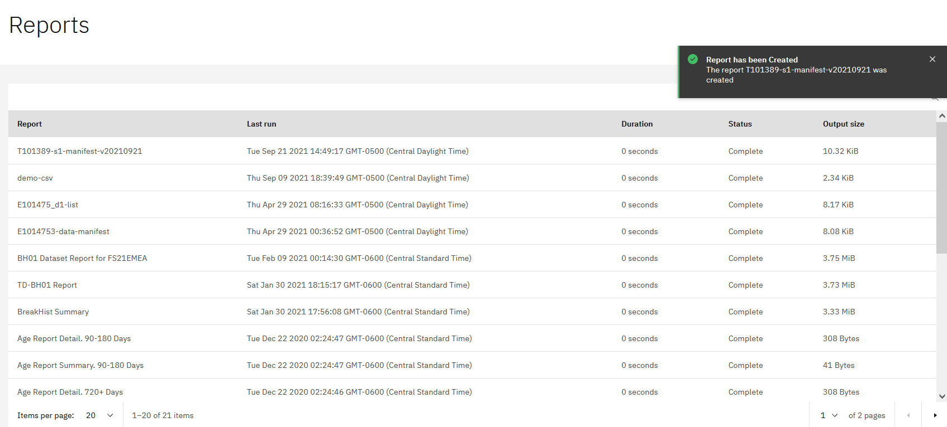
Export the New Dataset into a Manifest

Slide 17
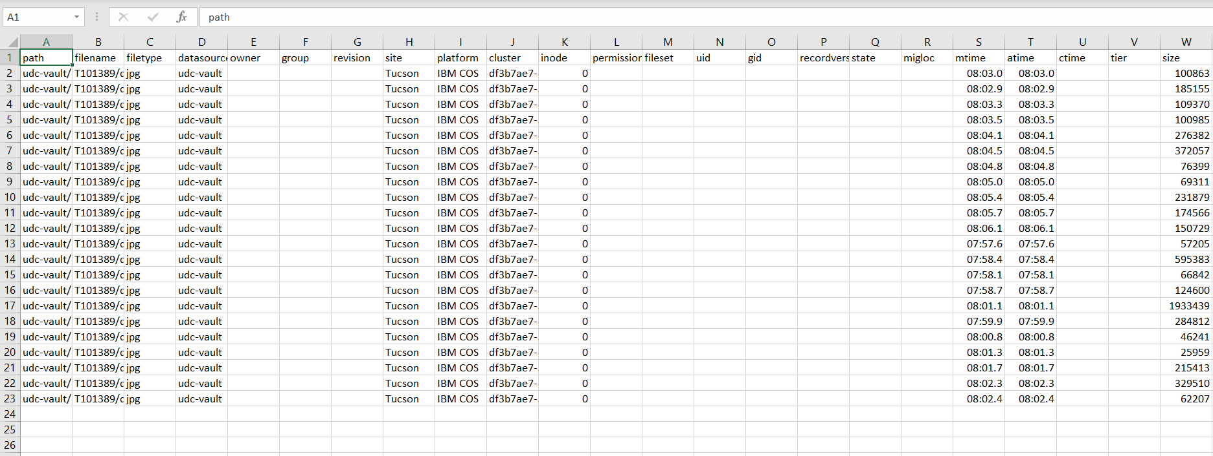
Export the New Dataset into a Manifest

