Slide 1
Unified Data Catalog for Imaging Analytics
Scenario 1: Create Tags from AutoTag Policy, Custom-Tagging and Filtering
Frank Lee, Joanna Wong, Joe Dain, Reginald D’Souza
https://github.com/drfranknlee/udc-for-image-analytics/

Slide 2
1. Set up Spectrum Discover to Manage Data Sources

Slide 3
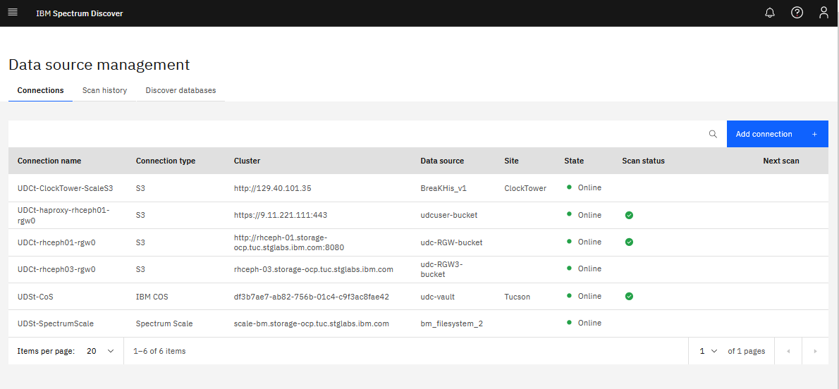

Slide 4
2. Upload Dataset to Object Storage

Slide 5
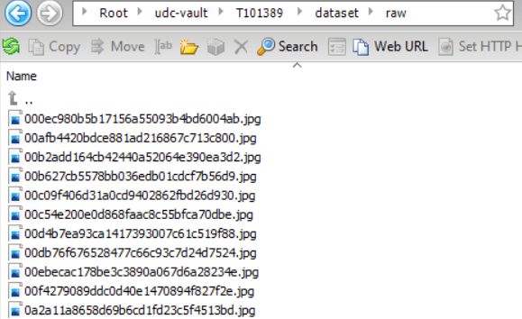
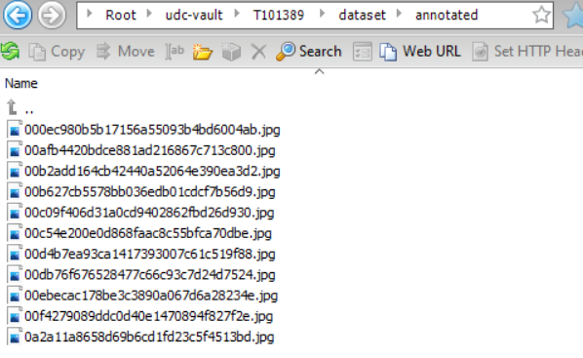
Upload Original Data to Cloud Object Storage Bucket

Slide 6
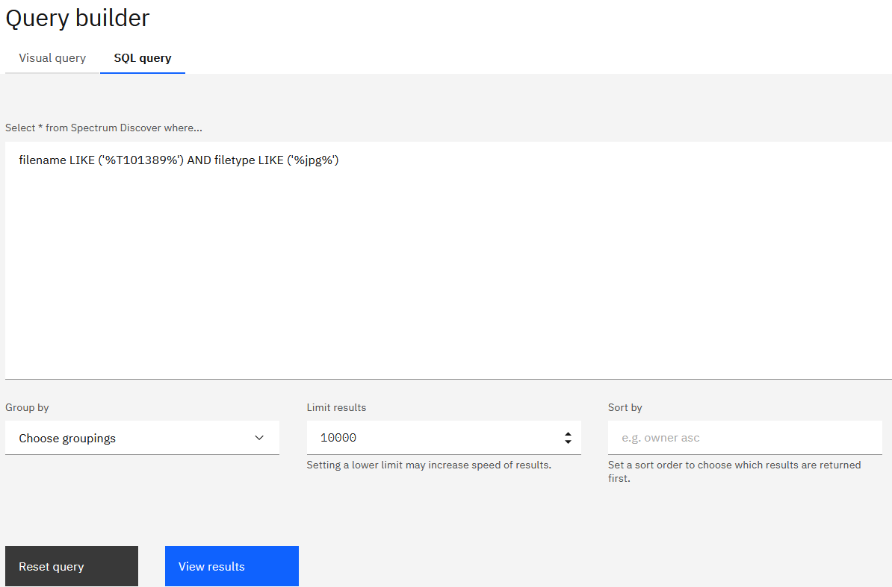
Search for Dataset using SQL Query from Query Builder

Slide 7
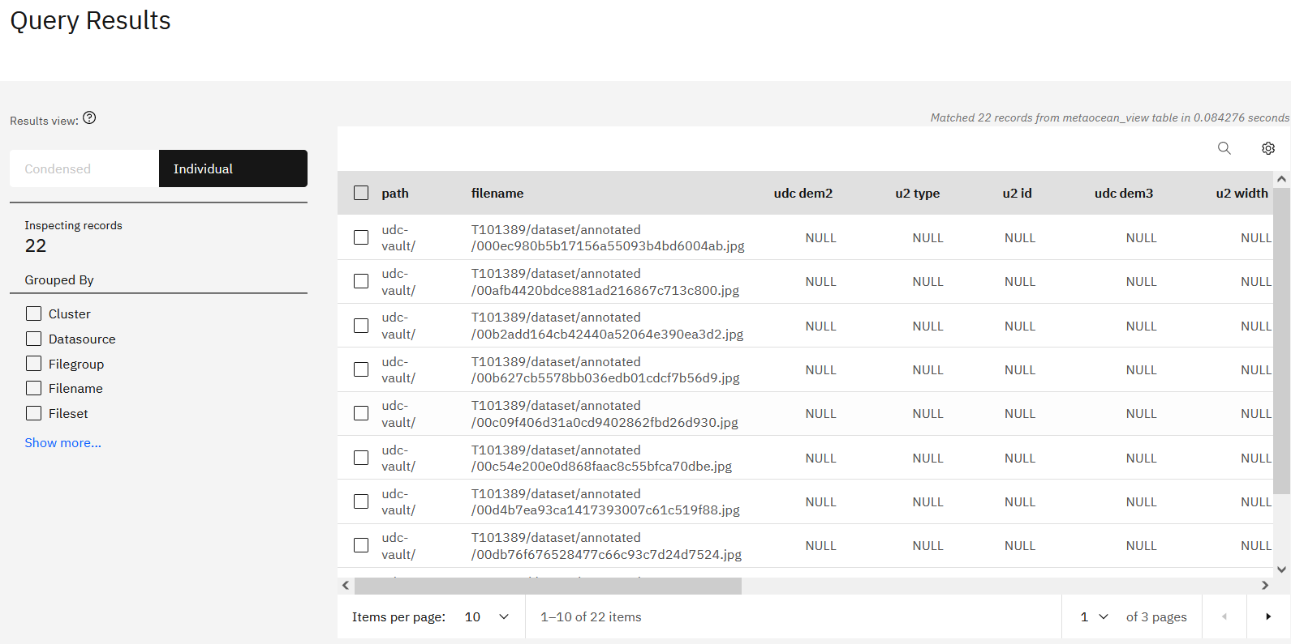
Query Results Displayed

Slide 8
3. Set up AutoTag Policy in Spectrum Discover

Slide 9
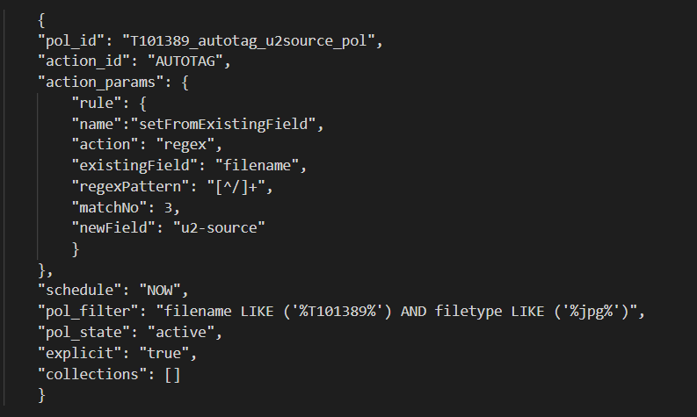
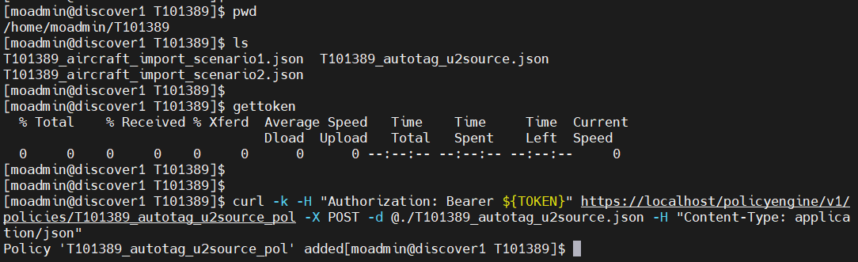
Create AutoTag Policy
Create the autotag policy in json
Execute the policy on server

Slide 10
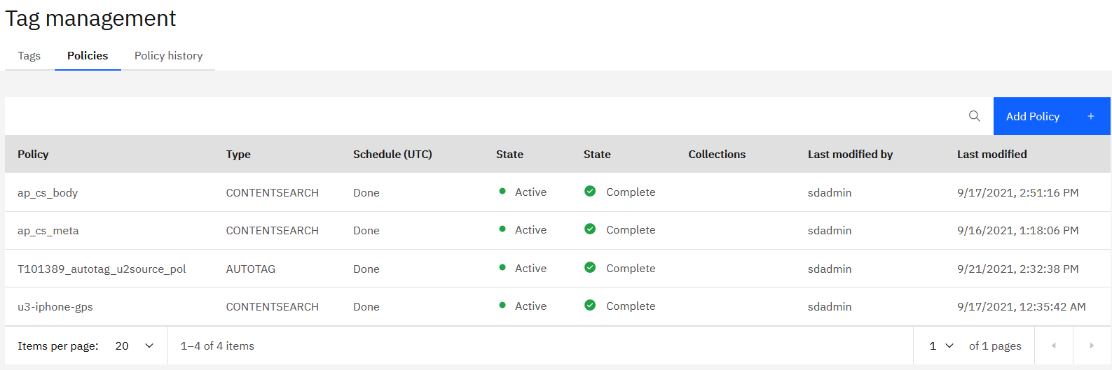
AutoTag Policy Added to Spectrum Discover Console

Slide 11
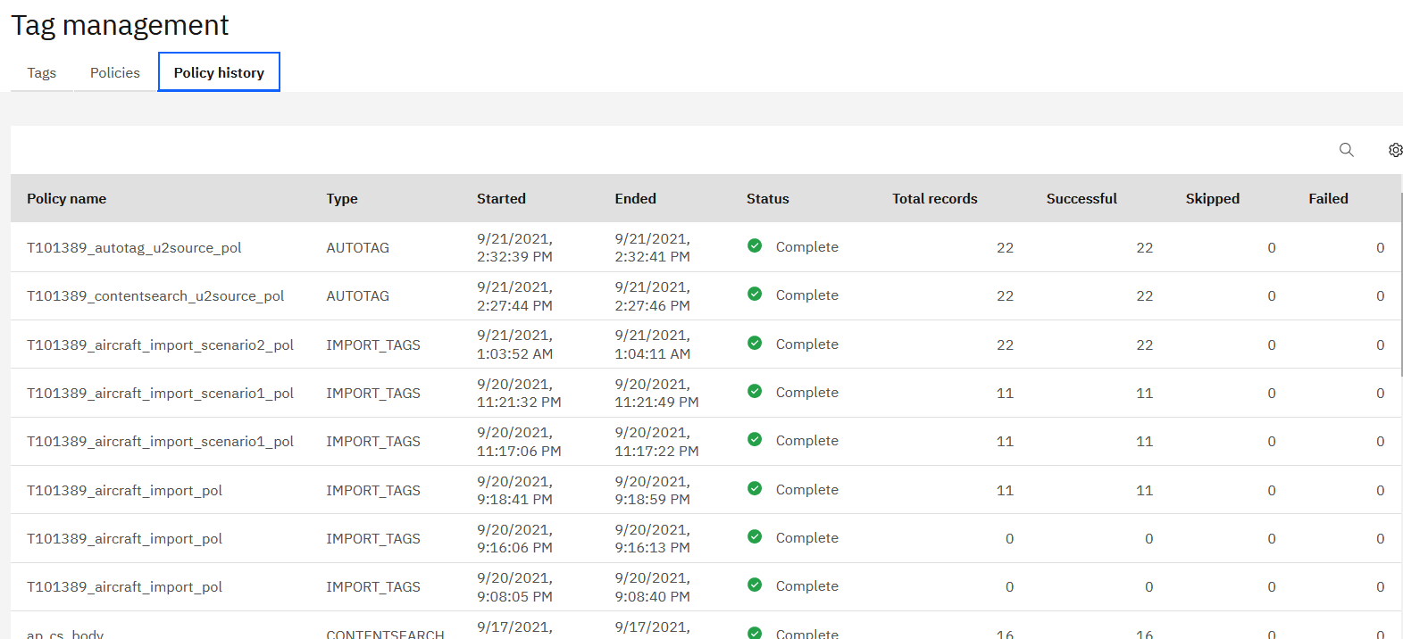
Newly Created AutoTag Policy Executed Automatically for First Time

Slide 12
4. Custom-tag the New Dataset

Slide 13
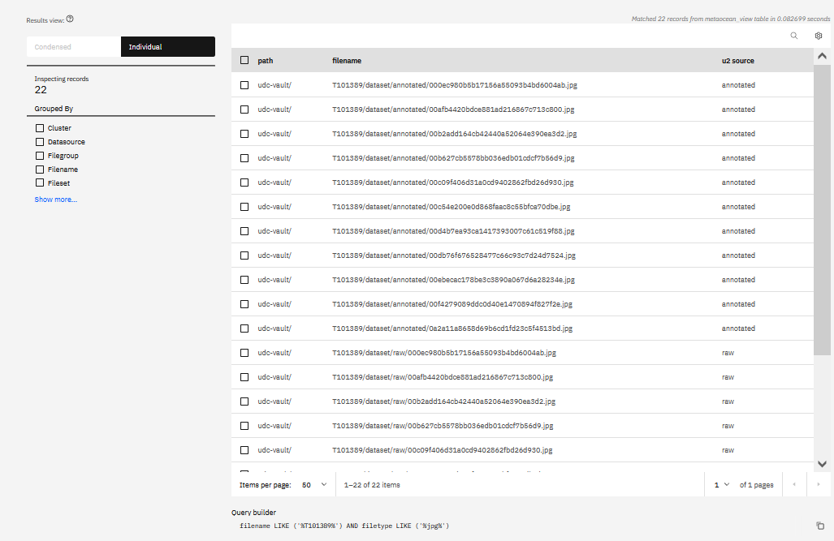
Metadata Tag “u2-source” Populated with Values Extracted by AutoTag Policy Run

Slide 14
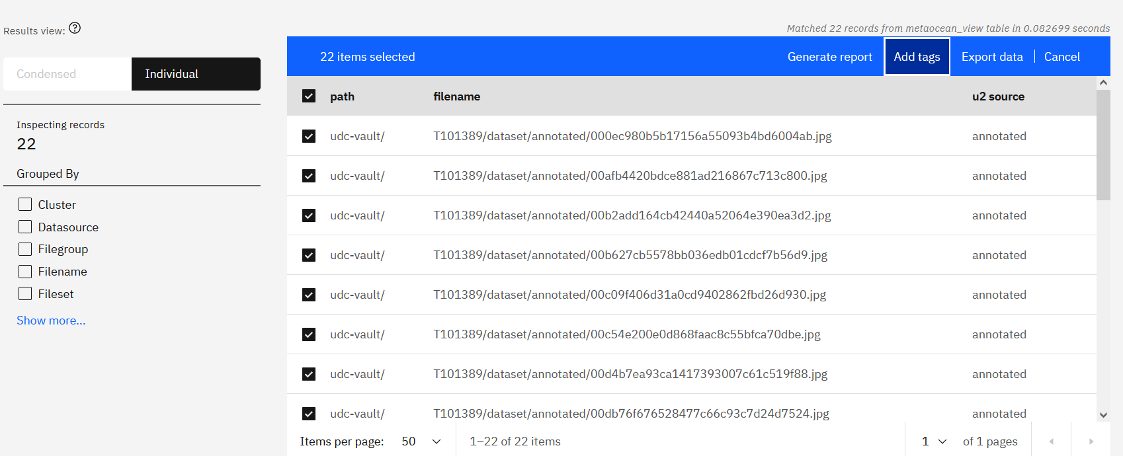
Custom-Tag Dataset

Slide 15
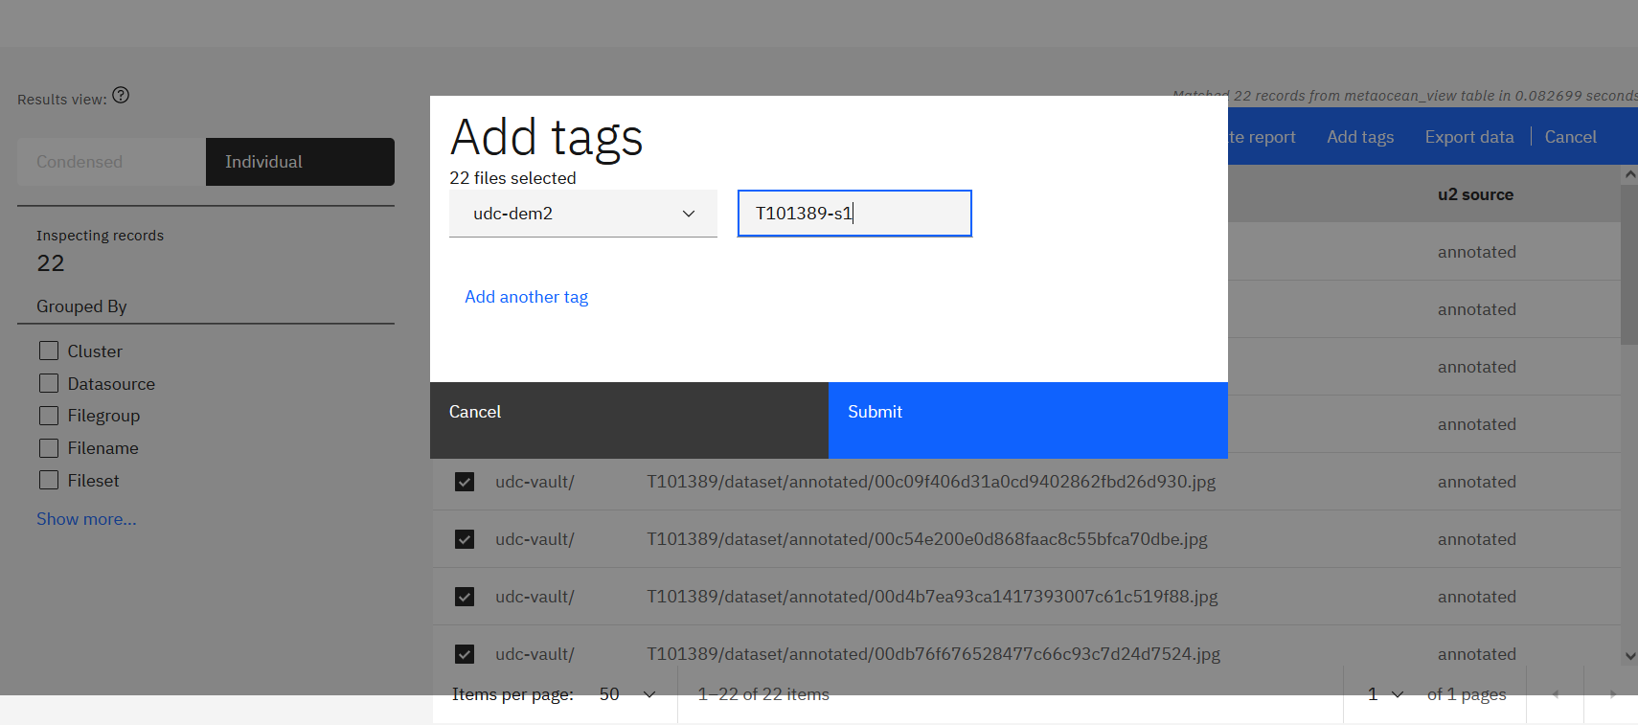
Custom-Tag Dataset

Slide 16
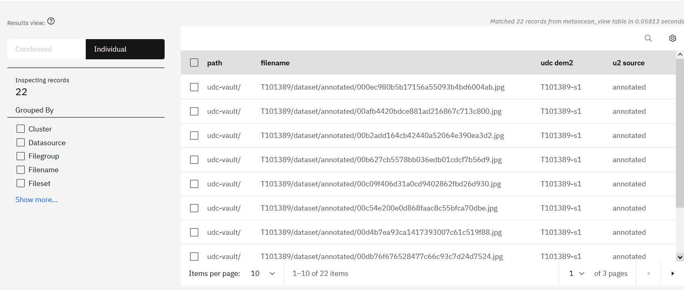
Custom-Tag Dataset with T101389-s1

Slide 17
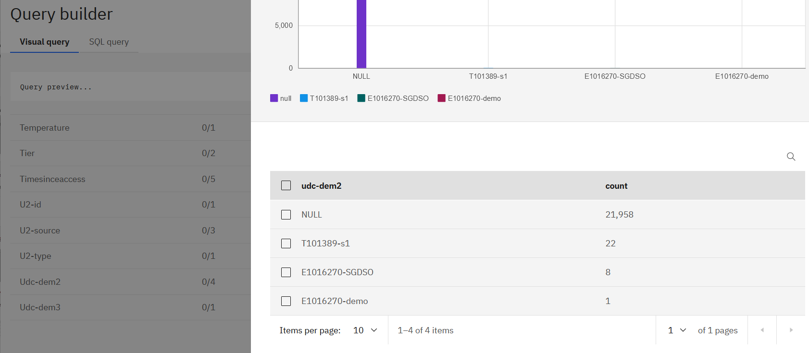
Browse for New Dataset (udc-dem2 = T101389-s1) with Visual Query

Slide 18
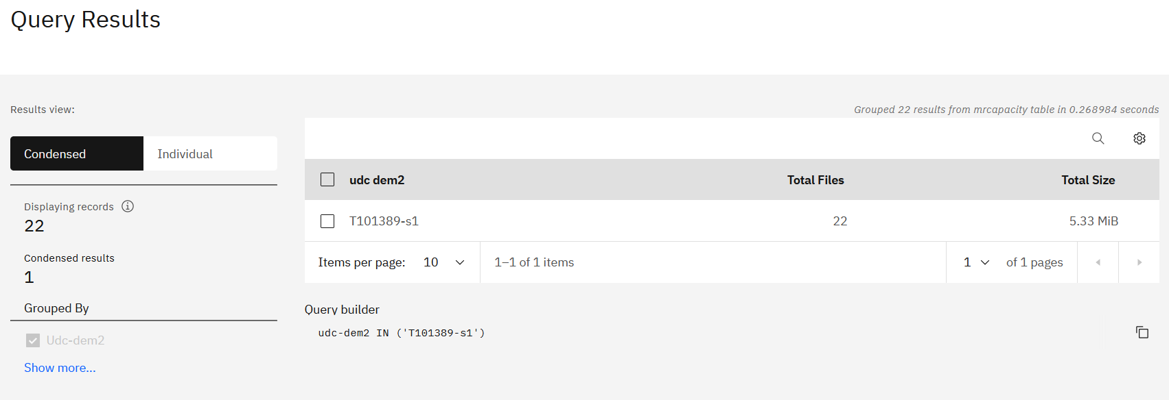
New Dataset (T101389-s1) Can be Found using a Single-query Search

Slide 19
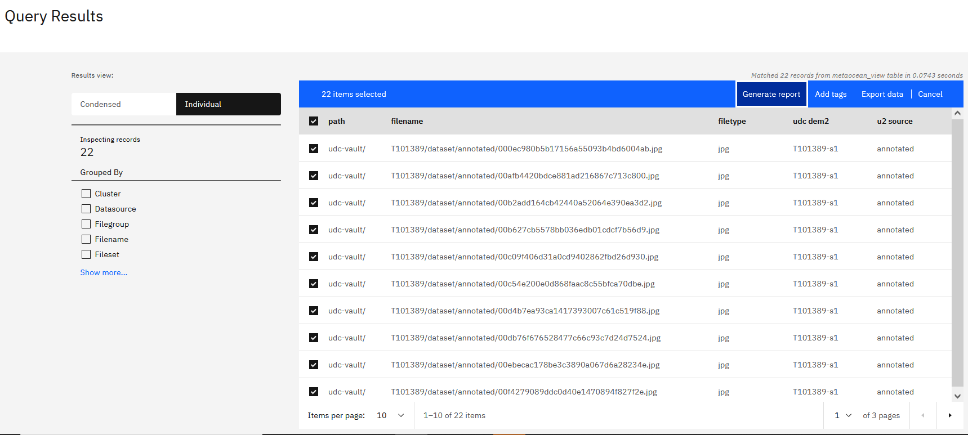
Generate a Report of the New Dataset as a CSV Manifest

Slide 20
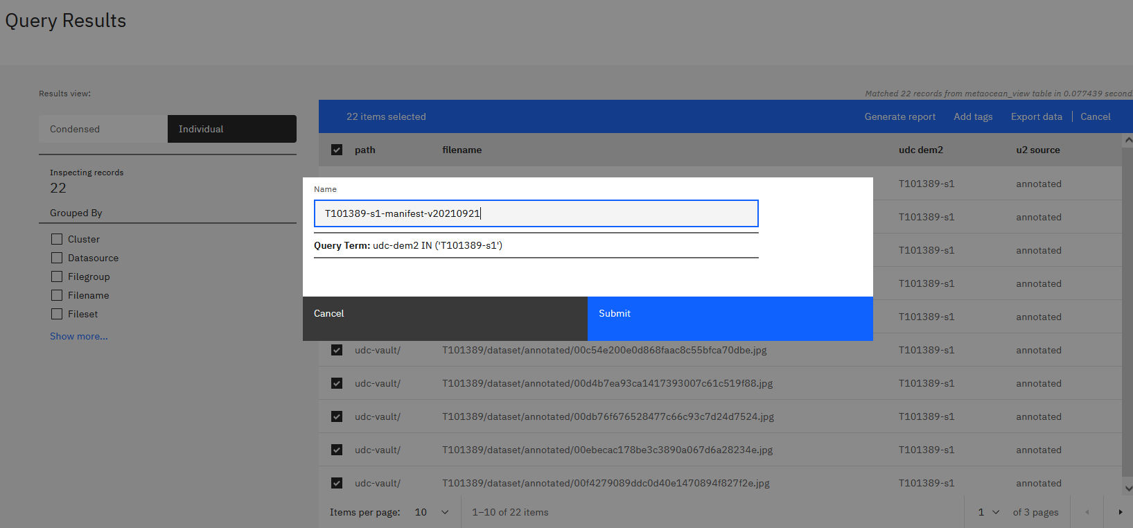
Export the New Dataset into a Manifest

Slide 21
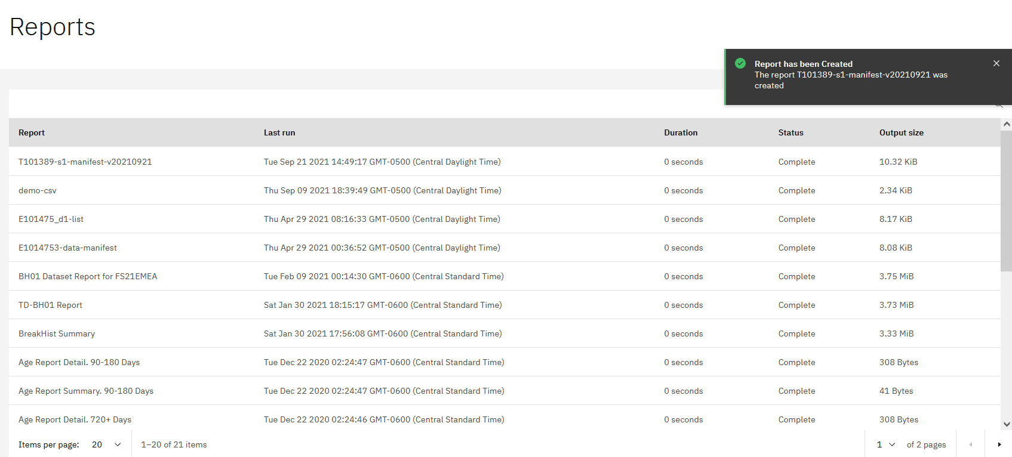
The Manifest is Stored in Console as Report

Slide 22
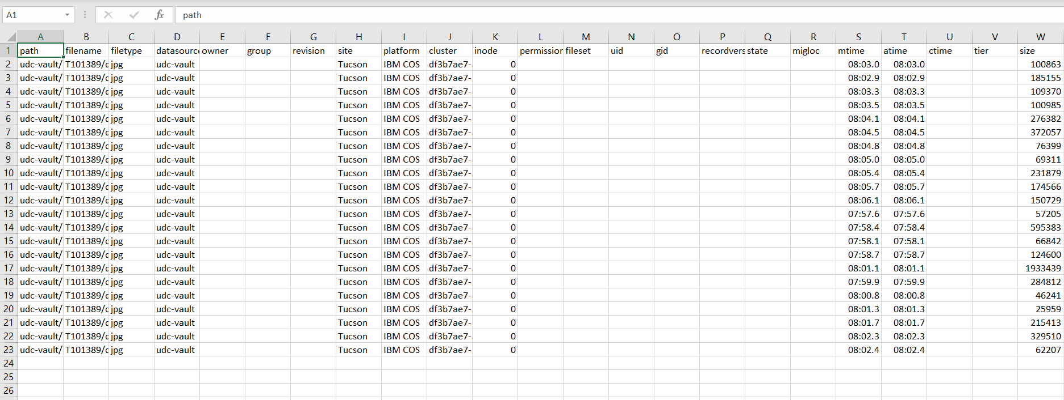
Manifest Can be Downloaded Locally as CSV File

Slide 23
5. Create New Tags Based on Filters

Slide 24
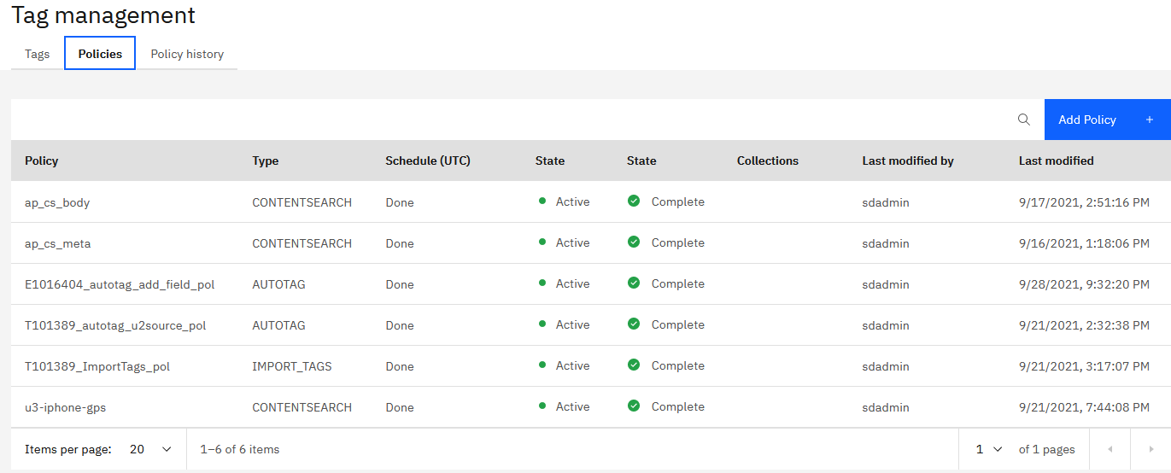
Notes:
E1016404-10-autotag-policy-added

Slide 25
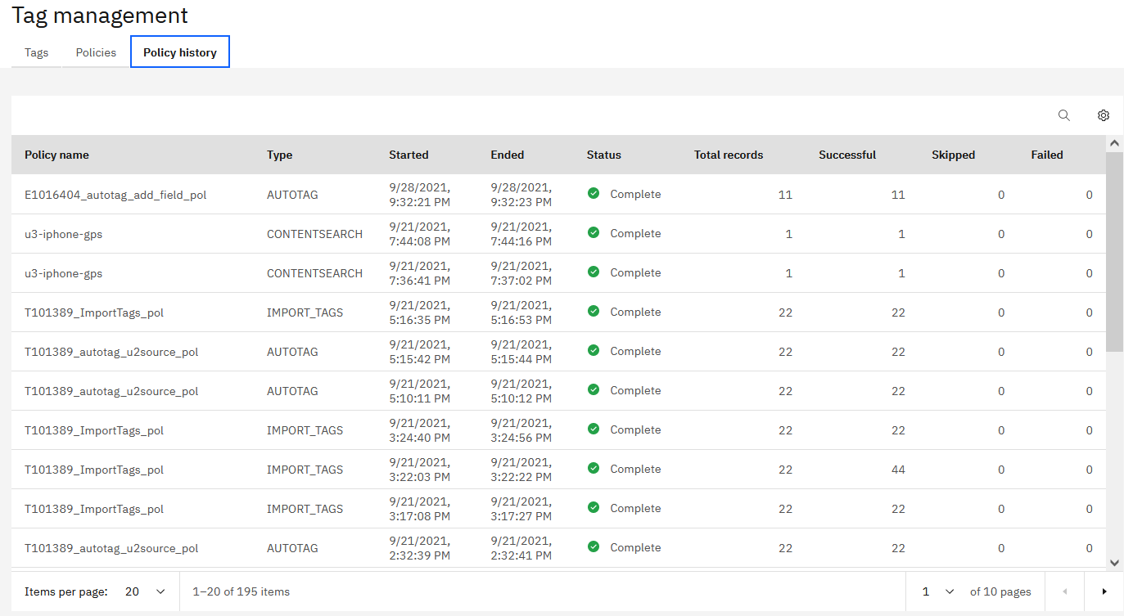
Notes:
E1016404-20-autotag-policy-run-completed

Slide 26
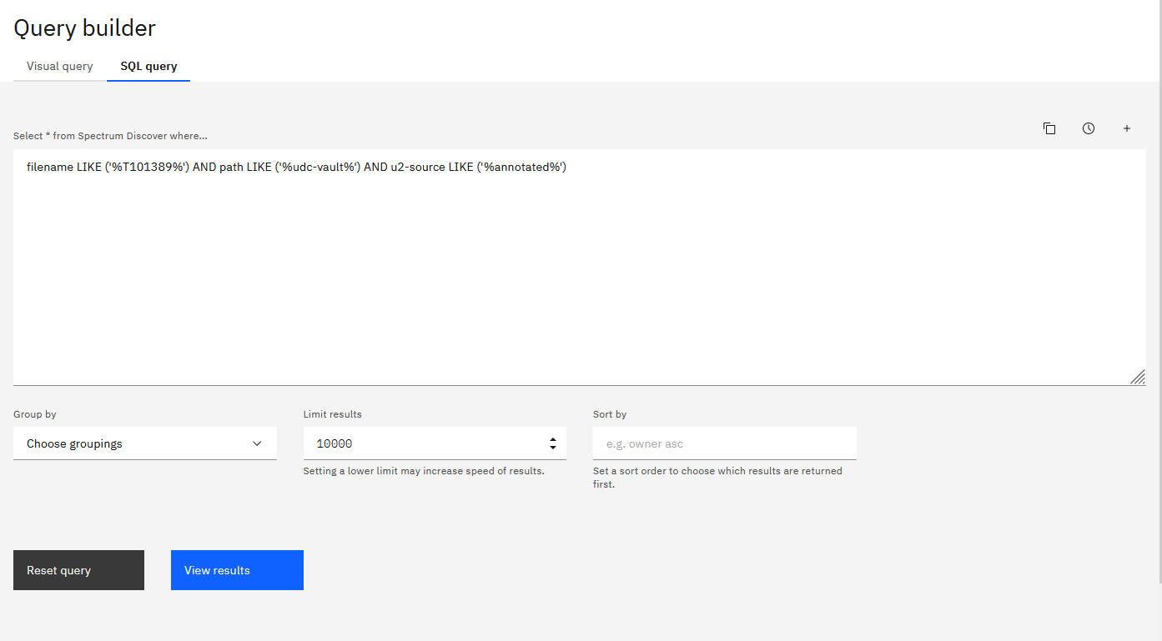
Notes:
E1016404-30-query-for-new-dataset

Slide 27
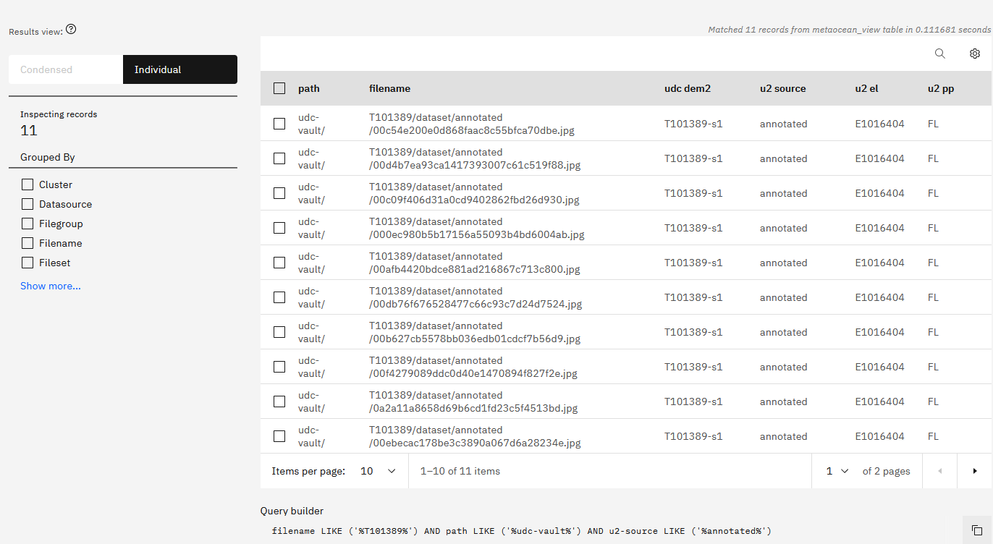
Notes:
E1016404-40-new-dataset-w-calculated-tag

Slide 28
6. View Images Directly with Calculated URL

Slide 29
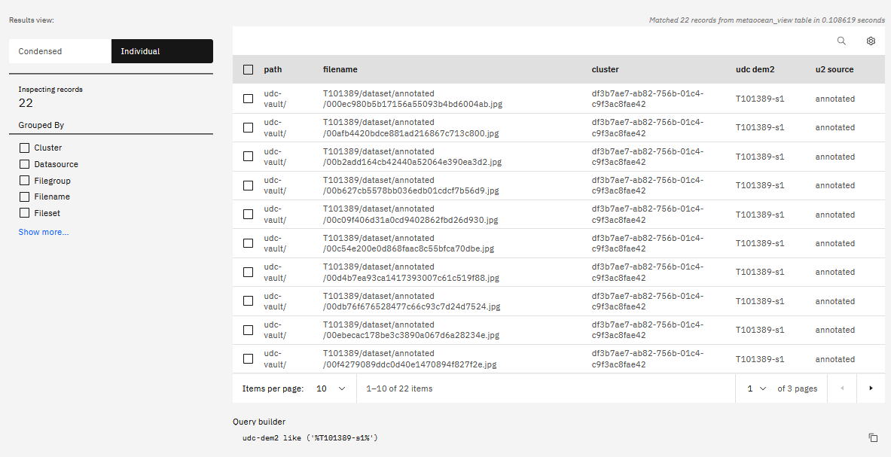

Slide 30
