Slide 1
Demo: Unified Data Catalog for Aircraft Images
Scenario 1: Initialize Catalog with Metadata
Frank Lee
https://github.com/drfranknlee/demo-udc-aircraft

Slide 2
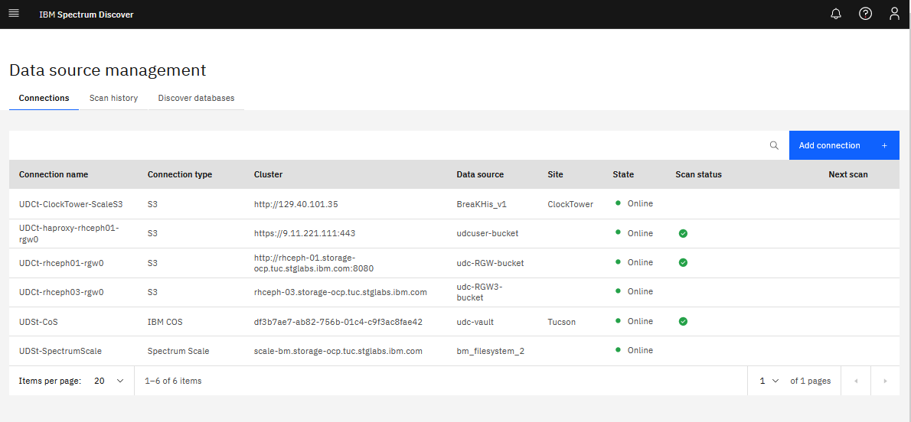

Slide 3
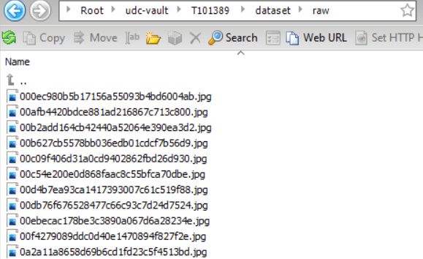
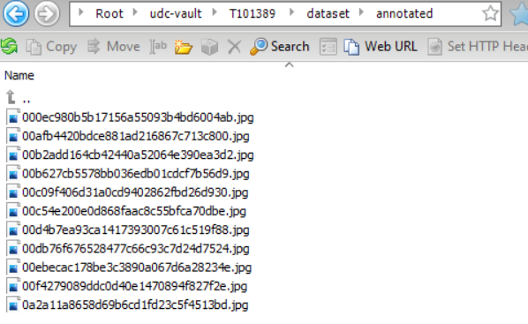
Upload Original Data to Cloud Object Storage Bucket

Slide 4
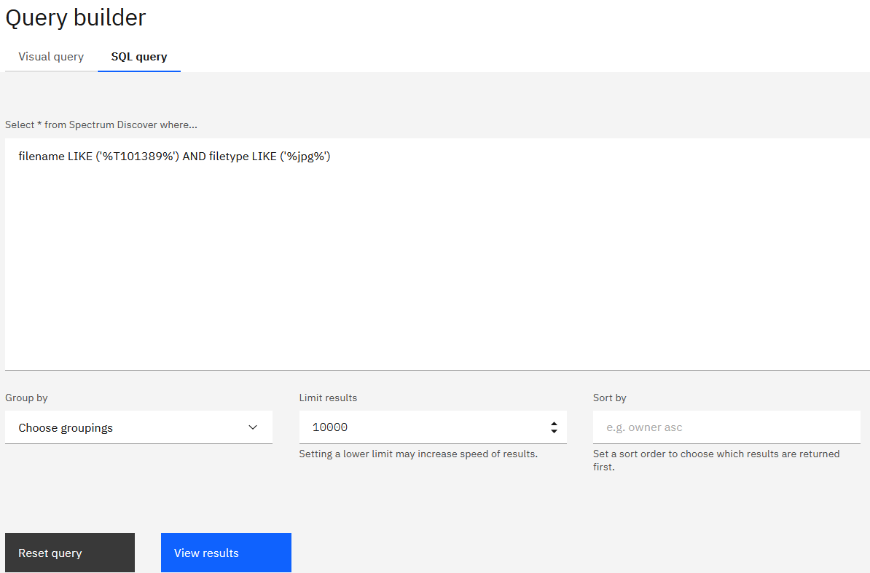
Search for Dataset using SQL Query from Query Builder

Slide 5
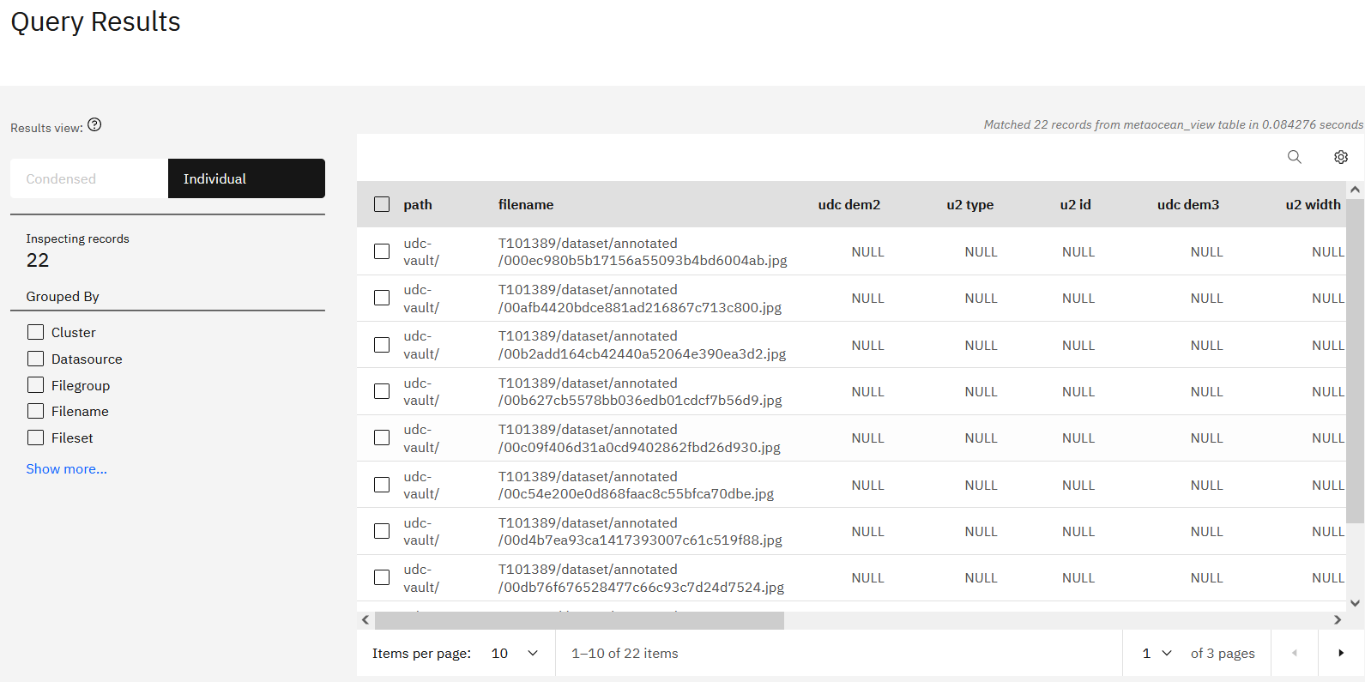
Query Results Displayed

Slide 6
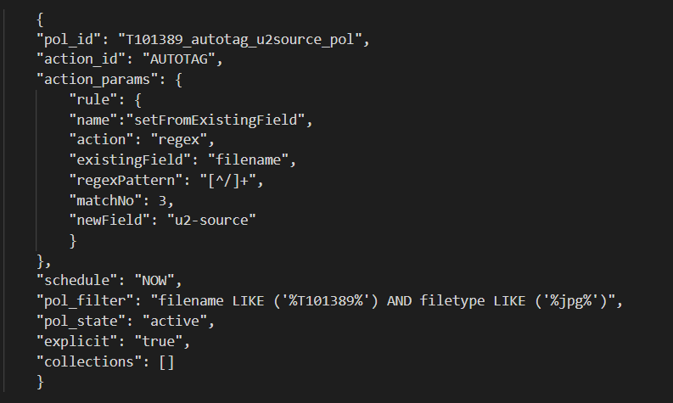
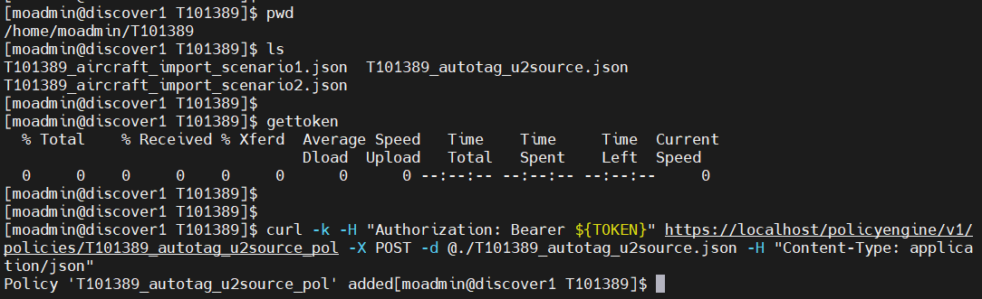
Create AutoTag Policy
Create the autotag policy in json
Execute the policy on server

Slide 7
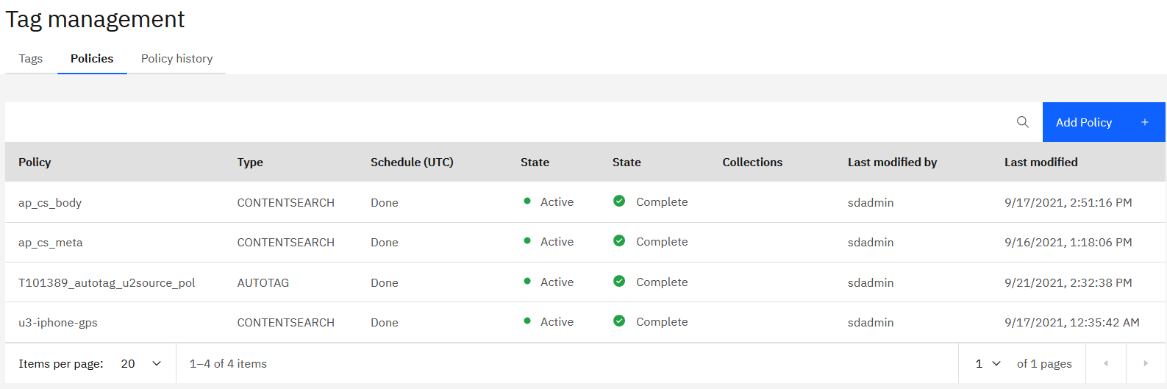
AutoTag Policy Added to Spectrum Discover Console

Slide 8
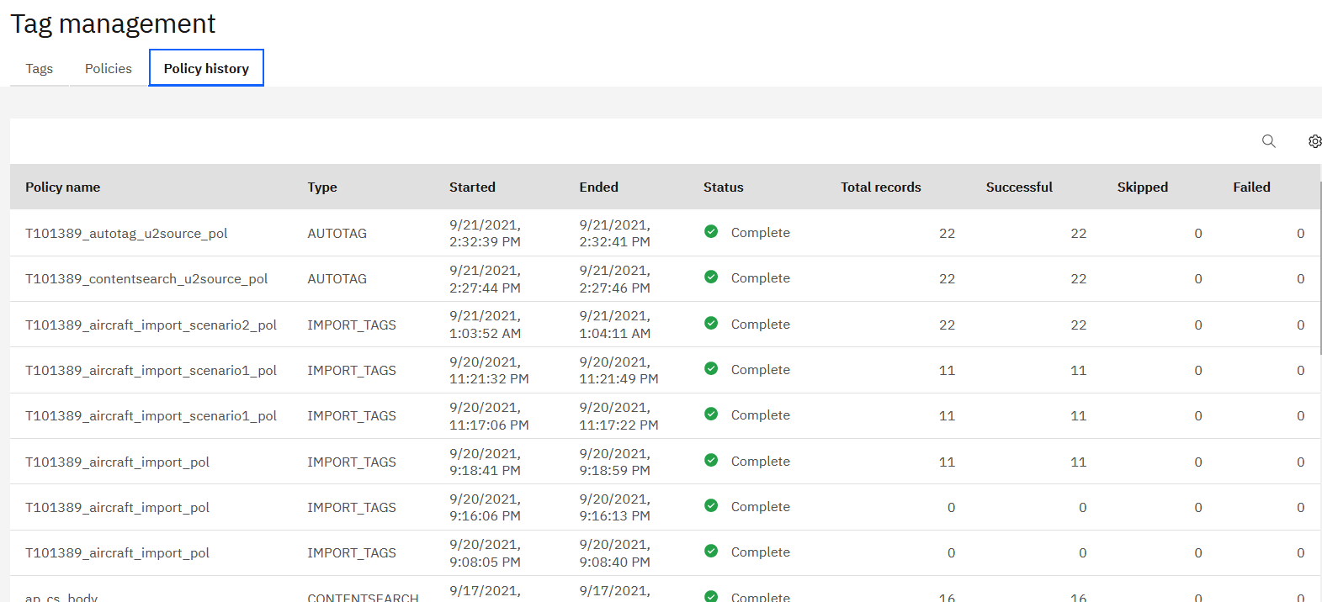
Newly Created AutoTag Policy Executed Automatically for First Time

Slide 9
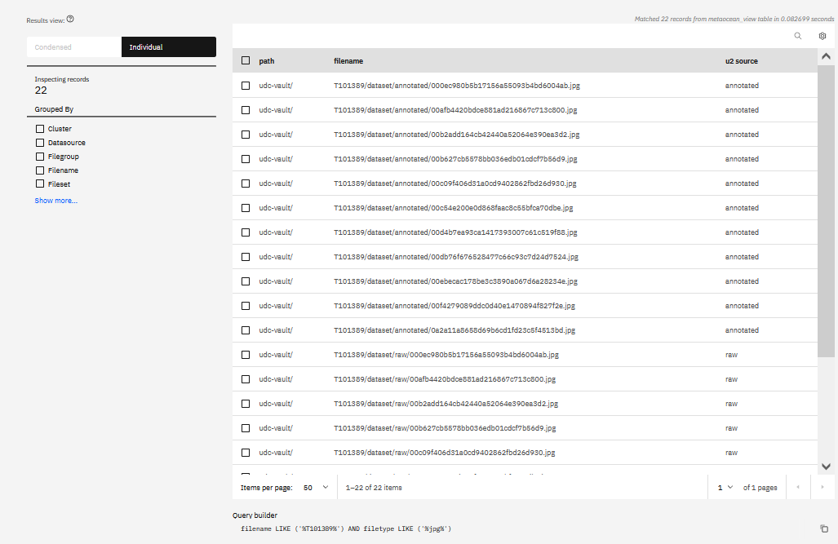
Metadata Tag “u2-source” Populated with Values Extracted by AutoTag Policy Run

Slide 10
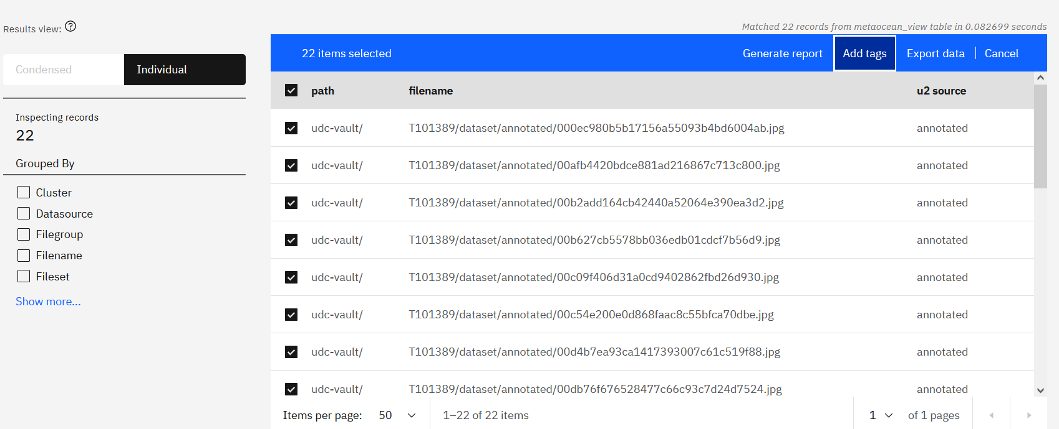
Custom-Tag Dataset

Slide 11
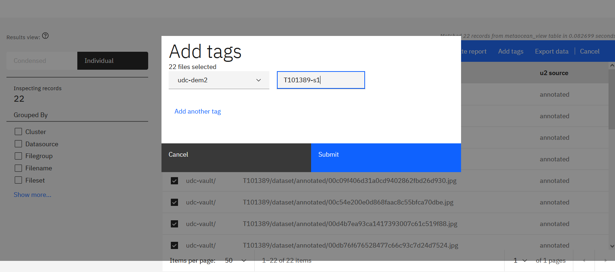
Custom-Tag Dataset

Slide 12
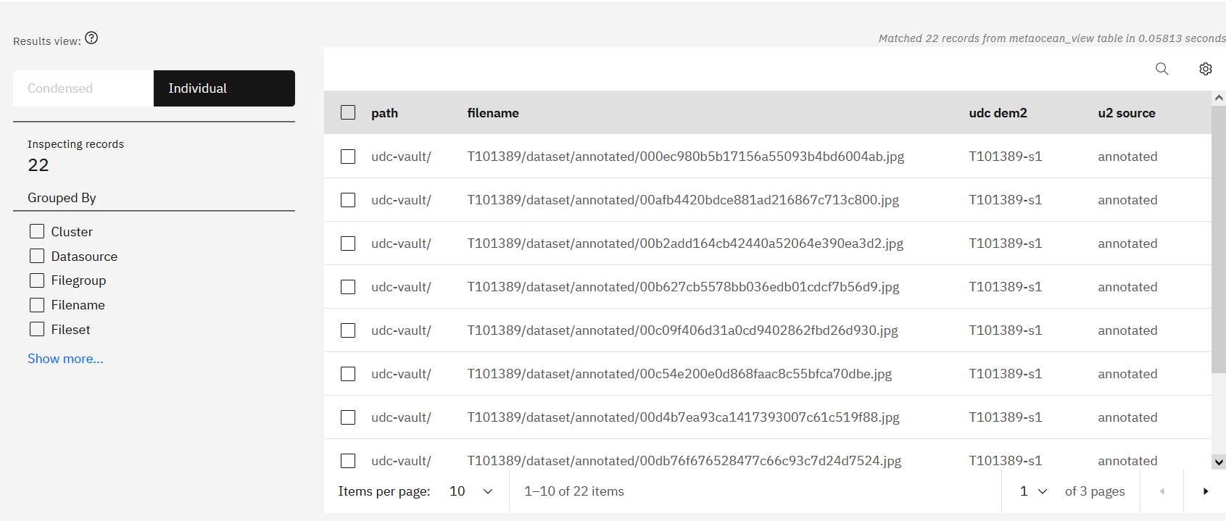
Custom-Tag Dataset with T101389-s1

Slide 13
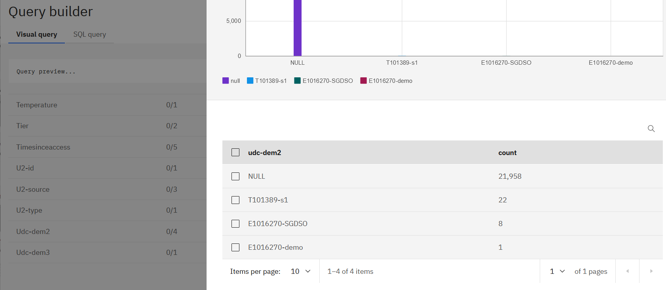
Browse for New Dataset (udc-dem2 = T101389-s1) with Visual Query

Slide 14
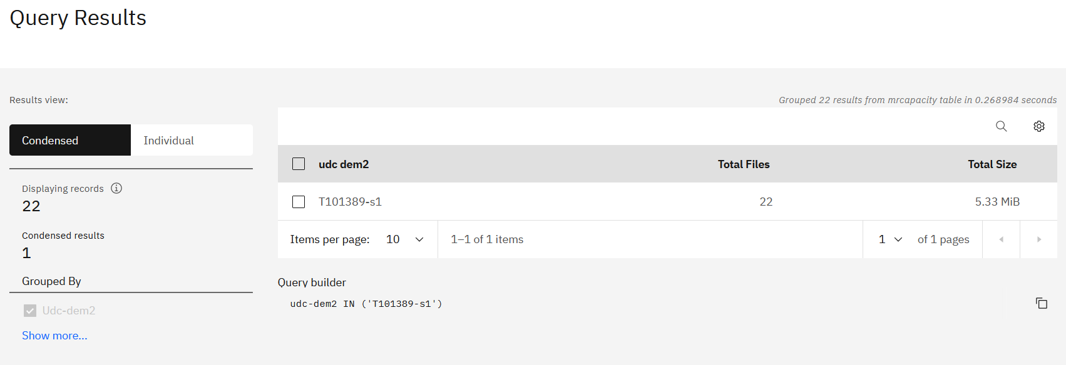
New Dataset (T101389-s1) Can be Found using a Single-query Search

Slide 15
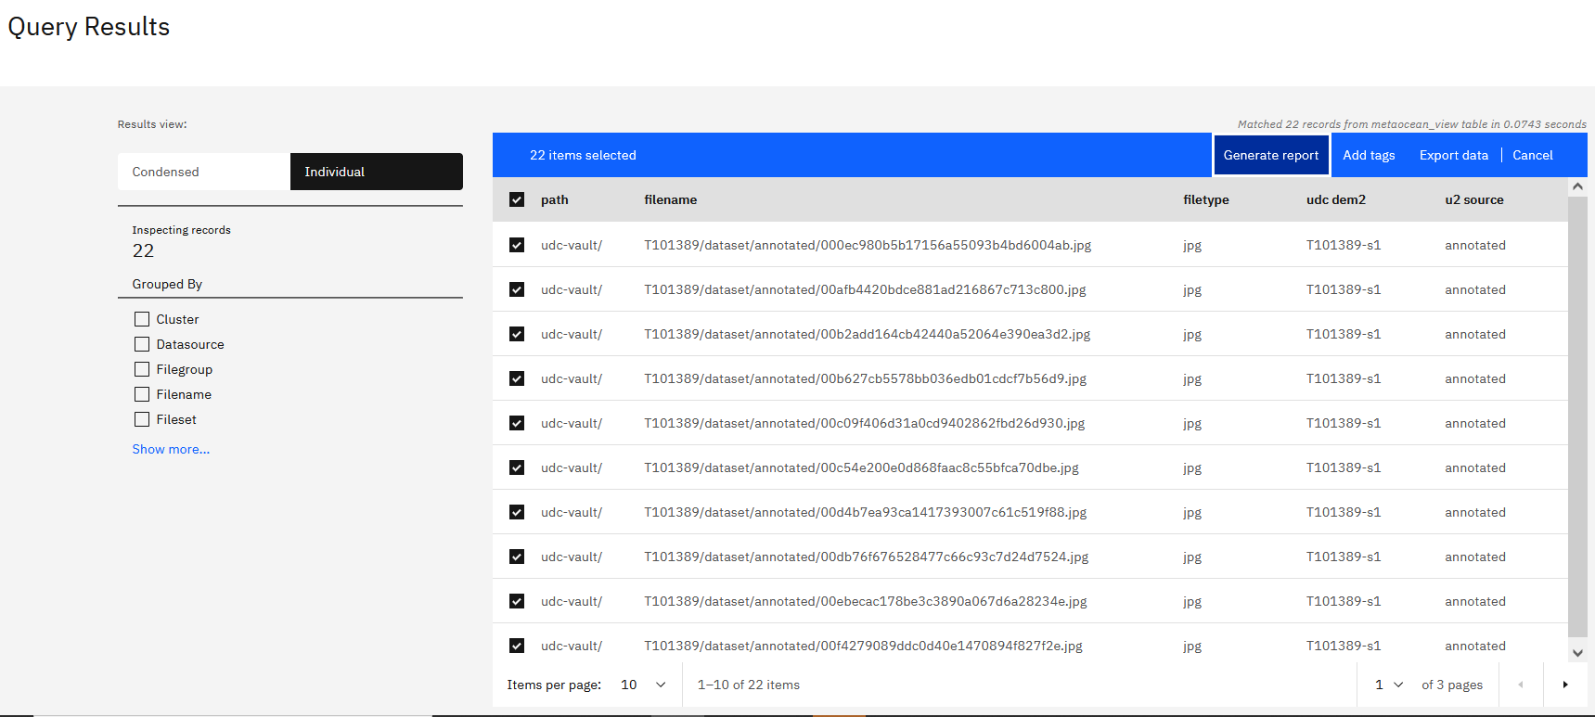
Generate a Report of the New Dataset as a CSV Manifest

Slide 16
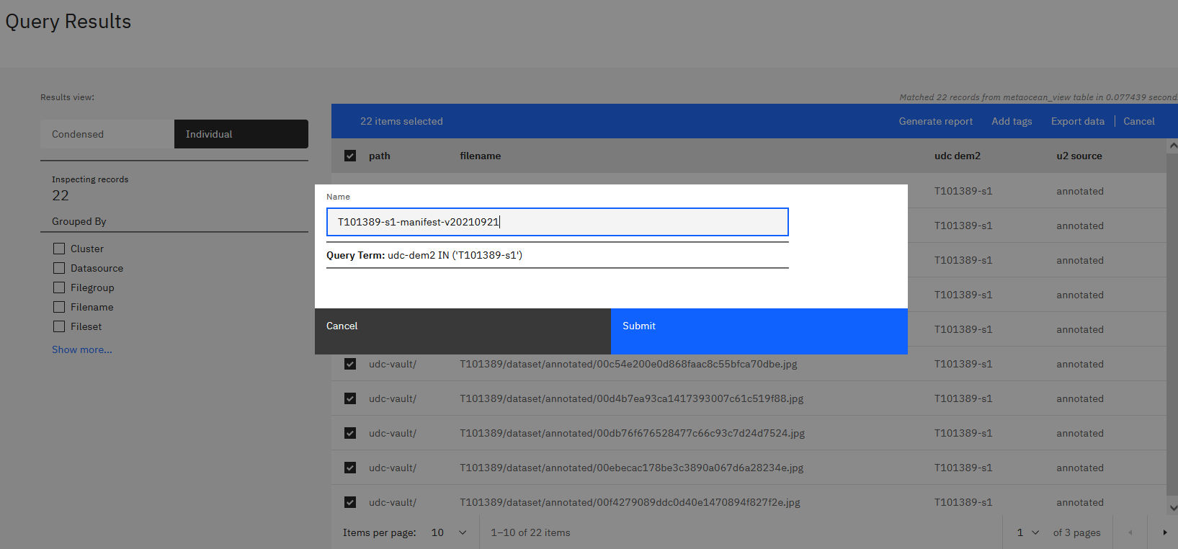
Export the New Dataset into a Manifest

Slide 17
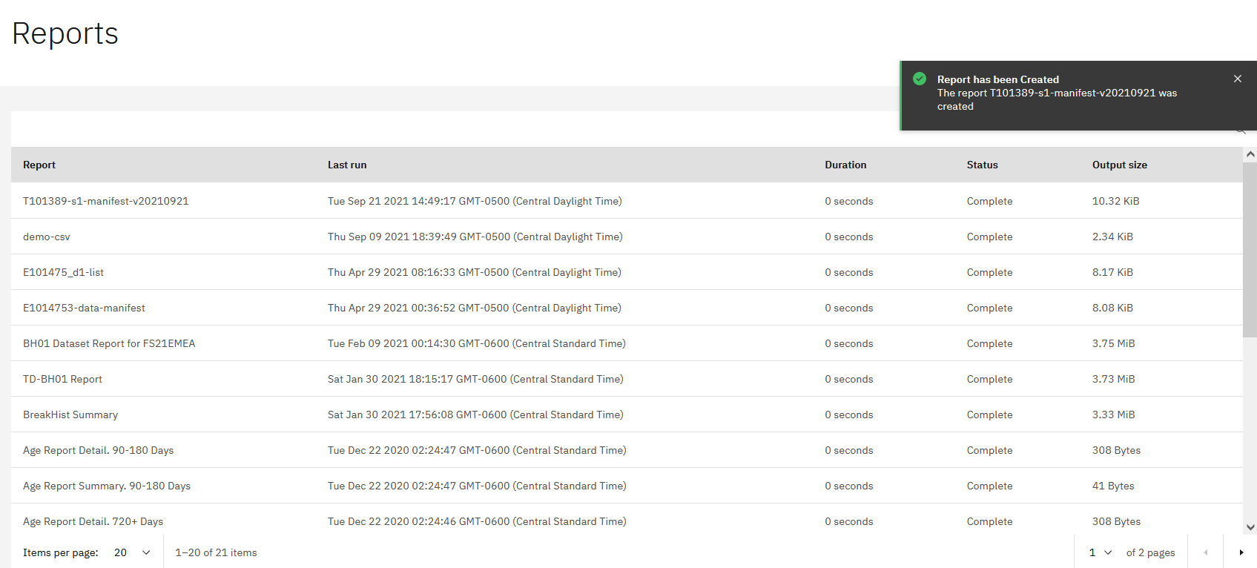
The Manifest is Stored in Console as Report

Slide 18
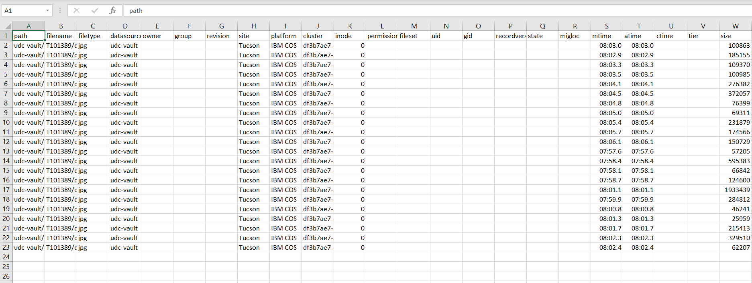
Manifest Can be Downloaded Locally as CSV File

Slide 19
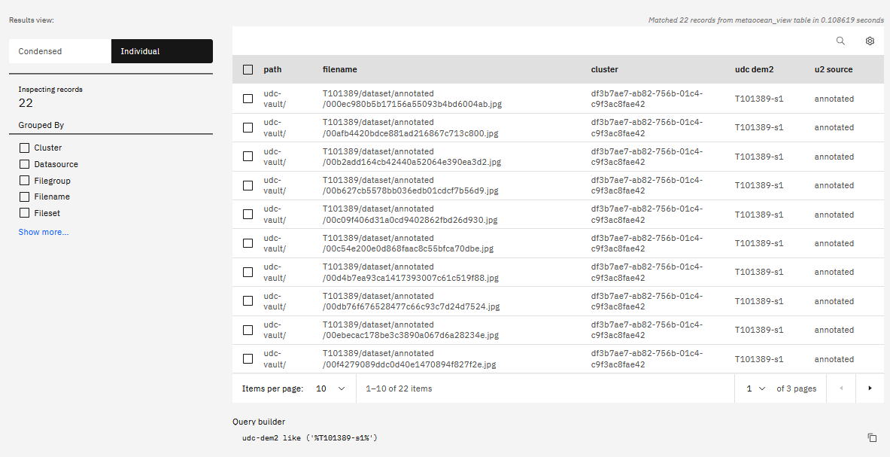

Slide 20
