Slide 1
Demo: Unified Data Catalog for Military Aircraft
Scenario 4: ContentSearch of Photo Metadata to Enrich Catalog
Frank Lee, Joe Dain
https://github.com/drfranknlee/demo-udc-aircraft

Slide 2
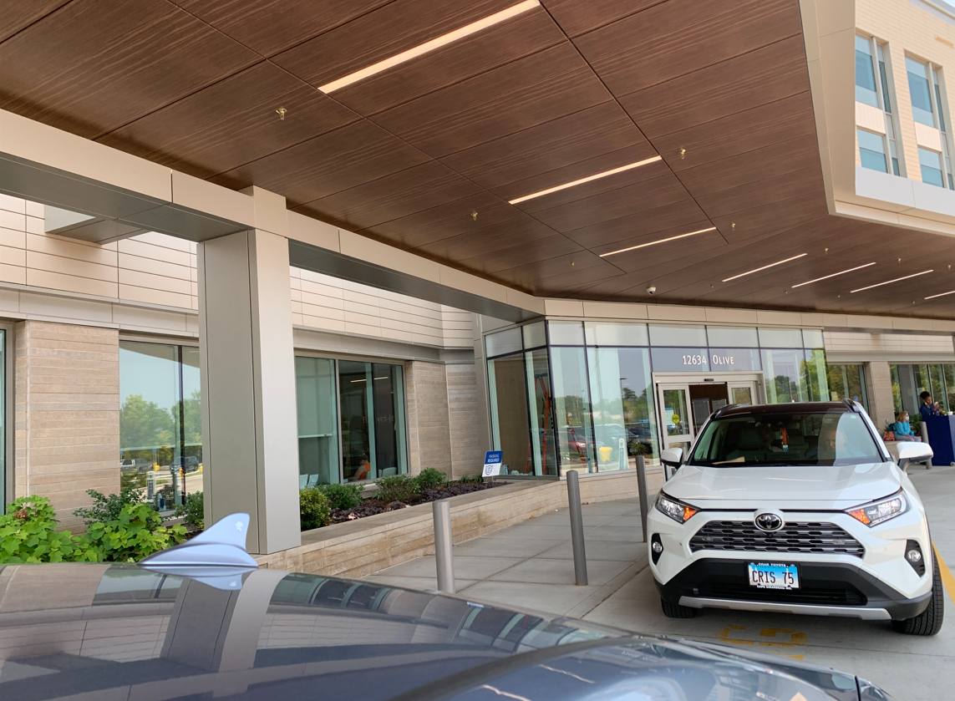

Slide 3
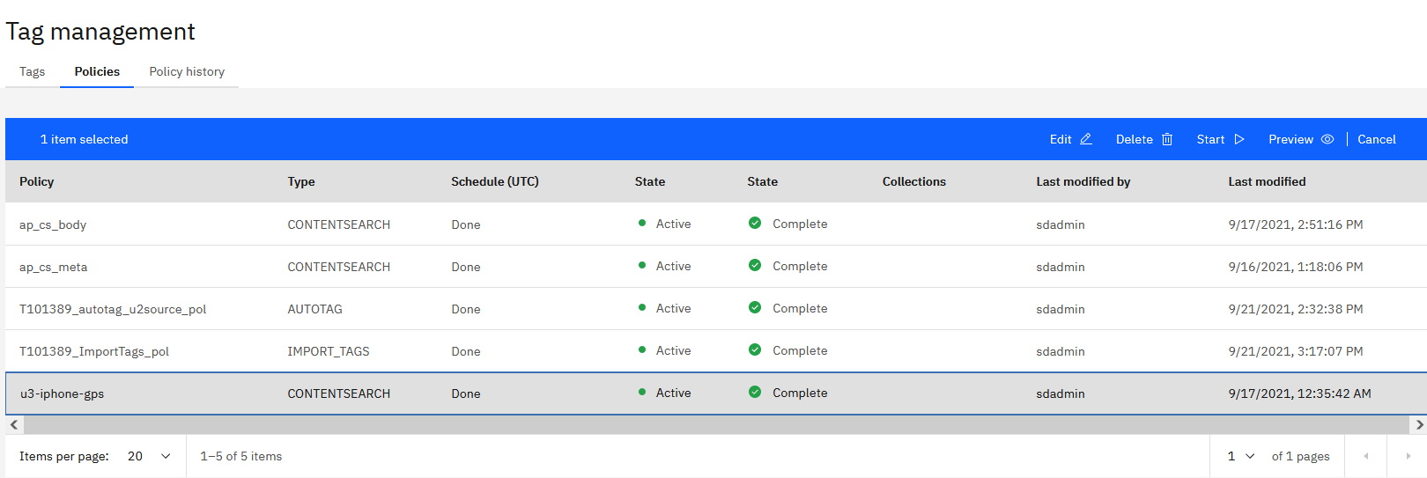
Create ContentSearch Policy to Extract Metadata Headers from Photos

Slide 4
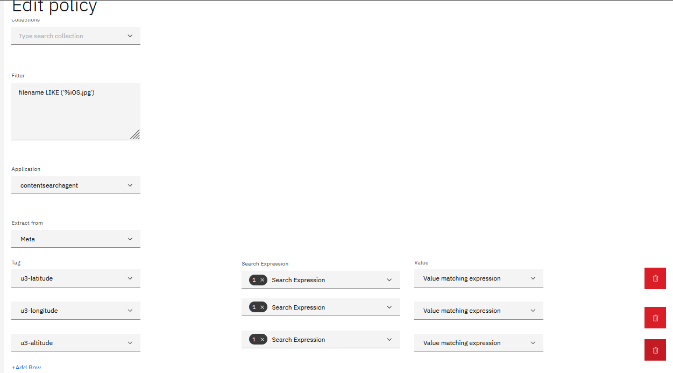
Create ContentSearch Policy to Extract Metadata Headers from Photos

Slide 5
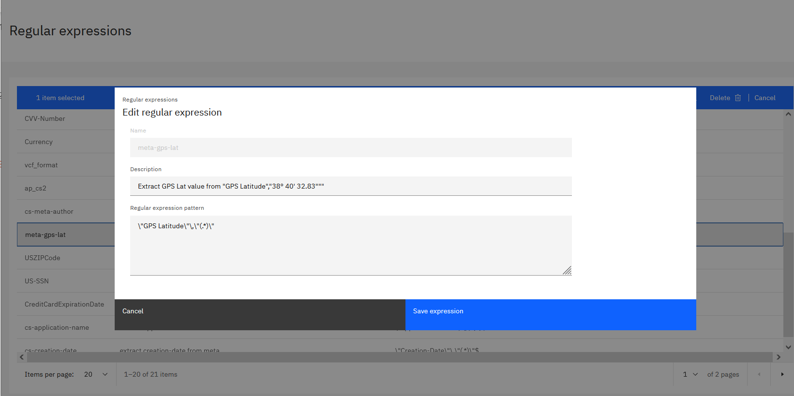
Regular Expression Created to Extract “GPS Latitude” Value from Header

Slide 6
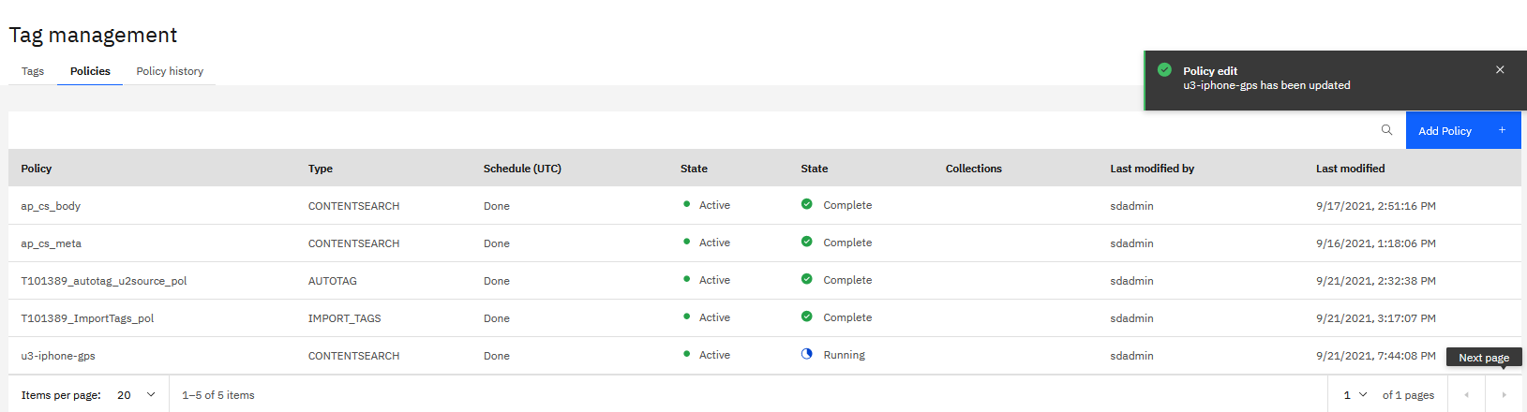
Schedule the Policy Run Now

Slide 7
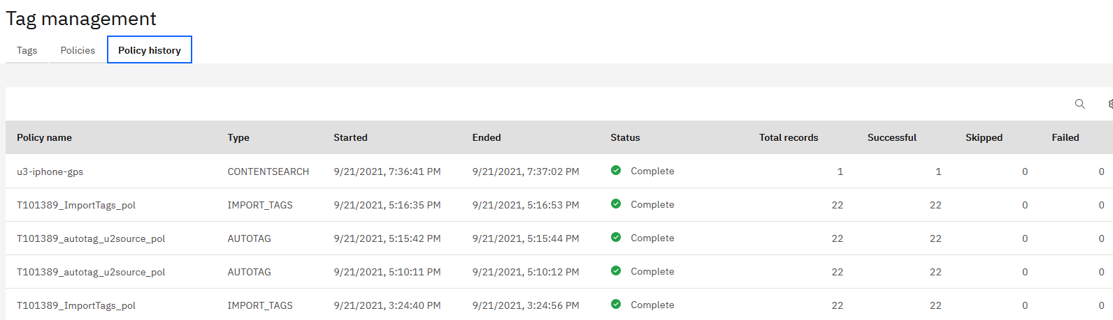
Schedule the Policy Run

Slide 8
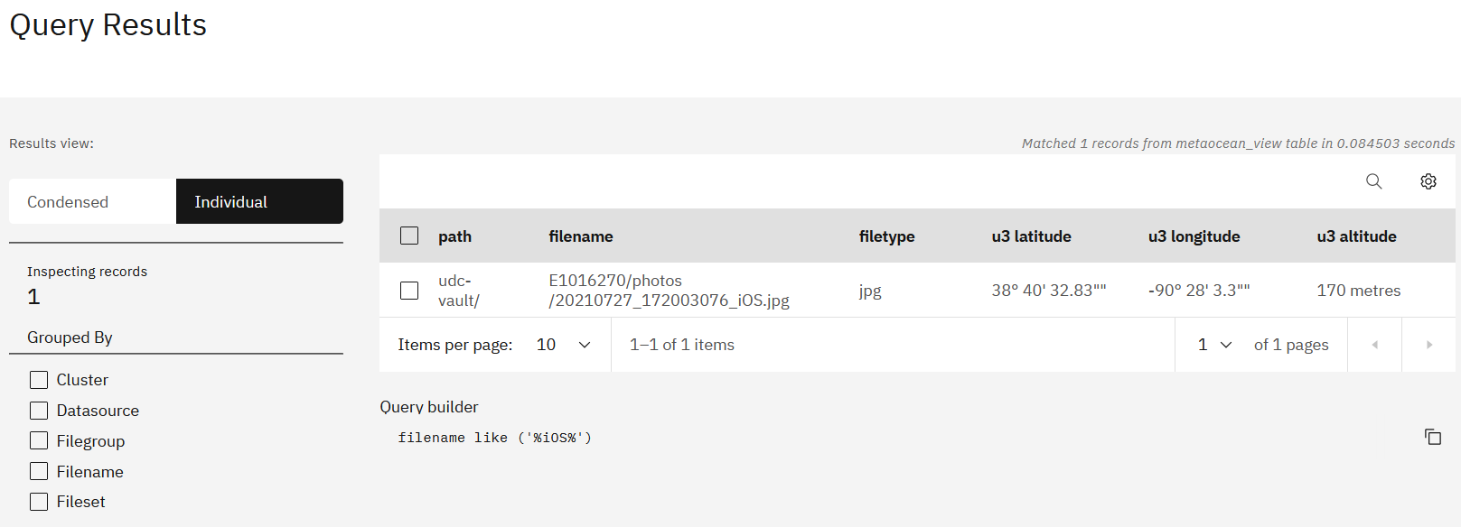
Result: the iOS.jpg Has two Metadata Tags based on Geospatial Coordinates

