Slide 1
Demo: Unified Data Catalog for Military Aircraft
Scenario 1: Index Dataset & Prepare Catalog
Frank Lee
https://github.com/drfranknlee/demo-udc-aircraft

Slide 2
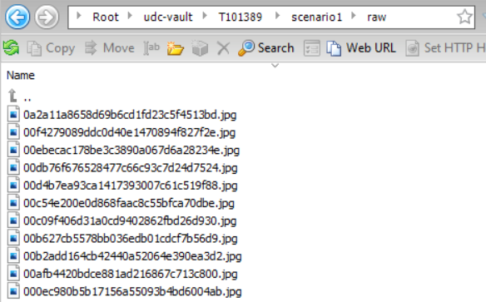
Upload Dataset to Cloud Object Storage Bucket

Slide 3
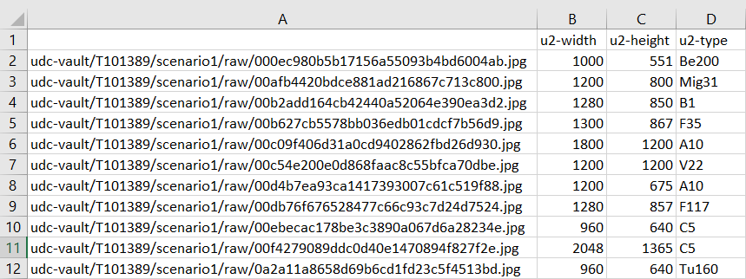
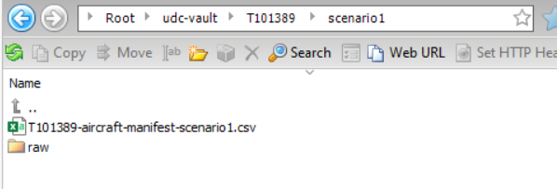
Upload Manifest to Cloud Object Storage Bucket

Slide 4
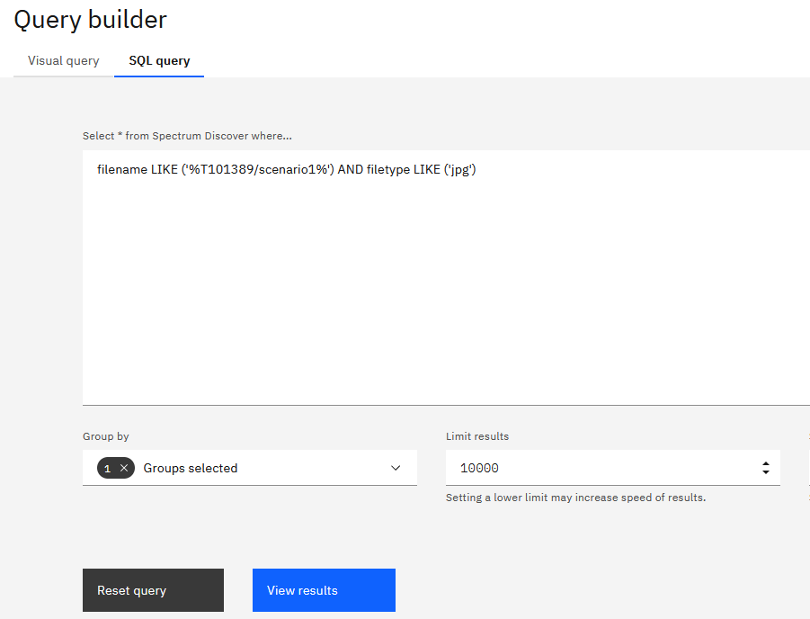
Search for Dataset and Manifest in Spectrum Discover Web Console

Slide 5
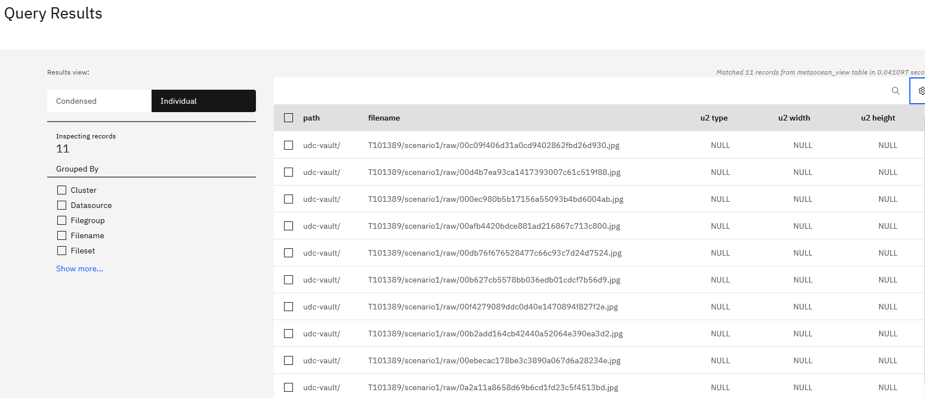
Search for Dataset and Manifest in Spectrum Discover Web Console: Results

Slide 6
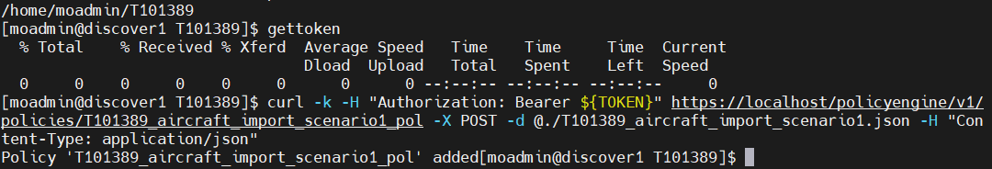
Create IMPORT_TAGS Policy

Slide 7
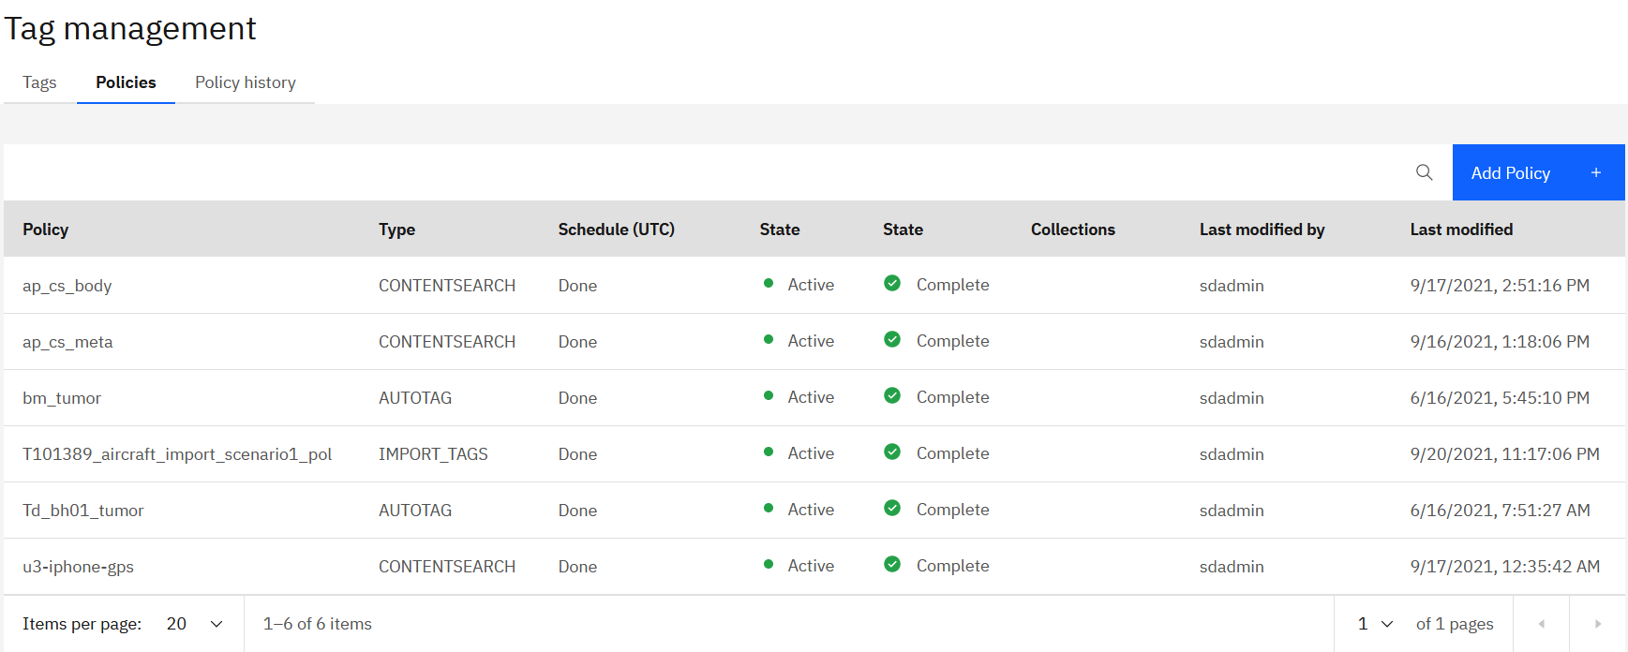
Create IMPORT_TAGS Policy: Result-1

Slide 8
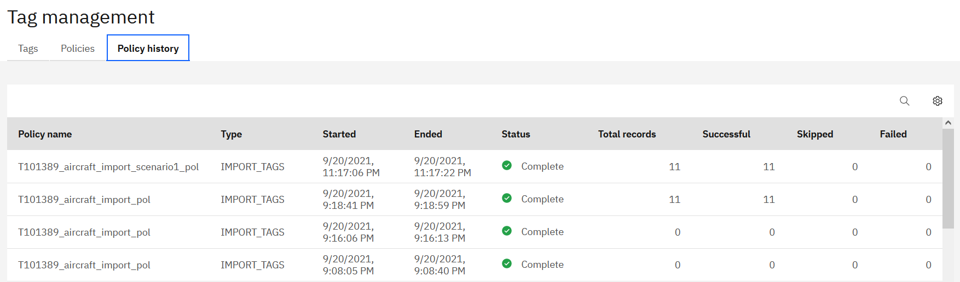
Create IMPORT_TAGS Policy: Result-2

Slide 9
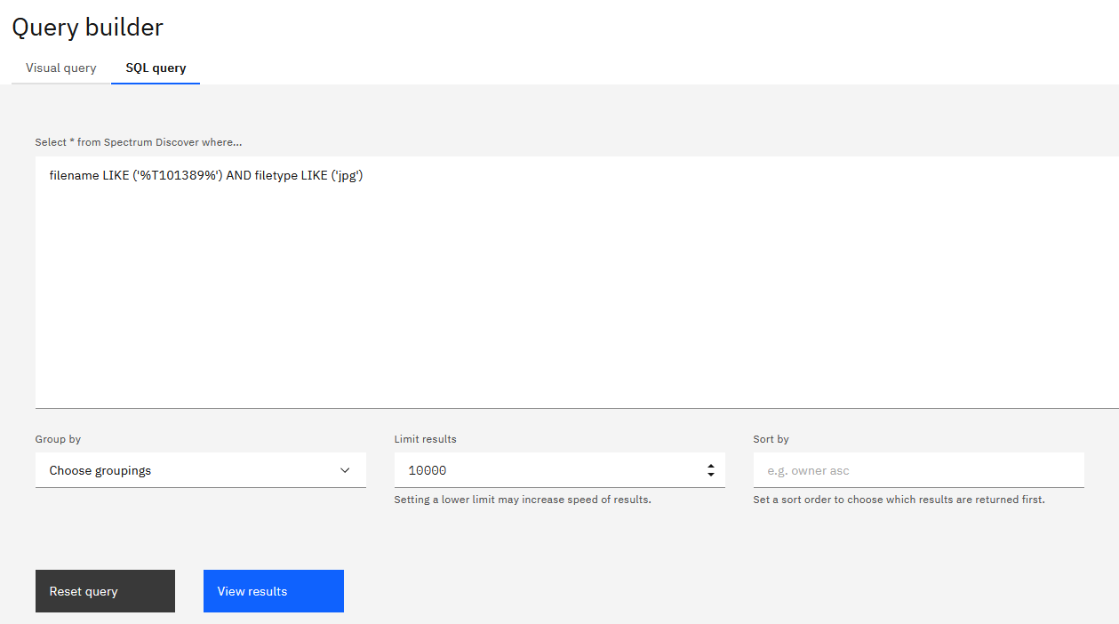
Find the Newly Tagged Dataset: Method-1 using SQL Query

Slide 10
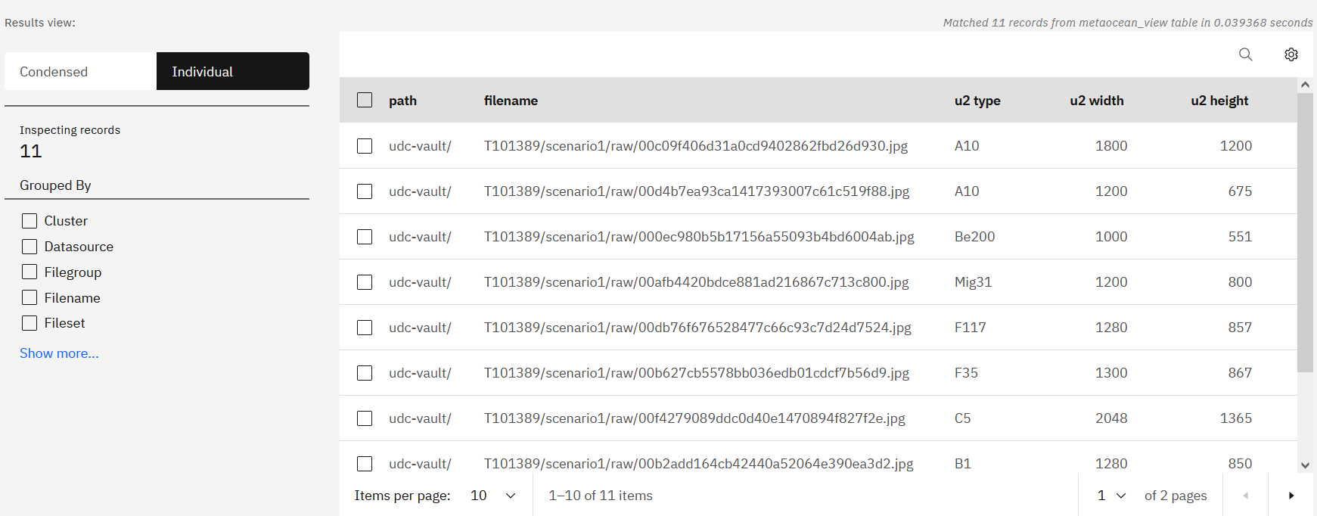
Find the Newly Tagged Dataset: Method-1 Result

Slide 11
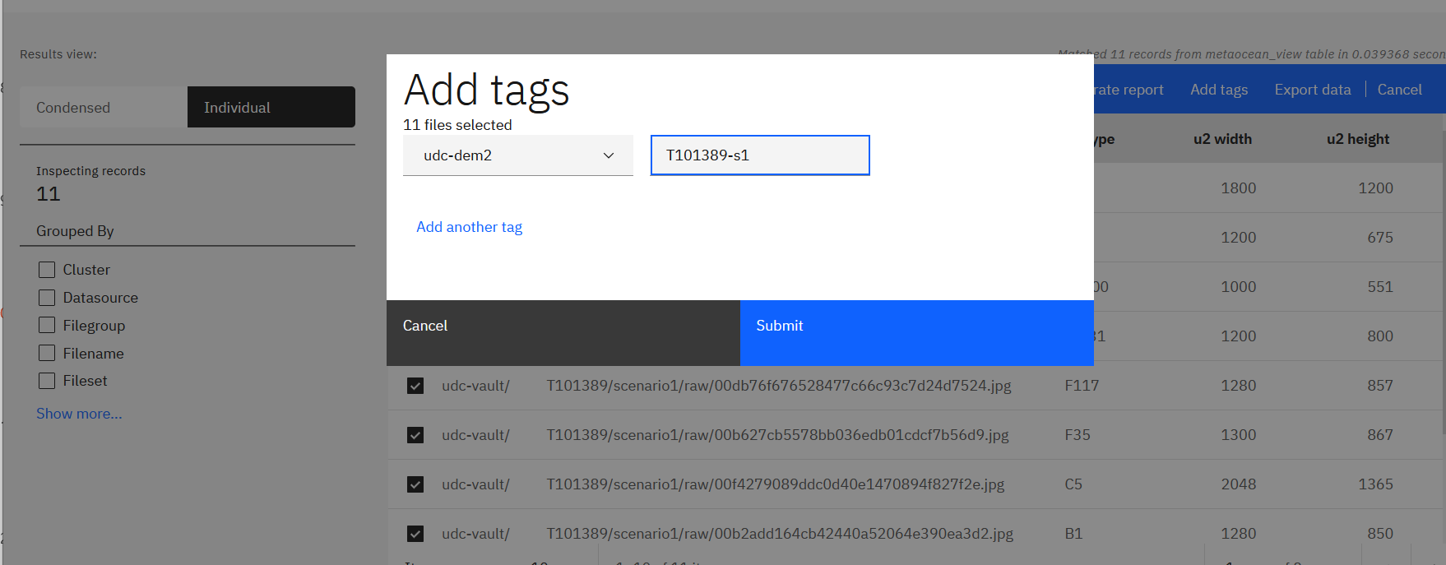
Custom-tag the Selected Data to create a New Dataset “T101389-s1”

Slide 12
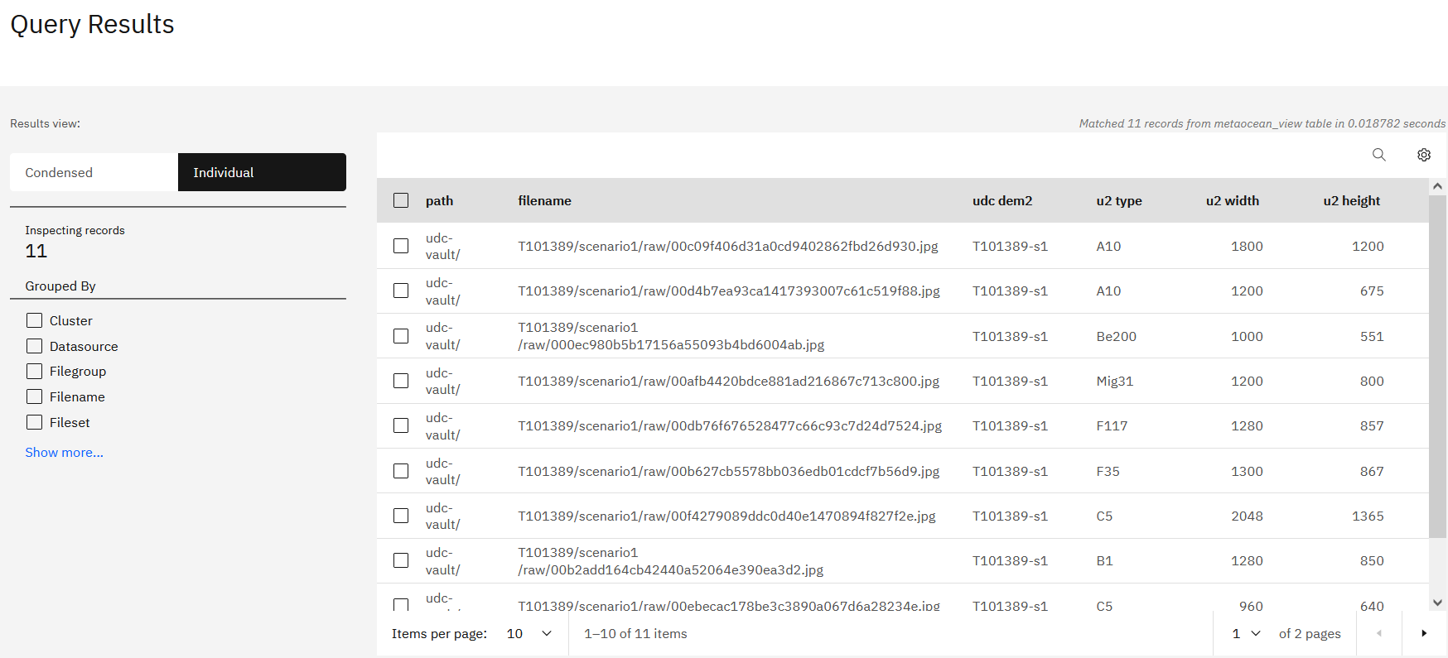
Custom-tag the Selected Data to create a New Dataset “T101389-s1”: Result

Slide 13
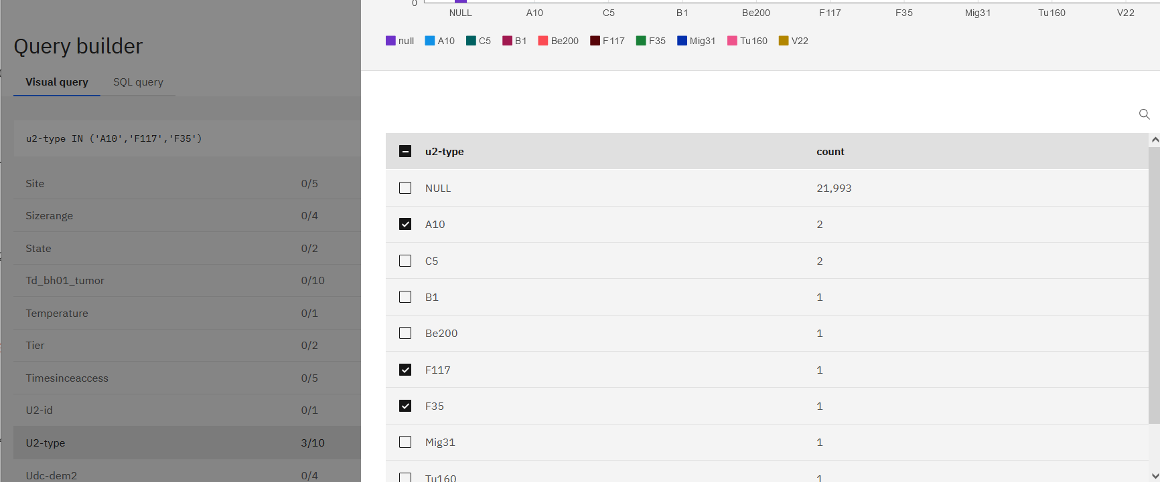
Find the Newly Tagged Dataset with Visual Query

Slide 14
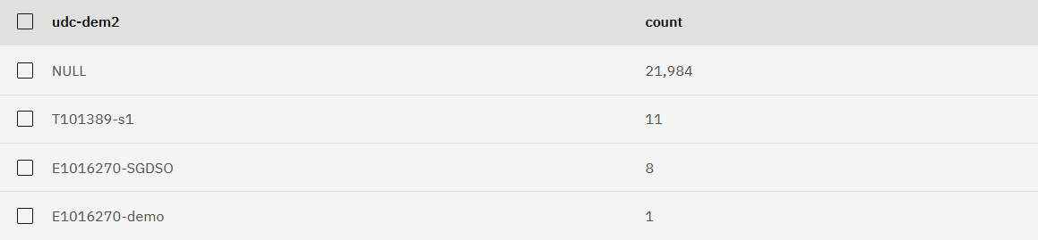
Find the Newly Tagged Dataset with Visual Query

Slide 15
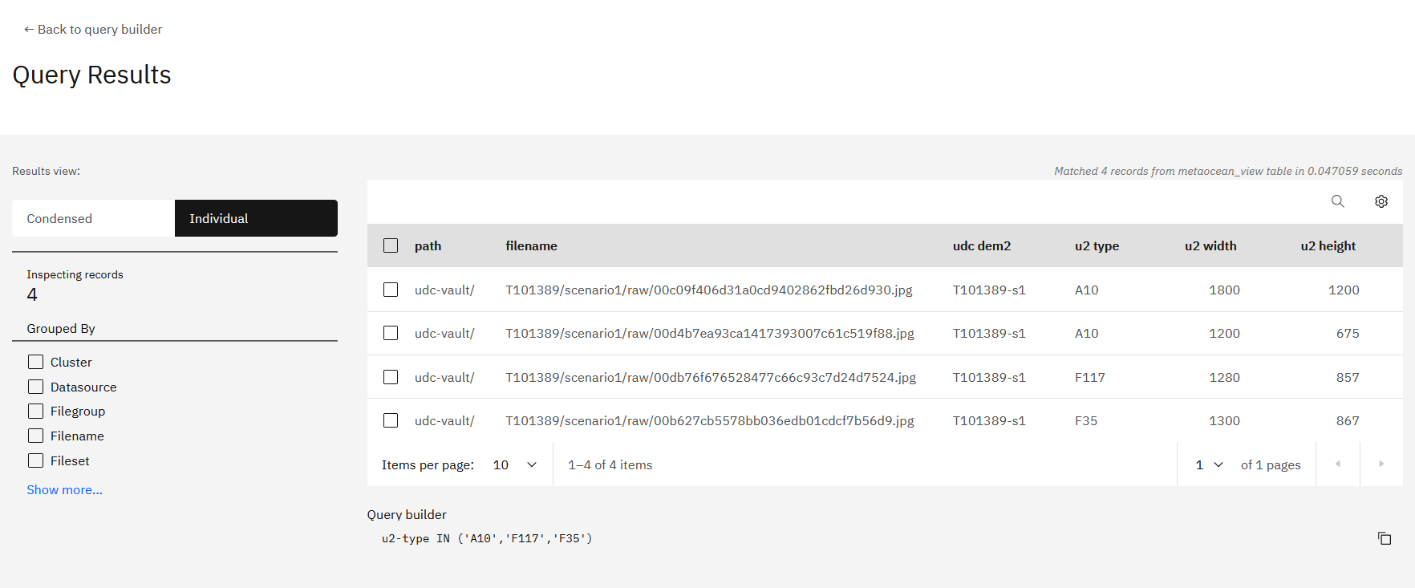
Find the Newly Tagged Dataset: Method-2 using Visual Query Results

