Slide 1
Unified Data Catalog for Cancer Imaging
Scenario 1: Initialize Catalog with Metadata Ingest & Indexing, AutoTag and Custom-Tagging

Slide 2
1. Set up Spectrum Discover to Manage Data Sources

Slide 3
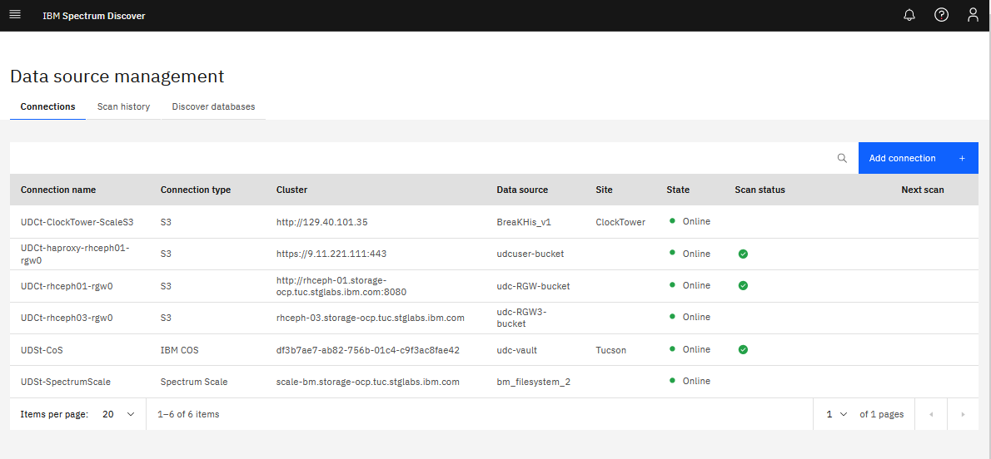

Slide 4
2. Metadata Ingest and Default Indexing

Slide 5
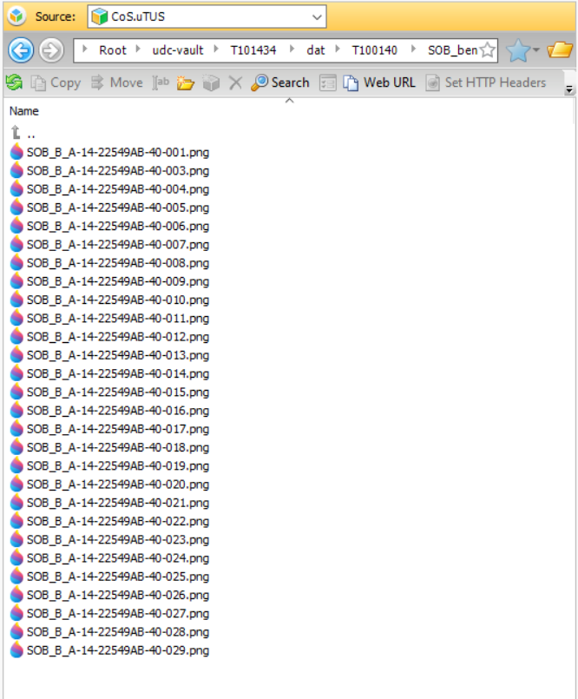
Notes:
01-upload-data-to-CoS.png

Slide 6
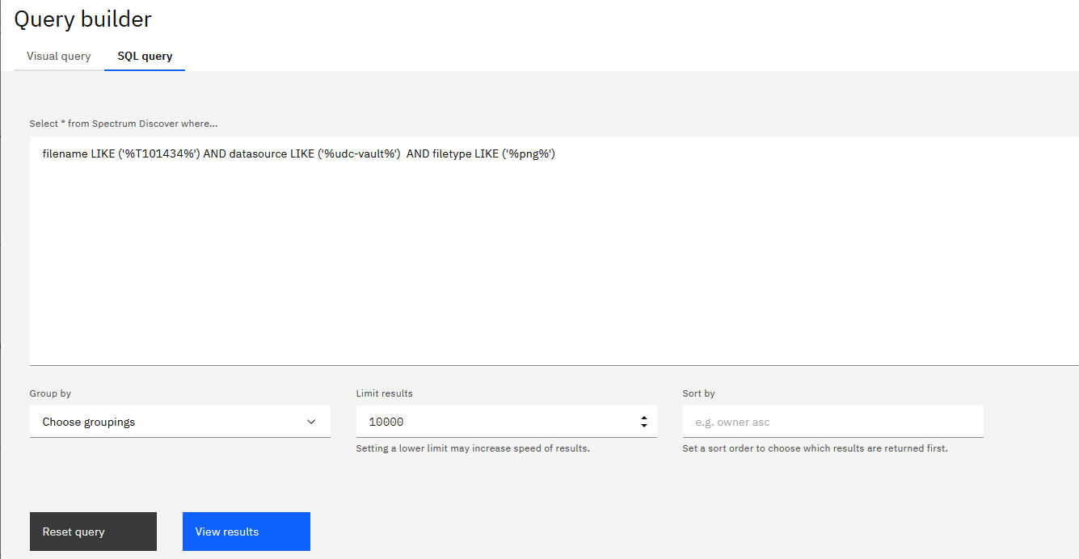
Notes:
02-discover-query-newly-added-and-tagged-dataset.png

Slide 7
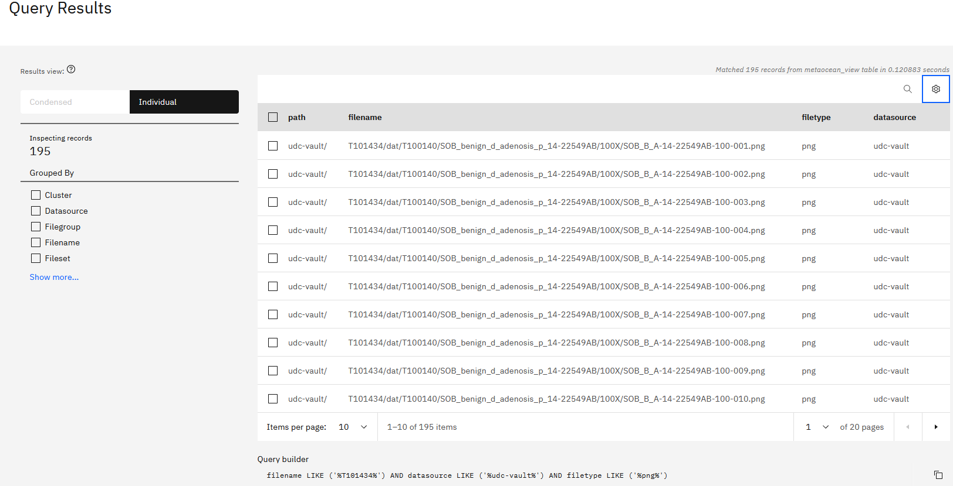
Notes:
05-auto-indexed-ingested-dataset.png

Slide 8
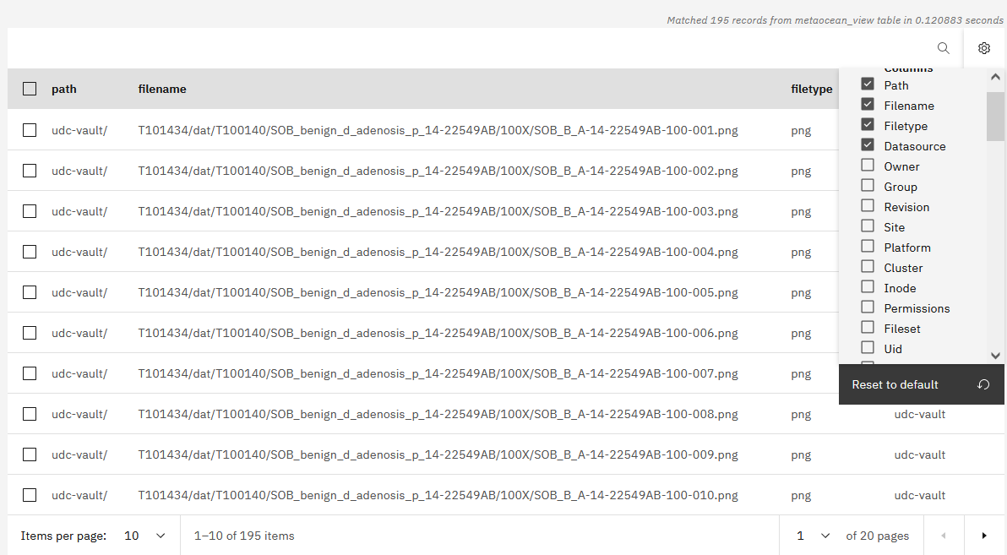
Notes:
06-auto-indexed-ingested-dataset_more.png

Slide 9
3. Set up AutoTag Policy in Spectrum Discover

Slide 10
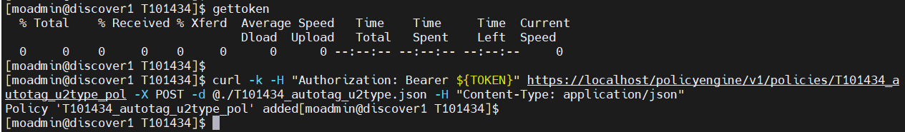
Notes:
10-create-autotag-policy-default.png

Slide 11
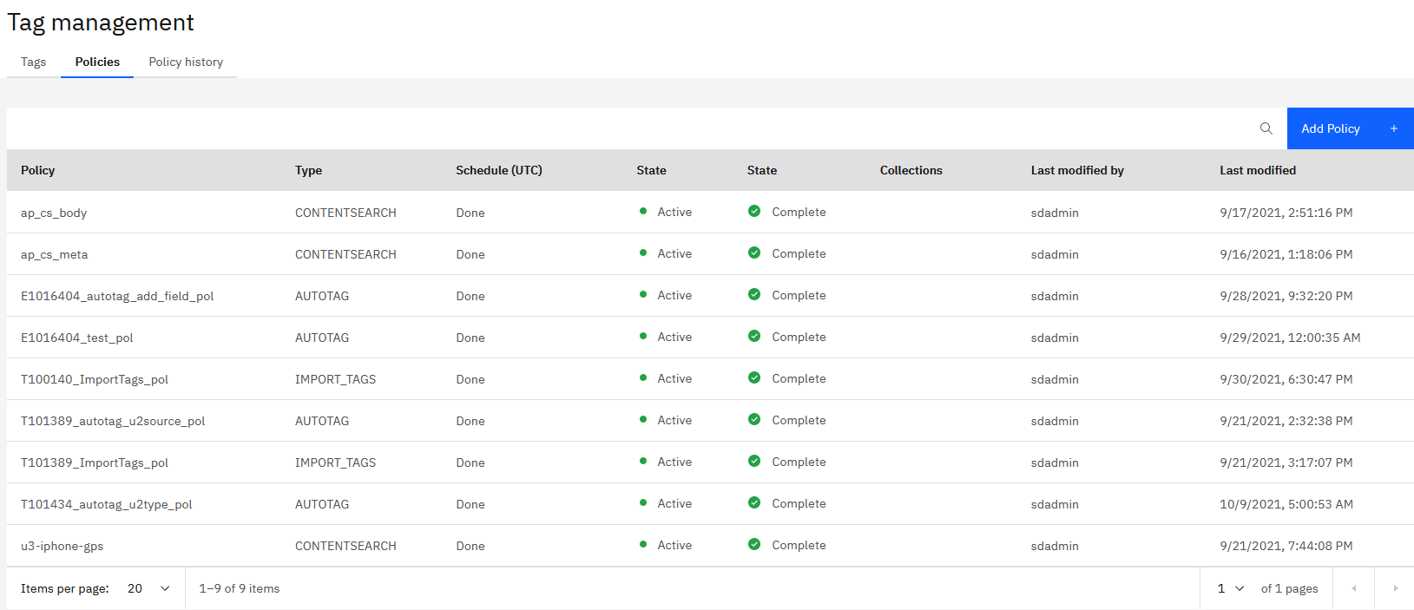
Notes:
15-autotag-default-policy-created.png

Slide 12
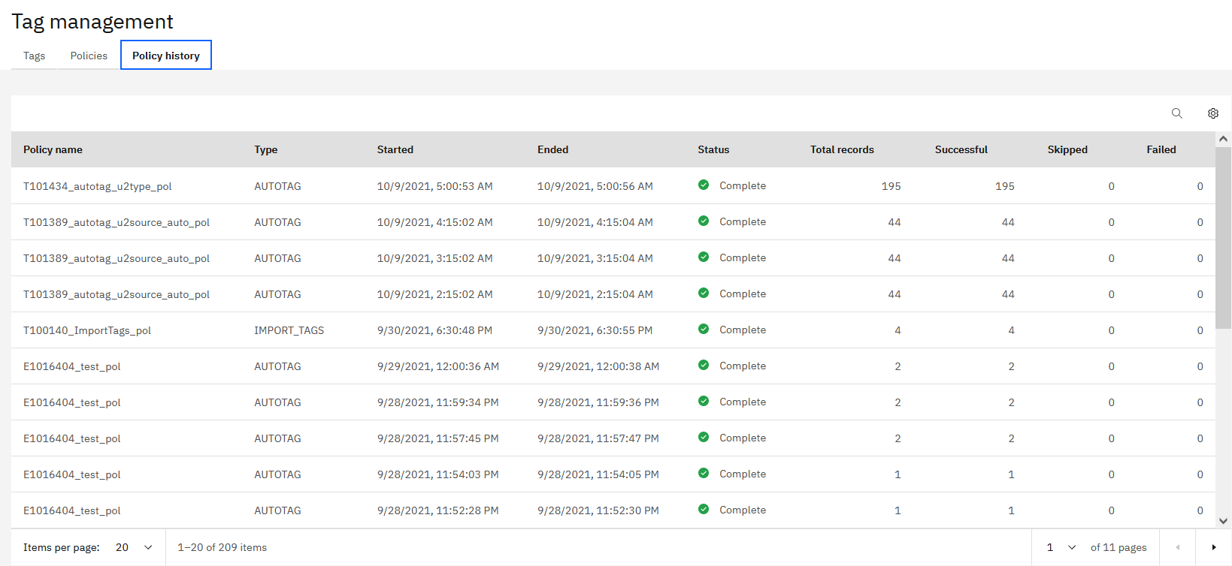
Notes:
20-autotag-default-policy-executed-now.png

Slide 13
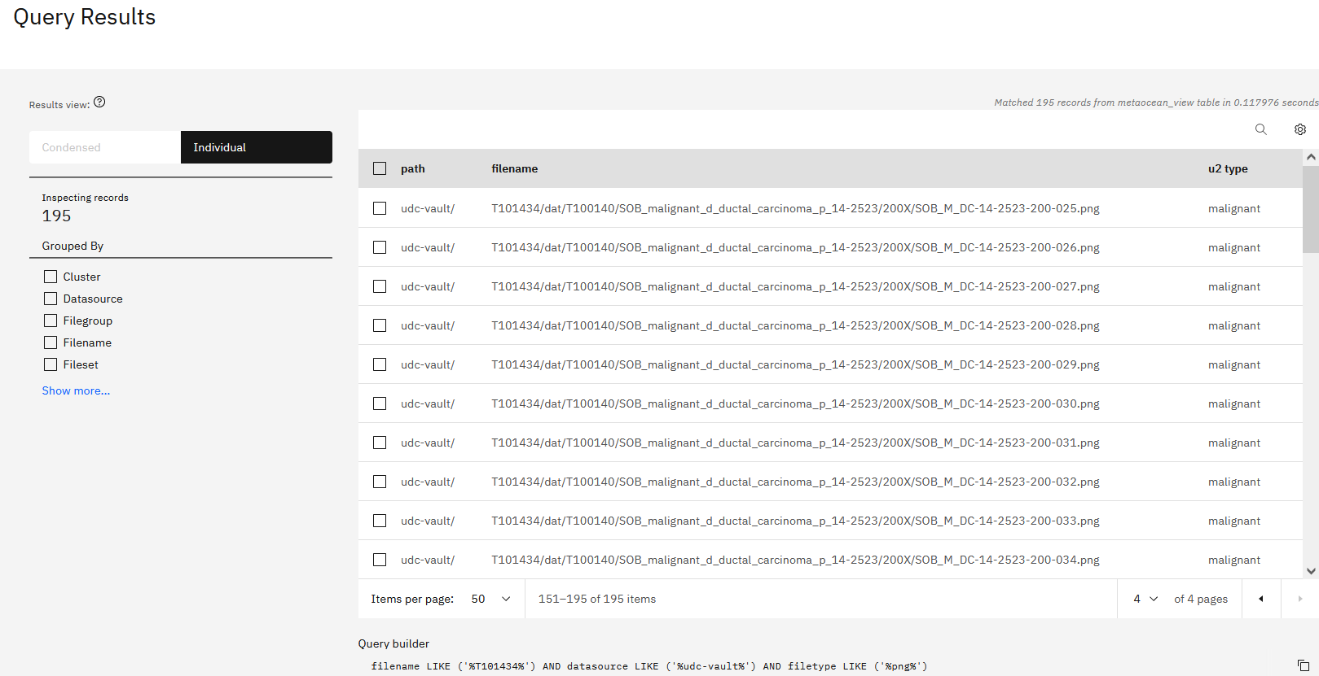
Notes:
21-u2type-tagged-by-autotag-policy.png

Slide 14
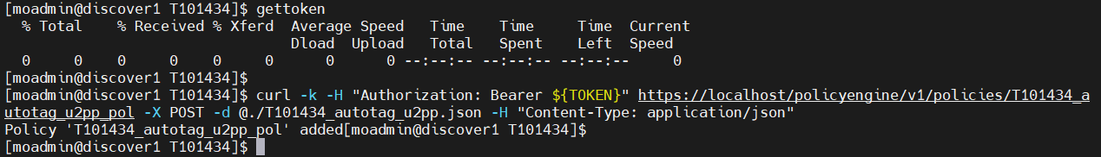
Notes:
23-create-autotage-policy-with-schedule.png

Slide 15
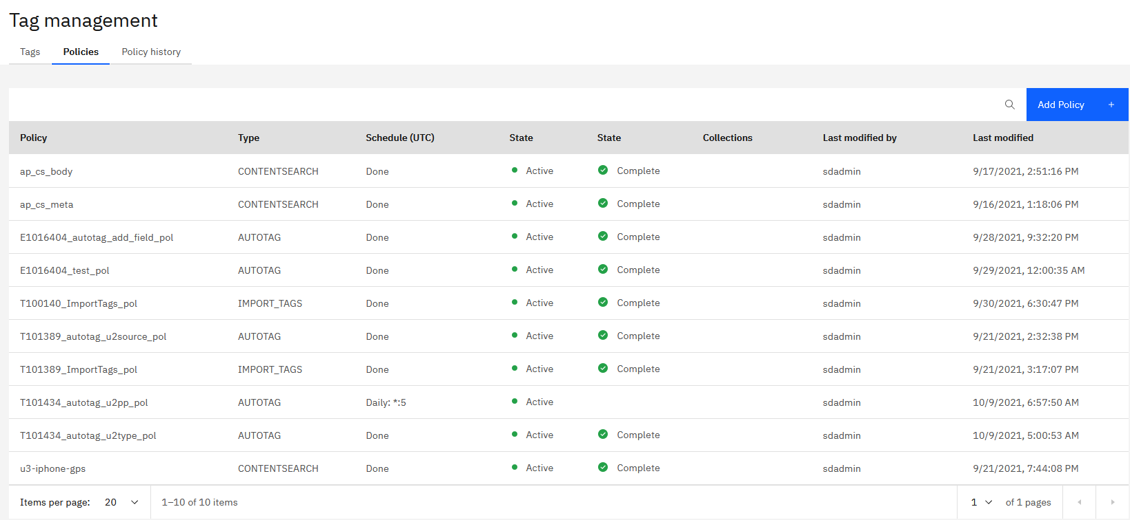
Notes:
25-autotag-auto-policy-created.png

Slide 16
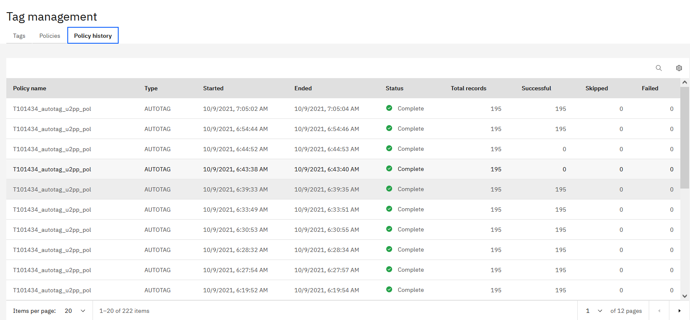
Notes:
25-autotag-auto-policy-executed.png

Slide 17
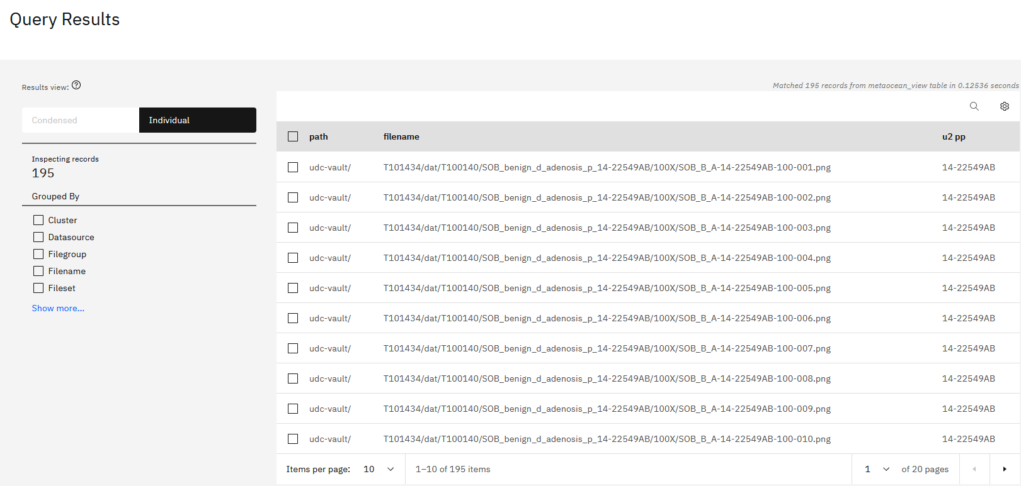
Notes:
26-autotag-auto-policy-executed-result.png

Slide 18
4. Custom-tag Dataset

Slide 19
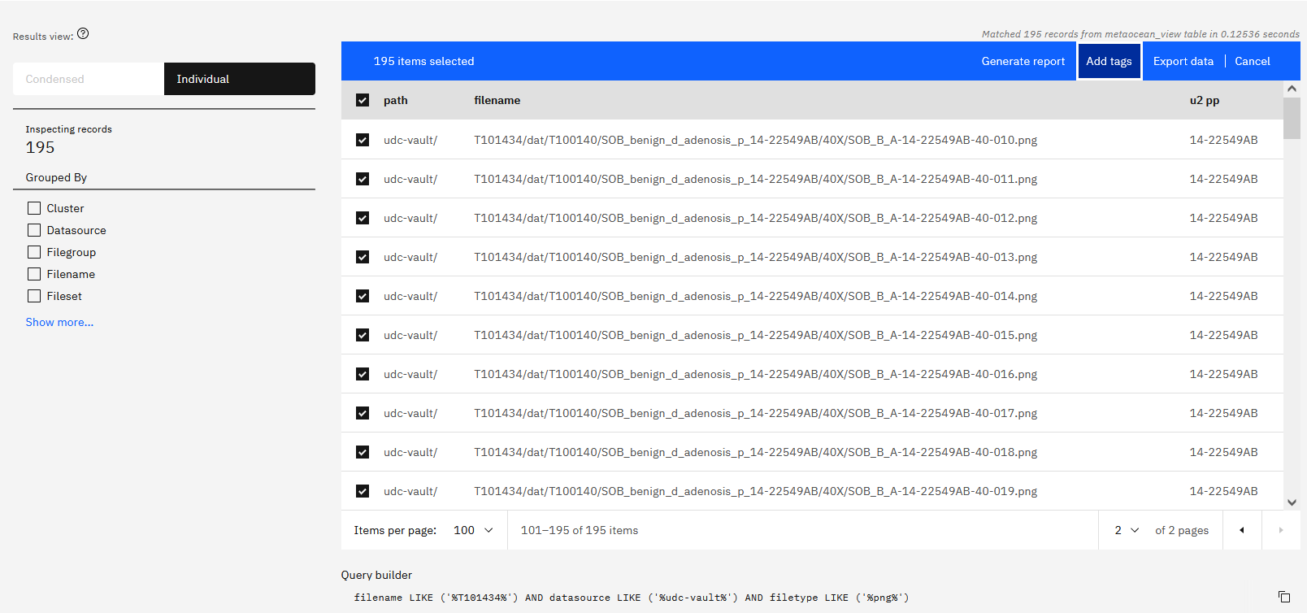
Notes:
40-select-files-to-add-tags.png

Slide 20
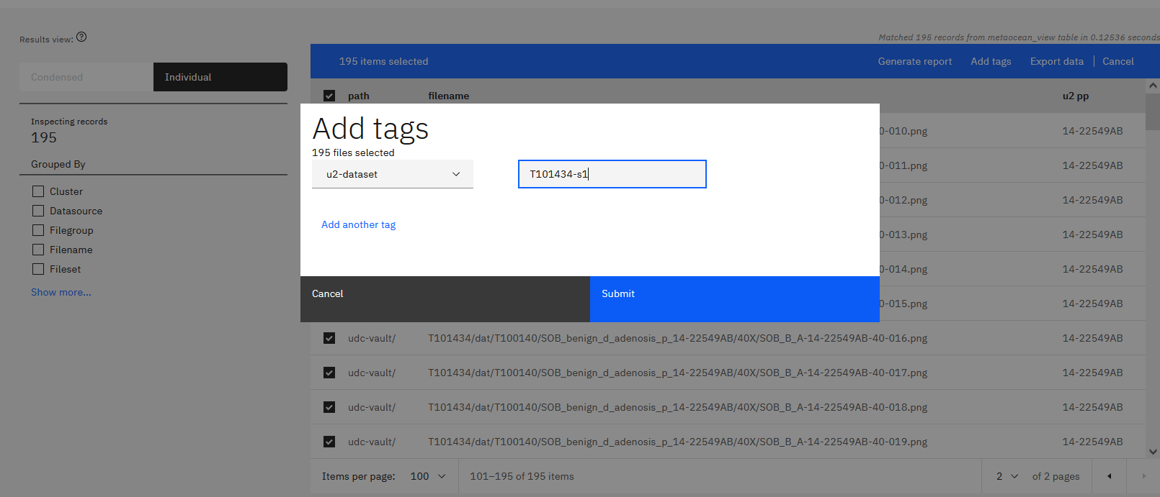
Notes:
45-add-tag-to-dataset.png

Slide 21
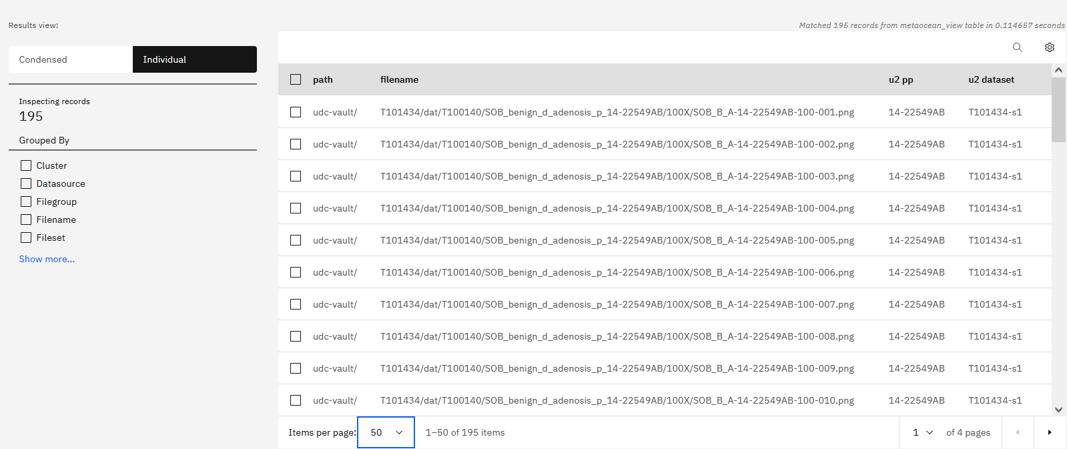
Notes:
46-tagged-dataset.png

Slide 22
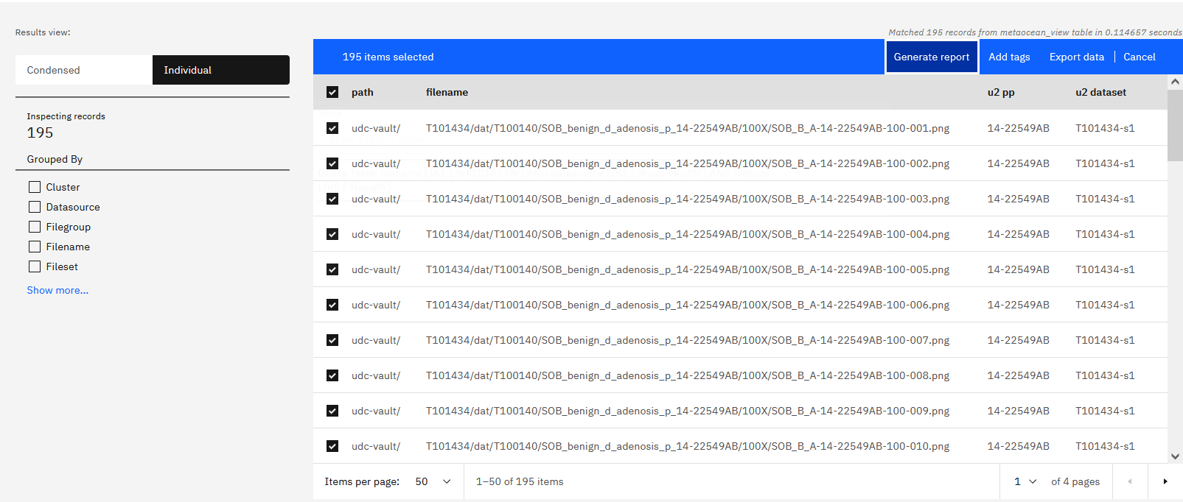
Notes:
47-create-report-as-manifest.png

Slide 23
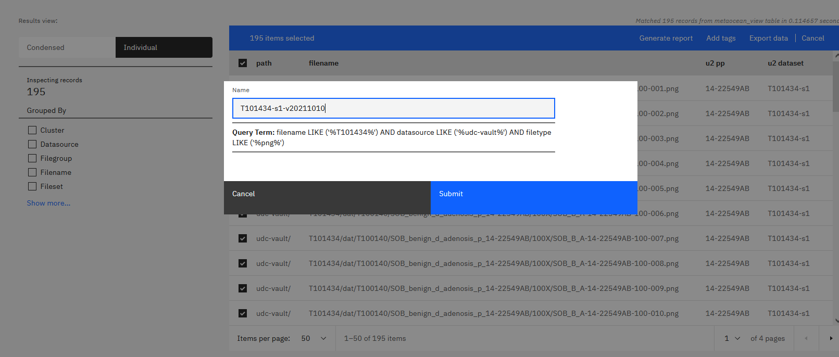
Notes:
48-create-report-as-manifest.png

Slide 24
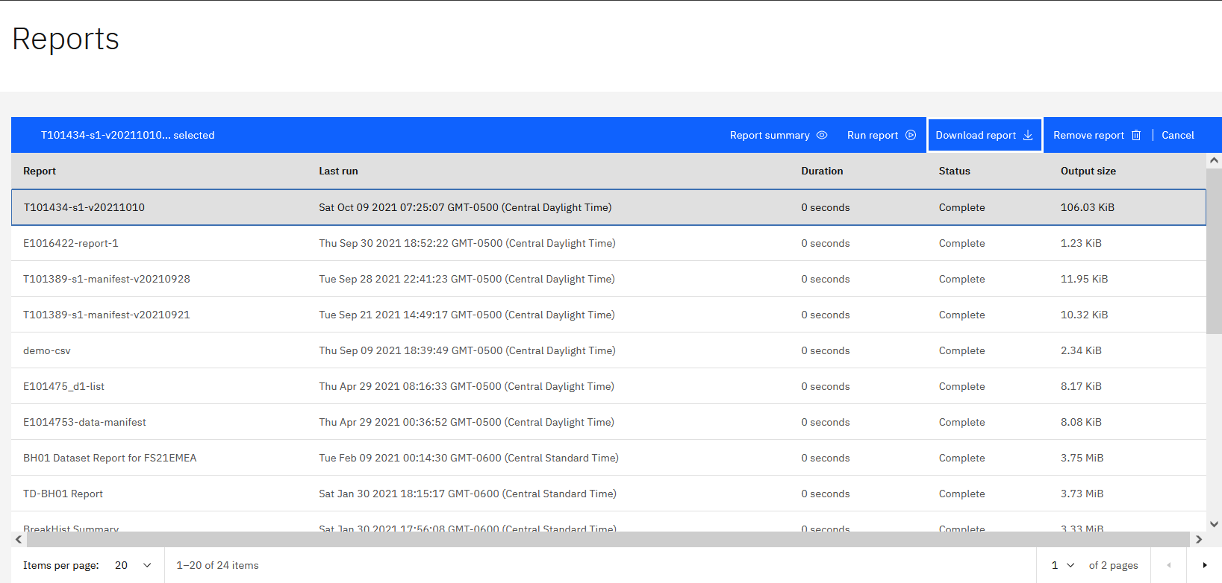
Notes:
49-report-created.png

Slide 25
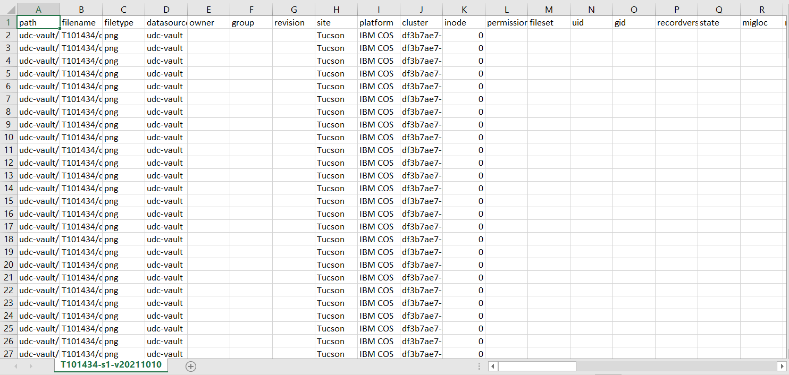
Notes:
49-report-created-2.png

Slide 26
5. AutoTag Based on Filters

Slide 27
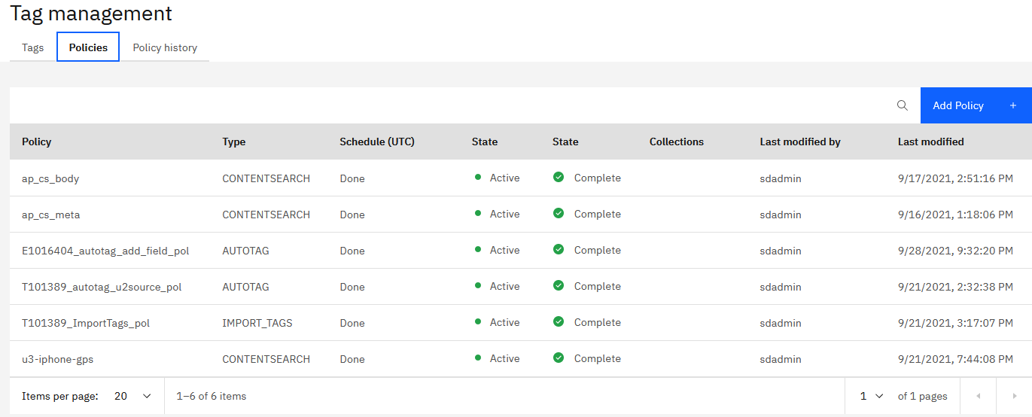
Notes:
E1016404-10-autotag-policy-added

Slide 28
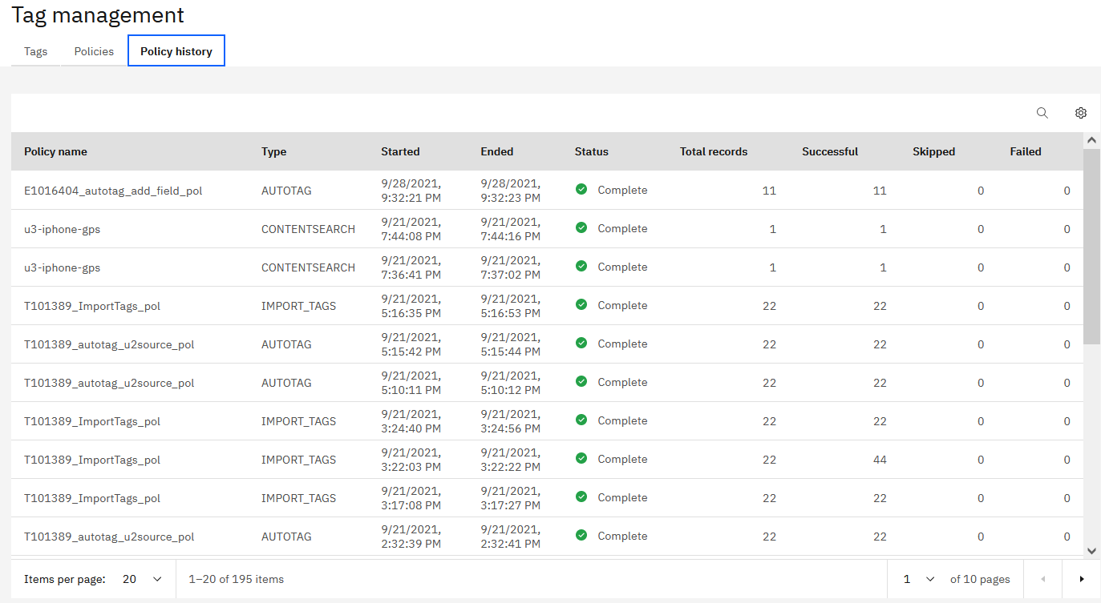
Notes:
E1016404-20-autotag-policy-run-completed

Slide 29
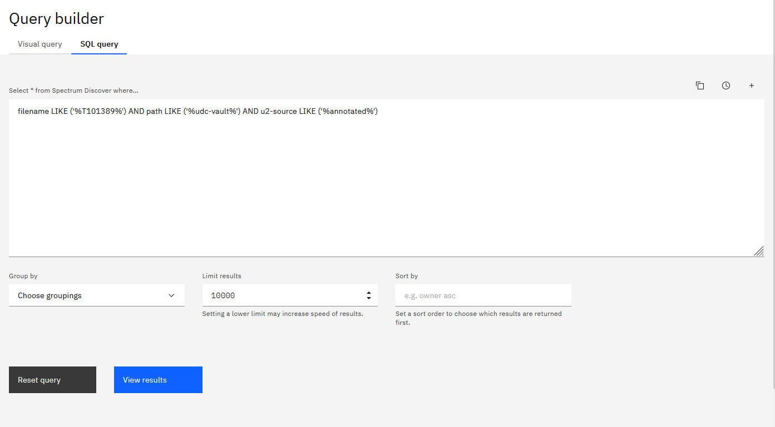
Notes:
E1016404-30-query-for-new-dataset

Slide 30
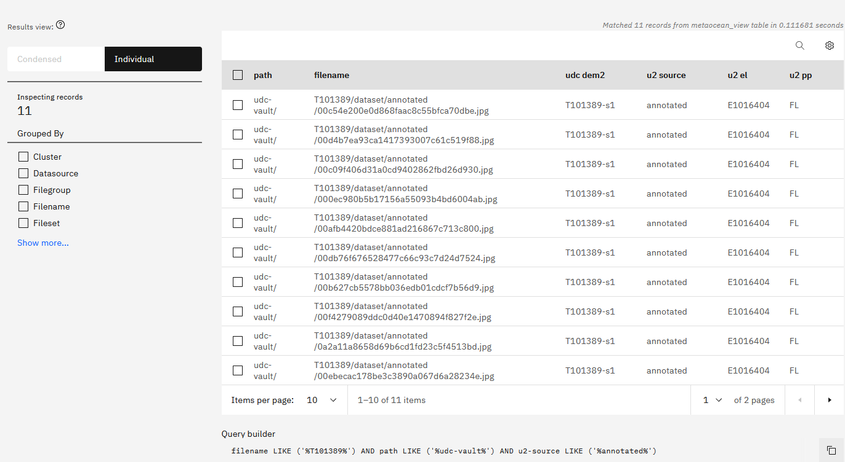
Notes:
E1016404-40-new-dataset-w-calculated-tag

Slide 31
6. View Images Directly with Calculated URL

Slide 32
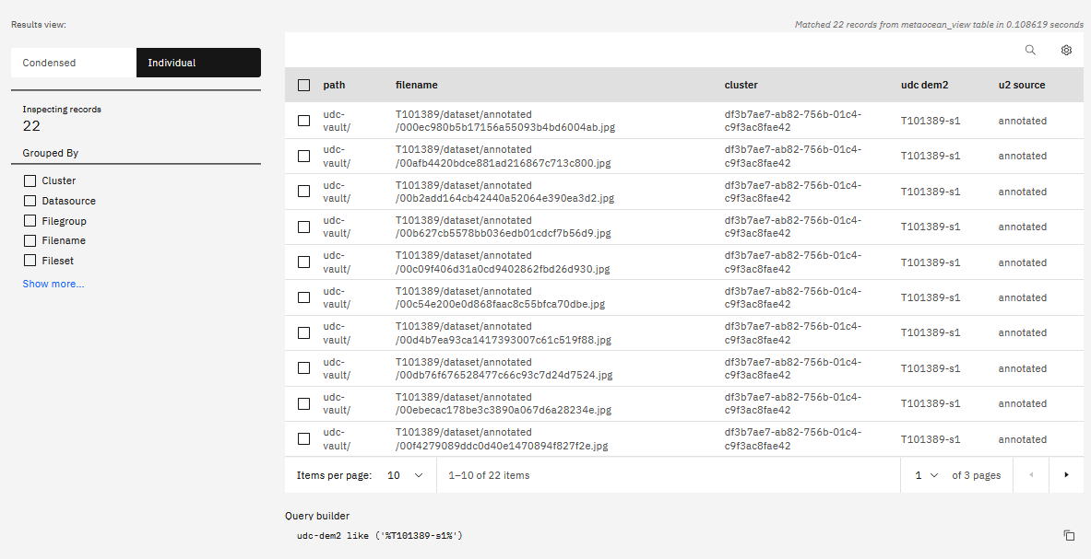

Slide 33
