Slide 1
Demo: Unified Data Catalog for Cancer Imaging
Scenario 2: Import Metadata to Enrich Catalog

Slide 2
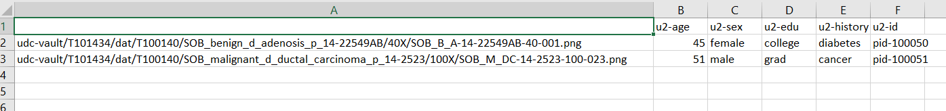

Slide 3
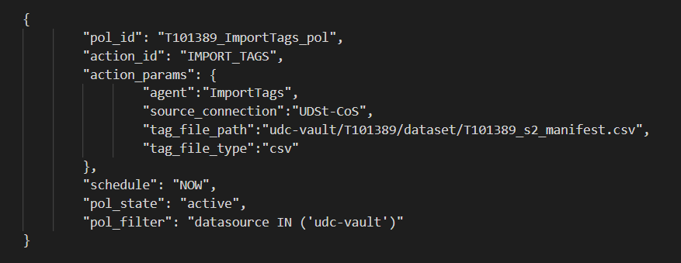
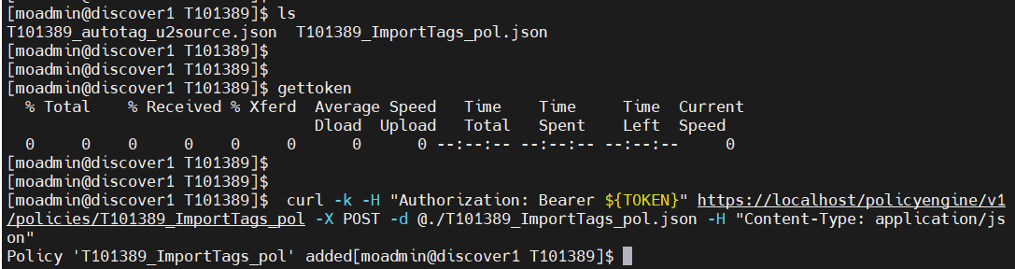
Create IMPORT_TAGS Policy

Slide 4
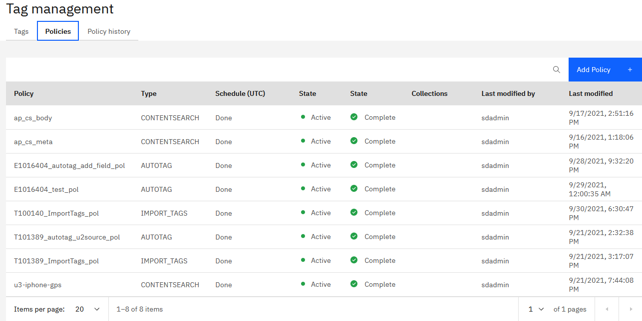
New IMPORT_TAGS Policy Created in Web Console

Slide 5
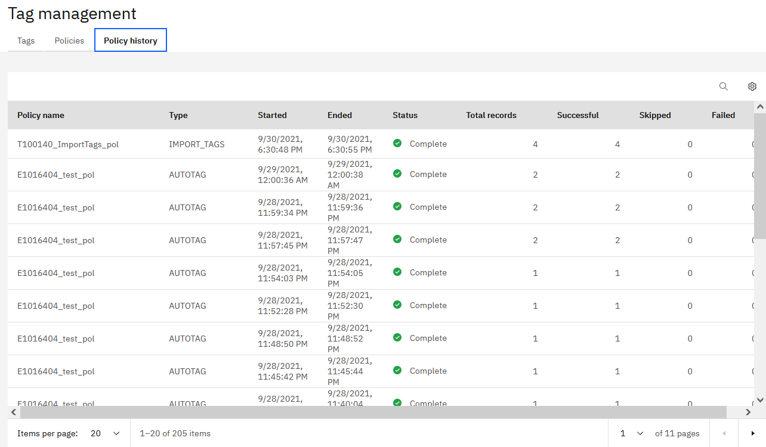
New Policy Executed for the First Time Automatically

Slide 6
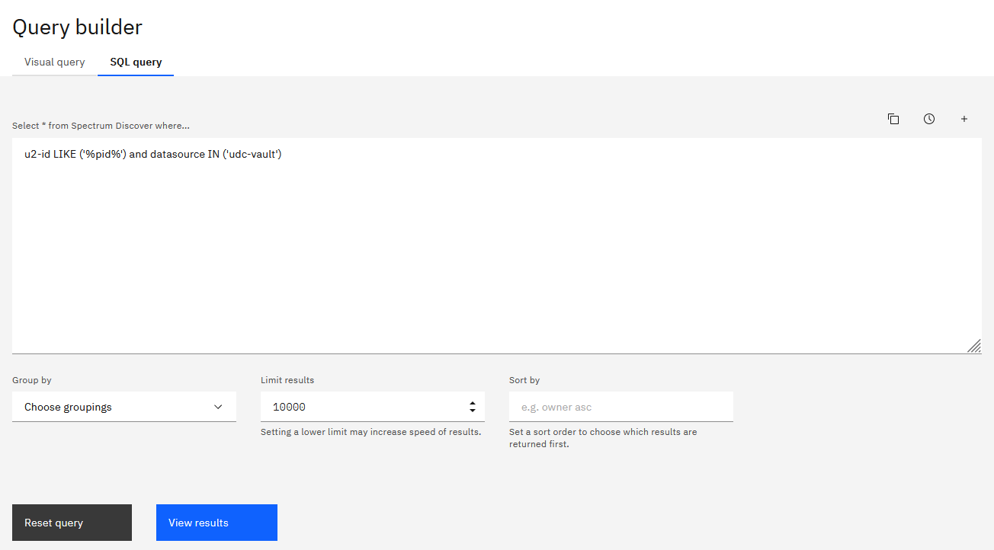

Slide 7
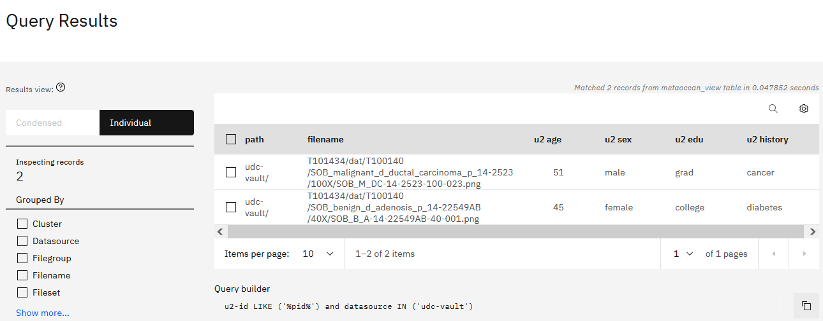
New Sets of Metadata Tags Populated with Values from Manifest by IMPORT_TAGS Policy

Slide 8
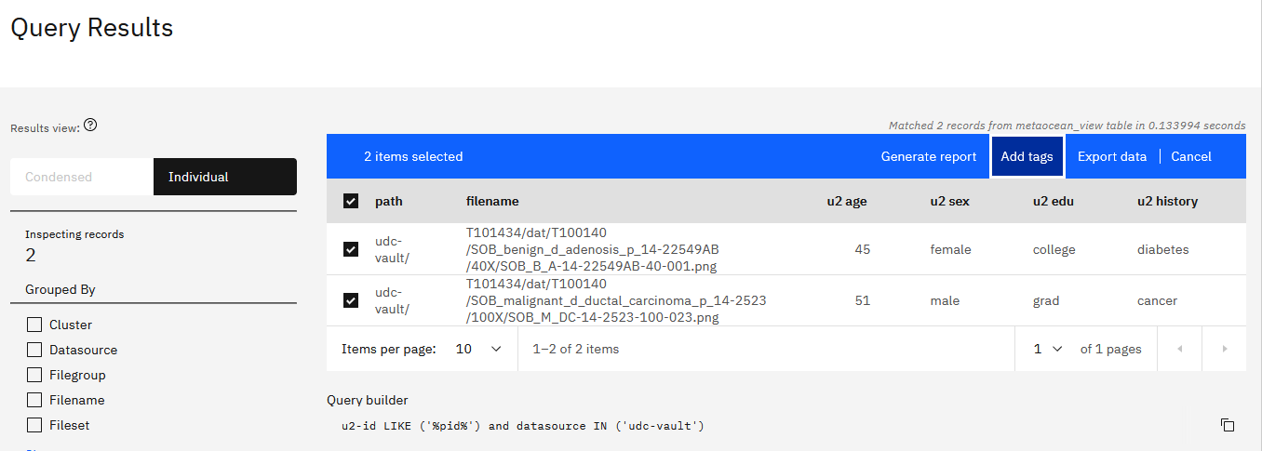

Slide 9
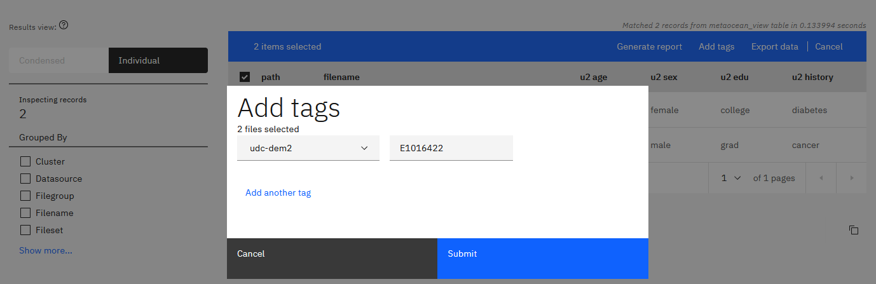
Custom-tag Updated Dataset as “T101389-s2”

Slide 10
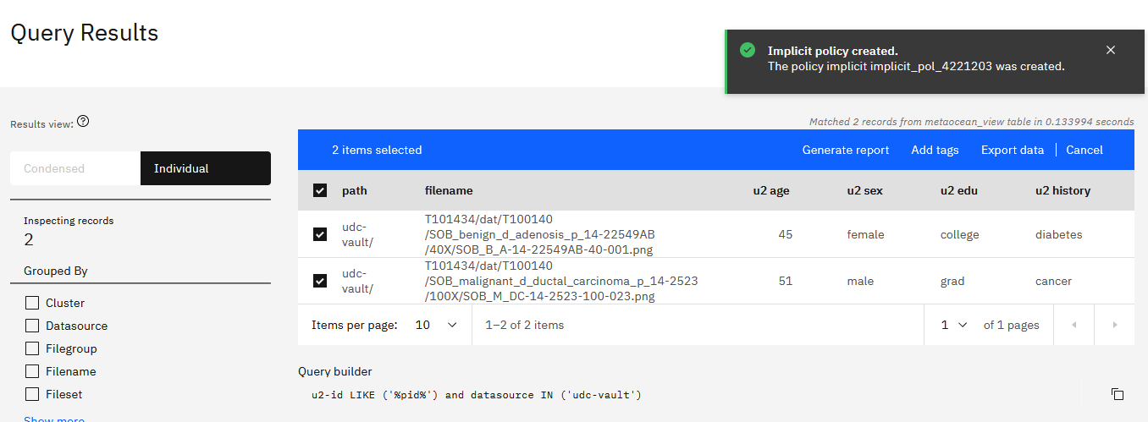

Slide 11
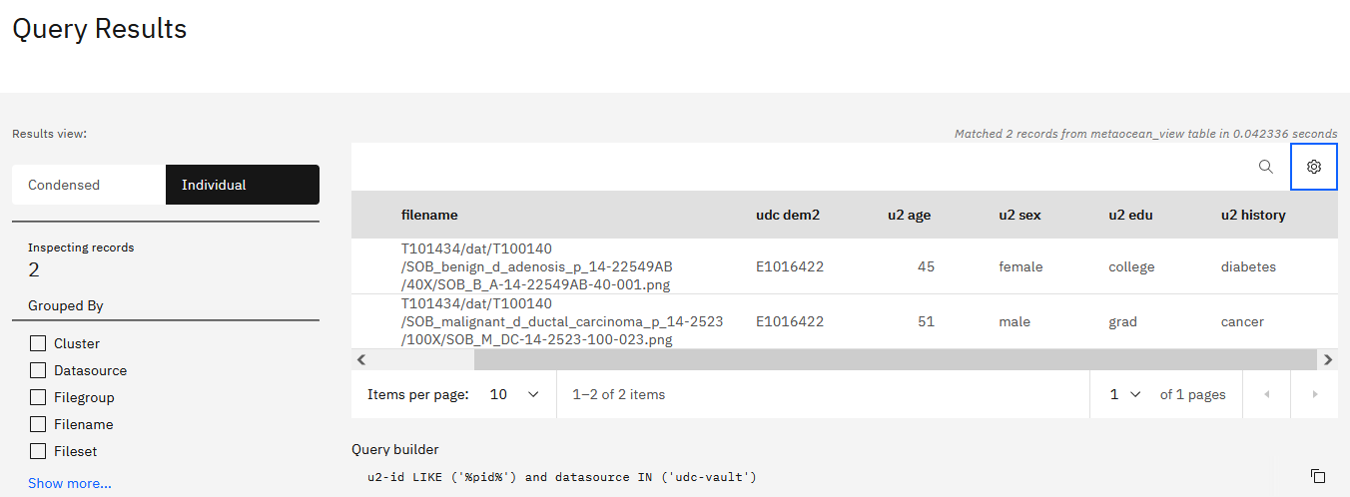

Slide 12
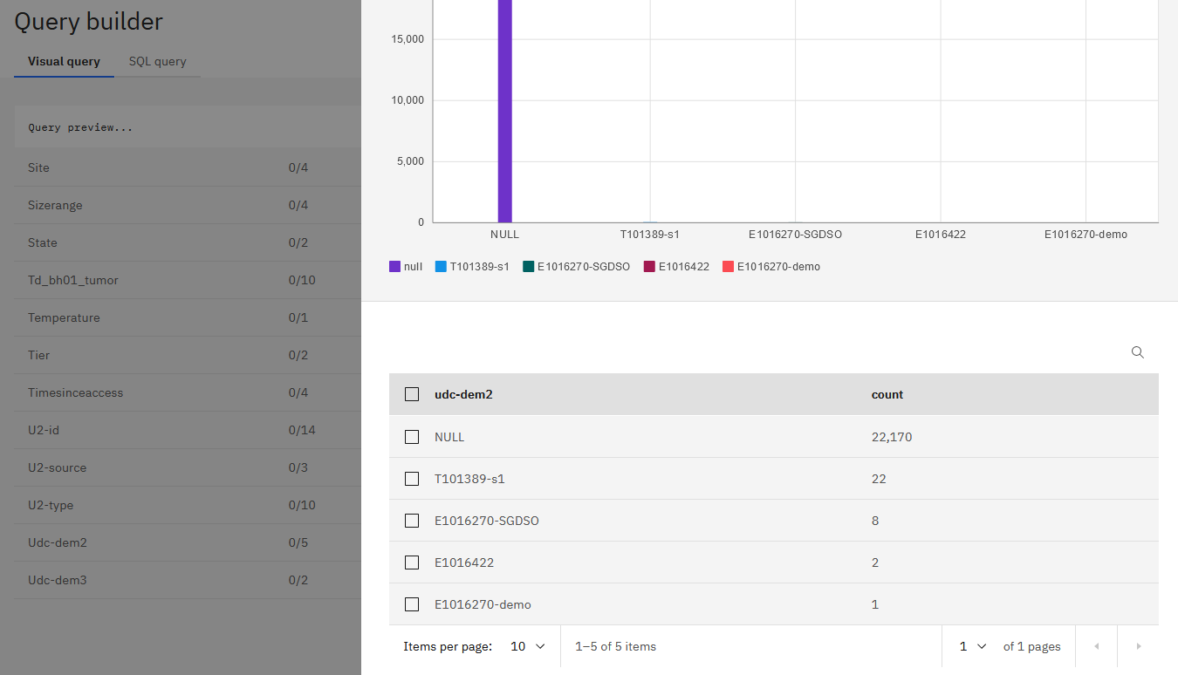
Browse for Dataset T101389-s2 with Visual Query

Slide 13
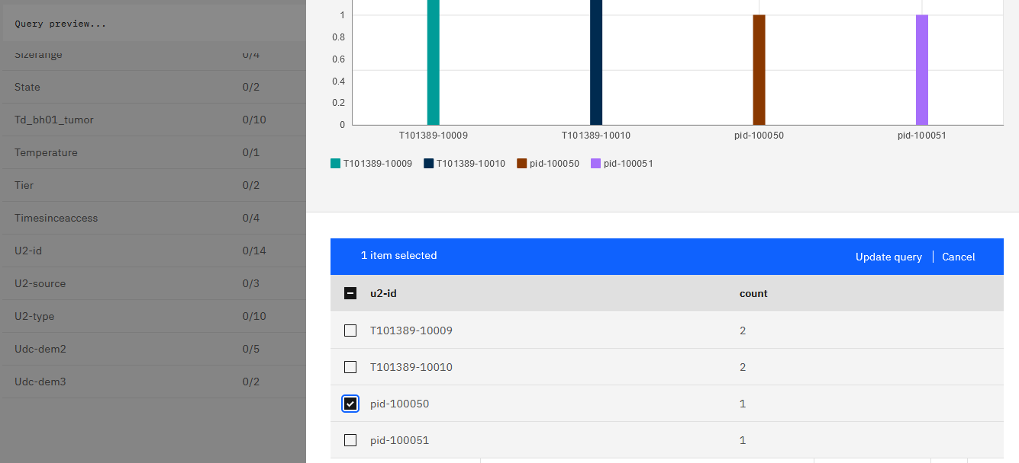
Find data based on Metadata Tag “u2-id”

Slide 14
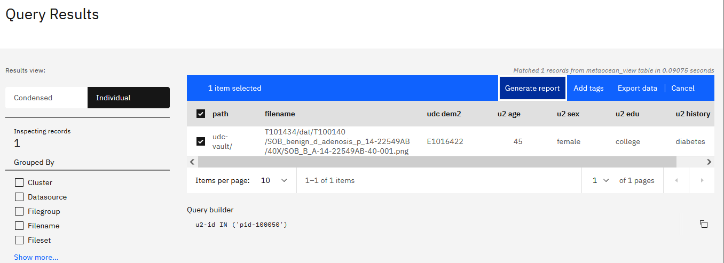

Slide 15
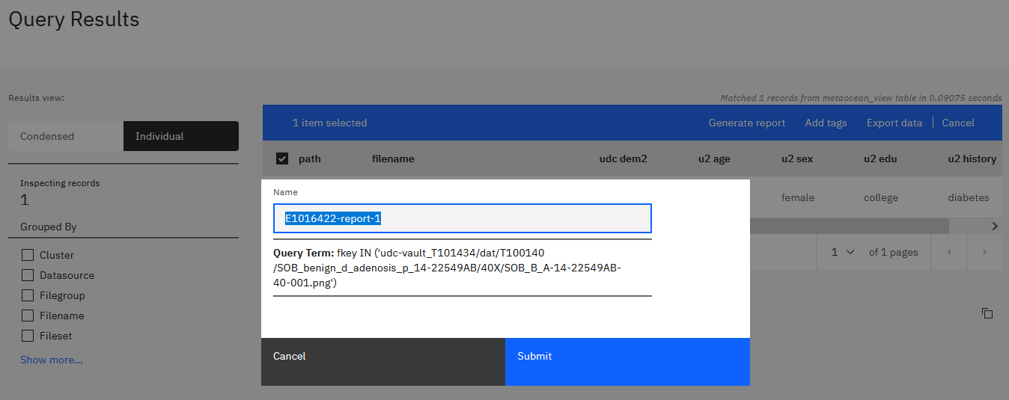

Slide 16
