Slide 1
Demo: Unified Data Catalog for Cancer Imaging
Scenario 3: Extend Catalog to Data & AI Workbench
Frank Lee, Joanna Wong, Reginald D’Souza
https://github.com/drfranknlee/demo-udc-aircraft

Slide 2
Working with Images

Slide 3
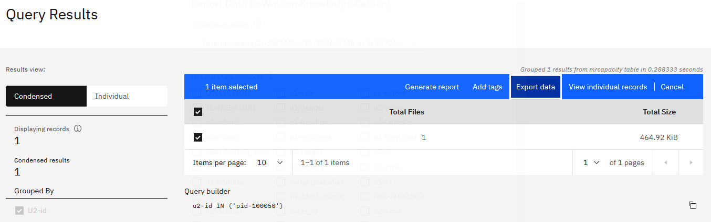

Slide 4
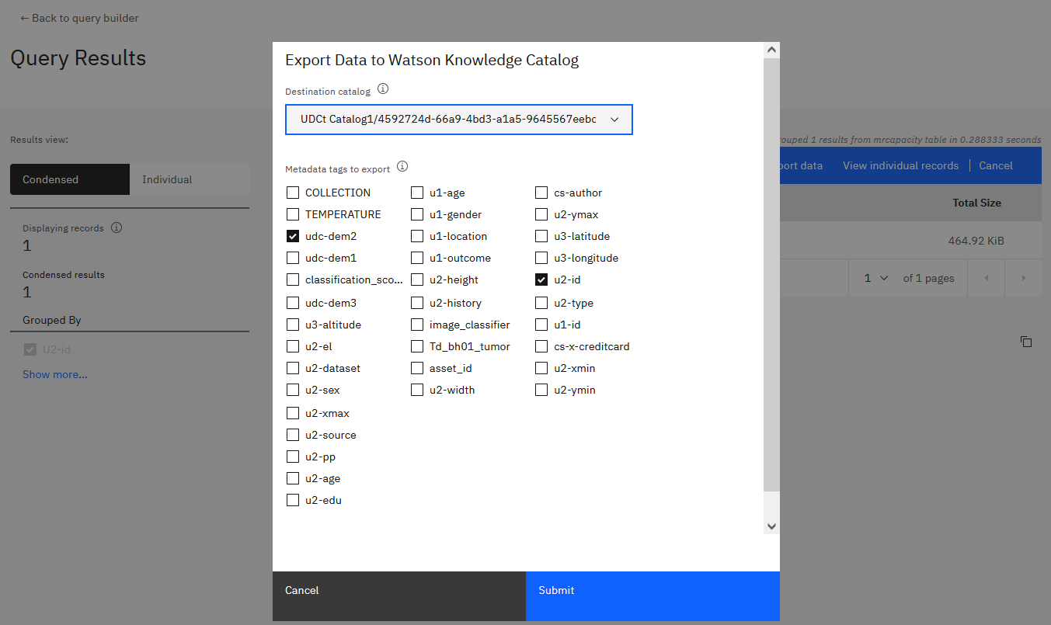

Slide 5
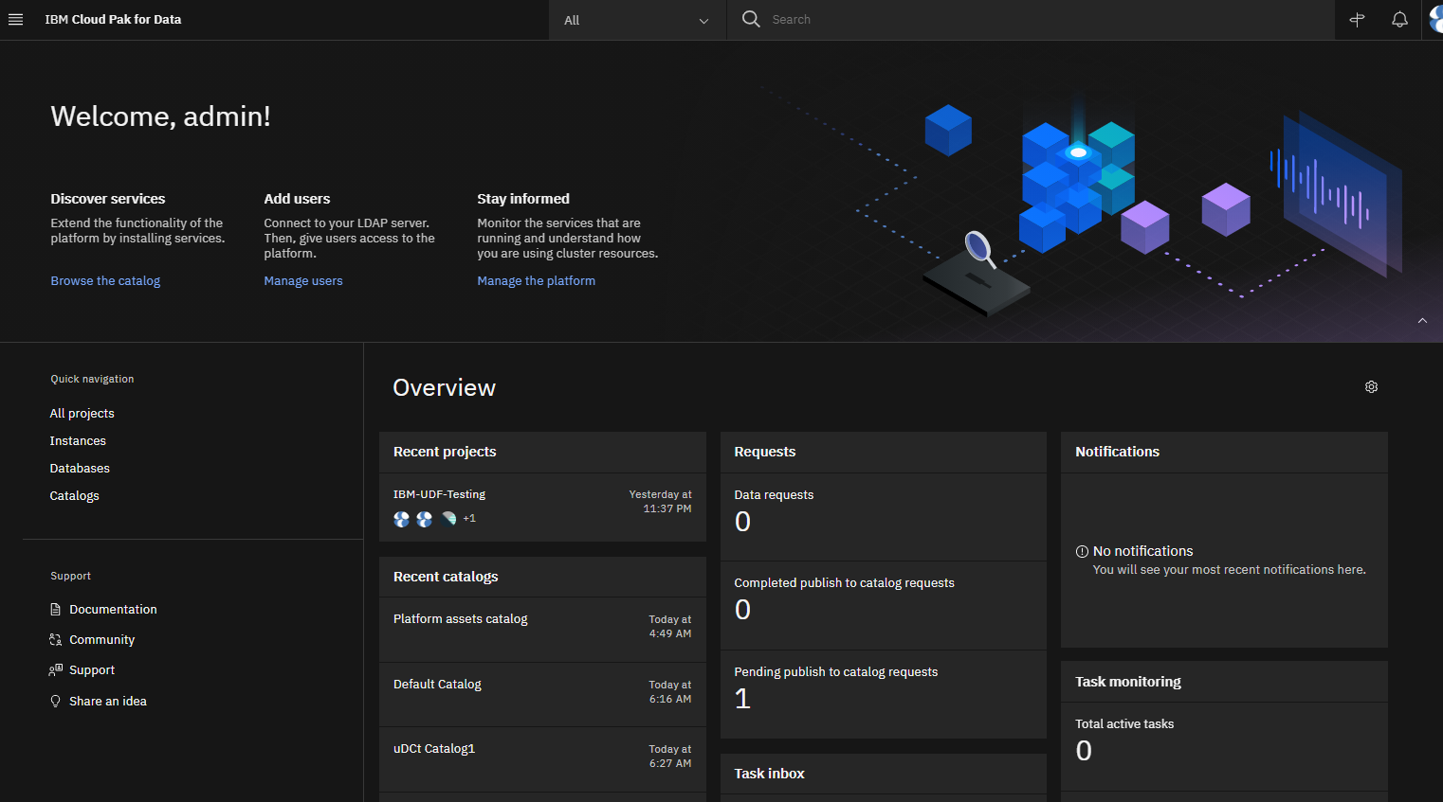

Slide 6
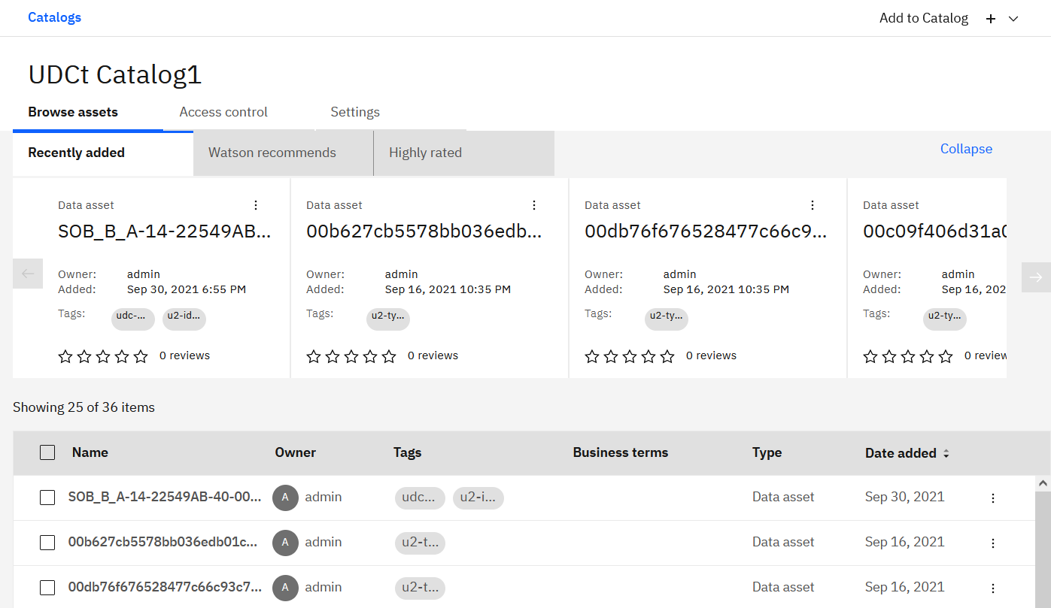
Watson Knowledge Catalog “uDCt Catalog1”

Slide 7
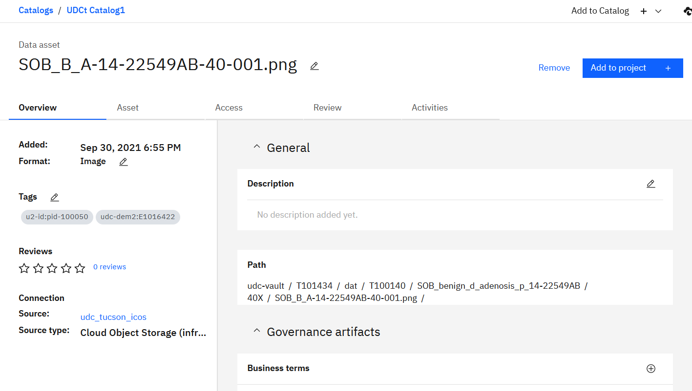
Data Asset View

Slide 8
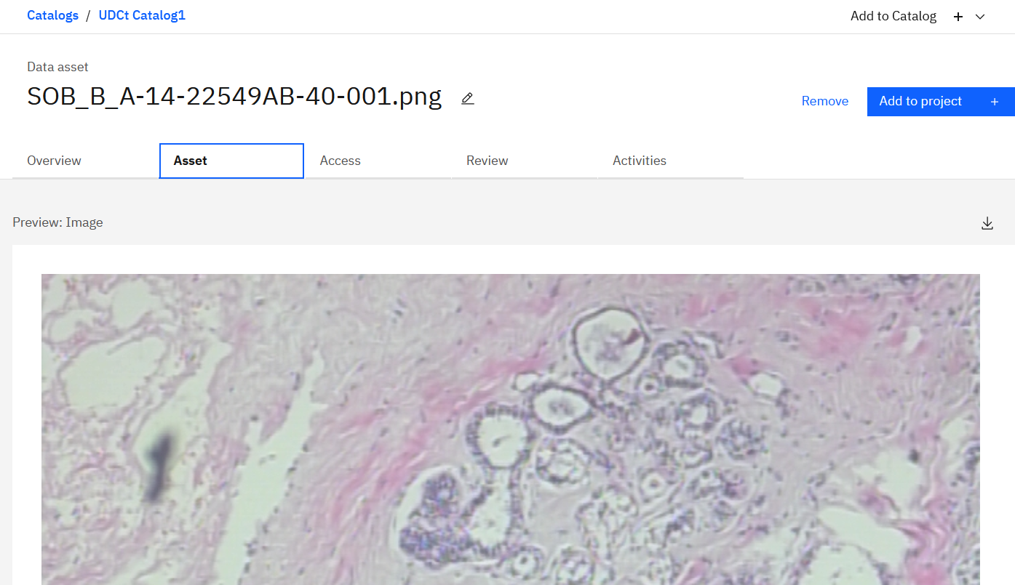
Data Asset View

Slide 9
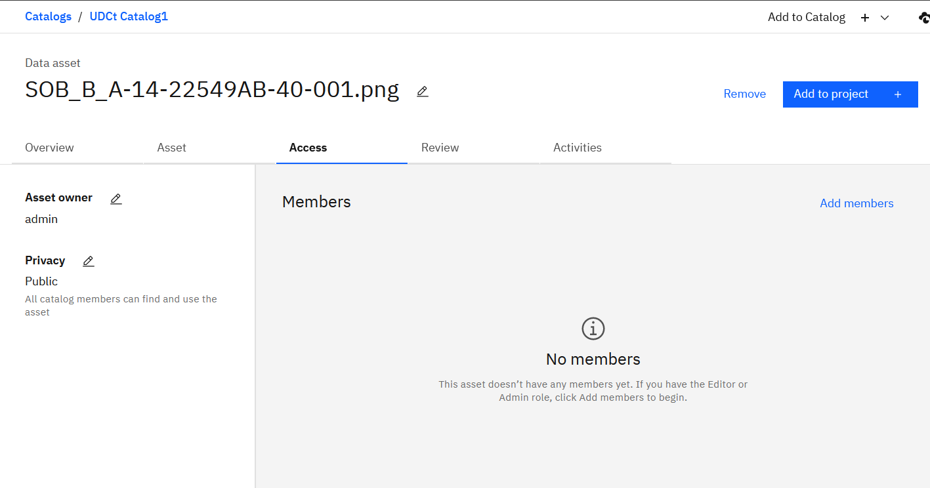

Slide 10
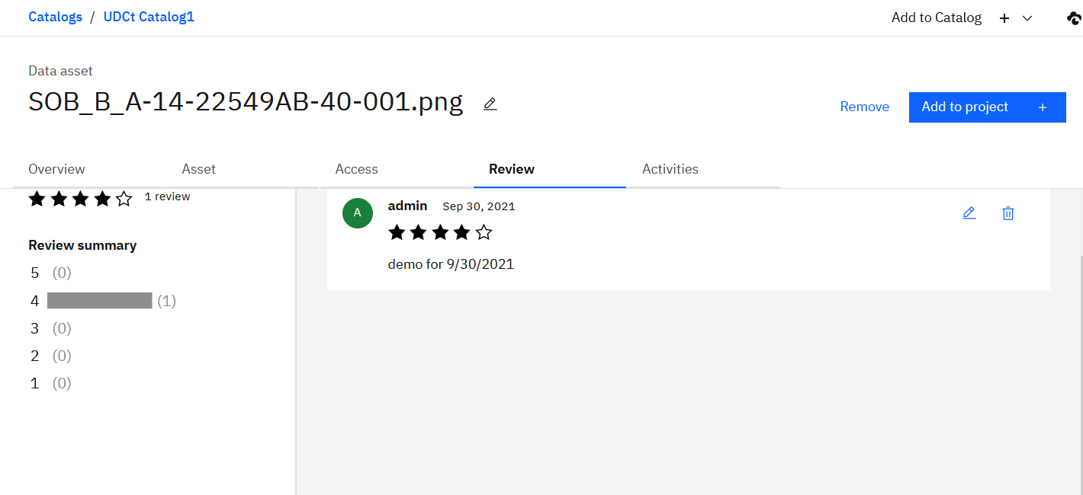

Slide 11
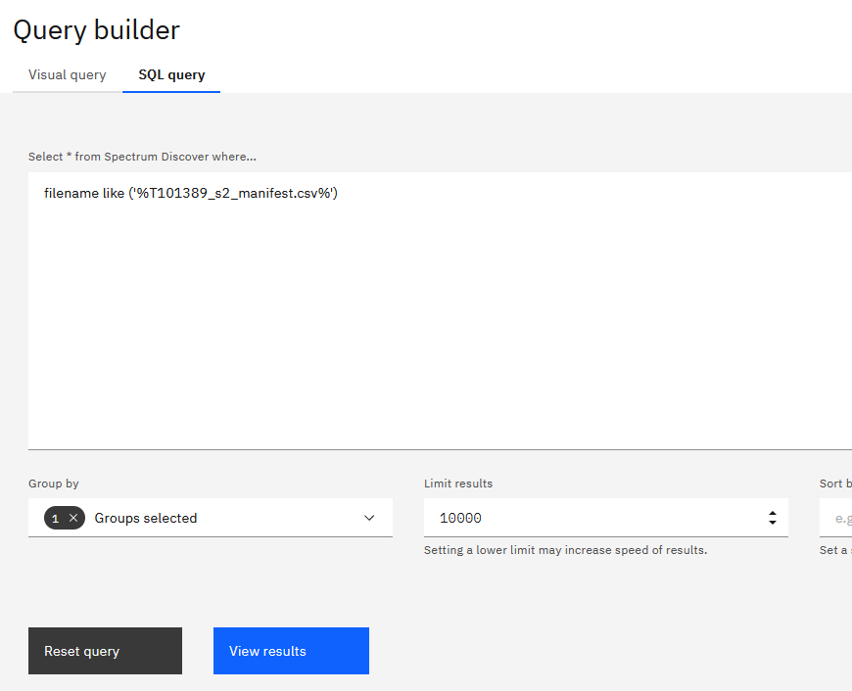
Find Master Manifest

Slide 12
Working with Manifest

Slide 13
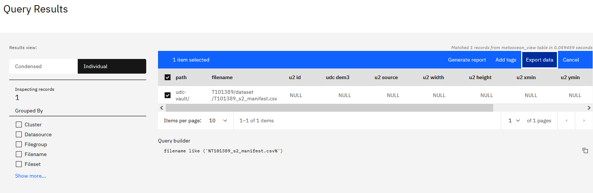
Find the T101389-s2 Master Manifest: Result

Slide 14
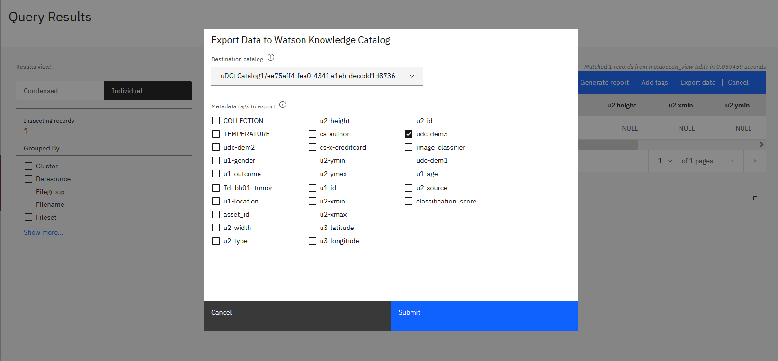
Export Manifest to WKC/CP4D

Slide 15
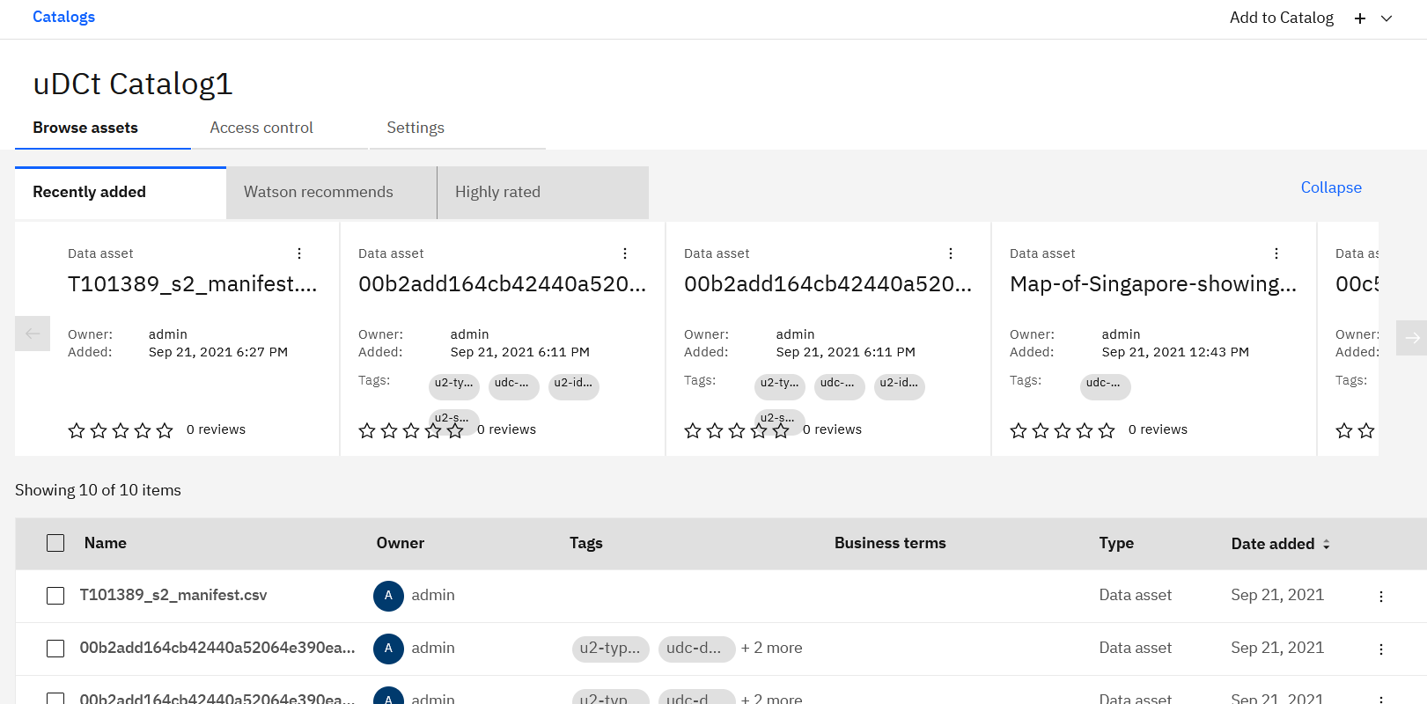
Manifest (T101389_s2_manifest.csv) Exported to WKC

Slide 16
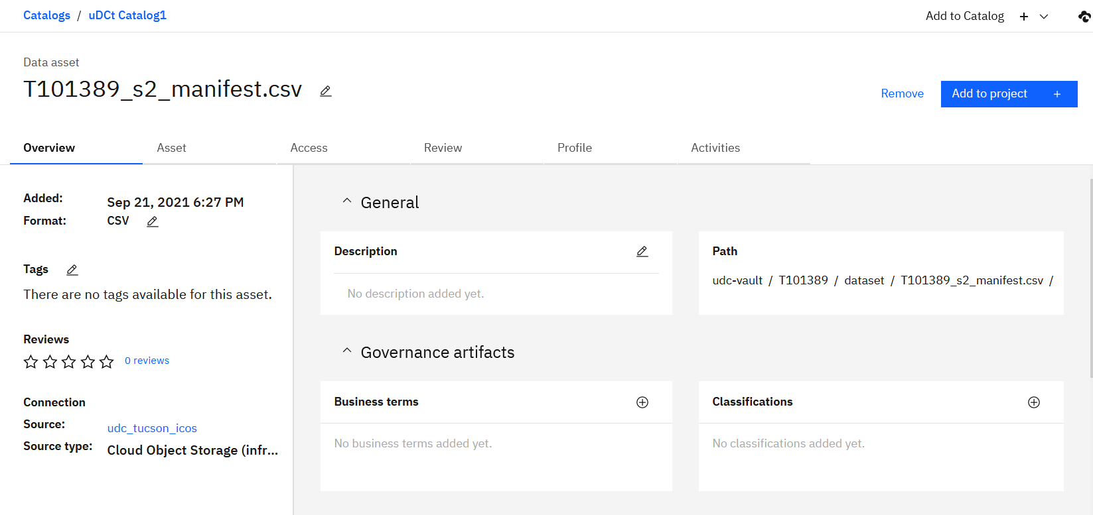
Working with the Manifest in WKC

Slide 17
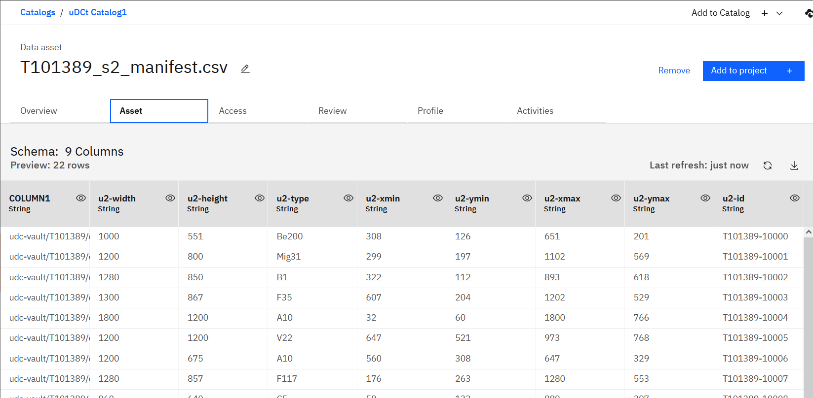
Working with the Manifest in WKC

Slide 18
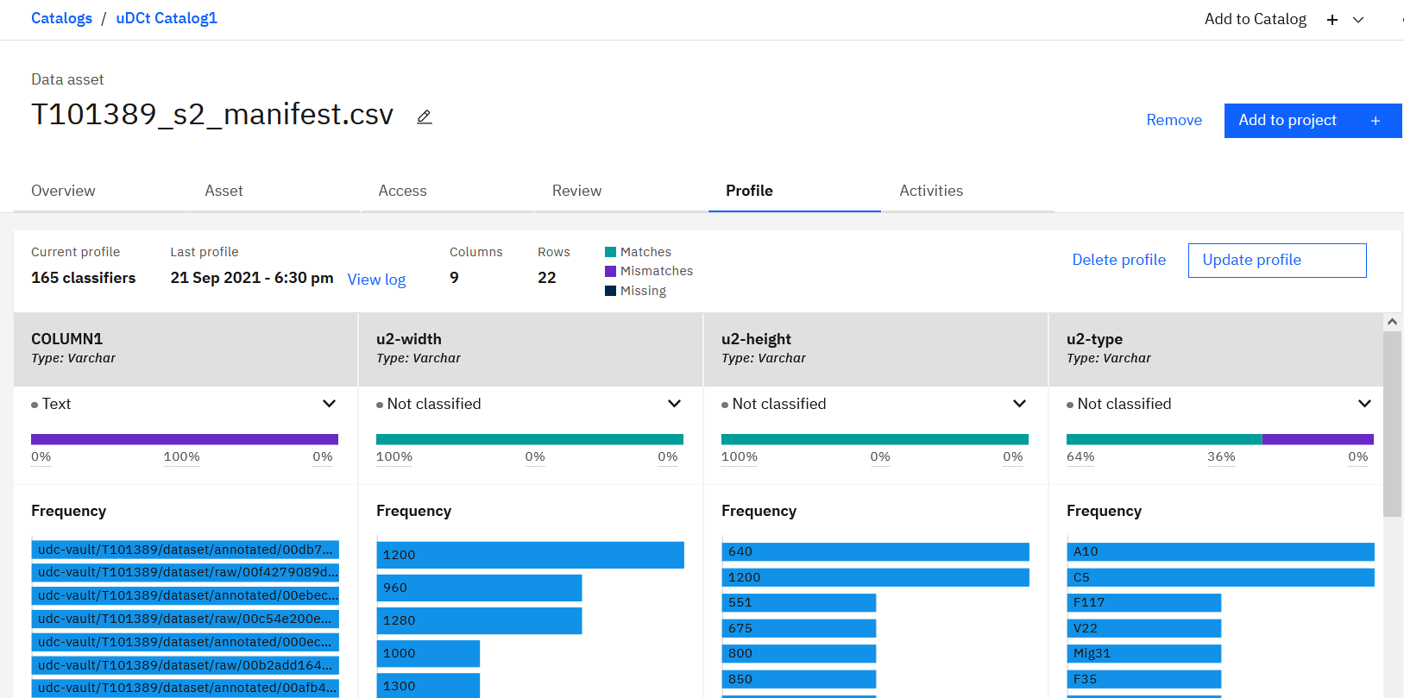
Working with the Manifest in WKC

Slide 19
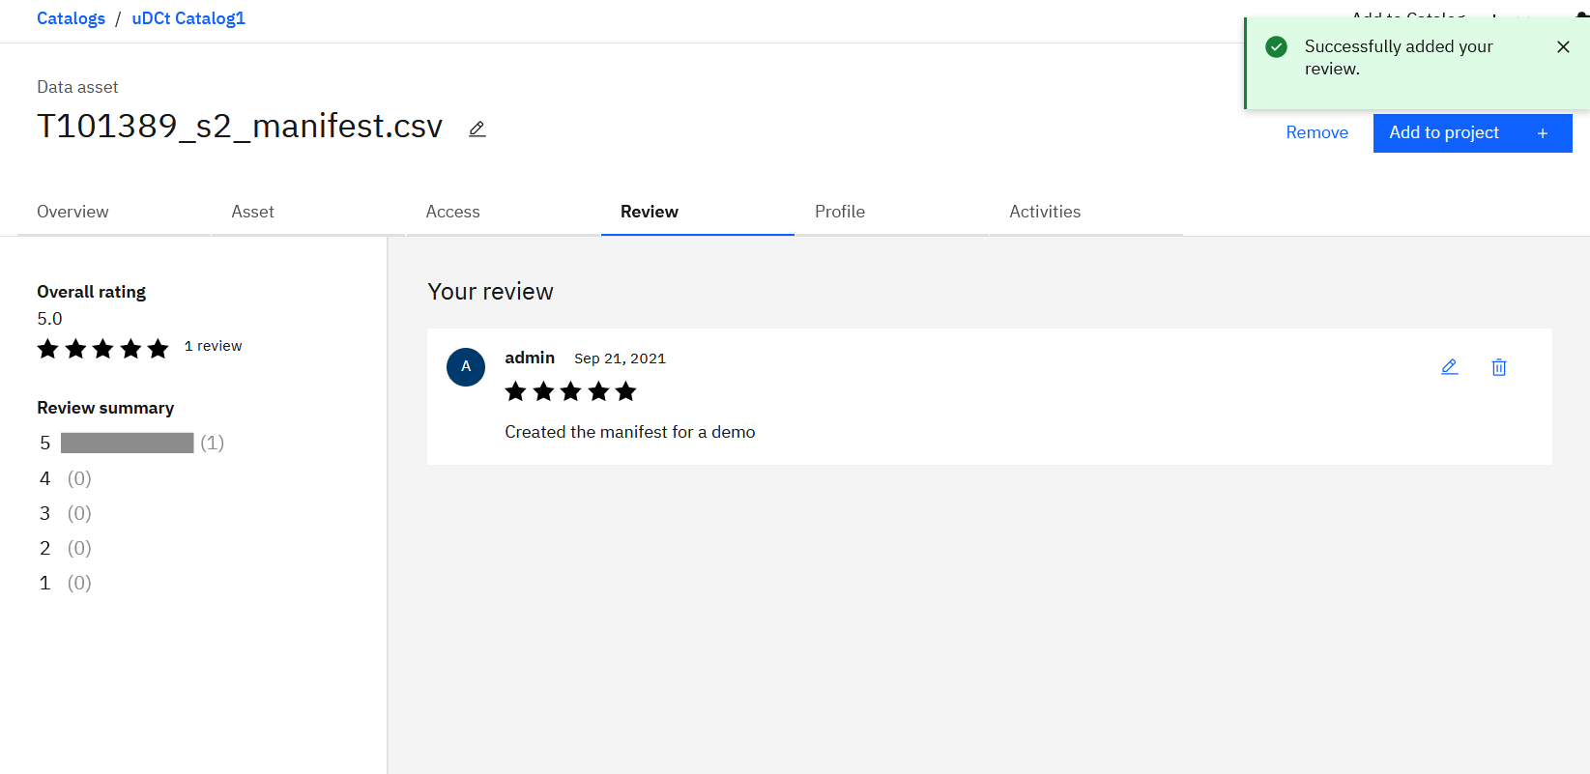
Working with the Manifest in WKC

Slide 20
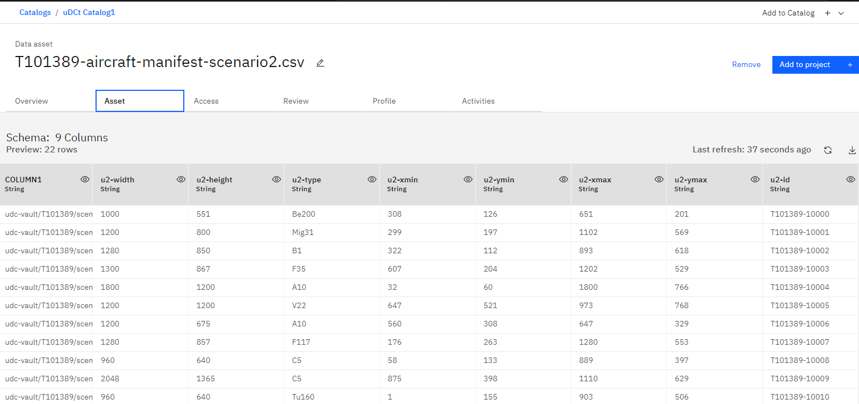
Working with the Manifest

Slide 21
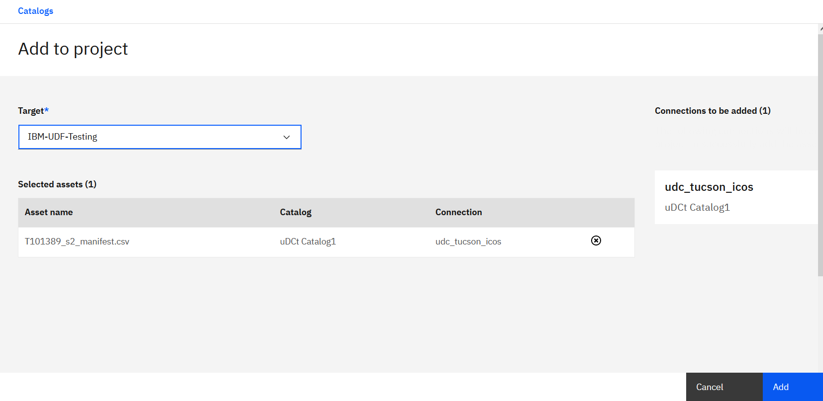
Add Manifest to Project “IBM-UDF-Testing”

Slide 22
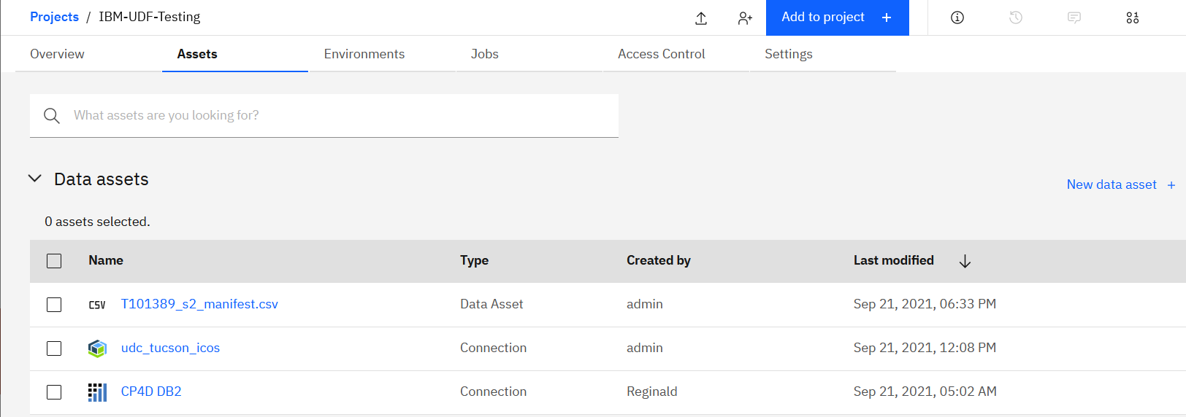
Manifest available as Data Asset in Project (Watson Studio)

Slide 23
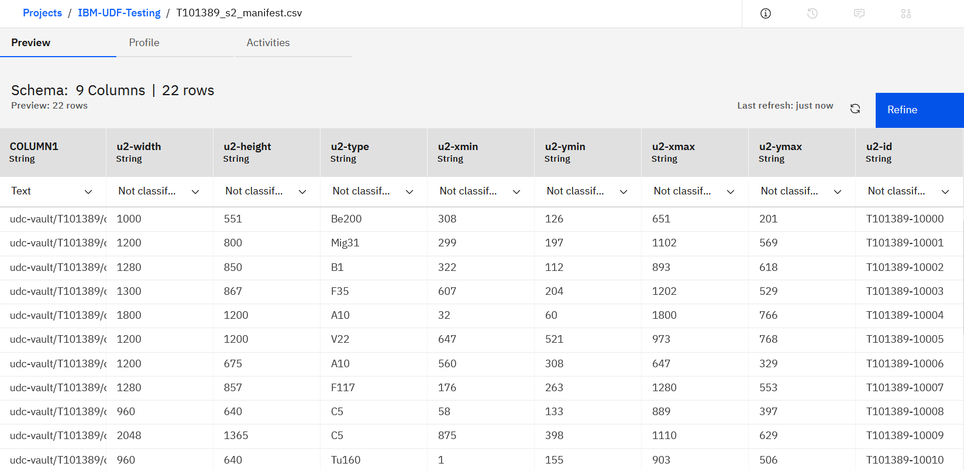
Working with the Manifest: Refine the Manifest in Data Refinery

Slide 24
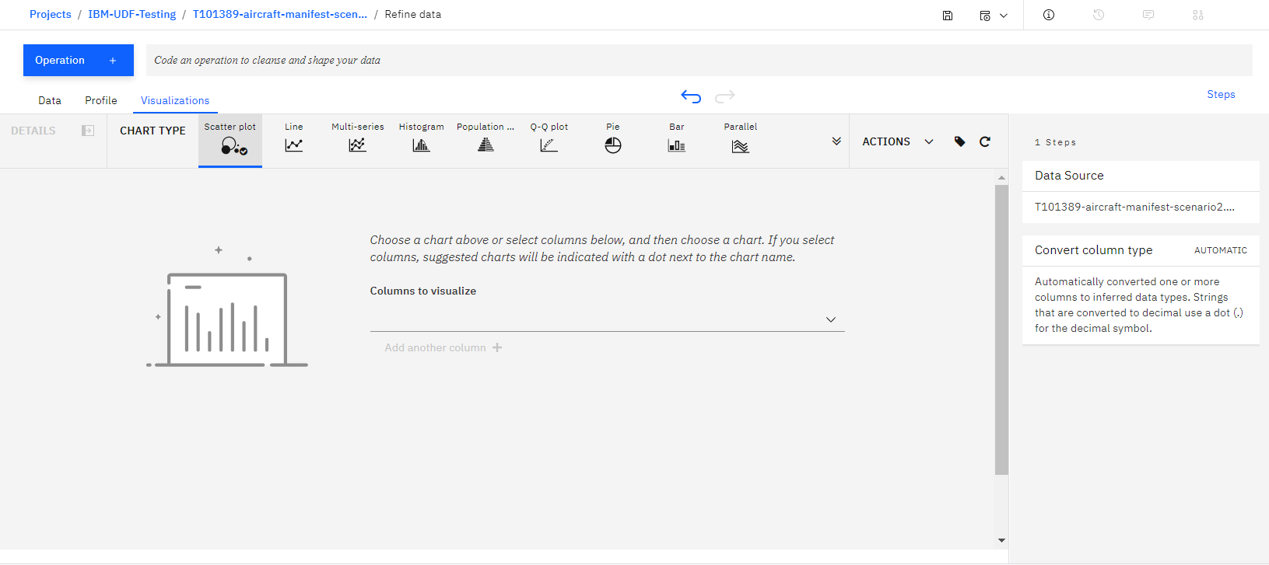
Working with the Manifest: Refine the Manifest in Data Refinery – Visualization

Slide 25
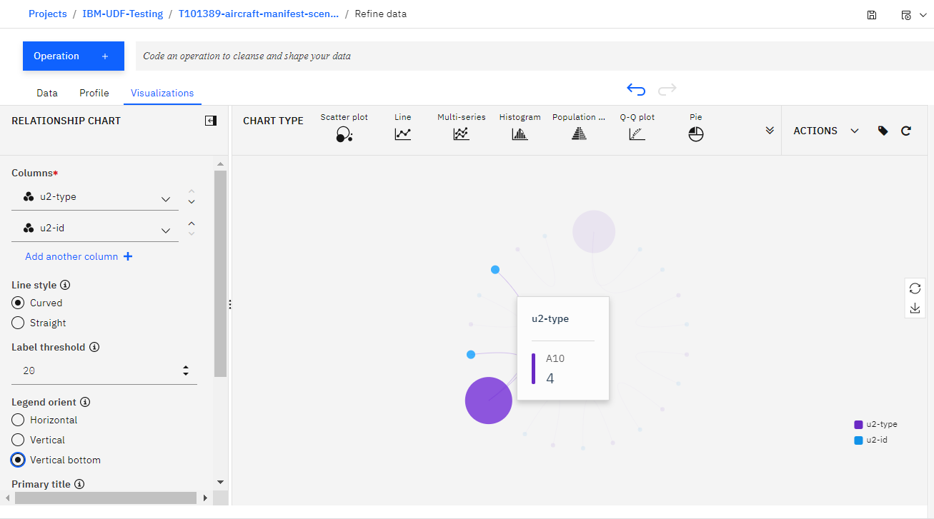
Working with the Manifest: Refine the Manifest in Data Refinery – Visualization

Slide 26
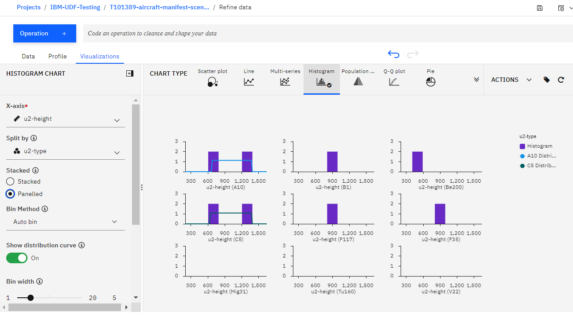
Working with the Manifest: Refine the Manifest in Data Refinery – Visualization

Slide 27
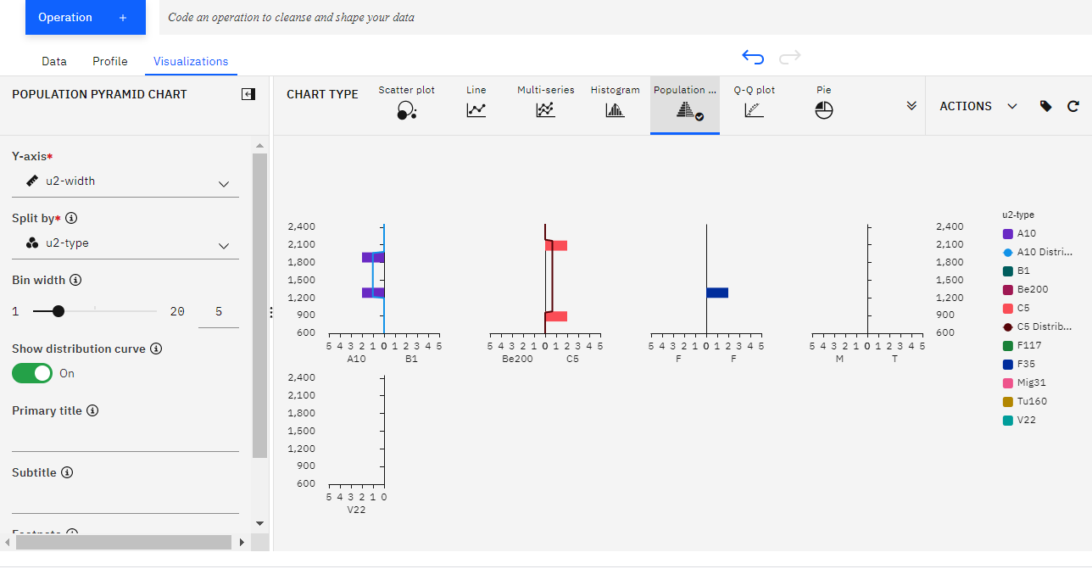
Working with the Manifest: Refine the Manifest in Data Refinery – Visualization

