Slide 1
Unified Data Catalog for Imaging Analytics
Scenario 1: Create Tags from AutoTag Policy, Custom-Tagging and Filtering
Frank Lee, Joanna Wong, Joe Dain, Reginald D’Souza
https://github.com/drfranknlee/udc-for-image-analytics/

Slide 2
1. Set up Spectrum Discover to Manage Data Sources

Slide 3
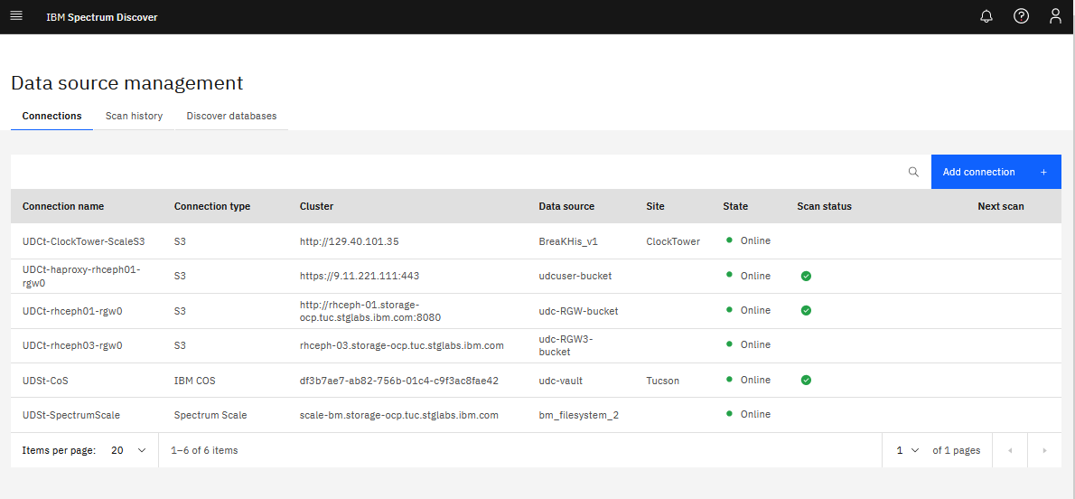

Slide 4
2. Upload Dataset to Object Storage

Slide 5
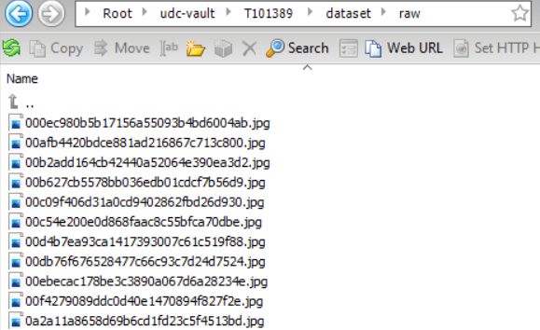
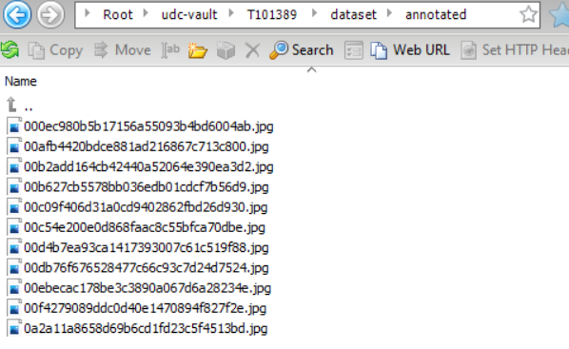
Upload Original Data to Cloud Object Storage Bucket

Slide 6
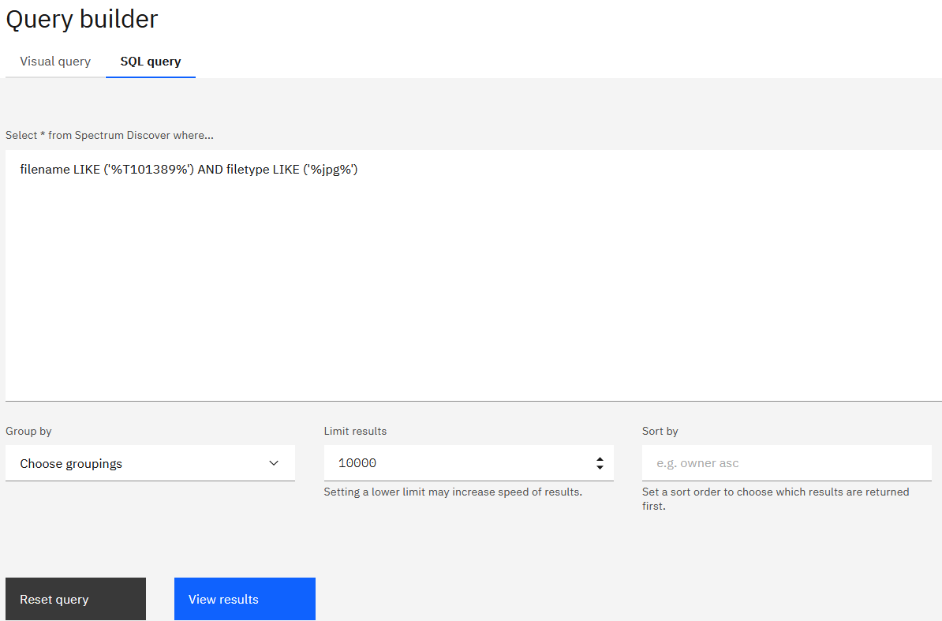
Search for Dataset using SQL Query from Query Builder

Slide 7
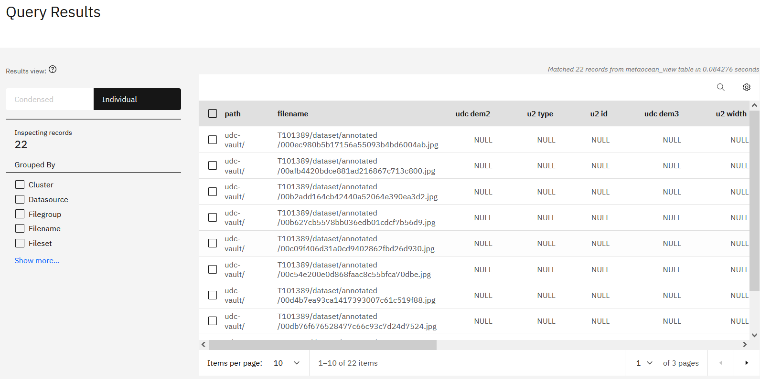
Query Results Displayed

Slide 8
3. Set up AutoTag Policy in Spectrum Discover

Slide 9
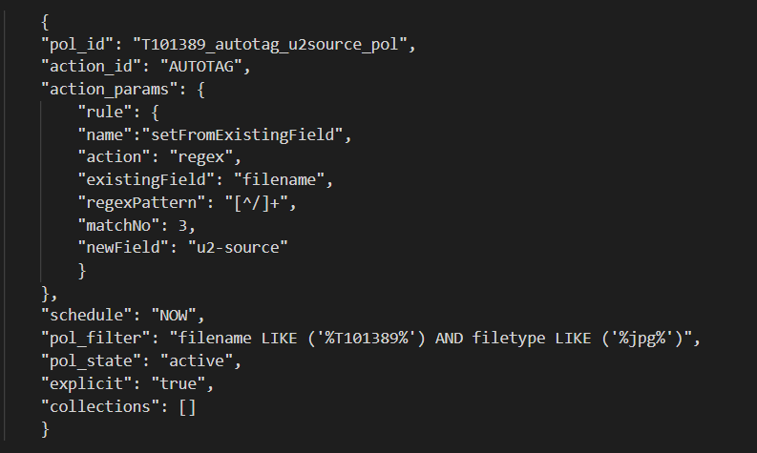
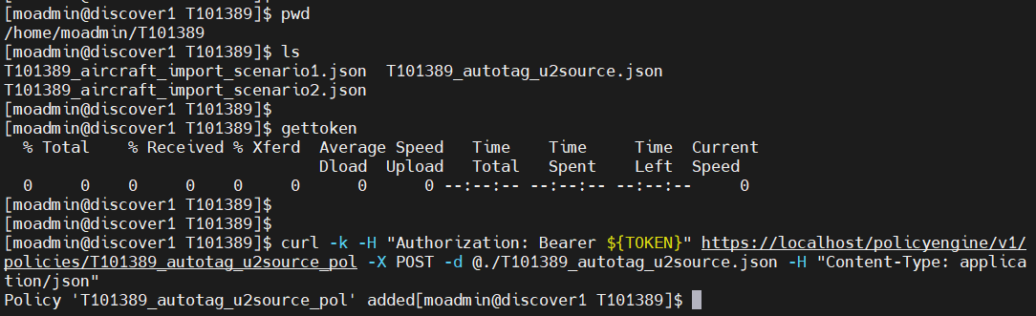
Create AutoTag Policy
Create the autotag policy in json
Execute the policy on server

Slide 10
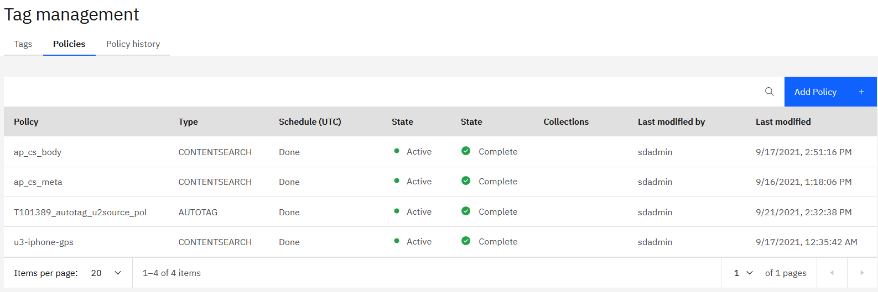
AutoTag Policy Added to Spectrum Discover Console

Slide 11
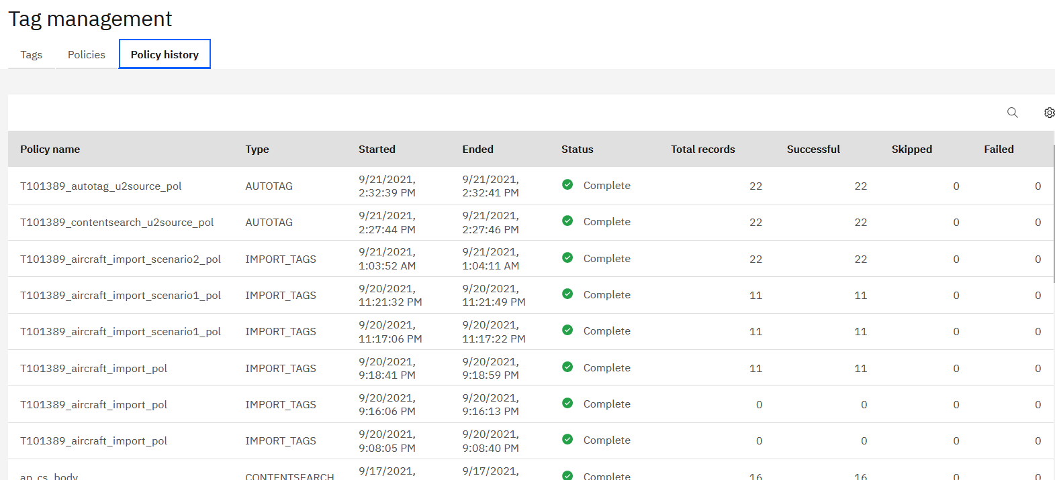
Newly Created AutoTag Policy Executed Automatically for First Time

Slide 12
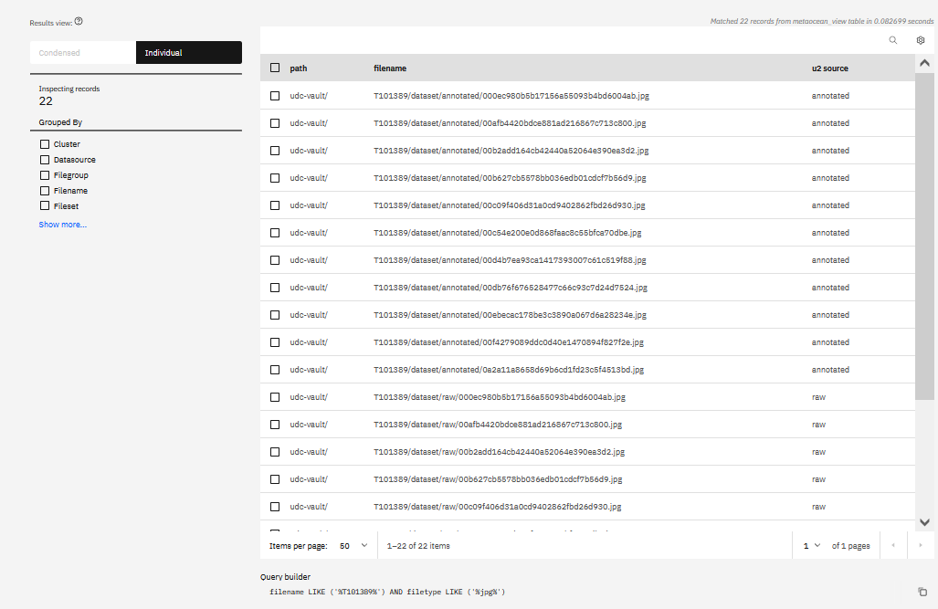
Metadata Tag “u2-source” Populated with Values Extracted by AutoTag Policy Run

Slide 13
4. Custom-tag the New Dataset

Slide 14
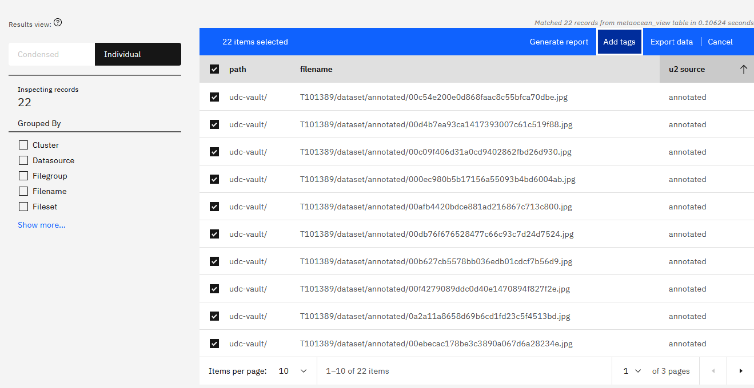
Notes:
T101389-s1-04-select-files-to-add-tags

Slide 15
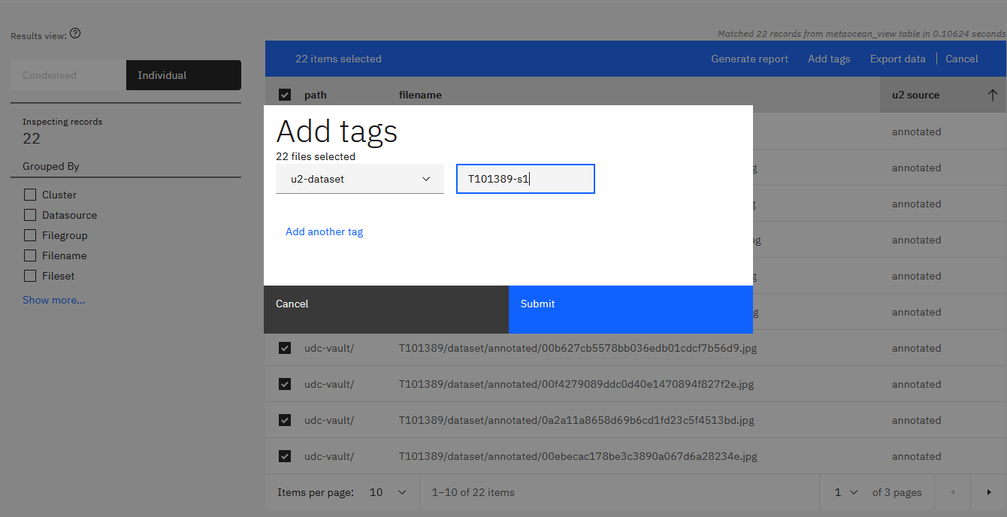
Notes:
T101389-s1-04-add-cutom-tag

Slide 16
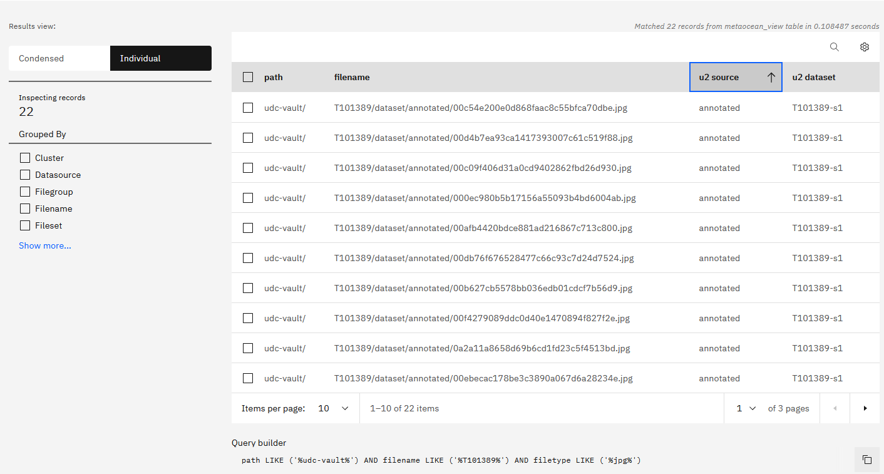
Notes:
T101389-s1-customtagnewdataset

Slide 17
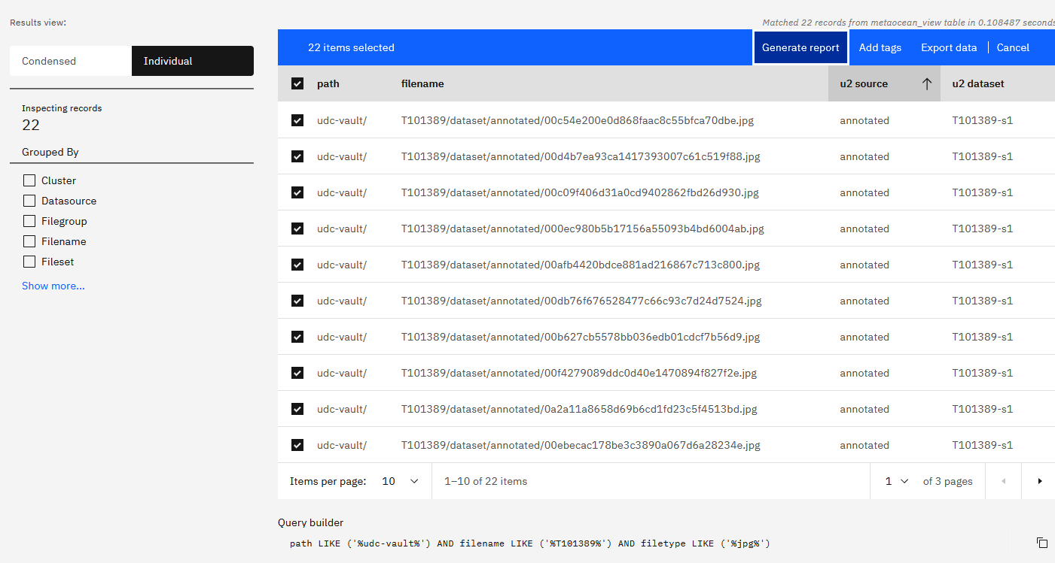
Notes:
T101389-s1-exporttomanifest

Slide 18
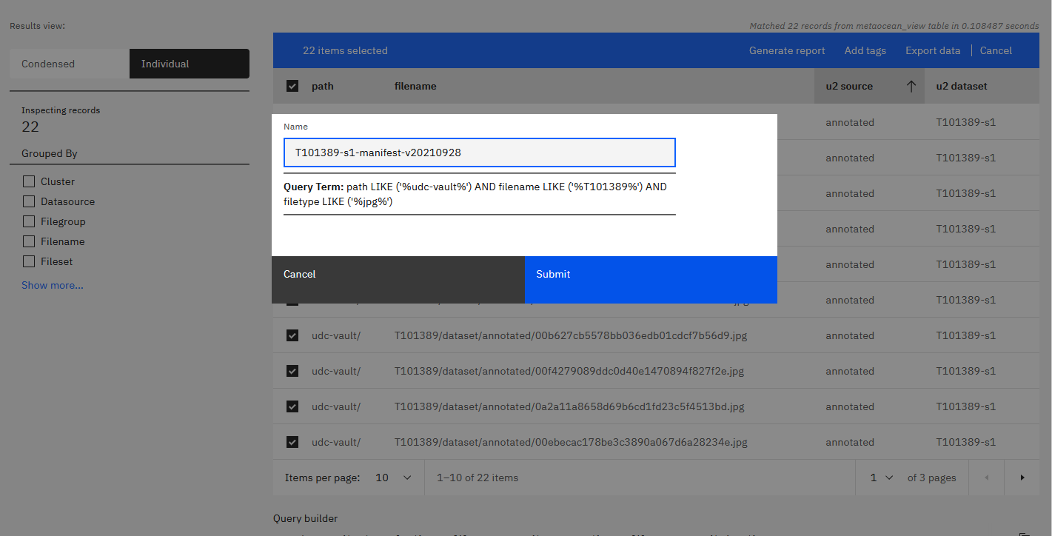
Notes:
T101389-s1-exporttomanifest2

Slide 19
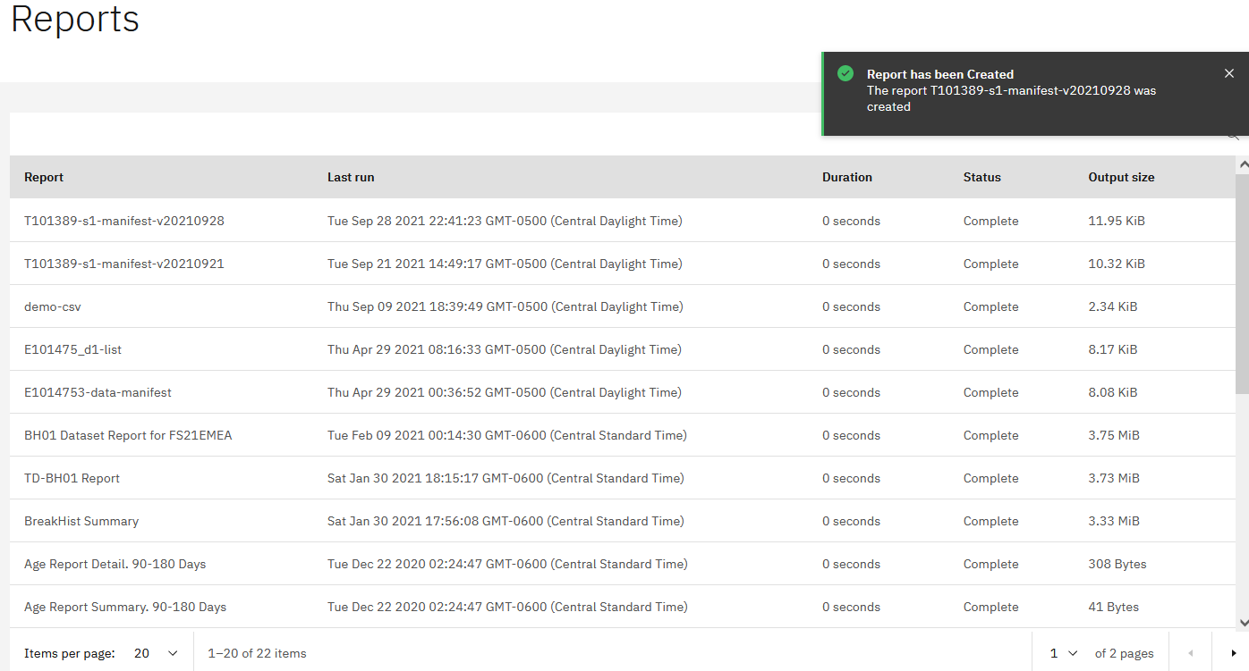
Notes:
T101389-s1-04-manifest-report-stored-in-discover

Slide 20
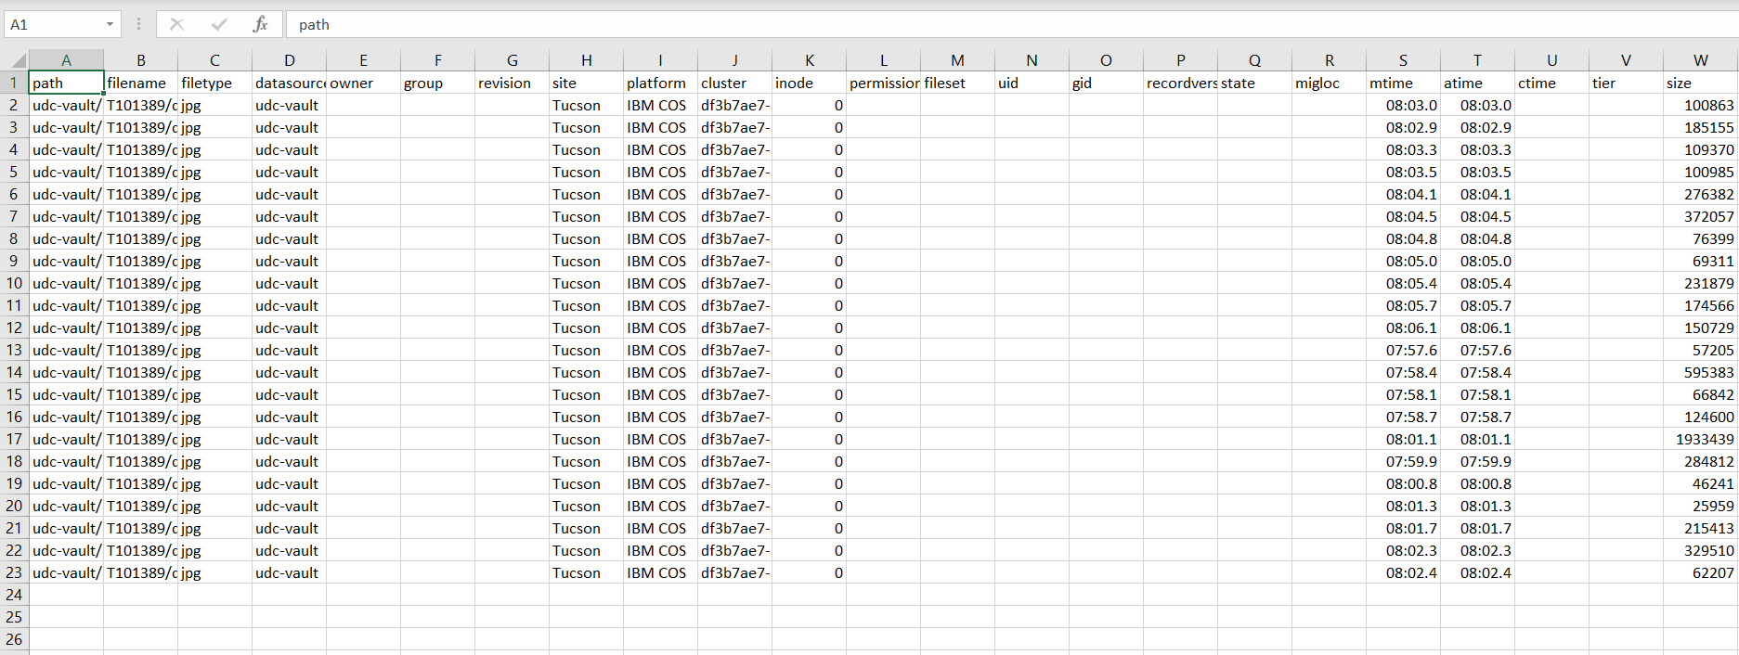
Manifest Can be Downloaded Locally as CSV File

Slide 21
5. Create New Tags Based on Filters

Slide 22
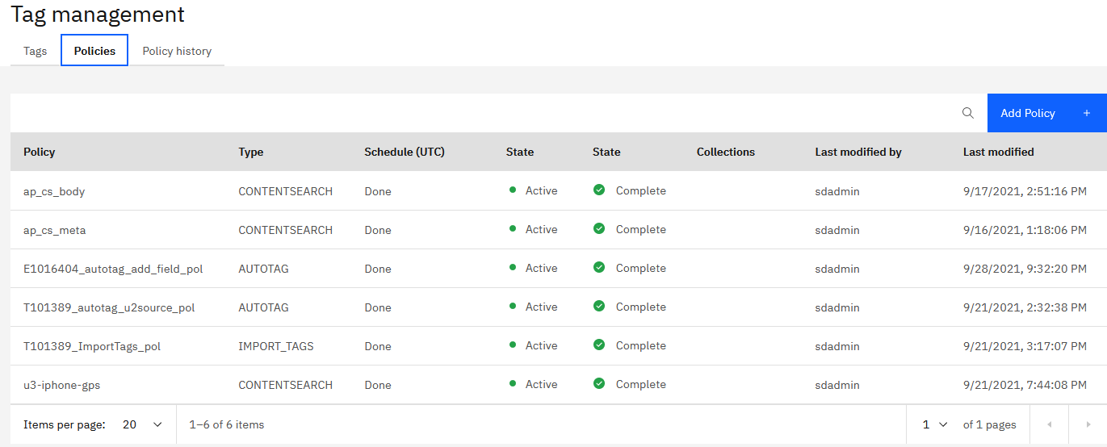
Notes:
E1016404-10-autotag-policy-added

Slide 23
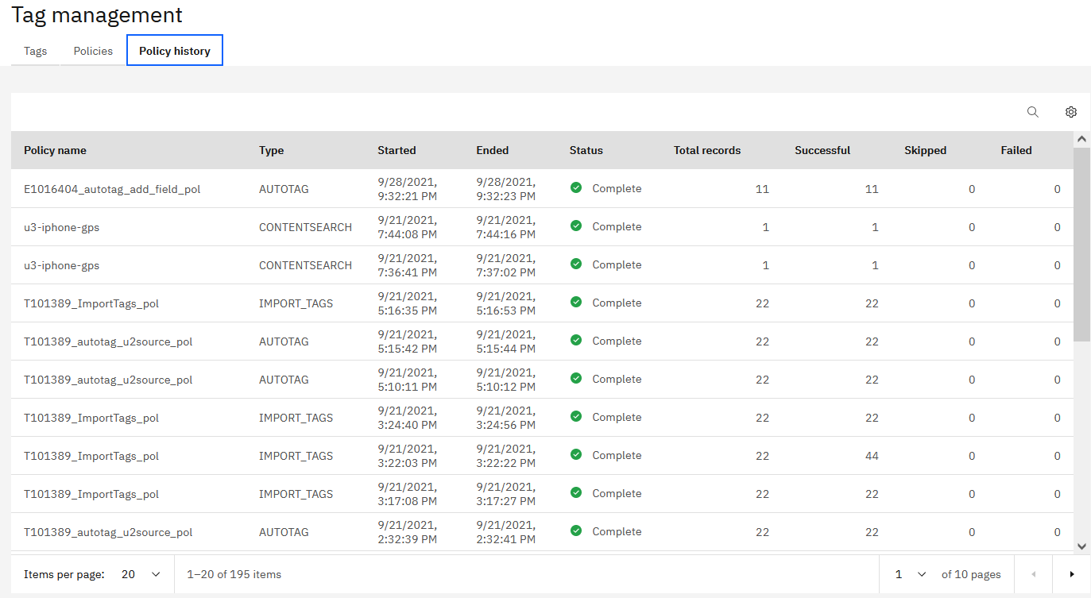
Notes:
E1016404-20-autotag-policy-run-completed

Slide 24
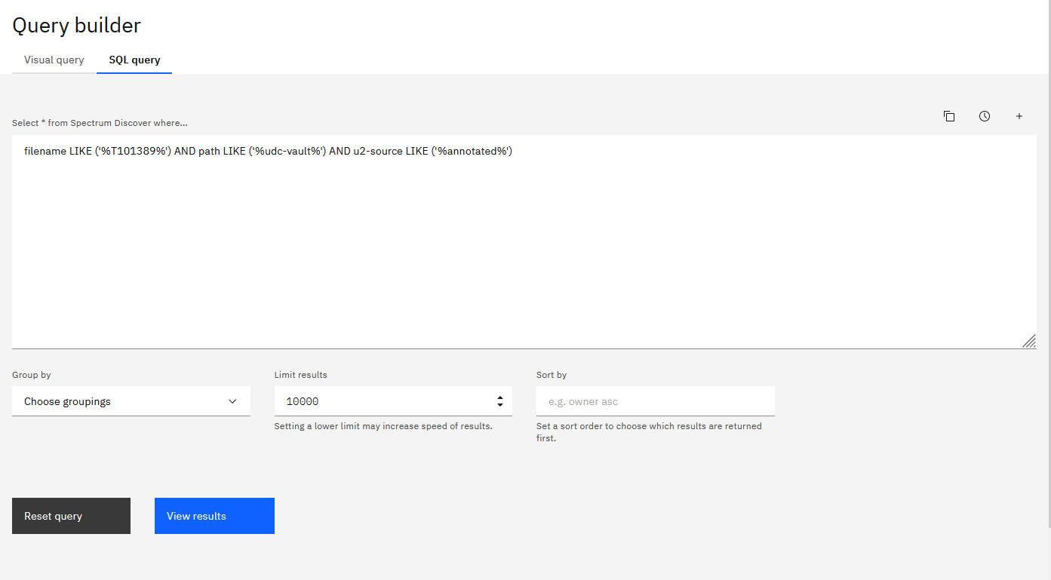
Notes:
E1016404-30-query-for-new-dataset

Slide 25
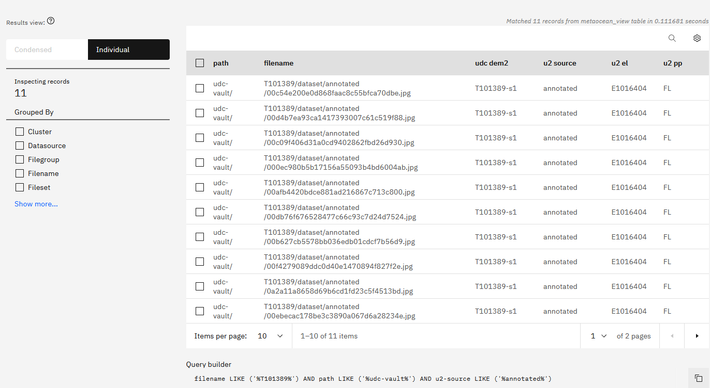
Notes:
E1016404-40-new-dataset-w-calculated-tag

Slide 26
6. View Images Directly with Calculated URL

Slide 27
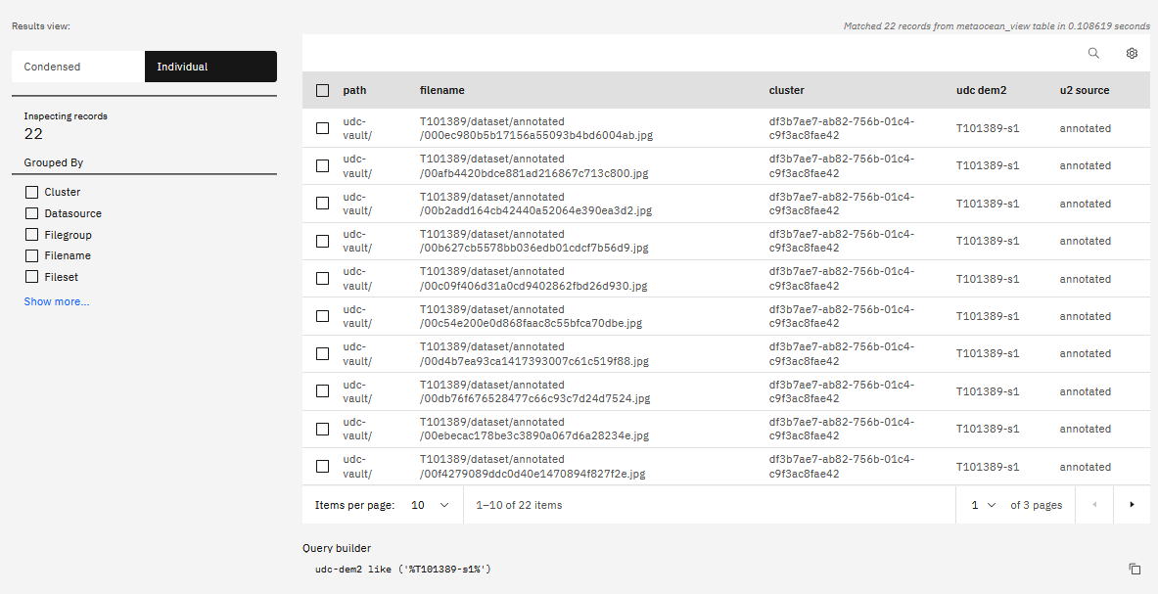

Slide 28
