Slide 1
Demo: Unified Data Catalog for Aircraft Images
Scenario 2: Import Metadata to Enrich Catalog
Frank Lee
https://github.com/drfranknlee/demo-udc-aircraft

Slide 2
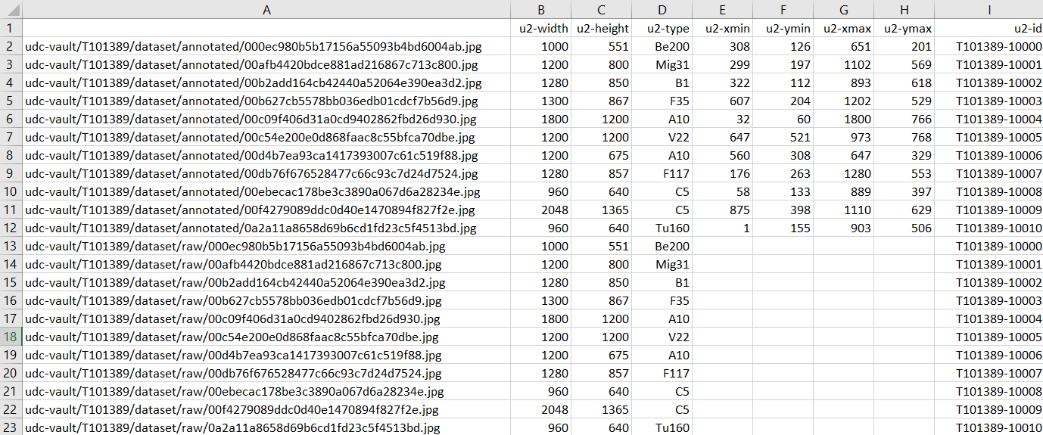
Create Manifest for New Dataset “T101389-s2”

Slide 3
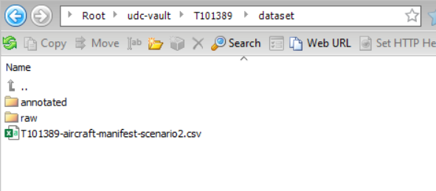
Upload Manifest to Cloud Object Storage Bucket

Slide 4
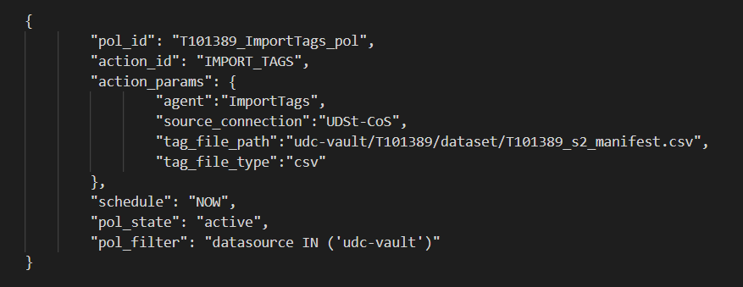
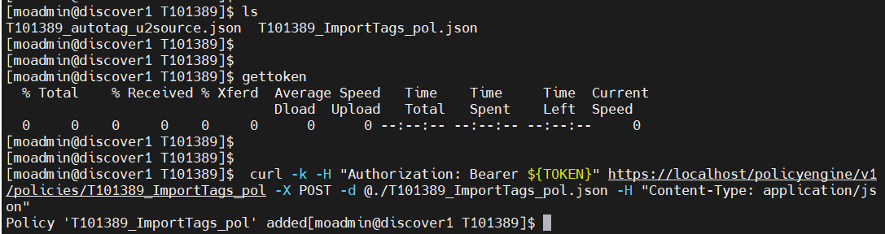
Create IMPORT_TAGS Policy

Slide 5
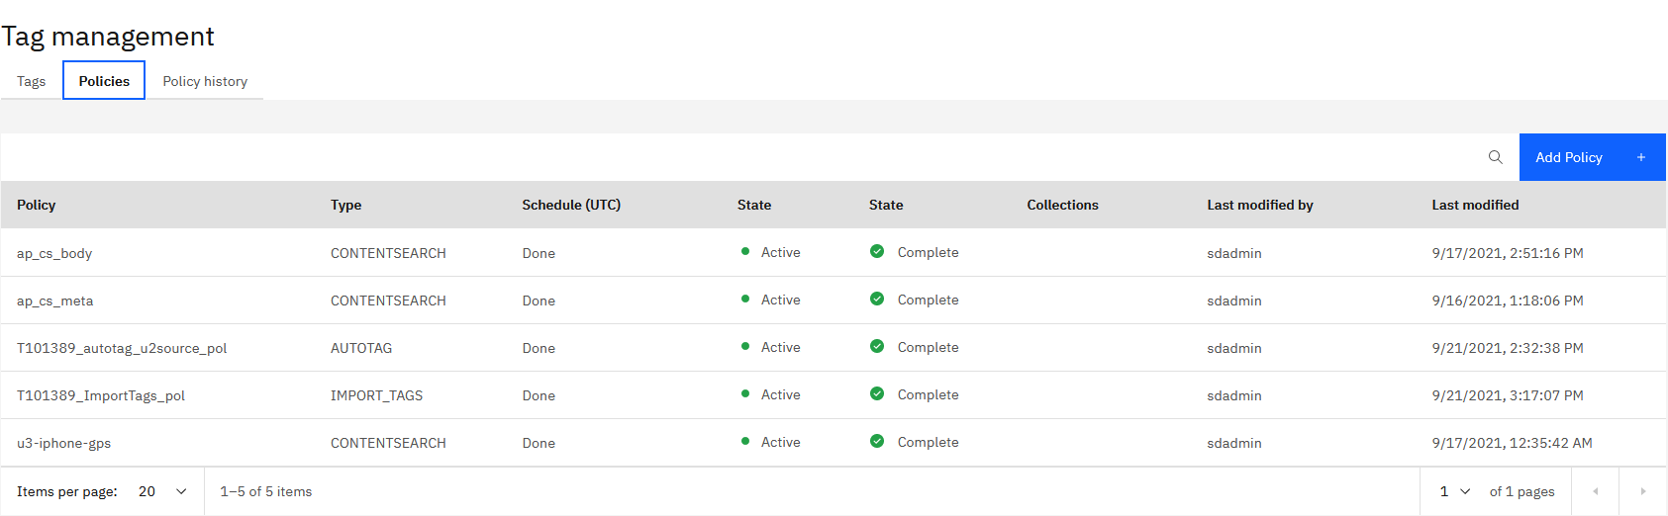
New IMPORT_TAGS Policy Created in Web Console

Slide 6
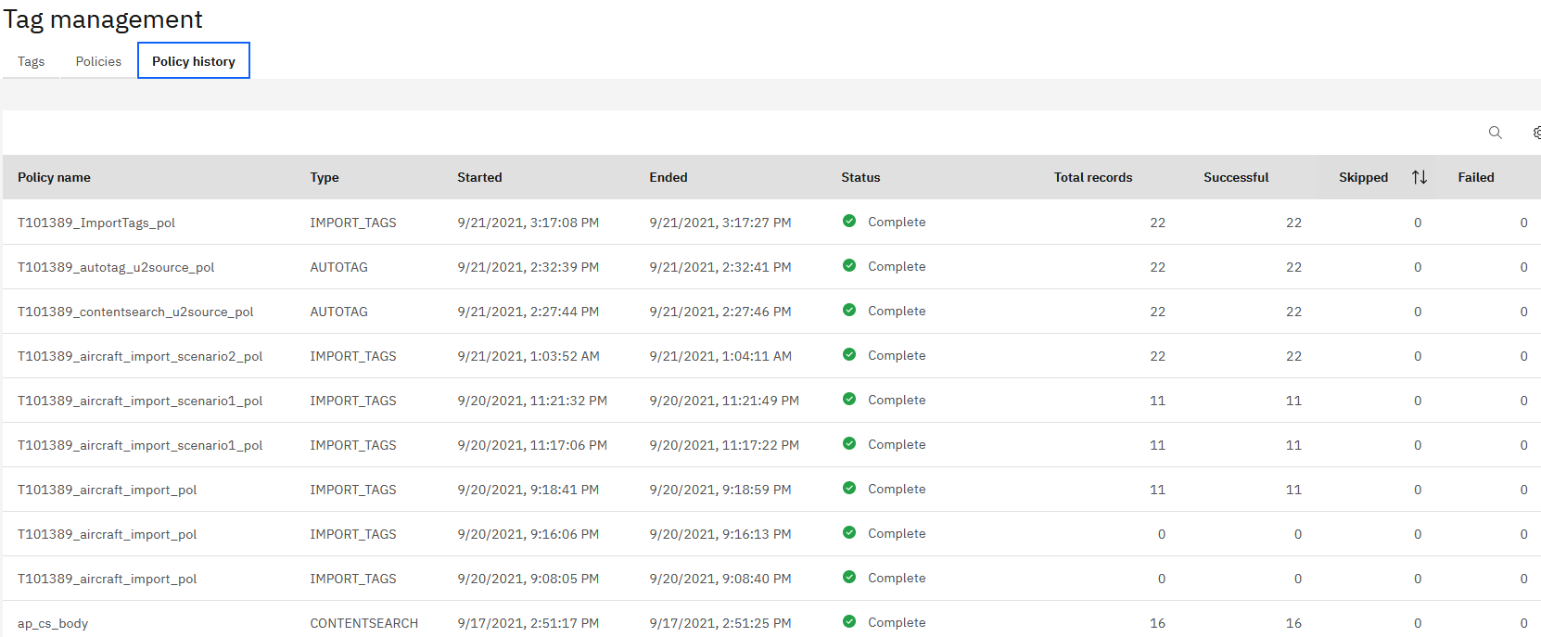
New Policy Executed for the First Time Automatically

Slide 7
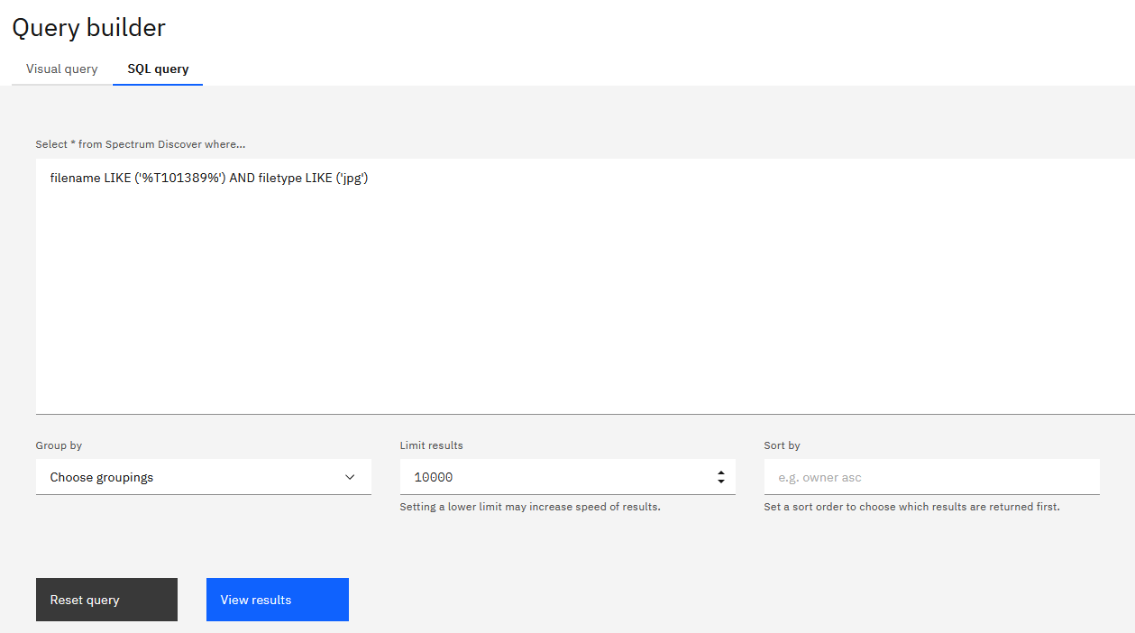
Find the Dataset using SQL Query

Slide 8
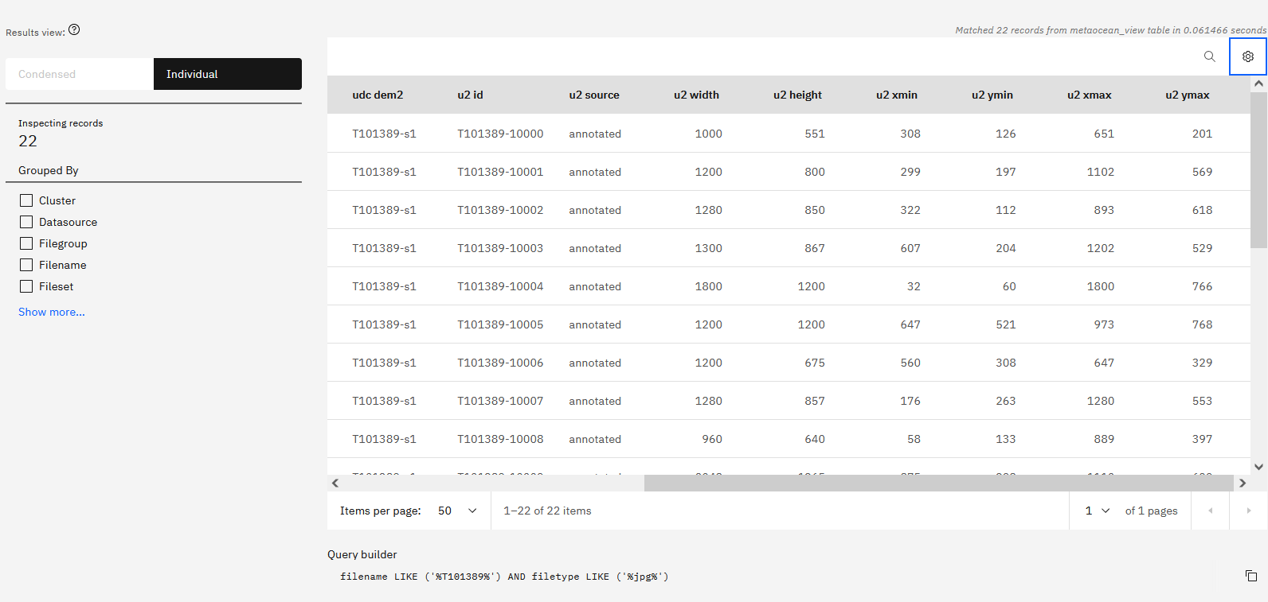
New Sets of Metadata Tags Populated with Values from Manifest by IMPORT_TAGS Policy

Slide 9
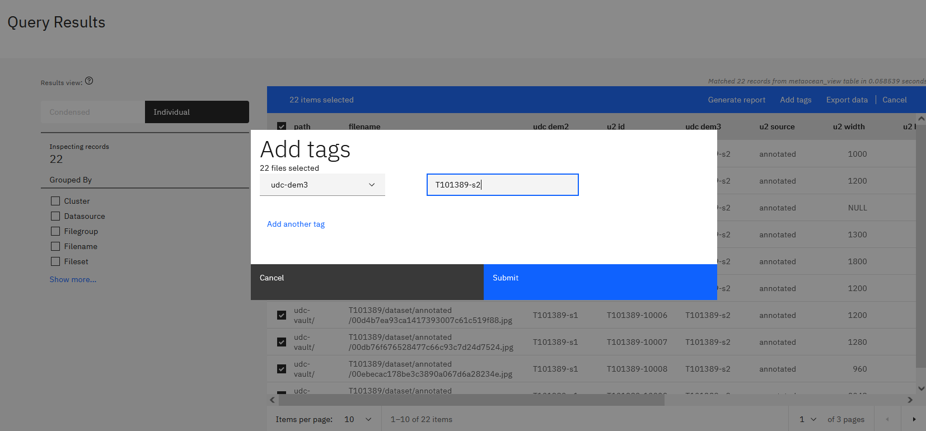
Custom-tag Updated Dataset as “T101389-s2”

Slide 10
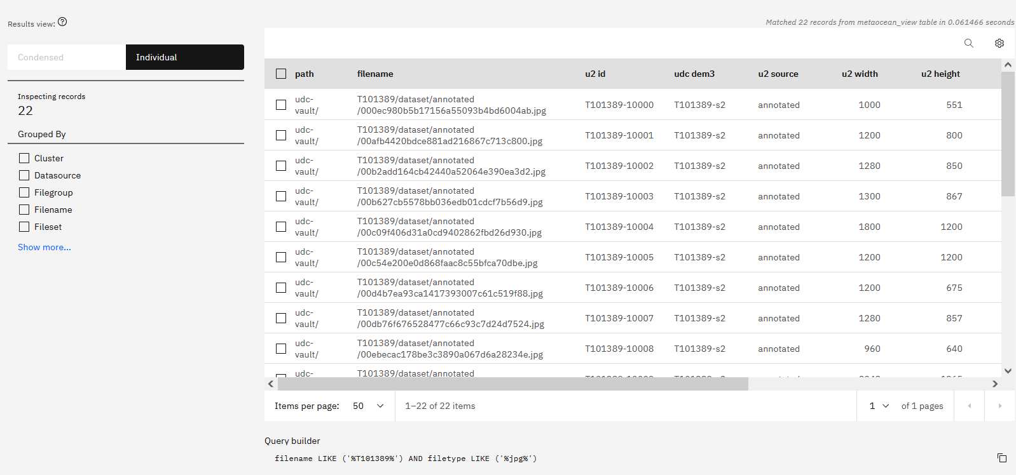
Dataset T101389-S2 Displayed with Query Builder

Slide 11
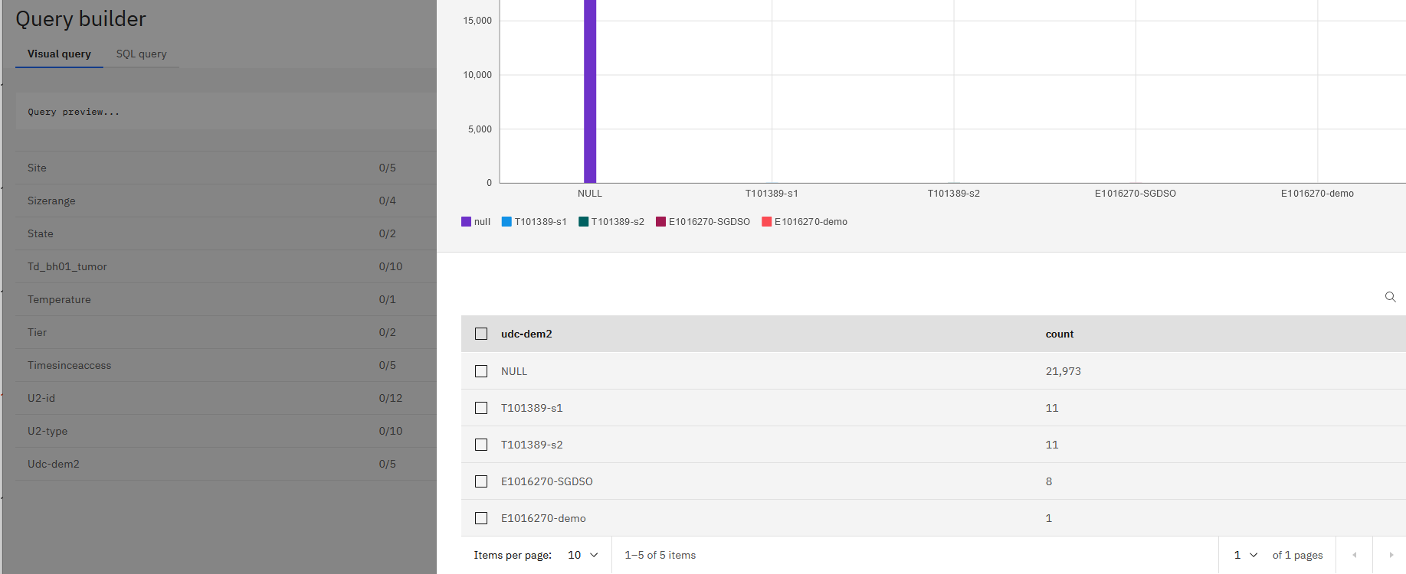
Browse for Dataset T101389-s2 with Visual Query

Slide 12
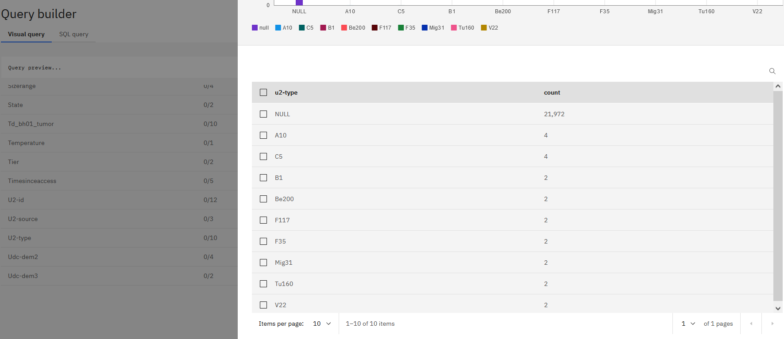
Browse Dataset with Metadata Tag “u2-type”

Slide 13
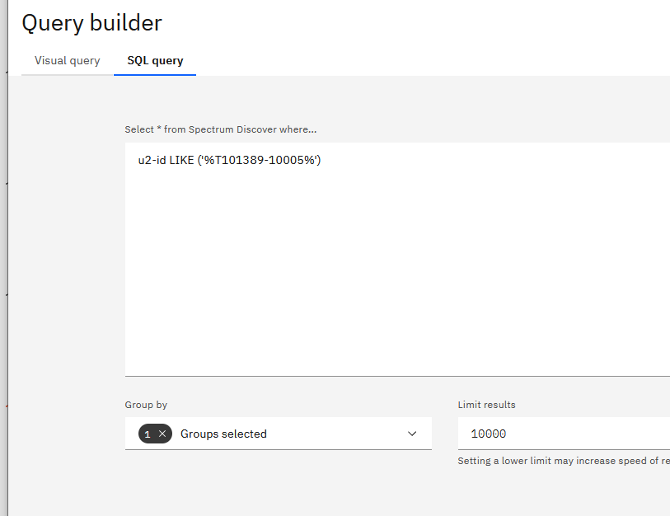
Find the Paring Data (raw-annotated) based on Metadata Tag “u2-id”

Slide 14
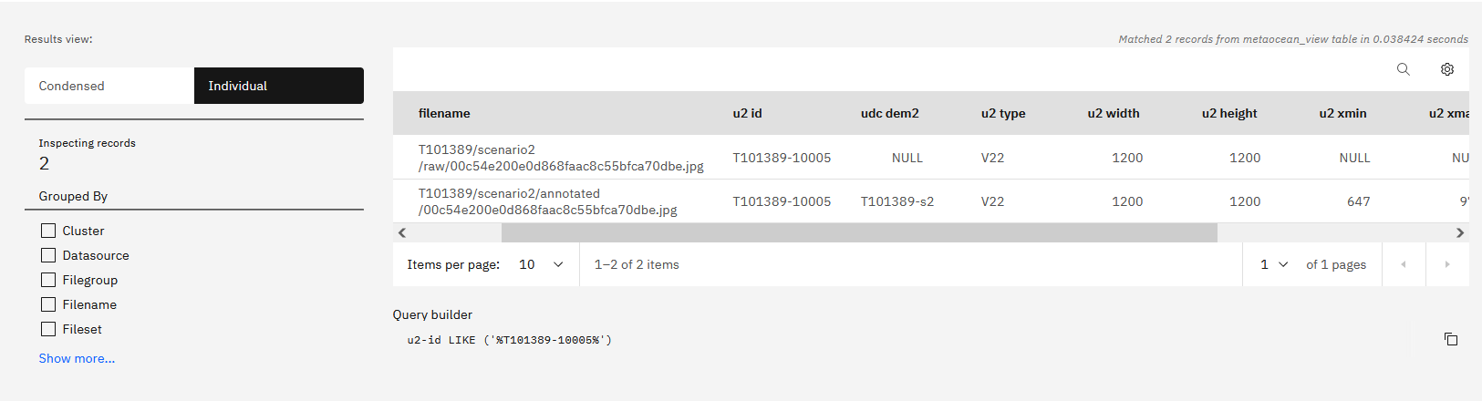
Result of u2-id Search

Slide 15

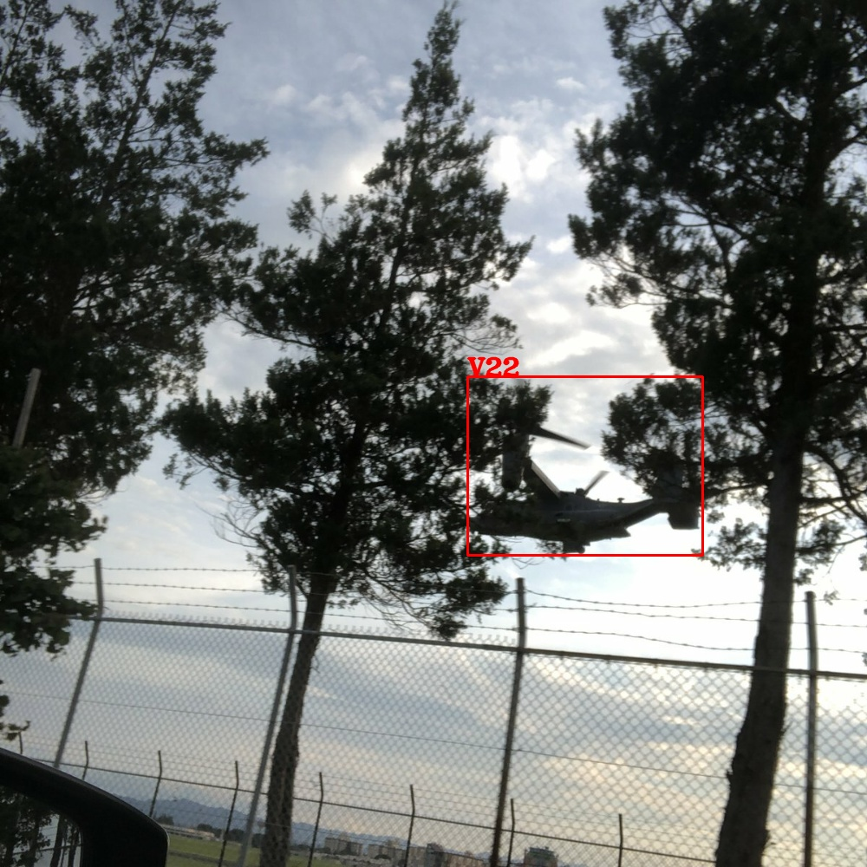
Two Images Shown Next to Each Other
647, 768
973, 768
647, 521
973, 521
u2-id = T101389-10005

