Slide 1
Title Slide Deck
Student1; Student2; Student 3

Slide 2
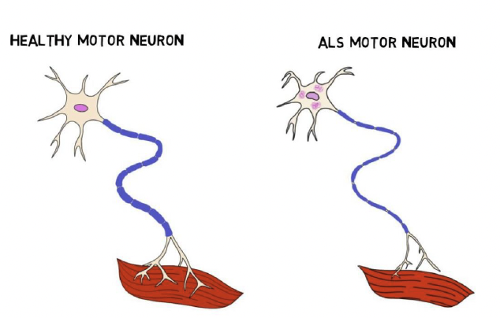
Introduction/Neurophysiology
Describe your movement disorder
Explain its physiological basis
Discuss who it generally affects

Slide 3
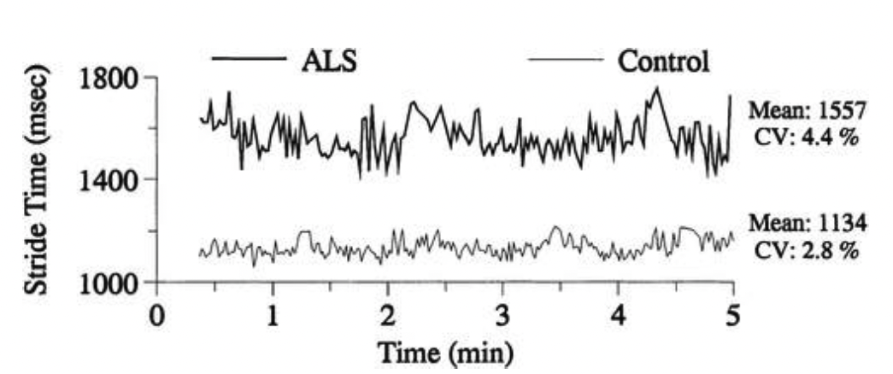
Skill Performance
Describe how individuals with this disorder perform certain skills

Slide 4
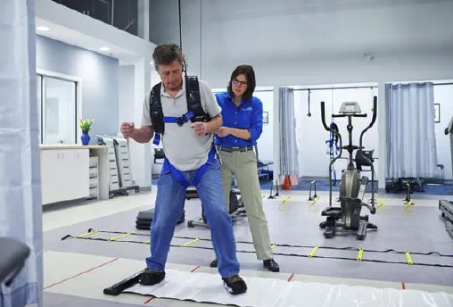
Treatment
Discuss common pharmacological treatments (detailed mechanisms not required)
Explain typical rehab approaches

Slide 5
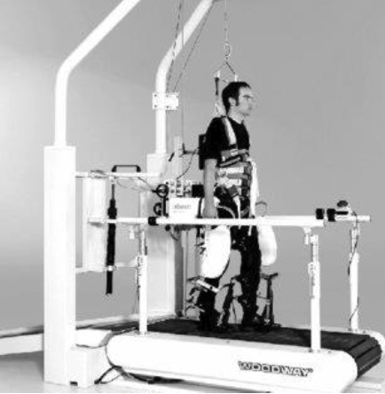
Overall Outlook
Discuss the current state of the science
Suggest areas for future research focus
Mention any new treatment modalities on the horizon

Slide 6
About References
Cite references throughout the presentation using APA style (7th edition)
e.g., (Driskell et al., 1992)
Include a slide at the end with full references
See below how the source (Driskell et al., 1992) is listed on the Reference slide
For more information about apa style citation click here for in-text citation and click here for creating references
Driskell, J. E., Willis, R. P., & Copper, C. (1992). The effect of overlearning on retention. Journal of Applied Psychology, 77(5), 615.

