Slide 1
Title Slide Deck
Student1; Student2; Student 3

Slide 2
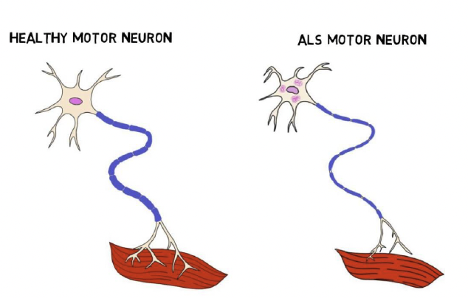
Introduction/Neurophysiology
Describe your movement disorder
Explain its physiological basis
Discuss who it generally affects

Slide 3
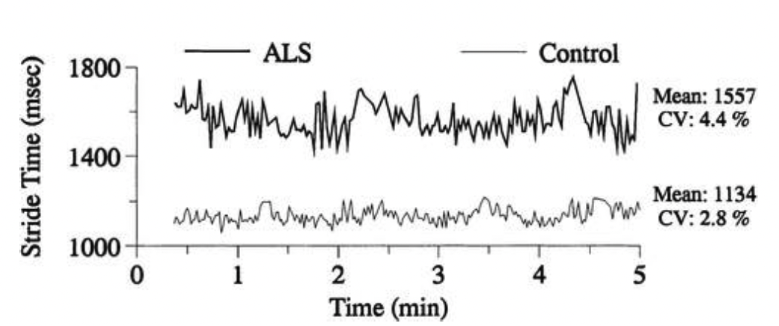
Skill Performance
Describe how individuals with this disorder perform certain skills

Slide 4
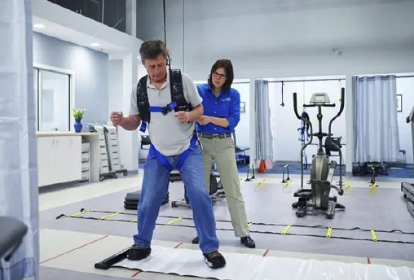
Treatment
Discuss common pharmacological treatments (detailed mechanisms not required)
Explain typical rehab approaches

Slide 5
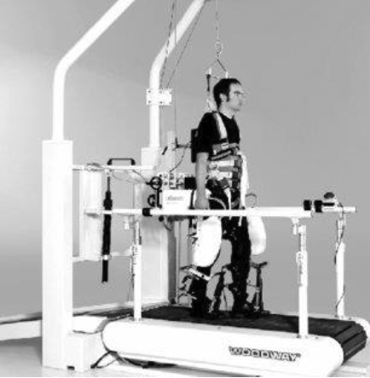
Overall Outlook
Discuss the current state of the science
Suggest areas for future research focus
Mention any new treatment modalities on the horizon

Slide 6
References
Cite references throughout the presentation using APA style (7th edition)
e.g., (Driskell et al., 1992)
Include a slide at the end with full references
See below how the source (Driskell et al., 1992) is listed on the Reference slide
Driskell, J. E., Willis, R. P., & Copper, C. (1992). The effect of overlearning on retention. Journal of Applied Psychology, 77(5), 615.

