Slide 1
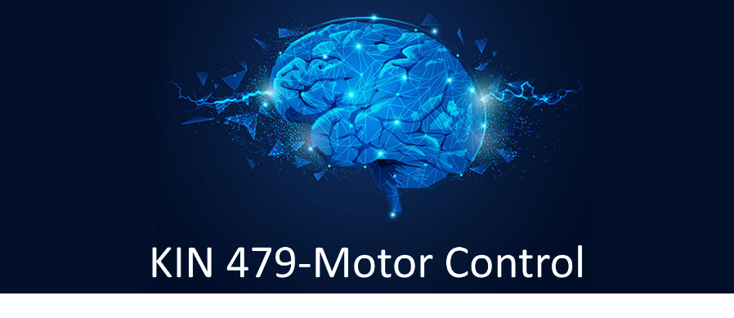
Ovande Furtado, Jr., Ph.D.
Spring 2025

Slide 2

Motor
Behavior
Motor Development
changes in motor performance across the life span and factors that influence these changes
Motor Control
how the brain and central nervous system interact with muscles to produce movements—cross sectional
Motor Learning
relatively permanent changes in motor performance due to practice or experience

Slide 3
Motor Control-Integration of knowledge
Physics
Determinants and limits of motor performance
Engineering
Rehabilitative devices and robotics
Statistics
Variability
Behavioral sciences
Psychology of motor control
Physiology
Structure and function of motor control

Slide 4
Instructor Info
Office: RE 289
Phone: 818-677-6958
Office Hours:
Tuesdays and Thursdays 9 am –12 pm
Also available at https://bit.ly/drfurtado-appointment

Slide 5
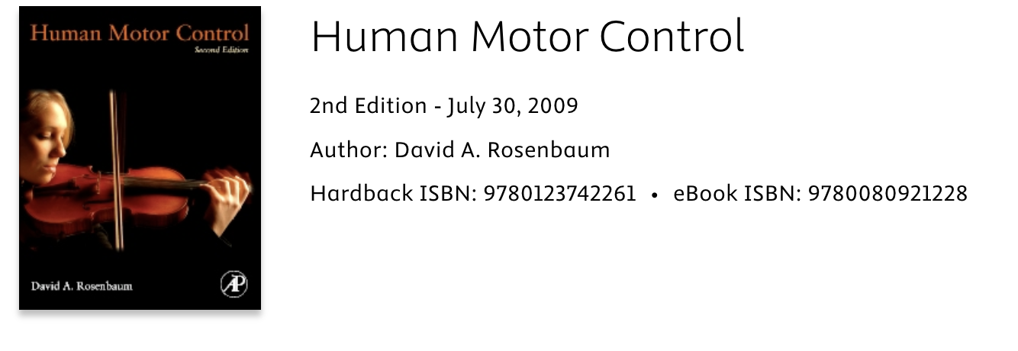
Textbook

Slide 6
Learning Objectives
By the end of this course, you will be able to…
Describe different approaches to motor control
Apply physiological knowledge to further MC understanding
Describe psychological theories that frame MC
Use articles to establish evidence for rehab approaches
Be able to scientifically critique MC research
Know how historical concepts have shaped the current state of MC

Slide 7
Online Format
Fully asynchronous: No live meetings all term
Everything for the week will be posted on Canvas page!
All materials for the week: Monday at 5:00 PM
Lecture slides + recordings
Quizzes

Slide 8
Performance Evaluation
25%: Quizzes: most weeks
Lowest score dropped
15%: Presentation
Groups will record a presentation on a specific movement disorder
More to come next week (Week 3)

Slide 9
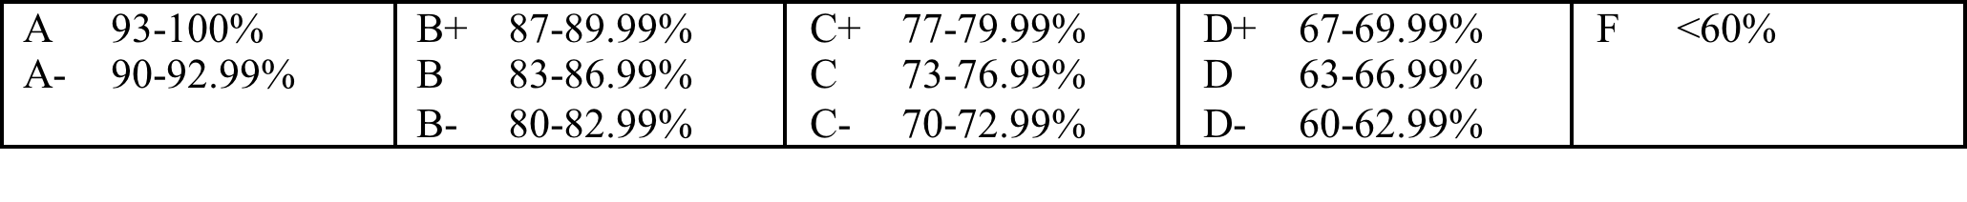
Performance Evaluation
30%: Midterm (week 10; due Mar 25th @ 5 PM)
30%: Final exam (due May 13 @ 5 PM)
**Please refer to syllabus for campus policy regarding students with disabilities and other course policies**
Cheating and plagiarism: DON’T DO IT

Slide 10
Sequence

Slide 11
Sequence

