Slide 1
Movie Recommendation
MovieLens (ml-1m dataset)
Group Members:
1814067 - Akshit Sanchala
1814071 - Krunal Dattani
1814072 - Atharva Dave
1814076 - Dharmil Gada
1924010 - Mitanshu Gada
Batch: 3 | AML-TF | SEM: 6 | IT

Slide 2
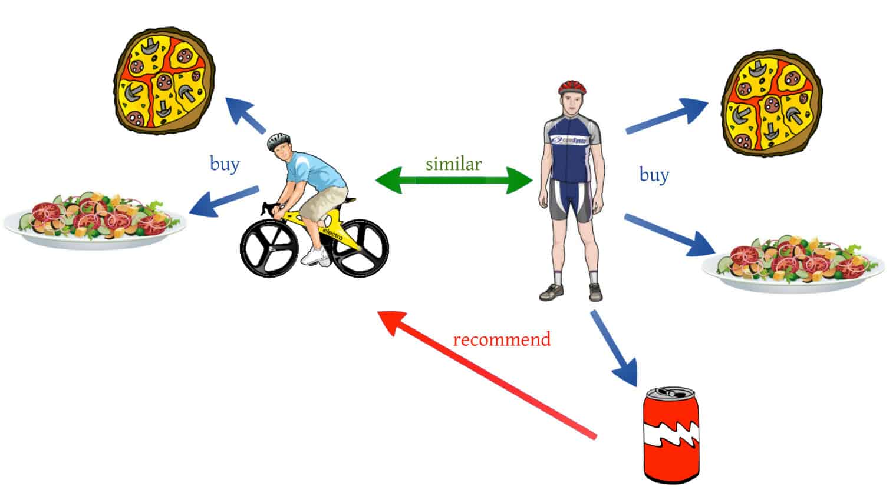
What is Recommender System?
Recommender System is a system that seeks to predict or filter preferences according to the user’s choices. Recommender systems are utilized in a variety of areas including movies, music, news, books, research articles, search queries, social tags, and products in general.
Recommendations typically speed up searches and make it easier for users to access content they’re interested in, and surprise them with offers they would have never searched for.
Notes:
Simply put a Recommendation System is a filtration program whose prime goal is to predict the “rating” or “preference” of a user towards a domain-specific item or item. In our case, this domain-specific item is a movie, therefore the main focus of our recommendation system is to filter and predict only those movies which a user would prefer given some data about the user him or herself.
https://www.geeksforgeeks.org/python-implementation-of-movie-recommender-system/#:~:text=Recommender%20System%20is%20a%20system,tags%2C%20and%20products%20in%20general.

Slide 3
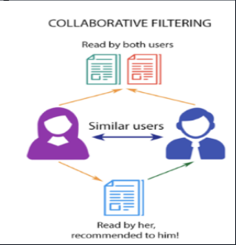
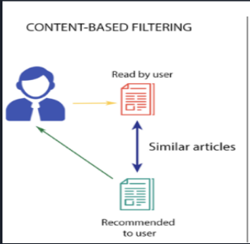
Recommender systems produce a list of recommendations
in any of the two ways :
Collaborative filtering: Collaborative filtering
approaches build a model from user’s past behavior
as well as similar decisions made by other users.
Content-based filtering: Content-based filtering
methods are totally based on a description of the
item and a profile of the user’s preferences. It
recommends items based on user’s past preferences.

Slide 4
Introduction
➢ A Tensorflow dataset known as ‘MovieLens (ml-1m dataset)’ was chosen which comprises of ratings given by the users belonging to different age groups to different movies belonging to different genres.
➢ This dataset is used to build a model which will recommend top 10 movies which is highly rated by other users with similar taste.
➢ For this Dataset, we have used Collaborative filtering method.

Slide 5
MovieLens Dataset
A Tensorflow dataset known as ‘MovieLens’ was chosen which comprises a set of movie ratings from the MovieLens website, a movie recommendation service.
This dataset contains 10,00,209 anonymous ratings of approximately 3,900 movies made by 6,040 MovieLens unique users
Download size of the dataset is 5.64 MiB. Dataset size is 23.7 MiB
Each user has rated at least 20 movies. In demographic data, age values are divided into ranges and the lowest age value for each range is used in the data instead of the actual values.
Our goal is to be able to predict ratings for movies a user has not yet watched. The movies with the highest predicted ratings can then be recommended to the user.
Notes:
Demographic Data explained: "bucketized_user_age": bucketized age values of the user who made the rating, the values and the corresponding ranges are:
1: "Under 18"
18: "18-24"
25: "25-34"
35: "35-44"
45: "45-49"
50: "50-55"
56: "56+"

Slide 6
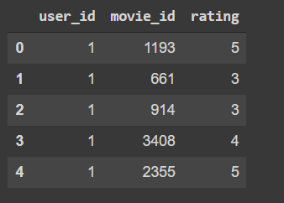
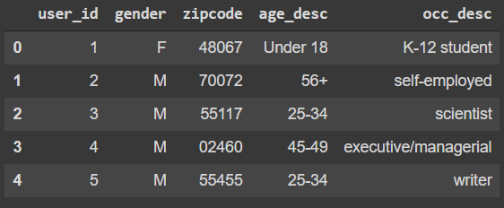
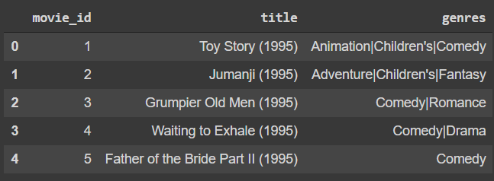
Features of Dataset
Dataset Contains following features:
user_id
user_rating
movie_genres
movie_title
movie_id
gender
age
occupation
Notes:
The features below are included in all versions with the "-ratings" suffix.
"movie_id": a unique identifier of the rated movie
"movie_title": the title of the rated movie with the release year in parentheses
"movie_genres": a sequence of genres to which the rated movie belongs
"user_id": a unique identifier of the user who made the rating
"user_rating": the score of the rating on a five-star scale
"timestamp": the timestamp of the ratings, represented in seconds since midnight Coordinated Universal Time (UTC) of January 1, 1970
"1m-ratings" versions in addition include the following demographic features.
"user_gender": gender of the user who made the rating; a true value corresponds to male
"bucketized_user_age": bucketized age values of the user who made the rating, the values and the corresponding ranges are:
1: "Under 18"
18: "18-24"
25: "25-34"
35: "35-44"
45: "45-49"
50: "50-55"
56: "56+"
"user_occupation_label": the occupation of the user who made the rating represented by an integer-encoded label; labels are preprocessed to be consistent across different versions
"user_occupation_text": the occupation of the user who made the rating in the original string; different versions can have different set of raw text labels
"user_zip_code": the zip code of the user who made the rating

Slide 7
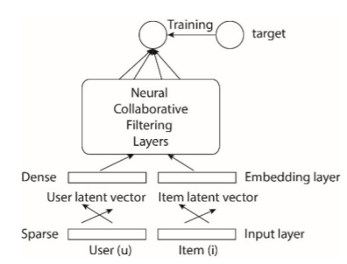
Collaborative Filtering Architecture

Slide 8
Project Flow
Download dataset and extract it into the drive
Data preprocessing
Create Train and Test folder having the respective images
Map user ID to a "user vector" via an embedding matrix
Map movie ID to a "movie vector" via an embedding matrix
Compute the dot product between the user vector and movie vector, to obtain the a match score between the user and the movie (predicted rating).
Train the embeddings via gradient descent using all known user-movie pairs.
Create a graph showing the loss of our model
Show movie recommendations to users

Slide 9
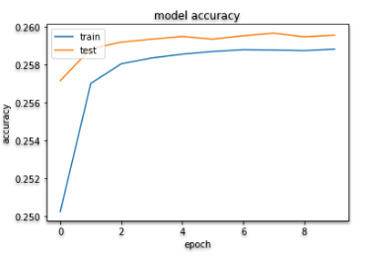
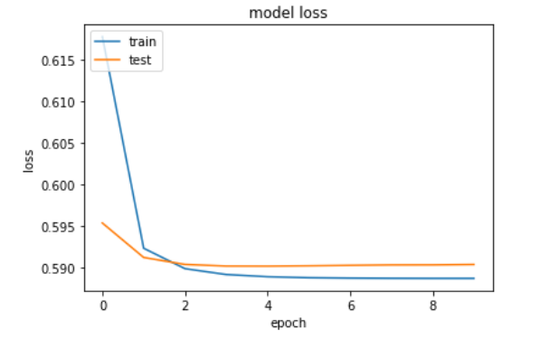
Evaluating Models

Slide 10
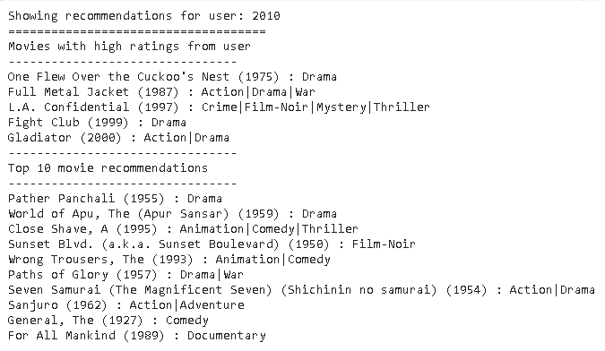
Recommendations
Highest Ratings given by this user to watched movies and Top 10 movie recommendations:

Slide 11
References
http://www.ijstr.org/final-print/dec2019/A-Review-Paper-On-Collaborative-Filtering-Based-Moive-Recommedation-System-.pdf
http://www.riejournal.com/article_106395_c6c0038f1bf5d4c421bd552d0541d6be.pdf
https://www.researchgate.net/publication/319487277_Design_and_Implementation_of_Movie_Recommendation_System_Based_on_Knn_Collaborative_Filtering_Algorithm
https://hcis-journal.springeropen.com/articles/10.1186/s13673-018-0161-6

Slide 12
Thank You

