Slide 1
Lab #8
Git

Slide 2
Agenda
Final Project Info
All things Git
Make sure to come to lab for Python next week

Slide 3
Final Project Low Down
The Projects are Creative AI, Arduino, Web Scheduler, iOS and Connect 4
Notes about working on a Team

Slide 4
Being on a Team: Tricks for Maximizing Efficiency
Take meeting minutes
Write down who is supposed to do what when and what time you are going meet up next
hint: make a .txt file and push it to your repo before and after EVERY meeting
Actually meet up in person, group chat does NOT suffice
Set times and stick with them!

Slide 5
Using Git through the command line

Slide 6

Motivations behind version control
Ease of collaboration & sharing
Serves as a distributed backup
⛄️

Slide 7
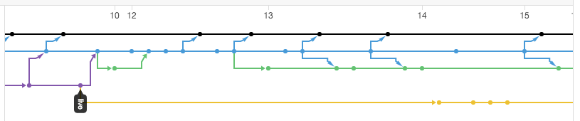
Motivations behind version control
Ease of collaboration & sharing
Serves as a distributed backup
Builds a narrative of your project:
⛄️
Notes:
Timeline of commits → versions of your code

Slide 8
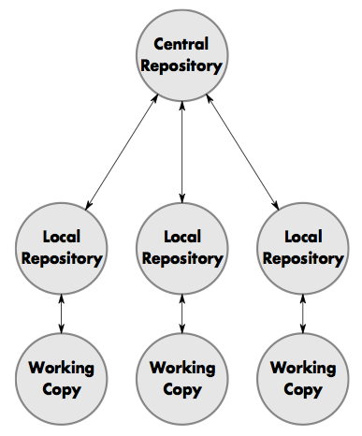
Distributed
Distributed repos (à la git)
⛄️
Notes:
Different local copes on every team member’s computer

Slide 9
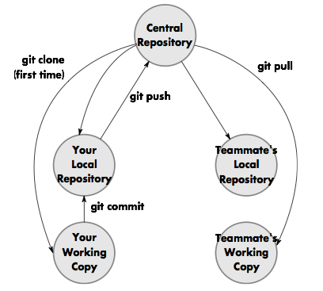
Collaborating via git
⛄️

Slide 10
Best practices with git
Don’t use commits as a way to “save” your code.
Don’t wait too long to commit.
Careful not to commit sensitive info when pushing to GitHub.
Choose helpful commit messages. (Spoiler: good luck with this one at 4 AM.)
⛄️
Notes:
Commits should have a purpose → not just every time you CTRL + S
Sensitive info = personal information

Slide 11
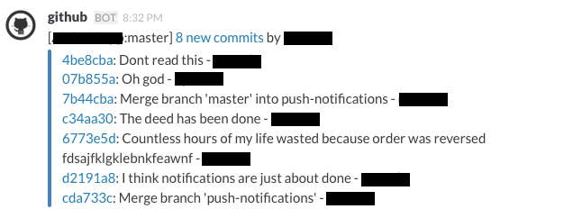
Best practices with git
Choose helpful commit messages. (Spoiler: good luck with this one at 4 AM.)
⛄️
Notes:
Example commit messages

Slide 12
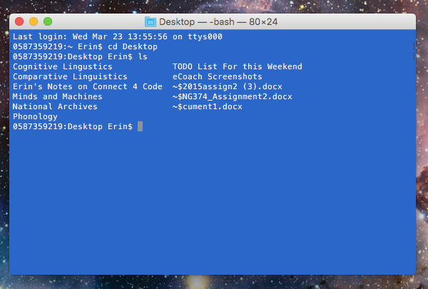
Using Terminal

Slide 13
Useful Commands To Know
cd [path] | change directory to [path/place]
ls | list files/folders in directory | ls -la (detailed list)
pwd | print working directory
q | quit
mkdir [folder name or path] | make directory
Ctrl-A | Cursor to front of command
Ctrl-E | Cursor to end of command
Ctrl-L | Clear screen
Ctrl-R | Reverse command search | Find that one long command you typed a few minutes ago
⛄️

Slide 14
Getting Started
git clone
git status
git push
git pull
git commit
edit files
git add
Notes:
Git status = very important! You’ll type this the most → gives you information about your local repo compared to master copy
Also type this before every git add or git pull!!

Slide 15
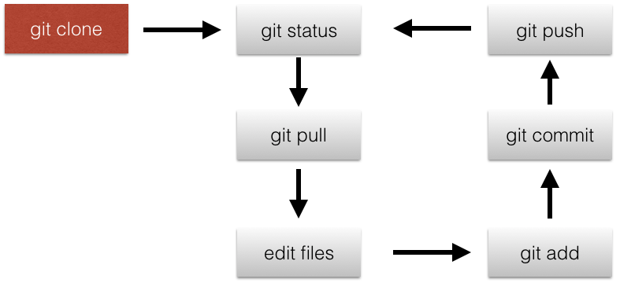
git clone
This command makes a copy of a Git repository on your computer, in the directory that you run the command from
Example
> git clone https://github.com/yourName/hello.git
If you ran this command from your Desktop, you would have a copy of the https://github.com/yourName/hello repository called hello on your Desktop
Your hello repo on your Desktop is not the same copy as the repo you cloned from GitHub
However, the other Git commands allow you to sync changes between the GitHub repository and your own

Slide 16
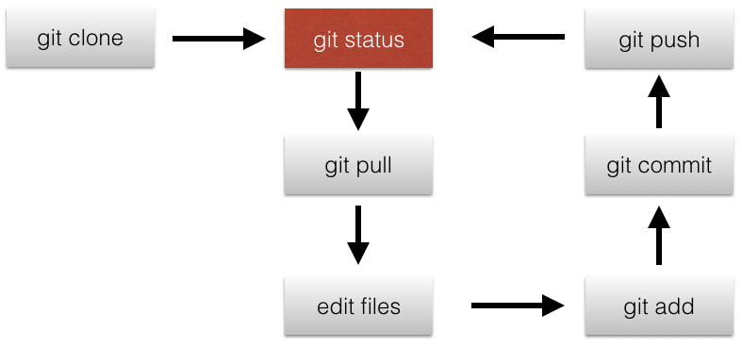
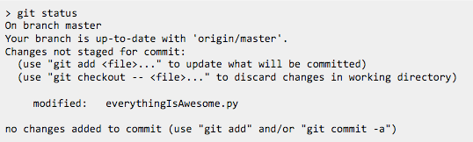
git status
This command will output some information on the “status” of the repository you’re working in

Slide 17
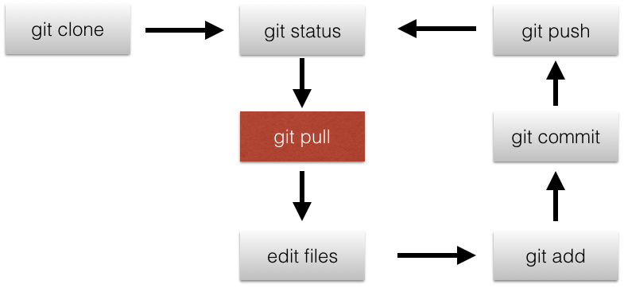
git pull
This command “pulls” any changes from the centralized repository you cloned to your computer
If someone else changed the repository that you cloned from, you need to be able to get the latest version of that repository
git pull will make your local copy of the code up to date with whatever changes are in the repository you cloned from

Slide 18
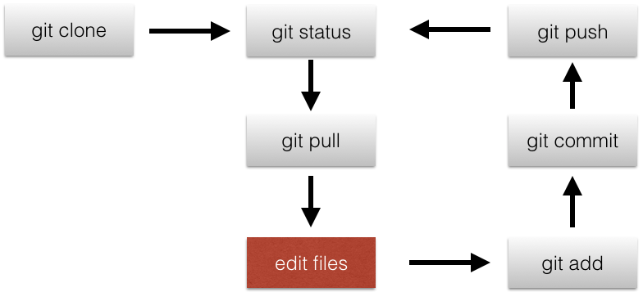
edit files
Just like you would in whichever IDE that you are using!

Slide 19
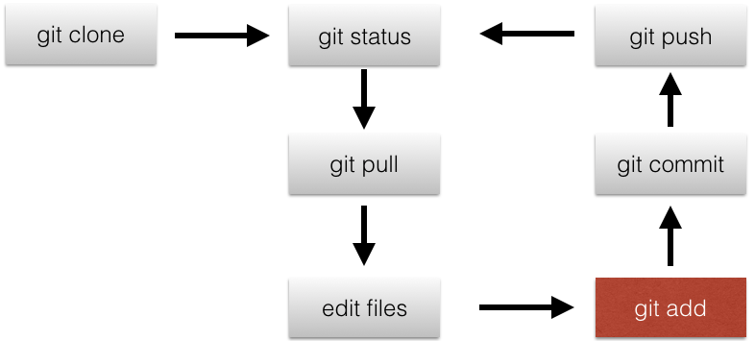
git add
Going back to the idea of version control: you take “snapshots” of your code at different points in its lifetime
git add is the first step to taking those “snapshots”
It makes Git aware that you changed some files
Say you edited myFirstGitProgram.cpp in your hello repository. You want to include your changes to myFirstGitProgram.cpp in your next “snapshot” of your code:

Slide 20
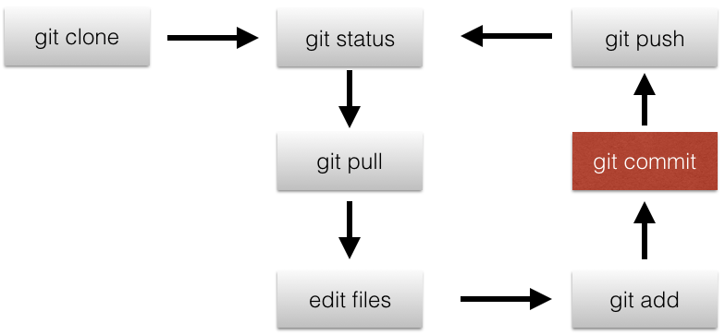
git commit
This command “takes a snapshot” of your local repository, by saving the state of whatever files you added
git commit allows you to make versions of your code
You can only commit files that you have first added using git add
When you commit your code, you must always include a commit message that explains briefly what updates you have made to the code

Slide 21
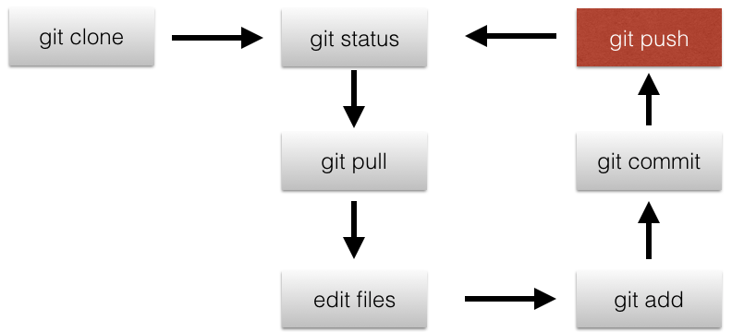
git push
This command sends your local version of a repository back to the centralized repository that you cloned from
Say you cloned from a repo on GitHub and committed some changes
git push sends the changes you committed back to the centralized repository hosted on GitHub

Slide 22
Potential Problems in git

Slide 23

Merge Conflicts
Let’s say you and your teammate both edited line 1 of myFirstGitProgram.cpp. Your teammate pushed her changes to the centralized repository first, and then you committed your changes and pulled from your centralized repository
Now Git is confused because there are two versions of the same code, and Git doesn’t know which one is right

Slide 24
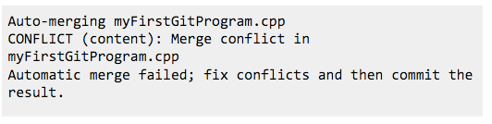
Merge Conflicts
That is called a merge conflict
When it happens you will see something like this in the terminal:

Slide 25

Merge Conflicts
Your myFirstGitProgram.cpp file will look like something like this
Don’t be scared by these symbols! Git just puts them there to differentiate between the two versions of the code it’s looking at
The top part above ===== is your version of the code, the bottom part is the version that you pulled (your teammate’s version)

Slide 26

Merge Conflicts
To fix a merge conflict, delete all the symbols Git added along with the version of the code you don’t want to keep
In this example, everything highlighted in yellow will be deleted

Slide 27
Merge Conflicts
git add the file after you delete the symbols, and git commit to “resolve” the merge conflict
That’s all you need to do to fix a merge conflict !!!

Slide 28
fatal: not a Git Repository
If you ever get this error when running a Git command, you’re likely in the wrong directory
Type pwd to print the directory that you’re currently in
Navigate to where you should be (your directory that has your Git repo)

Slide 29
Lab
Two parts for the lab today.
No exam practice
Practice learning Git
Complete “Learn Git in 15 minutes” tutorial
Submit Google form answering questions on Git
Also opportunity to ask questions about your team GitHub repository!

