Slide 1
Lab 9
Python Intro
What stays the same and what changes
More advanced Python

Slide 2
Python Intro
Main Differences:
True and False are capitals
Python floors (always down) with int division (matters with negatives): -3 / 2 = -2
No variable declarations (automatically interprets based on what you assign it to)
my_string = “hello”
Python has no ++ operator
Review lecture slides for more details
Use str[-1] to access last element in string
Notes:
C++ truncates
-3/2 would be -1
Fairly straightforward from lecture slides
Same goes for str[-2] is second to last element in string

Slide 3
New things in Python
raw_input() is how you extract from the input stream
Raise to a power using **
Concatenation using +
Multiplication using *
Works on strings (see lecture slides!)
print is like cout but no ‘<<‘ needed
No ‘endl’ needed to print a new line
Add a comma to force output on the same line
This comma adds a space between the two outputs

Slide 4
Python: common syntax
No semicolons!
No curly braces!
No parentheses for loops and conditionals!
Colons are used in python
Everything is decided by indentation
determines scope as well
if x == 35:
return True
for index in my_str:
#do something iterating through my_str
Notes:
Assume my_str was created already
You can’t modify index or my_str using the loop

Slide 5
if, elif, else
Very similar, all logic is the same
! → not
&& → and
|| → or
name = “Castiel”
if name == “Dean” or name == “Sam”:
print “hunter”
elif name == “Castiel”:
print “angel”
else:
print “demon”

Slide 6
raw_input()
Used for reading in from the user
Reads until it hits an <enter> (like getline)
Ignores leading and trailing white space
Can directly store into a variable (remember: no type declaration!)
print 'Please enter your name: ' # prompt
your_name = raw_input()
~or~
your_name = raw_input('Please enter your name: ')

Slide 7
Printing out variables
name = 'Fred'
print 'Hi there %s!' %name
%s is for string
%d is for int (double will get truncated)
%f is for floats (if you want to save the decimals)
Notes:
Output would be
I think your name is Fred, but I’m not sure

Slide 8
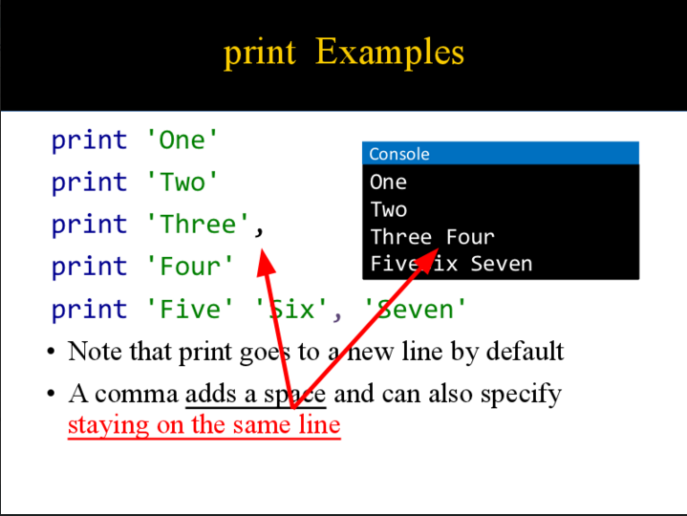

Slide 9
Loops
while condition:
#do something
for <variable> in <container>:
#do something
variable can be anything (make a new one)
Takes on the value of, or refers to, each successive member in the container
Container is any type that holds other values
You can’t modify the elements of the container
for index in my_str: #loops through each char in my_str
Notes:
So you cant modify variable or container

Slide 10
Looping through a container
name_list = ['Erin', 'Leah', 'Austin', 'Maxim']
for name in name_list:
name = 'bestTA'
What will name_list look like after this code runs?

Slide 11
Looping through a container
name_list = ['Erin', 'Leah', 'Austin', 'Maxim']
for name in name_list:
name = 'bestTA'
What will name_list look like after this code runs?
['Erin', 'Leah', 'Austin', 'Maxim']

Slide 12
range()
This function creates a list of values in the requested range (creates indices for your use)
range(n) creates a list of values from 0 to n-1
It can also accept up to 3 parameters
1 param represents (stop)
2 params = (start, stop)
range(start, stop, step)
start: Starting number of the sequence.
stop: Generate numbers up to, but not including this number.
step: Difference between each number in the sequence.
http://pythoncentral.io/pythons-range-function-explained/
Notes:
Go to the link!

Slide 13
len()
This function returns the number of elements in a list
Use range() and len() to loop over a list when you want to change values in the container
my_list = ['hello', 'world' , 'it', 'is', 'me']
for k in range(len(my_list)):
my_list[k] = 'x'
print my_list[k]
#will make every word in the list an 'x'
Notes:
----- Meeting Notes (11/10/15 13:02) -----
do again next week - havent learned it

Slide 14
User-defined functions
def add(a, b):
sum = a + b
return sum
def main():
x = 3
y = 5
sum = add(x, y) ← function call
print sum
No return type necessary!
Notes:
What would the output be?
8

Slide 15
User-defined functions
def add(a, b):
sum = a + b
return sum
def main():
x = 3
y = 5
sum = add(x, y) ← function call
print sum
No return type necessary!
Output:
8
Notes:
What would the output be?
8

Slide 16
Python: passed by object reference
In python, variables are neither passed by value nor passed by reference
Variables are just names that refer to objects
Anytime a variable is set to an object, it is said to refer to that object (in memory)
Look at lecture slides for more details!
http://robertheaton.com/2014/02/09/pythons-pass-by-object-reference-as-explained-by-philip-k-dick/

Slide 17
Lists
You can think of a list as an array that can also:
Have different data types in one list
Add elements to it, increasing length
Start out with any number of elements (no need to declare or decide on a size)
You can access elements with brackets [] just like with an array
Notes:
Still 0 indexed
Might need to skip for Tuesday Discussion – discussions after Wednesday they will have covered

Slide 18
Lists: which are valid?
my_list = []
my_list = [73, 1, 33]
my_list = [“name”, ‘hi’, 3, 4.0]

Slide 19
Lists: which are valid?
my_list = [] #empty list
my_list = [73, 1, 33]
my_list = ['name', "hi", 3, 4.0]
ALL ARE VALID!
Notice use of "" and '', and different types in the same list
Notes:
String can be specified with ‘ or “”

Slide 20
Slicing
A slice is a way to specify a portion of a container (list, tuple, string)
Format:
object[start:end]
Other format options:
object[1:] #means from index 1 to the end
object[:5] #means from first index up to (but not including), index 5 (or through index 4)
Negative index = relative to the back end
object[-3:-1] #means third to last index up to but not including last index
Notes:
These features of slicing important for the exam

Slide 21
Slicing question
text = 'review discussion!'
print text[-4:]
What does this print?

Slide 22
Slicing question
text = ‘review discussion!’
print text[-4:]
What does this print?
ion!

Slide 23
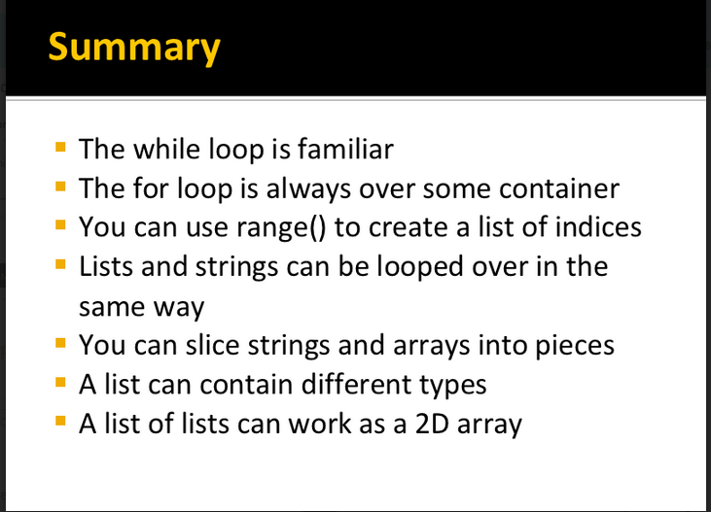

Slide 24
Answer to a good question
In Python if you type:
print "Leah" print "me”
All on one line what prints?
This is a compile error.
Notes:
Separate lines of code must be on their own line
How do you print a line of python without spaces

Slide 25
Answer to a good question (2)
If you pass in variables to a function in Python but they aren't the types the function is expecting, for instance:
def sum(x,y):
sum = x + y
return sum
And you pass it 3 and "yes"
What will happen?
You will get runtime type error which fires inside sum when it tries to apply the + operator to objects that are not the same type.
TypeError: cannot concatenate 'str' and 'int' objects
Notes:
Programmer’s responsibility to fit RME and understand the parameters of the function
Doesn’t help you quite as much as c++ and visual studio and xcode do

Slide 26
Answer to a good question (3)
Using range and len together allows you to modify the container
range() gives you indices to use to loop over a container
len() gives you the number of elements in the container
But this isn’t true with a string: strings are immutable (cannot be changed)
To modify a string you need to make a new string variable and append what you want from the original string to it

Slide 27
Notes on a good question (4)
You cannot modify the container at all in a normal for var in container loop
You CAN modify the variable
But modifying the variable that is holding each value of the container WILL NOT modify the container

Slide 28
Review Lecture Slides for Python!
For python:
you should become familiar with the new things you can do with it
If you are working on CreativeAI you will be writing python code
Otherwise, it’s great to be familiar with another coding language
Feel free to ask any questions
It can be confusing at first, but it comes very easily as you keep working with it

Slide 29
Python practice question
define a main function
Read into a variable pswrd from the user, printing the prompt: “password please: “
Concatenate a ‘2’ and an ‘&’ to the end of pswrd
Print out each letter of the password, separated by a space using a loop
Create a variable hide_pswrd
Set each letter in the pswrd to x for hide_pswrd and print this new hidden pswrd

Slide 30
Python practice question solution
def main():
pswrd = raw_input(“password please: “)
pswrd += “2&” for k in pswrd: print k, hide_pswrd = “”
for j in pswrd: hide_pswrd += 'x' print hide_pswrd
Notes:
Since we are iterating over the container, the elements of the container can’t be changed, so you can’t do pswrd[l] = ‘x’
So we create a new variable that will be manipulated by iterating through pswrd

