Slide 1

RV32I R-Type Design
대한상공회의소 AI 시스템반도체 설계 2기
최현우

Slide 2
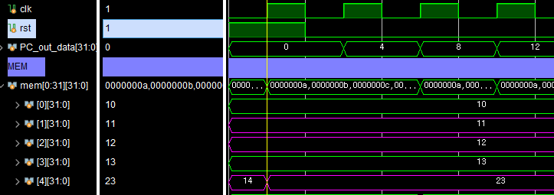
Add x4, x2, x1
X2 = 12
X1 = 11
X4 = 23

Slide 3
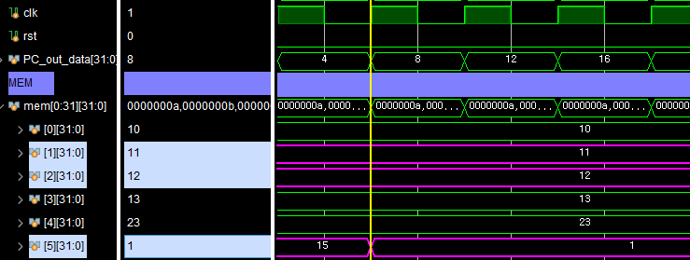
sub x5, x2, x1
X2 = 12
X1 = 11
X5 = 1

Slide 4
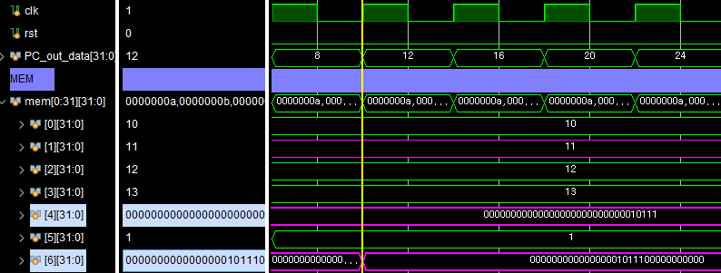
sll x6, x4, x1
X4 = 32’b0000_0000_0000_0000_0000_0000_0001_0111
X1 = 32’d11
X6 = 32’b0000_0000_0000_0000_1011_1000_0000_0000

Slide 5
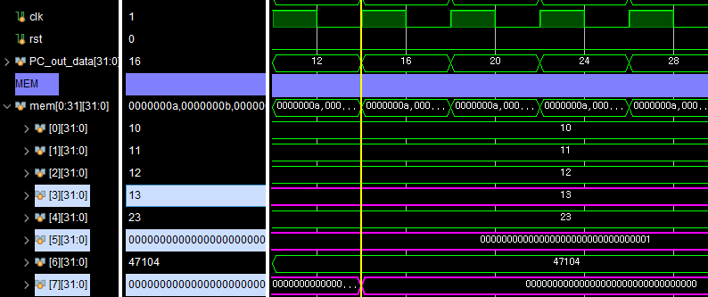
srl x7, x5, x3
X5 = 32’b0000_0000_0000_0000_0000_0000_0000_0001
X3 = 32’d13
X7 = 32’b0000_0000_0000_0000_0000_0000_0000_0000

Slide 6
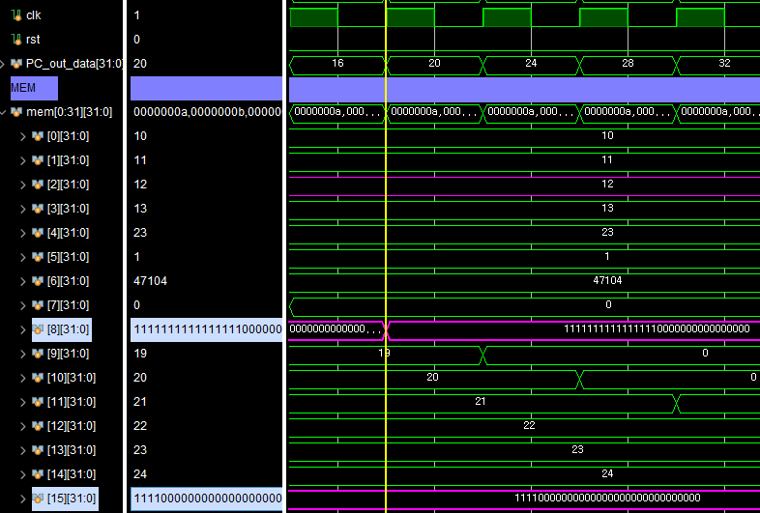
sra x8, x15, x2
X15 = 32’b1111_0000_0000_0000_0000_0000_0000_0000
X2 = 32’d12
X8 = 32’b1111_1111_1111_1111_0000_0000_0000_0000

Slide 7
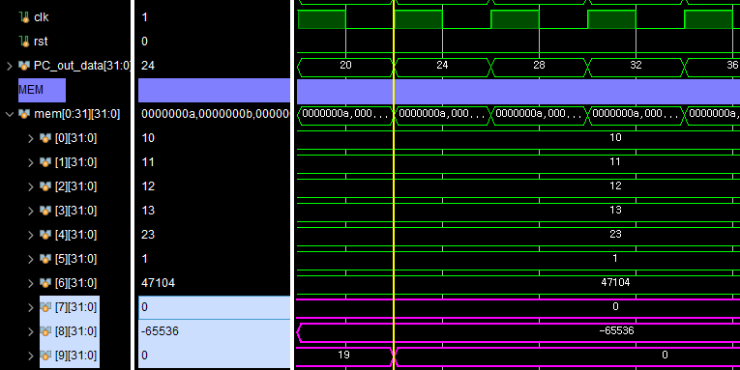
slt x9, x7, x8
X7 = 32’d0
X8 = -32’d65536
X9 = 32’d0

Slide 8
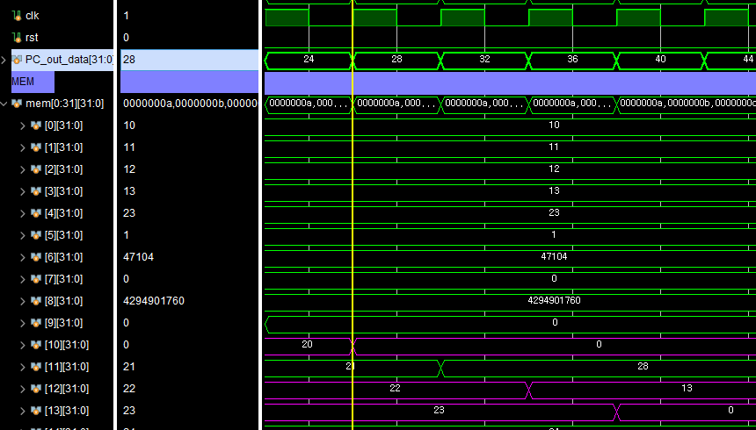
sltu x10, x13, x12
X13 = 32’d23
X12 = 32’d22
X10 = 32’d0

Slide 9
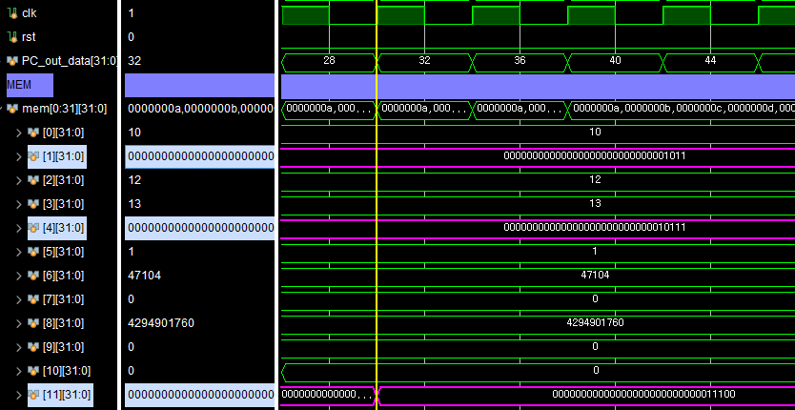
xor x11, x4, x1
X4 = 32’b0000_0000_0000_0000_0000_0000_0001_0111
X1 = 32’b0000_0000_0000_0000_0000_0000_0000_1011
X11 = 32’b0000_0000_0000_0000_0000_0000_0001_1100

Slide 10
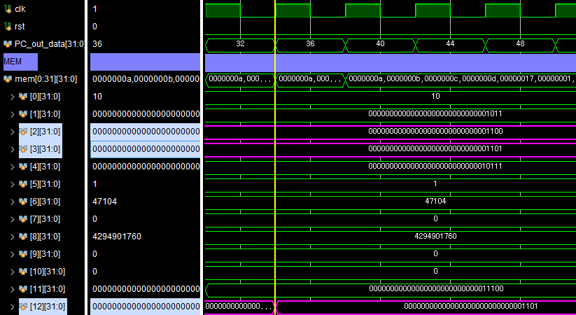
or x12, x2, x3
X2 = 32’b0000_0000_0000_0000_0000_0000_0000_1100
X3 = 32’b0000_0000_0000_0000_0000_0000_0000_1101
X12 = 32’b0000_0000_0000_0000_0000_0000_0000_1101

Slide 11
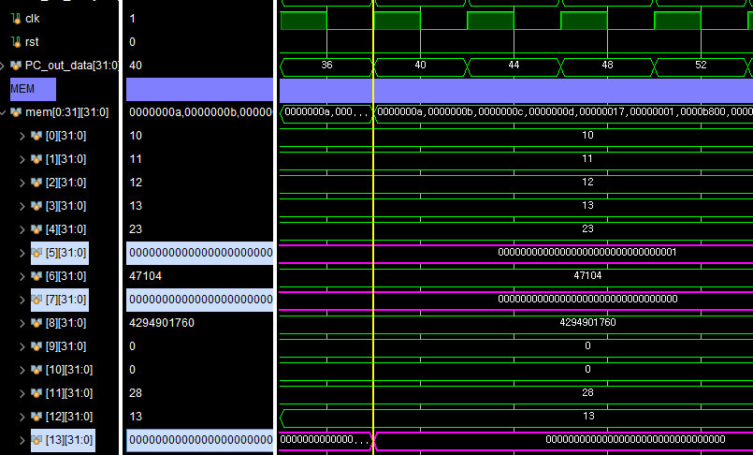
and x13, x5, x7
X5 = 32’b0000_0000_0000_0000_0000_0000_0000_0001
X7 = 32’b0000_0000_0000_0000_0000_0000_0000_0000
X13 = 32’b0000_0000_0000_0000_0000_0000_0000_0000

