Slide 1

RV32I I-Type Design
대한상공회의소 AI 시스템반도체 설계 2기
최현우

Slide 2
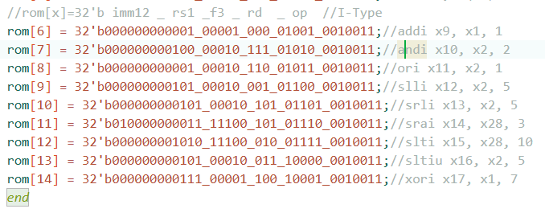
ROM 코드

Slide 3
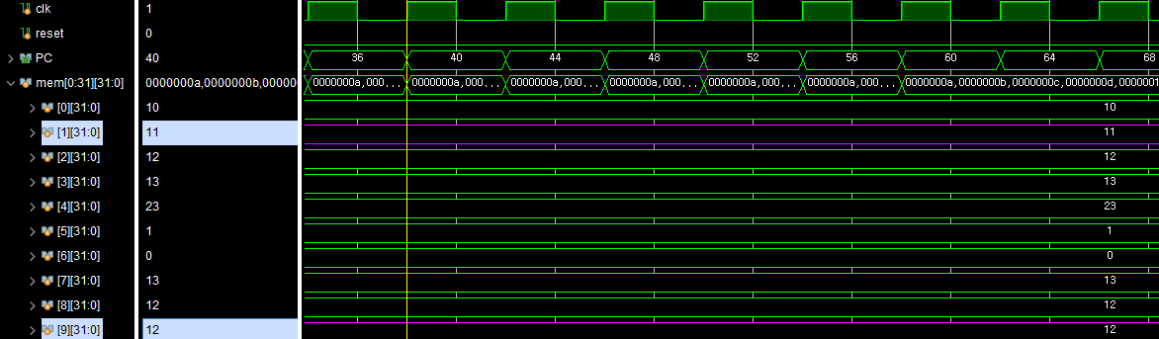
addi x9, x1, 1
X1 = 11
Imm = 1
X9 = 12

Slide 4
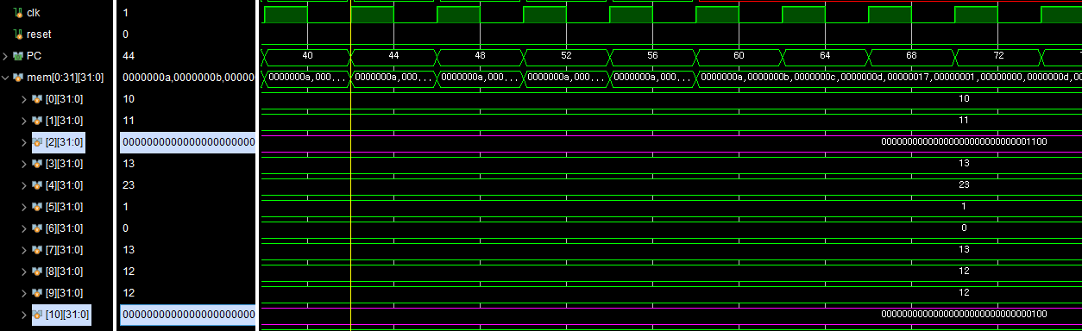
andi x10, x2, 2
X2 = 32’b00000000000000000000000000001100
imm = 32’b00000000000000000000000000000010
X10 = 32’b00000000000000000000000000000000

Slide 5
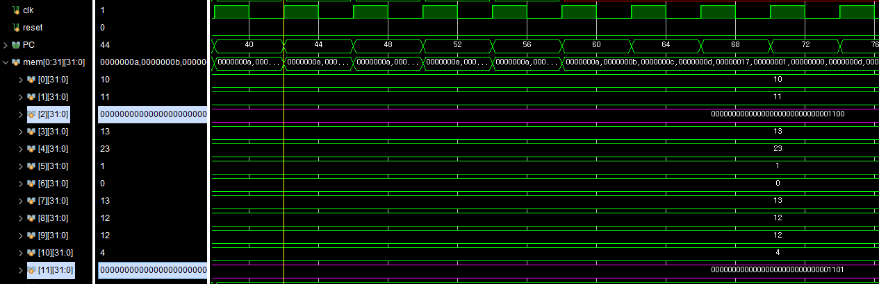
ori x11, x2, 1
X2 = 32’b00000000000000000000000000001100
imm = 32’d00000000000000000000000000000001
X11 = 32’b00000000000000000000000000001101

Slide 6
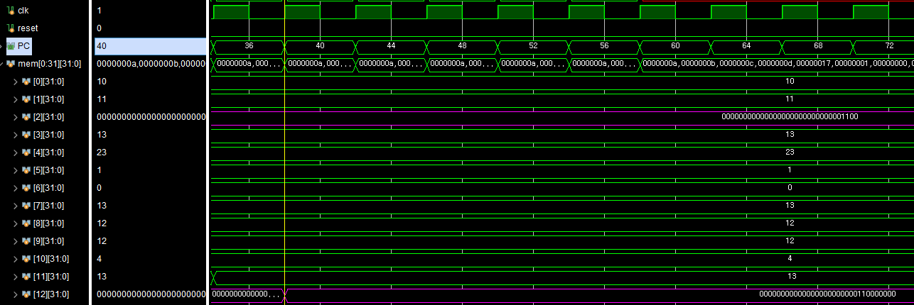
slli x12, x2, 5
X2 = 32’b00000000000000000000000000001100
imm = 5
X12 = 32’b00000000000000000000000110000000

Slide 7
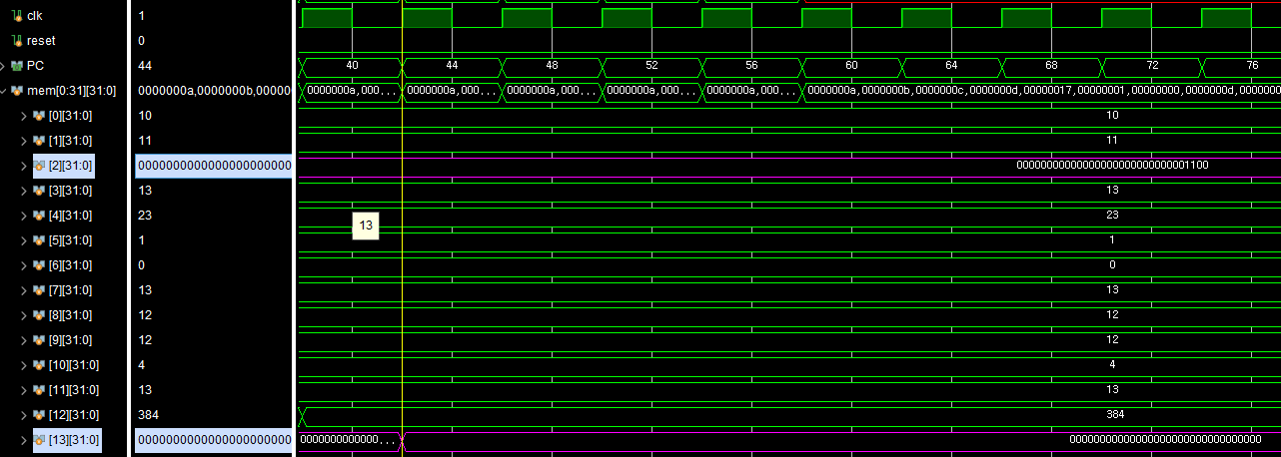
srli x13, x2, 5
X2 = 32’b00000000000000000000000000001100
imm = 5
X13 = 32’b00000000000000000000000000000000

Slide 8
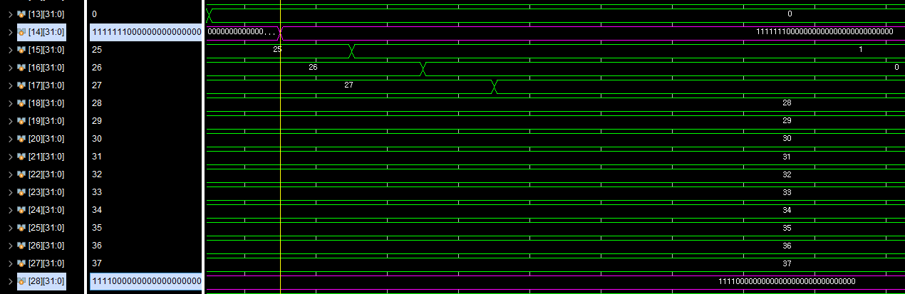
srai x14, x28, 3
X28 = 32’b11110000000000000000000000000000
imm = 3
X14 = 32’b11111110000000000000000000000000

Slide 9
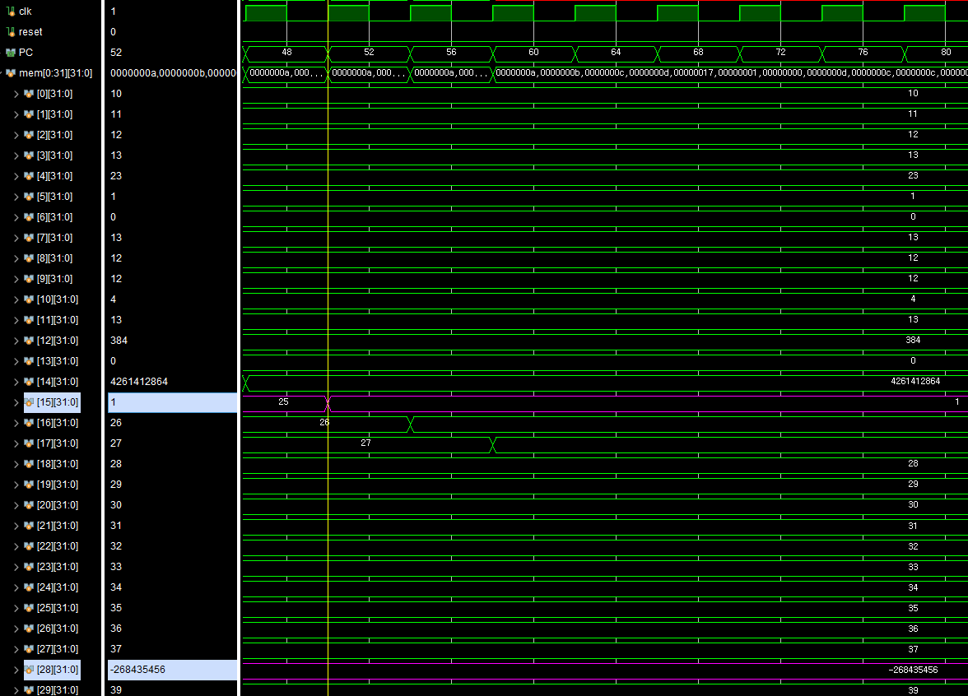
slti x15, x28, 10
X28 = -32’d-268435456
imm = 10
X15 = 32’d1

Slide 10
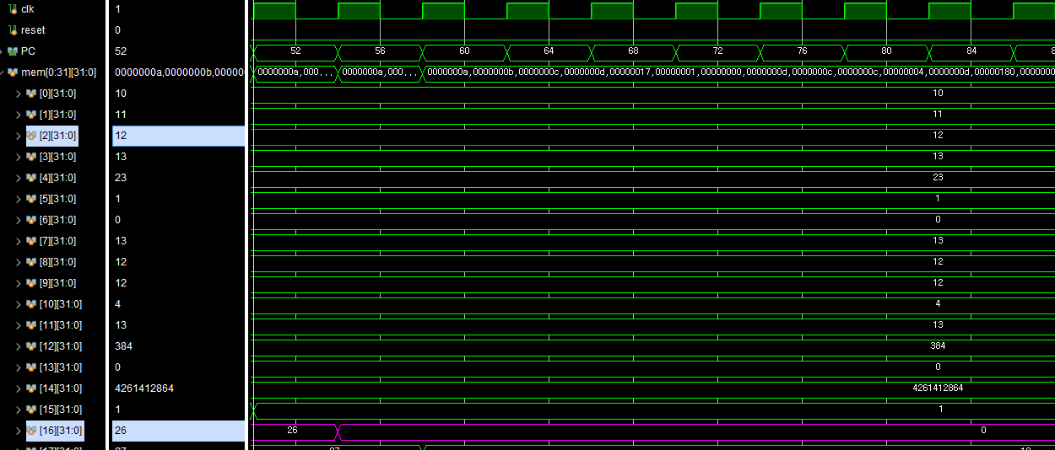
sltiu x16, x2, 5
X2 = 12
imm = 5
X16 = 0

Slide 11
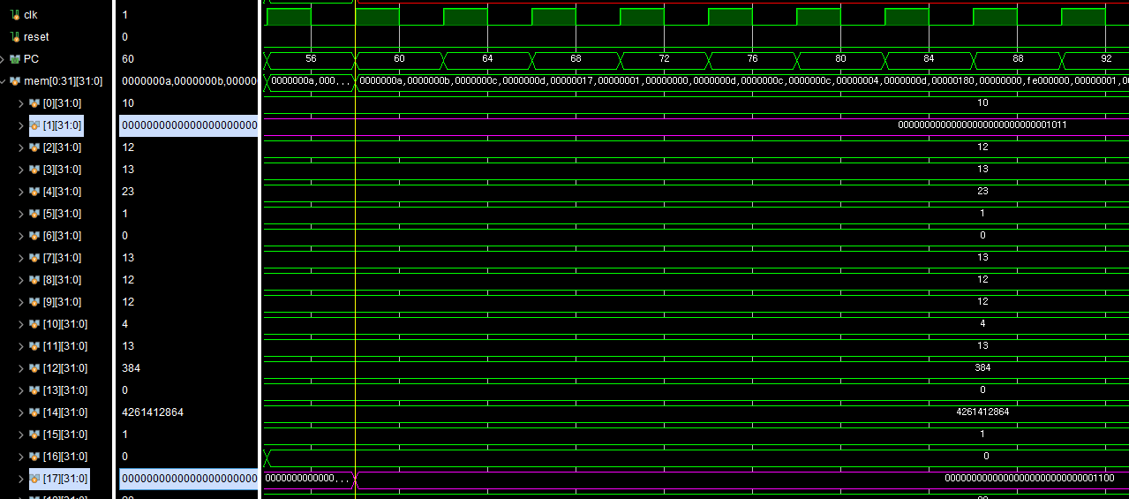
xori x17, x1, 7
X1 = 32’b00000000000000000000000000001011
imm = 32’b00000000000000000000000000000111
X17 = 32’b00000000000000000000000000001100

