Slide 1

RV32I (LU,AU,J,JL) Design
대한상공회의소 AI 시스템반도체 설계 2기
최현우

Slide 2
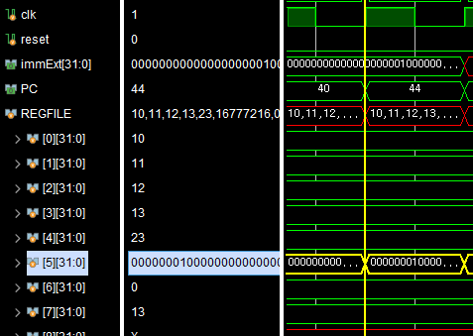
lui x5, 0x1000(x5 = 0x1000 <<12)
imm = 32’b0000_0000_0000_0000_0001_0000_0000_0000
X5 = 32’b0000_0001_0000_0000_0000_0000_0000_0000

Slide 3
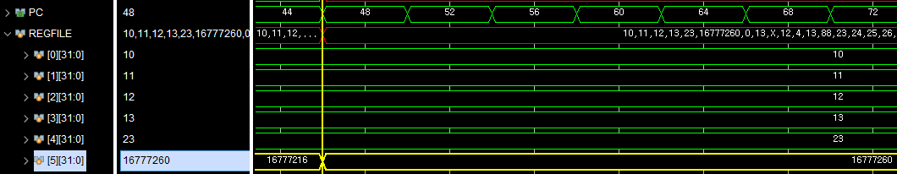
auipc x5, 0x1000(x5 = PC +(0x1000 << 12))
PC = 44
Imm<<12 = 16777216
X5 = 16777260

Slide 4
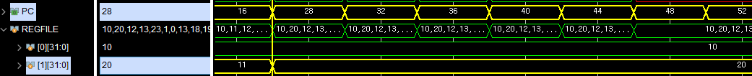
jal x1, rom[7]
Before: PC = 16
After PC = 28(==rom[7])
X1 = 20 (== Before PC + 4)

Slide 5
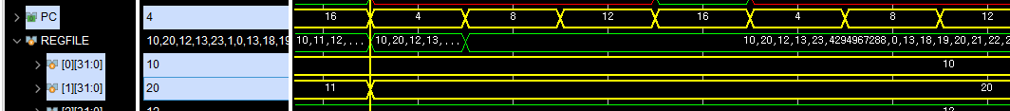
jalr x1, x0, 4
Before: PC = 16
After PC = 4 ( == x0(0) + 4 == rom[1])
X1 = 20 (== Before PC + 4)

