Slide 1

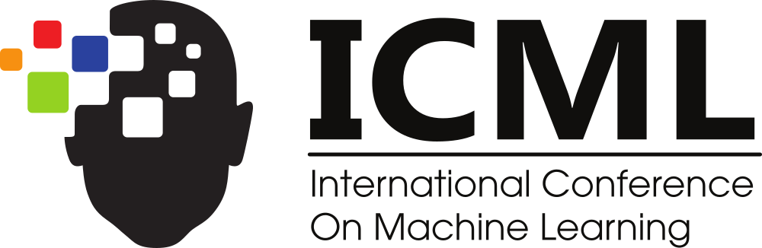

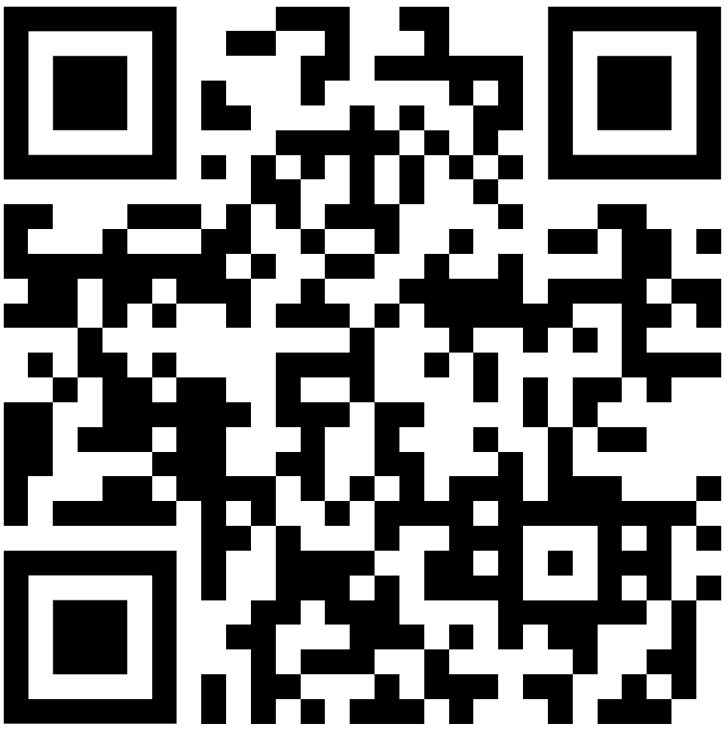
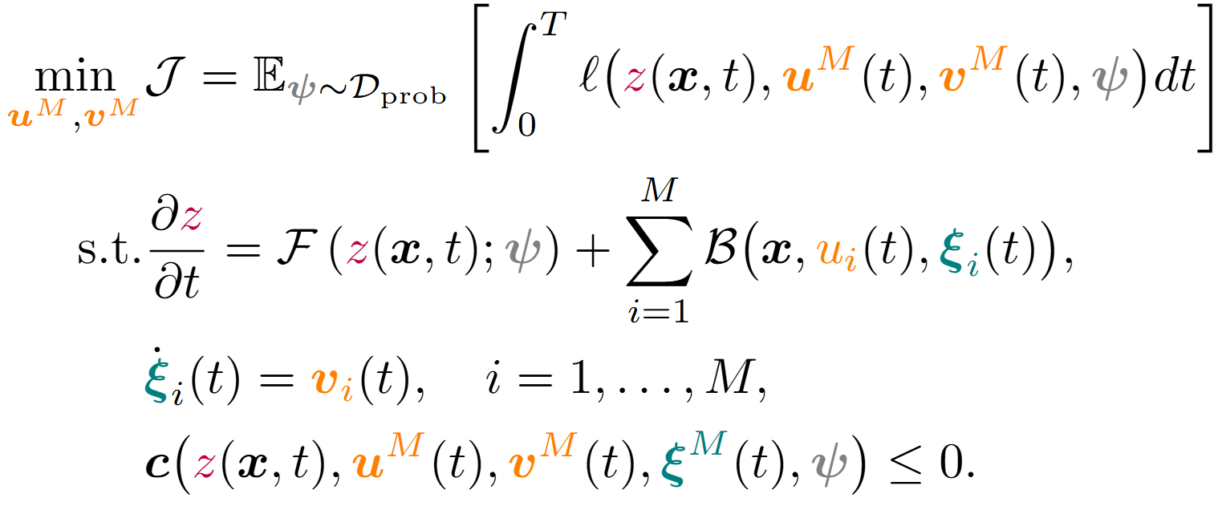
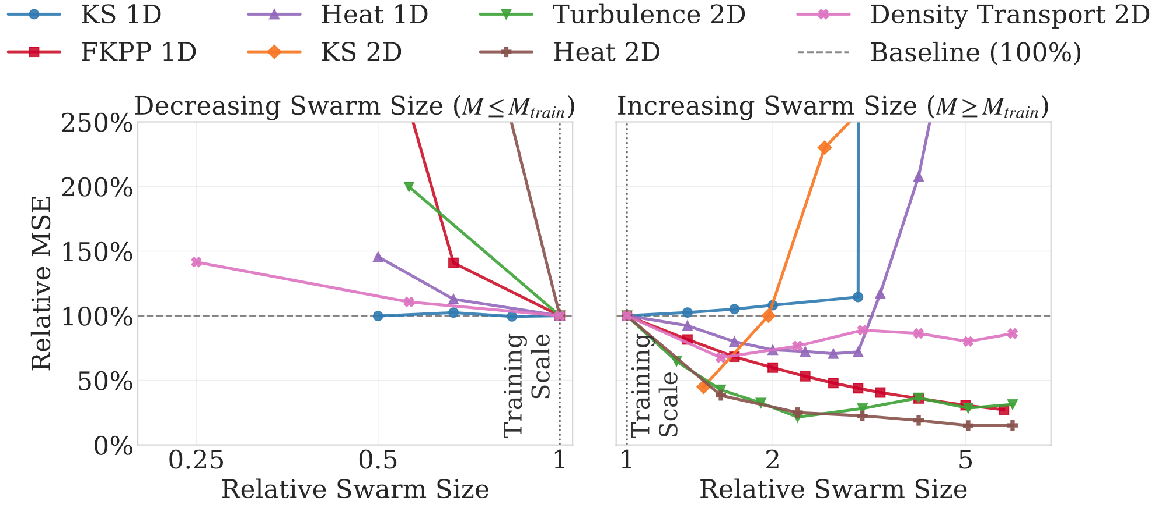
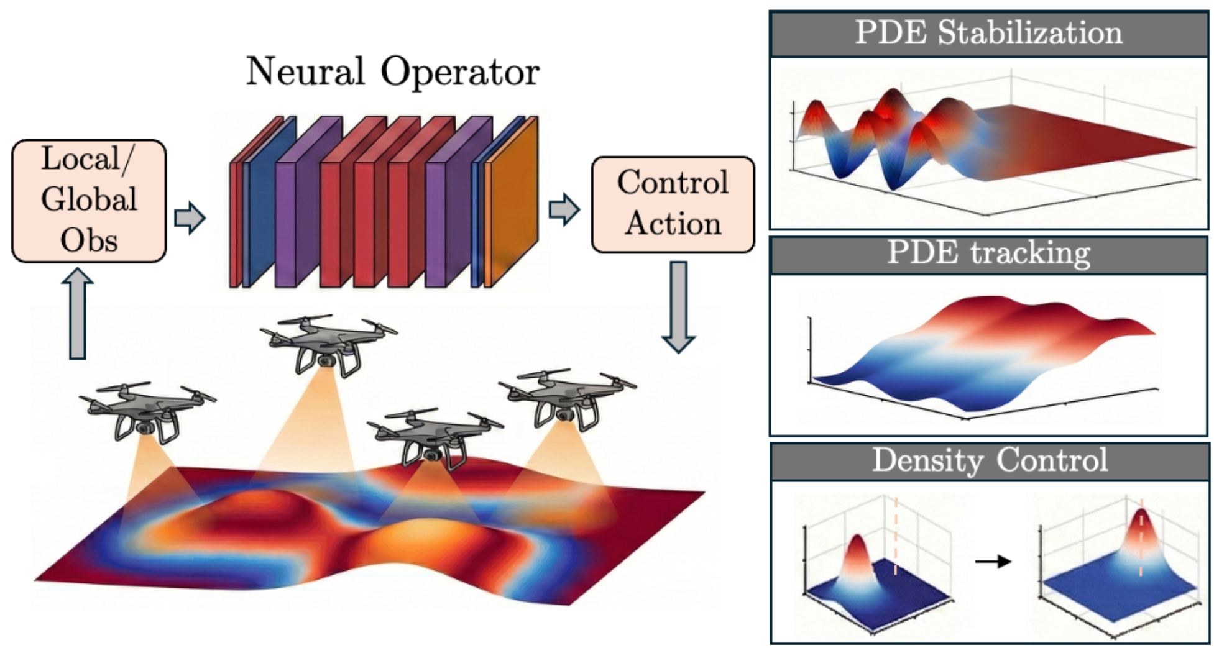
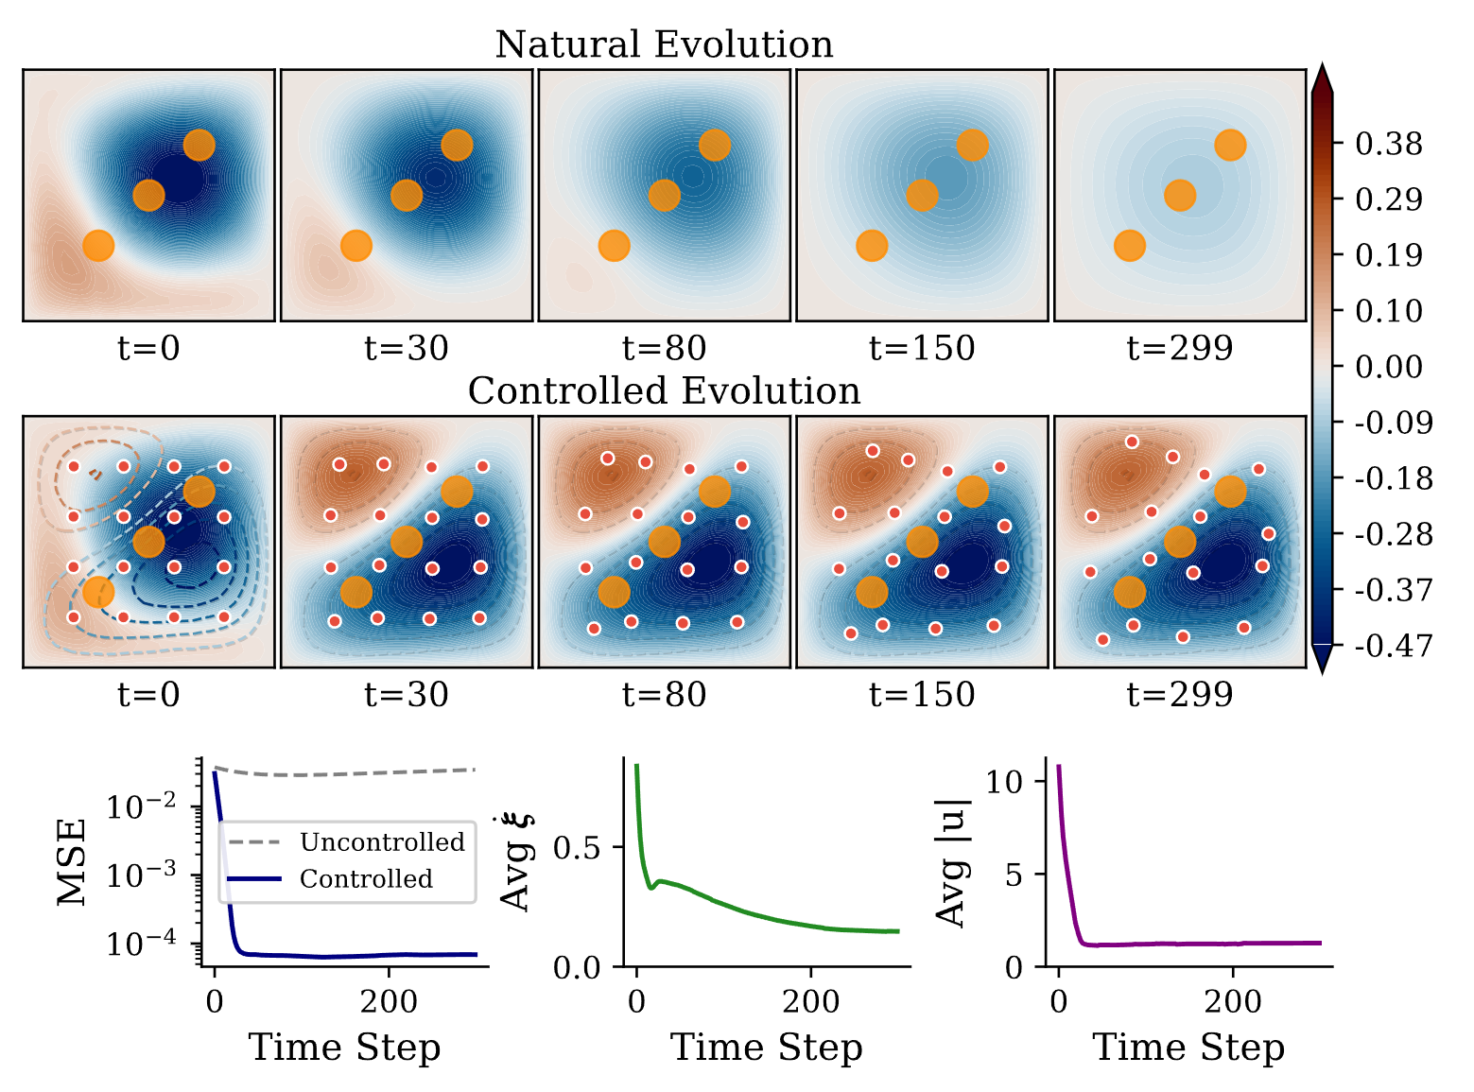
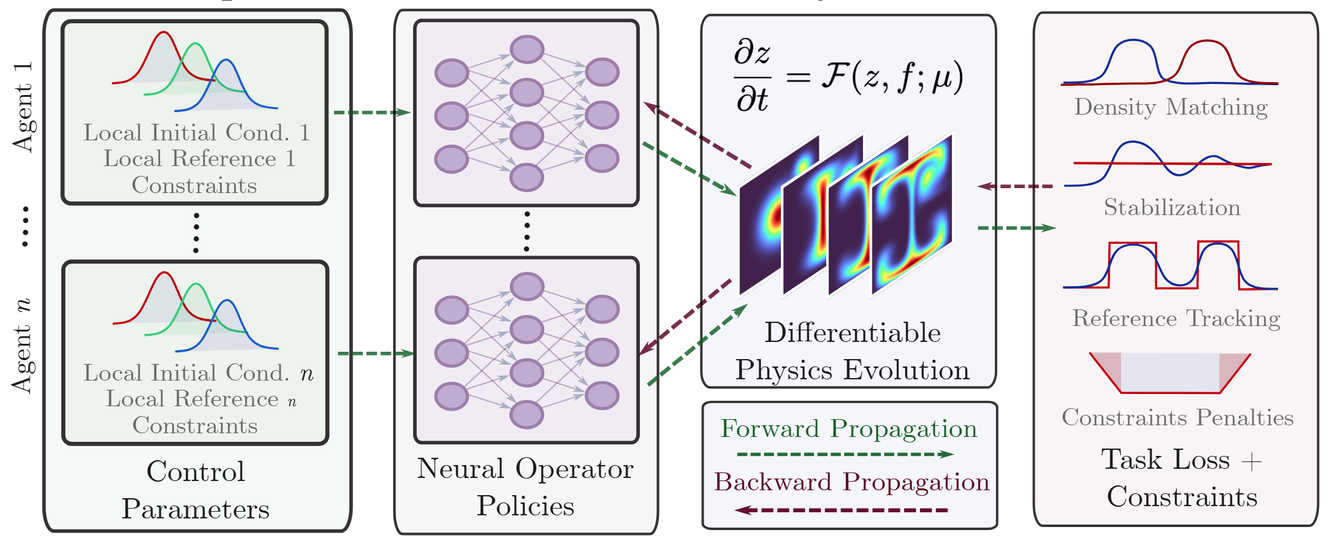
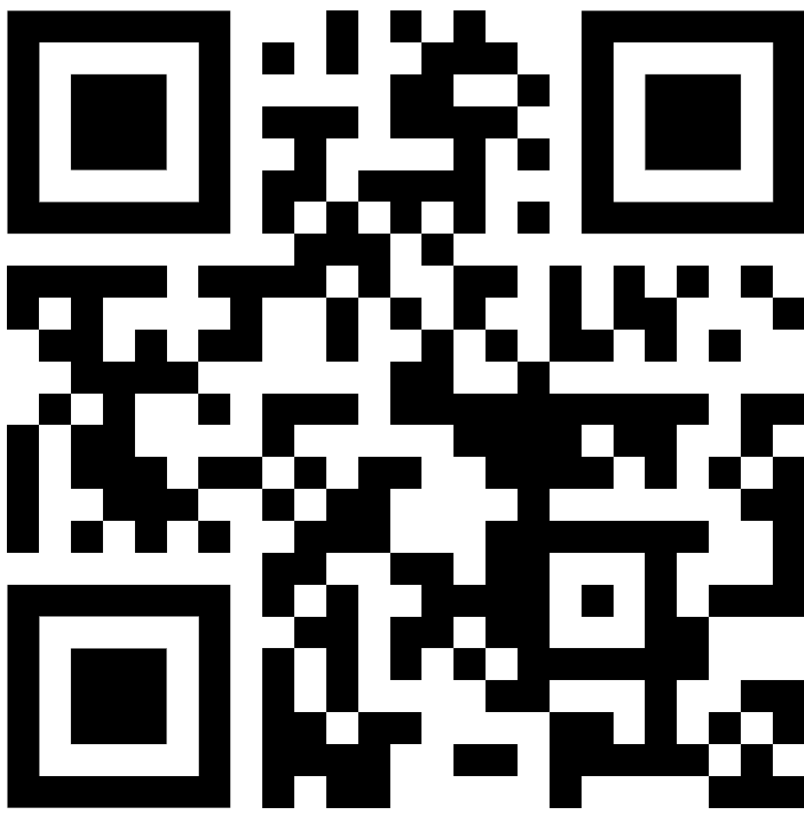
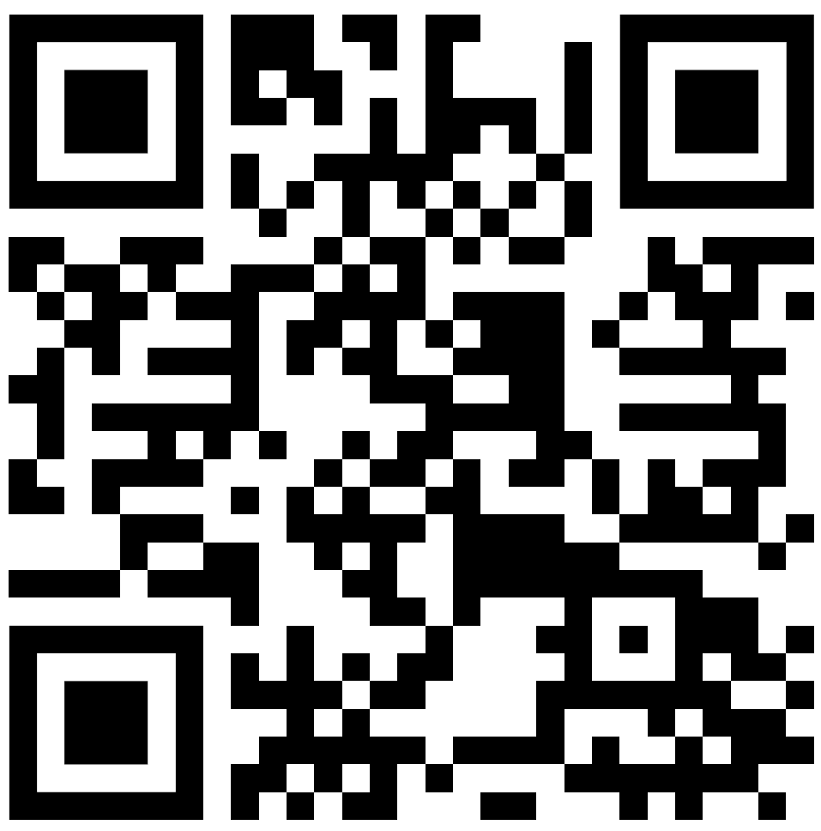
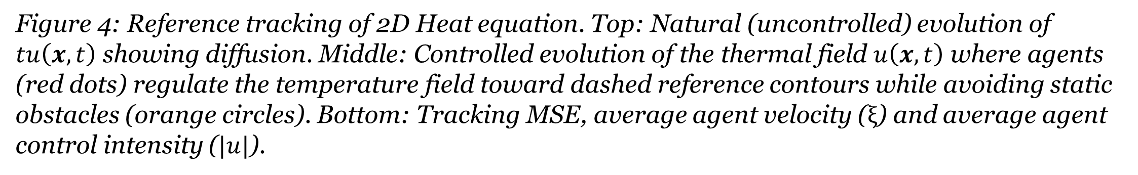

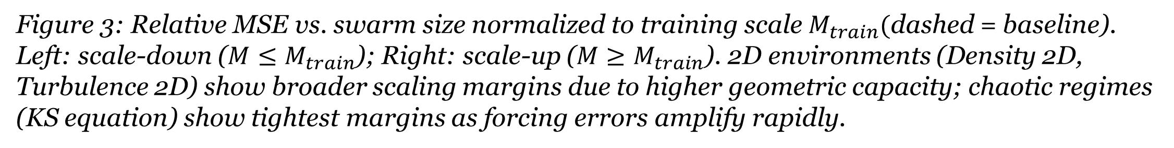
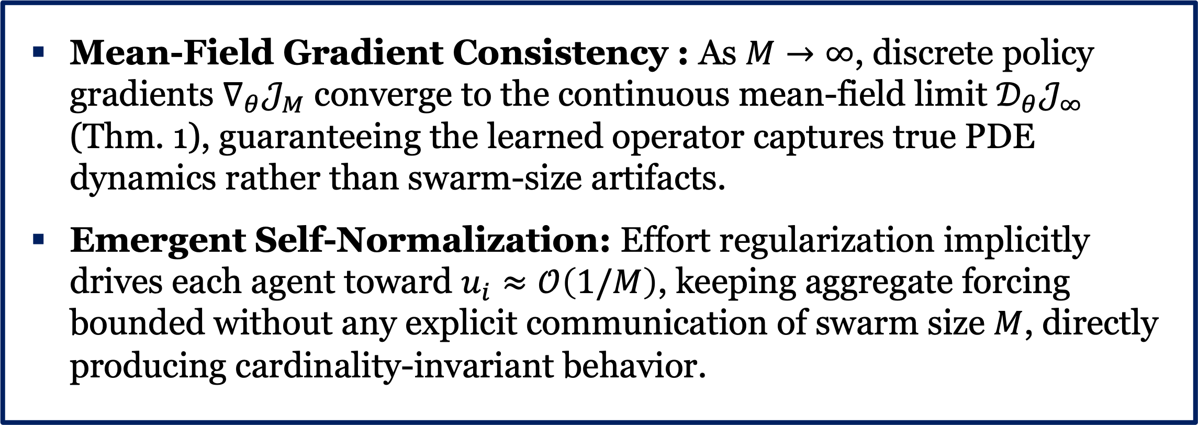
CINOC: Cardinality-Invariant Neural Operator Policies for Scalable PDE Control
Pietro Zanotta, Dibakar Roy Sarkar, Honghui Zheng, Somdatta Goswami, Ján Drgoňa
Civil and System Engineering, Johns Hopkins University
Introduction
Problem formulation and Methodology
Results
The Challenge: Controlling partial differential equations (PDEs) is critical, but existing learning-based multi-agent policies generally rely on fixed-dimensional representations.
Our Solution: We recast PDE policy synthesis as an operator learning problem, mapping state fields to continuous control functions.
The Result: End-to-end training via differentiable physics yields policies with cardinality invariance, allowing zero-shot transfer to significantly larger agent populations.
This formulation defines the objective for our framework:
Orange (Continuous Control Policy): the variables we are actively optimizing. The neural operator maps local observations to the control functions $u^{M}$and velocities $v^{M}$.
Purple (System Dynamics): represents the PDE state field ($z$).
Teal (Decentralized Actuation):. The spatial coordinates ($ξ$) define the position of each agent, whose effect on the field is given by $ℬ$.
Gray (Distributional Robustness): we evaluate the expected cost over a distribution of parameters ($ψ$, e.g. initial and reference shapes).
Figure 3: Relative MSE vs. swarm size normalized to training scale $M_{train}($dashed = baseline). Left: scale-down ($M≤M_{train}$); Right: scale-up ($M≥M_{train}​$). 2D environments (Density 2D, Turbulence 2D) show broader scaling margins due to higher geometric capacity; chaotic regimes (KS equation) show tightest margins as forcing errors amplify rapidly.
Figure 1: A shared neural operator maps PDE field observations to control actions for multiple agents, enabling zero-shot scalability across agent populations. Framework handles diverse tasks: (top right) chaos stabilization, (middle right) reference tracking, and (bottom right) density transport.
Contributions
Neural Operator Framework: Control policies parameterized as neural operators yield configuration-invariant behavior across variable sensing/actuation/population setups.
Differentiable-Physics Optimization: Policies trained end-to-end by differentiating through PDE solvers, providing scalable and efficient policy gradients.
Cardinality-Invariant Multi-Agent Control: An emergent self-normalization phenomenon enables consistent multi-agent behavior independent of agent count.
Mean-Field Grounding: Finite-population policy gradient learning is formally linked to a mean-field limit, theoretically establishing cardinality invariance.
Diverse PDE Benchmarks: Demonstrated across stabilization, tracking, and density transport on nonlinear, diffusion, and chaotic spatiotemporal dynamics.
Figure 2: Schematic of the multi-agent operator learning for PDE control. The PDE solver acts as a differentiable layer. The operator policy (shared among the agents) takes error observations and outputs control actions. Gradients propagate through the solver to update
Figure 4: Reference tracking of 2D Heat equation. Top: Natural (uncontrolled) evolution of $tu\left(x,t\right)$ showing diffusion. Middle: Controlled evolution of the thermal field $u\left(x,t\right)$ where agents (red dots) regulate the temperature field toward dashed reference contours while avoiding static obstacles (orange circles). Bottom: Tracking MSE, average agent velocity ($ξ$) and average agent control intensity ($|u|$).
Theoretical Analysis
Mean-Field Gradient Consistency : As $M→∞$, discrete policy gradients $∇_{θ}𝒥_{M}$ converge to the continuous mean-field limit $𝒟_{θ}𝒥_{∞}$ (Thm. 1), guaranteeing the learned operator captures true PDE dynamics rather than swarm-size artifacts.
Emergent Self-Normalization: Effort regularization implicitly drives each agent toward $u_{i}≈𝒪\left(1/M\right)$, keeping aggregate forcing bounded without any explicit communication of swarm size $M$, directly producing cardinality-invariant behavior.
Conclusion
CINOC reformulates PDE control as operator learning, achieving zero-shot cardinality invariance across agent populations. Emergent self-normalization, grounded by mean-field gradient consistency, enables bounded aggregate forcing without explicit swarm-size communication. Future work targets parametric operators conditioned on physical coefficients and scaling to high-dimensional industrial environments.
Read the paper
Supported by U.S. DOE Office of Science ASCR (SciDAC LEADS) and ROSEI at JHU. Computing: JHU ARCH & Rockfish cluster (NSF OAC1920103). DRS and SG supported by NSF Grant 2436738.
View the code

