Slide 1




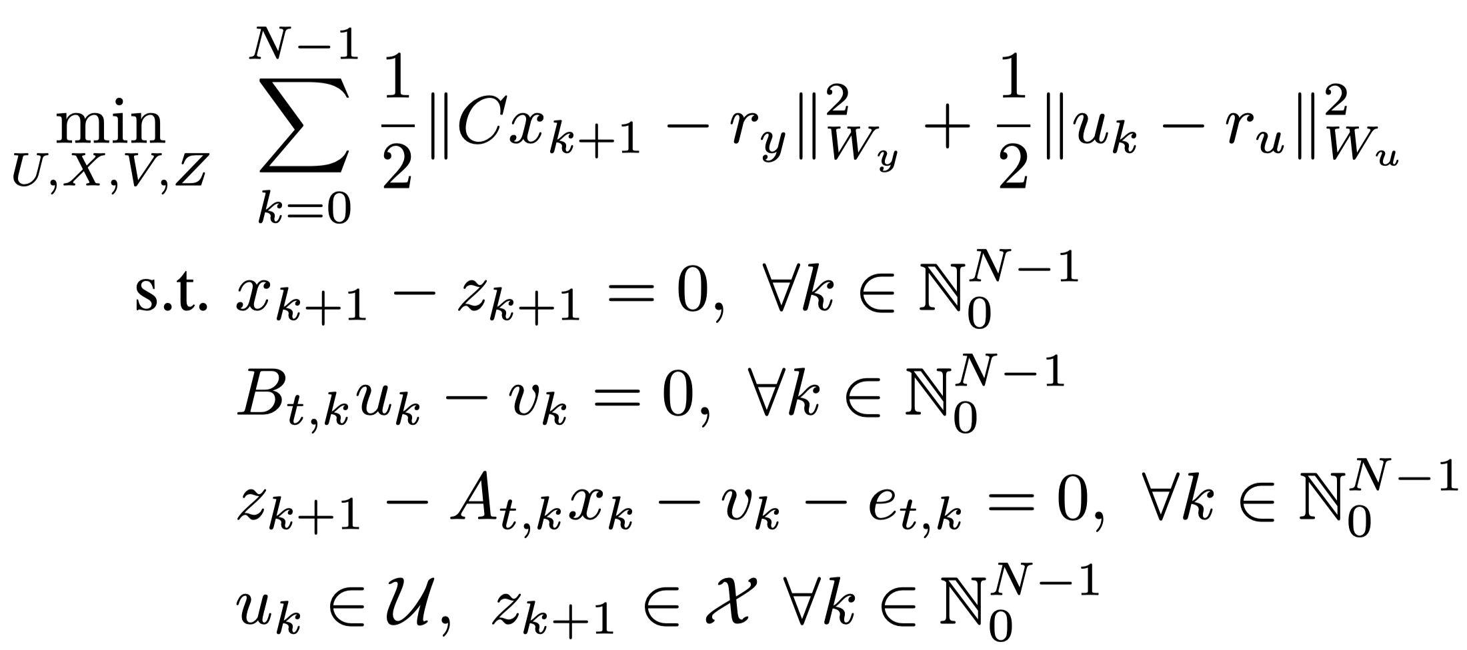
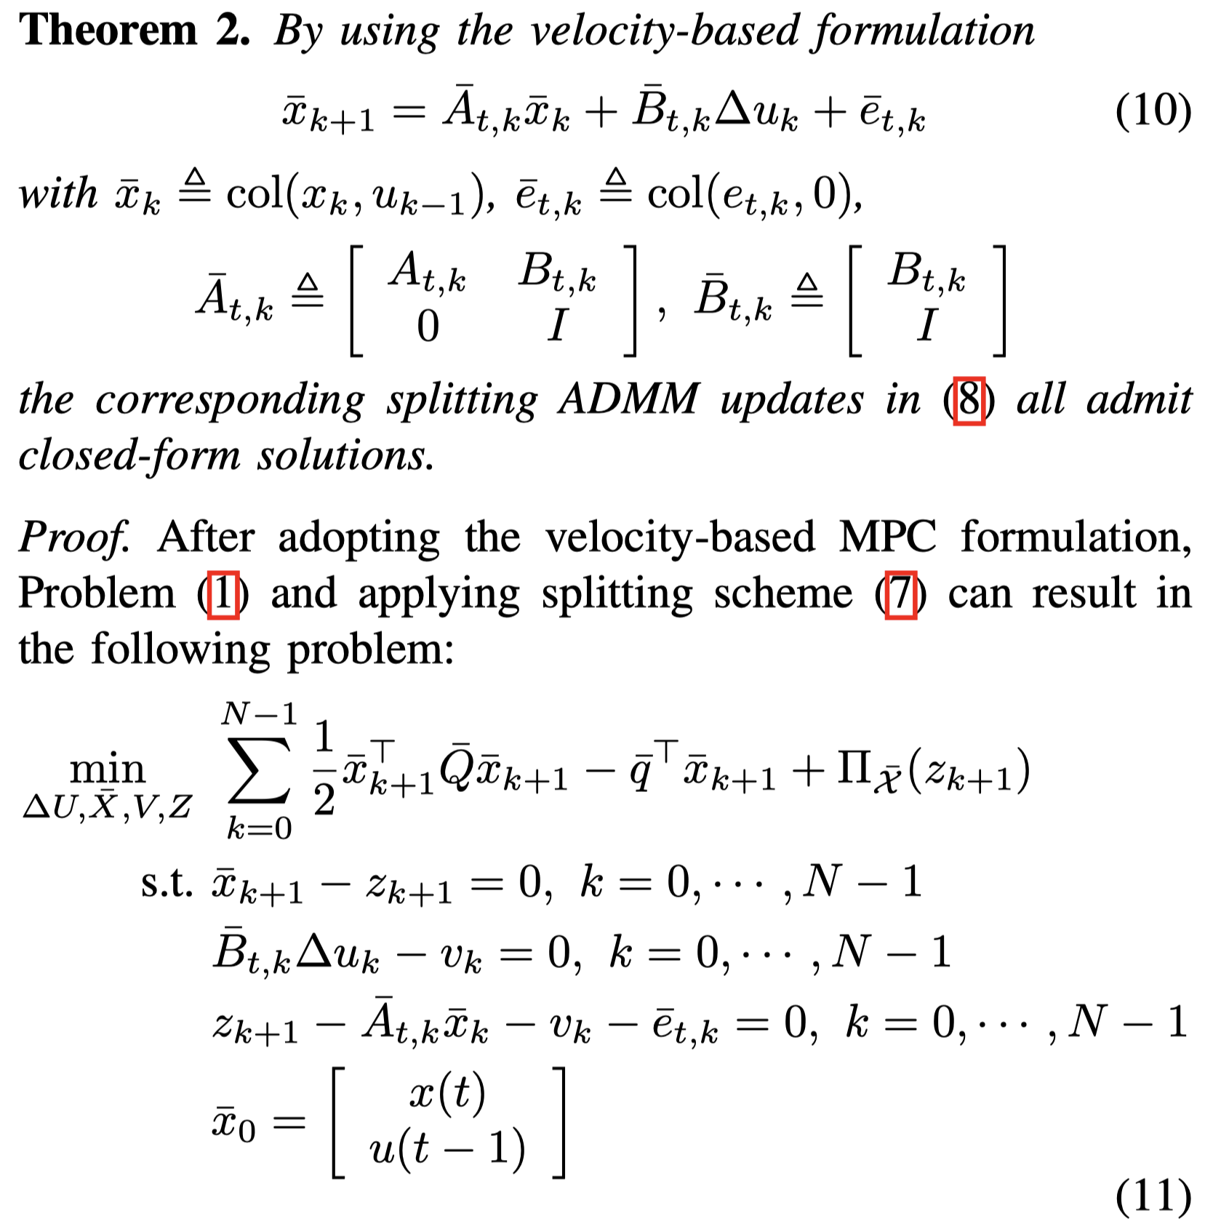
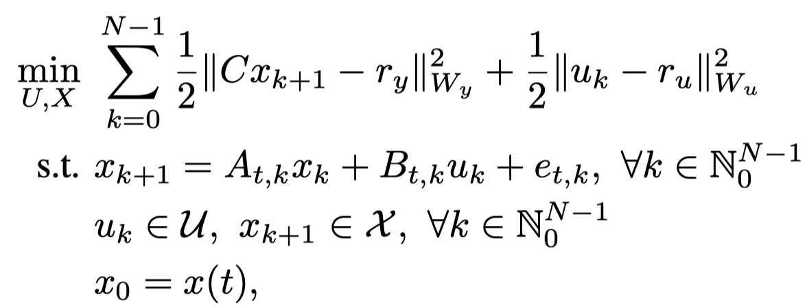

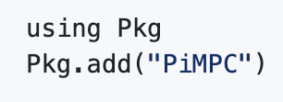
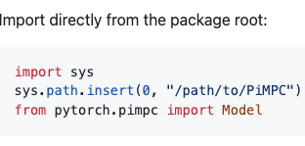

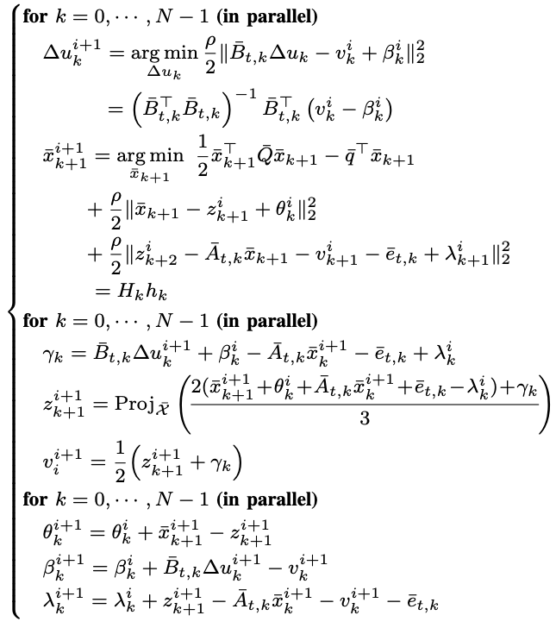
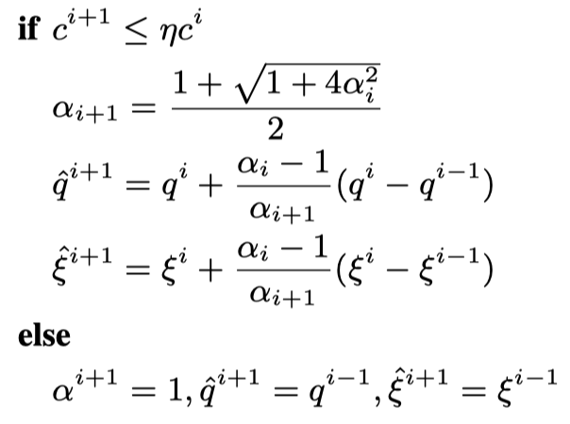
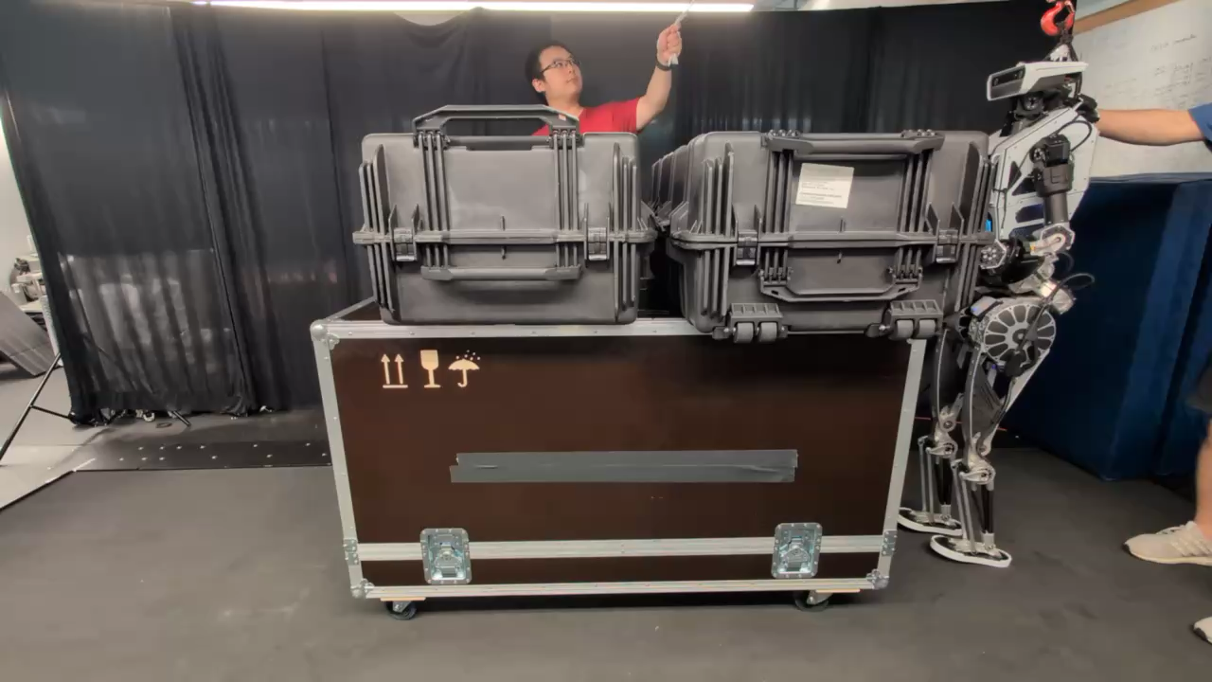
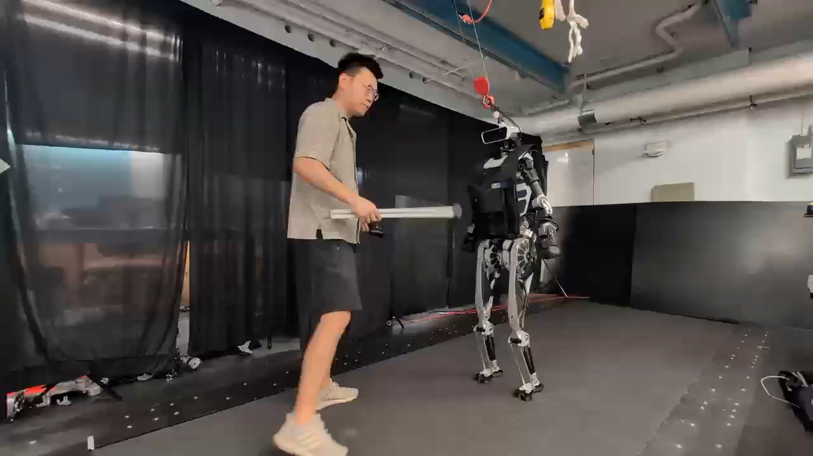
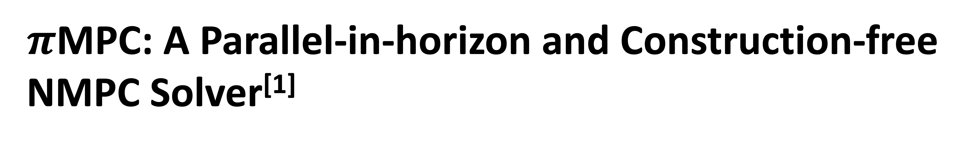
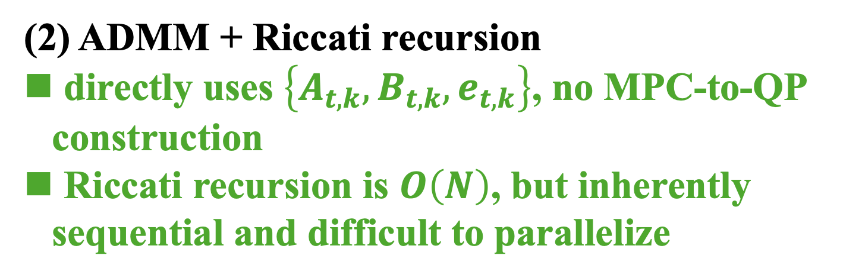
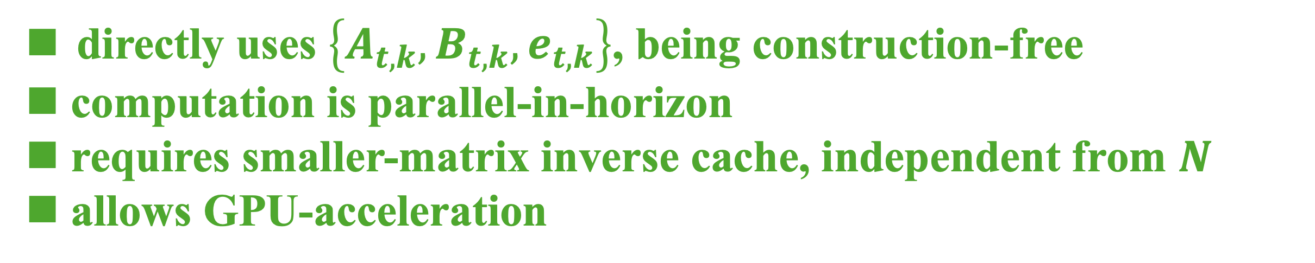
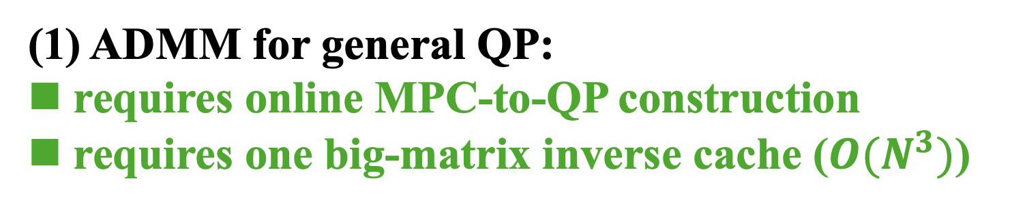
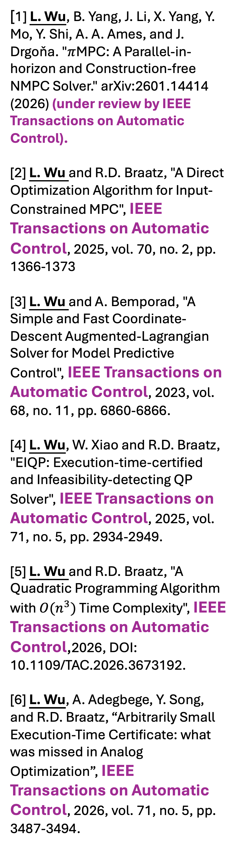
$π$MPC: A Parallel-in-horizon and Construction-free NMPC Solver^{[1]}
Code:
Liang Wu, Bo Yang, Junheng Li, Xu Yang, Yilin Mo, Yang Shi, Aaron D. Ames, Jan Drgona
Motivation
Contributions
References
[1] L. Wu, B. Yang, J. Li, X. Yang, Y. Mo, Y. Shi, A. A. Ames, and J. Drgoňa. "$π$MPC: A Parallel-in-horizon and Construction-free NMPC Solver." arXiv:2601.14414 (2026) (under review by IEEE Transactions on Automatic Control).
[2] L. Wu and R.D. Braatz, "A Direct Optimization Algorithm for Input-Constrained MPC", IEEE Transactions on Automatic Control, 2025, vol. 70, no. 2, pp. 1366-1373
[3] L. Wu and A. Bemporad, "A Simple and Fast Coordinate-Descent Augmented-Lagrangian Solver for Model Predictive Control", IEEE Transactions on Automatic Control, 2023, vol. 68, no. 11, pp. 6860-6866.
[4] L. Wu, W. Xiao and R.D. Braatz, "EIQP: Execution-time-certified and Infeasibility-detecting QP Solver", IEEE Transactions on Automatic Control, 2025, vol. 71, no. 5, pp. 2934-2949.
[5] L. Wu and R.D. Braatz, "A Quadratic Programming Algorithm with $O(n^{3})$ Time Complexity", IEEE Transactions on Automatic Control,2026, DOI: 10.1109/TAC.2026.3673192.
[6] L. Wu, A. Adegbege, Y. Song, and R.D. Braatz, “Arbitrarily Small Execution-Time Certificate: what was missed in Analog Optimization”, IEEE Transactions on Automatic Control, 2026, vol. 71, no. 5, pp. 3487-3494.
Consider a real-time iteration (RTI) based NMPC
ADMM: promising in lower the barrier of embedded NMPC deployment
πMPC = new variable splitting scheme in ADMM + velocity formulation
code simplicity & pain-free parameter selection
ADMM in solving RTI-NMPC
(1) ADMM for general QP:
requires online MPC-to-QP construction
requires one big-matrix inverse cache ($O(N^{3})$)
long-horizon setting for good performance
online MPC-to-QP construction
occupies computation and complicates NMPC implementation
(2) ADMM + Riccati recursion
directly uses $\left\{A_{t,k},B_{t,k},e_{t,k}\right\}$, no MPC-to-QP construction
Riccati recursion is $O\left(N\right)$, but inherently sequential and difficult to parallelize
directly uses $\left\{A_{t,k},B_{t,k},e_{t,k}\right\}$, being construction-free
computation is parallel-in-horizon
requires smaller-matrix inverse cache, independent from $N$
allows GPU-acceleration
Implementation
Numerical Experiments
(a) AFTI16: validating the iteration performance
(b) Centroidal-dynamics MPC: validating the scalability
Nesterov Acceleration with Restart scheme
πMPC does not sacrifice the iteration convergence speed (its number of iterations is comparable to other ADMM variants)
πMPC on GPU maintains scalable performance and ha no out of memory issue
(c) “Accelerating and Scaling MPC-Guided Reinforcement Learning for Humanoid Locomotion and Manipulation” (J. Li, L. Wu, S. A. Esteban, L. Yang, J. Drgona, and A. D. Ames) is coming soon
$π$MPC supports batch scenarios and is thus applied to massive parallel MPC-RL training pipelines
Contact
The corresponding author is with the Johns Hopkins University, Baltimore, MD, USA, wliang14@jh.edu.

