Slide 1
Announcements
Homework 6 due Friday 12/1 @ 11:59pm

Slide 2
Today’s learning goals
At the end of today, you should be able to
Describe arguments for and against a mechanical definition of intelligence
Explain the formulation of AI as a hierarchy of single-task components

Slide 3
Revisiting definition of AI
Google Doc

Slide 4
Weak vs Strong AI
Weak AI
A physical symbol system can act intelligently.
Strong AI
A physical symbol system can have a mind and mental states.
Definitions due to John Searle

Slide 5
Weak vs Strong AI
Weak AI
A physical symbol system can act intelligently.
In practice: applications focused on one narrow task (everything now!)
Strong AI
A physical symbol system can have a mind and mental states.
In practice: an AI system with consciousness (not yet!)

Slide 6
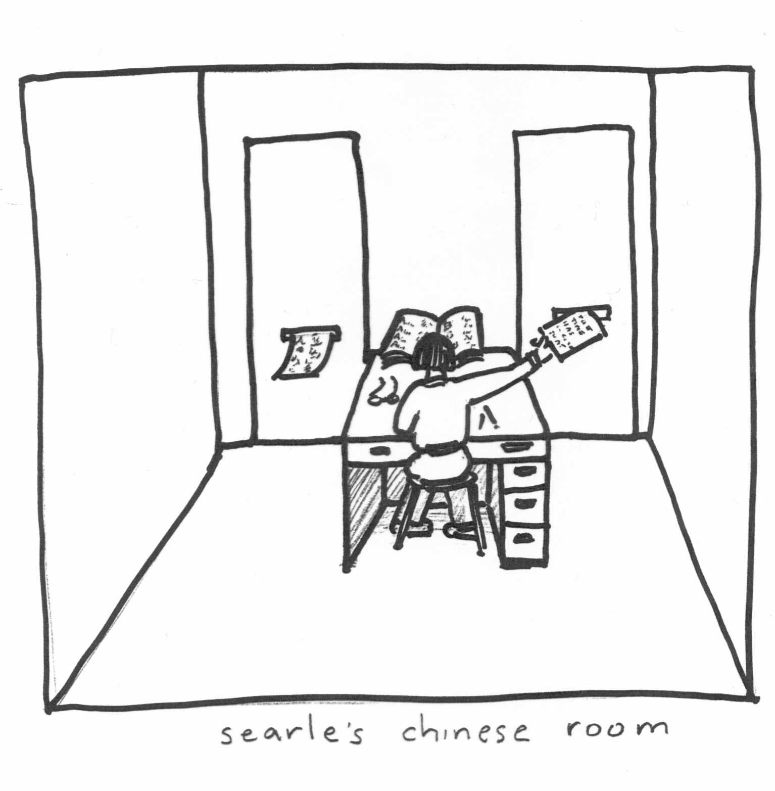
The Chinese Room
Searle’s thought experiment against Strong AI (1979)
Setup:
Black box room with input/output slots
Operator in the room
Library of code books
Mandarin speakers outside the room
Image from http://staffwww.dcs.shef.ac.uk/people/Y.Wilks/ai_course/lecture4.ppt

Slide 7
The Chinese Room
Room operation
People outside the room write questions in Mandarin on paper, push through Input slot
Operator in room takes the input symbols, consults code books for instructions
Code books give a sequence of symbol manipulations
Operator follows instructions to write output symbols, passes out through Output slot
People outside the room read responses, are impressed

Slide 8
The Chinese Room
Does the operator understand Mandarin?
Does the system understand Mandarin?
Notes:
Do worksheet here

Slide 9
Another perspective: Society of Mind
Proposed by Marvin Minsky and Seymour Papert (book: 1985)
Short version:
Minds are what brains do.
Slightly longer version:
“What we call intelligence can be a product of the interaction of non-intelligent parts.”
Quotes via Wikipedia

Slide 10

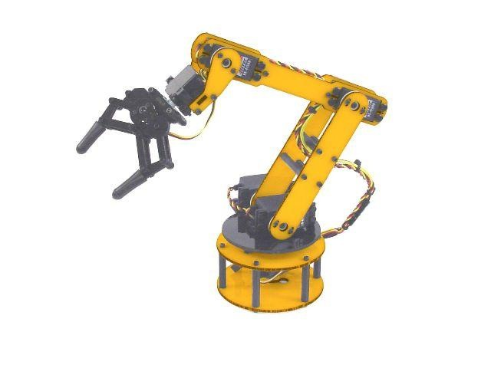
Building a block tower
What components go into building a block tower?
Break into subtasks
Keep breaking down to reach atomic operations (rotate, move, grasp)
Notes:
Arm from: https://robotics.stackexchange.com/questions/7091/design-and-construction-of-universal-robotic-arm-5kg-1m

Slide 11
Block tower society
BUILDER
BEGIN
ADD
END
FIND
GET
PUT
SEE
ISBLOCK
GRASP
MOVE
RELEASE
Notes:
Diagram adapted from Minsky (1985)

Slide 12
Block tower society
BUILDER
The organization matters as much as the agents!
BEGIN
ADD
END
FIND
GET
PUT
SEE
ISBLOCK
GRASP
MOVE
RELEASE
Notes:
Diagram adapted from Minsky (1985)

Slide 13
Block tower society
The organization matters as much as the agents!
GET
Note that low-level agents don’t talk to high-level agents
GRASP
Notes:
Diagram adapted from Minsky (1985)

Slide 14
Block tower society
The organization matters as much as the agents!
GET
PUT
Note that low-level agents don’t talk to high-level agents
MOVE
Notes:
Diagram adapted from Minsky (1985)

Slide 15
Block tower society
BUILDER
The organization matters as much as the agents!
ADD
FIND
GET
PUT
Note that low-level agents don’t talk to high-level agents
Notes:
Diagram adapted from Minsky (1985)

Slide 16
Agents and Agencies
Agent – the program definition, with input/output, control flow, and communication
Agency – the program in action; observed behavior
Builder agent
Builder agency
BUILDER
BUILDER
BEGIN
ADD
END

Slide 17
Minsky’s argument
No individual agent is intelligent.
But their organization and control flow makes the agency intelligent!
Strong AI via lots of Weak AI

Slide 18
Activity: Agent societies for AI problems

Slide 19
Next time
How do we make sure that AI systems/development are ethical?
Analyzing recent ethical breaches

