Slide 1
Announcements
Grader office hours posted on course website
AI seminar today: Mining code answers for natural language questions
(3-4pm in DL480)

Slide 2

What have we done so far?
State-based search
Determining an optimal sequence of actions to reach the goal
Choose actions using knowledge about the goal
Assumes a deterministic problem with known rules
Single agent only

Slide 3
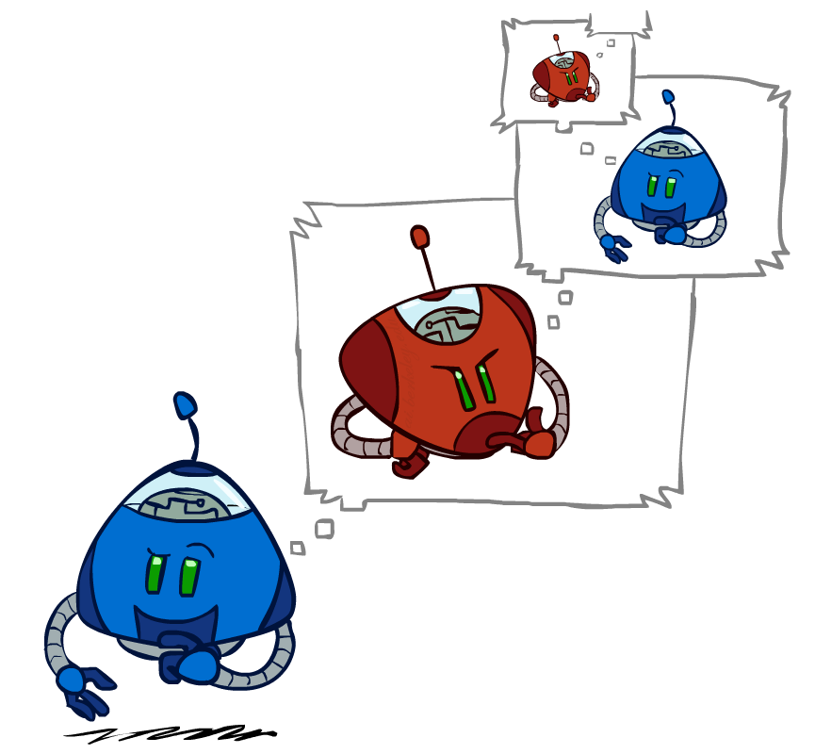
What have we done so far?
Adversarial state-based search
Determining the best next action, given what opponents will do
Choose actions using knowledge about the goal
Assumes a deterministic problem with known rules
Multiple agents, but in a zero-sum competitive game

Slide 4

What have we done so far?
Knowledge-based agents
Using existing knowledge to infer new things about the world
Determining best next action, given changes to the world
Choose actions using knowledge about the world
Assumes a deterministic problem; may be able to infer rules
Any number of agents, but limited to KB contents

Slide 5
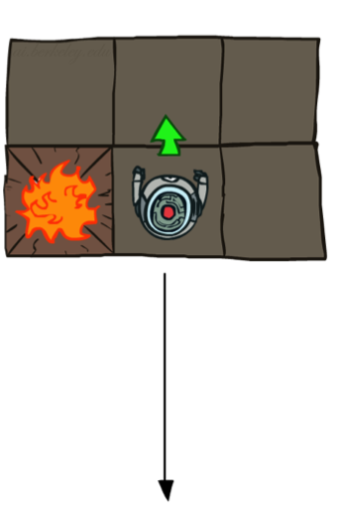
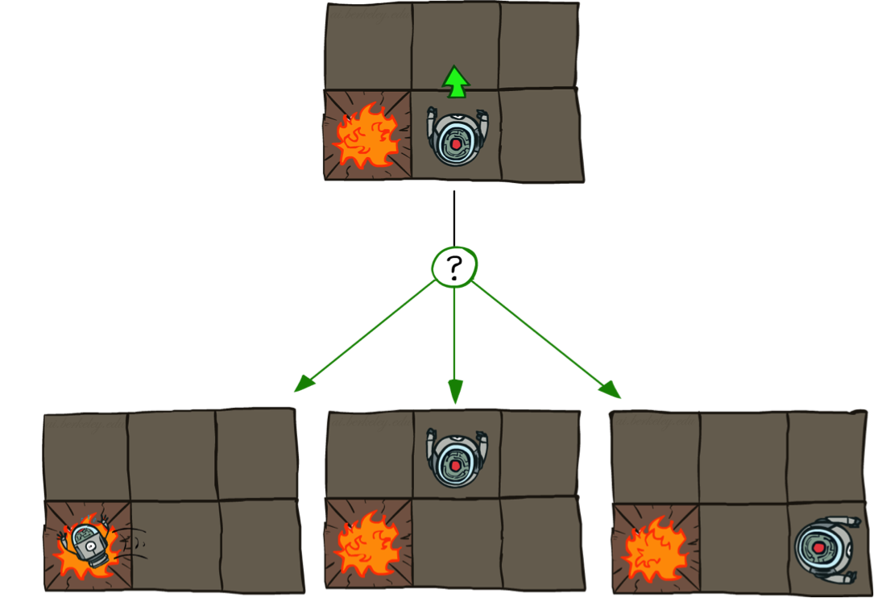
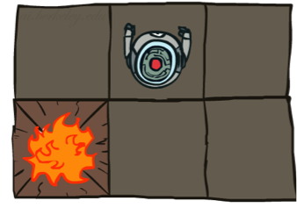
What about non-determinism?
Deterministic Grid World
Stochastic Grid World

Slide 6
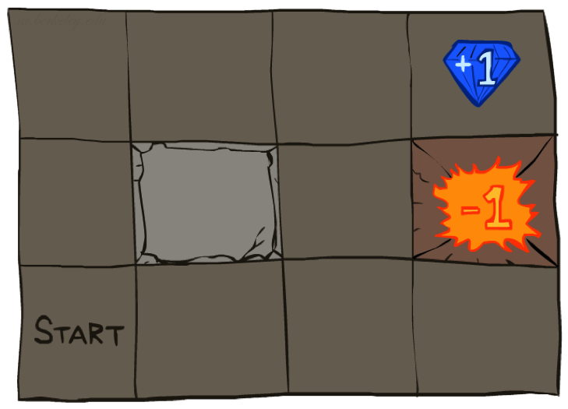




Non-deterministic search
Markov Decision Process (MDP)
Defined by:
A set of states s ∈ S
A set of actions a ∈ A
A transition function T(s, a, s’)
Probability that a from s leads to s’, i.e., P(s’| s, a)
Also called the model or the dynamics
A reward function R(s, a, s’)
Sometimes just R(s) or R(s’)
A start state
Maybe a terminal state
Successor function now expanded!
Rewards replace action costs.

Slide 7
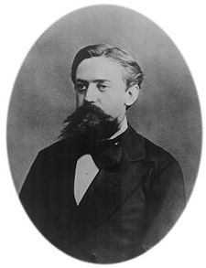

What is Markov about MDPs?
“Markov” generally means that given the present state, the future and the past are independent
For Markov decision processes, “Markov” means action outcomes depend only on the current state
This is just like search, where the successor function could only depend on the current state (not the history)
Andrey Markov (1856-1922)
Notes:
Like search: successor function only depended on current state
Can make this happen by stuffing more into the state;
Very similar to search problems: when solving a maze with food pellets, we stored which food pellets were eaten

Slide 8
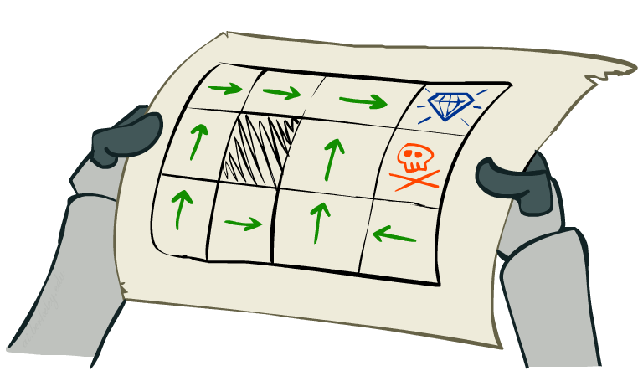
What does a solution look like?
In deterministic single-agent search problems, we wanted an optimal plan, or sequence of actions, from start to a goal
Logical inference made this easier/more efficient
Multi-agent case did this one action at a time
For MDPs, we want an optimal policy π*: S → A
A policy π gives an action for each state
An explicit policy defines a reflex agent
An optimal policy is one that maximizes expected utility if followed
Notes:
Dan has a DEMO for this.

Slide 9
Expected utility
Deterministic Grid World
Deterministic outcomes make utility of an action straightforward
Utility of action is utility of resulting state
Handled this before with heuristics and evaluation functions
Here, using the reward function
U(Up) = 5
R(s’) = 5

Slide 10
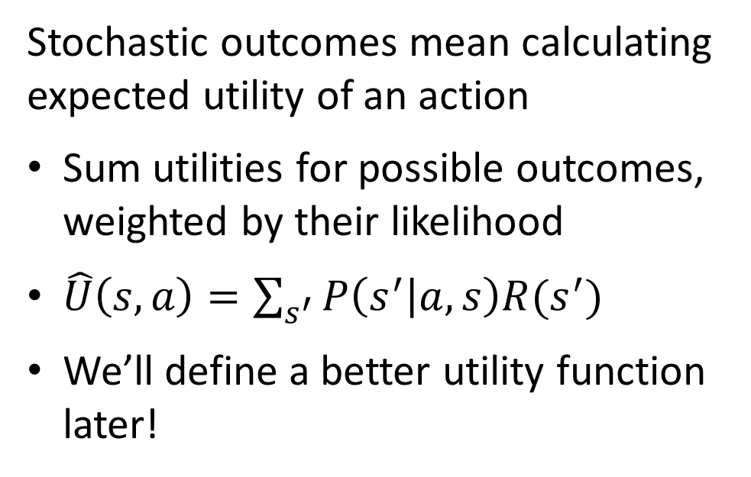
Expected utility
Stochastic Grid World
Stochastic outcomes mean calculating expected utility of an action
Sum utilities for possible outcomes, weighted by their likelihood
$\hat{U}\left(s,a\right)=\sum_{s^{′}}{P\left(s^{′} | a,s\right)R(s^{′})}$
We’ll define a better utility function later!
U(Up) = -1 + 4 + .2
= 3.2
0.1
0.1
0.8
An optimal policy always picks the actions with highest expected utility.
R(s’) = -10
R(s’) = 5
R(s’) = 2

Slide 11
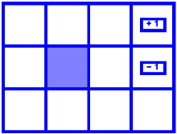
Impact of reward function
Behavior of optimal policy is determined by the reward function for different states
For example, a positive reward function for non-goal states may lead to staying infinitely!

Slide 12
Impact of reward function
R(s) = -0.01
R(s) = -0.03
R(s) = -0.4
R(s) = -2.0
Notes:
R(s) = the “living reward”

Slide 13
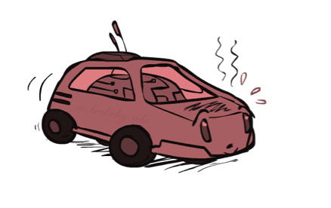
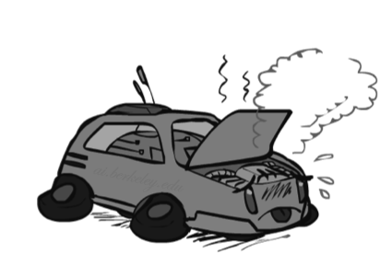
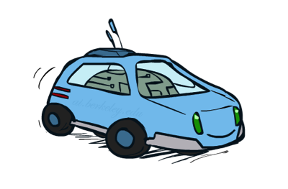
Searching for a policy: Racing
A robot car wants to travel far, quickly
Three states: Cool, Warm, Overheated
Two actions: Slow, Fast
Going faster gets double reward
0.5
+1
1.0
Fast
Slow
-10
+1
0.5
Warm
Slow
Fast
0.5
+2
Cool
0.5
Overheated
+1
1.0
+2

Slide 14




Racing Search Tree

Slide 15
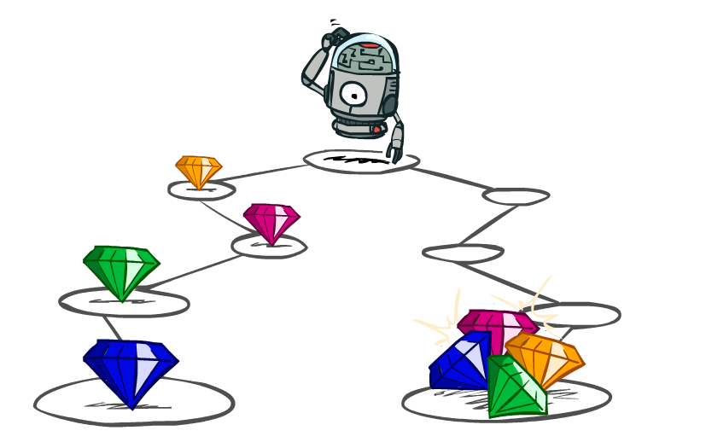
Calculating utilities of sequences

Slide 16
Calculating utilities of sequences
Utility of a state sequence is additive:
$$U\left(S=s_{0},s_{1},s_{2},…\right)=R\left(s_{0}\right)+R\left(s_{1}\right)+R\left(s_{2}\right)+…$$
What preferences should an agent have over reward sequences?
More or less?
Now or later?
[1, 2, 2]
or
[2, 3, 4]
[0, 0, 1]
or
[1, 0, 0]

Slide 17

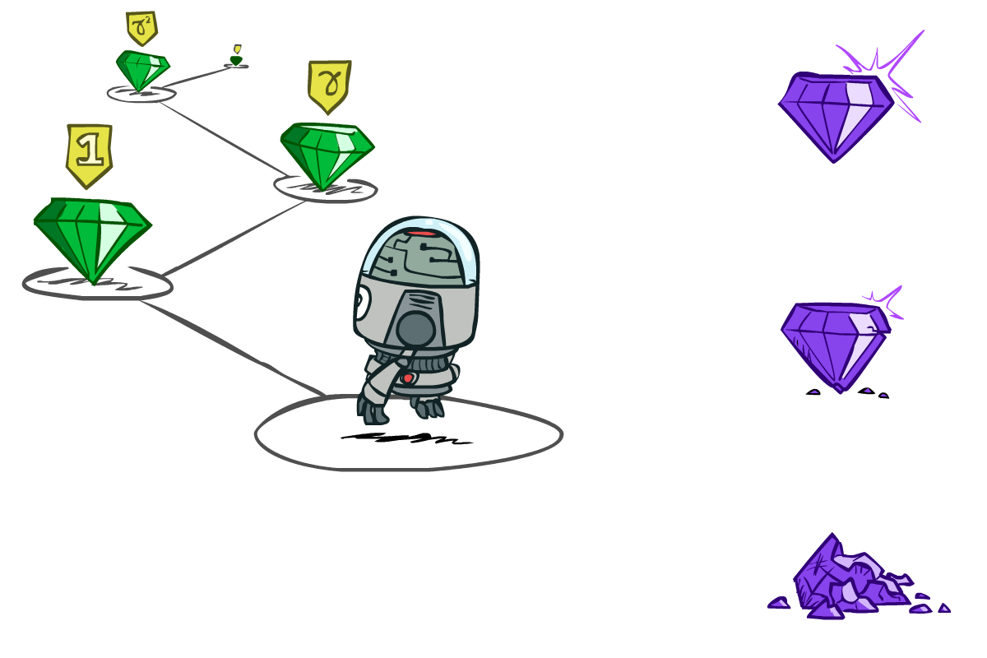

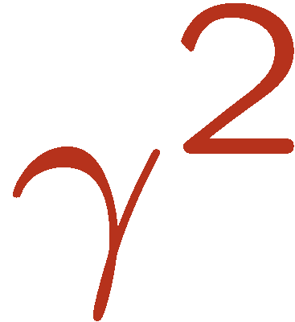

Discounting
It’s reasonable to maximize the sum of rewards
It’s also reasonable to prefer rewards now to rewards later
One solution: values of rewards decay exponentially
Worth Now
Worth Next Step
Worth In Two Steps

Slide 18

Discounting
How to discount?
Each time we descend a level, we multiply in the discount once
Why discount?
Sooner rewards probably do have higher utility than later rewards
Also helps our algorithms converge
Example: discount of 0.5
U([1,2,3]) = 1*1 + 0.5*2 + 0.25*3
U([1,2,3]) < U([3,2,1])
Notes:
Rewards in the future (deeper in the tree) matter less
Interesting: running expectimax, if having to truncate the search, then not losing much; e.g., less then \gamma^d / (1-\gamma)

Slide 19
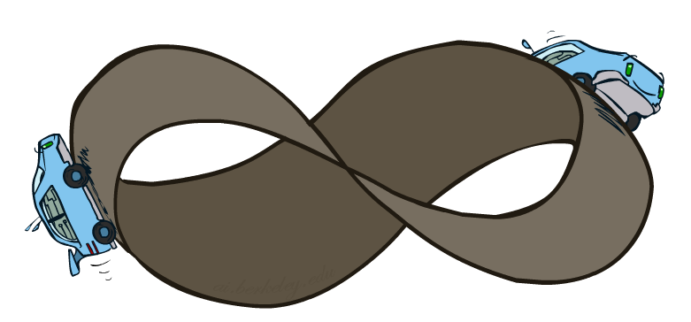
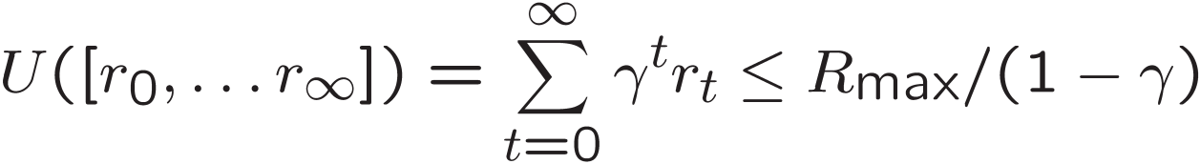
Infinite Utilities?!
Problem: What if the game lasts forever? Do we get infinite rewards?
Solutions:
Finite horizon: (similar to depth-limited search)
Terminate episodes after a fixed T steps (e.g. life)
Gives nonstationary policies (π depends on time left)
Discounting: use 0 < γ < 1
Smaller γ means smaller “horizon” – shorter term focus
Absorbing state: guarantee that for every policy, a terminal state will eventually be reached (like “overheated” for racing)

Slide 20

Calculating a policy
How to be optimal:
Step 1: Take correct first action
Step 2: Keep being optimal

Slide 21
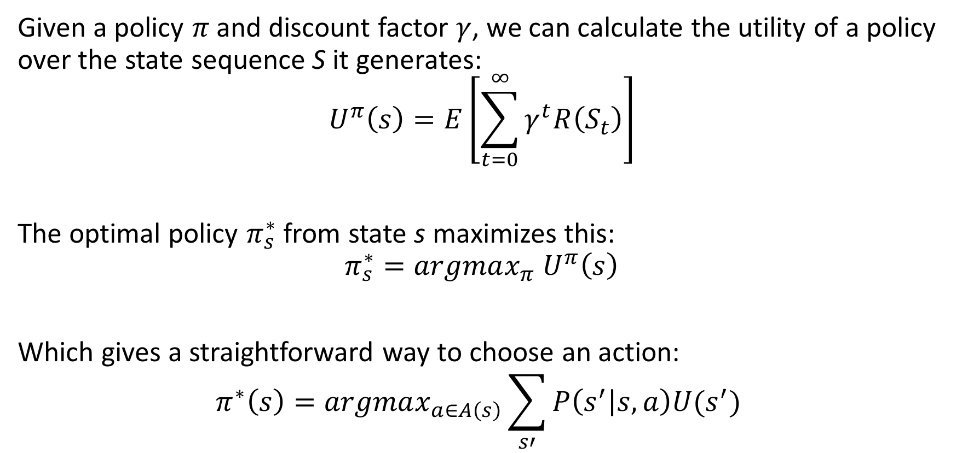
Policy nuts and bolts
Given a policy $π$ and discount factor $γ$, we can calculate the utility of a policy over the state sequence S it generates:
$$U^{π}\left(s\right)=E\left[\sum_{t=0}^{∞}{γ^{t}R\left(S_{t}\right)}\right]$$
The optimal policy $π_{s}^{∗}$ from state s maximizes this:
$$π_{s}^{∗}=argmax_{π} U^{π}\left(s\right)$$
Which gives a straightforward way to choose an action:
$$π^{∗}\left(s\right)=argmax_{a∈A\left(s\right)}\sum_{s′}{P\left(s^{′} | s,a\right)U(s^{′}) }$$

Slide 22
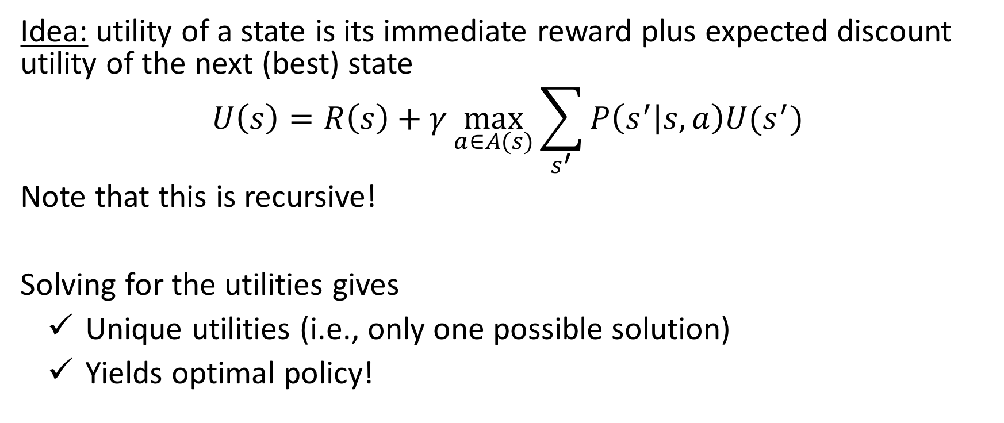
Bellman equation for utility
Idea: utility of a state is its immediate reward plus expected discount utility of the next (best) state
$$U\left(s\right)=R\left(s\right)+γ\max_{a∈A(s)}{\sum_{s^{′}}{P\left(s^{′} | s,a\right)U(s^{′})}}$$
Note that this is recursive!
Solving for the utilities gives
Unique utilities (i.e., only one possible solution)
Yields optimal policy!

Slide 23
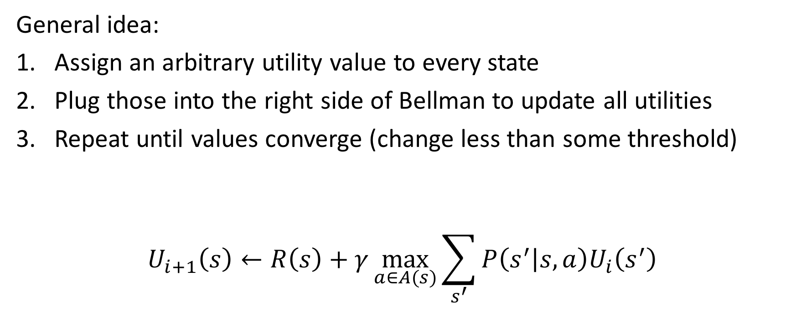
Solving Bellman iteratively: Value Iteration
General idea:
Assign an arbitrary utility value to every state
Plug those into the right side of Bellman to update all utilities
Repeat until values converge (change less than some threshold)
$$U_{i+1}\left(s\right)←R\left(s\right)+γ\max_{a∈A(s)}{\sum_{s^{′}}{P\left(s^{′} | s,a\right)U_{i}\left(s^{′}\right)}}$$

Slide 24
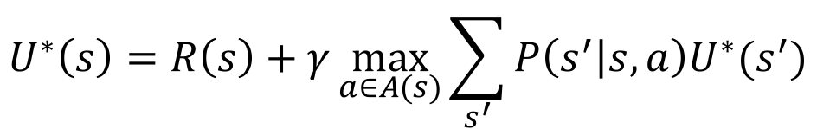
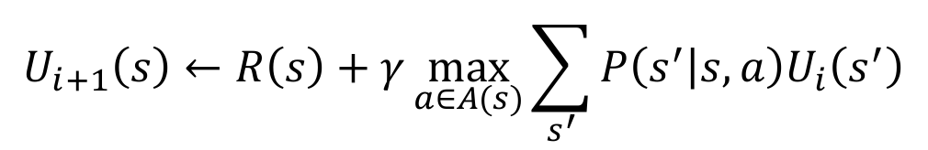
Nice things about Value Iteration
Bellman equations characterize the optimal values:
Value iteration computes them:
Value iteration is just a fixed point solution method
Gives unique and optimal solution
V(s)
$$U^{∗}\left(s\right)=R\left(s\right)+γ\max_{a∈A(s)}{\sum_{s^{′}}{P\left(s^{′} | s,a\right)U^{∗}(s^{′})}}$$
a
s, a
s,a,s’
V(s’)
$$U_{i+1}\left(s\right)←R\left(s\right)+γ\max_{a∈A(s)}{\sum_{s^{′}}{P\left(s^{′} | s,a\right)U_{i}\left(s^{′}\right)}}$$
Notes:
Discuss computational complexity: S * A * S times number of iterations
Note: updates not in place [if in place, it means something else and not even clear what it means]

Slide 25
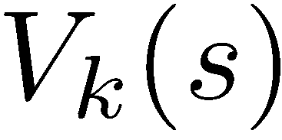
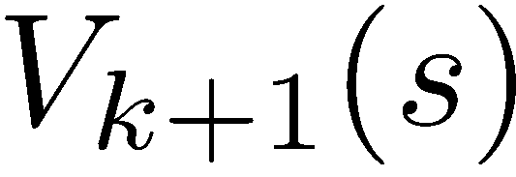
Convergence of Value Iteration
How do we know the V_{k} vectors are going to converge?
Case 1: If the tree has maximum depth M, then V_{M} holds the actual untruncated values
Case 2: If the discount is less than 1
Sketch: For any state V_{k} and V_{k+1} can be viewed as depth k+1 expectimax results in nearly identical search trees
The difference is that on the bottom layer, V_{k+1} has actual rewards while V_{k} has zeros
That last layer is at best all R_{MAX}
It is at worst R_{MIN}
But everything is discounted by γ^{k} that far out
So V_{k} and V_{k+1} are at most γ^{k} max|R| different
So as k increases, the values converge

Slide 26
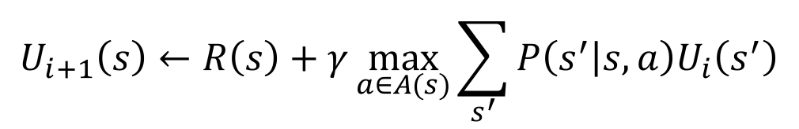
Problems with Value Iteration
s
Value iteration repeats the Bellman updates:
Problem 1: It’s slow – O(S²A) per iteration
Problem 2: The “max” at each state rarely changes
Problem 3: The policy often converges long before the values
a
$$U_{i+1}\left(s\right)←R\left(s\right)+γ\max_{a∈A(s)}{\sum_{s^{′}}{P\left(s^{′} | s,a\right)U_{i}\left(s^{′}\right)}}$$
s, a
s,a,s’
s’
Notes:
Demo steps through value iteration; snapshots of values shown on next slides.

Slide 27
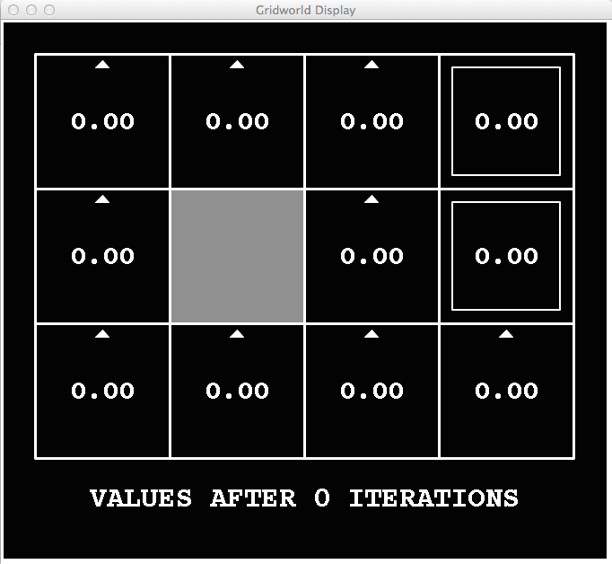
k=0
Noise = 0.2
Discount = 0.9
Living reward = 0
Notes:
Assuming zero living reward

Slide 28
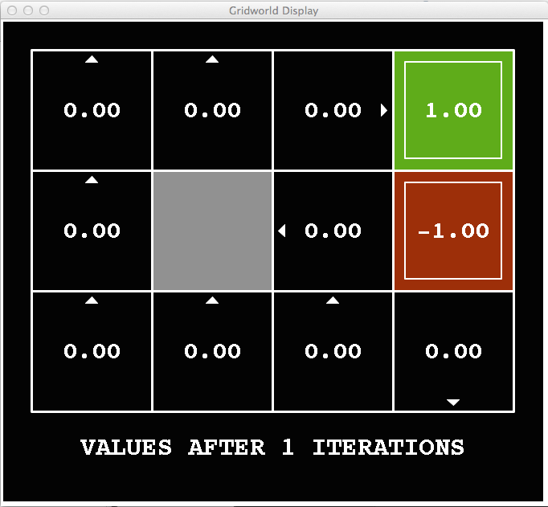
k=1
Noise = 0.2
Discount = 0.9
Living reward = 0
Notes:
Assuming zero living reward

Slide 29
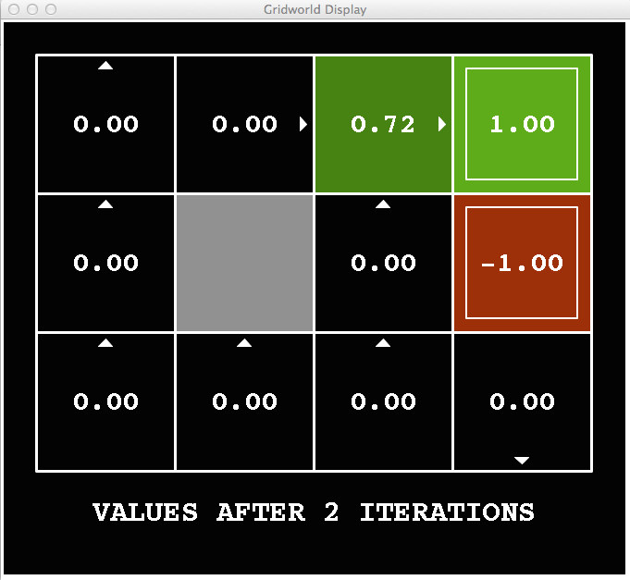
k=2
Noise = 0.2
Discount = 0.9
Living reward = 0
Notes:
Assuming zero living reward

Slide 30
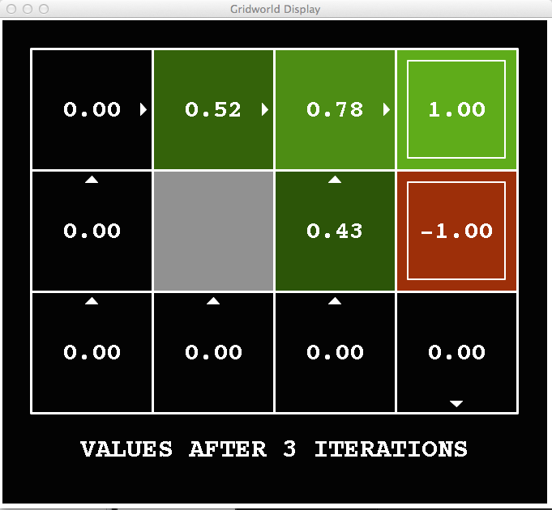
k=3
Noise = 0.2
Discount = 0.9
Living reward = 0
Notes:
Assuming zero living reward

Slide 31
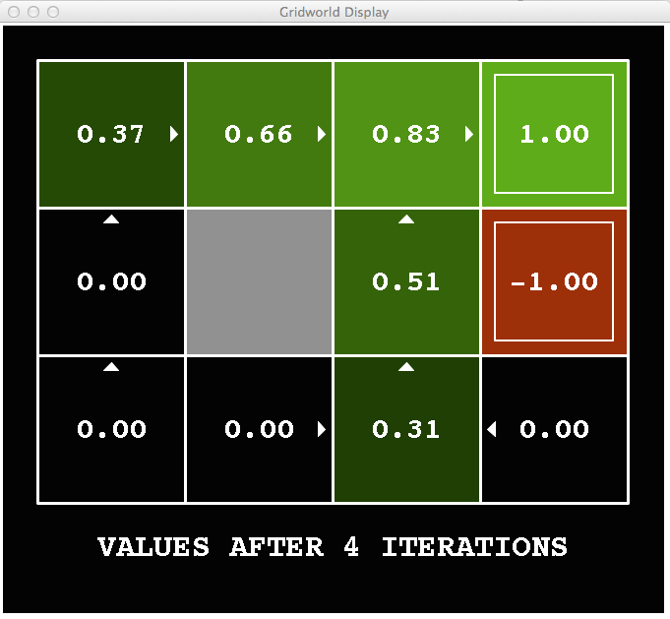
k=4
Noise = 0.2
Discount = 0.9
Living reward = 0
Notes:
Assuming zero living reward

Slide 32
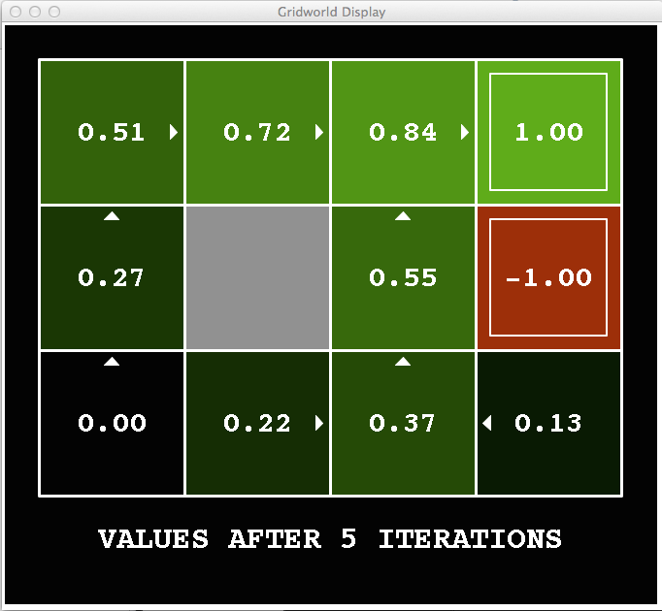
k=5
Noise = 0.2
Discount = 0.9
Living reward = 0
Notes:
Assuming zero living reward

Slide 33
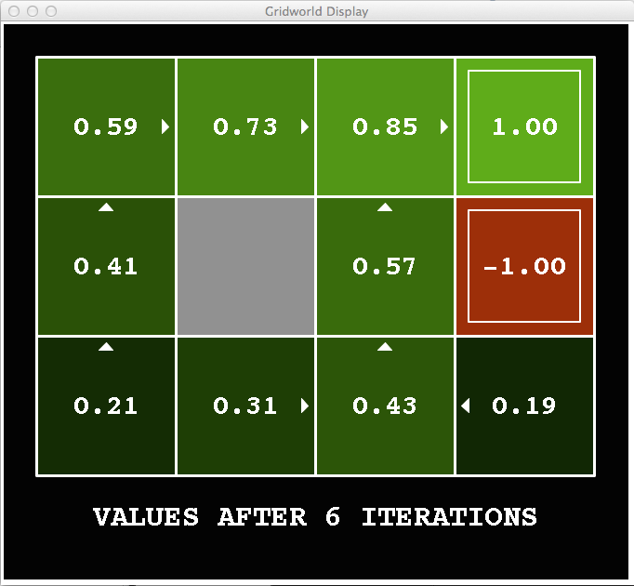
k=6
Noise = 0.2
Discount = 0.9
Living reward = 0
Notes:
Assuming zero living reward

Slide 34
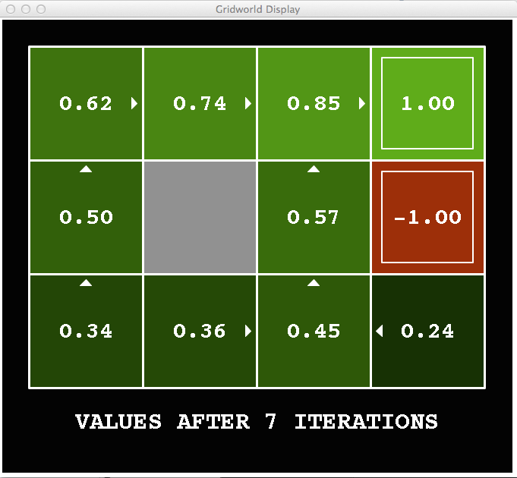
k=7
Noise = 0.2
Discount = 0.9
Living reward = 0
Notes:
Assuming zero living reward

Slide 35
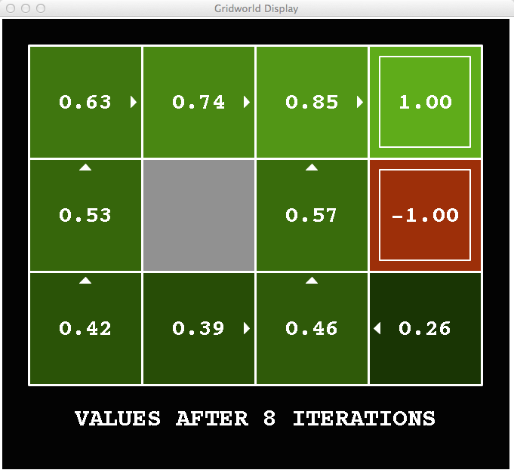
k=8
Noise = 0.2
Discount = 0.9
Living reward = 0
Notes:
Assuming zero living reward

Slide 36
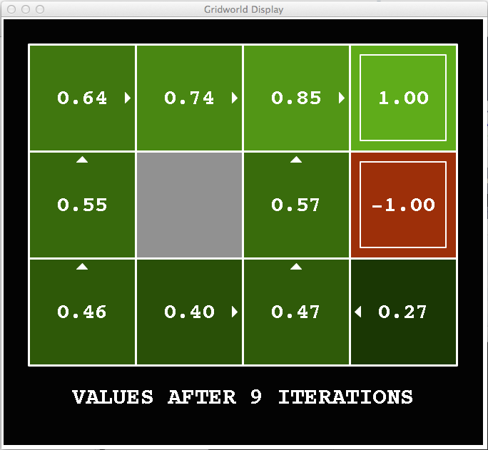
k=9
Noise = 0.2
Discount = 0.9
Living reward = 0
Notes:
Assuming zero living reward

Slide 37

k=10
Noise = 0.2
Discount = 0.9
Living reward = 0
Notes:
Assuming zero living reward

Slide 38

k=11
Noise = 0.2
Discount = 0.9
Living reward = 0
Notes:
Assuming zero living reward

Slide 39
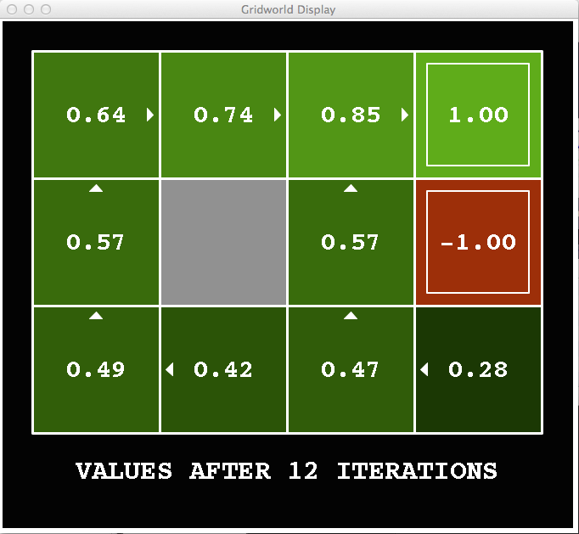
k=12
Noise = 0.2
Discount = 0.9
Living reward = 0
Notes:
Assuming zero living reward

Slide 40

k=100
Noise = 0.2
Discount = 0.9
Living reward = 0
Notes:
Assuming zero living reward

Slide 41
Policy Iteration
Alternative approach for optimal values:
Step 1: Policy evaluation: calculate utilities for some fixed policy (not optimal utilities!) until convergence
Step 2: Policy improvement: update policy using one-step look-ahead with resulting converged (but not optimal!) utilities as future values
Repeat steps until policy converges
This is policy iteration
It’s still optimal!
Can converge (much) faster under some conditions

Slide 42

Detour: Policy Evaluation

Slide 43
Fixed policies
Do the optimal action
Do what π says to do
s
s
a
π(s)
s, a
s, π(s)
s,a,s’
s, π(s),s’
s’
s’
Normally, maxing over all actions to compute the optimal values
If we fix some policy π(s), then only one action per state
… though the tree’s value would depend on which policy we fixed

Slide 44
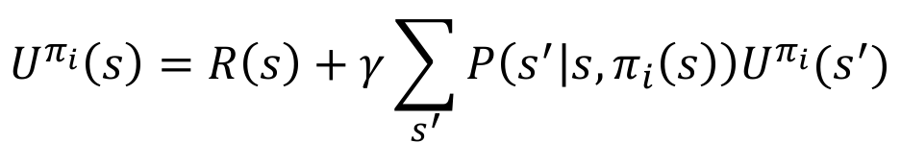
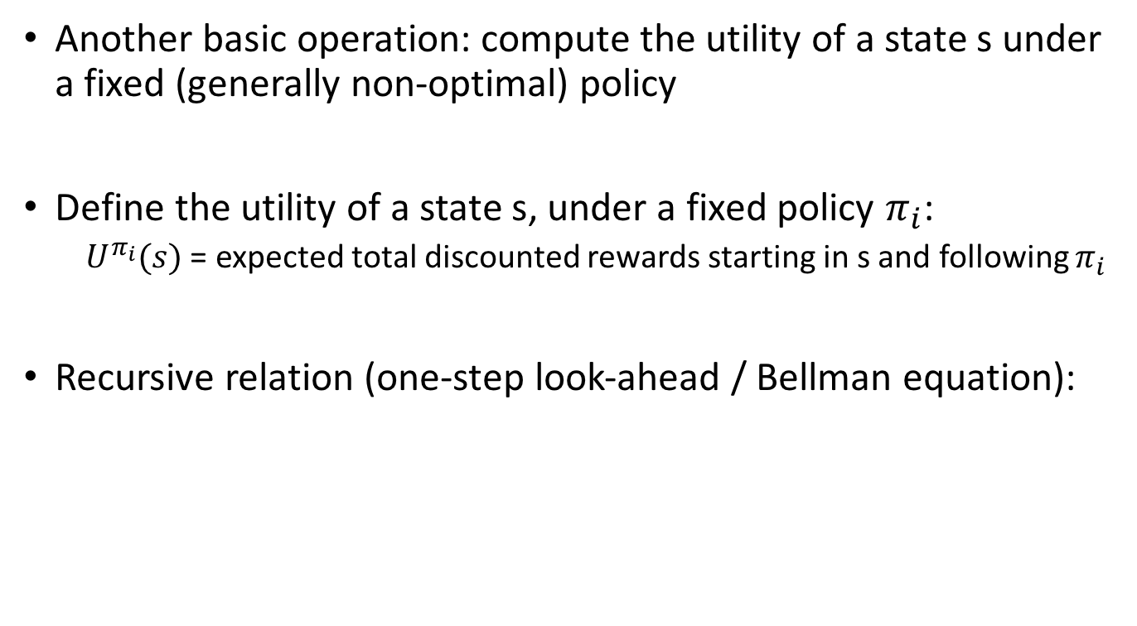
Utilities for a fixed policy
Another basic operation: compute the utility of a state s under a fixed (generally non-optimal) policy
Define the utility of a state s, under a fixed policy $π_{i}$:
$U^{π_{i}}(s)$ = expected total discounted rewards starting in s and following $π_{i}$
Recursive relation (one-step look-ahead / Bellman equation):
s
π(s)
s, π(s)
s, π(s),s’
s’
$$U^{π_{i}}\left(s\right)=R\left(s\right)+γ\sum_{s^{′}}{P\left(s^{′} | s,π_{i}\left(s\right)\right)U^{π_{i}}(s^{′})}$$
Now this is a linear system of equations! Can solve exactly in $O(n^{3})$ time.

Slide 45
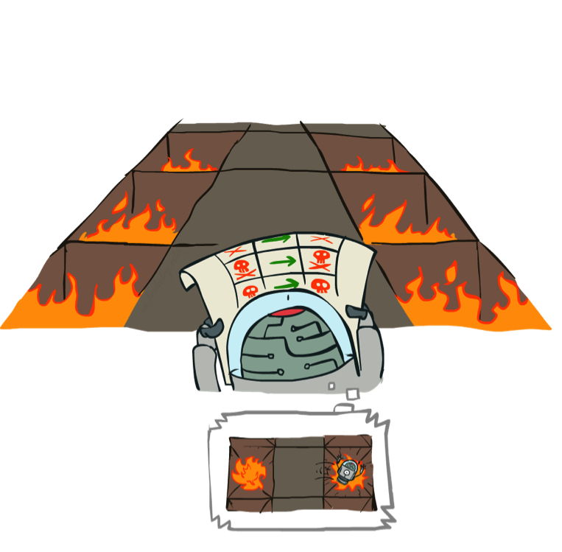
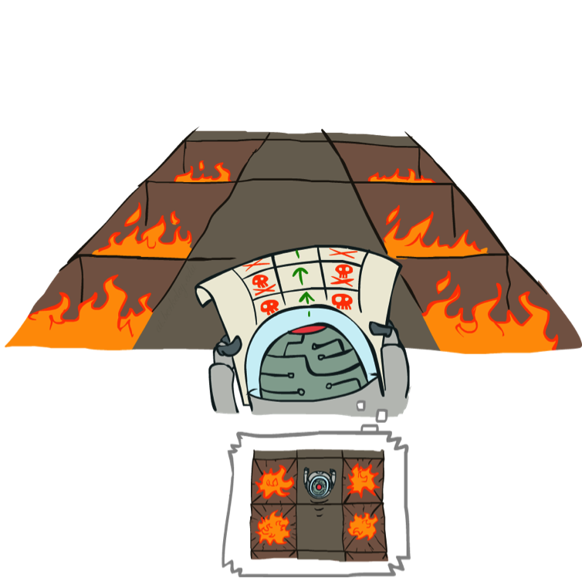
Example: Policy Evaluation
Always Go Right
Always Go Forward

Slide 46
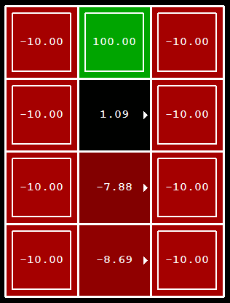
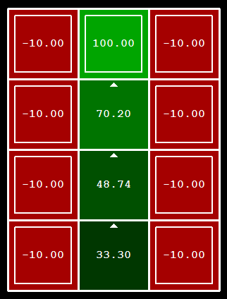
Example: Policy Evaluation
Always Go Right
Always Go Forward

Slide 47
Policy Iteration
Alternative approach for optimal values:
Step 1: Policy evaluation: calculate utilities for some fixed policy (not optimal utilities!) until convergence
Step 2: Policy improvement: update policy using one-step look-ahead with resulting converged (but not optimal!) utilities as future values
Repeat steps until policy converges
This is policy iteration
It’s still optimal!
Can converge (much) faster under some conditions

Slide 48
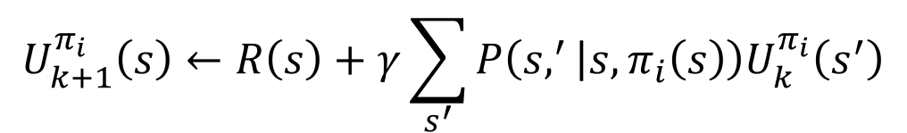
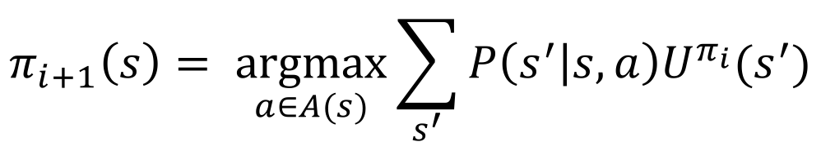
Policy Iteration
Evaluation: For fixed current policy π, find values with policy evaluation:
Solve exactly, if reasonably small state space
Or, approximate: iterate until values converge:
Improvement: For fixed values, get a better policy using policy extraction
One-step look-ahead:
$$U_{k+1}^{π_{i}}\left(s\right)←R\left(s\right)+γ\sum_{s^{′}}{P\left(s,^{′} | s, π_{i}\left(s\right)\right)U_{k}^{π_{i}}\left(s^{′}\right)}$$
$$π_{i+1}\left(s\right)= \underset{a∈A(s)}{argmax}{\sum_{s^{′}}{P\left(s^{′} | s,a\right)U^{π_{i}}(s^{′})}}$$

Slide 49
Comparison
Both value iteration and policy iteration compute the same thing (all optimal values)
In value iteration:
Every iteration updates both the values and (implicitly) the policy
We don’t track the policy, but taking the max over actions implicitly recomputes it
In policy iteration:
We do several passes that update utilities with fixed policy (each pass is fast because we consider only one action, not all of them)
After the policy is evaluated, a new policy is chosen (slow like a value iteration pass)
The new policy will be better (or we’re done)
Both are dynamic programs for solving MDPs

Slide 50
Summary: MDP Algorithms
So you want to….
Compute optimal values: use value iteration or policy iteration
Compute values for a particular policy: use policy evaluation
Turn your values into a policy: use policy extraction (one-step lookahead)
These all look the same!
They basically are – they are all variations of Bellman updates
They all use one-step lookahead search tree fragments
They differ only in whether we plug in a fixed policy or max over actions

Slide 51
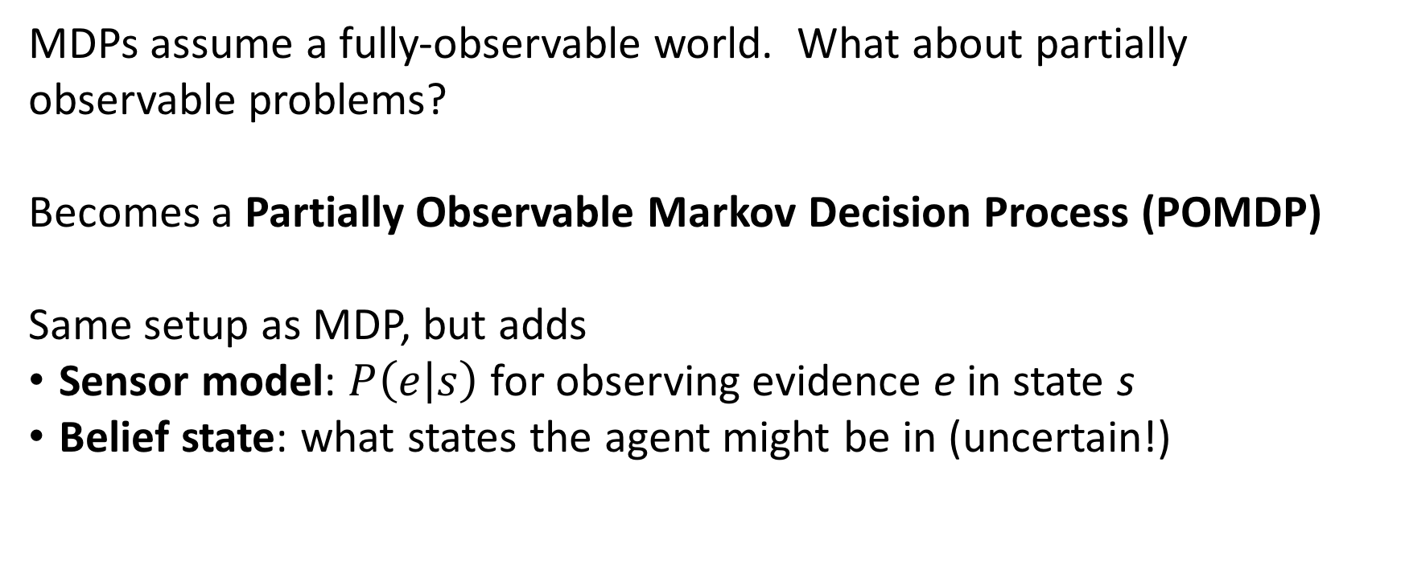
Digression 1: POMDPs
MDPs assume a fully-observable world. What about partially observable problems?
Becomes a Partially Observable Markov Decision Process (POMDP)
Same setup as MDP, but adds
Sensor model: $P\left(e | s\right)$ for observing evidence e in state s
Belief state: what states the agent might be in (uncertain!)

Slide 52
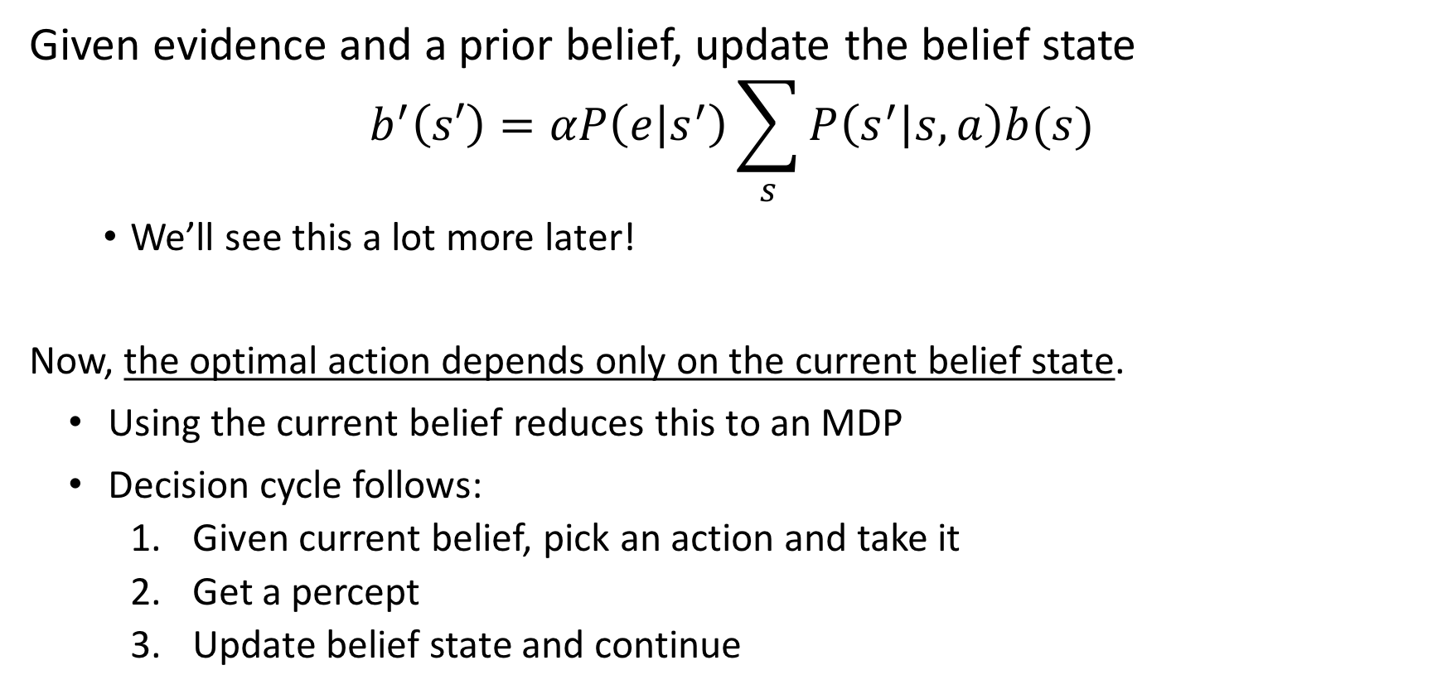
Digression 1: POMDPs
Given evidence and a prior belief, update the belief state
$$b^{′}\left(s′\right)=αP\left(e | s^{′}\right)\sum_{s}{P\left(s^{′} | s,a\right)b(s)}$$
We’ll see this a lot more later!
Now, the optimal action depends only on the current belief state.
Using the current belief reduces this to an MDP
Decision cycle follows:
Given current belief, pick an action and take it
Get a percept
Update belief state and continue
Value iteration out of scope!

Slide 53
Digression 2: Game Theory
What about multi-agent problems? Especially where
Agents aren’t competitive and zero-sum
Agents act simultaneously
Decision policies of other agents are unknown
Classic problem: Prisoner’s dilemma
Two robbers captured together, interrogated separately
If one testifies and the other doesn’t, good one goes free and bad gets 10 years
If both testify, both get 5 years
If neither testify, both get 1 year

Slide 54
Digression 2: Game Theory
Each agent knows:
What actions are available to other agents
What the end rewards are
Can use these to calculate possible strategies for the game
Nash equilibrium – no player can benefit by switching from their current strategy
Gets more complicated with sequential or repeated games

Slide 55
Digression 2: Game Theory
This is a large, complicated field in its own right!
Relevant to a lot of real-world problems:
Auctions, political decisions, military policy, etc, etc
And relevant to many AI problems!
Robots navigating multi-agent environments
Automated stock trading
Etc

Slide 56
Next Time
Reinforcement learning
What if we don’t know the transition function or the rewards?

