Slide 1
Announcements
Graders starting 9/20
Class 9/15 - Video on Watson playing Jeopardy
HW 2 (Logic) coming out later this week
No office hours today!

Slide 2
Last Time: Propositional Inference
Logical Agents
Use information about how states change to choose actions
Guided by knowledge about the world
Use Knowledge Bases (KBs) to support inference/derivation
Inference in Propositional Logic
Entailment
Wumpus World
Resolution: apply Modus Ponens, And Elimination, De Morgan’s Rule, etc. to derive new atomic statements

Slide 3



Review: Inference Rules
Modus Ponens $$\frac{A⇒B, A}{B}$$
If both $A⇒B$ and A are in the KB, then B can be inferred
And Elimination $$\frac{A∧B}{A}$$
If the conjunct is true, each element is true
De Morgan’s Rule
$$¬\left(A∨B\right)≡¬A∧¬B$$

Slide 4




Review: Proof by Resolution
General idea:
Apply inference rules
Use complementary literals to simplify clauses
Rinse, repeat
$$¬B$$
$$⊨$$
$$A∨C$$
$$A∨B∨C$$

Slide 5
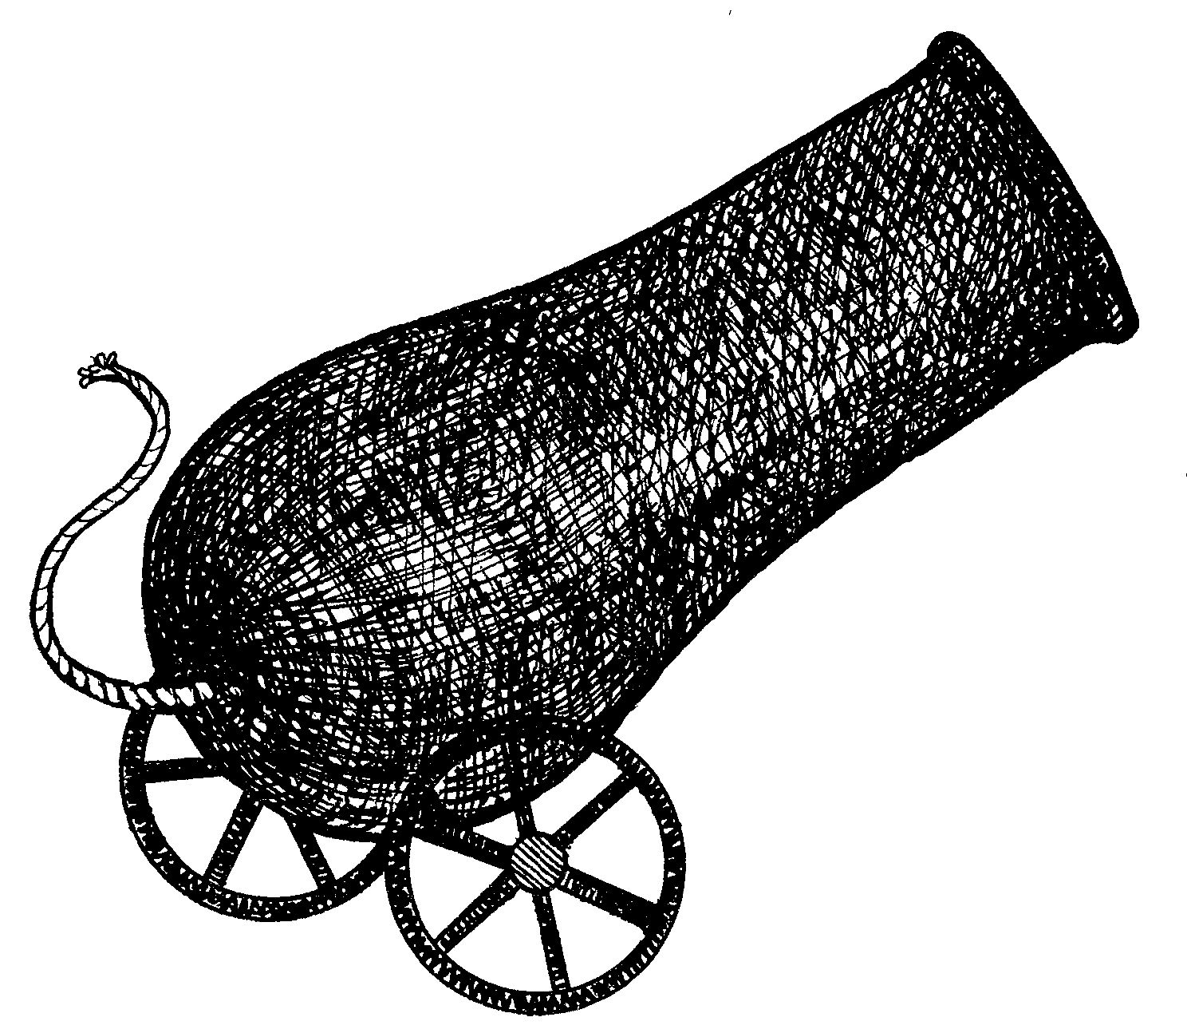

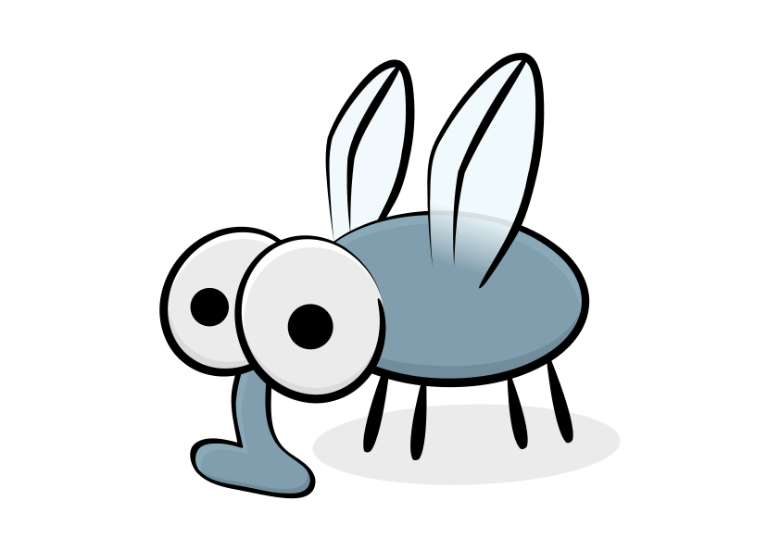
Making Inference more Efficient
Resolution
Inference
Forward-Backward Chaining

Slide 6
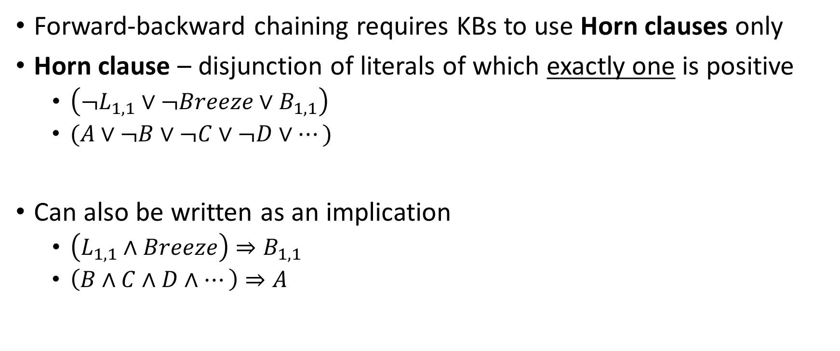
Horn Clauses
Forward-backward chaining requires KBs to use Horn clauses only
Horn clause – disjunction of literals of which exactly one is positive
$\left(¬L_{1,1}∨¬Breeze∨B_{1,1}\right)$
$(A∨¬B∨¬C∨¬D∨…)$
Can also be written as an implication
$\left(L_{1,1}∧Breeze\right)⇒B_{1,1}$
$\left(B∧C∧D∧…\right)⇒A$

Slide 7
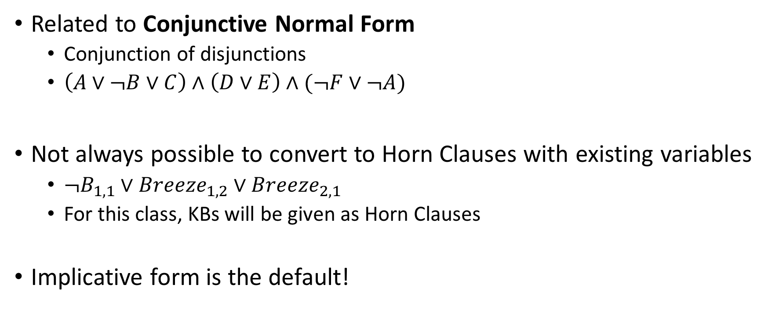
Horn Clauses
Related to Conjunctive Normal Form
Conjunction of disjunctions
$\left(A∨¬B∨C\right)∧\left(D∨E\right)∧(¬F∨¬A)$
Not always possible to convert to Horn Clauses with existing variables
$¬B_{1,1}∨Breeze_{1,2}∨Breeze_{2,1}$
For this class, KBs will be given as Horn Clauses
Implicative form is the default!

Slide 8
Forward-Backward Chaining
Forward Chaining
Reason forward to infer new facts from existing knowledge
Backward Chaining
Given a query, reason backward to find a chain of inference to prove it

Slide 9
Forward Chaining
def forward-chain(KB):
initialize count s.t. count[c] = the number of symbols in clause c’s premise
initialize inferred s.t. inferred[s] = False for all symbols
initialize agenda to an empty queue
add all symbols known to be true in KB to agenda
while agenda is not empty:
p = agenda.pop()
if inferred[p] == False:
inferred[p] = True
for each clause c in KB s.t. p is in c’s premise:
count[c] -= 1
if count[c] == 0: add c’s conclusion to agenda

Slide 10

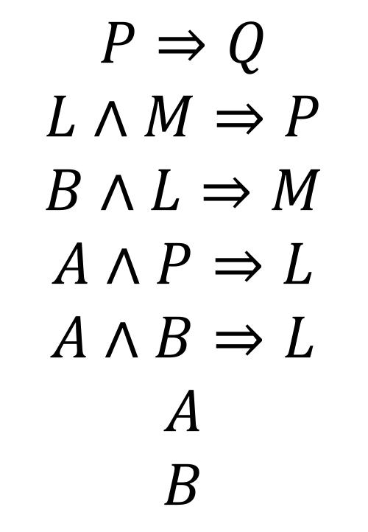
Forward Chaining Example
$$P⇒Q$$
$$L∧M⇒P$$
$$B∧L⇒M$$
$$A∧P⇒L$$
$$A∧B⇒L$$
$$A$$
$$B$$
Agenda
A
B
L
M
P
Q
L

Slide 11
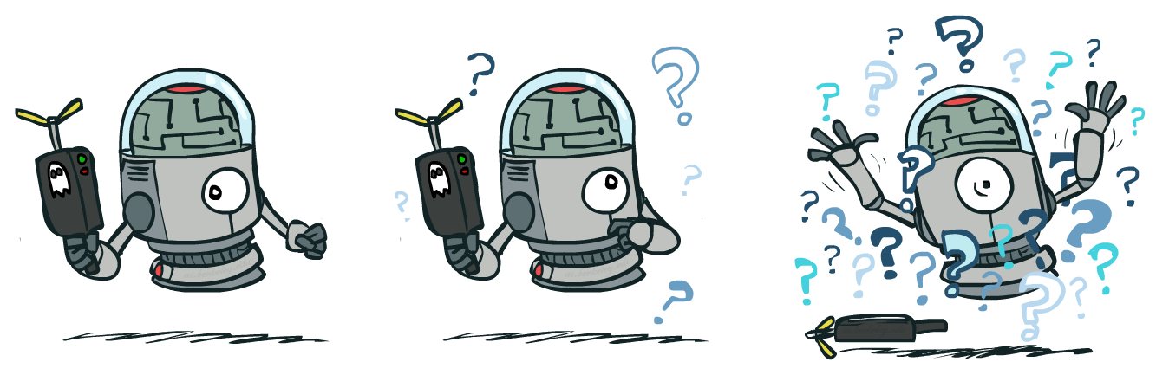
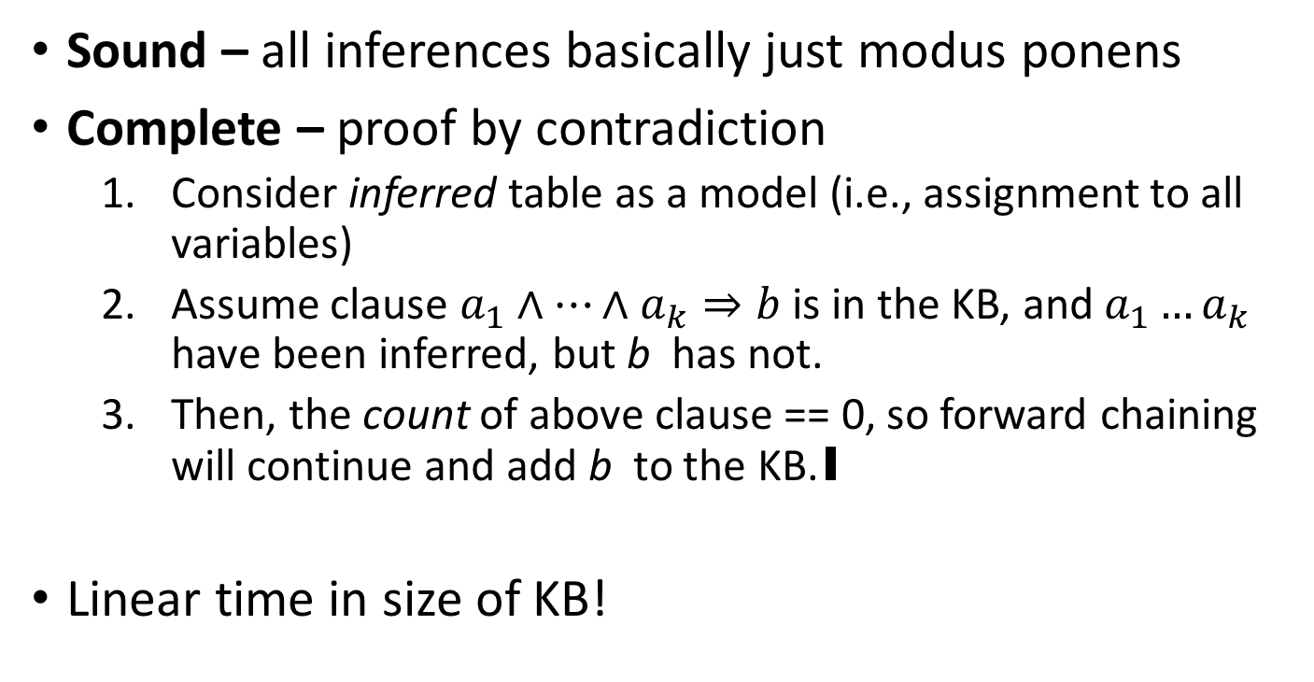
Forward Chaining Properties
Sound – all inferences basically just modus ponens
Complete – proof by contradiction
Consider inferred table as a model (i.e., assignment to all variables)
Assume clause $a_{1}∧…∧a_{k}⇒b$ is in the KB, and $a_{1}…a_{k}$ have been inferred, but b has not.
Then, the count of above clause == 0, so forward chaining will continue and add b to the KB.∎
Linear time in size of KB!

Slide 12
Applying Forward Chaining
Can run forward chaining either
To check if proposition q is entailed (return True if q is popped off the agenda)
To infer all atomic sentences entailed by the current KB
Incremental variant: add new facts to initiate new inferences
Good for e.g. wumpus agent!
Data-driven reasoning
Start with the known data, derive all entailed conclusions.

Slide 13
Forward-Backward Chaining
Forward Chaining
Reason forward to infer new facts from existing knowledge
Backward Chaining
Given a query, reason backward to find a chain of inference to prove it

Slide 14
Backward Chaining
def backward-chain(KB, q):
if q is True in KB: return True
else:
premises = premises of each clause c in KB s.t. c’s conclusion is q
for each premise in premises:
proven = 0
for each symbol in premise:
if backward-chain(KB, symbol): proven += 1
if proven == len(premise): return True
return False

Slide 15
Backward Chaining Example
$$P⇒Q$$
$$L∧M⇒P$$
$$B∧L⇒M$$
$$A∧P⇒L$$
$$A∧B⇒L$$
$$A$$
$$B$$

Slide 16
Backward Chaining Properties
Sound – only returns True when all premises are satisfied (definition of entailment)
Complete – given any q that is entailed by the KB, exhaustive recursive search of the premise symbols will find all steps of the entailment chain.
Also linear time in size of KB!
Often much faster than forward chaining for a specific q, because only uses the relevant statements

Slide 17
Applying Backward Chaining
Can only run backward chaining to check if specific q is entailed.
Goal-driven reasoning
Given a goal, work backwards to try to find an inference route to it.

Slide 18

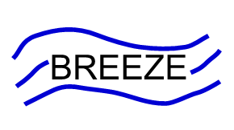



PIT
PIT

Slide 19
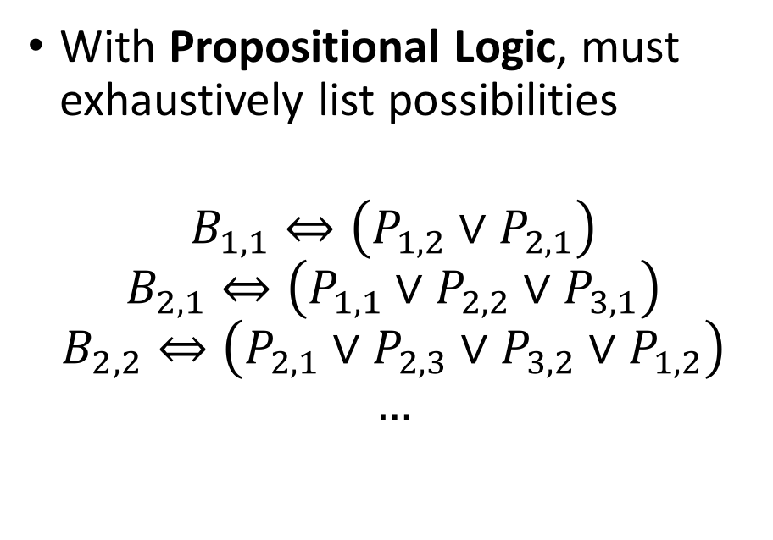
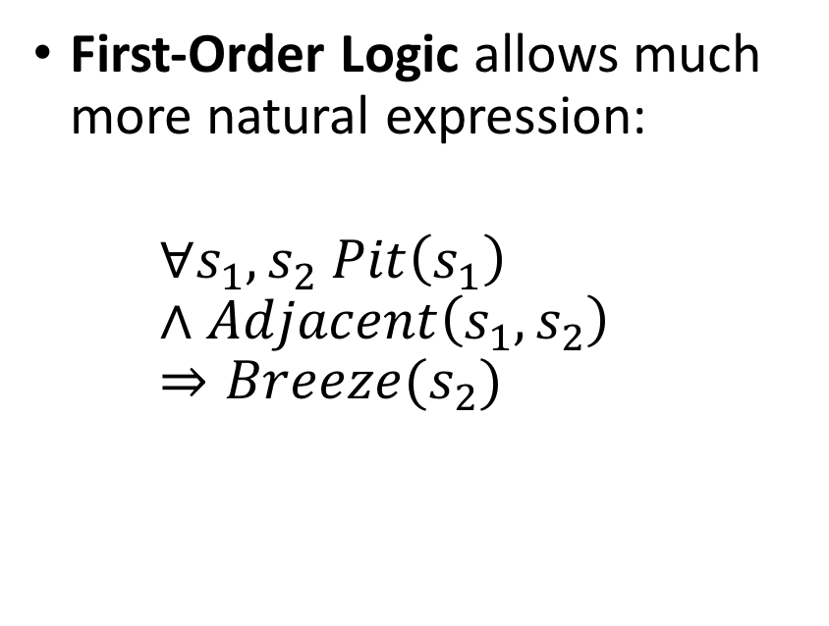
Expressiveness of Propositional Logic
Want to say: “There is a breeze in a square if it is next to a pit.”
With Propositional Logic, must exhaustively list possibilities
$$B_{1,1}⇔\left(P_{1,2}∨P_{2,1}\right)$$
$$B_{2,1}⇔\left(P_{1,1}∨P_{2,2}∨P_{3,1}\right)$$
$$B_{2,2}⇔\left(P_{2,1}∨P_{2,3}∨P_{3,2}∨P_{1,2}\right)$$
$$…$$
First-Order Logic allows much more natural expression:
$$∀s_{1},s_{2} Pit\left(s_{1}\right)∧Adjacent\left(s_{1},s_{2}\right)⇒Breeze(s_{2})$$

Slide 20
First-Order vs Propositional
First-Order Logic also involves statements about individual facts
Includes three changes for better expressivity:
Objects
Quantifiers
Relations and Functions
Allow FOL to better express statements about the real world!

Slide 21
FOL Models
Models (aka possible worlds) in first-order logic contain two kinds of things:
Objects – the specific things we’re talking about
Wumpus, adventurer, gold, squares, arrow
The set of these is the model’s domain
Must be nonempty!
Relations – sets of 1+ tuples of objects related in a certain way
Carry = { (adventurer, arrow) }
Binary, only one pair
Adjacent = { ([1,1], [1,2]), ([1,1], [2,1]), … }
Binary, many pairs
Adventurer = { (adventurer) }
Unary, only true for one object
Like a property
Object: w
Relation: Wumpus(w)

Slide 22
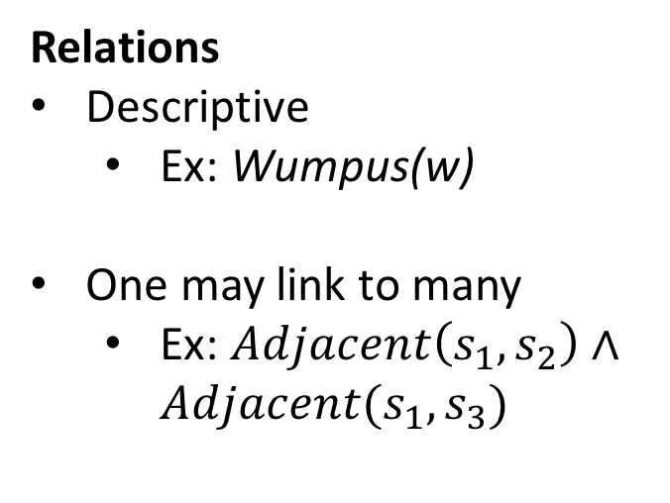
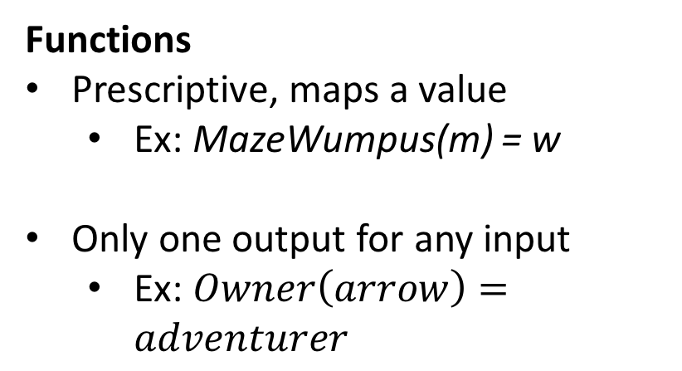
Relations vs Functions
Remember that this is just another name for the wumpus, not a subroutine!
Some relations are one-to-one in nature: only one “value” for any “input”. These can also be called functions.
Relations
Descriptive
Ex: Wumpus(w)
One may link to many
Ex: $Adjacent\left(s_{1},s_{2}\right)∧Adjacent(s_{1},s_{3})$
Functions
Prescriptive, maps a value
Ex: MazeWumpus(m) = w
Only one output for any input
Ex: $Owner\left(arrow\right)=adventurer$

Slide 23
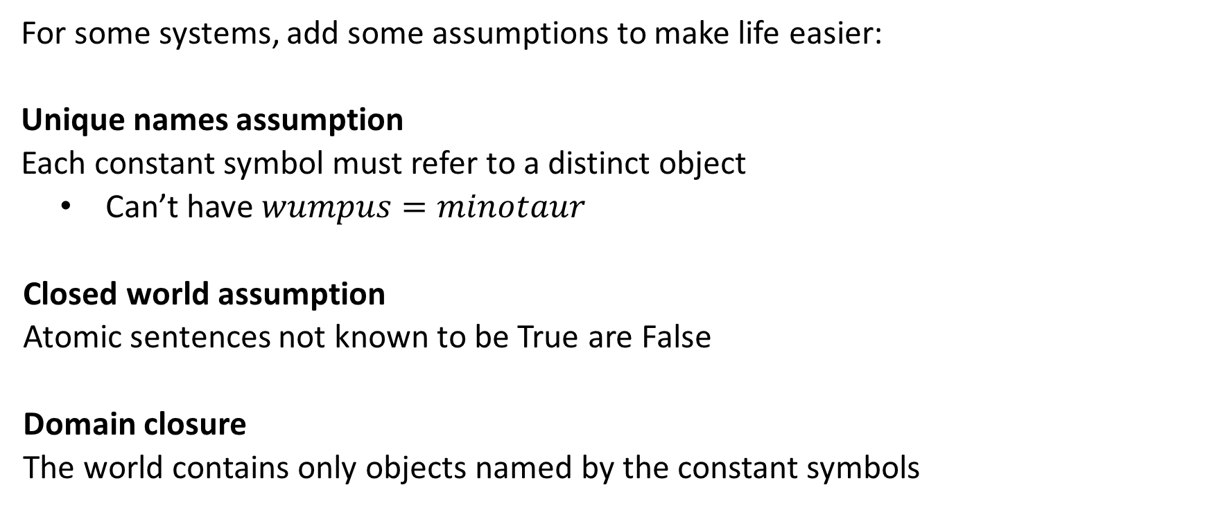
Aside: Database Semantics
For some systems, add some assumptions to make life easier:
Unique names assumption
Each constant symbol must refer to a distinct object
Can’t have $wumpus=minotaur$
Closed world assumption
Atomic sentences not known to be True are False
Domain closure
The world contains only objects named by the constant symbols
We mostly won’t be using these, but they’re important to know.

Slide 24
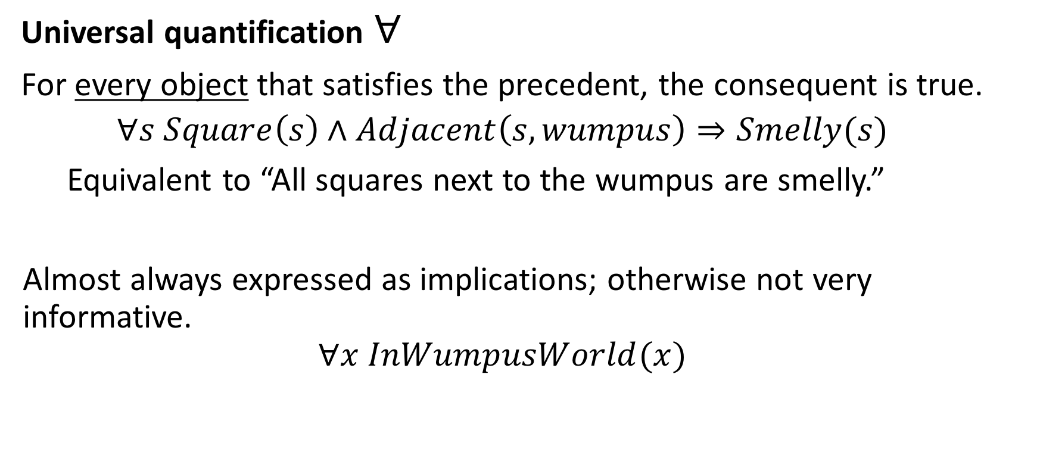
Quantifiers
Quantifiers allow expressing properties of collections of objects
Universal quantification $∀$
For every object that satisfies the precedent, the consequent is true.
$$∀s Square\left(s\right)∧Adjacent\left(s,wumpus\right)⇒Smelly(s)$$
Equivalent to “All squares next to the wumpus are smelly.”
Almost always expressed as implications; otherwise not very informative.
$$∀x InWumpusWorld(x)$$

Slide 25
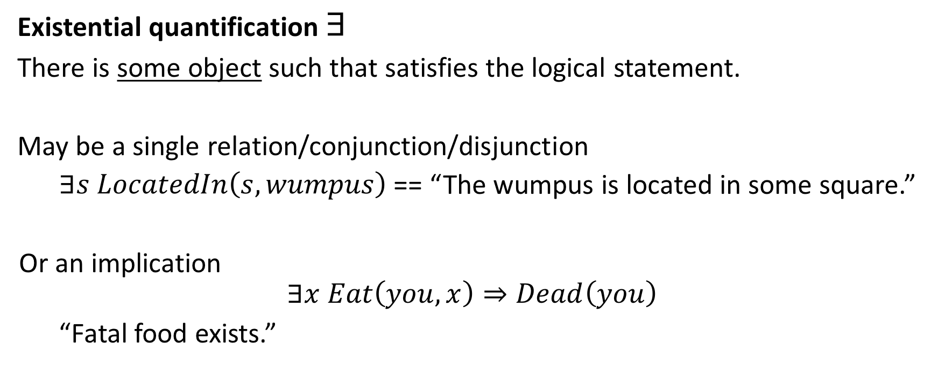
Quantifiers
Quantifiers allow expressing properties of collections of objects
Existential quantification $∃$
There is some object such that satisfies the logical statement.
May be a single relation/conjunction/disjunction
$∃s LocatedIn\left(s,wumpus\right)$ == “The wumpus is located in some square.”
Or an implication
$$∃x Eat\left(you, x\right)⇒Dead\left(you\right)$$
“Fatal food exists.”

Slide 26
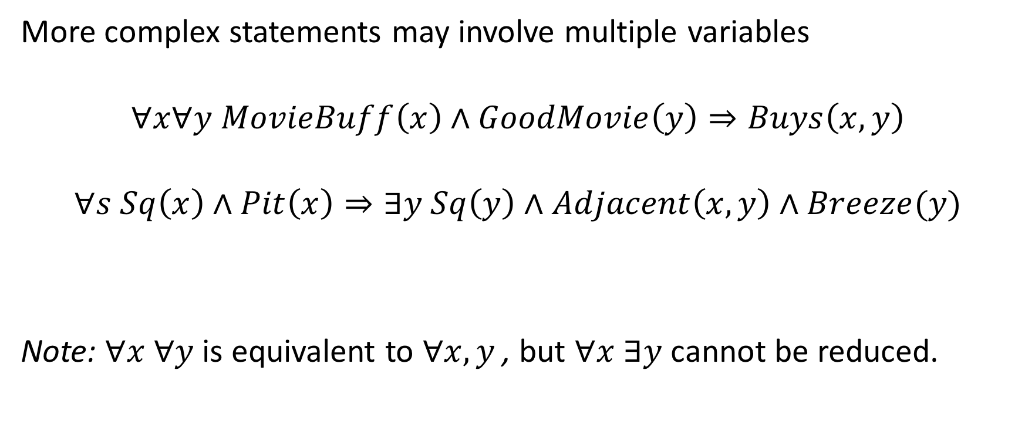
Nesting Quantifiers
More complex statements may involve multiple variables
$$∀x∀y MovieBuff\left(x\right)∧GoodMovie\left(y\right)⇒Buys\left(x,y\right)$$
$$∀s Sq\left(x\right)∧Pit\left(x\right)⇒∃y Sq\left(y\right)∧Adjacent\left(x,y\right)∧Breeze(y)$$
Note: $∀x ∀y$ is equivalent to $∀x,y$, but $∀x ∃y$ cannot be reduced.

Slide 27
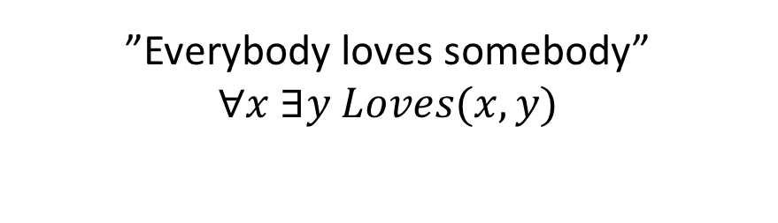
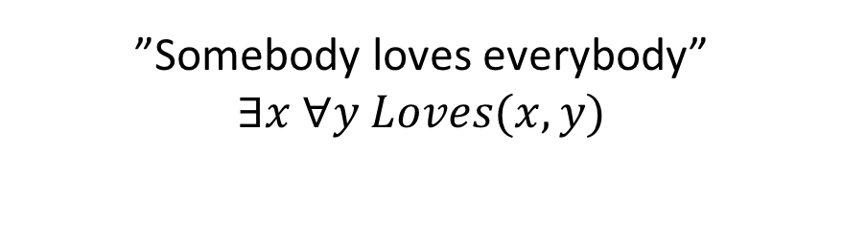
Order Matters!
”Everybody loves somebody”
$$∀x ∃y Loves(x,y)$$
”Somebody loves everybody”
$$∃x ∀y Loves(x,y)$$

Slide 28
Filling in Quantifiers
At inference time, we need concrete knowledge for inference.
Instantiation removes quantifiers by grounding the free variables in the scope to one or more concrete objects.
In practice, instantiation can often be done multiple ways; left up to programmer to decide.

Slide 29
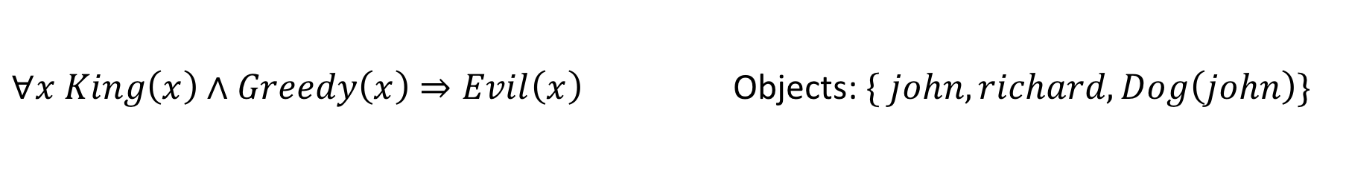
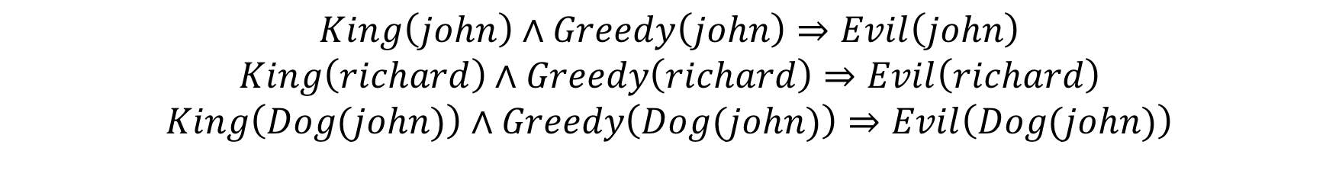
Instantiation
For Universals: can substitute in as many objects from the database as desired.
$∀x King\left(x\right)∧Greedy\left(x\right)⇒Evil\left(x\right)$ Objects: $\{ john, richard, Dog\left(john\right)\}$
$$King\left(john\right)∧Greedy\left(john\right)⇒Evil\left(john\right)$$
$$King\left(richard\right)∧Greedy\left(richard\right)⇒Evil\left(richard\right)$$
$$King\left(Dog(john)\right)∧Greedy\left(Dog(john)\right)⇒Evil\left(Dog(john)\right)$$
May not always be useful! (John’s dog will probably not be king, sadly)

Slide 30
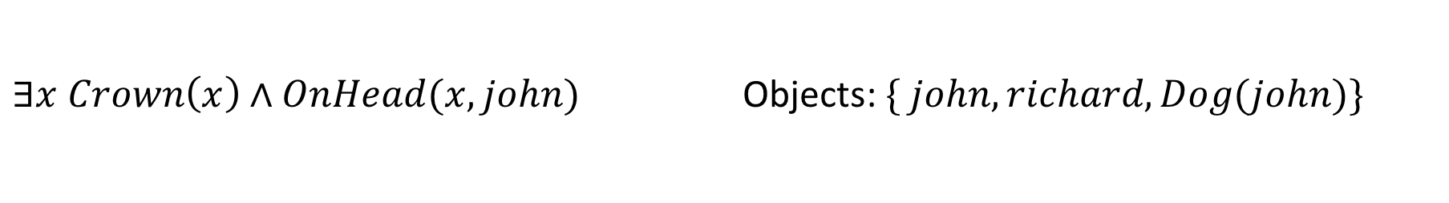
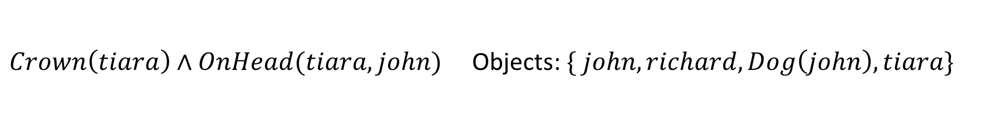
Instantiation
For Existentials: add a new object to the KB to replace the free variable
$∃x Crown\left(x\right)∧OnHead(x, john)$ Objects: $\{ john, richard, Dog(john)\}$
$Crown\left(tiara\right)∧OnHead(tiara, john)$ Objects: $\{ john, richard, Dog\left(john\right),tiara\}$
For implications, may want to substitute an existing object
Often determined by problem considerations in practice

Slide 31

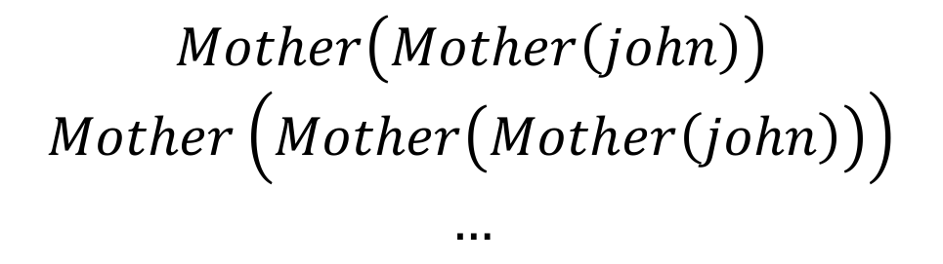
FOL back to Propositional Logic
Can keep applying instantiation to remove all quantifiers;
This is called propositionalization
Reduces a FOL knowledge base back to a propositional KB, allows for propositional inference
But, if KB includes functions, the propositional KB can be infinite!
$$Mother\left(Mother\left(john\right)\right)$$
$$Mother\left(Mother\left(Mother\left(john\right)\right)\right)$$
$$…$$
$$Mother(john)$$

Slide 32
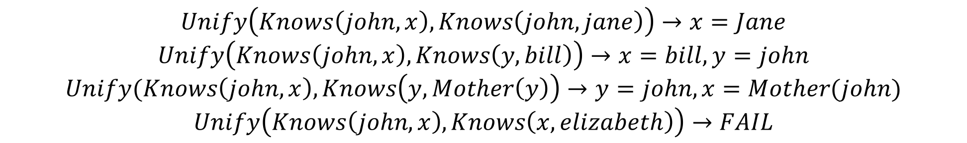
FOL Inference: Unification
Unification – finding ways to logically combine two sentences to make them equivalent
Returns variable assignments that support equivalence
$$Unify\left(Knows\left(john, x\right), Knows\left(john,jane\right)\right)→x=Jane$$
$$Unify\left(Knows\left(john,x\right), Knows\left(y,bill\right)\right)→x=bill, y=john$$
$$Unify(Knows\left(john,x\right), Knows\left(y,Mother\left(y\right)\right)→y=john, x=Mother(john)$$
$$Unify\left(Knows\left(john,x\right), Knows\left(x,elizabeth\right)\right)→FAIL$$
Main tool in FOL inference
Primary operation in Prolog (programming language designed for logical inference)

Slide 33
FOL Inference: Forward-Backward Chaining
Forward-backward chaining used for FOL also
Same general idea:
Forward chaining: reason up from existing evidence
Backward chaining: reason down from desired inference
Implementation gets a lot more complicated…
Out of scope!

Slide 34
FOL Inference: Human Practice
Describe relevant rules in English
Convert to FOL statements
Try to infer pit and wumpus status
???
???
???

Slide 35

Logical Inference Summary
Main point: it’s still search!
Primarily DFS
This is how unification is implemented in Prolog
Conjunction/disjunction/implication yield graph structures; can then use graph search.

Slide 36
Incorporating time
All knowledge (model info) about the current state must be represented as logic.
So what about things that change over time?
Position in wumpus world
Wumpus alive/dead state
Pacman dots

Slide 37
Incorporating time
Introduce time as a new variable
$Pos{\left(adventurer,x,y\right)}^{t}$ -- Adventurer’s position at time t
Movement rule:
$$Pos{\left(adv, x, y\right)}^{t}∧MoveNorth{\left(adv\right)}^{t}⇒Pos{\left(adv,x,y+1\right)}^{t+1}$$

Slide 38
Planning
Search for actions…
But now with logic!

Slide 39
Planning
Update our propositional logic agent to support variable-based action search
Propositional logic agent relies on fully-enumerated, variable-free KBs
As we’ve seen, variable-based inference is more flexible
And can handle infinite KBs!
Planning uses FOL-based representations of factored states
What is changing in the state due to the action

Slide 40
STRIPS language
Wikipedia

Slide 41
What problem is planning solving?
Practical problem
How can I efficiently reason about what actions to take, using knowledge about the world?
Can support sub-goals during progress through search space!
Philosophical problem
How much knowledge about the world do I actually need to decide on an action?
How much can I let the world itself tell me?

Slide 42
Next Time
Video on IBM’s Watson project
AI in the real world! (Discusses search, logic, machine learning)

