Slide 1
Announcements

Slide 2
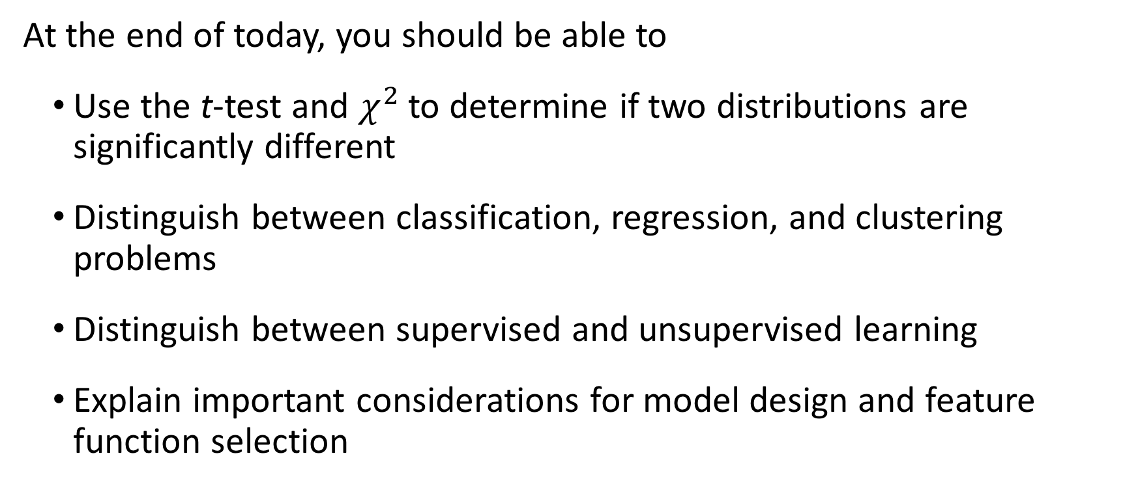
Today’s learning goals
At the end of today, you should be able to
Use the t-test and $χ^{2}$ to determine if two distributions are significantly different
Distinguish between classification, regression, and clustering problems
Distinguish between supervised and unsupervised learning
Explain important considerations for model design and feature function selection

Slide 3
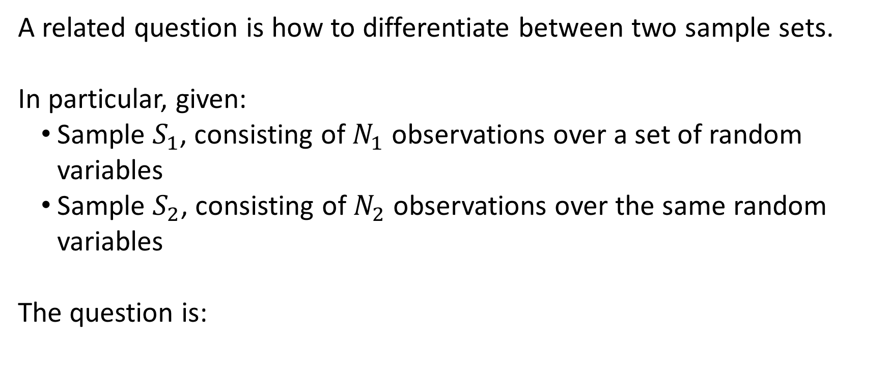

Telling if two distributions are different
A related question is how to differentiate between two sample sets.
In particular, given:
Sample $S_{1}$, consisting of $N_{1}$ observations over a set of random variables
Sample $S_{2}$, consisting of $N_{2}$ observations over the same random variables
The question is:
What is the likelihood that $S_{1}$ and $S_{2}$ came from the same underlying distribution?

Slide 4
Hypothesis testing
This question is approached via hypothesis testing.
The general approach is:
Formulate the null and alternative hypotheses
Choose a test statistic and significance level for determining which hypothesis is supported by evidence
These may be chosen based on assumptions about the problem
Compare observed distribution and reference distribution from test statistic to see if they are statistically significantly different

Slide 5

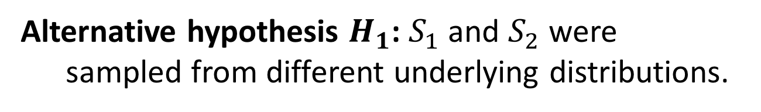
Hypothesis testing
Considering $S_{1}$ and $S_{2}$, this might look like the following:
Step 1: Formulate hypotheses
Null hypothesis $H_{0}$: $S_{1}$ and $S_{2}$ were sampled from the same underlying distribution.
Alternative hypothesis $H_{1}$: $S_{1}$ and $S_{2}$ were sampled from different underlying distributions.

Slide 6
Aside: Good hypotheses
Null and alternative hypotheses must satisfy at least the following conditions to be well formed:
The null hypothesis states the absence of the effect or relationship being tested for, while the alternative hypothesis states its presence
The hypotheses must be testable; i.e., you can make the necessary observations to estimate distributions to compare.

Slide 7
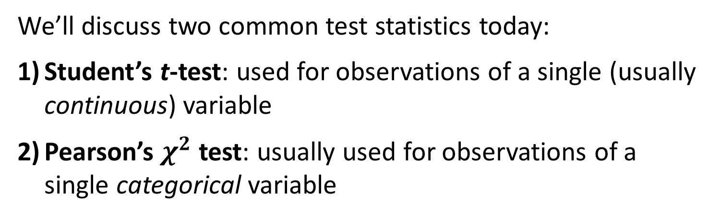
Hypothesis testing
Considering $S_{1}$ and $S_{2}$, this might look like the following:
Step 2a: Choose test statistic
We’ll discuss two common test statistics today:
Student’s t-test: used for observations of a single (usually continuous) variable
Pearson’s $χ^{2}$ test: usually used for observations of a single categorical variable

Slide 8
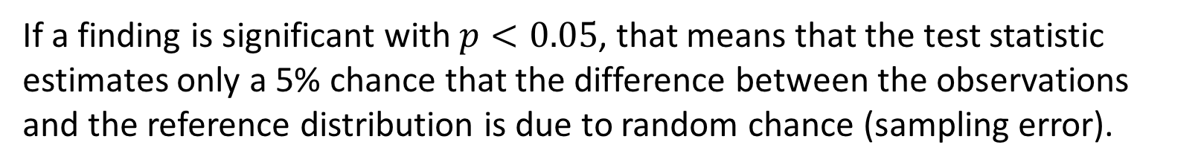
Hypothesis testing
Considering $S_{1}$ and $S_{2}$, this might look like the following:
Step 2b: Choose a significance level
Most commonly, $p<0.05$ or $p<0.01$ is chosen.
What does this mean?
If a finding is significant with $p<0.05$, that means that the test statistic estimates only a 5% chance that the difference between the observations and the reference distribution is due to random chance (sampling error).

Slide 9
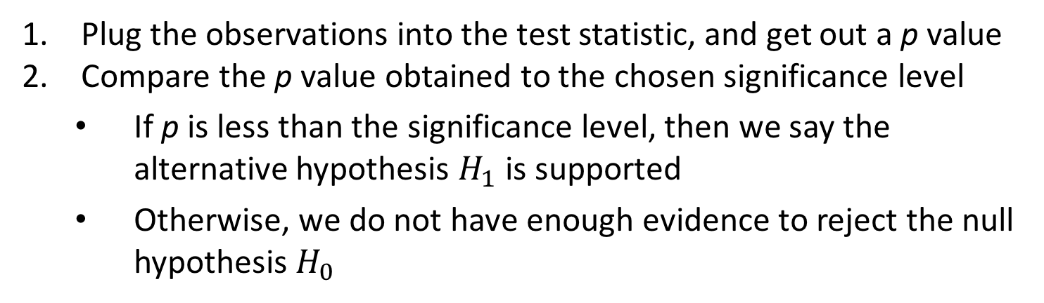
Hypothesis testing
Considering $S_{1}$ and $S_{2}$, this might look like the following:
Step 3: Evaluate the observed distribution using the test statistic
Plug the observations into the test statistic, and get out a p value
Compare the p value obtained to the chosen significance level
If p is less than the significance level, then we say the alternative hypothesis $H_{1}$ is supported
Otherwise, we do not have enough evidence to reject the null hypothesis $H_{0}$

Slide 10
Remember: significance is NOT proof

Slide 11
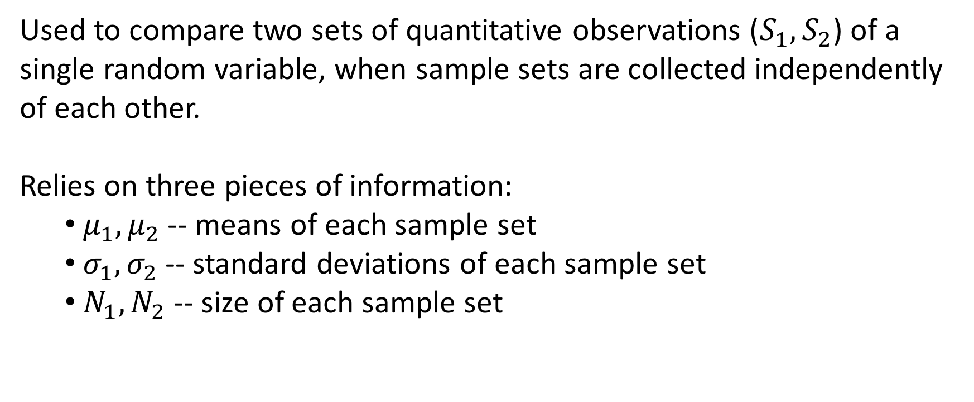
Student’s t-test
Used to compare two sets of quantitative observations ($S_{1},S_{2}$) of a single random variable, when sample sets are collected independently of each other.
Relies on three pieces of information:
$μ_{1},μ_{2}$ -- means of each sample set
$σ_{1},σ_{2}$ -- standard deviations of each sample set
$N_{1},N_{2}$ -- size of each sample set

Slide 12
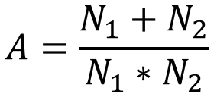
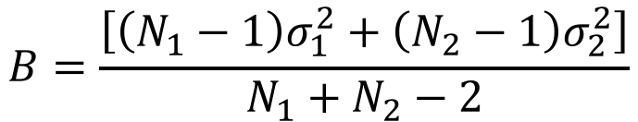
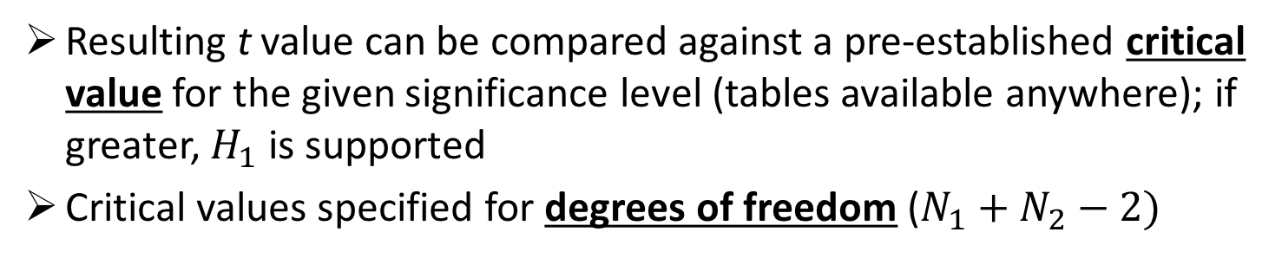
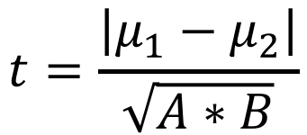
Student’s t-test
Calculated as:
$$t=\frac{\left|μ_{1}−μ_{2}\right|}{\sqrt{A∗B}}$$
Where:
$$A=\frac{N_{1}+N_{2}}{N_{1}∗N_{2}}$$
$$B=\frac{\left[\left(N_{1}−1\right)σ_{1}^{2}+\left(N_{2}−1\right)σ_{2}^{2}\right]}{N_{1}+N_{2}−2}$$
Resulting t value can be compared against a pre-established critical value for the given significance level (tables available anywhere); if greater, $H_{1}$ is supported
Critical values specified for degrees of freedom ($N_{1}+N_{2}−2)$

Slide 13
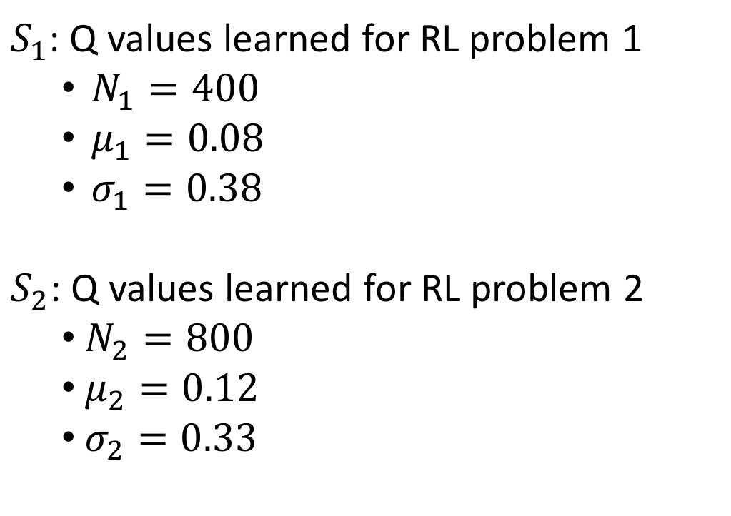
Example: are these RL problems different?
$S_{1}$: Q values learned for RL problem 1
$N_{1}=400$
$μ_{1}=0.08$
$σ_{1}=0.38$
$S_{2}$: Q values learned for RL problem 2
$N_{2}=800$
$μ_{2}=0.12$
$σ_{2}=0.33$
Using
Student’s t test
Significance level 0.05

Slide 14
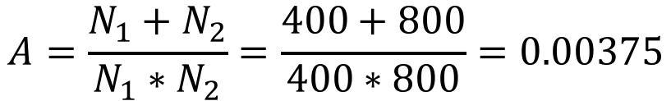
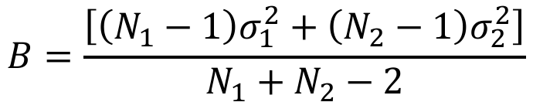
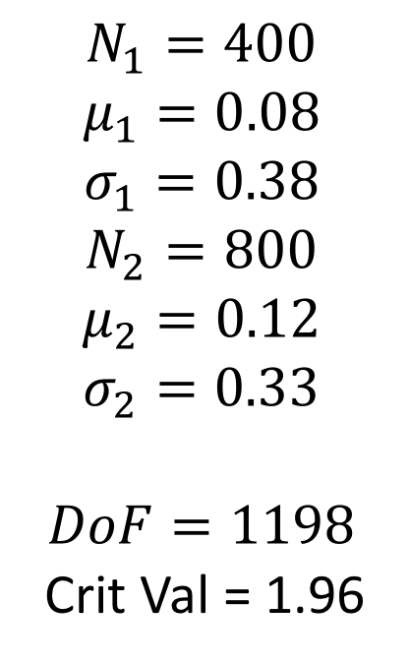
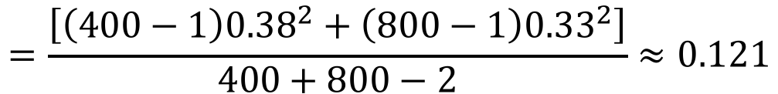
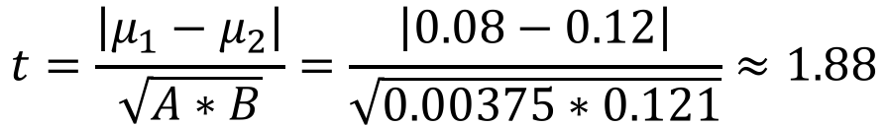
Example: are these RL problems different?
$$N_{1}=400$$
$$μ_{1}=0.08$$
$$σ_{1}=0.38$$
$$N_{2}=800$$
$$μ_{2}=0.12$$
$$σ_{2}=0.33$$
$$DoF=1198$$
Crit Val = 1.96
$$A=\frac{N_{1}+N_{2}}{N_{1}∗N_{2}}=\frac{400+800}{400∗800}=0.00375$$
$$B=\frac{\left[\left(N_{1}−1\right)σ_{1}^{2}+\left(N_{2}−1\right)σ_{2}^{2}\right]}{N_{1}+N_{2}−2}$$
$$=\frac{\left[\left(400−1\right){0.38}^{2}+\left(800−1\right){0.33}^{2}\right]}{400+800−2}≈0.121$$
$$t=\frac{\left|μ_{1}−μ_{2}\right|}{\sqrt{A∗B}}=\frac{\left|0.08−0.12\right|}{\sqrt{0.00375∗0.121}}≈1.88$$
Since 1.88 < 1.96, we cannot reject the null hypothesis (that the two problems are the same).

Slide 15

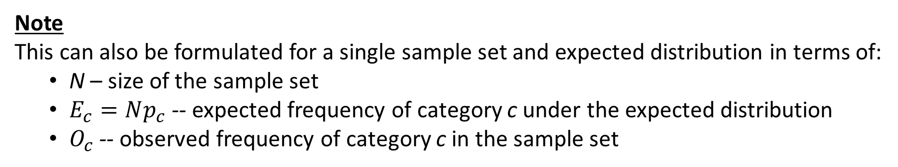
Pearson’s $χ^{2}$ test
Used to compare two sets of categorical observations ($S_{1},S_{2}$) of a single random variable.
With category set C, relies on:
$X_{1},X_{2}$ -- frequency of each category $c∈C$ in each sample set
Note
This can also be formulated for a single sample set and expected distribution in terms of:
N – size of the sample set
$E_{c}=Np_{c}$ -- expected frequency of category c under the expected distribution
$O_{c}$ -- observed frequency of category c in the sample set

Slide 16
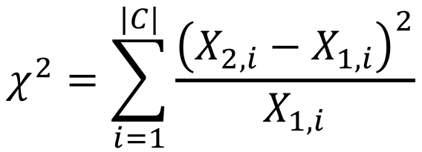
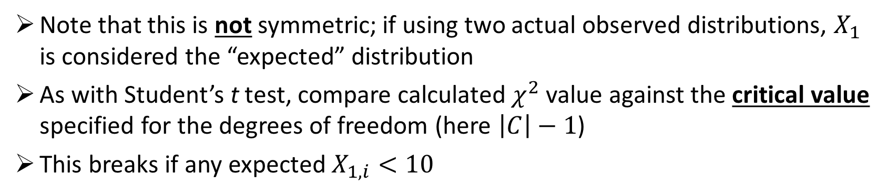
Pearson’s $χ^{2}$ test
Calculated as:
$$χ^{2}=\sum_{i=1}^{|C|}{\frac{{\left(X_{2,i}−X_{1,i}\right)}^{2}}{X_{1,i}}}$$
Where $X_{1,i}$ is the frequency of category $i$ in $X_{1}$ (and the same for $X_{2}$)
Note that this is not symmetric; if using two actual observed distributions, $X_{1}$ is considered the “expected” distribution
As with Student’s t test, compare calculated $χ^{2}$ value against the critical value specified for the degrees of freedom (here $\left|C\right|−1$)
This breaks if any expected $X_{1,i}<10$

Slide 17

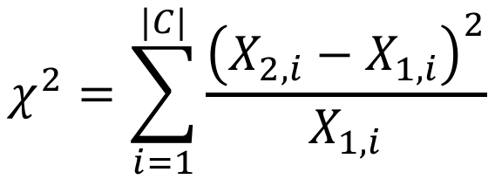
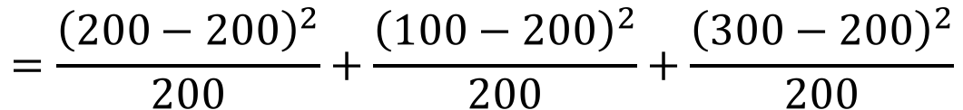


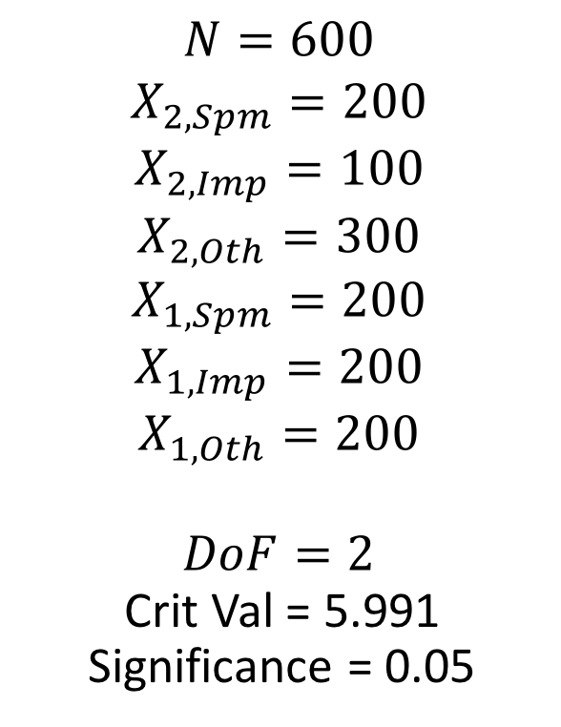
Example: Is an email classifier different from random?
$$C=\{Spam,Important,Other\}$$
$$N=600$$
$$X_{2,Spm}=200$$
$$X_{2,Imp}=100$$
$$X_{2,Oth}=300$$
$$X_{1,Spm}=200$$
$$X_{1,Imp}=200$$
$$X_{1,Oth}=200$$
$$DoF=2$$
Crit Val = 5.991
Significance = 0.05
$$χ^{2}=\sum_{i=1}^{|C|}{\frac{{\left(X_{2,i}−X_{1,i}\right)}^{2}}{X_{1,i}}}$$
$$=\frac{{\left(200−200\right)}^{2}}{200}+\frac{{\left(100−200\right)}^{2}}{200}+\frac{{\left(300−200\right)}^{2}}{200}$$
$$=100>5.991$$
Here, we reject $H_{0}$ and say that the email classifier is different from random.

Slide 18
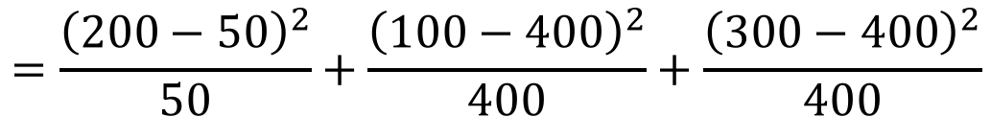


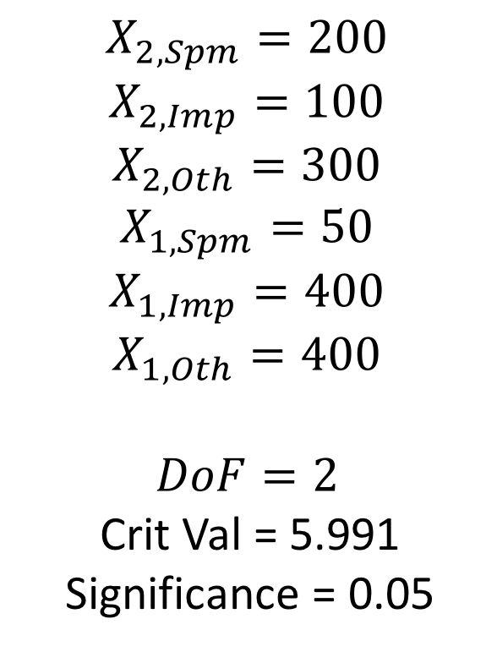
Example: Is one email classifier different from another?
$$C=\{Spam,Important,Other\}$$
$$X_{2,Spm}=200$$
$$X_{2,Imp}=100$$
$$X_{2,Oth}=300$$
$$X_{1,Spm}=50$$
$$X_{1,Imp}=400$$
$$X_{1,Oth}=400$$
$$DoF=2$$
Crit Val = 5.991
Significance = 0.05
$$χ^{2}=\sum_{i=1}^{|C|}{\frac{{\left(X_{2,i}−X_{1,i}\right)}^{2}}{X_{1,i}}}$$
$$=\frac{{\left(200−50\right)}^{2}}{50}+\frac{{\left(100−400\right)}^{2}}{400}+\frac{{\left(300−400\right)}^{2}}{400}$$
$$=700>5.991$$
Here, we reject $H_{0}$ and say that the second email classifier is different from the first.

Slide 19
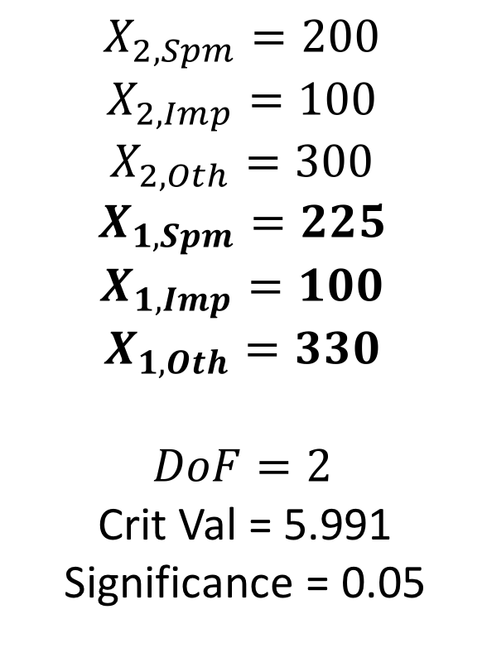
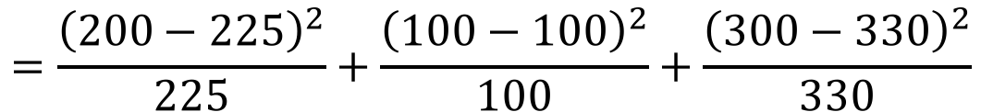

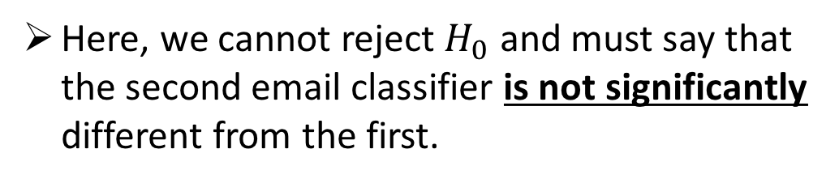
Example: Is one email classifier different from another?
$$C=\{Spam,Important,Other\}$$
$$X_{2,Spm}=200$$
$$X_{2,Imp}=100$$
$$X_{2,Oth}=300$$
$$X_{1,Spm}=225$$
$$X_{1,Imp}=100$$
$$X_{1,Oth}=330$$
$$DoF=2$$
Crit Val = 5.991
Significance = 0.05
$$χ^{2}=\sum_{i=1}^{|C|}{\frac{{\left(X_{2,i}−X_{1,i}\right)}^{2}}{X_{1,i}}}$$
$$=\frac{{\left(200−225\right)}^{2}}{225}+\frac{{\left(100−100\right)}^{2}}{100}+\frac{{\left(300−330\right)}^{2}}{330}$$
$$≈5.51<5.991$$
Here, we cannot reject $H_{0}$ and must say that the second email classifier is not significantly different from the first.
Notes:
Different reference distribution

Slide 20
How many samples do we need?
Now we have one clue!
Based on:
The size of the difference (effect) you want to measure
Number of categories/samples in the reference distribution
Chosen test and significance level
We can at least start to get an idea of how many samples we’d need to call an observed difference statistically significant or not.

Slide 21
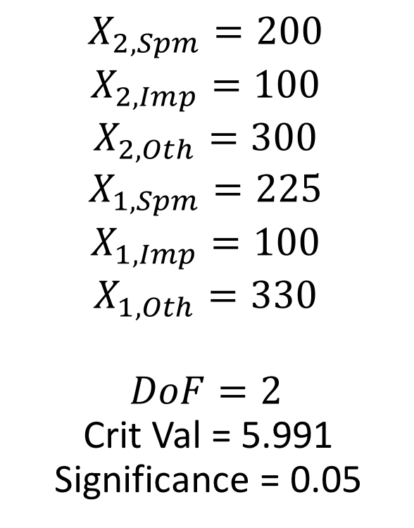
Example: doubling sample size
$$C=\{Spam,Important,Other\}$$
$$X_{2,Spm}=200$$
$$X_{2,Imp}=100$$
$$X_{2,Oth}=300$$
$$X_{1,Spm}=225$$
$$X_{1,Imp}=100$$
$$X_{1,Oth}=330$$
$$DoF=2$$
Crit Val = 5.991
Significance = 0.05
$$χ^{2}=\sum_{i=1}^{|C|}{\frac{{\left(X_{2,i}−X_{1,i}\right)}^{2}}{X_{1,i}}}$$
$$=\frac{{\left(200−225\right)}^{2}}{225}+\frac{{\left(100−100\right)}^{2}}{100}+\frac{{\left(300−330\right)}^{2}}{330}$$
$$≈5.51<5.991$$
Here, we cannot reject $H_{0}$ and must say that the second email classifier is not significantly different from the first.
Notes:
Original, not different

Slide 22
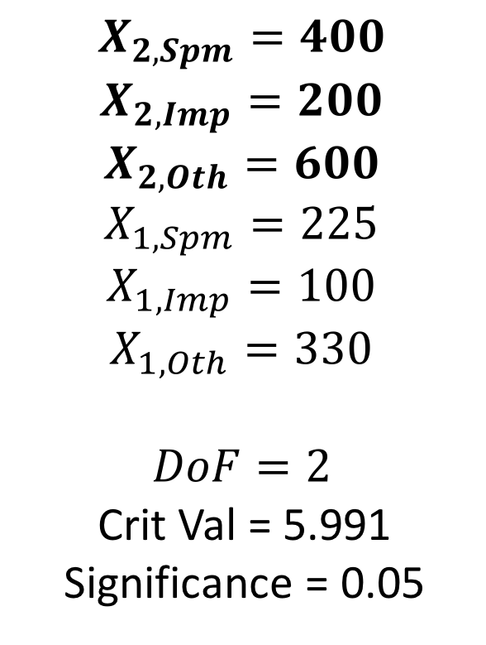
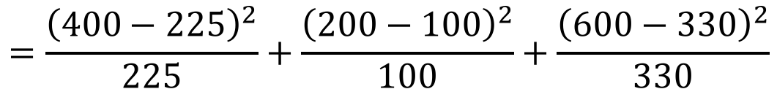


Example: doubling sample size
$$C=\{Spam,Important,Other\}$$
$$X_{2,Spm}=400$$
$$X_{2,Imp}=200$$
$$X_{2,Oth}=600$$
$$X_{1,Spm}=225$$
$$X_{1,Imp}=100$$
$$X_{1,Oth}=330$$
$$DoF=2$$
Crit Val = 5.991
Significance = 0.05
$$χ^{2}=\sum_{i=1}^{|C|}{\frac{{\left(X_{2,i}−X_{1,i}\right)}^{2}}{X_{1,i}}}$$
$$=\frac{{\left(400−225\right)}^{2}}{225}+\frac{{\left(200−100\right)}^{2}}{100}+\frac{{\left(600−330\right)}^{2}}{330}$$
$$≈457.02<5.991$$
Now we can reject $H_{0}$, because a larger sample size has made us more confident.
Notes:
Twice the samples, now it’s different

Slide 23
Summary: Probability
Frequentist approaches use many observations to develop a distribution
Bayesian approaches calculate a posterior from a prior distribution and evidence
Marginalization, normalization, the Product Rule (and Chain Rule), conditional probability, and Bayes’ Rule are the basic toolkit for probability with multiple random variables
Independence assumptions simplify models and reduce the number of samples needed
Hypothesis testing lets us tell if two distributions are statistically significantly different

Slide 24
Machine learning
We’ve been talking about learning distributions from evidence.
What about learning functions?
That’s machine learning!

Slide 25
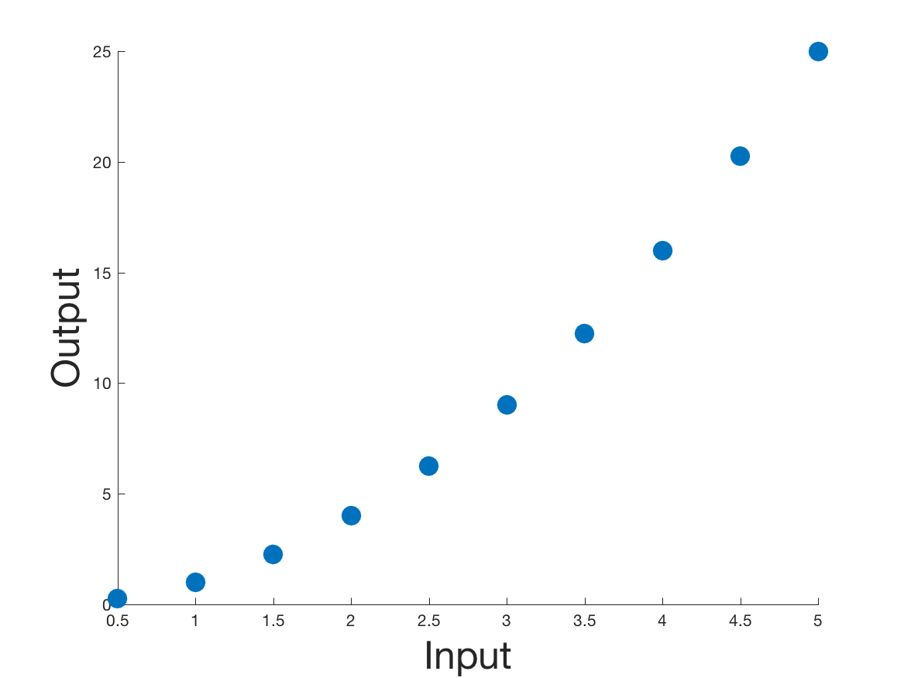
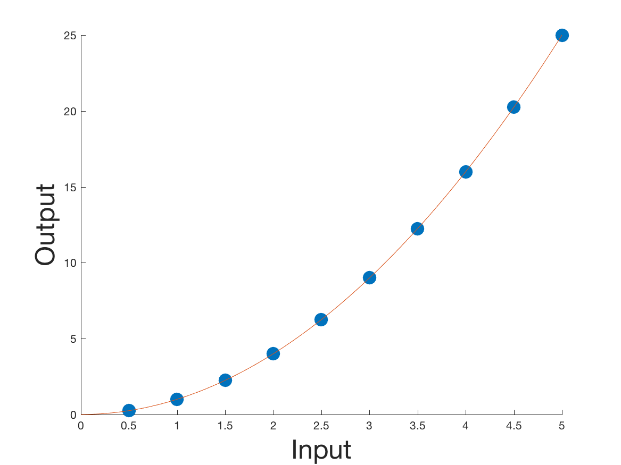
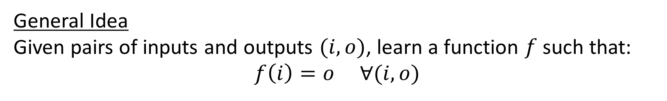
Machine learning
General Idea
Given pairs of inputs and outputs $(i,o)$, learn a function $f$ such that:
$$f\left(i\right)=o ∀(i,o)$$

Slide 26
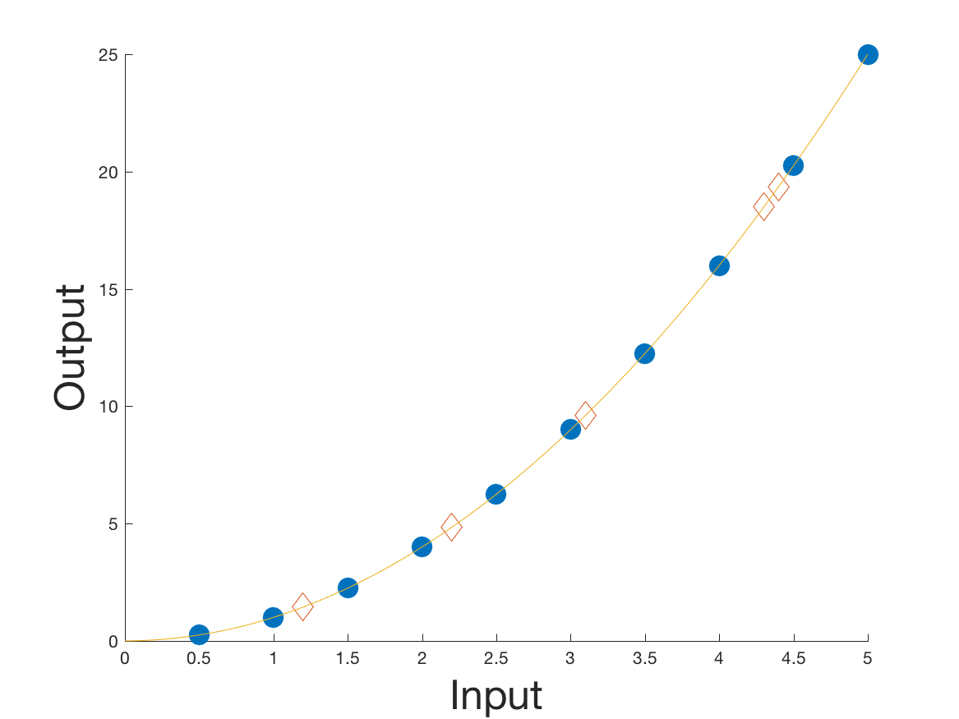
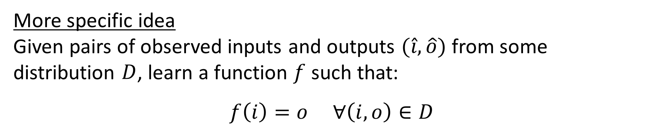
Machine learning
More specific idea
Given pairs of observed inputs and outputs $(\hat{i},\hat{o})$ from some distribution $D$, learn a function $f$ such that:
$$f\left(i\right)=o ∀\left(i,o\right)∈D$$

Slide 27
Kinds of machine learning problems
Three main kinds of problems:
Classification
Regression
Clustering

Slide 28
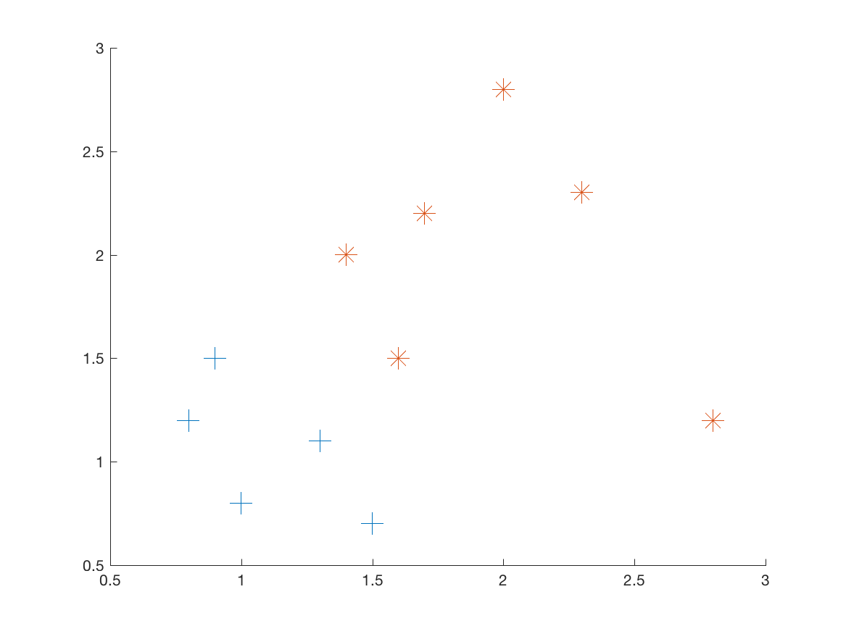
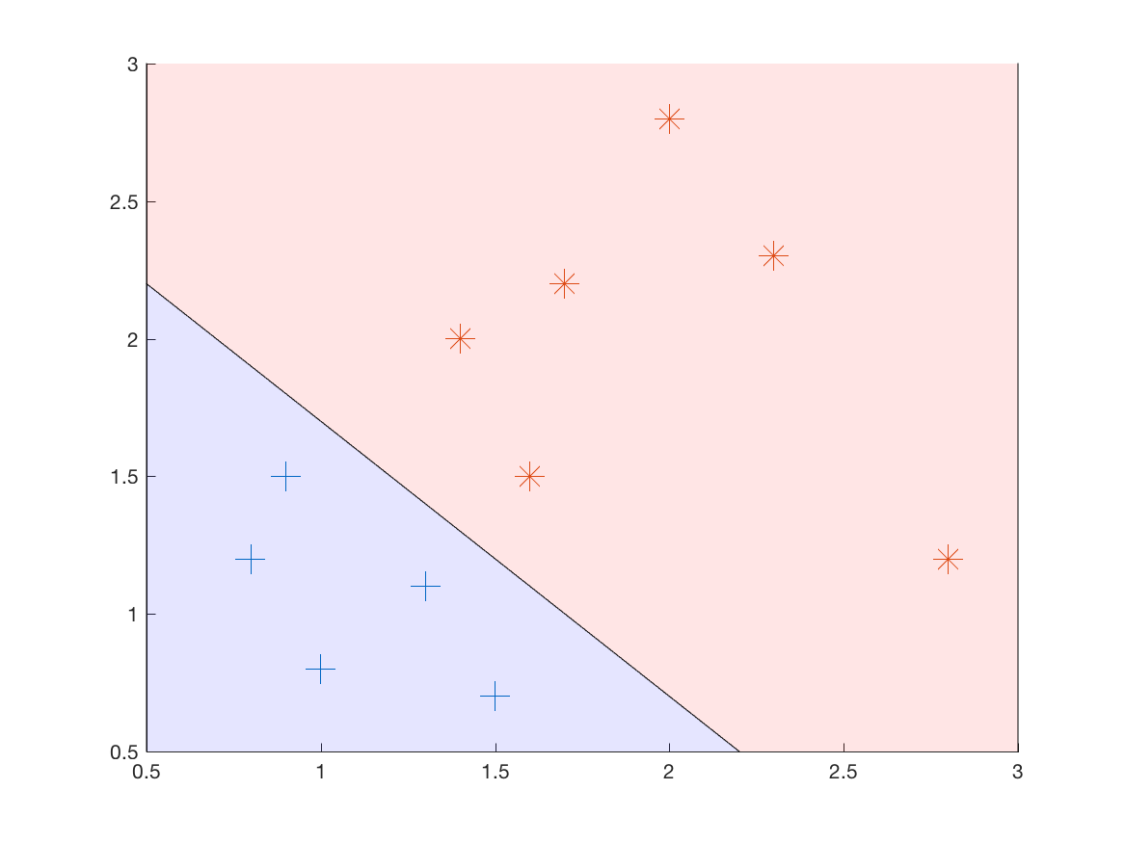
Classification
Task: Given points with some categorical label, learn to predict that label from input features.
Example with 2-D features and binary label

Slide 29
Regression
Task: Given points with some continuous label, learn to predict that label from input features.
Example with 1-D input and continuous label

Slide 30
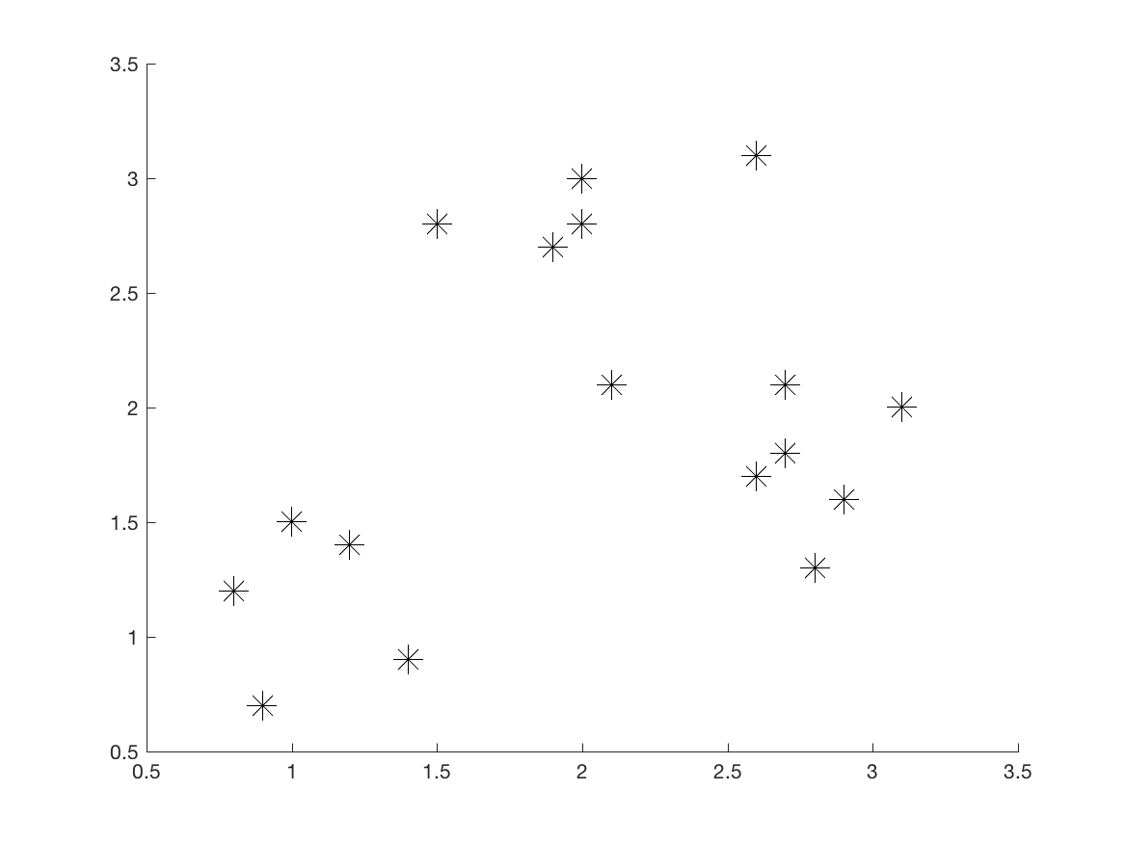
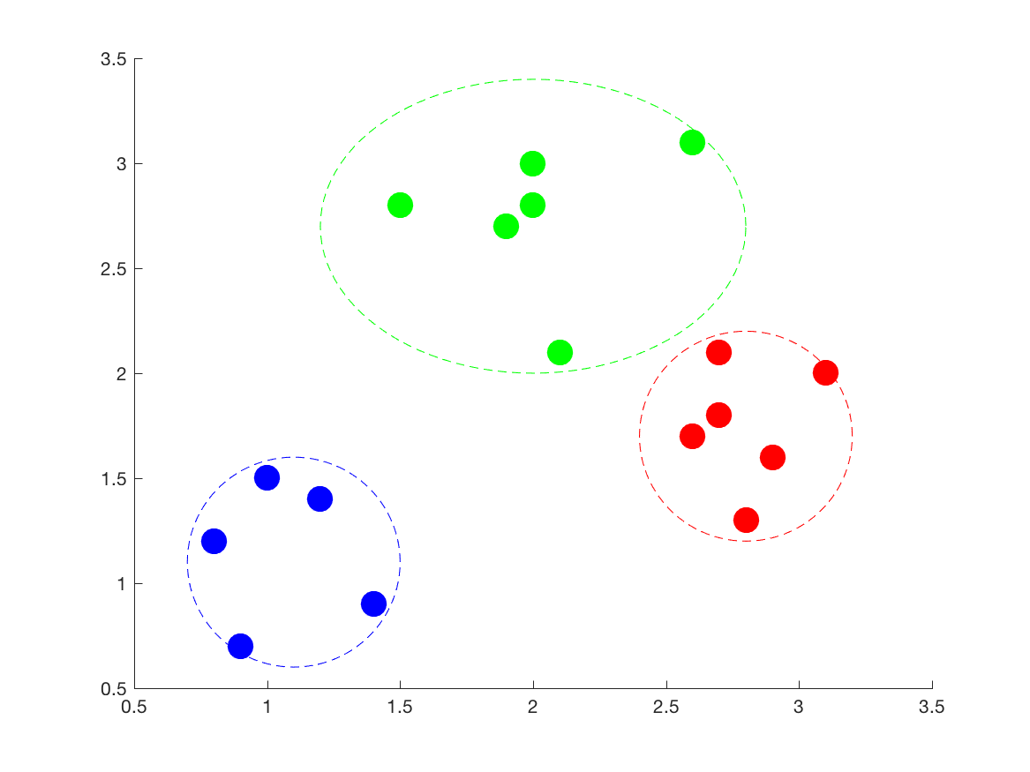
What is clustering?
Task: Given points (without a label), find descriptive structure in the data (i.e., similar points).
Example with 2-D input

Slide 31
How do we actually learn these things?
In general, follow a Bayesian style of learning:
Start with an initial model (the prior)
Sample data and get feedback on how well our model describes the samples
Use the feedback to adjust the model (get a posterior)
Questions we’ll talk about for the rest of today:
What kind of feedback do we use?
What can/should the model look like?
How do we represent the data?

Slide 32
Kinds of feedback for learning
Reinforcement learning
Get a reward (or punishment), use to learn if the actions you’ve taken are good.
Got this one down.

Slide 33
Kinds of feedback for learning
Supervised learning
Given inputs with ”correct” outputs
Get predicted output from current model
Use error between prediction and correct label to update the model
Classification and regression are supervised learning tasks.

Slide 34
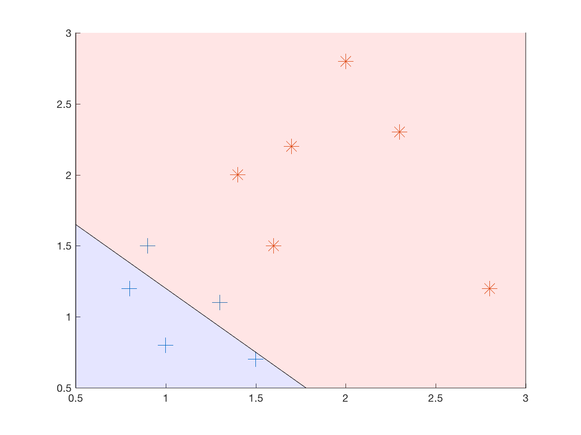
Example: binary classification
Output of current model
Updated model after feedback
Two + points are misclassified as * points

Slide 35
Kinds of feedback for learning
Unsupervised learning
Given inputs only, nothing designated as “output”
Try to describe patterns in the data with the current model
Update the model to get better patterns
Clustering is an unsupervised learning task.

Slide 36
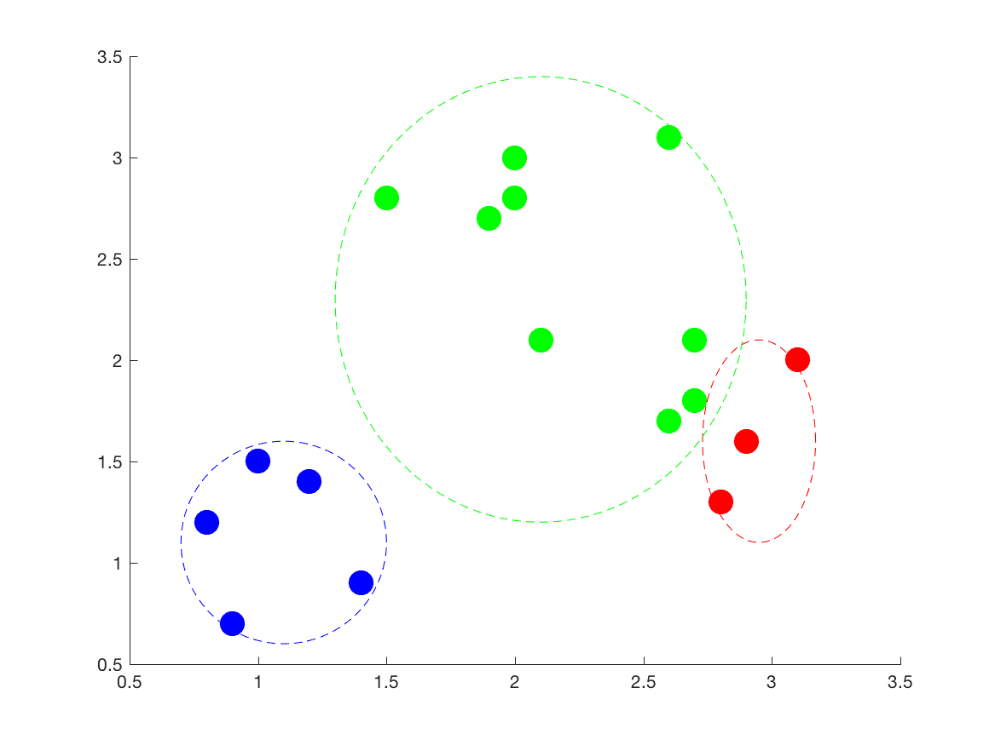
Example: clustering
Output of current model
Updated model after feedback
Three points in the green cluster don’t really seem to belong

Slide 37
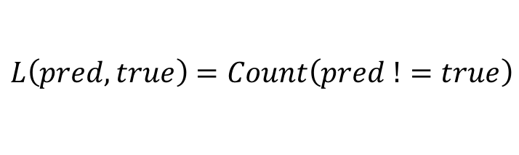
What form does feedback take?
Loss function – scalar measurement of the error under the current model.
Designed for the specific task at hand
Want to minimize this
Different loss functions emphasize different things
Examples:
$$L\left(pred,true\right)=Count\left(pred !=true\right)$$
Output of current model
Doesn’t care how far it was from the deciding line, just that it was wrong

Slide 38
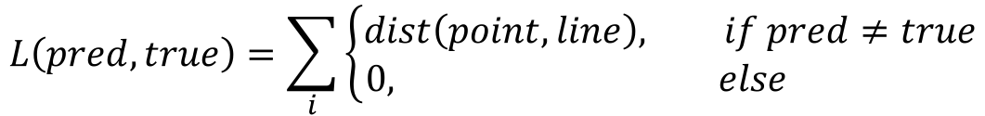
What form does feedback take?
Loss function – scalar measurement of the error under the current model.
Designed for the specific task at hand
Want to minimize this
Different loss functions emphasize different things
Examples:
$$L\left(pred,true\right)=\sum_{i}{\left\{\begin{aligned}dist\left(point,line\right), if pred≠true \\ 0, else \end{aligned}\right.}$$
Output of current model
Want to minimize the distance to the deciding long, when it’s wrong

Slide 39
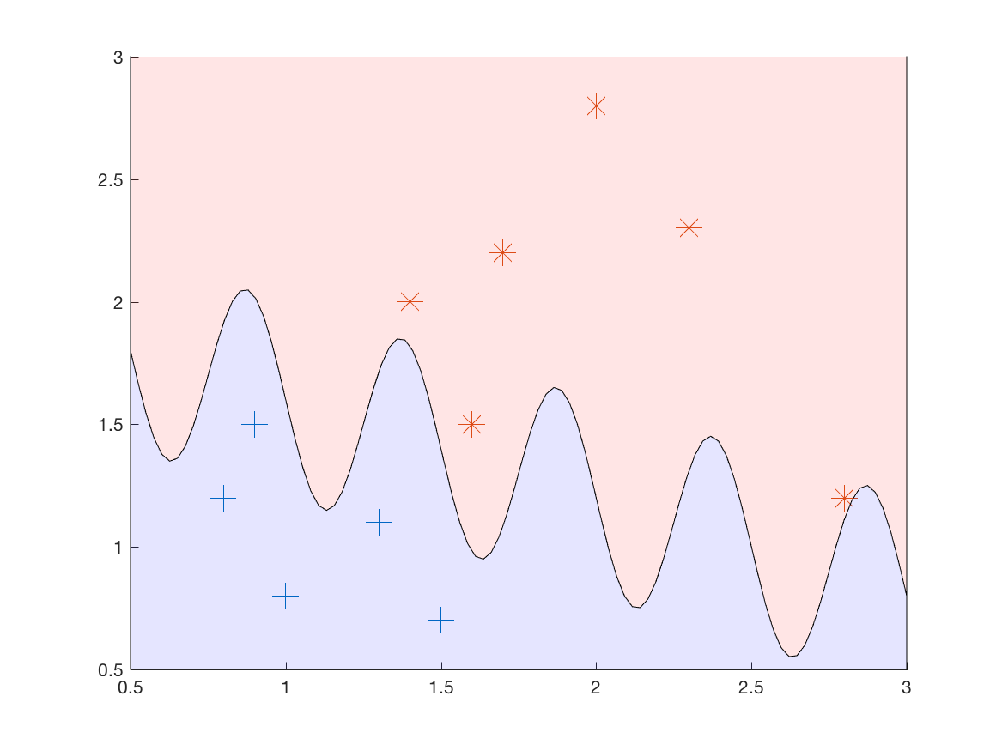
Model spaces
So what should a model look like?
We saw a simple linear decider:
But we could also use a sinusoidal one!
Is one of these “better” than the other?

Slide 40

Generalization and complexity
Remember that what we want is generalization
i.e., that the model will correctly describe new data
So if your data come from a simple distribution, a simple model will work well:
Original data
Two new points – correct!

Slide 41
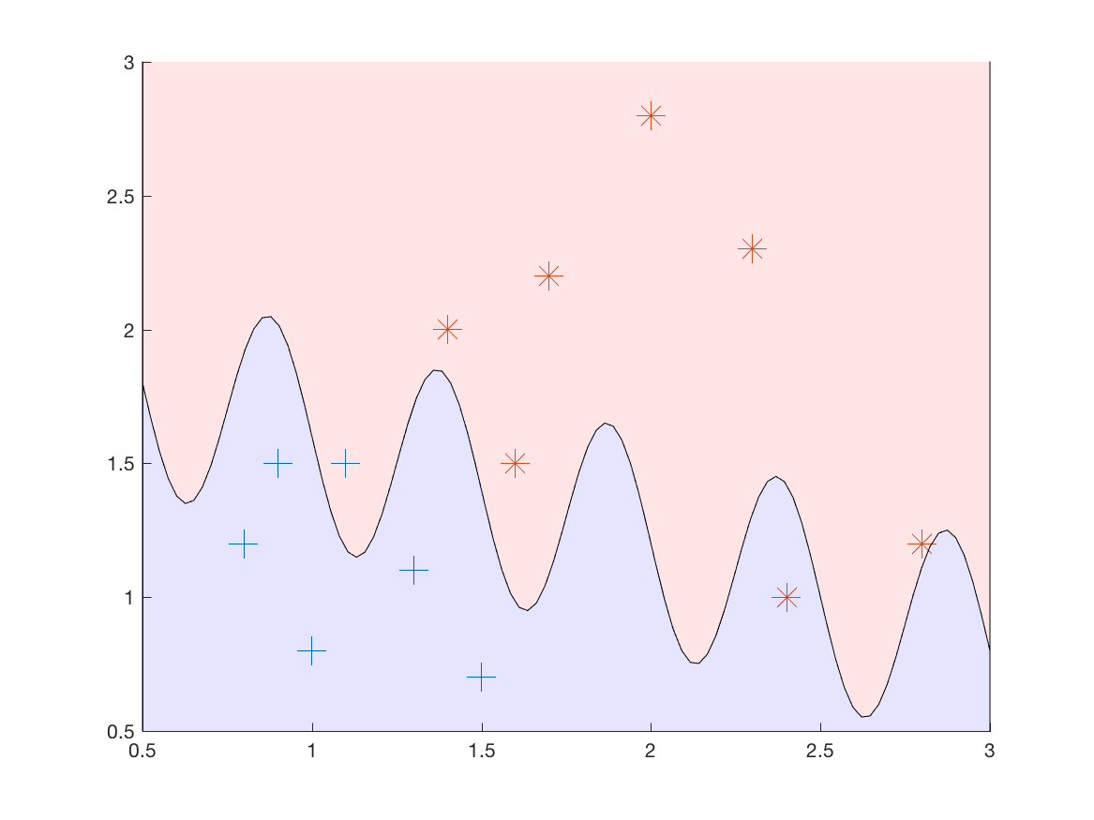
Generalization and complexity
Remember that what we want is generalization
i.e., that the model will correctly describe new data
But a complicated model might overfit the training data!
Original data
Two new points – wrong!

Slide 42
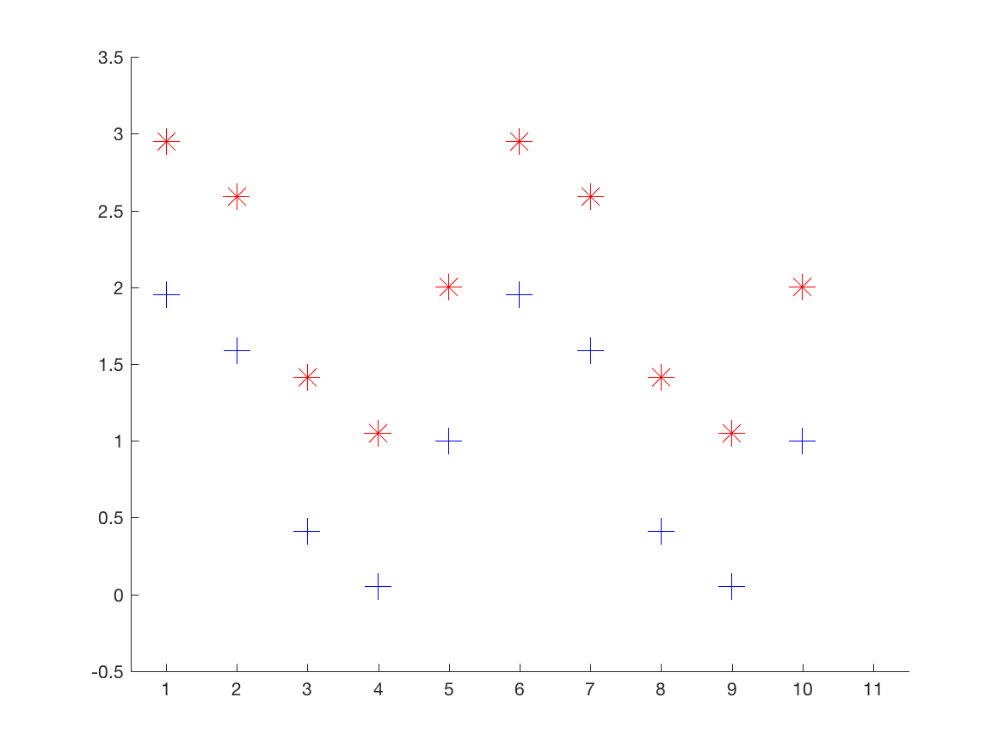
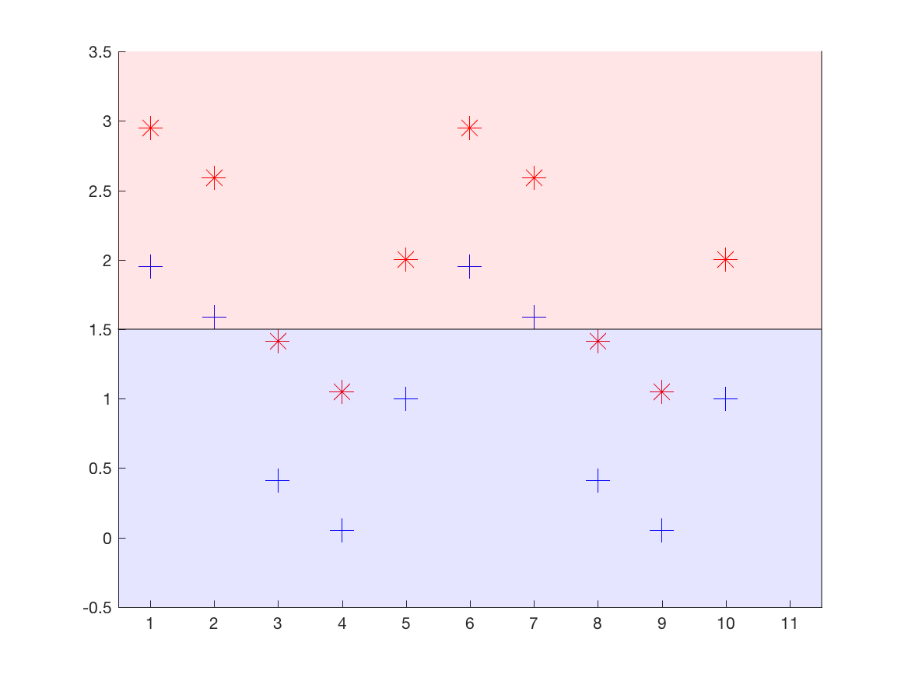
Generalization and complexity
But we also want enough complexity in the model to properly model the data
More complicated dataset
A linear model doesn’t cut it!

Slide 43
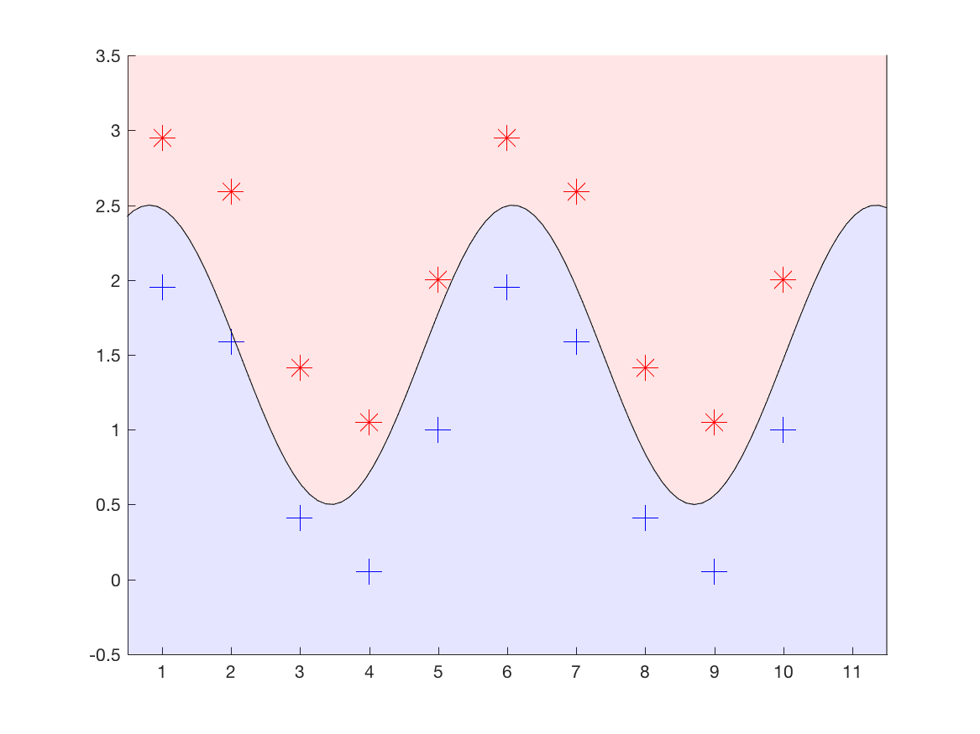
Generalization and complexity
But we also want enough complexity in the model to properly model the data
More complicated dataset
More complicated sin model gets it

Slide 44

Generalization and complexity
But we also want enough complexity in the model to properly model the data…still without overfitting!
More complicated dataset
Gets it right, but waaaay too complicated

Slide 45


What is a model, anyway?
Remember that what we’re modeling here is a function.
There are two parts to consider:
Model structure – the composition of the function (e.g., the family)
Parameters – the coefficients of the function
Structure
$$f\left(x,y\right)=sign(ay+bx+c)$$
Parameters
$$a=1; b=−1; c=2.7$$

Slide 46

What is a model, anyway?
Remember that what we’re modeling here is a function.
There are two parts to consider:
Model structure – the composition of the function (e.g., the family)
Parameters – the coefficients of the function
Structure
$$f\left(x,y\right)=sign(ay+bsin(cx+d)+e)$$
Parameters
$$a=1; b=−1;c=0.38π;d=0.5;e=1.5$$

Slide 47
Representing data
Data comes in many forms:
Images
Text
Audio
Communication metadata
Network packets
Etc.
To use mathematical functions, we need to turn these into vectors of numbers!

Slide 48

Representing data
For machine learning, we need feature functions to describe aspects of data.
Low-level features
Proportion of bright green = 0
Pixel size = 1280x1280
Mean intensity = 0.6
Std dev intensity = 0.2
High-level features
Number of animals = 5
HasForestBackground = 1
Image examples

Slide 49
Representing data
For machine learning, we need feature functions to describe aspects of data.
Low-level features
Freq(the) = 3
# distinct chars = 39
% numbers = 20%
High-level features
# of verbs = 3
RegardsLlamas = 1
Text examples
The height of a full-grown, full-size llama is 1.7 to 1.8 m (5.6 to 5.9 ft) tall at the top of the head, and can weigh between 130 and 200 kg (290 and 440 lb). At birth, a baby llama (called a cria) can weigh between 9 and 14 kg…

Slide 50
How to choose feature functions?
Tradeoff 1
The more features you use, the better a picture of your data you can paint.
But also the more model parameters you need!
Tradeoff 2
Lower-level features are (usually) easier/faster to compute
But they may be less informative

Slide 51
How to choose feature functions?
In general, we want to choose feature functions that seem:
Informative to the task at hand
Easy to compute
Not redundant to other features
The process of deciding which features to use is often empirical
i.e., try it, see how it works, and adjust
Crafting a set of good features is called feature engineering.

Slide 52

Example: choosing feature functions
Task setting: email classifier
Inputs:
Body text
Subject text
Sender
Attachment name
Output:
Is this email (a) Spam, (b) Important, or (c) Other?

Slide 53
Example: choosing feature functions
Potential feature functions:
Frequency of “the” (int)
Frequency of “dollars” (int)
Number of mis-spelled words (int)
All caps in subject (bool)
Number of verbs (int)
Number of grammatically correct sentences (int)
Is “pills” present? (bool)
Frequency of “money” (int)

Slide 54
Example: choosing feature functions
Potential feature functions:
Frequency of “the” (int)
Frequency of “dollars” (int)
Number of mis-spelled words (int)
All caps in subject (bool)
Number of verbs (int)
Number of grammatically correct sentences (int)
Is “pills” present? (bool)
Frequency of “money” (int)
Not informative
Too hard
Probably redundant

Slide 55
Next time
k-Nearest Neighbors for classification
k-Means clustering
Least squares regression
Naïve Bayes models

Slide 56
End of class recap
You want to model time from order to package delivery as a function of the weight of the ordered items. Is this classification, regression, or clustering?
You are training a model to group together points with similar feature values. Are you using supervised or unsupervised learning?
Your model has 6,000 parameters, and you’re using 3 feature functions for input. Are you likely to overfit? Yes or No.
What is your current biggest question about machine learning (or significance testing)?

