Slide 1
Announcements
Homework 3 due today (grace period through Friday)
Midterm Friday!

Slide 2
Fundamental question for this lecture (and really this whole class!):
How do you turn a real-world problem into an AI solution?

Slide 3
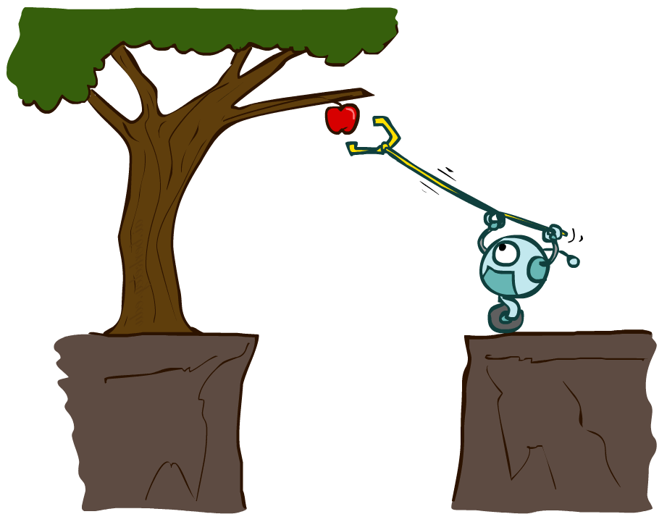
AI – Agents and Environments
Much (though not all!) of AI is concerned with agents operating in environments.
Agent – an entity that perceives and acts
Environment – the problem setting

Slide 4
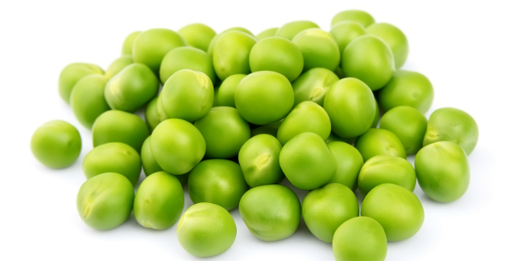
Fleshing it out
Performance – measuring desired outcomes
Environment – what populates the task’s world?
Actuators – what can the agent act with?
Sensors – how can the agent perceive the world?

Slide 5
What makes an Agent?
Agent – an entity that perceives its environment through sensors, and acts on it with actuators.
Percepts are constrained by
Sensors + Environment
Actions are constrained by
Actuators + Environment
Sensors
Agent
Percepts
Environment
?
Actuators
Actions
Agent Function – how does it choose the action?

Slide 6

What have we done so far?
State-based search
Determining an optimal sequence of actions to reach the goal
Choose actions using knowledge about the goal
Assumes a deterministic problem with known rules
Single agent only

Slide 7
Uninformed search: BFS/DFS/UCS
Breadth-first search
Good: optimal, works well when many options, but not many actions required
Bad: assumes all actions have equal cost
Depth-first search
Good: memory-efficient, works well when few options, but lots of actions required
Bad: not optimal, can run infinitely, assumes all actions have equal cost
Uniform-cost search
Good: optimal, handles variable-cost actions
Bad: explores all options, no information about goal location

Slide 8
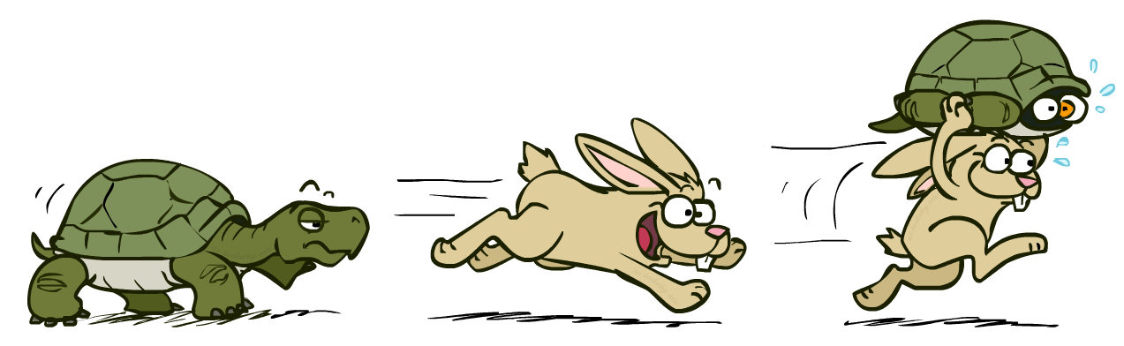
Informed search: A*
A* uses both backward costs and (estimates of) forward costs
A* is optimal with admissible / consistent heuristics
Heuristic design is key: often use relaxed problems

Slide 9
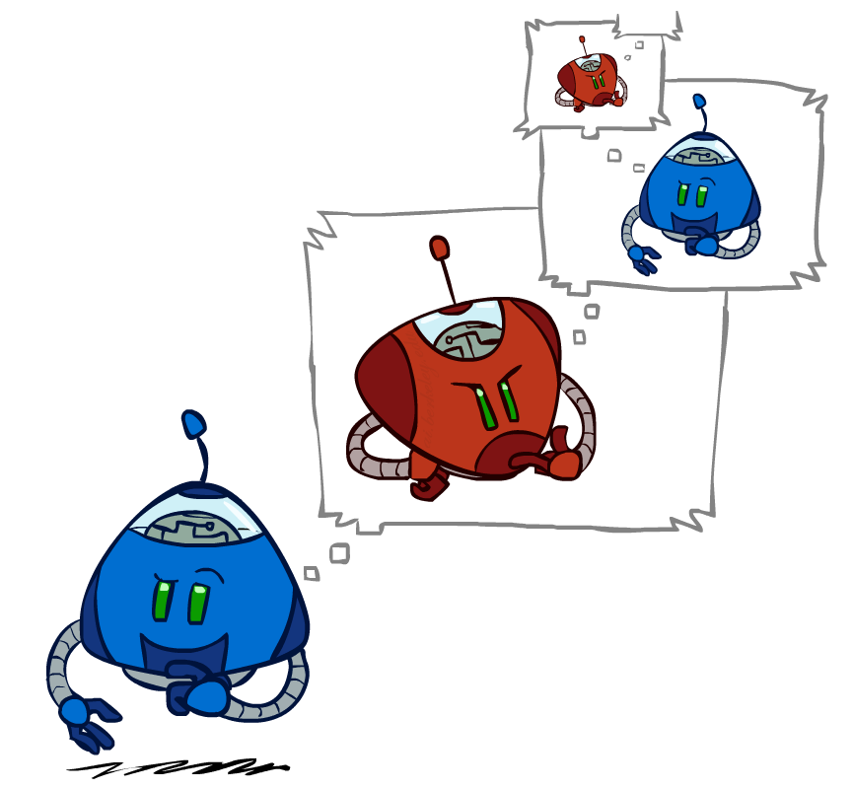
What have we done so far?
Adversarial state-based search
Determining the best next action, given what opponents will do
Choose actions using knowledge about the goal
Assumes a deterministic problem with known rules
Multiple agents, but in a zero-sum competitive game

Slide 10
Adversarial Search (Minimax)
Minimax search:
A state-space search tree
Players alternate turns
Compute each node’s minimax value: the best achievable utility against a rational (optimal) adversary
Use alpha-beta pruning for efficiency
Can have multiple minimizing opponents
Choose actions that yield best subtrees!
Minimax values: computed recursively
5
max
2
5
min
8
2
5
6
Terminal values: part of the game

Slide 11

What have we done so far?
Knowledge-based agents
Using existing knowledge to infer new things about the world
Determining best next action, given changes to the world
Choose actions using knowledge about the world
Assumes a deterministic problem; may be able to infer rules
Any number of agents, but limited to KB contents

Slide 12

Logical agents
Sensors
Agent
Percepts
Environment
+
?
Actuators
Actions
Knowledge Base
Contains sentences describing the state of the world
Supports inference and derivation
Dynamic; changes as a result of agent interactions with the environment!

Slide 13
Summary: Knowledge-based agents
Use knowledge about the world to choose actions
Inference with existing knowledge + new observations
Resolution, forward-backward chaining, instantiation and unification, etc.
Knowledge represented in knowledge bases
Contain statements about the world
Structured with an ontology
Represents how different kinds of objects/events/etc are categorized
Supports higher-level inference
Designed for a particular set of problems

Slide 14
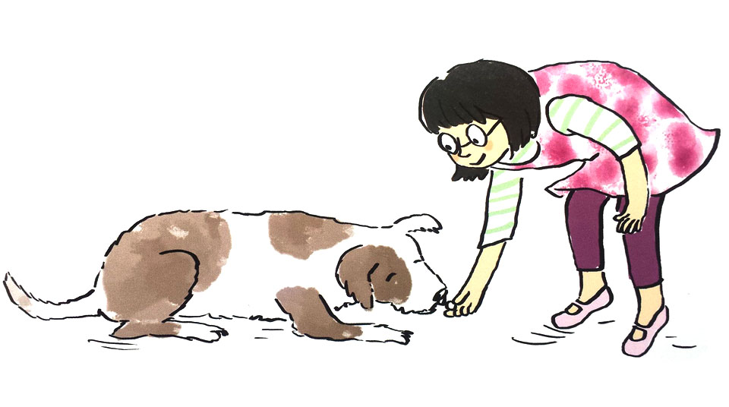
What have we done so far?
Reinforcement learning agents
Iteratively update estimates of state/action pair expected utilities
Adapting to random outcomes with expectation
Choose actions using learned information from the world
Handles stochastic and unknown problems
Focused on learning process of a single agent

Slide 15
Reinforcement Learning
Agent
State: s
Reward: r
Actions: a
Environment
Basic idea:
Receive feedback in the form of rewards
Agent’s utility is defined by the reward function
Must (learn to) act so as to maximize expected rewards
All learning is based on observed samples of outcomes!

Slide 16
Generalized Policy Iteration
Evaluation:
For fixed current policy π, use N starts into random (s₀,a₀) and run the policy to halt.
Then, for each (s,a), go through the N episodes and find the M episodes that use (s,a)
Update Q(s,a) with the average of discounted rewards starting at (s,a) on in each episode S_{i}
Improvement: With sampled Q values, get a better policy using policy extraction
$$Q_{k+1}^{π_{i}}\left(s,a\right)←R\left(s\right)+\frac{1}{M}\sum_{i=1}^{M}{DiscountedReward(s,a|S_{i}) }$$
$$π_{i+1}\left(s\right)= \underset{a∈A(s)}{argmax}{\sum_{s^{′}}{Q^{π_{i}}(s,a) }}$$

Slide 17
On-policy vs off-policy learning
In Sarsa, we choose a specific next action a’ for updating Q(s,a).
This is called on-policy learning, because we’re using the current policy to help decide an action for learning from.
Like policy iteration last time
We can also look at all possible next actions A(s’), and use the best one to update Q(s,a).
This is off-policy learning, because the action we use for updating is separate from the action we actually take.
Similar to value iteration, but active

Slide 18
Key things to know about
Intelligent Agents
How do we formulate AI problems?
What is the structure of an agent?
Search
How do uninformed search methods work?
How do informed search methods work?
Compare to uninformed
What makes a good heuristic?
How do we deal with opposing agents?

Slide 19
Key things to know about
Logic
What methods are available to us for inference?
What different formalisms do we know for representing knowledge?
Why is structuring our knowledge useful?
Decision Processes
How do we handle stochastic outcomes of actions?
How do we learn from observed experiences?

