Slide 1
Course feedback

Slide 2
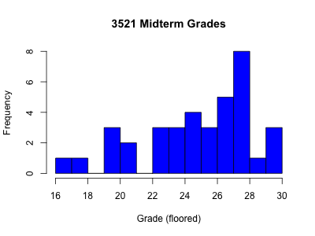
Mean: 25.4
Median: 26

Slide 3
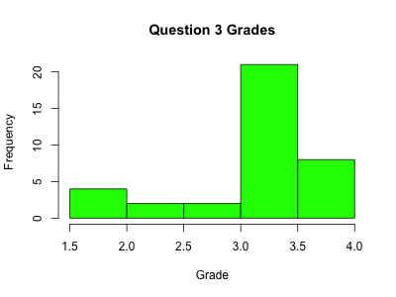

Slide 4
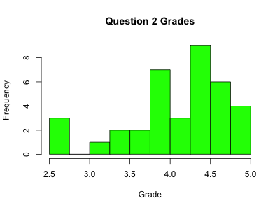

Slide 5
