Slide 1
Announcements
No AI seminar this week
Extra office hours today 3-4pm (DL580)

Slide 2
Last time:
Monte Carlo methods for RL
Get a whole bunch of sample action sequences (episodes)
Average out the rewards achieved to get values for each state/action
Generalized Policy Iteration
Evaluate the current policy by sampling experiences/episodes
Use updated values to improve the policy
Wash, rinse, repeat

Slide 3
Temporal-Difference (TD) Learning
Combine sample-based learning of Monte Carlo and dynamic programming efficiency of lookaheads
Basic Idea
Use lookahead with current estimates to learn from every experience!
Start with evaluation of fixed policy first
Then use GPI to learn new policies

Slide 4



TD learning: What we need
Observed reward
R(s’)
$a_{1}^{′}$
s
a
s’
$a_{2}^{′}$
Action we took to get here
$a_{3}^{′}$
Previous state
Current state
Actions we can take next

Slide 5
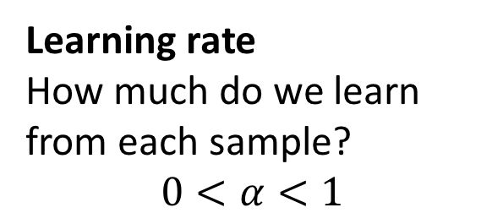
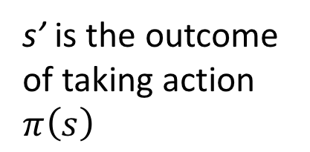
TD evaluation
Update current utility estimate for state s every time we take an action from it:
TD error at this timestep
$$U_{t+1}^{π}\left(s\right)=U_{t}^{π}\left(s\right)+α\left[R\left(s^{′}\right)+γU_{t}^{π}\left(s^{′}\right)−U_{t}^{π}\left(s\right)\right]$$
Learning rate
How much do we learn from each sample?
$$0<α<1$$
s’ is the outcome of taking action $π\left(s\right)$

Slide 6
TD evaluation
Update current utility estimate for state s every time we take an action from it:
$$U_{t+1}^{π}\left(s\right)=U_{t}^{π}\left(s\right)+α\left[R\left(s^{′}\right)+γU_{t}^{π}\left(s^{′}\right)−U_{t}^{π}\left(s\right)\right]$$
$$U_{t+1}^{π}\left(s\right)={(1−α)U}_{t}^{π}\left(s\right)+α\left[R\left(s^{′}\right)+γU_{t}^{π}\left(s^{′}\right)\right]$$
If we extend the lookahead to the end of the sequence, get Monte Carlo estimation
In the limit, will converge to true expected utility of s
And faster than Monte Carlo!
Finite lookahead allows dealing with infinite experience sequences!

Slide 7

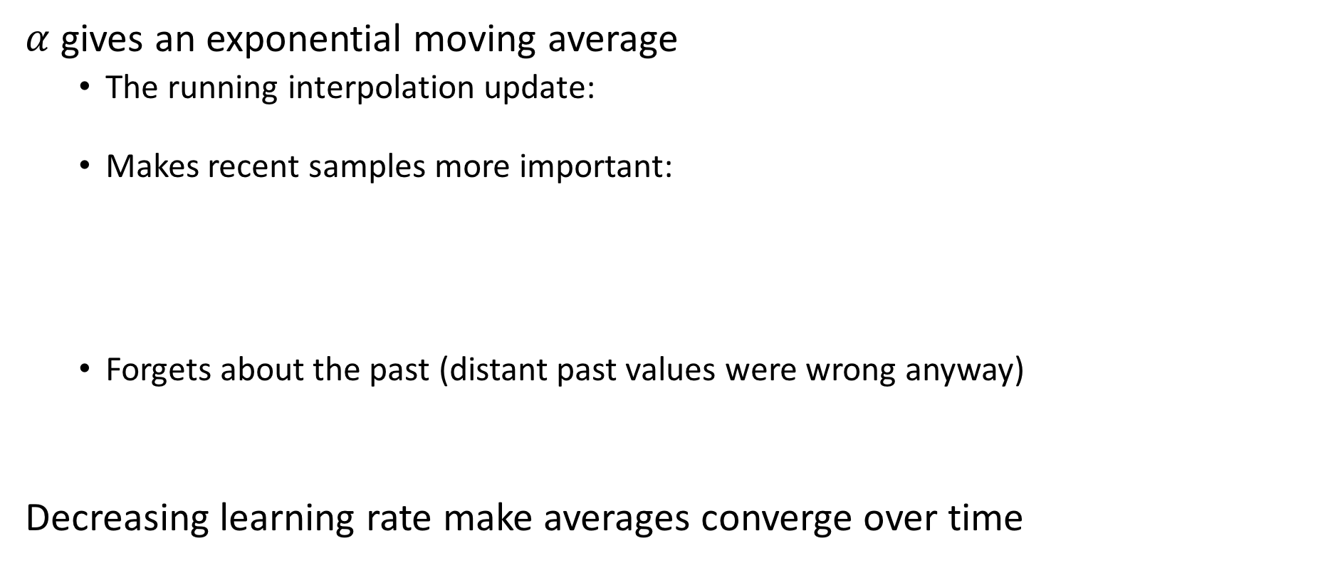
Effect of learning rate
$α$ gives an exponential moving average
The running interpolation update:
Makes recent samples more important:
Forgets about the past (distant past values were wrong anyway)
Decreasing learning rate make averages converge over time

Slide 8
Example: Temporal Difference learning
States
Observed Transitions
B, east, C, -2
C, east, D, -2
 | A
B | C | D
 | E
 | 0
0 | 0 | 8
 | 0
 | 0
-1 | 0 | 8
 | 0
 | 0
-1 | 3 | 8
 | 0
Assume: γ = 1, α = 1/2
$$U_{t+1}^{π}\left(s\right)={(1−α)U}_{t}^{π}\left(s\right)+α\left[R\left(s^{′}\right)+γU_{t}^{π}\left(s^{′}\right)\right]$$

Slide 9
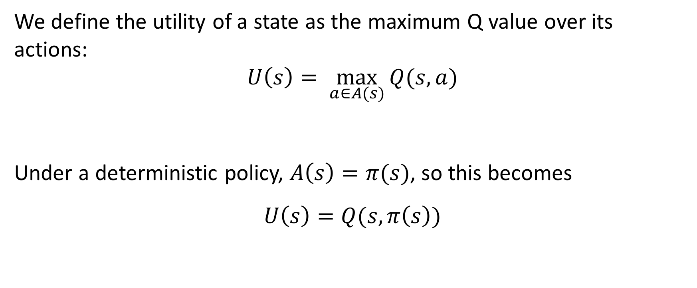
State utilities vs Q values
We define the utility of a state as the maximum Q value over its actions:
$$U\left(s\right)= \max_{a∈A(s)}{Q(s,a)}$$
Under a deterministic policy, $A\left(s\right)=π(s)$, so this becomes
$$U\left(s\right)=Q(s, π\left(s\right))$$

Slide 10
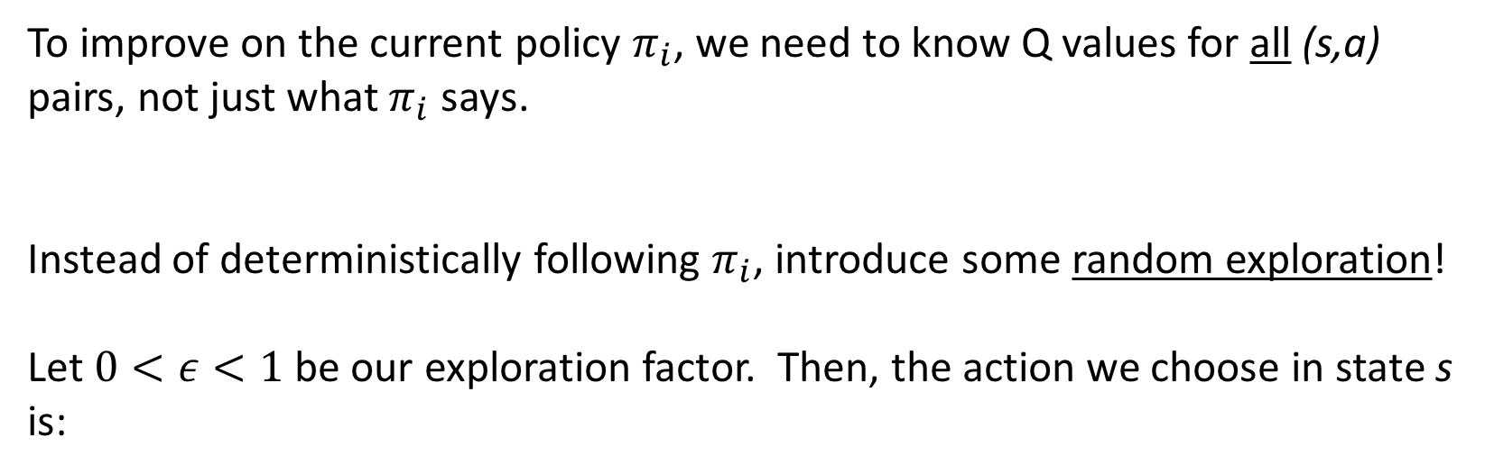
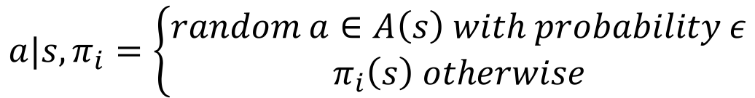
Exploration with $ε$-greedy policies
To improve on the current policy $π_{i}$, we need to know Q values for all (s,a) pairs, not just what $π_{i}$ says.
Instead of deterministically following $π_{i}$, introduce some random exploration!
Let $0<ε<1$ be our exploration factor. Then, the action we choose in state s is:
$$a|s,π_{i}=\left\{\begin{aligned}random a∈A\left(s\right) with probability ε \\ π_{i}\left(s\right) otherwise\end{aligned}\right.$$
This is called an $ε$-greedy policy

Slide 11
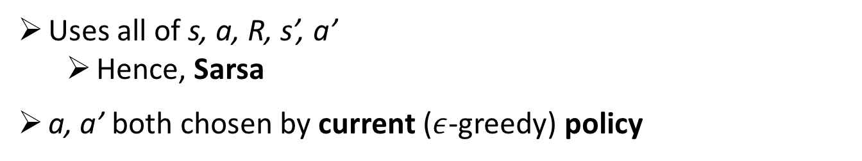
Sarsa: learning policies with TD
Like before, now estimate Q values for state-action pairs instead of state utilities
$$Q_{t+1}\left(s,a\right)←Q_{t}\left(s,a\right)+α\left[R\left(s^{′}\right)+γQ_{t}\left(s^{′},a^{′}\right)−Q_{t}\left(s,a\right)\right]$$
Uses all of s, a, R, s’, a’
Hence, Sarsa
a, a’ both chosen by current ($ε$-greedy) policy
Now, can use updated Q values to extract new policy $π_{t+1}$!

Slide 12
Example: Sarsa
States
Decisions/Experiences
B, east, C, -2
C, east, D, -2
C, east
 | A
B | C | D
 | E
 | 0
 |  | 8
 | 0
 |  | 8
 | 0
 |  | 8
0
1
0
1
0
1
1
-1
2
0.5
-1
2
0.5
-1
4
0
4
0
4
0
4
1
1
1
-1
4
-1
4
-1
4
Assume: γ = 1, α = 1/2
$$Q_{t+1}\left(s,a\right)=\left(1−α\right)Q_{t}\left(s,a\right)+α\left[R\left(s^{′}\right)+γQ_{t}\left(s^{′},a′\right)\right]$$

Slide 13
On-policy vs off-policy learning
In Sarsa, we choose a specific next action a’ for updating Q(s,a).
This is called on-policy learning, because we’re using the current policy to help decide an action for learning from.
Like policy iteration last time
We can also look at all possible next actions A(s’), and use the best one to update Q(s,a).
This is off-policy learning, because the action we use for updating is separate from the action we actually take.
Similar to value iteration, but active

Slide 14
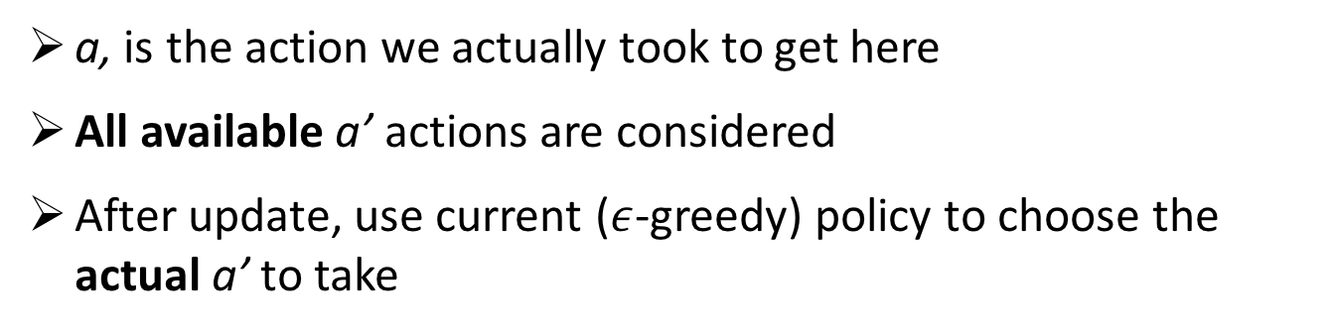
Q-learning: off policy TD
To update Q(s,a), now use the estimated value for the best next action:
$$Q_{t+1}\left(s,a\right)←Q_{t}\left(s,a\right)+α\left[R\left(s^{′}\right)+γ\max_{a^{′}∈A(s^{′})}{Q_{t}(s^{′},a^{′})}−Q_{t}\left(s,a\right)\right]$$
a, is the action we actually took to get here
All available a’ actions are considered
After update, use current ($ε$-greedy) policy to choose the actual a’ to take
This will estimate optimal Q values regardless of the quality of the policy being followed!

Slide 15
Example: Q learning
States
Decisions/Experiences
B, east, C, -2
C, east, D, -2
C, east
 | A
B | C | D
 | E
 | 0
 |  | 8
 | 0
 |  | 8
 | 0
 |  | 8
0
1
0
1
0
1
1
-1
2
1.5
-1
2
0.5
-1
4
0
4
0
4
0
4
1
1
1
-1
4
-1
4
-1
4
Assume: γ = 1, α = 1/2
$$Q_{t+1}\left(s,a\right)=\left(1−α\right)Q_{t}\left(s,a\right)+α\left[R\left(s^{′}\right)+γ\max_{a^{′}∈A(s^{′})}{Q_{t}\left(s^{′},a^{′}\right)}\right]$$

Slide 16


Properties of TD learning
Both Sarsa and Q learning improve the Q value estimates at each step
Note this also improves the policy, which is dynamically recalculated at every step!
With a couple assumptions, they will converge to the optimal policy/values, given infinite experiences
Assume learning rate decreases over time (we know what we’re doing, eventually)
Exploration factor must be high enough (though not too high!)
$$ε$$
Note: in the limit, it doesn’t matter how you select actions!

Slide 17
Which is better?
What are the advantages of on-policy vs off-policy learning?
On-policy is a bit more realistic (especially with large action space)
Off-policy sounds more optimal (but isn’t in the limit)
???
Mostly:

Slide 18

Making it (practically) better
Better exploration with exploration functions
Measuring mistakes with regret
Better generalization with feature functions

Slide 19

How to explore?
Several schemes for forcing exploration
Simplest: random actions (ε-greedy)
Every time step, flip a coin
With (small) probability ε, act randomly
With (large) probability 1-ε, act on current policy
Problems with random actions?
You do eventually explore the space, but keep thrashing around once learning is done
One solution: lower ε over time
Another solution: exploration functions

Slide 20
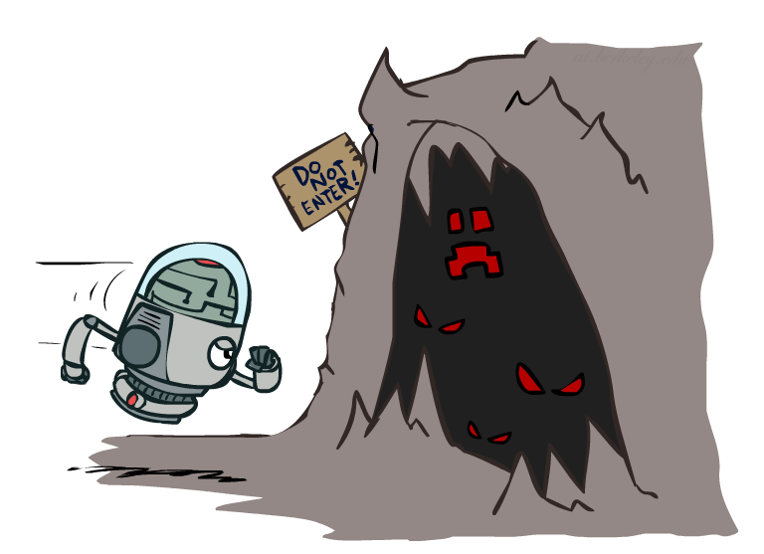
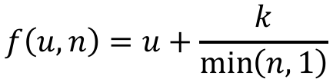
Exploration functions
When to explore?
Random actions: explore a fixed amount
Better idea: explore areas whose badness is not
(yet) established, eventually stop exploring
Exploration function
Takes a value estimate u and a visit count n, and
returns an optimistic utility, e.g.
Note: this propagates the “bonus” back to states that lead to unknown states as well!
$$f\left(u,n\right)=u+\frac{k}{\min\left(n,1\right)}$$
Modified Q update:
$$Q_{t+1}\left(s,a\right)←Q_{t}\left(s,a\right)+α\left[R\left(s^{′}\right)+γ\max_{a^{′}∈A(s^{′})}{f\left(Q_{t}\left(s^{′},a^{′}\right),N_{t}\left(s^{′},a^{′}\right)\right)}−Q_{t}\left(s,a\right)\right]$$

Slide 21
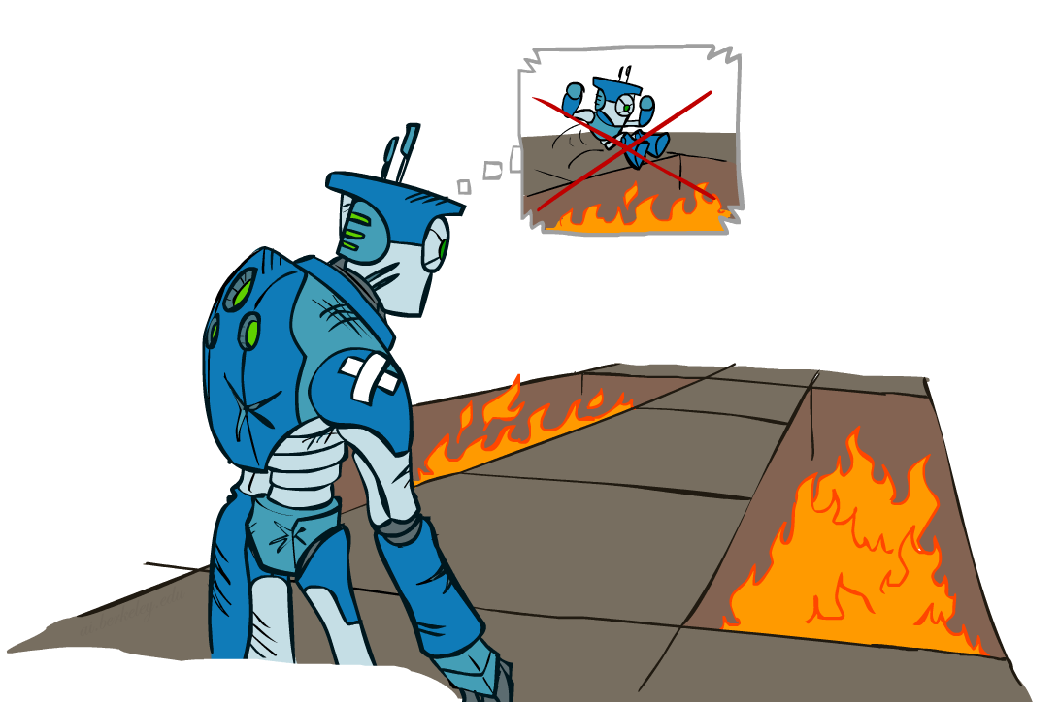
Regret
Even if you learn the optimal policy, you still make mistakes along the way!
Regret is a measure of your total mistake cost: the difference between your (expected) rewards, including youthful suboptimality, and optimal (expected) rewards
Minimizing regret goes beyond learning to be optimal – it requires optimally learning to be optimal
Example: random exploration and exploration functions both end up optimal, but random exploration has higher regret

Slide 22
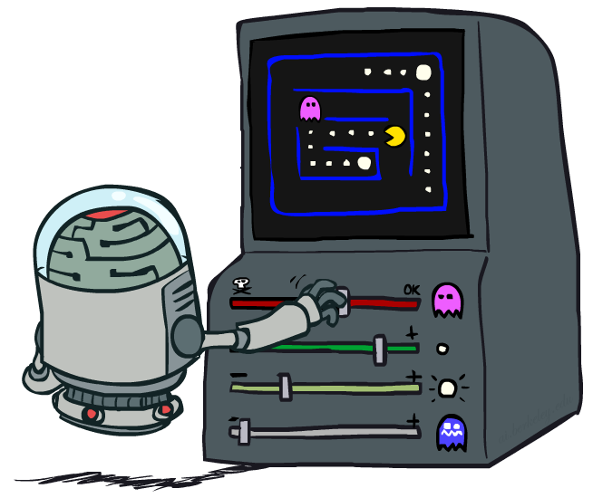
Approximate Q-learning with feature functions

Slide 23

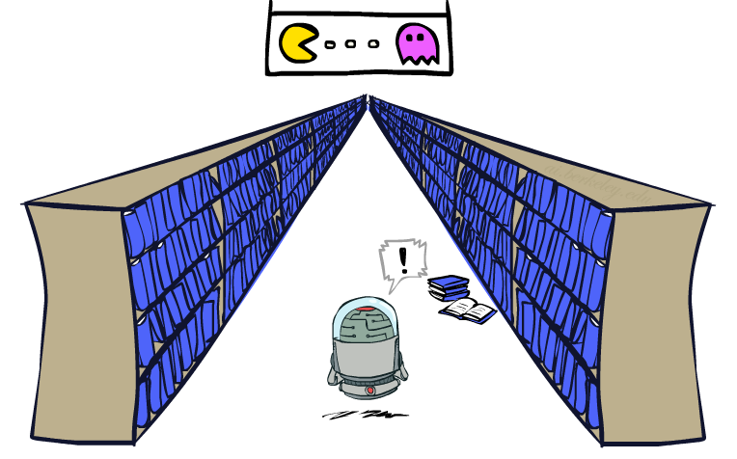
Generalizing across states
Basic Q-Learning keeps a table of all q-values
In realistic situations, we cannot possibly learn about every single state!
Too many states to visit them all in training
Too many states to hold the q-tables in memory
Instead, we want to generalize:
Learn about some small number of training states from experience
Generalize that experience to new, similar situations
This is a fundamental idea in machine learning, and we’ll see it over and over again

Slide 24
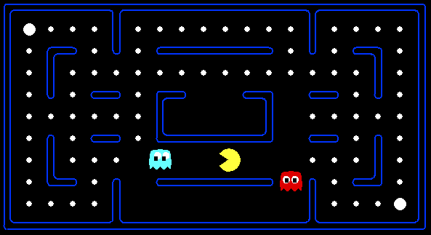



Example: Pacman
Let’s say we discover through experience that this state is bad:
In naïve q-learning, we know nothing about this state:
Or even this one!

Slide 25
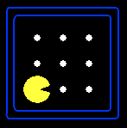
Back in time: Search vs Logic
Logic – Reason about the world to identify ”good” actions
Space of attributive states
Successor function defined over attribute values
Successors effectively partial states (what has changed?)
Guided by knowledge about the world
Pos: [1,2]
Dot4: False
Pos: [1,1]
Dot1: True
Dot2: True
…
Pos: [2,1]
Dot8: False

Slide 26
Feature-based representations
Describe a state using a vector of features (attributes)
Features are functions from states to real numbers (often 0/1) that capture important properties of the state
Example features:
Distance to closest ghost
Distance to closest dot
Number of ghosts
1 / (dist to dot)²
Is Pacman in a tunnel? (0/1)
…… etc.
Is it the exact state on this slide?
Can also describe a q-state (s, a) with features (e.g. action moves closer to food)

Slide 27


Linear Value Functions
Using a feature representation, we can write a q function (or value function) for any state using a few weights:
Advantage: our experience is summed up in a few powerful numbers
Disadvantage: some states may be similar in features, but we want them to have very different values!
$$U\left(s\right)=w_{1}f_{1}\left(s\right)+w_{2}f_{2}\left(s\right)+…+w_{n}f_{n}(s)$$
$$Q(s,a)=w_{1}f_{1}\left(s,a\right)+w_{2}f_{2}\left(s,a\right)+…+w_{n}f_{n}(s,a)$$

Slide 28
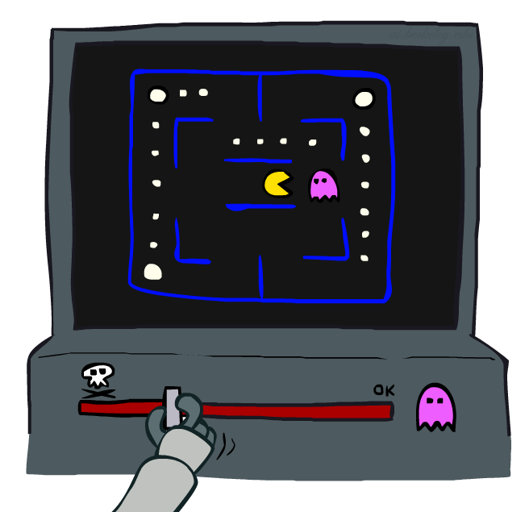
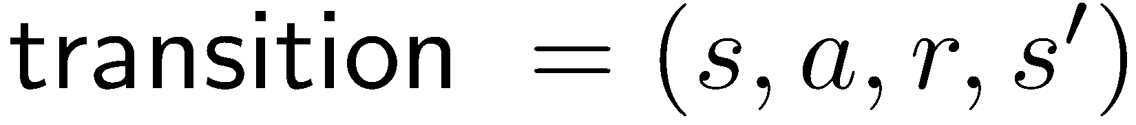
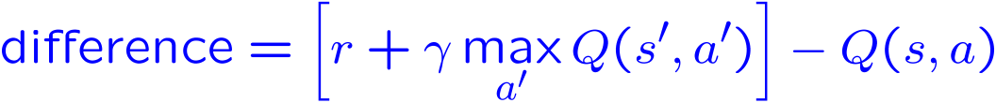
Approximate Q-Learning
Q-learning with linear Q-functions:
Exact Q’s
Approximate Q’s
Intuitive interpretation:
Adjust weights of active features
E.g., if something unexpectedly bad happens, blame the features that were on: disprefer all states with that state’s features
Formal justification: online least squares

Slide 29

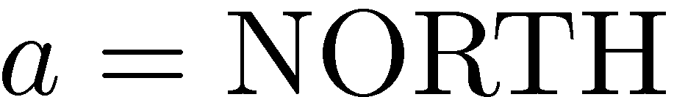
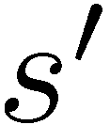
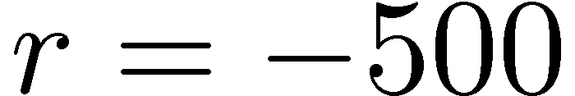


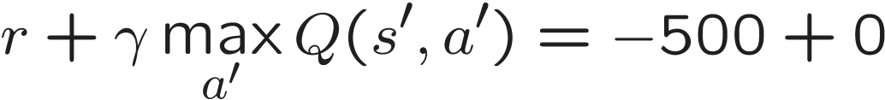
Example: Q-Pacman

Slide 30
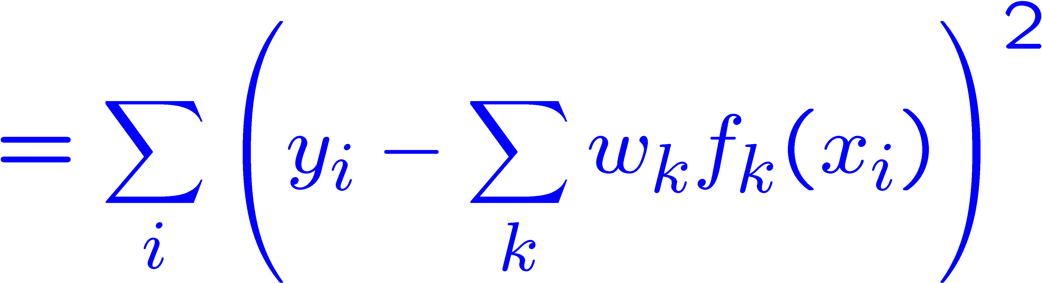
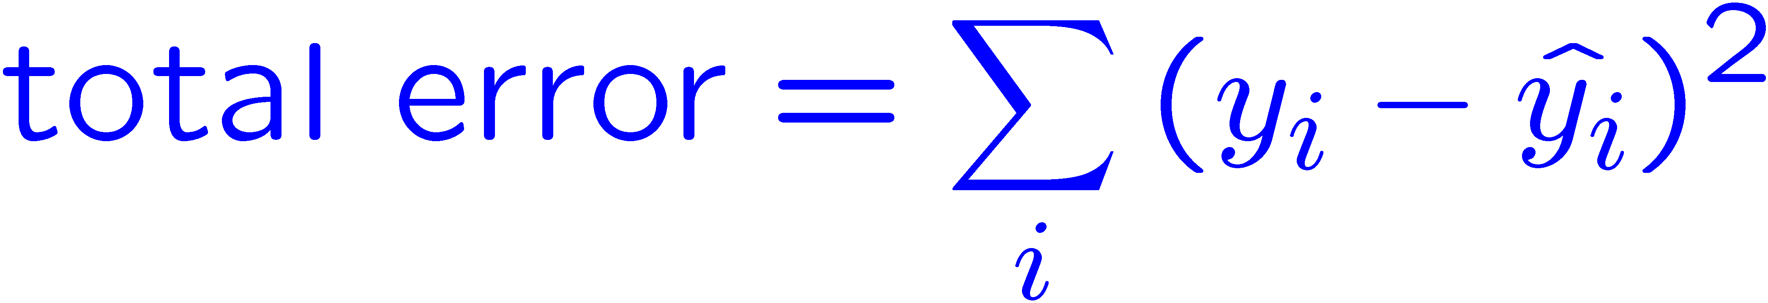
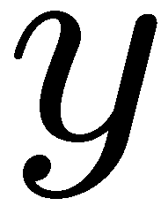
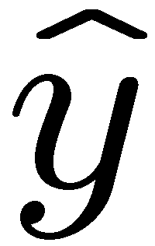
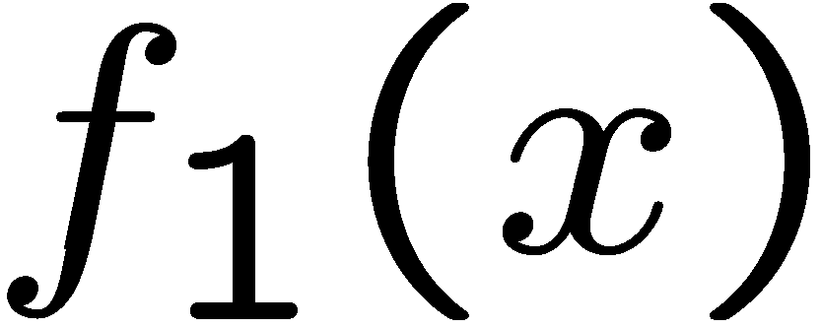
Optimization: Least Squares*
Error or “residual”
Observation
Prediction
0
0
20
Notes:
Figure 1: scatter(1:20,10+(1:20)+2*randn(1,20),'k','filled'); a=axis; a(3)=0; axis(a);

Slide 31
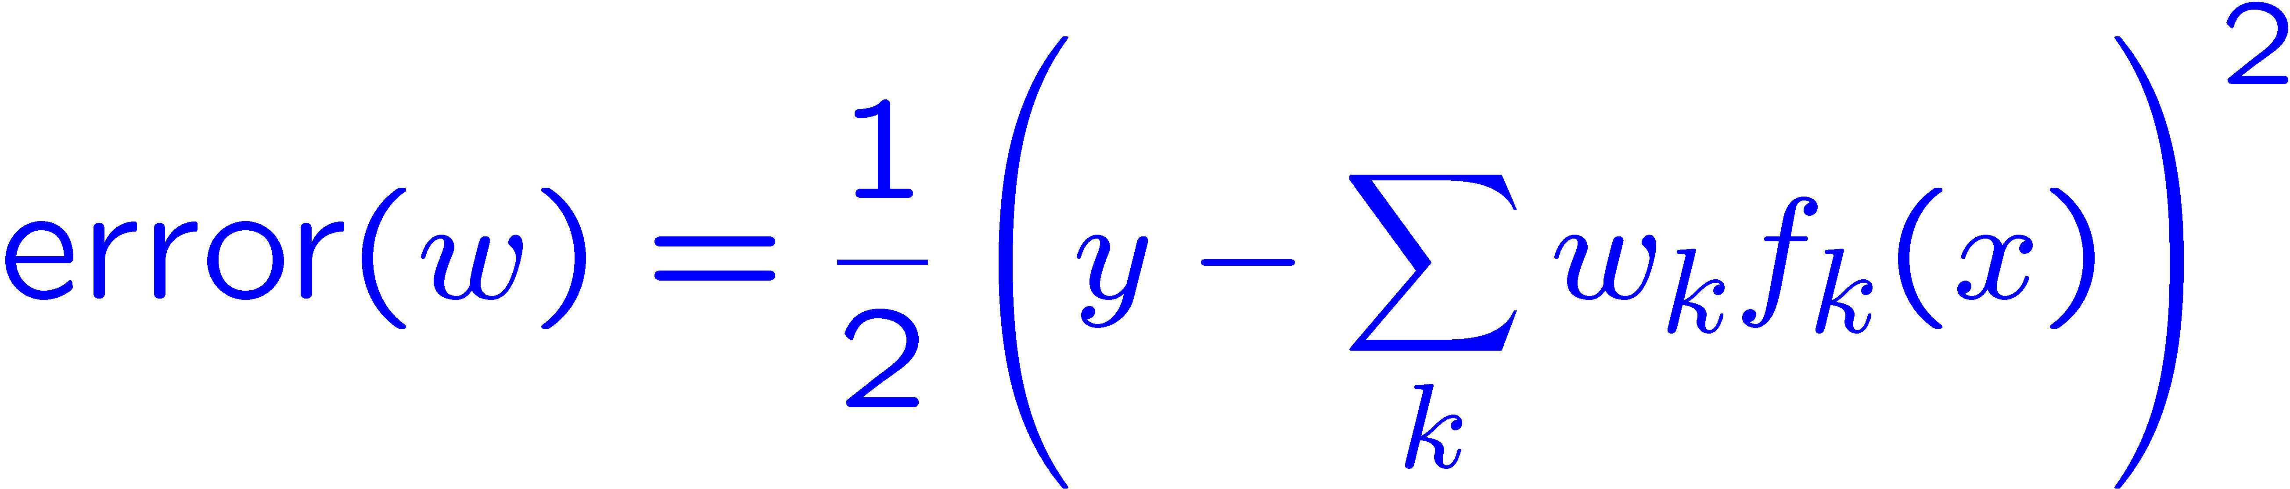
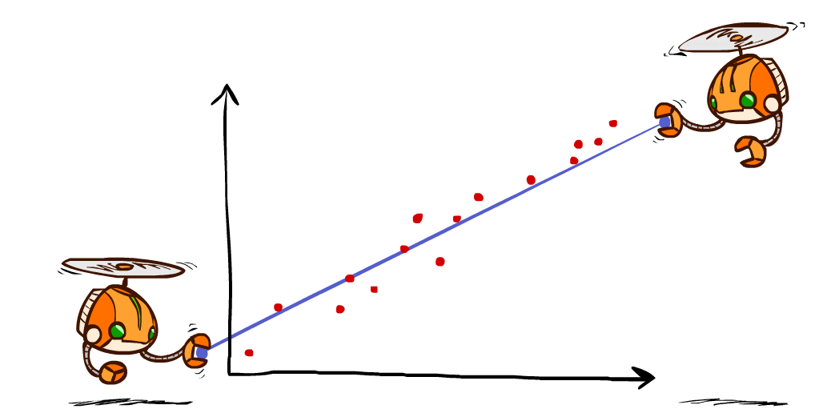
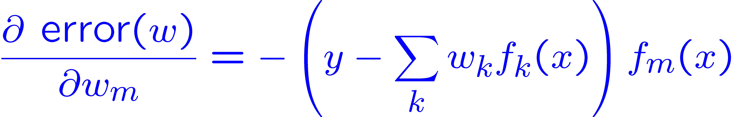
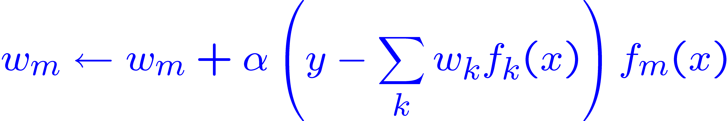
Minimizing Error*
Imagine we had only one point x, with features f(x), target value y, and weights w:
Approximate q update explained:
“target”
“prediction”

Slide 32
Policy Search
Problem: often the feature-based policies that work well (win games, maximize utilities) aren’t the ones that approximate U / Q best
Q-learning’s priority: get Q-values close (modeling)
Action selection priority: get ordering of Q-values right (prediction)
We’ll see this distinction between modeling and prediction again later in the course
Solution: learn policies that maximize rewards, not the values that predict them
Policy search: start with an ok solution (e.g. Q-learning) then fine-tune by hill climbing on feature weights

Slide 33
Policy Search
Simplest policy search:
Start with an initial linear value function or Q-function
Nudge each feature weight up and down and see if your policy is better than before
Problems:
How do we tell the policy got better?
Need to run many sample episodes!
If there are a lot of features, this can be impractical
Better methods exploit lookahead structure, sample wisely, change multiple parameters…

Slide 34
Next Time
First half review
Genetic algorithms

