Slide 2
Announcements
HW4 due today (11:59pm)
HW5 out today (due 11/17 11:59pm)

Slide 3
Today’s learning goals
At the end of today, you should be able to
Describe gradient descent for learning model parameters
Explain the difference between logistic regression and linear regression
Tell if a 2-D dataset is linearly separable
Explain the structure of a neural network

Slide 4
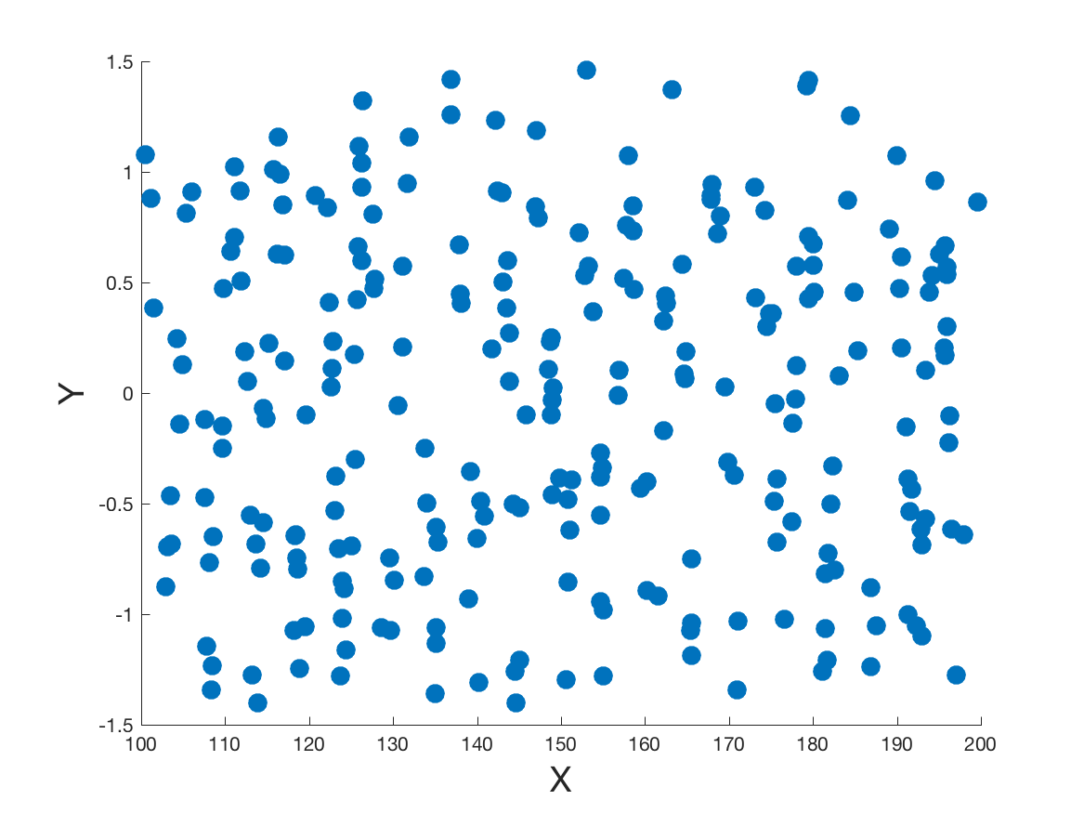
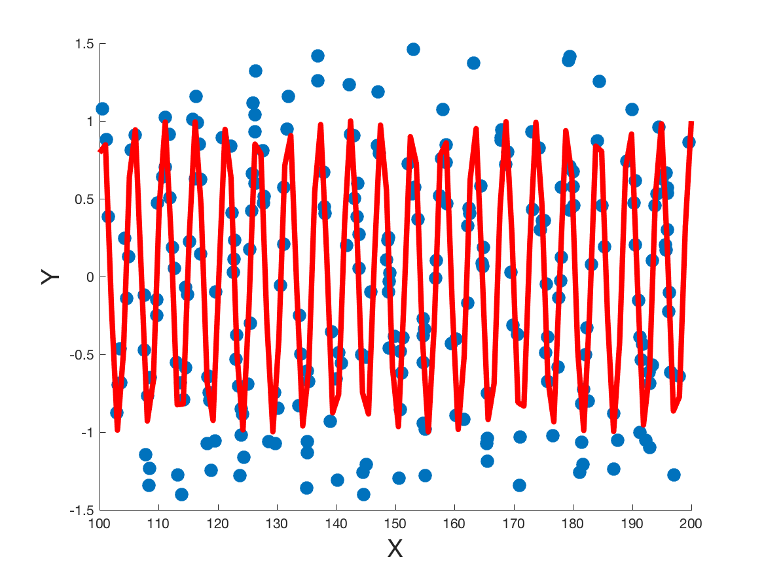

Least squares with a non-linear function
Consider data from a nonlinear distribution.
Here, assume sinusoidal
We now want the sine wave of best fit
$$y=sin⁡(w_{1}x+w_{0})$$
Considering only two of the 4 possible parameters for convenience

Slide 5
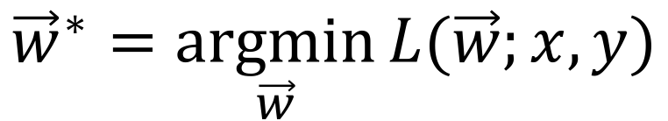
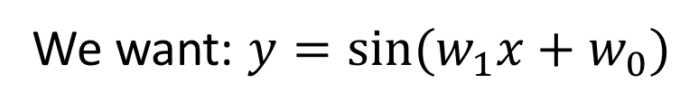
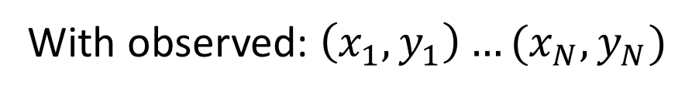
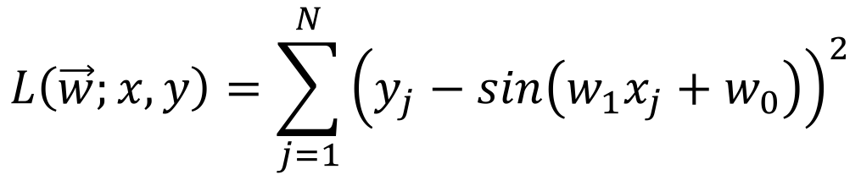
Least squares with a non-linear function
With observed: $\left(x_{1},y_{1}\right)…(x_{N},y_{N})$
We want: $y=sin⁡(w_{1}x+w_{0})$
Least squares: Minimizing L2 loss (sum of squared errors)
$$L\left(\vec{w};x,y\right)=\sum_{j=1}^{N}{{\left(y_{j}−sin\left(w_{1}x_{j}+w_{0}\right)\right)}^{2}}$$
$${\vec{w}}^{∗}=\underset{\vec{w}}{argmin}{L(\vec{w};x,y)}$$

Slide 6
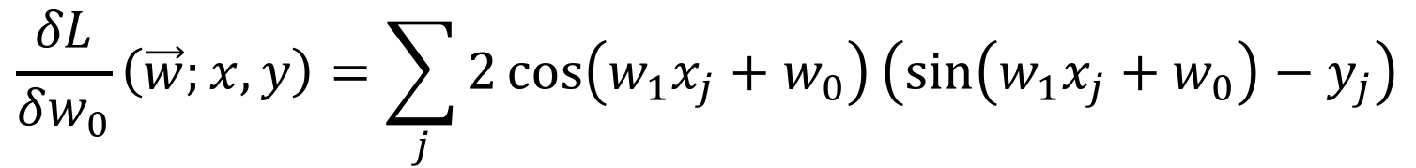
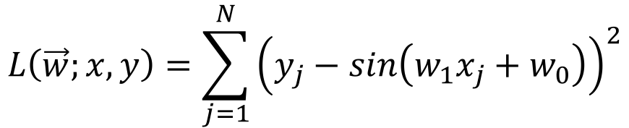
Least squares with a non-linear function
$$L\left(\vec{w};x,y\right)=\sum_{j=1}^{N}{{\left(y_{j}−sin\left(w_{1}x_{j}+w_{0}\right)\right)}^{2}}$$
Using L2 loss
Again, calculate the partial derivatives w.r.t. $w_{0},w_{1}$
$$\frac{δL}{δw_{1}}\left(\vec{w};x,y\right)=\sum_{j}{2x_{j}\cos\left(w_{1}x_{j}+w_{0}\right)\left(\sin\left(w_{1}x_{j}+w_{0}\right)−y_{j}\right)}$$
$$\frac{δL}{δw_{0}}\left(\vec{w};x,y\right)=\sum_{j}{2\cos\left(w_{1}x_{j}+w_{0}\right)\left(\sin\left(w_{1}x_{j}+w_{0}\right)−y_{j}\right)}$$

Slide 7
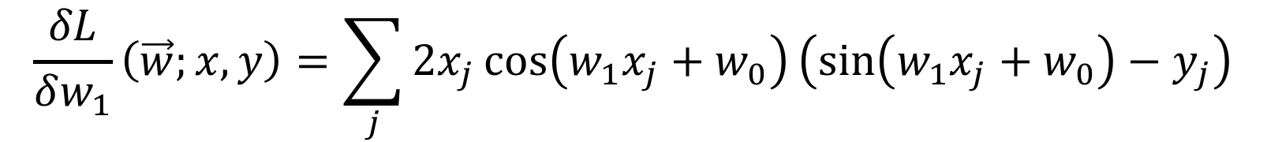
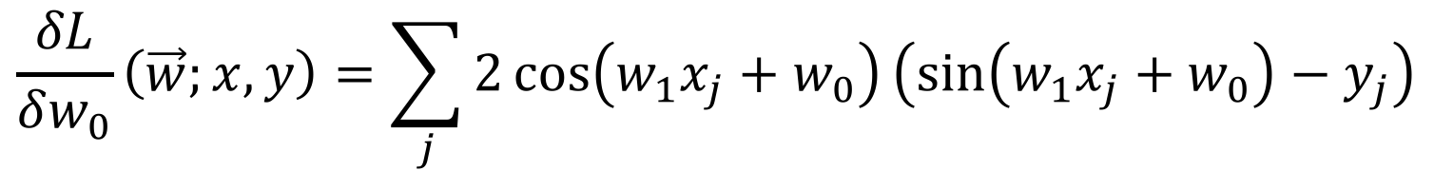
Least squares with a non-linear function
$$\frac{δL}{δw_{1}}\left(\vec{w};x,y\right)=\sum_{j}{2x_{j}\cos\left(w_{1}x_{j}+w_{0}\right)\left(\sin\left(w_{1}x_{j}+w_{0}\right)−y_{j}\right)}$$
$$\frac{δL}{δw_{0}}\left(\vec{w};x,y\right)=\sum_{j}{2\cos\left(w_{1}x_{j}+w_{0}\right)\left(\sin\left(w_{1}x_{j}+w_{0}\right)−y_{j}\right)}$$
But there’s no unique solution for these!
In many cases, there won’t even be a closed form solution

Slide 8
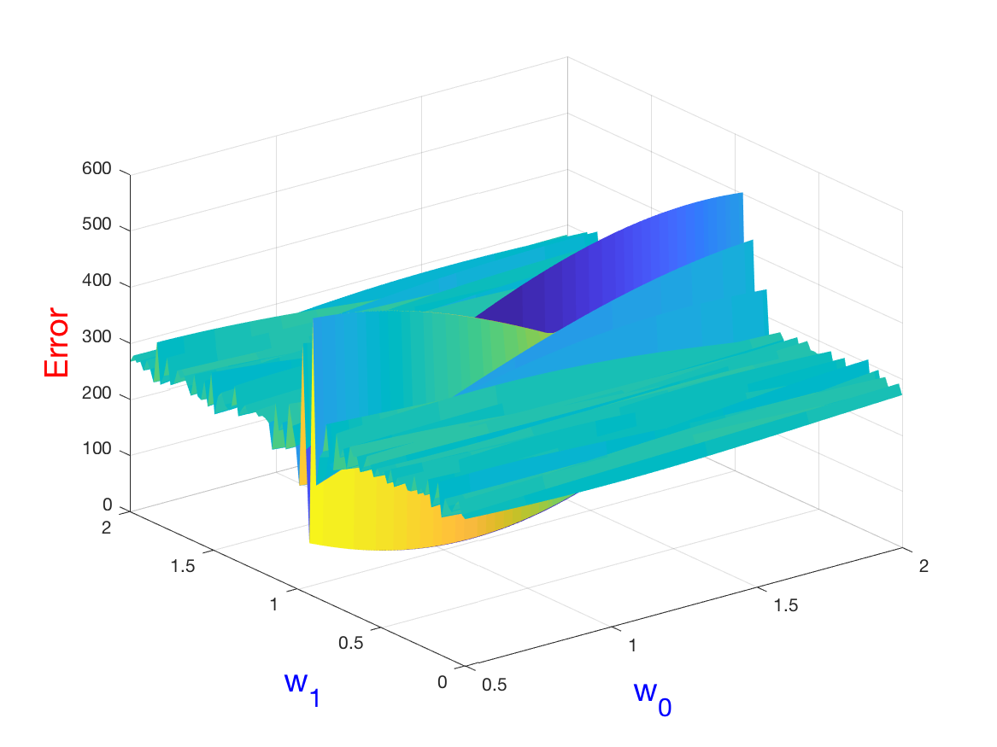
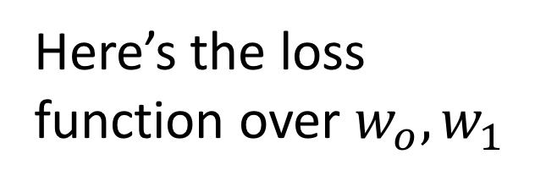
Least squares with a non-linear function
Here’s the loss function over $w_{o},w_{1}$
Very much non-convex!
Lots of local minima
Instead of solving exactly, iterative solution with gradient descent

Slide 9

Gradient descent algorithm
${\vec{w}}^{0}←$ random point in $w_{0},w_{1}$ space
loop until convergence do
for each $w_{i}$ in ${\vec{w}}^{t}$ do
$w_{i}←w_{i}−α\frac{δL}{δw_{i}}(\vec{w};x,y)$
Learning rate

Slide 10


Gradient descent
$$L(\vec{w};x,y)$$
$$w_{i}$$
Notes:
Good! Escaped the local solution for a better solution.

Slide 11
Gradient descent
$$L(\vec{w};x,y)$$
$$w_{i}$$
Notes:
Good! Escaped the local solution for a better solution.

Slide 12
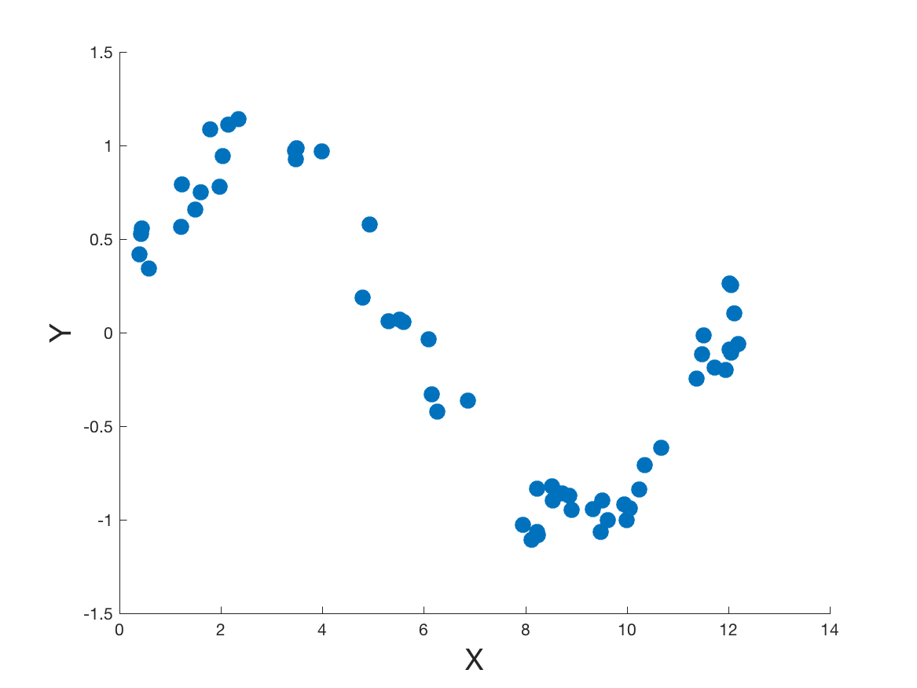
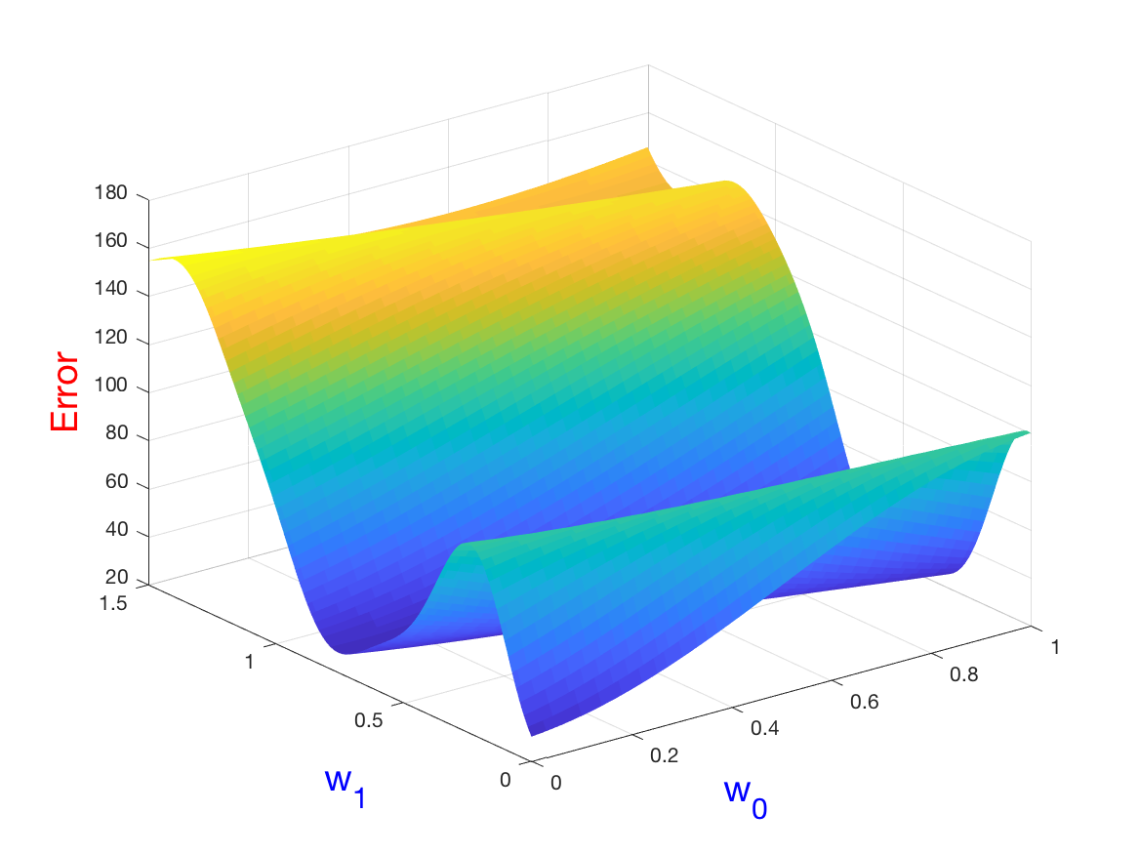
Let’s run it!
Simpler example:
Data
Loss

Slide 13
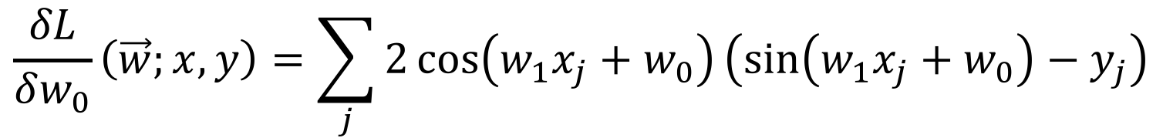
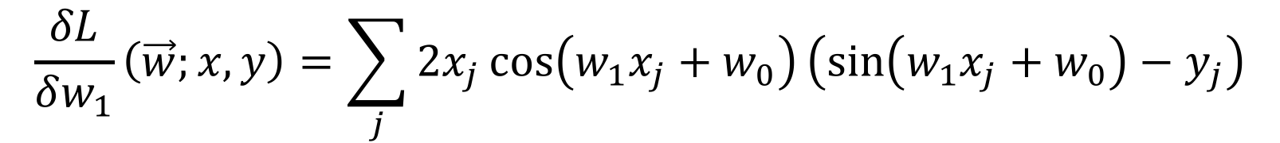
Let’s run it!
We have our partial derivatives:
$$\frac{δL}{δw_{1}}\left(\vec{w};x,y\right)=\sum_{j}{2x_{j}\cos\left(w_{1}x_{j}+w_{0}\right)\left(\sin\left(w_{1}x_{j}+w_{0}\right)−y_{j}\right)}$$
$$\frac{δL}{δw_{0}}\left(\vec{w};x,y\right)=\sum_{j}{2\cos\left(w_{1}x_{j}+w_{0}\right)\left(\sin\left(w_{1}x_{j}+w_{0}\right)−y_{j}\right)}$$
We have our data:
$$\left(2.04, 0.94\right) \left(6.15, −0.33\right)…$$

Slide 14
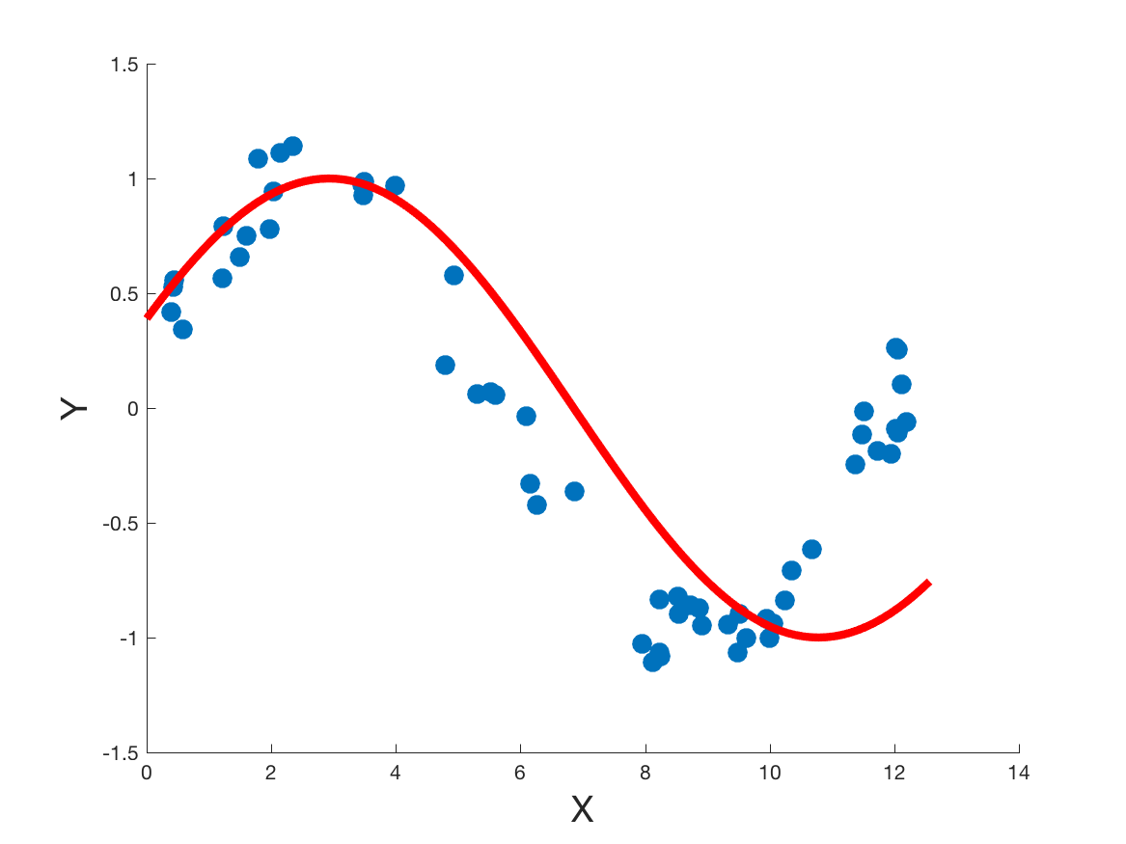
Gradient descent example
Start with random $w_{0}=0.4, w_{1}=0.4$

Slide 15
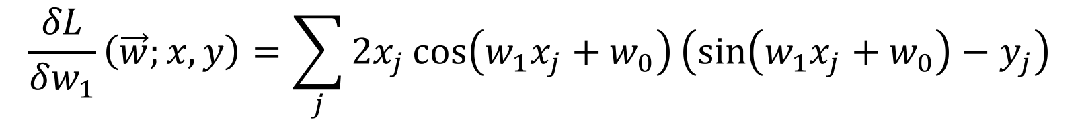
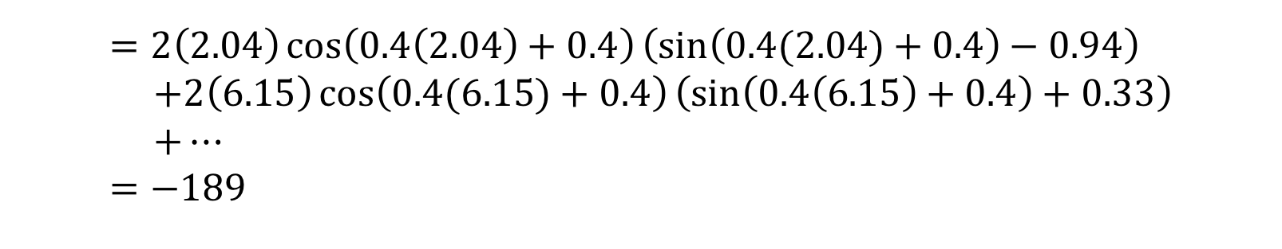

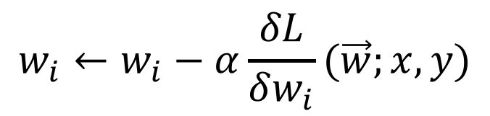
Gradient descent example
$$w_{i}←w_{i}−α\frac{δL}{δw_{i}}(\vec{w};x,y)$$
Gradient descent update:
$$α=0.0001$$
$$\frac{δL}{δw_{1}}\left(\vec{w};x,y\right)=\sum_{j}{2x_{j}\cos\left(w_{1}x_{j}+w_{0}\right)\left(\sin\left(w_{1}x_{j}+w_{0}\right)−y_{j}\right)}$$
$$=2\left(2.04\right)\cos\left(0.4\left(2.04\right)+0.4\right)\left(\sin\left(0.4(2.04)+0.4\right)−0.94\right) \\ +2\left(6.15\right)\cos\left(0.4(6.15)+0.4\right)\left(\sin\left(0.4\left(6.15\right)+0.4\right)+0.33\right) \\ +… \\ =−189$$
$$w_{1}←0.4−0.0001(−189)≈0.42$$

Slide 16
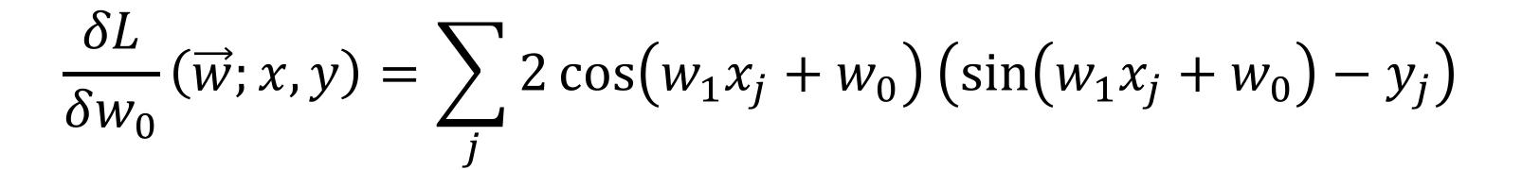
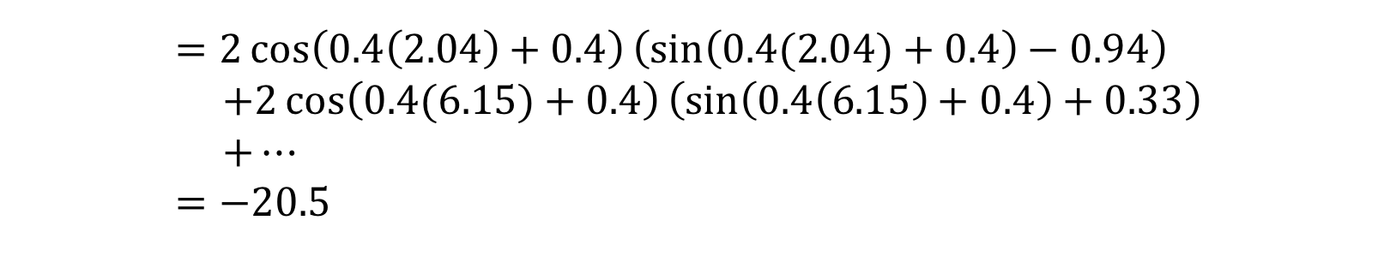
Gradient descent example
$$w_{i}←w_{i}−α\frac{δL}{δw_{i}}(\vec{w};x,y)$$
Gradient descent update:
$$α=0.0001$$
$$\frac{δL}{δw_{0}}\left(\vec{w};x,y\right)=\sum_{j}{2\cos\left(w_{1}x_{j}+w_{0}\right)\left(\sin\left(w_{1}x_{j}+w_{0}\right)−y_{j}\right)}$$
$$=2\cos\left(0.4\left(2.04\right)+0.4\right)\left(\sin\left(0.4(2.04)+0.4\right)−0.94\right) \\ +2\cos\left(0.4(6.15)+0.4\right)\left(\sin\left(0.4\left(6.15\right)+0.4\right)+0.33\right) \\ +… \\ =−20.5$$
$$w_{0}←0.4−0.0001(−20.5)≈0.402$$

Slide 17
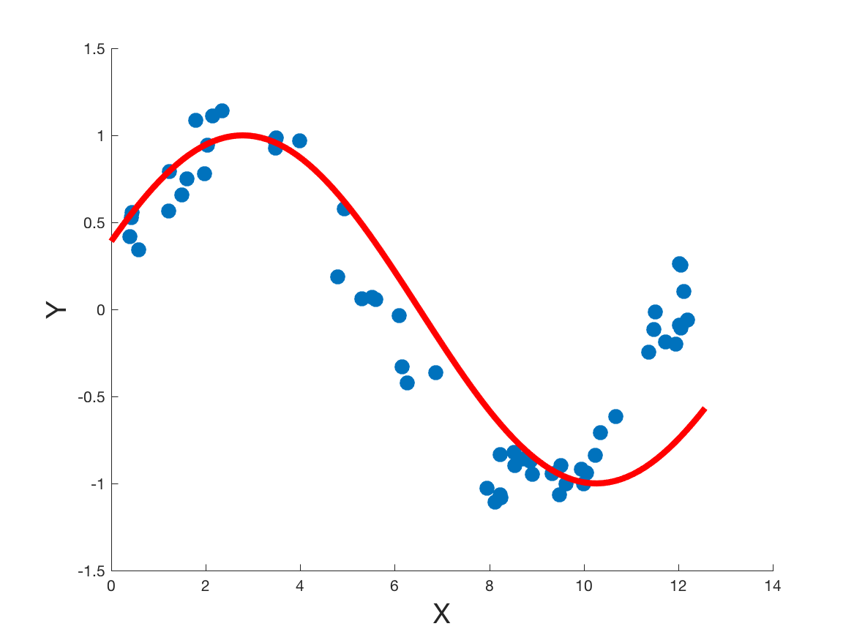
Gradient descent example
After 1 iteration, we have $w_{0}=0.402, w_{1}=0.42$

Slide 18
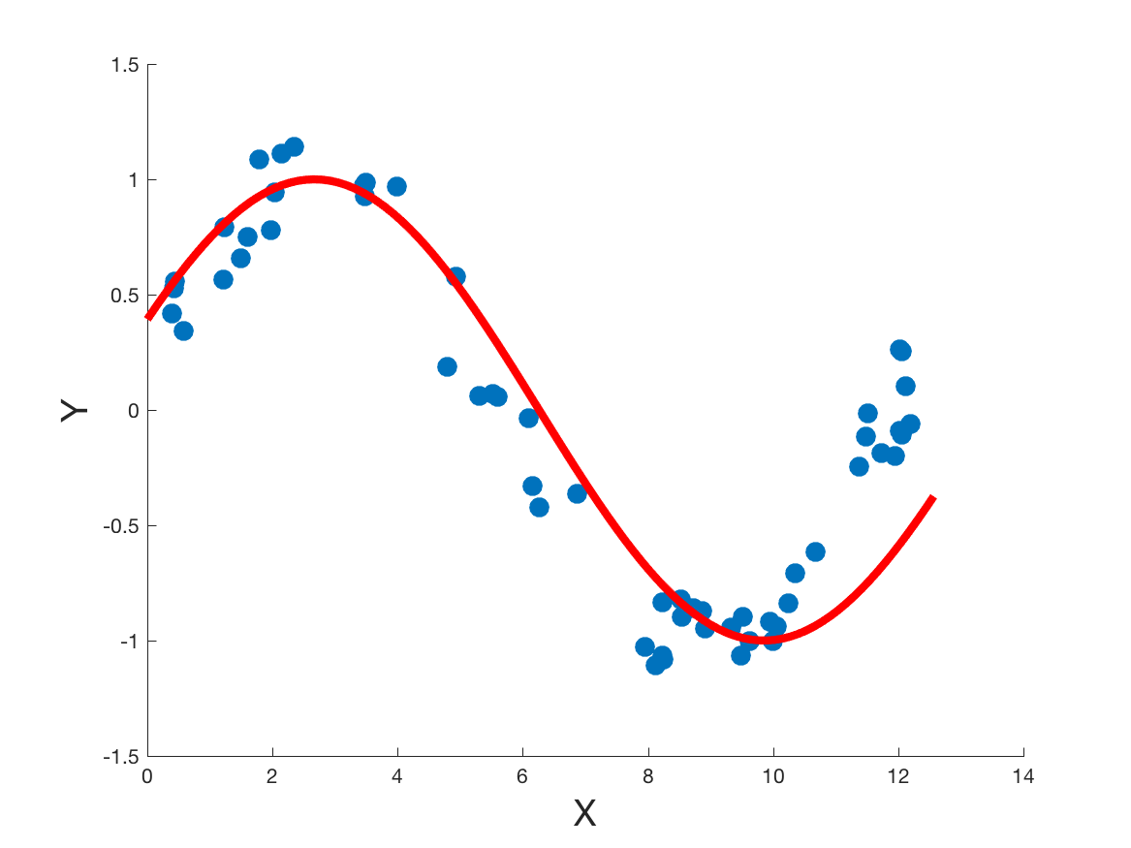
Gradient descent example
After 2 iterations, we have $w_{0}=0.404, w_{1}=0.44$

Slide 19
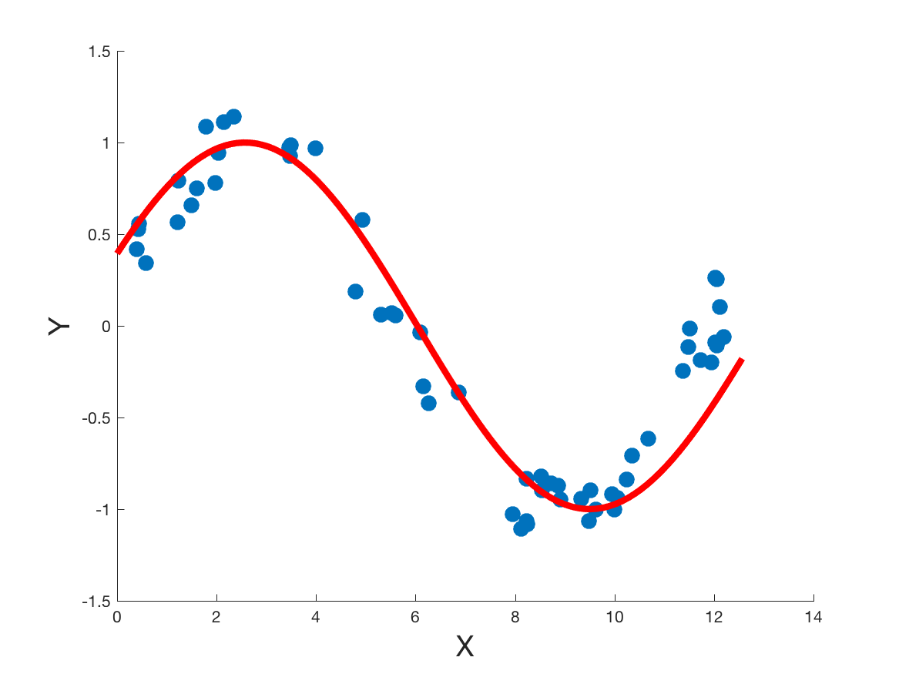
Gradient descent example
After 3 iterations, we have $w_{0}=0.405, w_{1}=0.45$

Slide 20
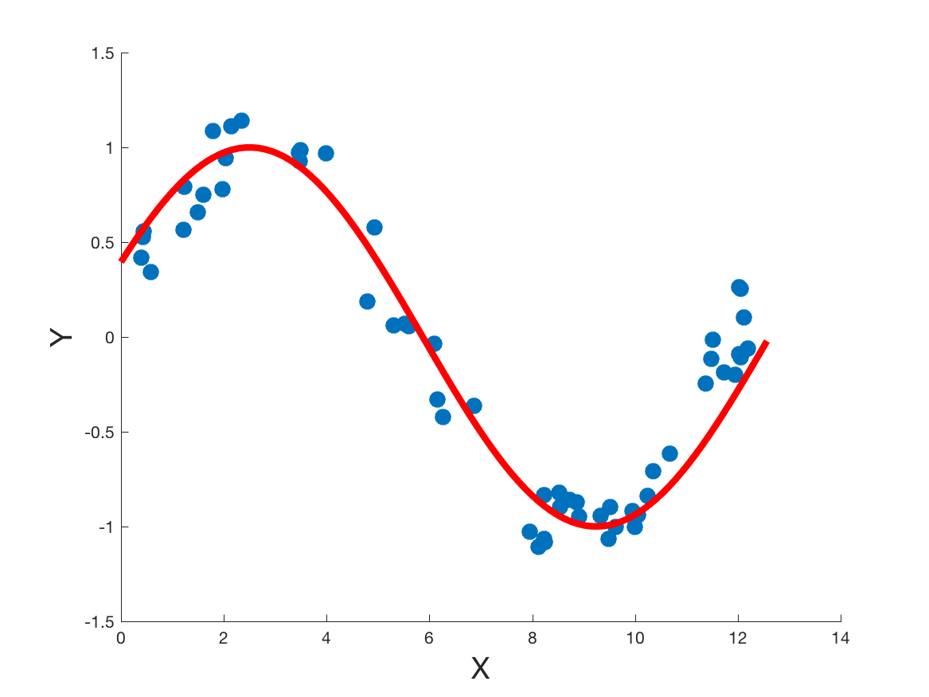
Gradient descent example
After 4 iterations, we have $w_{0}=0.407, w_{1}=0.47$

Slide 21
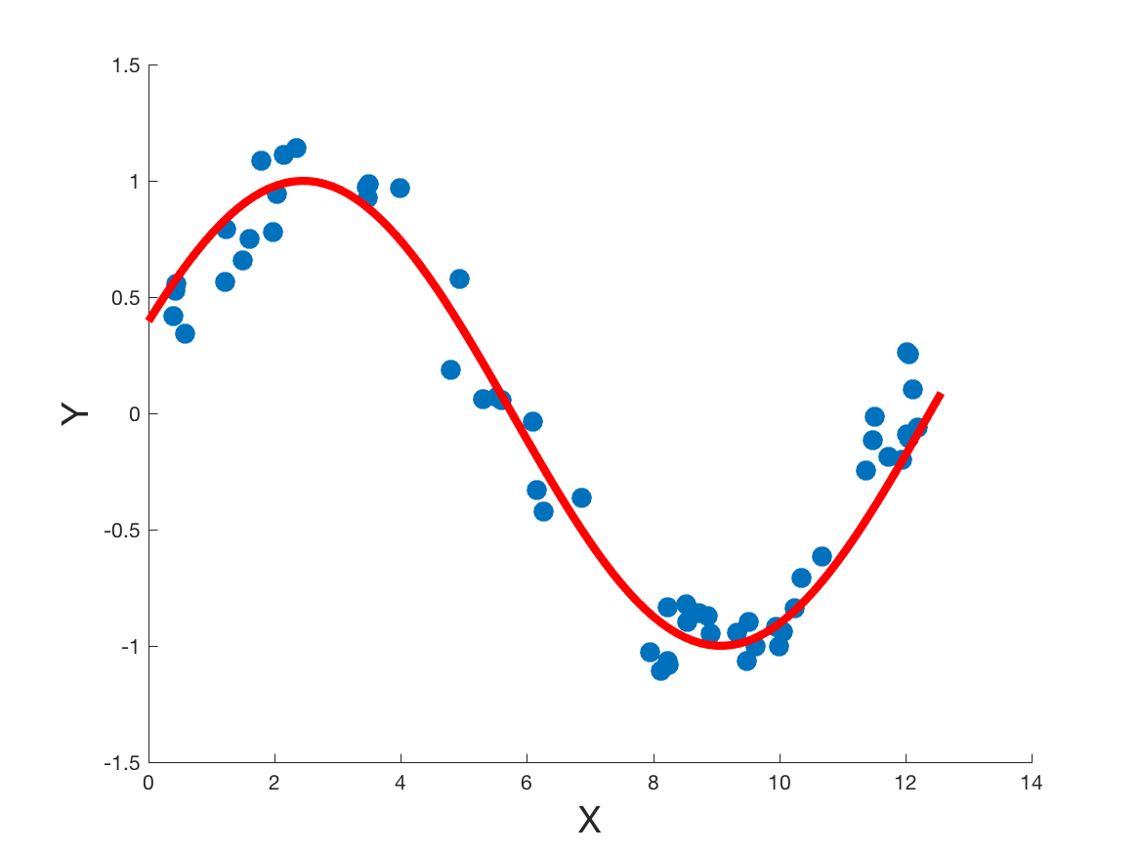
Gradient descent example
After 5 iterations, we still have $w_{0}=0.407, w_{1}=0.47$

Slide 22
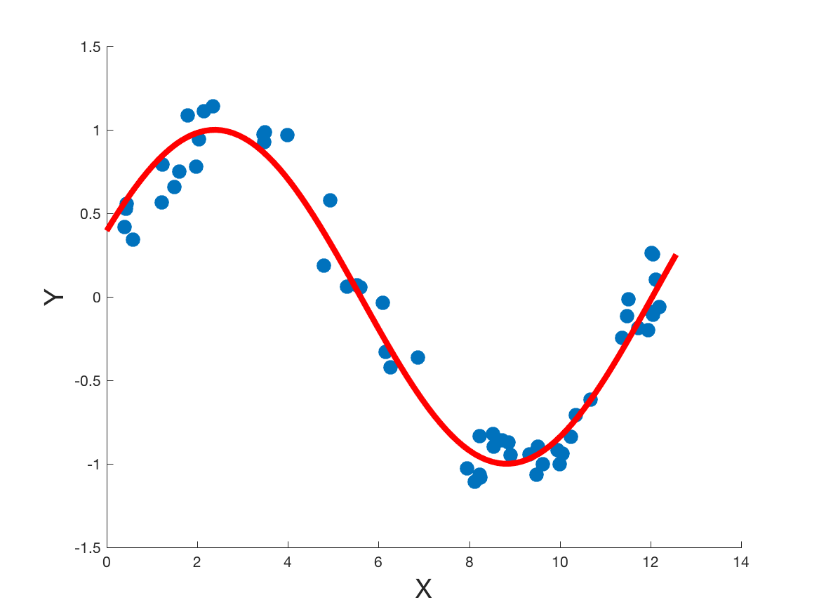
Gradient descent example
By 13 iterations, we’ve pretty well converged around $w_{0}=0.409, w_{1}=0.49$

Slide 23
What about the complicated example?
Gradient descent doesn’t always behave well with complicated data
It can
Overfit
Oscillate

Slide 24
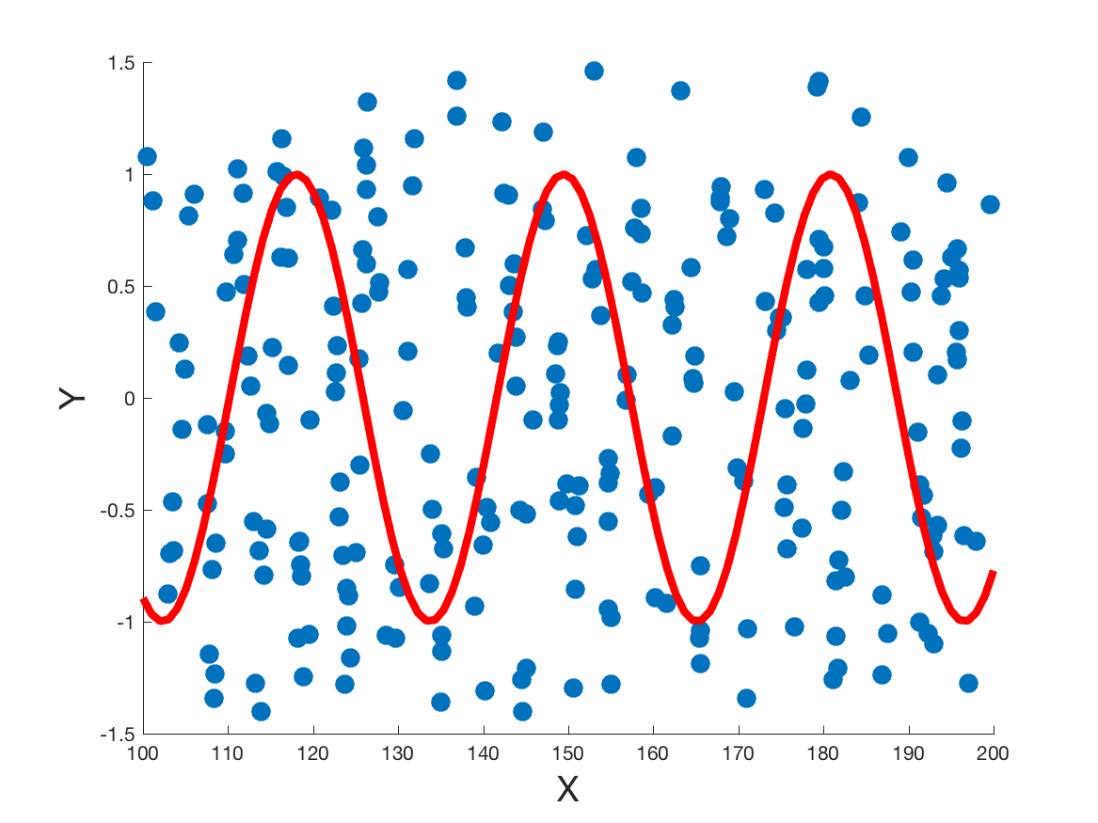
Gradient descent example
Start with random $w_{0}=3.1, w_{1}=0.2, α=0.01$

Slide 25
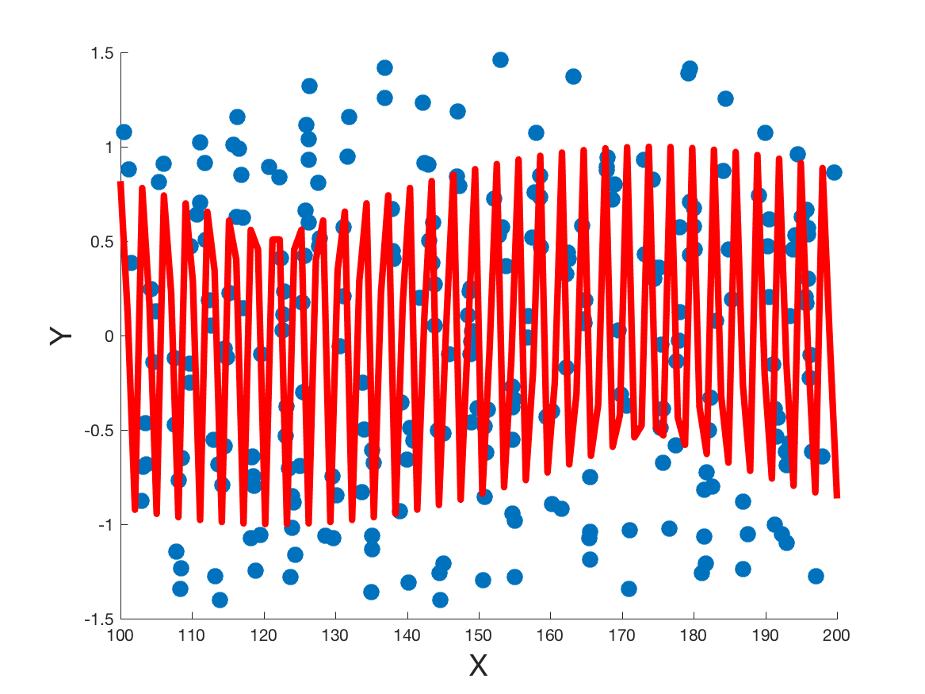
Gradient descent example
After 1 iteration

Slide 26
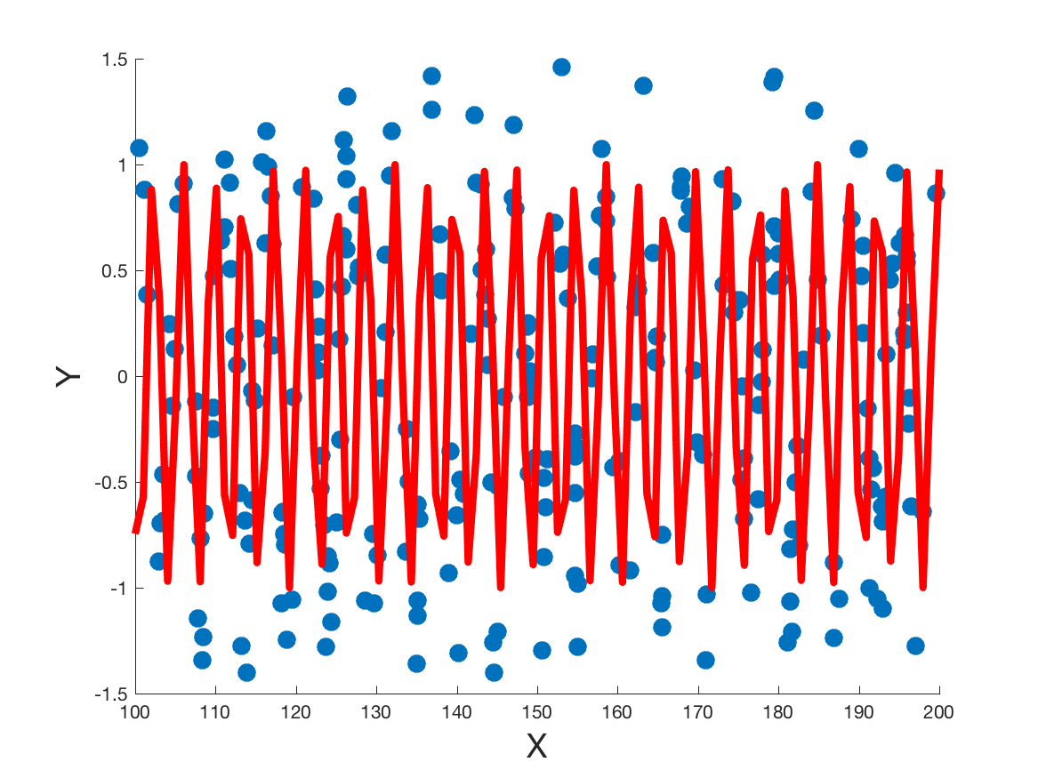
Gradient descent example
After 2 iterations

Slide 27
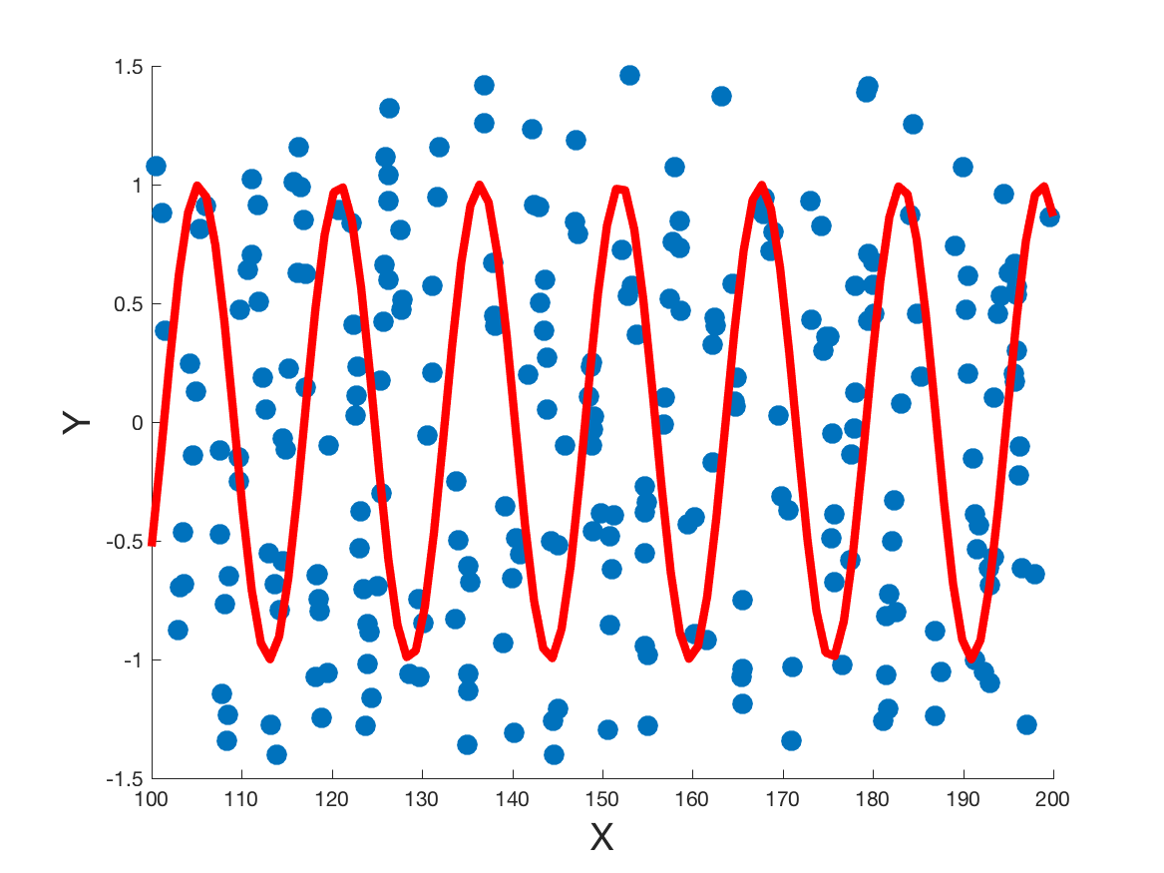
Gradient descent example
After 3 iterations

Slide 28
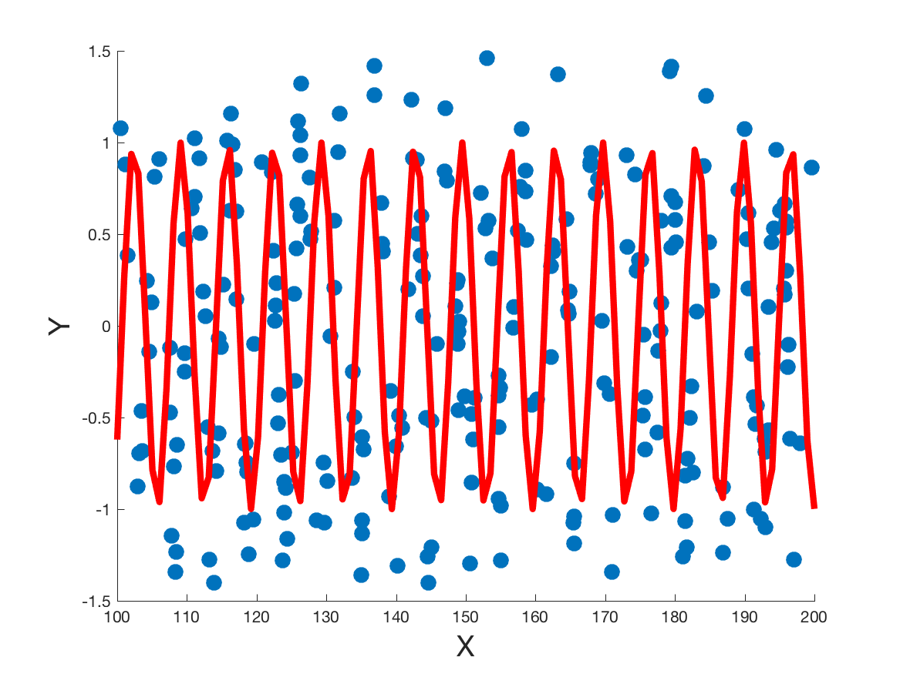
Gradient descent example
After 4 iterations

Slide 29
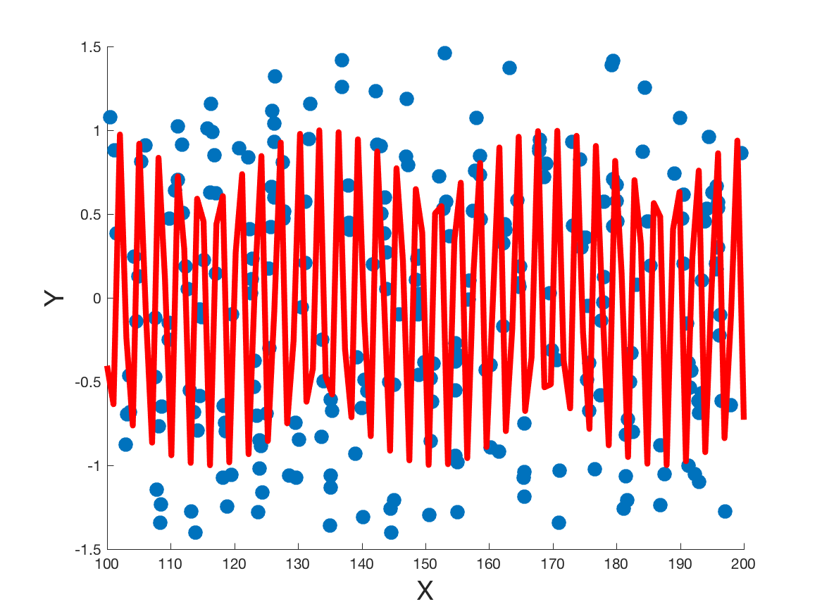
Gradient descent example
After 5 iterations

Slide 30
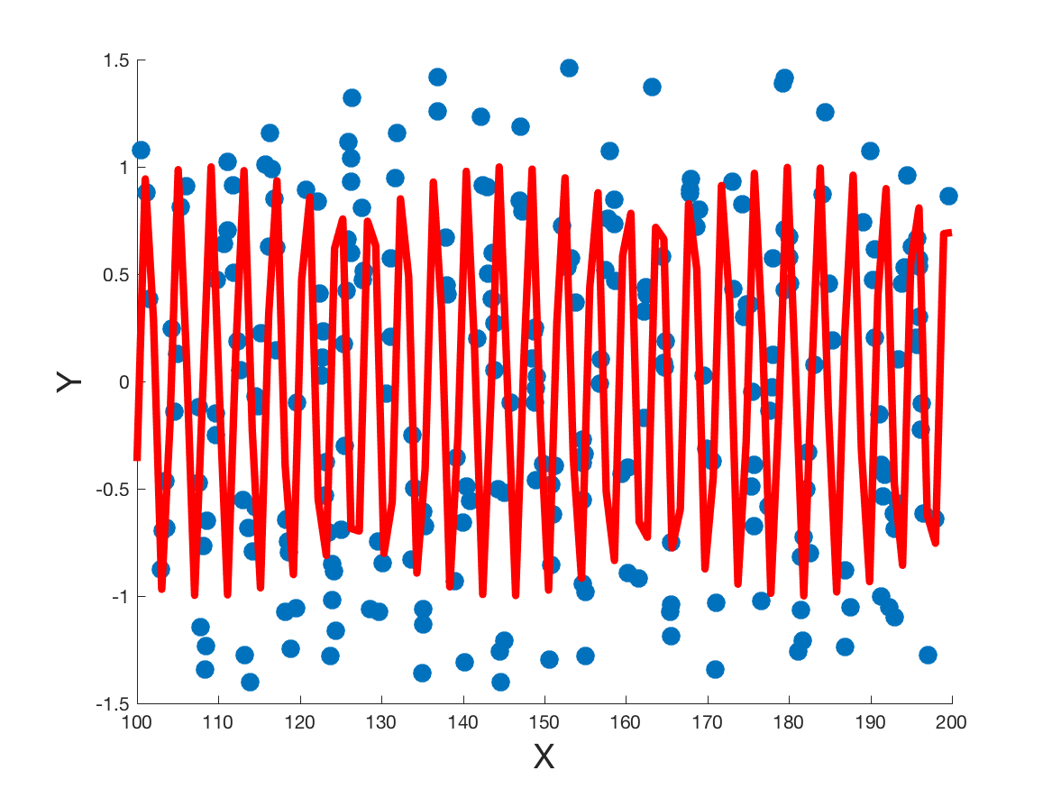
Gradient descent example
After 6 iterations

Slide 31
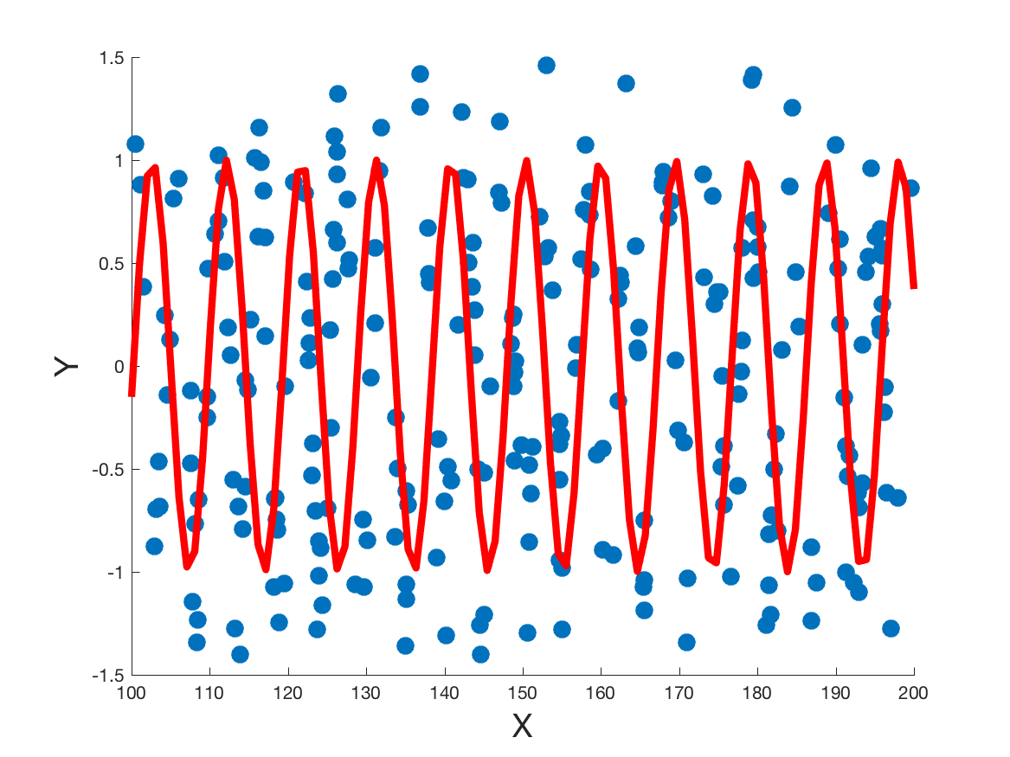
Gradient descent example
After 7 iterations

Slide 32
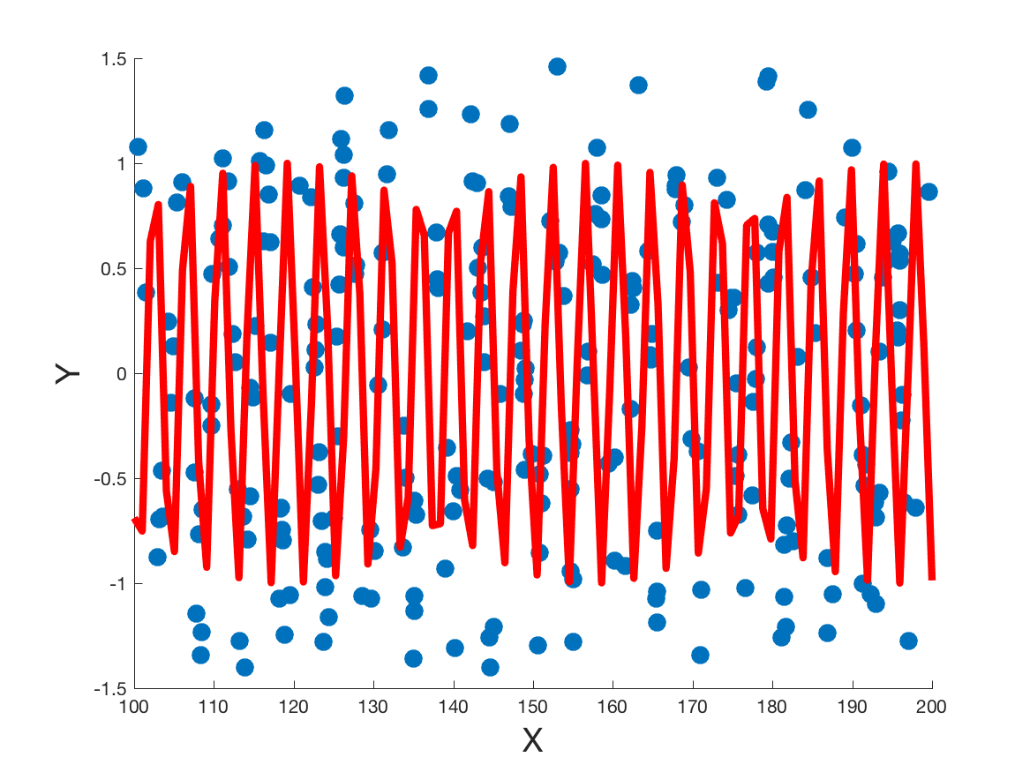
Gradient descent example
After 8 iterations

Slide 33
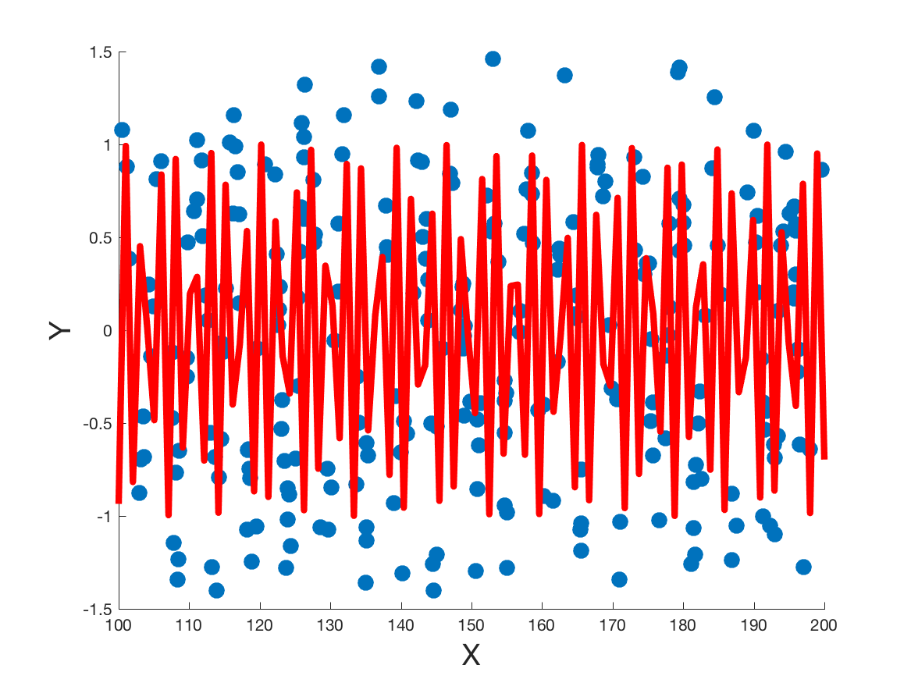
Gradient descent example
After 9 iterations

Slide 34
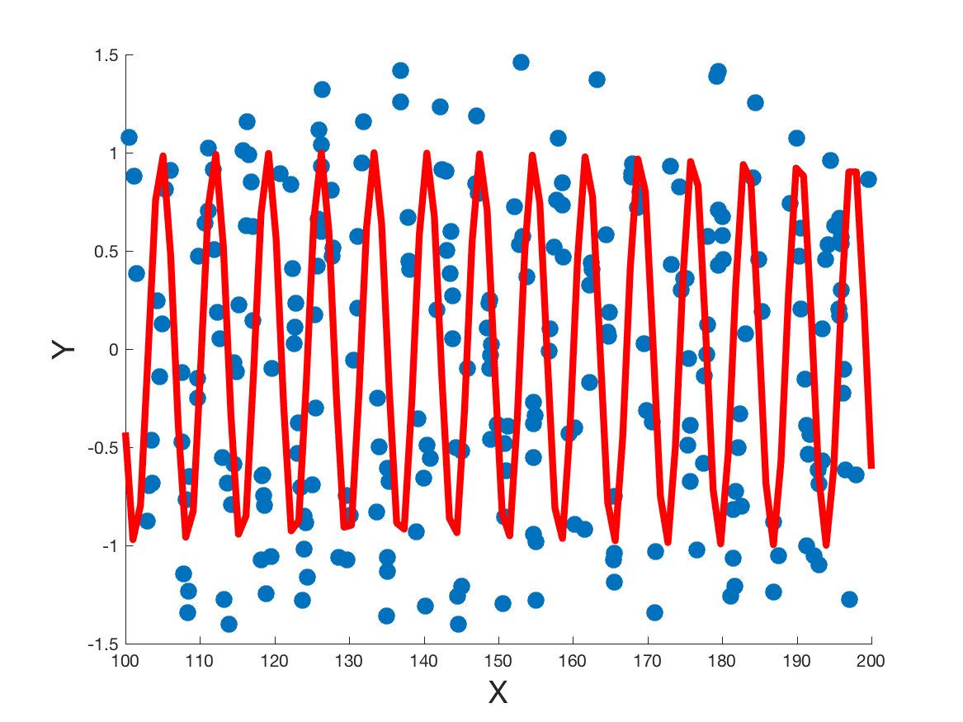
Gradient descent example
After 10 iterations

Slide 35
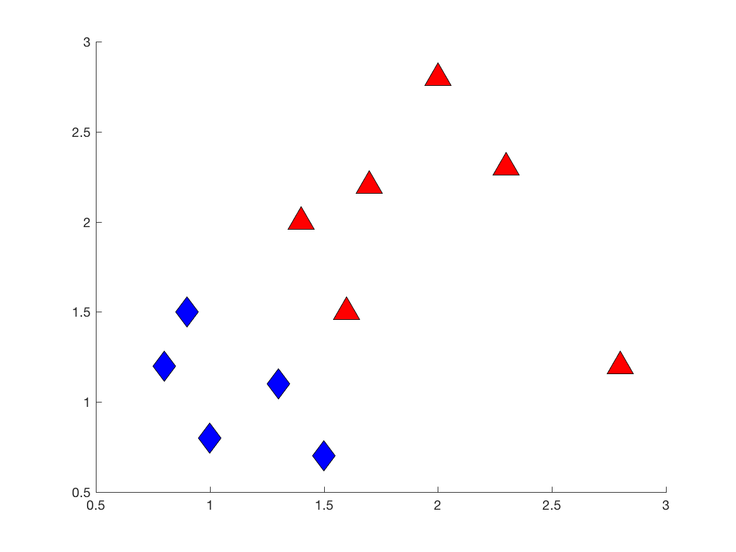
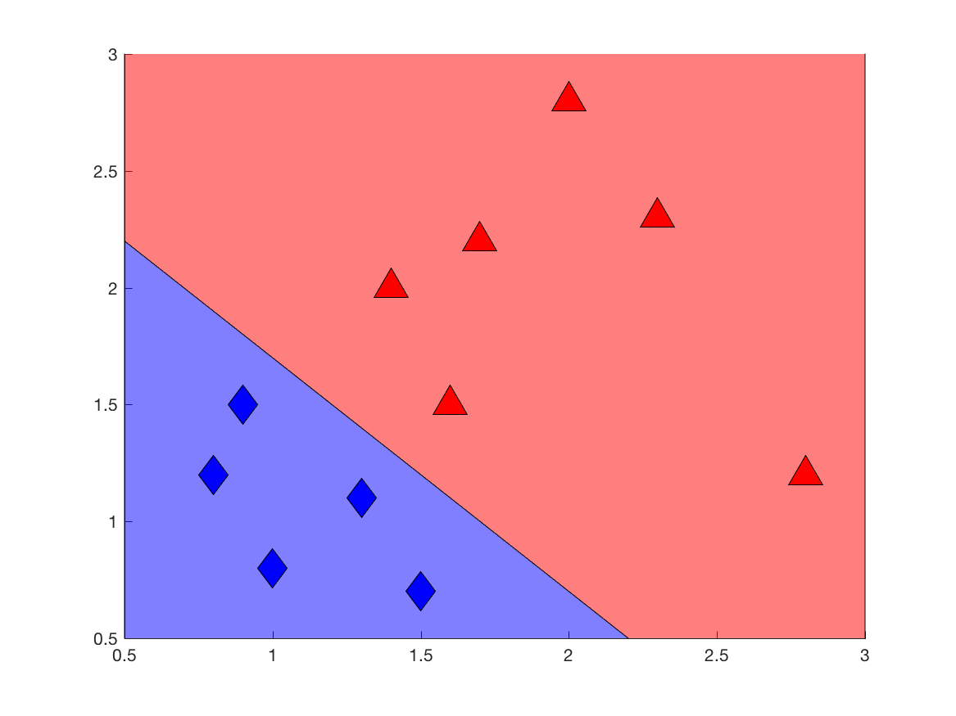
Linear classifiers
We’ve been talking about fitting a line.
But what about this linear classification example?
Remember that “linear” in AI means constant slope; other functions may be polynomial, trigonometric, etc.

Slide 36
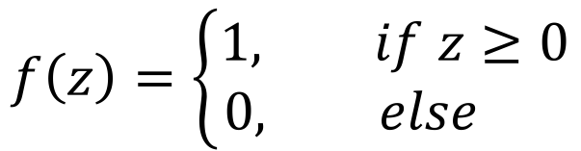
Threshold classifier
The line separating the two regions is a decision boundary.
Easiest is a hard threshold:
f(x)
1
$$f\left(z\right)=\left\{\begin{aligned}1, if z≥0 \\ 0, else \end{aligned}\right.$$
0
x
0

Slide 37
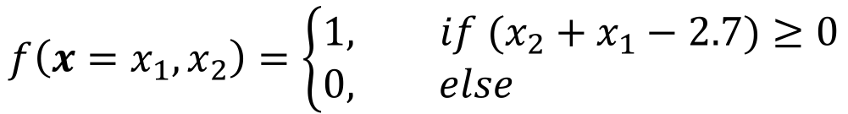
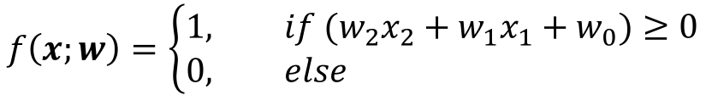
Linear classifiers
Here, our binary classifier would be
$$f\left({x=x}_{1},x_{2}\right)=\left\{\begin{aligned}1, if (x_{2}+x_{1}−2.7)≥0 \\ 0, else \end{aligned}\right.$$
In general, for any line:
$$f\left(x;w\right)=\left\{\begin{aligned}1, if (w_{2}x_{2}+w_{1}x_{1}+w_{0})≥0 \\ 0, else \end{aligned}\right.$$

Slide 38
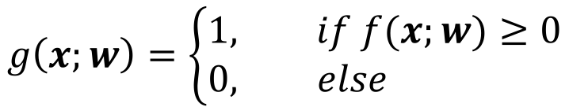







Perceptron (Neuron)
We can think of this as a composition of two functions:
$$g\left(x;w\right)=\left\{\begin{aligned}1, if f(x;w)≥0 \\ 0, else \end{aligned}\right.$$
$$f\left(x;w\right)=w_{2}x_{2}+w_{1}x_{1}+w_{0}$$
We can represent this composition graphically like:
$$w_{0}$$
$$x_{1}$$
$$w_{1}$$
$$g(x;w)$$
$$w_{2}$$
$$x_{2}$$

Slide 39

Perceptron learning rule
We can train a perceptron with a simple update:
$$w_{i}←w_{i}+α\left(y−g\left(x;w\right)\right)x_{i}$$
The error on x with model w
Called the perceptron learning rule
Iterative updates to the weight vector
Calculate updates to each weight and apply them all at once!
Will converge to the optimal solution if the data are linearly separable

Slide 40
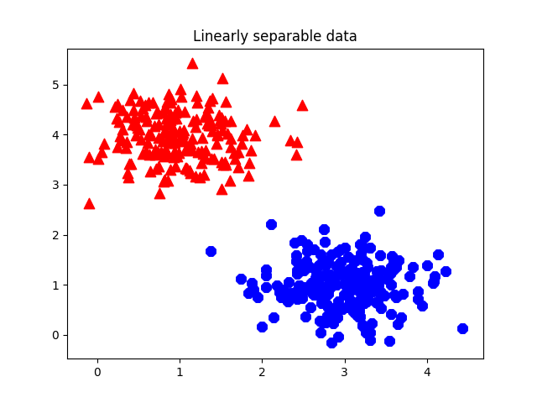
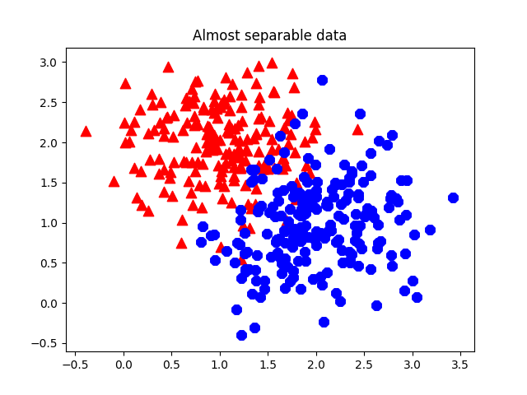
Linear separability
Can you draw a line that perfectly separates the classes?

Slide 41
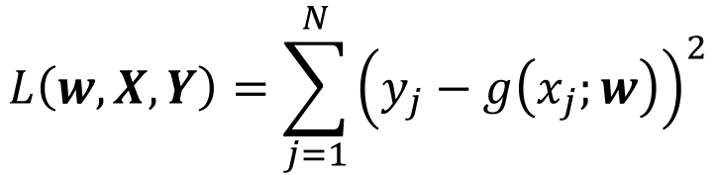
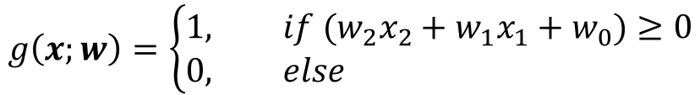
The problem with hard thresholding
Perceptron updates won’t converge if the data aren’t separable!
So let’s try gradient descent:
$$g\left(x;w\right)=\left\{\begin{aligned}1, if (w_{2}x_{2}+w_{1}x_{1}+w_{0})≥0 \\ 0, else \end{aligned}\right.$$
Minimizing the L2 loss w.r.t. true labels Y:
$$L\left(w,X,Y\right)=\sum_{j=1}^{N}{{\left(y_{j}−g\left(x_{j};w\right)\right)}^{2}}$$
What breaks this minimization?

Slide 42


Switching to Logistic Regression
We need a differentiable classifier function
Use the logistic function
(aka sigmoid function)
$$f\left(x;w\right)=\frac{1}{1+e^{−w⋅x}}$$
Using this, it’s now called logistic regression

Slide 43






Modified neuron
$$w_{0}$$
$$x_{1}$$
$$w_{1}$$
$$g(x;w)$$
$$w_{2}$$
$$x_{2}$$

Slide 44


Gradient descent for logistic regression
Now we have a differentiable loss function!
$$g\left(x;w\right)=\frac{1}{1+e^{−f\left(x;w\right)}}$$
$$f\left(x;w\right)=w_{2}x_{2}+w_{1}x_{1}+w_{0}$$
L2 loss w.r.t. true labels Y:
$$L\left(w,X,Y\right)=\sum_{j=1}^{N}{{\left(y_{j}−g\left(x_{j};w\right)\right)}^{2}}$$

Slide 45


Gradient descent for logistic regression
Partial differentiation gives
$$\frac{δL}{δw_{i}}\left(w\right)=\sum_{j}{−2(y_{j}−g\left(x_{j},w\right)×g\left(x_{j},w\right)\left(1−g\left(x_{j},w\right)\right)×x_{j,i} }$$
So now our gradient-based update for each $w_{i}$ looks like:
$$w_{i}←w_{i}+α\left[\sum_{j}{−2(y_{j}−g\left(x_{j},w\right)×g\left(x_{j},w\right)\left(1−g\left(x_{j},w\right)\right)×x_{j,i} }\right]$$

Slide 46
Gradient descent for logistic regression

Slide 47

Gradient descent for logistic regression

Slide 48

Gradient descent for logistic regression

Slide 49

Gradient descent for logistic regression

Slide 50

Gradient descent for logistic regression

Slide 51

Gradient descent for logistic regression

Slide 52

Gradient descent for logistic regression

Slide 53

The XOR problem
Logistic regression is great! But it requires tolerating error, and sometimes there’s just too much error.

Slide 54


The XOR problem
Logistic regression is great! But it requires tolerating error, and sometimes there’s just too much error.
1
1
0
$$x_{1}$$
A linear model will always have at least 50% error!
0
0
1
0
1
$$x_{2}$$

Slide 55



Neural Networks
We can model nonlinear decision boundaries by stacking up neurons
$$x_{1}$$
$$x_{2}$$
$$x_{3}$$

Slide 56







XOR neural network
XOR has two components: OR and $¬$AND
Each of these is linearly separable
OR
$$?$$
$$x_{1}$$
$$?$$
$$x_{1}∨x_{2}$$
$$?$$
$$x_{2}$$

Slide 57



XOR neural network
XOR has two components: OR and $¬$AND
Each of these is linearly separable
OR
$$−0.5$$
$$x_{1}$$
$$1$$
$$x_{1}∨x_{2}$$
$$1$$
$$x_{2}$$

Slide 58

XOR neural network
XOR has two components: OR and $¬$AND
Each of these is linearly separable
AND
$$?$$
$$x_{1}$$
$$?$$
$$x_{1}∧x_{2}$$
$$?$$
$$x_{2}$$

Slide 59

XOR neural network
XOR has two components: OR and $¬$AND
Each of these is linearly separable
AND
$$−1.5$$
$$x_{1}$$
$$1$$
$$x_{1}∧x_{2}$$
$$1$$
$$x_{2}$$

Slide 60










XOR neural network
XOR = $OR\left(x_{1},x_{2}\right)∧¬AND(x_{1},x_{2})$
$$−0.5$$
$$?$$
$$1$$
$$x_{1}$$
$$?$$
$$1$$
$$XOR(x_{1},x_{2})$$
$$1$$
$$?$$
$$x_{2}$$
$$1$$
$$−1.5$$

Slide 61



XOR neural network
XOR = $OR\left(x_{1},x_{2}\right)∧¬AND(x_{1},x_{2})$
$$−0.5$$
$$−0.1$$
$$1$$
$$x_{1}$$
$$1$$
$$1$$
$$XOR(x_{1},x_{2})$$
$$1$$
$$−1$$
$$x_{2}$$
$$1$$
$$−1.5$$

Slide 62


XOR neural network
Let’s see what’s going on
XOR = $OR\left(x_{1},x_{2}\right)∧¬AND(x_{1},x_{2})$
$$−0.5$$
$$f(x_{1},x_{2})$$
$$−0.1$$
$$1$$
$$x_{1}$$
$$1$$
$$1$$
$$XOR(x_{1},x_{2})$$
$$1$$
$$−1$$
$$x_{2}$$
$$1$$
$$h(x_{1},x_{2})$$
$$−1.5$$

Slide 63




Nonlinear mapping in middle layer
1
1
0
1
1
0
OR
$$x_{1}$$
$${f(x}_{1},x_{2})$$
0
0
1
0
0
0
1
0
1
$$x_{2}$$
$${h(x_{1},x}_{2})$$
AND

Slide 64
Nonlinear mapping in middle layer
1
1
0
1
1
0
OR
$$x_{1}$$
$${f(x}_{1},x_{2})$$
0
0
1
0
0
0
1
0
1
$$x_{2}$$
$${h(x_{1},x}_{2})$$
AND

Slide 65
Nonlinear mapping in middle layer
1
1
0
1
1
0
OR
$$x_{1}$$
$${f(x}_{1},x_{2})$$
0
0
1
0
0
0
1
0
1
$$x_{2}$$
$${h(x_{1},x}_{2})$$
AND

Slide 66
Nonlinear mapping in middle layer
1
1
0
1
1
0
OR
$$x_{1}$$
$${f(x}_{1},x_{2})$$
0
0
1
0
0
0
1
0
1
$$x_{2}$$
$${h(x_{1},x}_{2})$$
AND

Slide 67
Nonlinear mapping in middle layer
1
1
0
OR
Now it’s linearly separable!
$${f(x}_{1},x_{2})$$
0
0
0
1
$${h(x_{1},x}_{2})$$
AND

Slide 68


Backpropagation
This is just another composition of functions
$$XOR\left(x_{1},x_{2}\right)=OR\left(x_{1},x_{2}\right)∧¬AND(x_{1},x_{2})$$
Generally, let
$h_{1}…h_{m}$ be the intermediate functions (called the hidden layer)
$w_{1},w_{2}$ be the weight vectors for input->hidden, hidden->output
$sig(z)$ denote the sigmoid function over z
$$g\left(x;W\right)=sig\left(w_{2}⋅h\left(x;w_{1}\right)\right)$$

Slide 69



Backpropagation
To learn with gradient descent (example: L2 loss w.r.t. Y)
$$L\left(W,X,Y\right)=\sum_{j=1}^{N}{{\left(y_{j}−g\left(x_{j};W\right)\right)}^{2}}$$
$$g\left(x;W\right)=sig\left(w_{2}⋅h\left(x;w_{1}\right)\right)$$
Apply the Chain Rule (for differentiation this time) to differentiate the composed functions
Get partial derivatives of overall error w.r.t. each parameter in the network
In hidden node $h_{i}$, get derivative w.r.t. the output of $h_{i}$, then differentiate that w.r.t. $w_{j}$

Slide 70
“Deep” learning
Deep models use more than one hidden layer (i.e., more than one set of nonlinear functions before the final output
$$x_{1}$$
$$x_{2}$$
$$x_{3}$$

Slide 71
Today’s learning goals
At the end of today, you should be able to
Describe gradient descent for learning model parameters
Explain the difference between logistic regression and linear regression
Tell if a 2-D dataset is linearly separable
Explain the structure of a neural network

Slide 72
Next time
AI as an empirical science
Experimental design

Slide 73

End of class recap
How does gradient descent use the loss function to tell us how to update model parameters?
What machine learning problem is logistic regression for? What about linear regression?
Can the dataset at right be correctly classified with a logistic regression?
Can it be correctly classified with a neural network?
What is your current biggest question about machine learning?

