Slide 3
Announcements
Wednesday office hours moving to Thursday 2-3 next week (11/16)

Slide 4
Today’s learning goals
At the end of today, you should be able to
Describe methods for developing and testing hypotheses
Explain a scientific control and what it’s for
Use significance testing and performance metrics to compare two classifiers on the same dataset

Slide 5
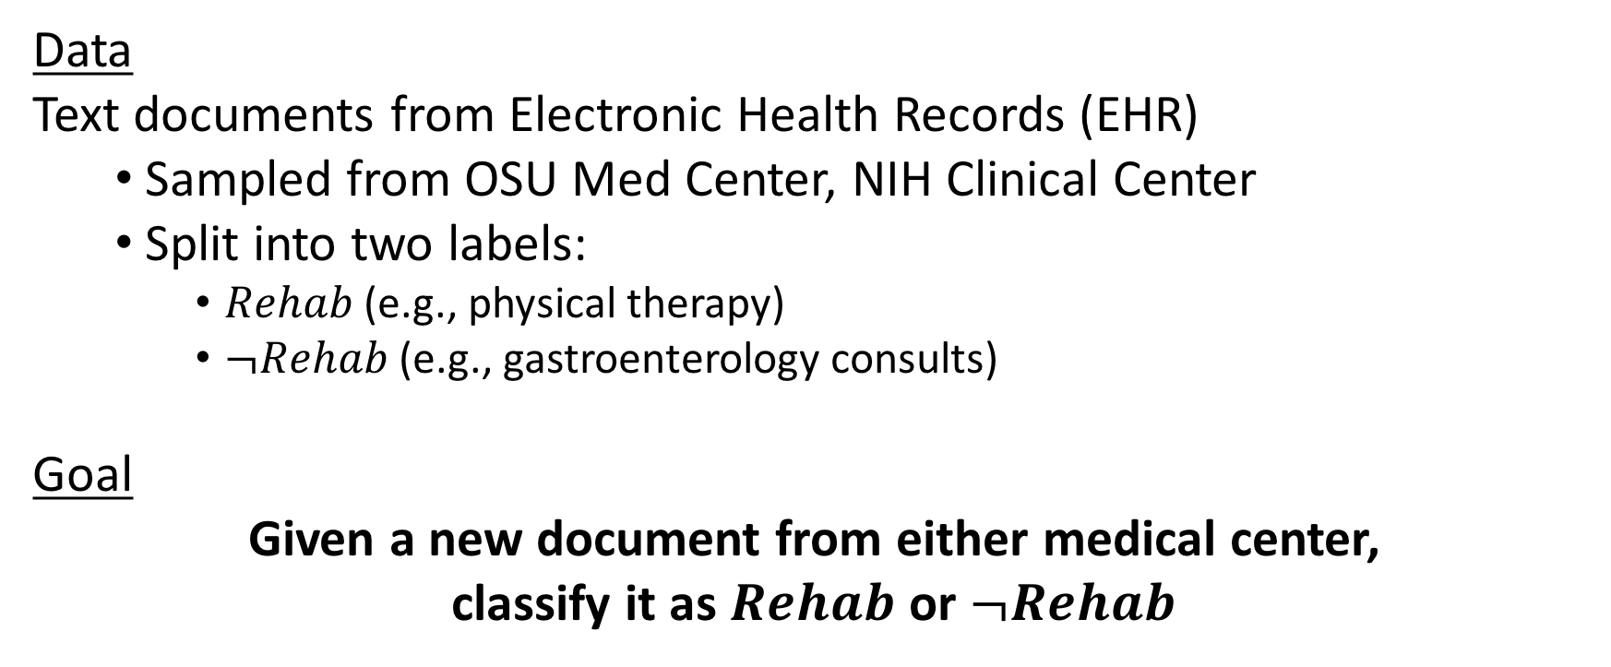
Case study: Text classification
Data
Text documents from Electronic Health Records (EHR)
Sampled from OSU Med Center, NIH Clinical Center
Split into two labels:
$Rehab$ (e.g., physical therapy)
$¬Rehab$ (e.g., gastroenterology consults)
Goal
Given a new document from either medical center,
classify it as $Rehab$ or $¬Rehab$

Slide 6
Understanding the data
This is always the first step!
What kinds of things are we looking at?
How can we describe them?
What format does desired output take?

Slide 7
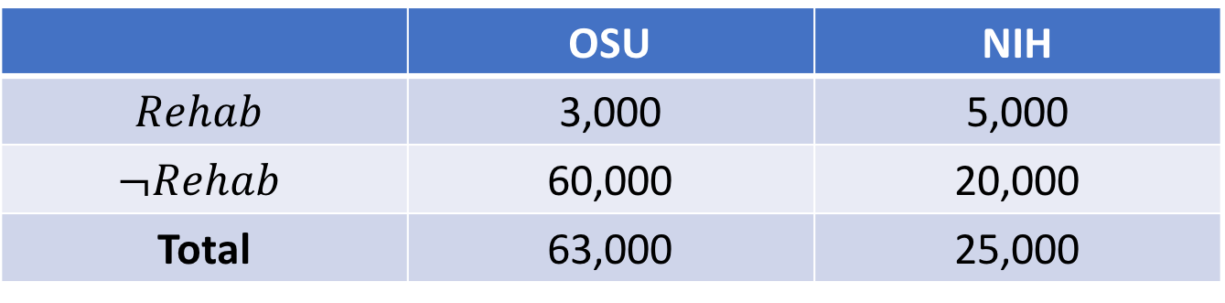
Understanding the data
 | OSU | NIH
$$Rehab$$ | 3,000 | 5,000
$$¬Rehab$$ | 60,000 | 20,000
Total | 63,000 | 25,000
Possible features:
Word frequencies
Part-of-speech tags (Verb, Noun, etc.)
# of sentences
Medical concepts found in the text by trained software

Slide 8
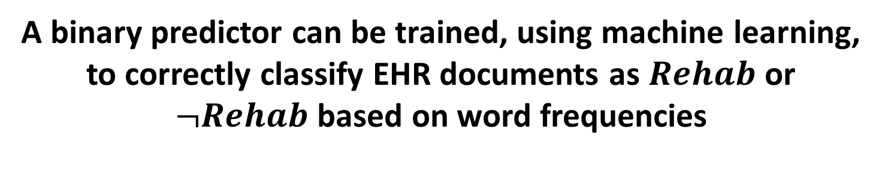
My broad hypothesis
A binary predictor can be trained, using machine learning, to correctly classify EHR documents as $Rehab$ or $¬Rehab$ based on word frequencies
This is not a testable hypothesis, in the sense of statistical hypothesis testing
Procedure to explore this question:
Convert the broad hypothesis into one or more specific, testable hypotheses
Design experiments to test each hypothesis
Evaluate experimental results

Slide 9
What do we need for testable hypotheses?
What is the reference distribution?
In ML, this is often taken as the decisions made by a baseline system to compare against
Common baselines: random, majority classifier
How do we evaluate “correctness”?
Given the predictions made by the system, compare to labels somehow
Common metrics: accuracy, precision, recall

Slide 10
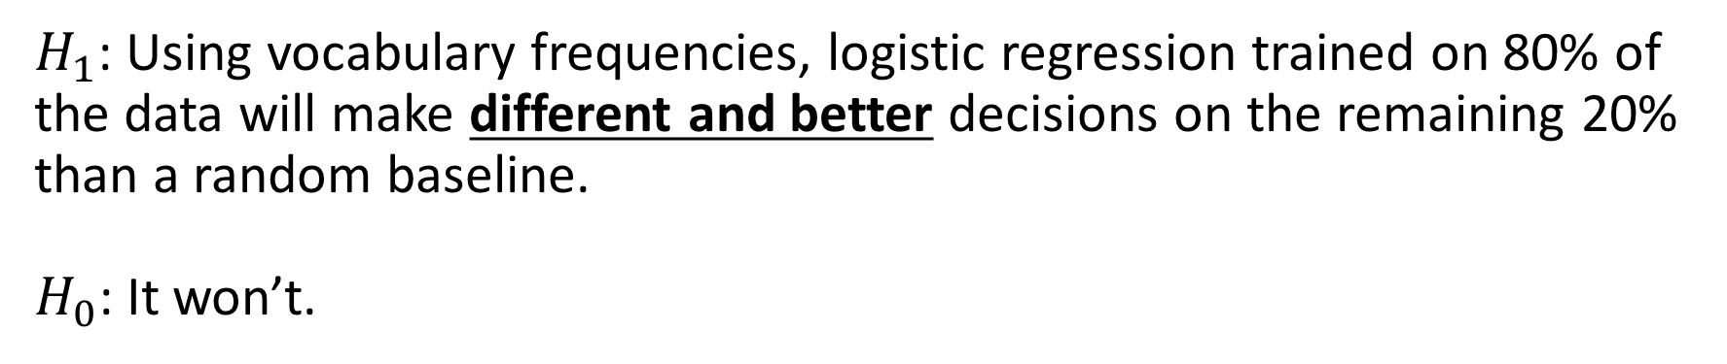
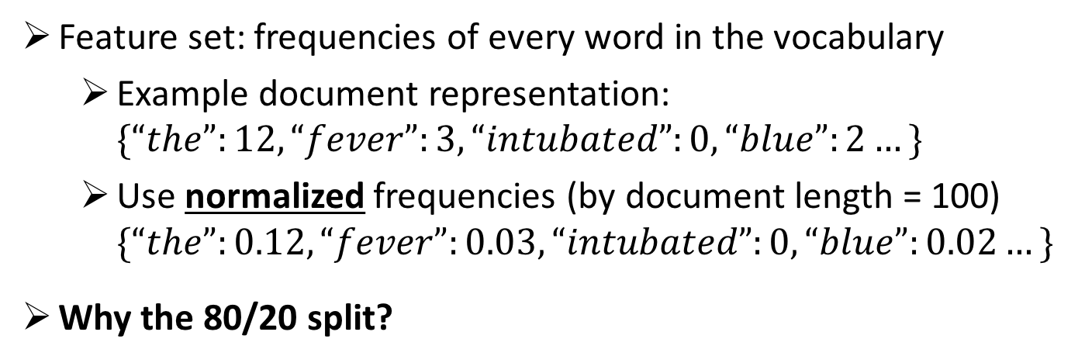
Testable hypothesis (1)
$H_{1}$: Using vocabulary frequencies, logistic regression trained on 80% of the data will make different and better decisions on the remaining 20% than a random baseline.
$H_{0}$: It won’t.
Feature set: frequencies of every word in the vocabulary
Example document representation: $\{“the”:12, “fever”:3, “intubated”:0, “blue”:2…\}$
Use normalized frequencies (by document length = 100) $\{“the”:0.12, “fever”:0.03, “intubated”:0, “blue”:0.02…\}$
Why the 80/20 split?

Slide 11
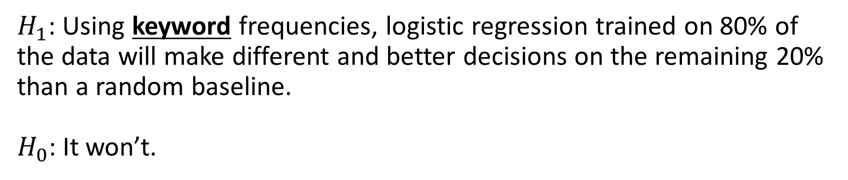
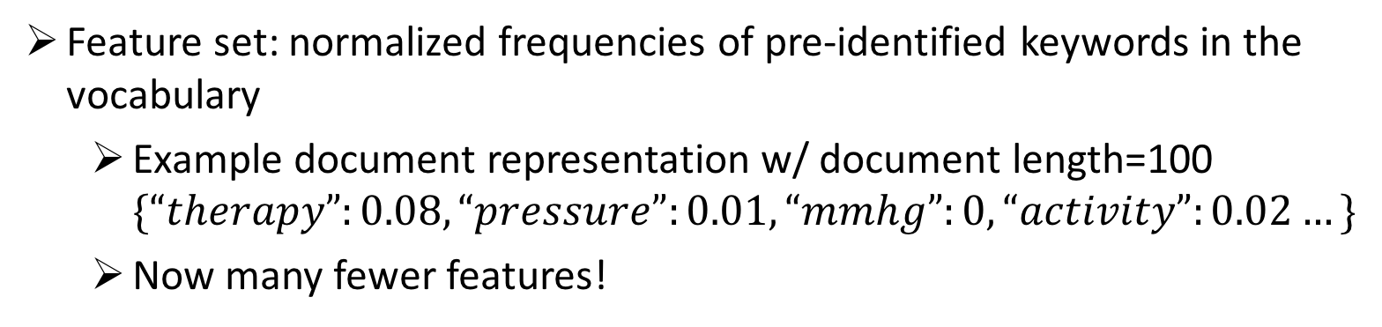
Testable hypothesis (2)
$H_{1}$: Using keyword frequencies, logistic regression trained on 80% of the data will make different and better decisions on the remaining 20% than a random baseline.
$H_{0}$: It won’t.
Feature set: normalized frequencies of pre-identified keywords in the vocabulary
Example document representation w/ document length=100 $\{“therapy”:0.08, “pressure”:0.01, “mmhg”:0, “activity”:0.02…\}$
Now many fewer features!

Slide 12
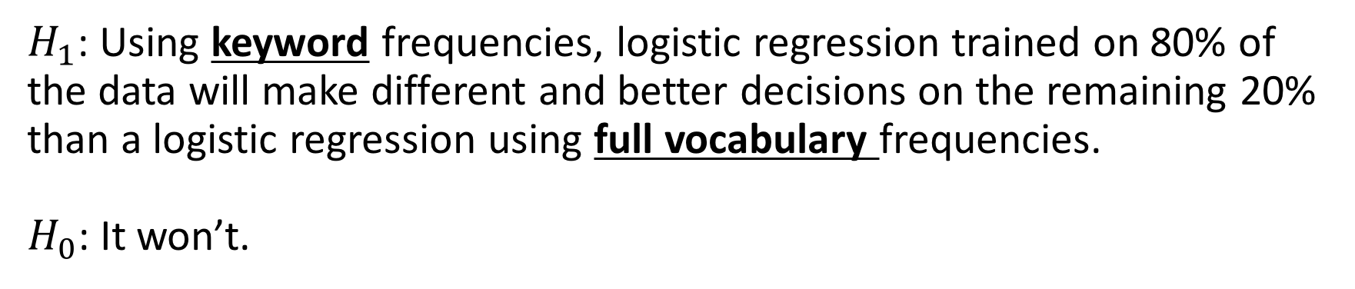
Testable hypothesis (3)
$H_{1}$: Using keyword frequencies, logistic regression trained on 80% of the data will make different and better decisions on the remaining 20% than a logistic regression using full vocabulary frequencies.
$H_{0}$: It won’t.
Now comparing between the two feature sets!

Slide 13
Designing an experiment
Let’s test the first hypothesis, comparing full vocabulary frequencies with the random baseline.
Proposed pipeline:
Randomly select 80/20 train/test split
Extract vocab frequencies for train/test documents
Train LR on training data
Get LR predictions on testing data
Calculate reference distribution from random baseline
Compare decisions for
Are they significantly different?
Is LR better? (Higher accuracy)
What’s missing here?

Slide 14
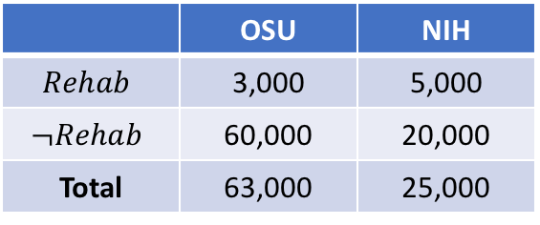
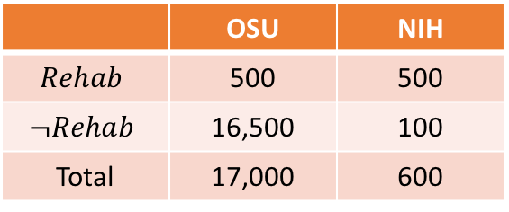
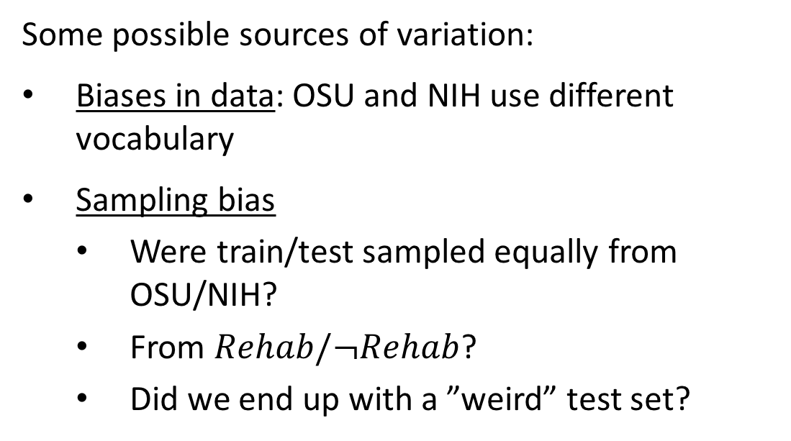
Experimental controls
We need to control for other potential sources of variation in our data.
Overall
Some possible sources of variation:
Biases in data: OSU and NIH use different vocabulary
Sampling bias
Were train/test sampled equally from OSU/NIH?
From $Rehab/¬Rehab$?
Did we end up with a ”weird” test set?
 | OSU | NIH
$$Rehab$$ | 3,000 | 5,000
$$¬Rehab$$ | 60,000 | 20,000
Total | 63,000 | 25,000
Test
 | OSU | NIH
$$Rehab$$ | 500 | 500
$$¬Rehab$$ | 16,500 | 100
Total | 17,000 | 600

Slide 15
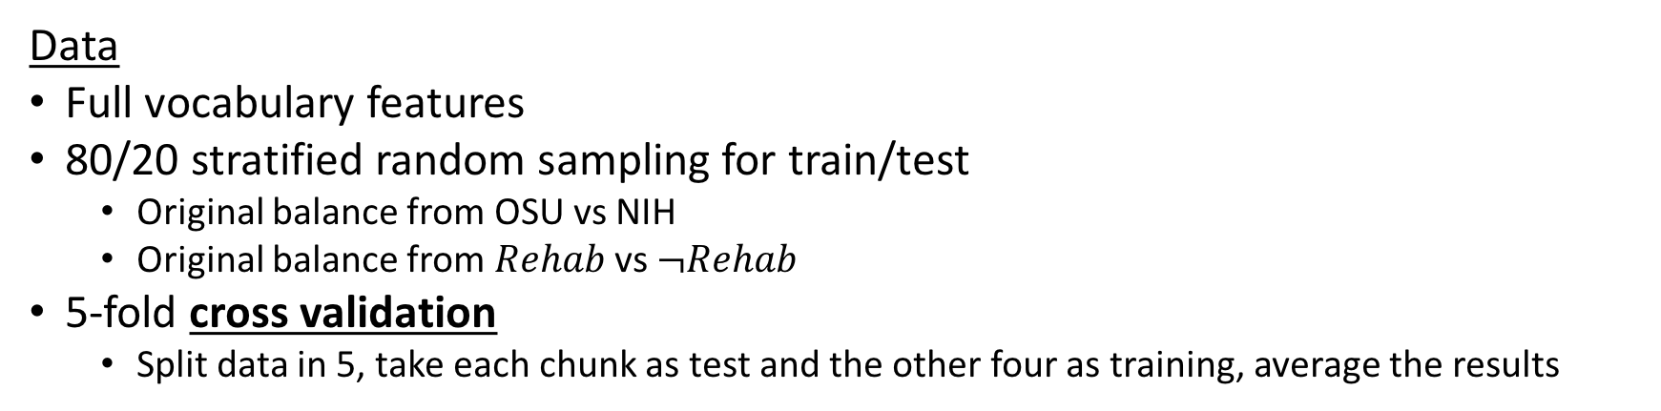
Expanded experiments for Hypothesis (1)
Data
Full vocabulary features
80/20 stratified random sampling for train/test
Original balance from OSU vs NIH
Original balance from $Rehab$ vs $¬Rehab$
5-fold cross validation
Split data in 5, take each chunk as test and the other four as training, average the results
Experiments
Use OSU data only for train/test
Use NIH data only for train/test
Train on OSU, test on NIH
Train on OSU, test on both
Train on NIH, test on OSU
Train on NIH, test on both
Train on both, test on OSU/NIH
Train on both, test on both

Slide 16
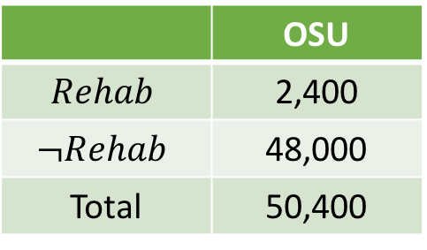
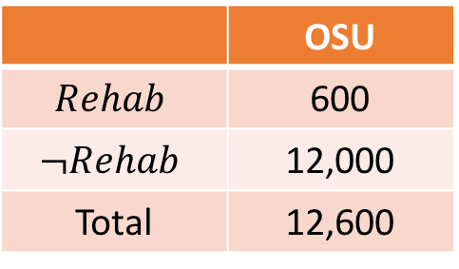
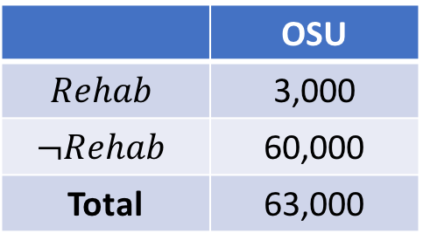
Single experiment: OSU data only
Full dataset to work with:
 | OSU
$$Rehab$$ | 3,000
$$¬Rehab$$ | 60,000
Total | 63,000
Train (80%)
Test (20%)
Train/test split:
 | OSU
$$Rehab$$ | 2,400
$$¬Rehab$$ | 48,000
Total | 50,400
 | OSU
$$Rehab$$ | 600
$$¬Rehab$$ | 12,000
Total | 12,600

Slide 17
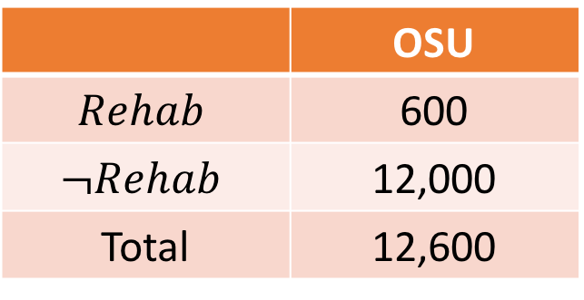
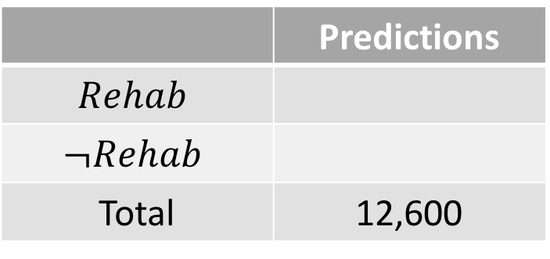
Single experiment: baseline predictions
 | OSU
$$Rehab$$ | 600
$$¬Rehab$$ | 12,000
Total | 12,600
Test data (frequencies):
What do the expected outcomes of a random classifier look like?
 | Predictions
$$Rehab$$
$$¬Rehab$$
Total | 12,600
6,300
6,300

Slide 18
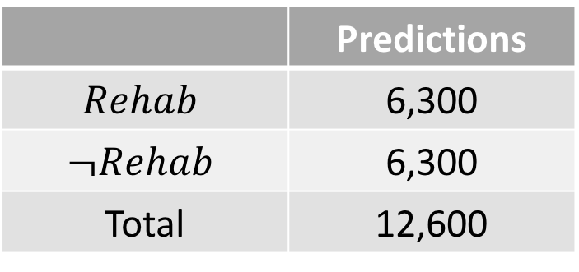
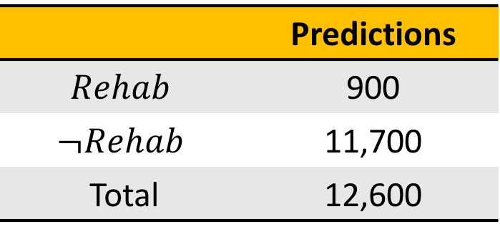
Single experiment: observed predictions
 | Predictions
$$Rehab$$ | 6,300
$$¬Rehab$$ | 6,300
Total | 12,600
Random baseline gives:
 | Predictions
$$Rehab$$ | 900
$$¬Rehab$$ | 11,700
Total | 12,600
Trained logistic regression gives:

Slide 19
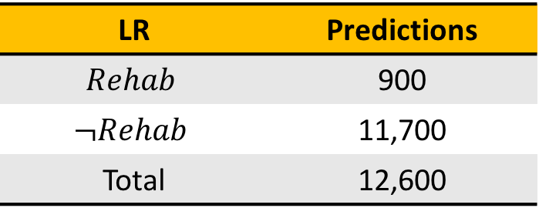
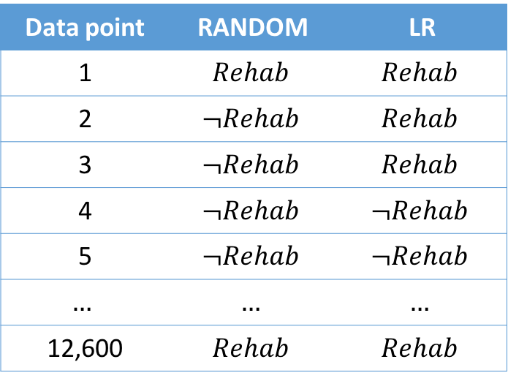
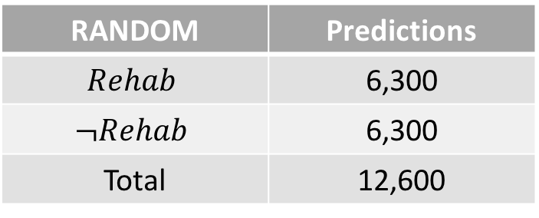
Single experiment: paired predictions
Rewrite these in terms of individual decisions:
RANDOM | Predictions
$$Rehab$$ | 6,300
$$¬Rehab$$ | 6,300
Total | 12,600
Data point | RANDOM | LR
1 | $$Rehab$$ | $$Rehab$$
2 | $$¬Rehab$$ | $$Rehab$$
3 | $$¬Rehab$$ | $$Rehab$$
4 | $$¬Rehab$$ | $$¬Rehab$$
5 | $$¬Rehab$$ | $$¬Rehab$$
$$…$$ | $$…$$ | $$…$$
12,600 | $$Rehab$$ | $$Rehab$$
LR | Predictions
$$Rehab$$ | 900
$$¬Rehab$$ | 11,700
Total | 12,600

Slide 20
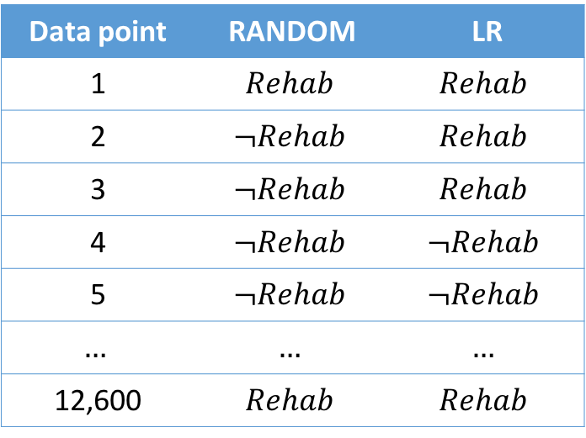
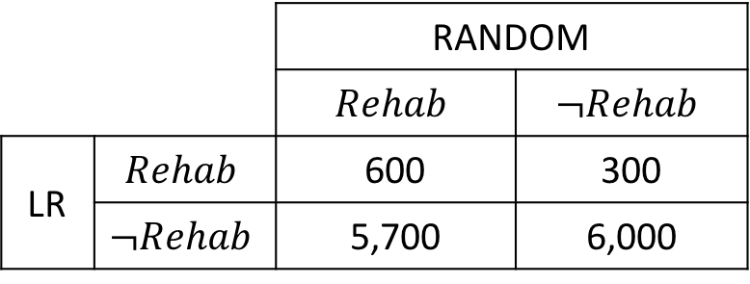
Single experiment: paired predictions
Use paired data to derive a contingency table over outcomes
Data point | RANDOM | LR
1 | $$Rehab$$ | $$Rehab$$
2 | $$¬Rehab$$ | $$Rehab$$
3 | $$¬Rehab$$ | $$Rehab$$
4 | $$¬Rehab$$ | $$¬Rehab$$
5 | $$¬Rehab$$ | $$¬Rehab$$
$$…$$ | $$…$$ | $$…$$
12,600 | $$Rehab$$ | $$Rehab$$
 |  | RANDOM
 |  | $$Rehab$$ | $$¬Rehab$$
LR | $$Rehab$$ | 600 | 300
 | $$¬Rehab$$ | 5,700 | 6,000

Slide 21
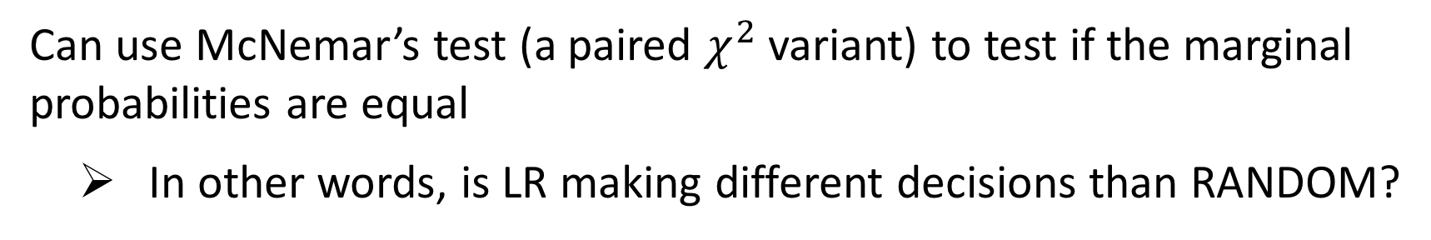
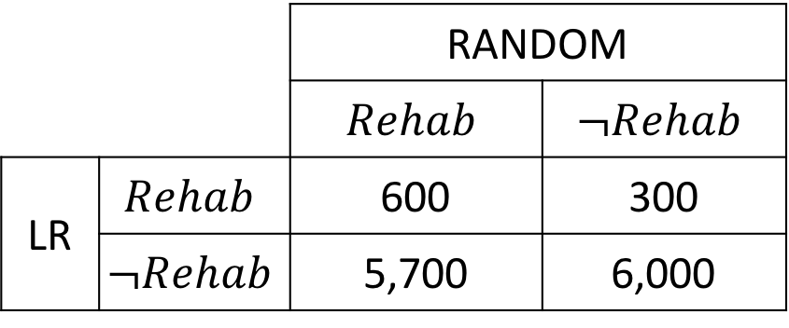
Are paired predictions different?
Can use McNemar’s test (a paired $χ^{2}$ variant) to test if the marginal probabilities are equal
In other words, is LR making different decisions than RANDOM?
 |  | RANDOM
 |  | $$Rehab$$ | $$¬Rehab$$
LR | $$Rehab$$ | 600 | 300
 | $$¬Rehab$$ | 5,700 | 6,000

Slide 22
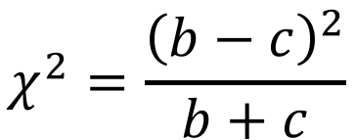
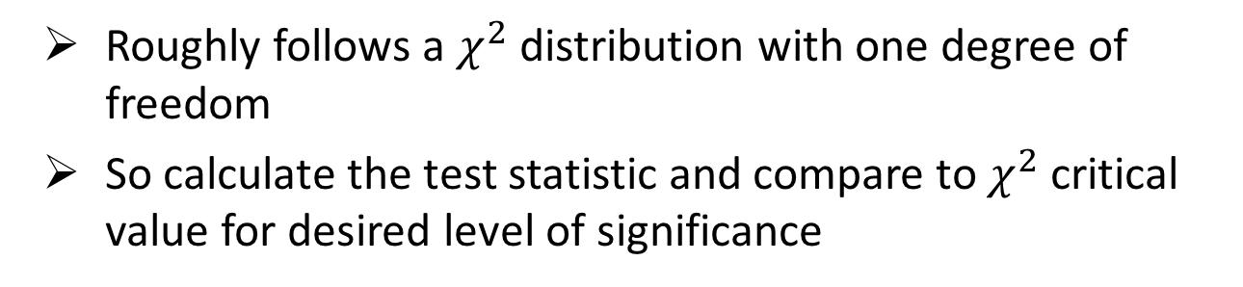
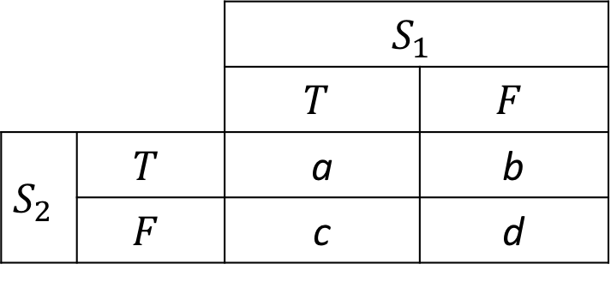
McNemar’s test
With contingency table like:
Calculate test statistic as:
 |  | $$S_{1}$$
 |  | $$T$$ | $$F$$
$$S_{2}$$ | $$T$$ | a | b
 | $$F$$ | c | d
$$χ^{2}=\frac{{\left(b−c\right)}^{2}}{b+c}$$
Roughly follows a $χ^{2}$ distribution with one degree of freedom
So calculate the test statistic and compare to $χ^{2}$ critical value for desired level of significance

Slide 23
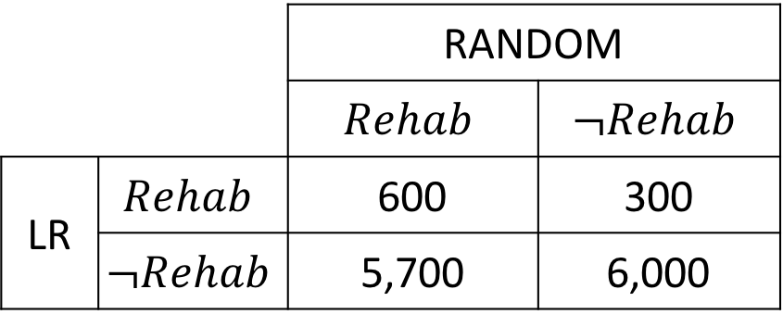
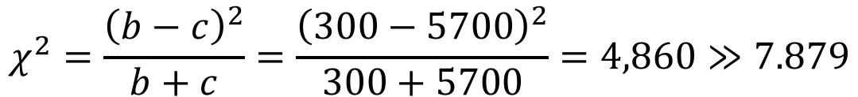
Testing our experimental results
For our observed contingency table:
 |  | RANDOM
 |  | $$Rehab$$ | $$¬Rehab$$
LR | $$Rehab$$ | 600 | 300
 | $$¬Rehab$$ | 5,700 | 6,000
Critical value for p < 0.005
$$χ^{2}=\frac{{\left(b−c\right)}^{2}}{b+c}=\frac{{\left(300−5700\right)}^{2}}{300+5700}=4,860≫7.879$$
LR is definitely making different decisions from the random baseline.

Slide 24
Is it better?
Now we know that LR is significantly different from the random baseline.
To see if it’s better, we need to calculate our performance metric of choice.
Again, use a contingency table, but now with labels vs predictions.

Slide 25
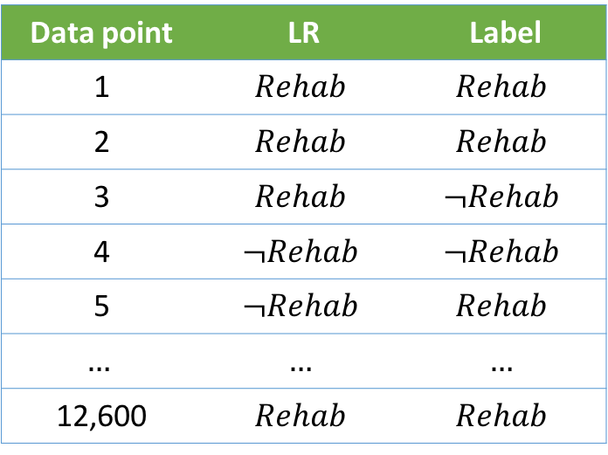
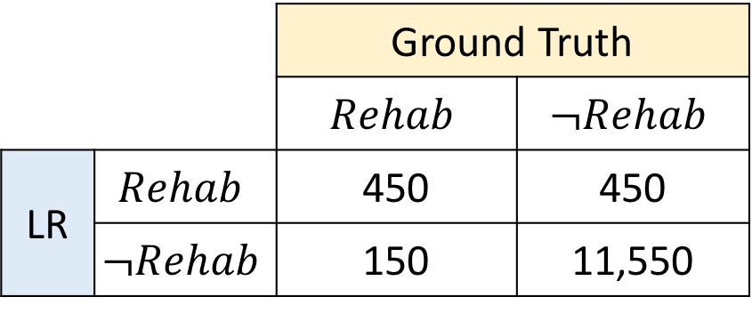
Predictions vs ground truth
Data point | LR | Label
1 | $$Rehab$$ | $$Rehab$$
2 | $$Rehab$$ | $$Rehab$$
3 | $$Rehab$$ | $$¬Rehab$$
4 | $$¬Rehab$$ | $$¬Rehab$$
5 | $$¬Rehab$$ | $$Rehab$$
$$…$$ | $$…$$ | $$…$$
12,600 | $$Rehab$$ | $$Rehab$$
 |  | Ground Truth
 |  | $$Rehab$$ | $$¬Rehab$$
LR | $$Rehab$$ | 450 | 450
 | $$¬Rehab$$ | 150 | 11,550

Slide 26
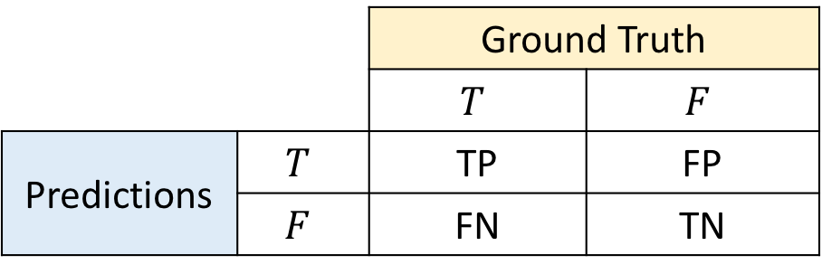
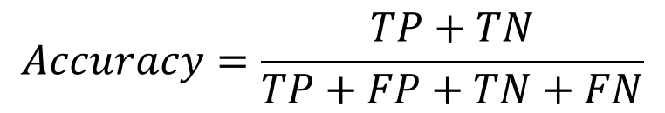
Performance metrics
 |  | Ground Truth
 |  | $$T$$ | $$F$$
Predictions | $$T$$ | TP | FP
 | $$F$$ | FN | TN
TP = True Positive
FP = False Positive
TN = True Negative
FN = False Negative
$$Accuracy=\frac{TP+TN}{TP+FP+TN+FN}$$

Slide 27
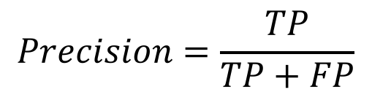
Performance metrics
 |  | Ground Truth
 |  | $$T$$ | $$F$$
Predictions | $$T$$ | TP | FP
 | $$F$$ | FN | TN
TP = True Positive
FP = False Positive
TN = True Negative
FN = False Negative
$$Accuracy=\frac{TP+TN}{TP+FP+TN+FN}$$
$$Precision=\frac{TP}{TP+FP}$$

Slide 28
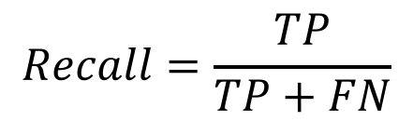
Performance metrics
 |  | Ground Truth
 |  | $$T$$ | $$F$$
Predictions | $$T$$ | TP | FP
 | $$F$$ | FN | TN
TP = True Positive
FP = False Positive
TN = True Negative
FN = False Negative
$$Accuracy=\frac{TP+TN}{TP+FP+TN+FN}$$
$$Precision=\frac{TP}{TP+FP}$$
$$Recall=\frac{TP}{TP+FN}$$

Slide 29
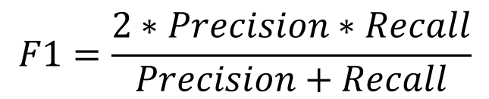
Performance metrics
 |  | Ground Truth
 |  | $$T$$ | $$F$$
Predictions | $$T$$ | TP | FP
 | $$F$$ | FN | TN
TP = True Positive
FP = False Positive
TN = True Negative
FN = False Negative
$$Accuracy=\frac{TP+TN}{TP+FP+TN+FN}$$
$$F1=\frac{2∗Precision∗Recall}{Precision+Recall}$$
$$Precision=\frac{TP}{TP+FP}$$
$$Recall=\frac{TP}{TP+FN}$$

Slide 30
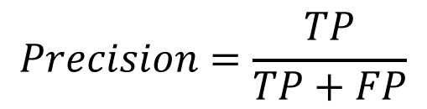
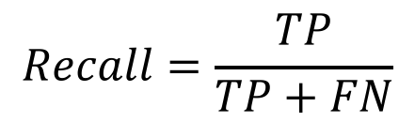
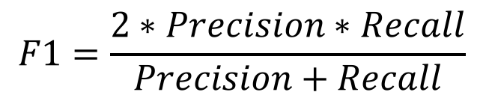
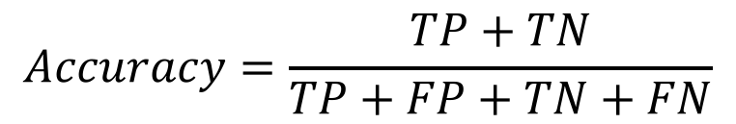
Metrics report on performance differently
$$Accuracy=\frac{TP+TN}{TP+FP+TN+FN}$$
$$F1=\frac{2∗Precision∗Recall}{Precision+Recall}$$
$$Precision=\frac{TP}{TP+FP}$$
$$Recall=\frac{TP}{TP+FN}$$
Accuracy says how well you got the correct labels, overall
Precision says how predictive you were in making positive decisions
Recall says how sensitive you were to finding all the positive cases
F-1 score combines precision and recall

Slide 31
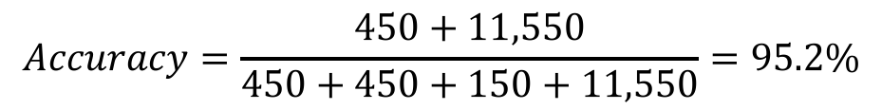
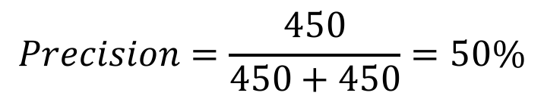
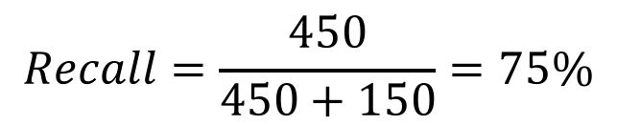
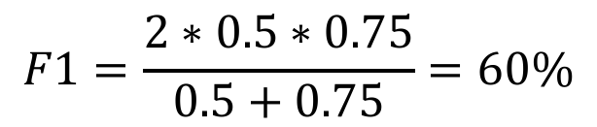

Results of our experiment
 |  | Ground Truth
 |  | $$Rehab$$ | $$¬Rehab$$
LR | $$Rehab$$ | 450 | 450
 | $$¬Rehab$$ | 150 | 11,550
$$Accuracy=\frac{450+11,550}{450+450+150+11,550}=95.2\%$$
$$F1=\frac{2∗0.5∗0.75}{0.5+0.75}=60\%$$
$$Precision=\frac{450}{450+450}=50\%$$
$$Recall=\frac{450}{450+150}=75\%$$

Slide 32
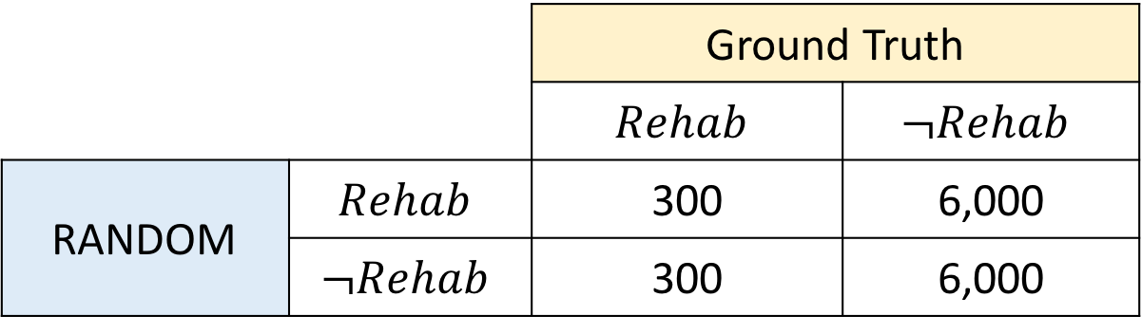

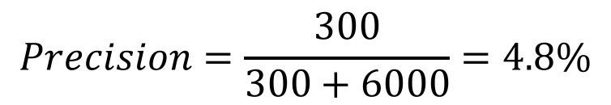
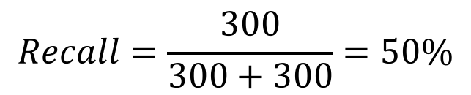
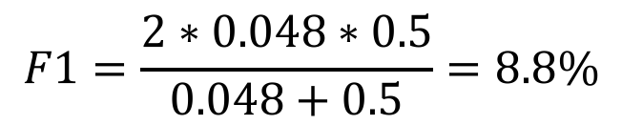

What about the random baseline?
 |  | Ground Truth
 |  | $$Rehab$$ | $$¬Rehab$$
RANDOM | $$Rehab$$
 | $$¬Rehab$$
 |  | Ground Truth
 |  | $$Rehab$$ | $$¬Rehab$$
RANDOM | $$Rehab$$ | 300 | 6,000
 | $$¬Rehab$$ | 300 | 6,000
$$Accuracy=50\%$$
$$F1=\frac{2∗0.048∗0.5}{0.048+0.5}=8.8\%$$
$$Precision=\frac{300}{300+6000}=4.8\%$$
$$Recall=\frac{300}{300+300}=50\%$$

Slide 33
Back to the hypothesis
$H_{1}$: Using vocabulary frequencies, logistic regression trained on 80% of the data will make different and better decisions on the remaining 20% than a random baseline.
$H_{0}$: It won’t.
For train/test on OSU data only
Logistic regression makes different decisions (p < 0.005)
Logistic regression makes better decisions (95.2% acc >> 50% acc)

Slide 34

Expanded experiments for Hypothesis (1)
Data
Full vocabulary features
80/20 stratified random sampling for train/test
Original balance from OSU vs NIH
Original balance from $Rehab$ vs $¬Rehab$
5-fold cross validation
Split data in 5, take each chunk as test and the other four as training, average the results
Experiments
Use OSU data only for train/test
Use NIH data only for train/test
Train on OSU, test on NIH
Train on OSU, test on both
Train on NIH, test on OSU
Train on NIH, test on both
Train on both, test on OSU/NIH
Train on both, test on both
Now repeat for the rest!

Slide 35
Testable hypothesis (2)
$H_{1}$: Using keyword frequencies, logistic regression trained on 80% of the data will make different and better decisions on the remaining 20% than a random baseline.
$H_{0}$: It won’t.
Follow same procedure, but with different feature set

Slide 36
Testable hypothesis (3)
$H_{1}$: Using keyword frequencies, logistic regression trained on 80% of the data will make different and better decisions on the remaining 20% than a logistic regression using full vocabulary frequencies.
$H_{0}$: It won’t.
Now, reference distribution is the decisions from the full vocabulary model

Slide 37
What does one experiment tell you?
We did one experiment on one sample from OSU.
Does it tell us about:
How we’ll perform on NIH data?
How a neural network classifier will perform on OSU data?
The utility of vocabulary frequencies for document classification?
Our ability to generalize to more samples from OSU?
One experiment only tells one (small) part of an overall story. Know what it does and doesn’t tell you!

Slide 38

How do you choose a good model?
One answer: try a bunch of models on your task, take whichever one gives best test set performance.
Another option: find people who’ve done similar things, and try their models.
But remember
In general, try things and see what does well!
Start simple, then get more complicated if you need to!
Notes:
Image from https://drawception.com/game/3GFw2LtLpA/occams-razor/

Slide 39
AI is empirical
via Google: “based on, concerned with, or verifiable by observation or experience rather than theory or pure logic.”
Basically, we can’t know for certain:
the true nature of a problem
the true quality of a model
much of anything, really
Part of why science is iterative!
This is why scientific rigor is important: it makes it clear what is and is not shown

Slide 40
Next time
Examples of AI applications

