Slide 1
What is this?
This slide deck compiles my learning goals for you from each class this semester.
These are the things that I want you to leave the class knowing, and these are the kinds of things I will test you over in the final.
For the review session, please bring any questions you have about any of these points.

Slide 2
Note on verbs and calculations
Verbs are used carefully in these learning goals.
I will not ask you to execute any algorithms on the final unless I state in these goals that you should be able to execute them.
For any calculations I ask you to perform in the exam, I will provide you with the necessary formulas and/or value tables.

Slide 3
Fundamental question for this whole class
How do you turn a real-world problem into an AI solution?

Slide 4
Introduction
You should be able to:
Provide at least one definition for Artificial Intelligence
Describe the Turing Test

Slide 5
Intelligent agents
You should be able to:
Describe the PEAS (Performance, Environment, Actuators, and Sensors) of a particular agent
Define a rational agent
Describe different types of task environments

Slide 6
Uninformed search
You should be able to:
List and describe the components of a search problem
Describe and execute Breadth-First Search, Depth-First Search, and Uniform-Cost Search
Describe the differences between BFS, DFS, and UCS

Slide 7
Informed search
You should be able to:
Define a heuristic
Determine if a given heuristic is admissible or not
Describe and execute A* Search

Slide 8
Adversarial search
You should be able to:
Describe and execute Minimax Search for zero-sum games (with one or more opponents)
Describe the intuition behind alpha-beta pruning in minimax

Slide 9
Logical agents
You should be able to:
Describe the difference between attributive states and atomic states
Define the term “knowledge base”
Convert English sentences to propositional logic and vice versa
Describe and execute forward and backward chaining for inference

Slide 10
First-order logic
You should be able to:
Describe each of the following elements of first-order logic: objects, quantifiers, and relations/functions
Convert English sentences to first-order logic and vice versa
Describe how quantifiers can be resolved for inference using instantiation

Slide 11
Expert systems
You should be able to:
Describe the difference between an ontology and a knowledge base
Describe how inheritance and classification can be used with ontologies for efficient inference
Explain why different ontology structures are better/worse for different agent environments

Slide 12
Markov decision processes
You should be able to:
Explain the difference between stochastic and deterministic outcomes of actions
Define the components of an MDP (states, actions, transition function, reward function, start/terminal state)
Define a policy and the expected utility of a state
Describe the value iteration algorithm

Slide 13
Reinforcement learning (1/2)
You should be able to:
Describe the difference between an online reinforcement learning problem and an offline solution to an MDP
Describe the Monte Carlo learning process
Describe the difference between Temporal-Difference learning and Monte Carlo learning

Slide 14
Reinforcement learning (2/2)
You should be able to:
Describe the difference between the Sarsa and Q-learning algorithms
Execute one step of Sarsa and Q-learning on a given problem
Describe the motivation for exploration in reinforcement learning

Slide 15
Probability (1/2)
You should be able to:
Estimate the probability of events from observed samples
Calculate joint, conditional, and independent probabilities from a joint probability table
Calculate joint probabilities from conditional probabilities
Explain Bayes’ Rule for conditional probability

Slide 16
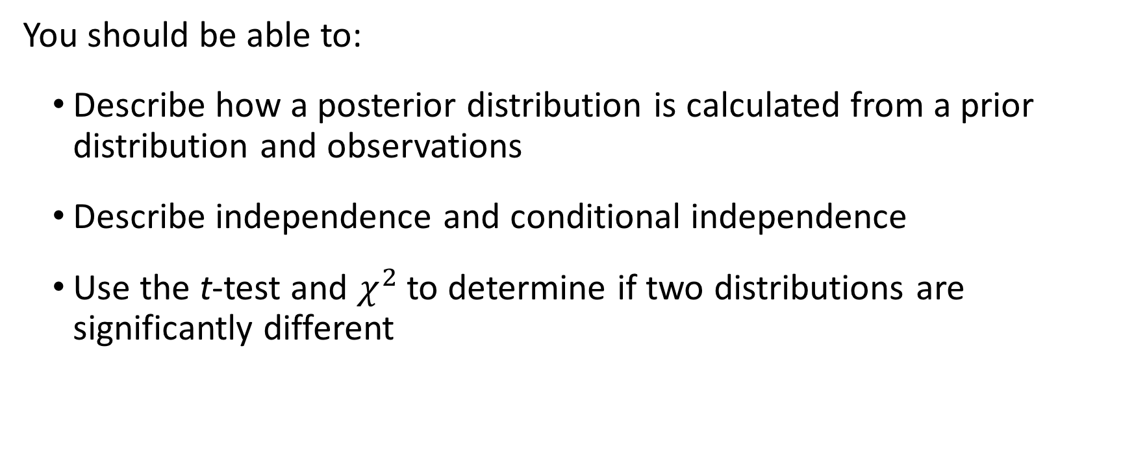
Probability (2/2)
You should be able to:
Describe how a posterior distribution is calculated from a prior distribution and observations
Describe independence and conditional independence
Use the t-test and $χ^{2}$ to determine if two distributions are significantly different

Slide 17
Machine learning (1/2)
You should be able to:
Distinguish between classification, regression, and clustering problems
Distinguish between supervised and unsupervised learning
Explain important considerations for model design and feature function selection

Slide 18
Machine learning (2/2)
You should be able to:
Explain considerations in choosing feature functions
Describe and execute k-Nearest Neighbors classification
Describe and execute k-Means clustering
Describe gradient descent for learning model parameters

Slide 19
Neural networks
You should be able to:
Describe gradient descent for learning model parameters
Explain the difference between logistic regression and linear regression
Tell if a 2-D dataset is linearly separable
Explain the structure of a neural network

Slide 20
Experimental design
You should be able to:
Describe methods for developing and testing hypotheses
Explain a scientific control and what it’s for
Use significance testing and performance metrics to compare two classifiers on the same dataset

Slide 21
Applications (Speech and Language)
You should be able to:
Describe AI applications to speech recognition and speech separation
Describe AI applications to POS tagging, information extraction, and information retrieval

Slide 22
Applications (Vision and Robotics)
You should be able to:
Describe AI applications to image classification and gestural control
Describe AI applications to problems in robotics

Slide 23
Philosophy
You should be able to:
Describe arguments for and against a mechanical definition of intelligence
Explain the formulation of AI as a hierarchy of single-task components

Slide 24
Ethics
You should be able to:
Describe how ethical concerns fit into data collection, model design, and applications
Explain where recent ethical failures in AI went wrong

