Slide 1
Announcements
Homework 1 will be posted this afternoon. After today, you should be able to do Questions 1-3.
Python 2.7 only for the homework; turns out Python 3 plays merry hell with the autograder.

Slide 2
Kinds of task environments
6 common properties to distinguish tasks (not exhaustive)
Fully observable vs Partially observable
Single agent vs Multiagent
Deterministic vs Stochastic
Episodic vs Sequential
Static vs Dynamic
Discrete vs Continuous
Col 1 – Poker
Col 2 – Self-driving taxi
Col 3 – Spam classifier
Col 4 – Pacman with ghosts
Col 5 – Oil refinery control system
Col 6 – Automatic speech transcription
Notes:
Take 3 minutes, in your column, answer each of these values

Slide 3
AI in practice
Mostly trying to define a problem in such a way that someone else has already solved it!
Optimally (or close)
Efficiently

Slide 4
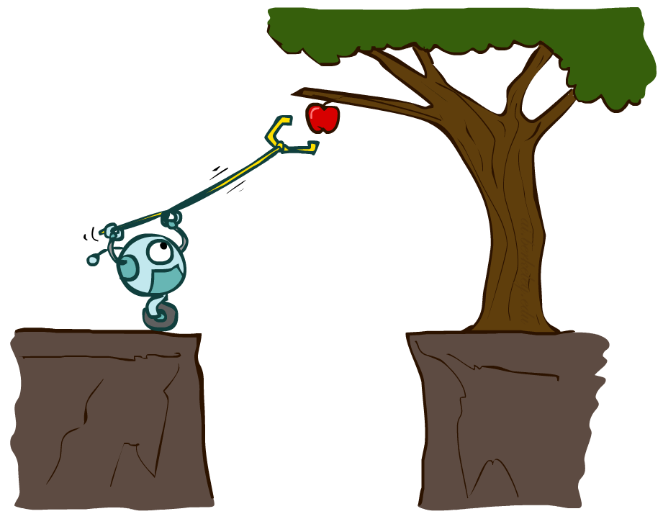


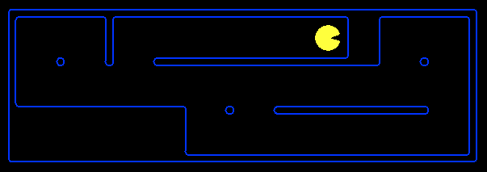
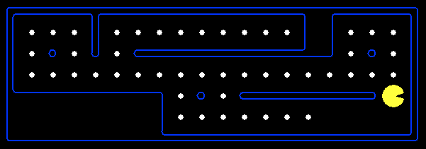
Planning Agents
Planning agents:
Ask “what if”
Decisions based on (hypothesized) consequences of actions
Must have a model of how the world evolves in response to actions
Must formulate a goal (test)
Consider how the world WOULD BE
Notes:
How does a planning agent plan?

Slide 5

Search Problems

Slide 6
Search?
Nope!

Slide 7
Information Retrieval vs Search
Search
(Problem-Solving)
(Information Retrieval)
Result
Best!
Query
(Start)
Result
Best!
Start
Result
Result
Notes:
IR – Known query, want to find best result; path doesn’t really matter (e.g. Google search)
Search – Known query and goal, want to find best path (e.g. network routing for that search result)

Slide 8
Definition of Search
Finding a (best) sequence of actions to solve a problem
For now, assume the problem is
Deterministic
Fully observable
Known

Slide 9

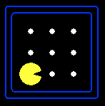





Search Problem Mechanics
A search problem consists of:
A state space
A successor function
(with actions, costs)
A start state and a goal test
A solution is a sequence of actions (a plan) which transforms the start state to a goal state
“N”, 1.0
“E”, 1.0
Notes:
State space may be fully or partially enumerated
Goal test – sometimes more than one state that satisfies having achieved the goal, for example, “eat all the dots”
Abstraction

Slide 10

Search Problems Are Models

Slide 11
Example: Traveling in Romania
State space:
Cities
Successor function:
Roads: Go to adjacent city with cost = distance
Start state:
Arad
Goal test:
Is state == Bucharest?
Solution?

Slide 12
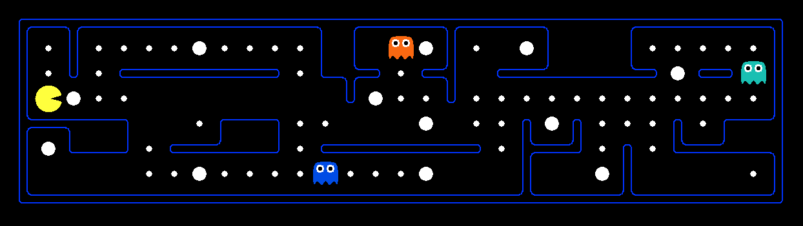
What’s in a State Space?
The world state includes every last detail of the environment
A search state keeps only the details needed for planning (abstraction)
Problem: Pathing
States: (x,y) location
Actions: NSEW
Successor: update location only
Goal test: is (x,y)=END
Problem: Eat-All-Dots
States: {(x,y), dot booleans}
Actions: NSEW
Successor: update location and possibly a dot boolean
Goal test: dots all false
Notes:
Wrong example for “eat-all-dots”: (x, y, dot count)

Slide 13
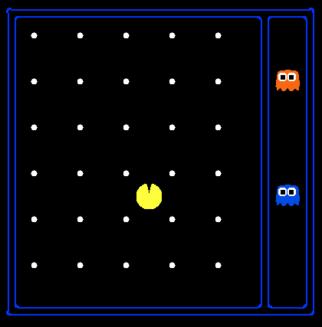
State Space Sizes?
World state:
Agent positions: 120
Food count: 30
Ghost positions: 12
Agent facing: NSEW
How many
World states?
120x(2³⁰)x(12²)x4
States for pathing?
120
States for eat-all-dots?
120x(2³⁰)
Notes:
90 * (2^30-1) + 30 * 2^29 = 145 billion
2^29 = 536 870 912

Slide 14
Quiz: Safe Passage
Problem: eat all dots while keeping the ghosts perma-scared
What does the state space have to specify?
(agent position, dot booleans, power pellet booleans, remaining scared time)

Slide 15
Search Problem Mechanics
A search problem consists of:
A state space
A successor function
(with actions, costs)
A start state and a goal test
A solution is a sequence of actions (a plan) which transforms the start state to a goal state
What are some problems that can’t be formulated as search?
“N”, 1.0
“E”, 1.0
Notes:
State space may be fully or partially enumerated
Goal test – sometimes more than one state that satisfies having achieved the goal, for example, “eat all the dots”
Abstraction

Slide 16
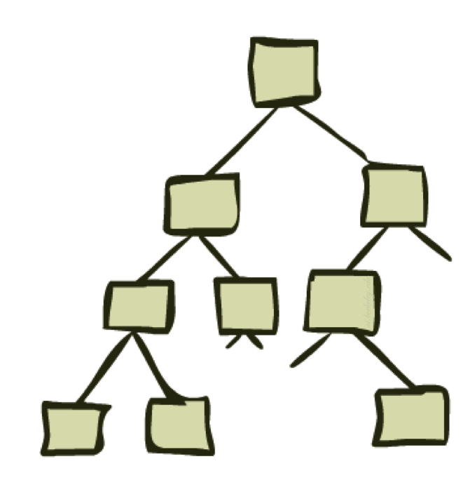
State Space Graphs and Search Trees

Slide 17
State Space Graphs
State space graph: A mathematical representation of a search problem
Nodes are (abstracted) world configurations
Arcs represent successors (action results)
The goal test is a set of goal nodes (maybe only one)
In a state space graph, each state occurs only once!
We can rarely build this full graph in memory (it’s too big), but it’s a useful idea

Slide 18
State Space Graphs
State space graph: A mathematical representation of a search problem
Nodes are (abstracted) world configurations
Arcs represent successors (action results)
The goal test is a set of goal nodes (maybe only one)
In a state space graph, each state occurs only once!
We can rarely build this full graph in memory (it’s too big), but it’s a useful idea
a
G
b
c
e
d
f
S
h
p
q
r
Tiny search graph for a tiny search problem

Slide 19
Search Trees
This is now / start
“N”, 1.0
“E”, 1.0
Possible futures
A search tree:
A “what if” tree of plans and their outcomes
The start state is the root node
Children correspond to successors
Nodes show states, but correspond to ACTION SEQUENCES that achieve those states
For most problems, we can never actually build the whole tree
Notes:
Different plans that achieve the same state, will be different nodes in the tree.

Slide 20
State Space Graphs vs. Search Trees
State Space Graph
Each NODE in in the search tree corresponds to an entire PATH in the state space graph.
Search Tree
S
a
G
d
e
p
b
c
q
b
c
e
h
r
d
e
f
a
a
h
r
p
q
f
S
h
We construct both on demand – and we construct as little as possible.
p
q
f
q
c
G
p
q
r
q
c
G
a
a

Slide 21

Quiz: State Space Graphs vs. Search Trees
Consider this 4-state graph:
How big is its search tree (from S)?
a
S
G
b
Important: Lots of repeated structure in the search tree!

Slide 22
Tree Search

Slide 23
Search Example: Romania

Slide 24
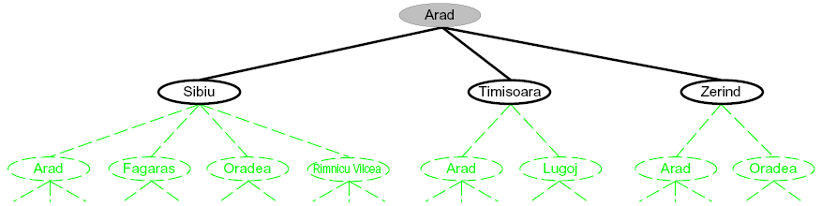
Searching with a Search Tree
Search:
Expand out potential plans (tree nodes)
Maintain a fringe of partial plans under consideration
Try to expand as few tree nodes as possible

Slide 25
General Tree Search
Important ideas:
Fringe
Expansion
Exploration strategy
Main question: which fringe nodes to explore?

Slide 26
Search Algorithm Properties
Complete: Guaranteed to find a solution if one exists?
Optimal: Guaranteed to find the least cost path?
Time complexity?
Space complexity?
Cartoon of search tree:
b is the branching factor
m is the maximum depth
solutions at various depths
Number of nodes in entire tree?
1 + b + b² + …. b^{m} = O(b^{m})
1 node
b
…
b nodes
b² nodes
m tiers
b^{m} nodes

Slide 27
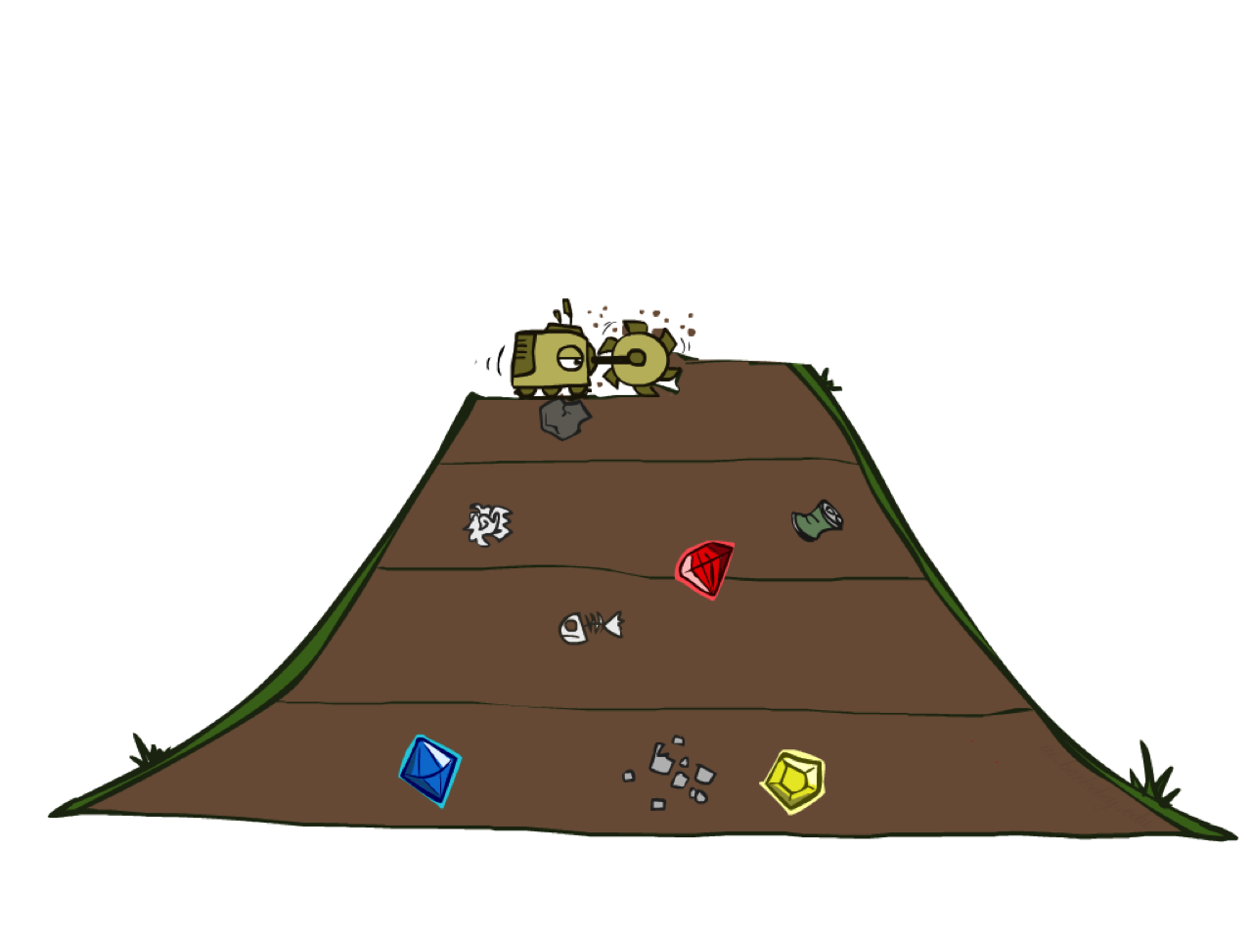
Breadth-First Search

Slide 28
Breadth-First Search
Strategy: expand a shallowest node first
Implementation: Fringe is a FIFO queue
a
G
b
c
d
e
f
S
h
p
q
r
S
d
e
p
Search
Tiers
b
c
e
h
r
q
a
a
h
r
p
q
f
p
q
f
q
c
G
q
c
G
a
a

Slide 29
Breadth-First Search (BFS) Properties
What nodes does BFS expand?
Processes all nodes above shallowest solution
Let depth of shallowest solution be s
Search takes time O(b^{s})
How much space does the fringe take?
Has roughly the last tier, so O(b^{s})
Is it complete?
s must be finite if a solution exists, so yes!
Is it optimal?
Only if costs are all 1 (more on costs later)
1 node
b
…
b nodes
s tiers
b² nodes
b^{s} nodes
b^{m} nodes

Slide 30
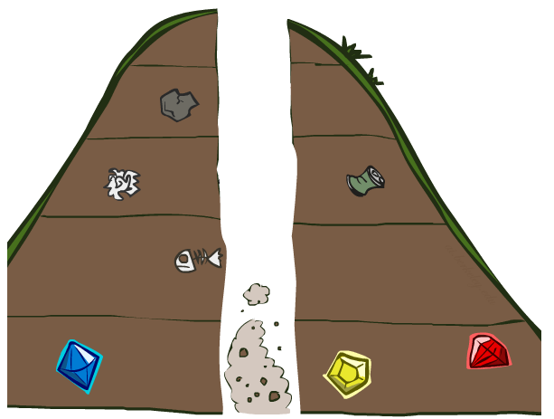
Depth-First Search

Slide 31
Depth-First Search
Strategy: expand a deepest node first
Implementation: Fringe is a LIFO stack
a
G
a
c
b
c
b
e
d
e
d
f
f
S
h
h
p
p
r
q
r
q
S
d
e
p
b
c
e
h
r
q
a
a
h
r
p
q
f
p
q
f
q
c
G
q
c
G
a
a

Slide 32
Depth-First Search (DFS) Properties
What nodes DFS expand?
Some left prefix of the tree.
Could process the whole tree!
If m is finite, takes time O(b^{m})
How much space does the fringe take?
Only has siblings on path to root, so O(bm)
Is it complete?
m could be infinite, so only if we prevent cycles (more later)
Is it optimal?
No, it finds the “leftmost” solution, regardless of depth or cost
1 node
b
…
b nodes
b² nodes
m tiers
b^{m} nodes

Slide 33
Iterative Deepening
Idea: get DFS’s space advantage with BFS’s time / shallow-solution advantages
Run a DFS with depth limit 1. If no solution…
Run a DFS with depth limit 2. If no solution…
Run a DFS with depth limit 3. …..
Isn’t that wastefully redundant?
Generally most work happens in the lowest level searched, so not so bad!
b
…

Slide 34
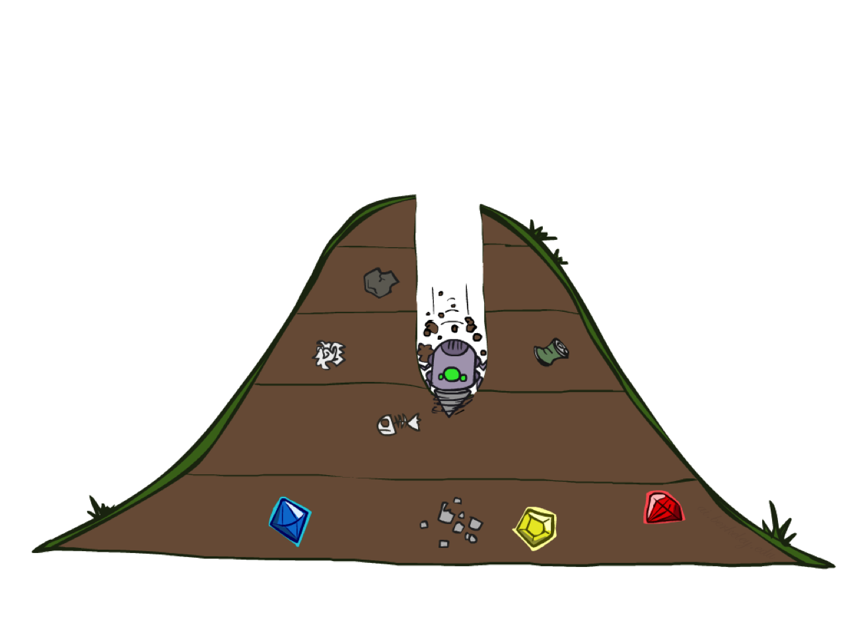
Quiz: DFS vs BFS

Slide 35
Quiz: DFS vs BFS
When will BFS outperform DFS?
When will DFS outperform BFS?
Pathological examples w/ 10 nodes?

Slide 36
Cost-Sensitive Search
a
GOAL
2
2
b
c
3
2
1
8
2
e
d
f
3
9
8
2
START
h
1
4
2
p
4
r
15
q
BFS finds the shortest path in terms of number of actions.
It does not find the least-cost path. We will now cover
a similar algorithm which does find the least-cost path.

Slide 37
Uniform Cost Search
2
G
a
Strategy: expand a cheapest node first:
Fringe is a priority queue (priority: cumulative cost)
b
c
1
8
2
2
e
3
d
f
9
8
2
S
h
1
1
p
q
r
15
0
S
d
3
e
9
p
1
b
4
e
5
h
17
r
11
q
16
c
11
Cost contours
a
6
a
h
13
r
7
p
q
f
p
q
f
8
q
c
G
q
c
a
11
G
10
a

Slide 38
Uniform Cost Search (UCS) Properties
What nodes does UCS expand?
Processes all nodes with cost less than cheapest solution!
If that solution costs C* and arcs cost at least ε , then the “effective depth” is roughly C*/ε
Takes time O(b^{C*/ε}) (exponential in effective depth)
How much space does the fringe take?
Has roughly the last tier, so O(b^{C*/ε})
Is it complete?
Assuming best solution has a finite cost and minimum arc cost is positive, yes!
Is it optimal?
Yes! (skipping the proof for now)
b
c ≤ 1
…
C*/ε “tiers”
c ≤ 2
c ≤ 3

Slide 39
Uniform Cost Issues
Remember: UCS explores increasing cost contours
The good: UCS is complete and optimal!
The bad:
Explores options in every “direction”
No information about goal location
We’ll fix that soon!
…
c ≤ 1
c ≤ 2
c ≤ 3
Start
Goal

Slide 40
Next time
Keep thinking: What are some problems that can’t be formulated as search?
Homework 1 going up later today
Informed search methods

