Slide 1
Announcements
HW 2 (Logic) out now; due 9/27
AI Seminar

Slide 2

Last Time: Watson Video
Notes:
Discuss major points from feedback
Implementation/methods and time to decision
Uncertainty in answering
Power/limitations of ML (leave for later)
Creativity, pun detection, ethical concerns
Current uses of Watson

Slide 3
Last Last Time: First-Order Logic
Forward-Backward Chaining
Forward chaining: working forward from what’s known
Backward chaining: working backward from a goal
First-Order Logic
Represent more complex statements about the real world
Objects, relations, quantifiers
Reduce to propositional inference with Instantiation

Slide 4
What problem do logical agents solve?
Practical problem
How can I efficiently reason about what actions to take, using knowledge about the world?
Can support sub-goals during progress through search space!
Philosophical problem
How much knowledge about the world do I actually need to decide on an action?
How much can I let the world itself tell me?

Slide 5
Three key questions
What kinds of knowledge do we need?
How much knowledge do we need?
How do we structure it effectively?

Slide 6


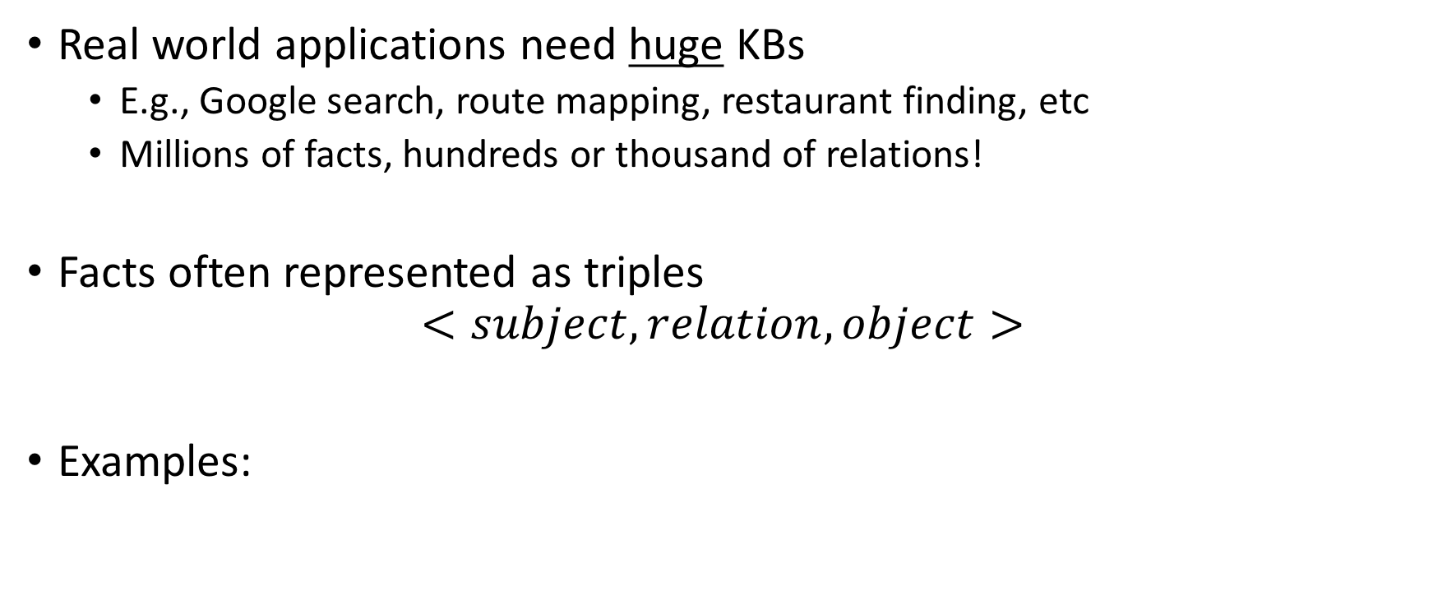
Large-scale knowledge bases
Real world applications need huge KBs
E.g., Google search, route mapping, restaurant finding, etc
Millions of facts, hundreds or thousand of relations!
Facts often represented as triples $<subject, relation, object>$
Examples:

Slide 7
Structuring knowledge in large KBs
Entities have types, labels
Relations (may) have type constraints
Some relations hold between types, some between entities
(We’ll define all of this more formally later)

Slide 8
Real KB demo
YAGO (Yet Another Great Ontology)
Notes:
Main things:
- Links to labels
Type relationships (click on rdf:type to see typing ontology)
Links to other entities
One bigass graph

Slide 9
Practical uses of large KBs
Finding similar or related information
Question answering

Slide 10
Watson as constraint satisfaction

Slide 11
Structuring knowledge representation
Ontology
Structure/framework of concepts
Database tables, essentially
Knowledge Base
Assertional facts about the world
Database rows
Note that database columns may be designed to encode relational info (e.g., “CostOf”); this is not like ontologies!

Slide 12
General-purpose ontology example
Anything
AbstractObjects
GeneralizedEvents
Places
Interval
Physical Objects
Sets
Representational Objects
Processes
Numbers
Moments
Things
Stuff
Categories
Sentences
Measurements
Solid
Gas
Animals
Liquid
Times
Weights
Agents
Humans

Slide 13
Wumpus ontology example
Object
StaticObject
DynamicObject
GridSquare
Danger
Gold
Agent
Arrow
Wumpus
Pit
Adventurer
What kind of knowledge is not shown?

Slide 14
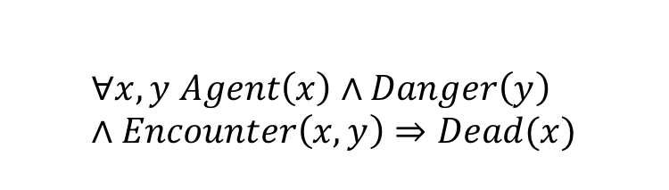
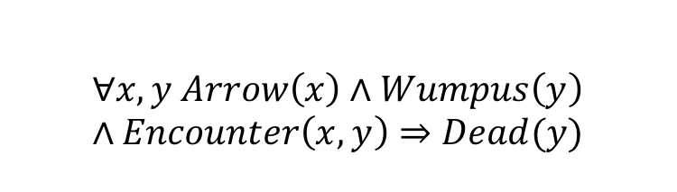
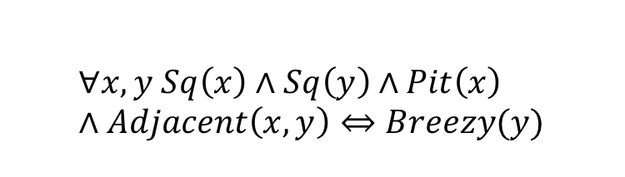
Wumpus KB
$$∀x,y Agent\left(x\right)∧Danger\left(y\right)∧Encounter\left(x,y\right)⇒Dead(x)$$
$$∀x,y Arrow\left(x\right)∧Wumpus\left(y\right)∧Encounter\left(x,y\right)⇒Dead(y)$$
$$∀x,y Sq\left(x\right)∧Sq\left(y\right)∧Pit\left(x\right)∧Adjacent\left(x,y\right)⇔Breezy(y)$$
$$…$$

Slide 15
Ways to design ontologies
Team of trained ontologists and logicians
Build the structure and write basic axioms
Example: CYC
Adapt existing database with categories, attributes, values
Build in additional constraints and hierarchy post hoc
Example: DBPedia
Read open-ended information from text
Noisy, but cheap!
Example: TEXTRUNNER
Get untrained amateurs to enter knowledge
Good way to capture commonsense facts
Example: OPENMIND

Slide 16
Knowledge about objects
Want to describe objects in terms of the categories and subcategories they belong to
Makes it easier to talk about general properties of objects
Allows for classifying objects into categories
Inheritance passes properties of parent categories into their subcategories
This structure determines how we can reason about objects!

Slide 17
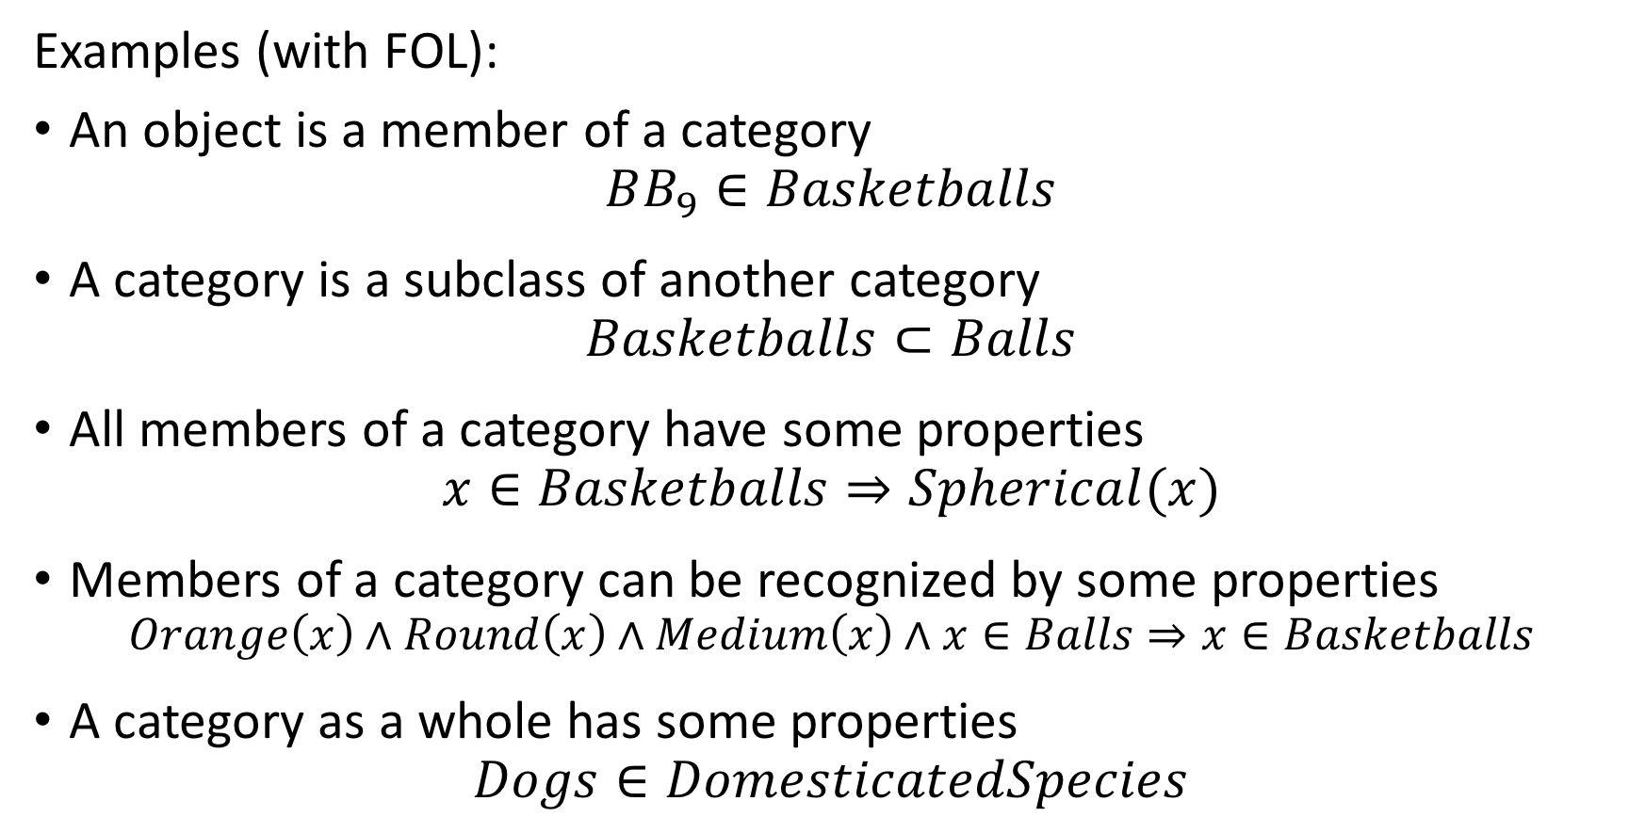
Knowledge about objects
Examples (with FOL):
An object is a member of a category $BB_{9}∈Basketballs$
A category is a subclass of another category $Basketballs⊂Balls$
All members of a category have some properties $x∈Basketballs⇒Spherical(x)$
Members of a category can be recognized by some properties $Orange\left(x\right)∧Round\left(x\right)∧Medium\left(x\right)∧x∈Balls⇒x∈Basketballs$
A category as a whole has some properties $Dogs∈DomesticatedSpecies$

Slide 18
Knowledge about events
Represent how things can change over time
Changes in properties
E.g., a Flight event changes Position
Also hierarchical
Flight is a kind of Motion event
May be instant or have a duration
The type of event continues throughout duration; e.g. 20 minutes of a 4-hour flight is still Flight
Object references may change over time
E.g., US_President refers to different objects in 1789 and 2017

Slide 19
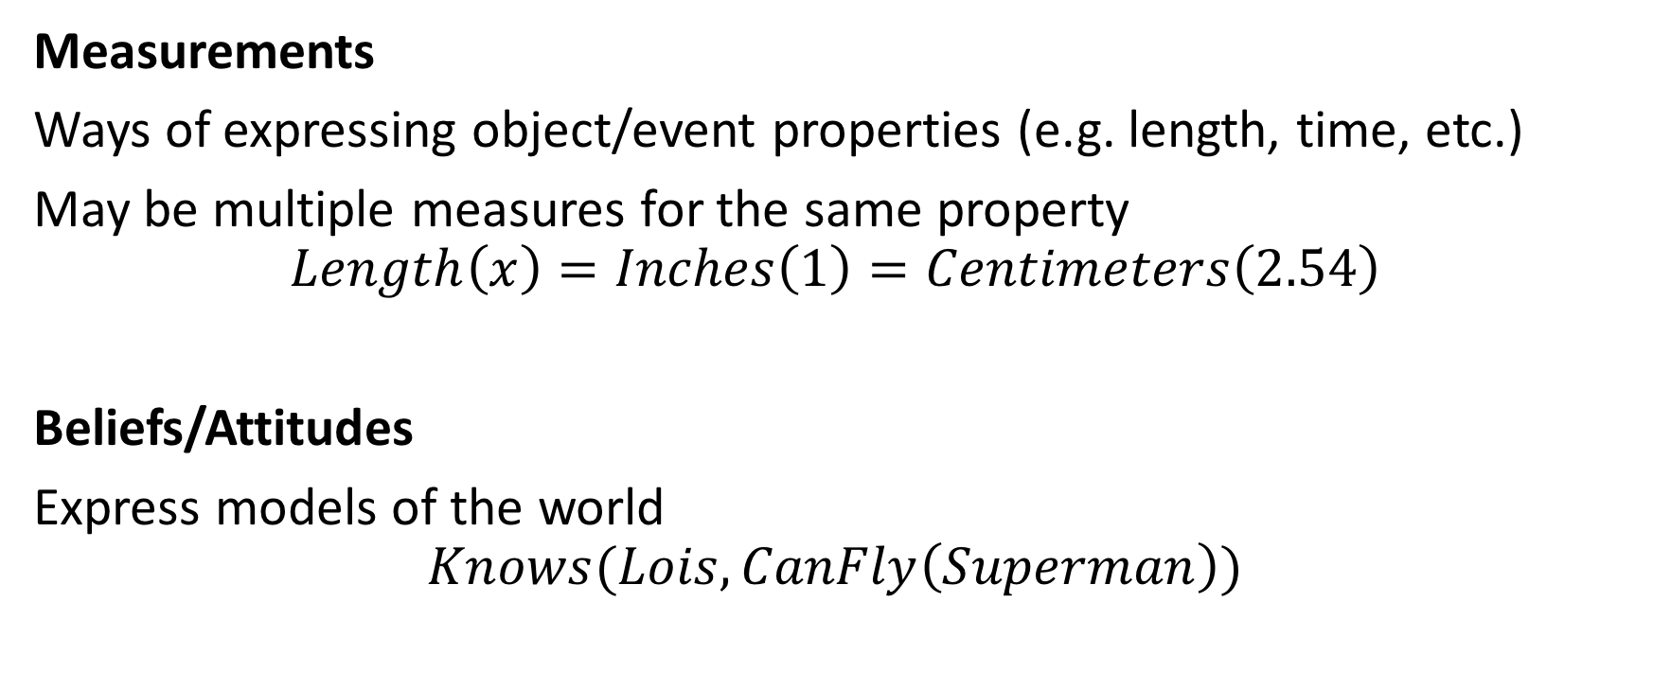
Other kinds of knowledge
Measurements
Ways of expressing object/event properties (e.g. length, time, etc.)
May be multiple measures for the same property
$$Length\left(x\right)=Inches\left(1\right)=Centimeters\left(2.54\right)$$
Beliefs/Attitudes
Express models of the world
$$Knows(Lois, CanFly\left(Superman\right))$$

Slide 20


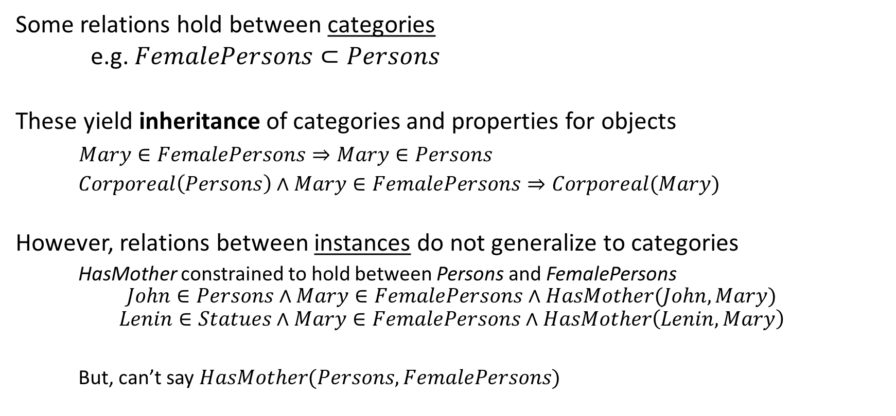
Reasoning with categories
Some relations hold between categories
e.g. $FemalePersons⊂Persons$
These yield inheritance of categories and properties for objects
$Mary∈FemalePersons⇒Mary∈Persons$
$Corporeal\left(Persons\right)∧Mary∈FemalePersons⇒Corporeal(Mary)$
However, relations between instances do not generalize to categories
HasMother constrained to hold between Persons and FemalePersons
$$John∈Persons∧Mary∈FemalePersons∧HasMother(John, Mary)$$
$$Lenin∈Statues∧Mary∈FemalePersons∧HasMother\left(Lenin, Mary\right)$$
But, can’t say $HasMother(Persons, FemalePersons)$

Slide 21
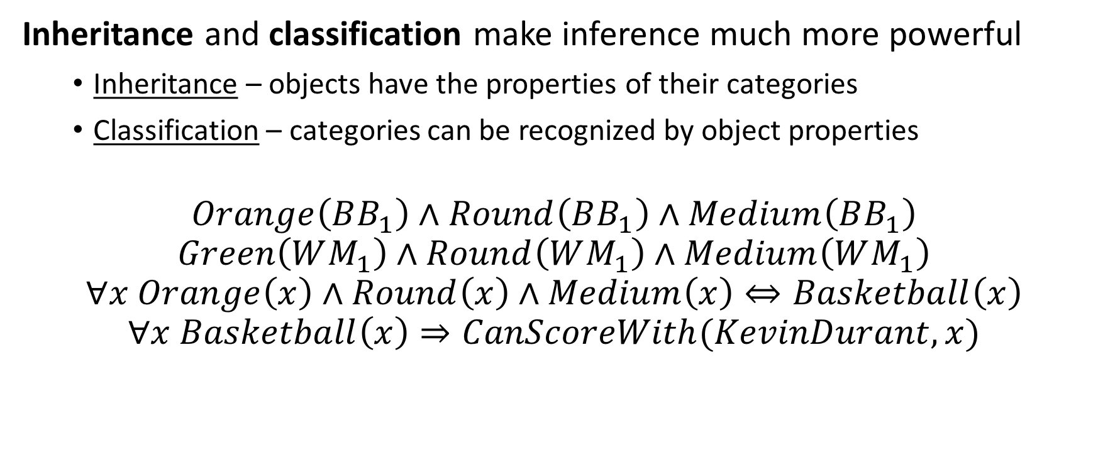
Reasoning with categories
Inheritance and classification make inference much more powerful
Inheritance – objects have the properties of their categories
Classification – categories can be recognized by object properties
$$Orange\left(BB_{1}\right)∧Round\left(BB_{1}\right)∧Medium\left(BB_{1}\right)$$
$$Green\left(WM_{1}\right)∧Round\left(WM_{1}\right)∧Medium\left(WM_{1}\right)$$
$$∀x Orange\left(x\right)∧Round\left(x\right)∧Medium\left(x\right)⇔Basketball\left(x\right)$$
$$∀x Basketball\left(x\right)⇒CanScoreWith(KevinDurant, x)$$
$$CanScoreWith(KevinDurant, BB_{1})$$
$$CanScoreWith(KevinDurant, WM_{1})$$

Slide 22
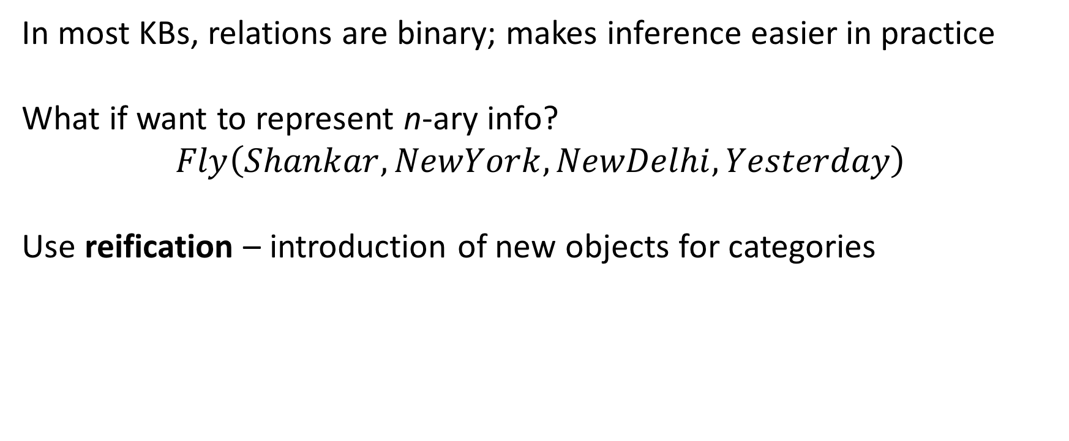
Practical note: reification for n-ary relations
In most KBs, relations are binary; makes inference easier in practice
What if want to represent n-ary info?
$$Fly\left(Shankar, NewYork,NewDelhi,Yesterday\right)$$
Use reification – introduction of new objects for categories
FlyEvents
Fly₁₇
Passenger
Time
Shankar
Destination
Yesterday
Origin
NewYork
NewDelhi

Slide 23
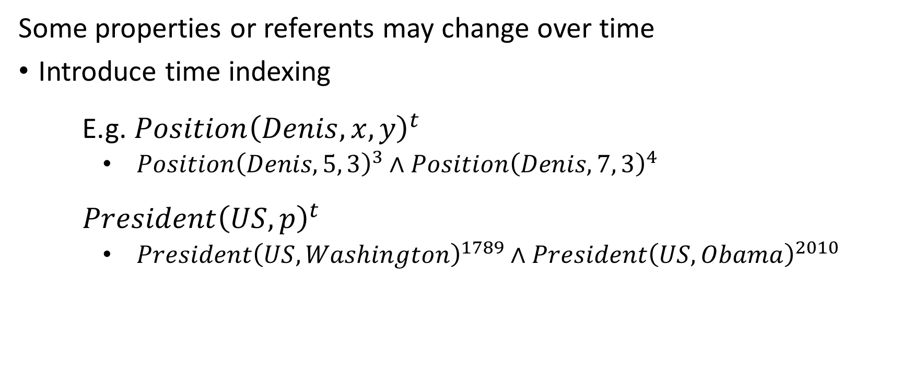
Updating knowledge over time
Some properties or referents may change over time
Introduce time indexing
E.g. $Position{\left(Denis, x, y\right)}^{t}$
$Position{\left(Denis, 5, 3\right)}^{3}∧Position{\left(Denis, 7, 3\right)}^{4}$
$President{\left(US, p\right)}^{t}$
$President{\left(US, Washington\right)}^{1789}∧President{\left(US, Obama\right)}^{2010}$

Slide 24
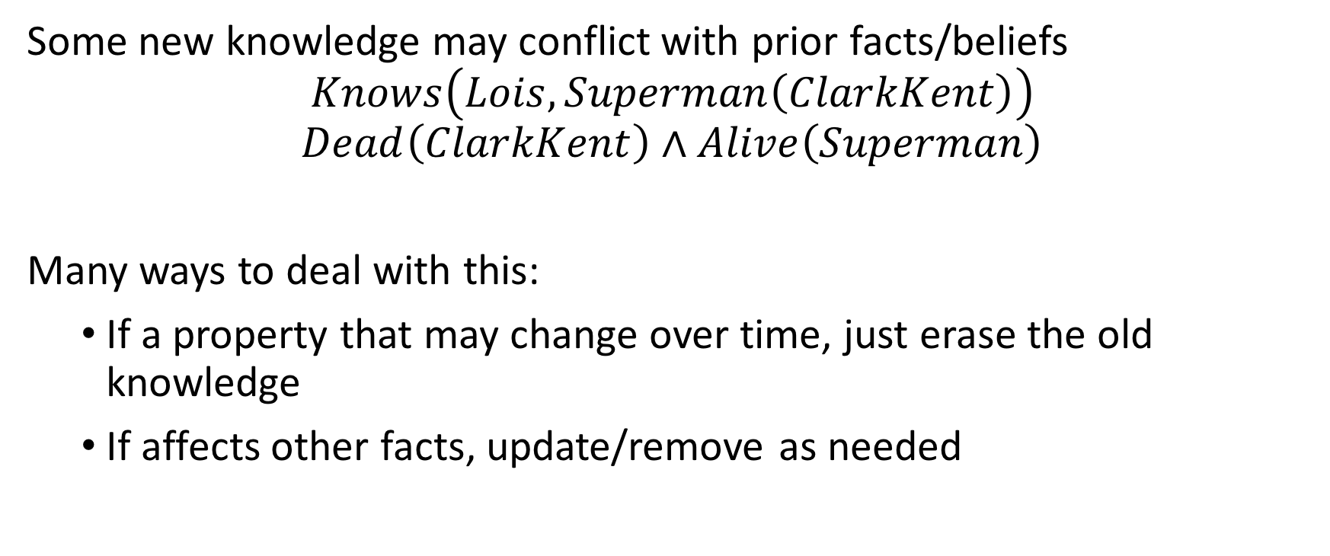
Updating knowledge over time
Some new knowledge may conflict with prior facts/beliefs
$$Knows\left(Lois, Superman\left(ClarkKent\right)\right)$$
$$Dead\left(ClarkKent\right)∧Alive\left(Superman\right)$$
Many ways to deal with this:
If a property that may change over time, just erase the old knowledge
If affects other facts, update/remove as needed

Slide 25
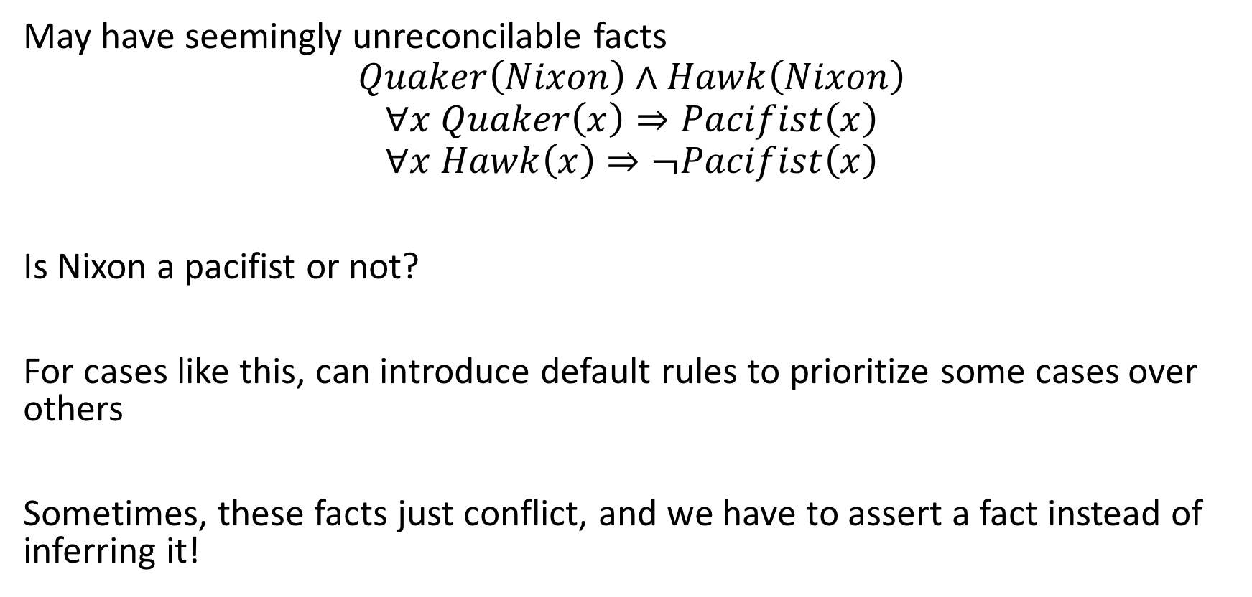
Handling undetermined/conflicting information
May have seemingly unreconcilable facts
$$Quaker\left(Nixon\right)∧Hawk\left(Nixon\right)$$
$$∀x Quaker\left(x\right)⇒Pacifist\left(x\right)$$
$$∀x Hawk\left(x\right)⇒¬Pacifist\left(x\right)$$
Is Nixon a pacifist or not?
For cases like this, can introduce default rules to prioritize some cases over others
Sometimes, these facts just conflict, and we have to assert a fact instead of inferring it!

Slide 26
So, lots of ways to use knowledge representation structure for inference and model tracking.
But, how do we choose a structure?

Slide 27
How do you pick a representation scheme?
Could attempt to make a general ontology for everything
People keep trying; it hasn’t worked yet!
Too much information to handle with finite computation, anyway
Better: use design considerations of problem
What kinds of objects/events/measures/etc are relevant?
Are there properties of the problem that suggest an organization?
What sort of inferences do we need to support?

Slide 28
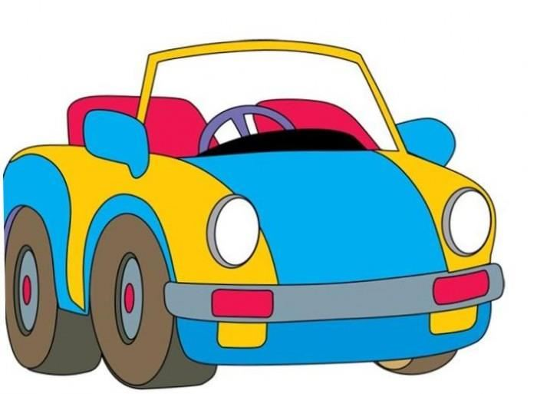
Case study: self-driving car
Goal: get passengers to destination
without accidents
with minimal cost (distance/time/money)
Sensors:
Front, rear, and side cameras
Speedometer, rain sensors
Road marking/sign recognizer

Slide 29
Case study: self-driving car
Do we need to know everything about everything?
E.g., mating habits of giraffes, properties of black holes
What kinds of things (objects) do we need to know about?
Pedestrians
Cyclists
Other cars
Ducks in the road
Stop signs
Edge markings
Etc.
Objects in the road
Objects about the road

Slide 30
Case study: self-driving car
What kinds of events do we need to know about?
Colliding with things
Crossing over road markings
Movement (and changing it)
Arriving at a location
What kinds of measurements do we need to know about?
Speed
Distance to objects
GPS coordinates

Slide 31
Case study: self-driving car
Anything
Objects
Events
Measurements
InRoad
AboutRoad
Intersection
Movement
Squishy
NotSquishy
Signs
Markings
Acceleration
Deceleration
StopSign
Edge
Ducks
Automobiles
Collision
Cyclists
Crossing
Pedestrians
Cars
Semis
Approaching
Position
Speed
Direction

Slide 32
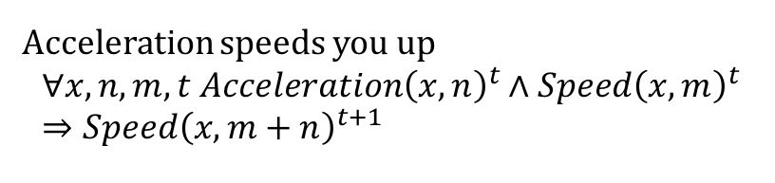
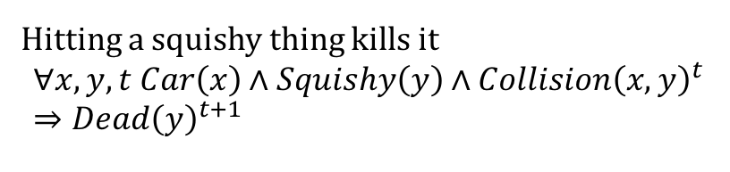
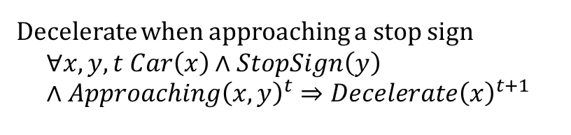
Case study: self-driving car
Acceleration speeds you up
$$∀x,n,m,t Acceleration{\left(x, n\right)}^{t}∧Speed{\left(x,m\right)}^{t}⇒Speed{\left(x,m+n\right)}^{t+1}$$
Hitting a squishy thing kills it
$$∀x,y,t Car\left(x\right)∧Squishy\left(y\right)∧Collision{\left(x,y\right)}^{t}⇒Dead{\left(y\right)}^{t+1}$$
Decelerate when approaching a stop sign
$$∀x,y,t Car\left(x\right)∧StopSign\left(y\right)∧Approaching{\left(x,y\right)}^{t}⇒Decelerate{\left(x\right)}^{t+1}$$
$$…$$

Slide 33
Filling Knowledge Bases
Two ways to pre-populate KB with starting info
Declarative – at startup, TELL the KB all the facts it needs to model the rules of the world
Procedural – bake the rules of the world into the program
In practice, use a mix of both

Slide 34
Using Knowledge Bases
Two ways to make use of KB/ontology knowledge
Inference – to make every decision, rely entirely on the KB
TELL percepts, ASK for action; KB engine infers
Procedural – bake the rules of the world into the program
In practice, use a mix of both

Slide 35

Summary: Knowledge-based agents
Use knowledge about the world to choose actions
Inference with existing knowledge + new observations
Resolution, forward-backward chaining, instantiation and unification, etc.
Knowledge represented in knowledge bases
Contain statements about the world
Structured with an ontology
Represents how different kinds of objects/events/etc are categorized
Supports higher-level inference
Designed for a particular set of problems

Slide 36
Next Time
Non-deterministic searching
Fundamental robotics problem: what happens when reality gets in the way?

