Slide 1
Announcements
Homework 1 Full assignment posted.

Slide 2



Last time: Search
Today: Logic

Slide 3



Search vs Logic
Search – What is the best action sequence to achieve a goal?
Space of atomic states
Successor function defined for each state
Fully enumerates each possible successor
Guided by knowledge about the goal

Slide 4
Search vs Logic
Logic – Reason about the world to identify ”good” actions
Space of attributive states
Successor function defined over attribute values
Successors effectively partial states (what has changed?)
Guided by knowledge about the world
Pos: [1,2]
Dot4: False
Pos: [1,1]
Dot1: True
Dot2: True
…
Pos: [2,1]
Dot8: False

Slide 5

Logical agents
Sensors
Agent
Percepts
Environment
+
?
Actuators
Actions
Knowledge Base
Contains sentences describing the state of the world
Supports inference and derivation
Dynamic; changes as a result of agent interactions with the environment!

Slide 6
Logical Agent – Control Flow
…reasoning...
TELL
(Percept)
Knowledge Base
ASK
Agent
TELL
(Action)

Slide 7
Knowledge Bases
Agent models – what the agent knows about the world
Store different kinds of knowledge
Background knowledge – the rules of the world
Note that if this is an unknown problem, the agent may need to discover the rules!
Typically does not change due to agent actions
Situational knowledge – what is currently true
Describes the current state of the world
Change from state to state, as a result of agent actions (successor function)
Remember: KB sentences are agent’s model of the world, not the true world state!

Slide 8
Filling Knowledge Bases
KBs have sentences – complete statements about one aspect of the world
Exact form depends on the knowledge representation language
Two kinds of sentences
Derived – follow logically from other sentences in the KB
Axiomatic – cannot be derived from the KB, must be given
Axioms | Derived
1 + 1 = 2 2 + 1 = 3 3 + 1 = 4 | 2 + 2 = 4

Slide 9
Filling Knowledge Bases
Two ways to pre-populate KB with starting info
Declarative – at startup, TELL the KB all the facts it needs to model the rules of the world
Procedural – bake the rules of the world into the program
In practice, use a mix of both

Slide 10



Example: Wumpus World

Slide 11
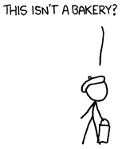
Wumpus World
World: cave with rooms connected by passageways
Rooms may contain: Gold, a Bottomless Pit, or The Terrible Wumpus
PIT
Agent: intrepid explorer, armed with a single arrow
Arrow continues until it hits the Wumpus (and kills it) or a wall.
Goal: escape alive with the gold!

Slide 12
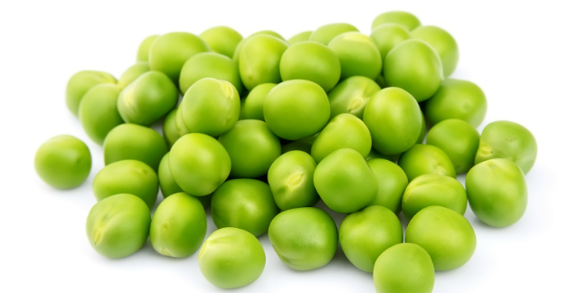
The PEAS of Wumpus World
Performance Measure
+1000 for climbing out with the gold
-1000 for dying (pit or wumpus)
-1 for each action taken
-10 for using up your only arrow

Slide 13
The PEAS of Wumpus World
Environment
4x4 grid of rooms
Agent always starts in [1,1] facing Right
Gold, wumpus, and pit locations chosen randomly

Slide 14
The PEAS of Wumpus World
Actuators
Move Forward, Turn Left, or Turn Right
Death if enter a square with a pit or live Wumpus
No change if walk into a wall
Grab gold if in same square
Shoot arrow in direction Agent is facing
Continues in straight line until hits Wumpus (=dead Wumpus) or wall
Only 1 arrow!
Climb to escape the cave (only from [1,1])

Slide 15
The PEAS of Wumpus World
Sensors
Stench if in square adjacent to Wumpus square
Breeze if in square adjacent to Pit square
Glitter if in square where Gold is
Bump if walked into a wall
Scream heard if Wumpus is hit by Arrow and dies

Slide 16



Wumpus World – Example Configuration
PIT
PIT

Slide 17
Wumpus World – Example Play
???
???
???
PIT

Slide 18


Propositional Logic and Inference
Inference

Slide 19

Logic Basics
Representation language specifies the syntax to determine which sentences are valid
“x + y = 4” “x4y + =“
Semantics define the truth of sentences under possible worlds
“x + y = 4” → True if x = y = 2; False if x = y = 1
Possible worlds (models) specified by assignment to all variables
Each model determines truth of every sentence
Assignment m to variables such that sentence S is True → m satisfies S

Slide 20


Logical Entailment
Sentence A entails sentence B iff
in every model where A is true, B is also true
$$A⊨B$$
All humans are mortal
Socrates is human
$$⊨$$
Socrates is mortal

Slide 21
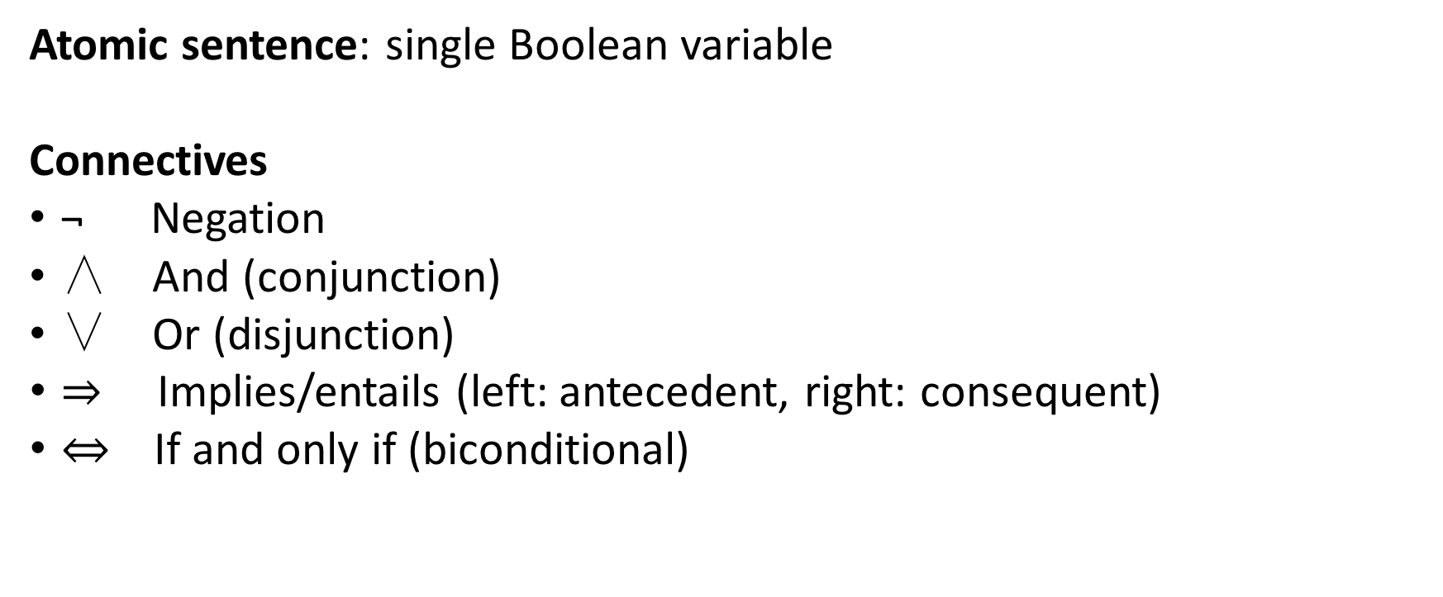
Propositional Logic
Atomic sentence: single Boolean variable
Connectives
¬ Negation
∧ And (conjunction)
∨ Or (disjunction)
$⇒$ Implies/entails (left: antecedent, right: consequent)
$⇔$ If and only if (biconditional)

Slide 22
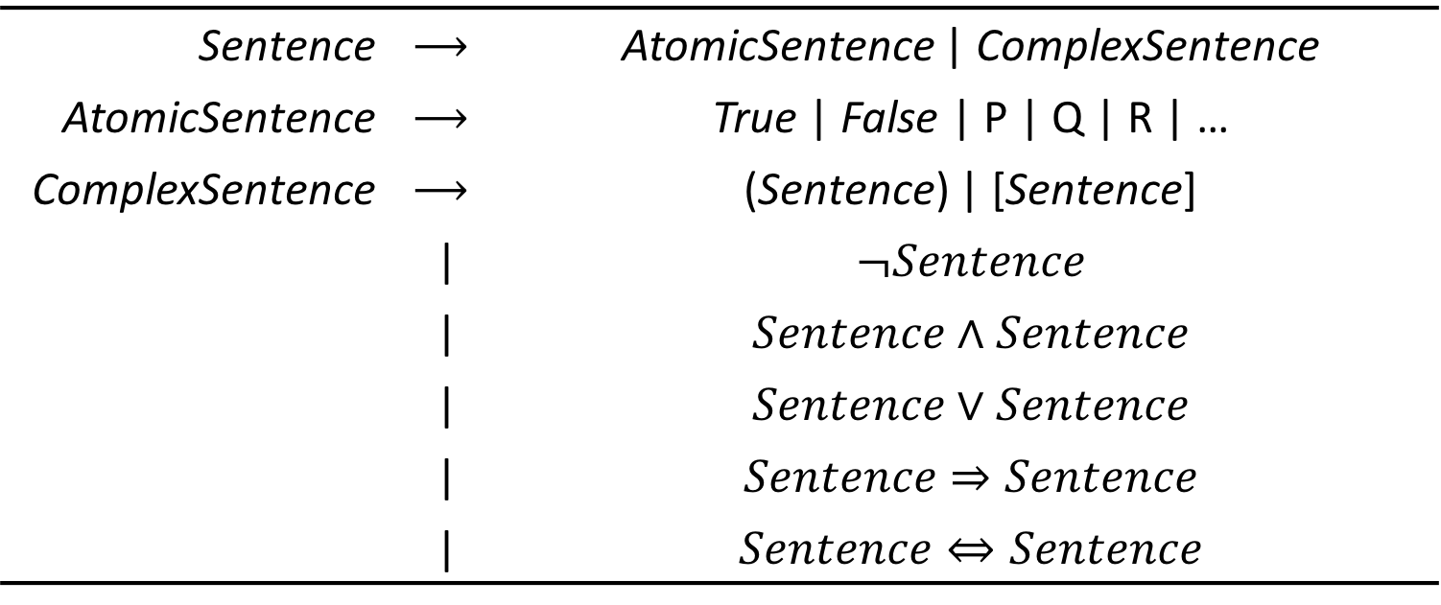
Propositional Logic – BNF Grammar
Sentence | $$⟶$$ | AtomicSentence | ComplexSentence
AtomicSentence | $$⟶$$ | True | False | P | Q | R | …
ComplexSentence | $$⟶$$ | (Sentence) | [Sentence]
 | | | $$¬Sentence$$
 | | | $$Sentence∧Sentence$$
 | | | $$Sentence∨Sentence$$
 | | | $$Sentence⇒Sentence$$
 | | | $$Sentence⇔Sentence$$
Specifies all syntactically valid sentences in Prop Logic

Slide 23
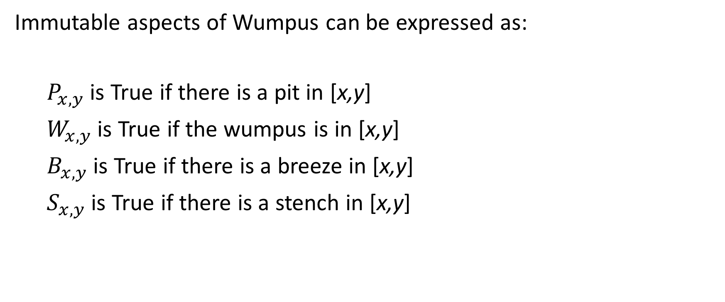
Wumpus Propositional Logic
Immutable aspects of Wumpus can be expressed as:
$P_{x,y}$ is True if there is a pit in [x,y]
$W_{x,y}$ is True if the wumpus is in [x,y]
$B_{x,y}$ is True if there is a breeze in [x,y]
$S_{x,y}$ is True if there is a stench in [x,y]

Slide 24
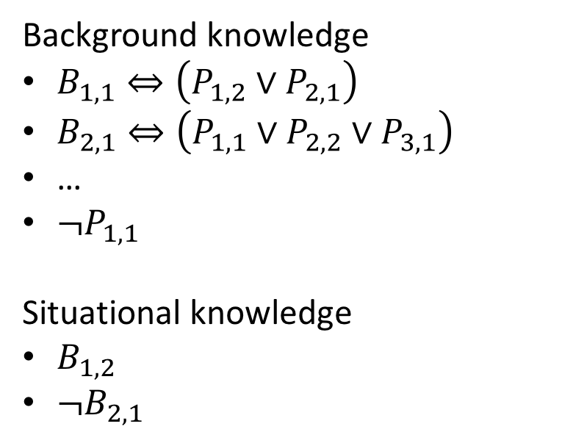
Wumpus World – Current KB
Background knowledge
$B_{1,1}⇔\left(P_{1,2}∨P_{2,1}\right)$
$B_{2,1}⇔\left(P_{1,1}∨P_{2,2}∨P_{3,1}\right)$
…
$¬P_{1,1}$
Situational knowledge
$B_{1,2}$
$¬B_{2,1}$
???

Slide 25
Inference
Question: $KB⊨P_{3,1}$?
Inference algorithm must be
Consistent – Only derives sentences that are entailed
Complete – Can derive any sentence that is entailed

Slide 26
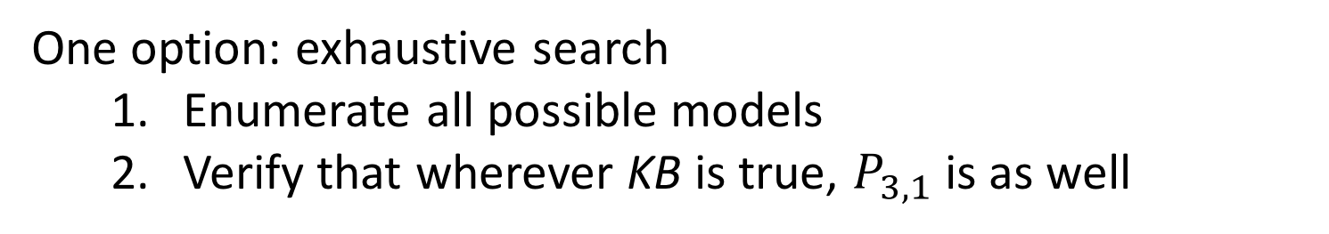
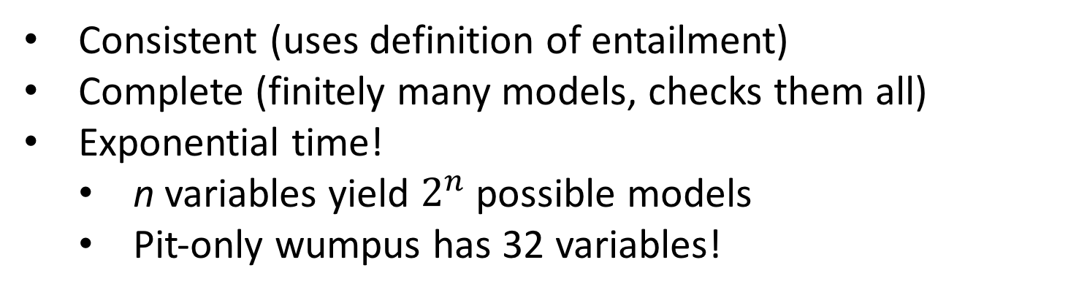
Inference
Question: $KB⊨P_{3,1}$?
One option: exhaustive search
Enumerate all possible models
Verify that wherever KB is true, $P_{3,1}$ is as well
Consistent (uses definition of entailment)
Complete (finitely many models, checks them all)
Exponential time!
n variables yield $2^{n}$ possible models
Pit-only wumpus has 32 variables!

Slide 27


Better: Theorem Proving
Important concepts
A and B are logically equivalent if they are true in the same set of worlds
A is valid if it is true in all worlds
Aka tautologies
A is satisfiable if there is some world in which it is true
The original NP-complete problem!
A is valid iff $¬A$ is unsatisfiable
A is satisfiable iff $¬A$ is invalid

Slide 28



Inference Rules
Modus Ponens $$\frac{A⇒B, A}{B}$$
If both $A⇒B$ and A are in the KB, then B can be inferred
And Elimination $$\frac{A∧B}{A}$$
If the conjunct is true, each element is true
De Morgan’s Rule
$$¬\left(A∨B\right)≡¬A∧¬B$$

Slide 29




Proof by Resolution
General idea:
Apply inference rules
Use complementary literals to simplify clauses
Rinse, repeat
$$¬B$$
$$⊨$$
$$A∨C$$
$$A∨B∨C$$

Slide 30
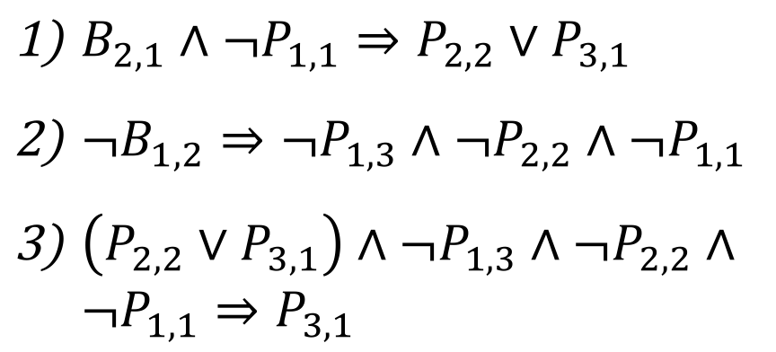
Wumpus World – Resolving
$B_{2,1}∧¬P_{1,1}⇒P_{2,2}∨P_{3,1}$
$¬B_{1,2}⇒¬P_{1,3}∧¬P_{2,2}∧¬P_{1,1}$
$\left(P_{2,2}∨P_{3,1}\right)∧¬P_{1,3}∧¬P_{2,2}∧¬P_{1,1}⇒P_{3,1}$
???
PIT

Slide 31
Next Time
Forward-backward chaining for efficient inference
First-order logic

