Slide 1
Announcements
Office hours now Mon 3:30-4:30 and Thu 2:30-3:30

Slide 2
Today’s learning goals
At the end of today, you should be able to
Describe AI applications to speech recognition and speech separation
Describe AI applications to POS tagging, information extraction, and information retrieval

Slide 3
AI applications!
Goal of today’s and Friday’s classes
Familiarize you with a bunch of different applications of AI methods, so you can figure out what’s next
Today
Speech processing
Automatic speech recognition
Speech separation
Speech synthesis
Natural language processing
Part-of-speech tagging
Information extraction
Information retrieval

Slide 4

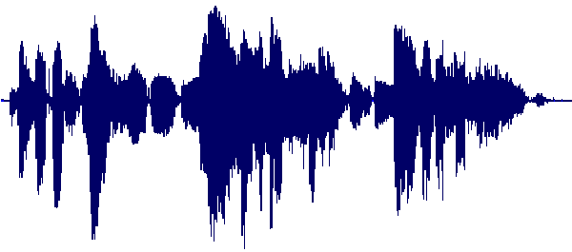

Speech processing

Slide 5
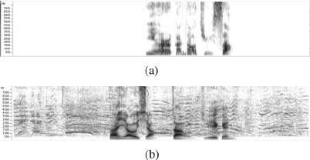
Speech processing
Fig. 1. Spectrograms of clean and noisy data included in the Mandarin SPEECON database. (a) Clean data recorded in office space. (b) Noisy data recorded in public space.
Yamagishi et al., “Thousands of Voices for HMM-based Speech Synthesis – Analysis and Application of TTS Systems Built on Various ASR Corpora.” TASLP 18(5):984-1004. 2010.

Slide 6
Speech data
Data come in many forms
Raw waveforms
Spectrograms
Binned frequency statistics
All representing the same thing
Different kinds of data
Noisy vs clean
Single/multi-speaker
Conversational vs read
Child vs adult
etc.

Slide 7
Speech processing applications
Automatic Speech Recognition (ASR)
Speaker identification
Speech separation
Speech denoising
Speech synthesis
Dialogue systems
…

Slide 8
Speech Recognition
Input
Audio signals
Sequence of 10ms frames
ASR
Output
Text transcript of what was said
“AI is cool”

Slide 9
Breaking down the ASR box
Three main steps to ASR:
Acoustic modeling – audio signal to phonemes
Pronunciation modeling – phoneme sequences to words
Language modeling – word sequences to utterances
Th – uh – k – ae – t
Th/d – uh – k – ae/e – t/p
The – cat
The/A – cat/hat
The cat [eats dog food]

Slide 10
Sequence modeling with Hidden Markov Models
Audio frames are sequential (i.e., order matters)
Th
Th
uh
uh
Use a sequential model like an HMM to label with phonemes
Phonemes treated as latent variables
Observations (acoustic data) are conditionally independent given phoneme labels

Slide 11
Sequence modeling with Hidden Markov Models
Discuss HMM details here

Slide 12
Sequence modeling with Hidden Markov Models
HMMs have:
(Hidden) State space
Transition probabilities between states
Emission probabilities to emit observations
Th
Th
uh
uh

Slide 13
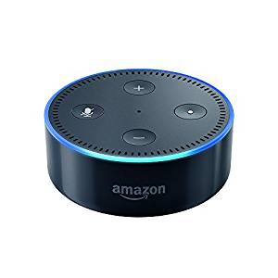

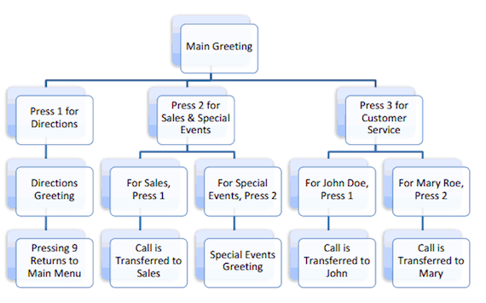
Examples everywhere

Slide 14
Experimental considerations
What kinds of things do you have to consider for ASR?
Recording conditions
Noise (type and level)
Speaker-mic distance
Room characteristics (reverb)
Multiple speakers?
Speech characteristics
Native language
Accent
Age
Gender

Slide 15
Sample ASR experimental questions
Can I make the ASR model adjust on the fly to changes in noise conditions?
What component of my ASR model fails on young, male, French speakers?
How little noisy training data can I get away with to still hit 95% accuracy?

Slide 16



Speech separation
Scenario
One microphone, multiple speakers talking at the same time
Task
Split out what each individual speaker is saying

Slide 17
Noisy signals
Add up multiple simple waves:
Get a complex wave:
Multi-speaker sound waves are compositions of complex waves from each speaker

Slide 18
Masking part of a signal
So we’ll mask part of the signal to try to remove the parts we’re not interested in
Mask is a [0,1] multiplier for a specific frequency band at a specific timestep
Learn to calculate this mask with machine learning!
x
Noisy signal
Binary mask
Clean signal
Images from Srinivasan et al. “Binary and ratio time-frequency masks for robust speech recognition.” Speech Communication. 2006

Slide 19
Masking part of a signal
Learn the mask by using a bunch of (noisy, clean) data samples
Input: time-frequency values
Output: mask values (0=discard, 1=keep)
Common model: (deep) neural network
,
Noisy signal
Clean signal
Binary mask
Images from Srinivasan et al. “Binary and ratio time-frequency masks for robust speech recognition.” Speech Communication. 2006

Slide 20

Example
2-speaker mixture:
Estimated Speaker 1
Reference Speaker 1
Estimated Speaker 2
Reference Speaker 2
Example due to Masood Delfarah

Slide 21
Sample speech separation experimental questions
Does the same mask learning idea apply when there are 15 speakers?
Do humans “like” the separated speech better if I use a binary on/off mask or a real-valued [0,1] mask?
Can I use the same model to separate speech when one speaker is 10 times as loud as the other as when it’s 2x?

Slide 22
Speech synthesis
Input
Text content (sequence of words)
“AI is cool”
ASR
Output
Audio speech signal

Slide 23
From text to speech
“AI is cool”
Words
Decompose words to sequences of characters
Deterministic operation, not much to do here
Characters

Slide 24
From text to speech
“AI is cool”
Convert sequence of characters to sequence of phonemes
Context-sensitive!
“B” handled differently in ”lamb” vs “tub”
Sequential task
Not a one-to-one mapping
”laugh” → “læf”
Words
Characters
Phonemes

Slide 25
From text to speech
“AI is cool”
Words
Compose phonemes with prosodic signals
Pitch, speed, intonation
Speaker- and situation-dependent
May need many different models
Characters
Phonemes
Prosody

Slide 26
From text to speech
“AI is cool”
Words
Concatenate prosodic phonemes to an utterance
Need smooth transitions
Search problem!
Noise conditions?
Characters
Phonemes
Prosody
Utterance

Slide 27
Speech synthesis
4 sub-problems in one large problem
However, all are related to one another
Phoneme probabilities are joint with utterance-level
Multiple modalities in one problem
Text and audio signals

Slide 28


Real-world examples

Slide 29
Sample speech synthesis experimental questions
Do humans perceive the generated speech as “more natural” if I don’t include any noise or if I do?
How do I adjust the model to support synthesizing speech with a Scottish accent?
How much quality do I lose if I make my model fast for real-time synthesis?

Slide 30

Natural language processing

Slide 31
Language data
Language data is always text, but comes in many different flavors.
Formal, stand-alone documents
Messages/conversations
Source domains (medical, sports, news)

Slide 32
Already did document classification!
Data
Text documents from Electronic Health Records (EHR)
Sampled from OSU Med Center, NIH Clinical Center
Split into two labels:
$Rehab$ (e.g., physical therapy)
$¬Rehab$ (e.g., gastroenterology consults)
Goal
Given a new document from either medical center,
classify it as $Rehab$ or $¬Rehab$

Slide 33
NLP applications
Language modeling
Part-of-Speech tagging
Sentiment analysis
Information extraction
Machine translation
Information retrieval
…

Slide 34
Part of speech tagging
Common low-level task
Important first step for lots of other applications
“AI is cool”
Input
Sequence of words
POS tag
Output
Sequence of part-of-speech (POS) tags (one per word)
AI
is
cool
N
V
Adj

Slide 35
Simple baseline: most common tag
Scan over a bunch of pre-labeled data
Count tag frequencies per word
At test time, use highest frequency tag
“The”
POS | Freq
N | 0
Det | 21,357
The yellow dog…
Det Adj N
“yellow”
POS | Freq
Adj | 870
V | 0
Problem: ambiguous words!
“cool” can be Adj or V

Slide 36
Solution: HMMs again!
Words in a sentence are sequential
N
V
Adv
Adj
Use HMMs to make it context sensitive
POS tags treated as latent variables
Observations are now individual words
AI
is
really
cool

Slide 37
Estimating HMM probabilities
Two-sentence corpus:
Transition probabilities
 | N | V | Adj | Adv | EX | INF
N | -- | 0.5 | -- | -- | -- | 0.5
V | -- | -- | 0.5 | 0.5 | -- | --
Adj | 1.0 | -- | -- | -- | -- | --
Adv | -- | -- | 1.0 | -- | -- | --
EX | -- | 1.0 | -- | -- | -- | --
INF | -- | 1.0 | -- | -- | -- | --
Artificial intelligence is really cool.
Adj N V Adv Adj
There are many problems to solve.
EX V Adj N INF V

Slide 38
Estimating HMM probabilities
Emission probabilities
Two-sentence corpus:
Word | P(w|Adj)
artificial | 0.34
intelligence | --
cool | 0.33
many | 0.33
Artificial intelligence is really cool.
Adj N V Adv Adj
There are many problems to solve.
EX V Adj N INF V
Word | P(w|N)
artificial | --
intelligence | 0.5
cool | --
problems | 0.5

Slide 39
Context-sensitive decisions
Adv
POS | P(POS|Adv)
N | 0
V | 0.1
Adj | 0.9
N
POS | P(POS|N)
N | 0
V | 0.6
Adj | 0.4
cool
cool

Slide 40
Sample POS tagging experimental questions
How complicated a tag set do I need for good downstream performance?
What happens if we use a 2-step independence assumption in an HMM-like model, instead of 1-step?
Does my new neural network model the POS-POS transition probabilities better than a count-and-divide model?

Slide 41
Information extraction
Extracting structured information from unstructured text
Input
Unlabeled text
IE
Output
Database rows, basically
Animal | Scientific Name
Platypus | Ornithorhynchus anatinus

Slide 42
Rule-based IE
Heuristic rule-based approaches can get you pretty far!
E.g., If I want to find out where famous people are born, use patterns:
“X was born in Y”
“Y, the birthplace of X”
…
Person | Birthplace
Barack Obama | Honolulu
Donald Trump | Queens
George W. Bush | ???
…Barack Obama was born in Honolulu, Hawaii…
…Queens, the birthplace of Donald Trump…
…Bush, born and raised in Connecticut...

Slide 43
More general IE pipeline
Recognize entities referred to in the text
Named Entity Recognition (NER)
Can use rule-based methods, dictionary matching, or machine learning
HMMs, sequential neural networks
Text
Entities
…Barack Obama was born in Honolulu, Hawaii…
Person
Place

Slide 44
More general IE pipeline
Recognize relationships between entities
Task of relation extraction
Patterns we used earlier are for specific relations
e.g., Born_In, CEO_Of, etc.
Non-sequential classification
Text
Entities
Relations
Born_In
…Barack Obama was born in Honolulu, Hawaii…

Slide 45
More general IE pipeline
Match to database rows/columns
Tasks of normalization and entity linking
Dictionary matching and machine learning both used here
Classification task: label with correct entity/relation
Text
Entities
Relations
[Person] Born_In [Place]
…Barack Obama was born in Honolulu, Hawaii…
Structured info
<Barack_Obama_Ent19397>
<Honolulu_Ent9937372>

Slide 46
Sample IE experimental questions
Does a sequential neural model work better than an HMM for entity recognition?
Instead of exact text patterns, can I build rules using abstracted word sets?
Which kinds of relationships does my new IE algorithm work best/worst on?
Can we perform IE for “common sense” knowledge?

Slide 47
Information retrieval
Flip side of information extraction
Input
Query (structured data or unstructured text)
Output
List of records (documents), ranked by relevance to query
“Information about platypi”
IR

Slide 48

Example

Slide 49
IR is more than just language
Information retrieval can be mostly structured
E.g., PageRank (Google’s early search algorithm)
Uses page connections via hyperlinks to define “important” pages
Does some keyword-based matching
Or mostly unstructured
Example medical document retrieval system:
Query: string of disease names (”emphysema, breast cancer, diabetes”)
Method: find documents that frequently mention these words
Rank by date entered (recent first)

Slide 50

IR example
Query: “emphysema AND diabetes”
Extra knowledge base info:
“chronic cough” is related to “emphysema”
“insulin” is related to “diabetes”
Document | F(emphysema) | F(diabetes) | F(cough) | F(insulin)
D1 | 14 | 0 | 2 | 0
D2 | 0 | 3 | 1 | 4
D3 | 0 | 0 | 0 | 0
D4 | 10 | 7 | 12 | 6

Slide 51
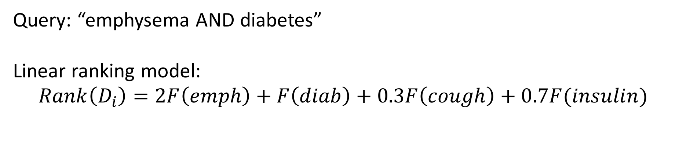
IR example
Query: “emphysema AND diabetes”
Linear ranking model:
$$Rank\left(D_{i}\right)=2F\left(emph\right)+F\left(diab\right)+0.3F\left(cough\right)+0.7F(insulin)$$
Document | F(emphysema) | F(diabetes) | F(cough) | F(insulin) | Score
D1 | 14 | 0 | 2 | 0 | 28.6
D2 | 0 | 3 | 1 | 4 | 6.1
D3 | 0 | 0 | 0 | 0 | 0
D4 | 10 | 7 | 12 | 6 | 34.9
Return documents in ranked order: [D4, D1, D2, D3]

Slide 52
Sample IR experimental questions
How does a unigram (1-word) frequency model compare to a bigram (2-word) model?
How important are hyperlinks vs text matches?
Does my new way of representing documents give me better IR generalization to different kinds of documents?
How do I efficiently rank tens of millions of documents?

Slide 53

Problems mix together
Information retrieval gets easier and faster when you have good information extraction
Errors in POS tagging mean errors farther down the line in information extraction or other applications
Speech recognition requires good (text-based) language modeling
etc.

Slide 54
Next time
More AI applications: vision and robotics

