Slide 1
Announcements
Homework 1 Full assignment posted.

Slide 2
Last Time: A* and Heuristics
A* search
Uses estimated distance to goal to reduce number of nodes expanded
Optimal (w/ right heuristics!), faster than UCS, but still does some extra work
UCS == special case of A*
Heuristics
Estimate amount of work left
Admissible: never over-estimate remaining work
Consistent: never over-estimate cost of a single action

Slide 3
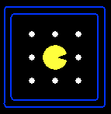
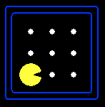
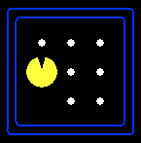
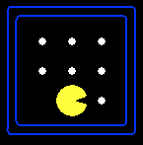



Search Problem Mechanics
A search problem consists of:
A state space
A successor function
(with actions, costs)
A start state and a goal test
A solution is a sequence of actions (a plan) which transforms the start state to a goal state
“N”, 1.0
“E”, 1.0
Notes:
State space may be fully or partially enumerated
Goal test – sometimes more than one state that satisfies having achieved the goal, for example, “eat all the dots”
Abstraction

Slide 4
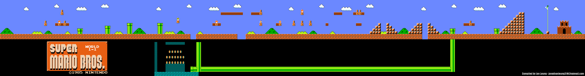
Practice: Search Problem Formulation
Goal?
State space?
Successor function?
Clip 1
Clip 2

Slide 5
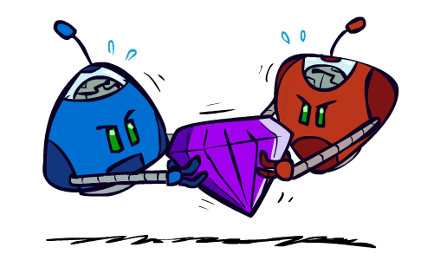
Adversarial Games

Slide 6
Games as Search
Game – a strategic interaction between individuals
agents
This is where search comes in!
Notes:
Definition courtesy Wikipedia

Slide 7
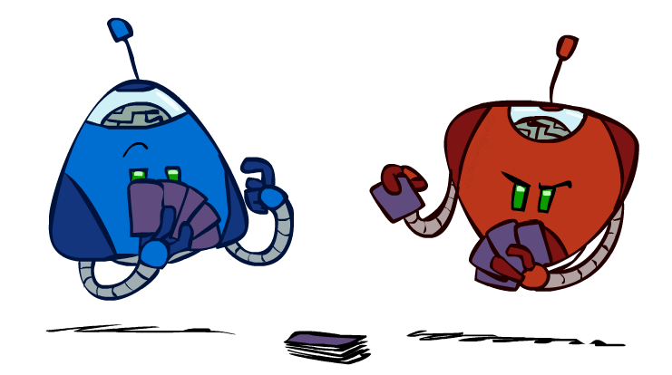
Types of Games
Many different kinds of games!
Axes:
Deterministic or stochastic?
One, two, or more players?
Zero sum?
Fully or partially observable?
Want algorithms for calculating a strategy (policy) which recommends a move from each state

Slide 8
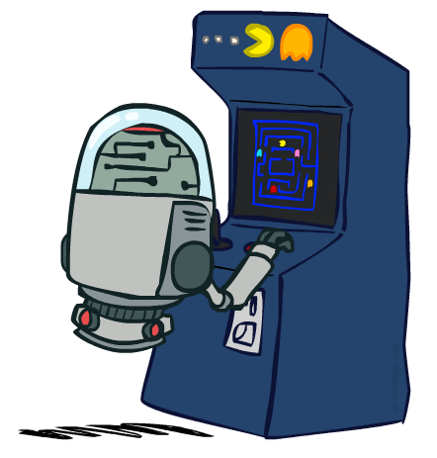
Deterministic Games
Many possible formalizations, one is:
States: S (start at s₀)
Players: P={1...N} (usually take turns)
Actions: A (may depend on player / state)
Transition Function: SxA → S
Terminal Test: S → {t,f}
Terminal Utilities: SxP → R
Solution for a player is a policy: S → A

Slide 9
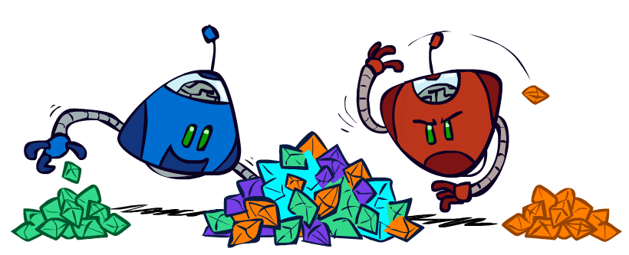
Types of Games
Zero-Sum Games
Agents have opposite utilities (values on outcomes)
Lets us think of a single value that one maximizes and the other minimizes
Adversarial, pure competition
General Games
Agents have independent utilities (values on outcomes)
Cooperation, indifference, competition, and more are all possible
Ignoring these for now!

Slide 10
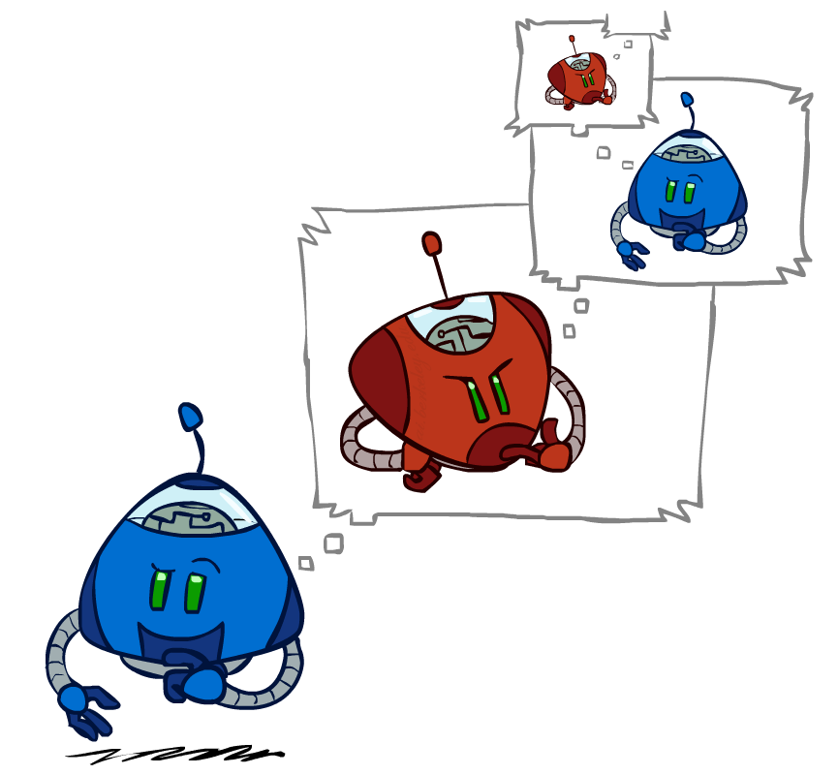
Adversarial Search

Slide 11
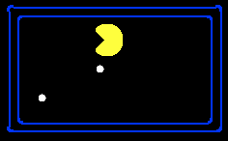
Single-Agent Trees
8
2
0
…
2
6
…
4
6

Slide 12
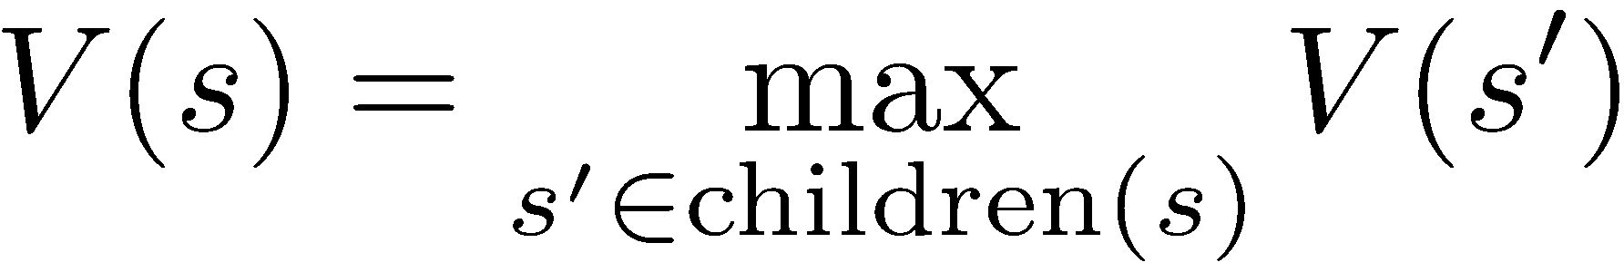
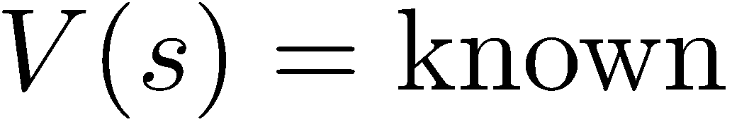
Value of a State
Value of a state: The best achievable outcome (utility) from that state
Non-Terminal States:
What will state values look like in a game that is:
Deterministic
Static
Single-agent?
8
2
0
…
2
6
…
4
6
Terminal States:

Slide 13

Adversarial Game Trees
-20
-8
…
-18
-5
…
-10
+4
-20
+8

Slide 14
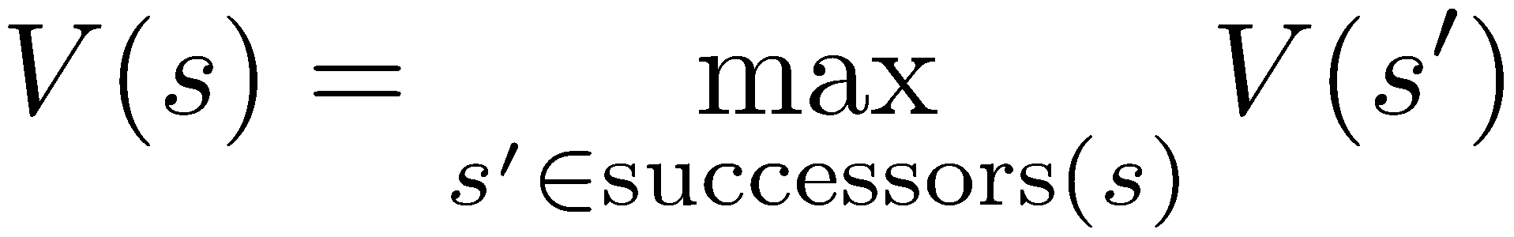
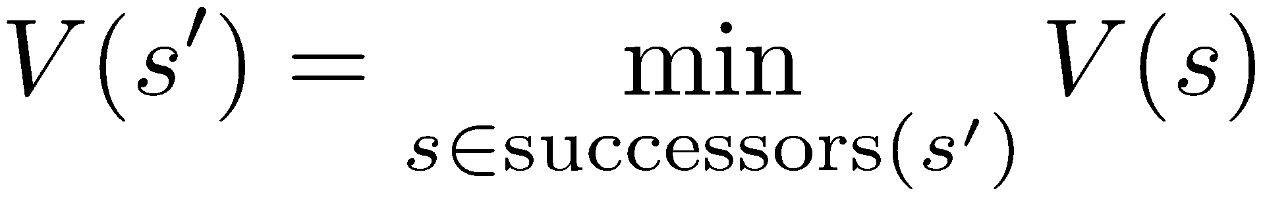
Minimax Values
States Under Agent’s Control:
States Under Opponent’s Control:
-8
-5
-10
+8
Terminal States:

Slide 15

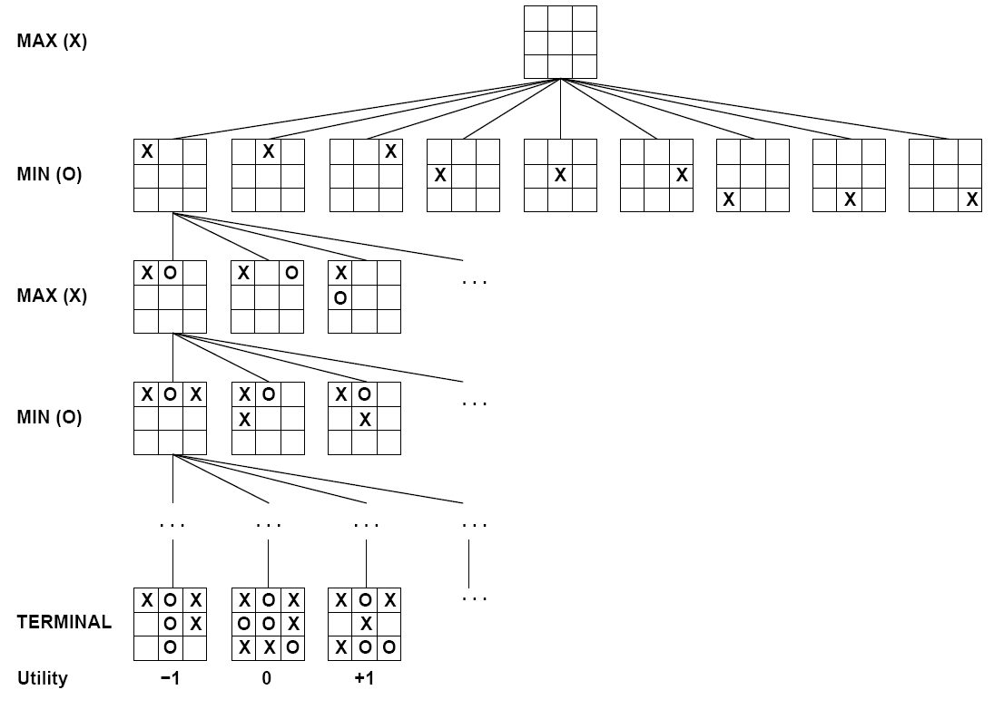

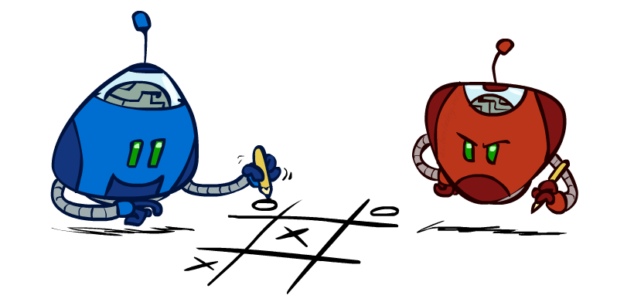
Tic-Tac-Toe Game Tree

Slide 16
Adversarial Search (Minimax)
Deterministic, zero-sum games:
Tic-tac-toe, chess, checkers
One player maximizes result
The other minimizes result
Minimax search:
A state-space search tree
Players alternate turns
Compute each node’s minimax value: the best achievable utility against a rational (optimal) adversary
Minimax values: computed recursively
5
max
2
5
min
8
2
5
6
Terminal values: part of the game

Slide 17
Minimax Implementation
def max-value(state):
initialize v = -∞
for each successor of state:
v = max(v, min-value(successor))
return v
def min-value(state):
initialize v = +∞
for each successor of state:
v = min(v, max-value(successor))
return v

Slide 18
Minimax Implementation (with control flow)
def value(state):
if the state is a terminal state: return the state’s utility
if the next agent is MAX: return max-value(state)
if the next agent is MIN: return min-value(state)
def max-value(state):
initialize v = -∞
for each successor of state:
v = max(v, value(successor))
return v
def min-value(state):
initialize v = +∞
for each successor of state:
v = min(v, value(successor))
return v
Notes:
Pick an order for two reasons: sequential processor and pruning

Slide 19
Minimax Example
3
3
2
2
3
12
8
2
4
6
14
5
2

Slide 20
Minimax Efficiency
How efficient is minimax?
Just like (exhaustive) DFS
Time: O(b^{m})
Space: O(bm)
Example: For chess, b ≈ 35, m ≈ 100
Exact solution is completely infeasible
But, do we need to explore the whole tree?

Slide 21
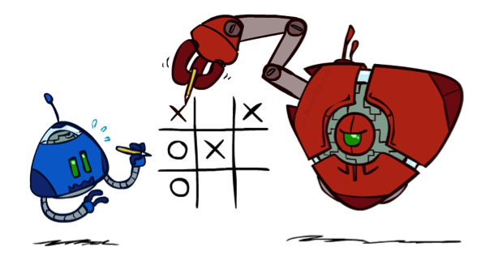
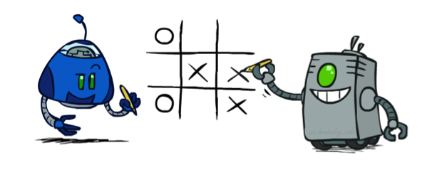
Minimax Properties
max
min
10
10
9
100
Optimal against a perfect player.
What about an imperfect one?

Slide 22

Resource Limits

Slide 23
Resource Limits
Problem: In realistic games, cannot search to leaves!
Solution: Depth-limited search
Instead, search only to a limited depth in the tree
Replace terminal utilities with an evaluation function for non-terminal positions
Example:
Suppose we have 100 seconds, can explore 10K nodes / sec
So can check 1M nodes per move
α-β reaches about depth 8 – decent chess program
Guarantee of optimal play is gone
More plies makes a BIG difference
Use iterative deepening for an anytime algorithm
max
4
-2
4
min
-1
-2
4
9
?
?
?
?

Slide 24
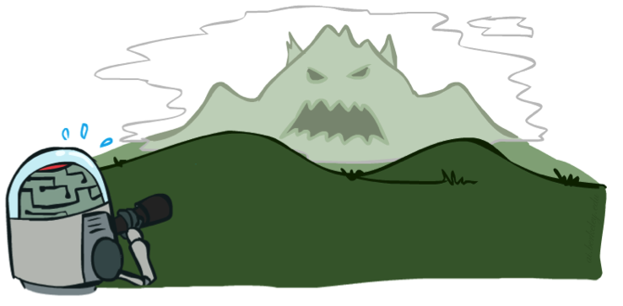

Depth Matters
Evaluation functions are always imperfect
The deeper in the tree the evaluation function is buried, the less the quality of the evaluation function matters
An important example of the tradeoff between complexity of features and complexity of computation

Slide 25
Evaluation Functions
Evaluation functions score non-terminals in depth-limited search
Ideal function: returns the actual minimax value of the position
In practice: typically weighted linear sum of features:
e.g. f₁(s) = (num white queens – num black queens), etc.

Slide 26
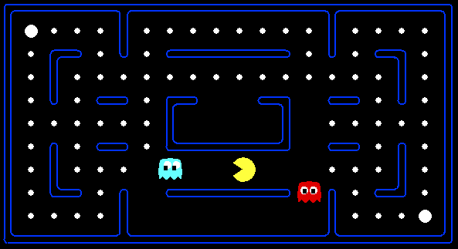




Evaluation for Pacman

Slide 27
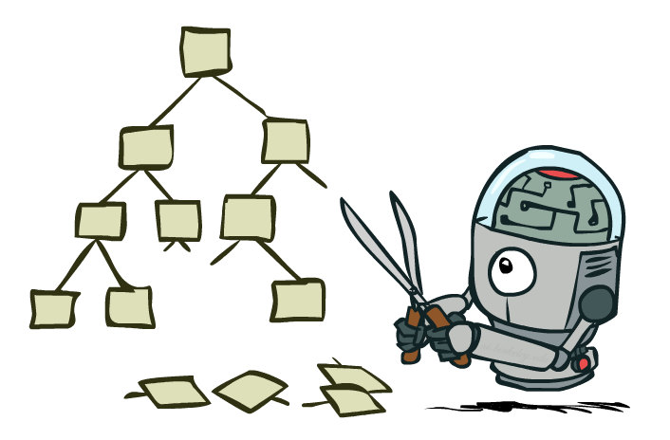
Game Tree Pruning

Slide 28
Minimax Example (now with pruning!)
3
3
<=2
2
3
12
8
2
14
5
2

Slide 29
Alpha-Beta Pruning
General configuration (MIN version)
We’re computing the MIN-VALUE at some node n
We’re looping over n’s children
n’s estimate of the childrens’ min is dropping
Who cares about n’s value? MAX
Let a be the best value that MAX can get at any choice point along the current path from the root
If n becomes worse than a, MAX will avoid it, so we can stop considering n’s other children (it’s already bad enough that it won’t be played)
MAX version is symmetric
MAX
MIN
a
MAX
MIN
n

Slide 30
Alpha-Beta Implementation
α: MAX’s best option on path to root
β: MIN’s best option on path to root
def max-value(state, α, β):
initialize v = -∞
for each successor of state:
v = max(v, min-value(successor, α, β))
if v ≥ β return v
α = max(α, v)
return v
def min-value(state , α, β):
initialize v = +∞
for each successor of state:
v = min(v, max-value(successor, α, β))
if v ≤ α return v
β = min(β, v)
return v
Notes:
Pick an order for two reasons: sequential processor and pruning

Slide 31
Alpha-Beta Pruning Properties
This pruning has no effect on minimax value computed for the root!
Values of intermediate nodes might be wrong
Important: children of the root may have the wrong value
So the most naïve version won’t let you do action selection
Good child ordering improves effectiveness of pruning
With “perfect ordering”:
Time complexity drops to O(b^{m/2})
Doubles solvable depth!
Full search of, e.g. chess, is still hopeless…
This is a simple example of metareasoning (computing about what to compute)
max
min
10
10
0

Slide 32
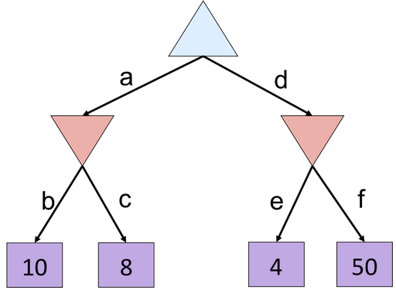
Alpha-Beta Practice
8
8
<=4

Slide 33
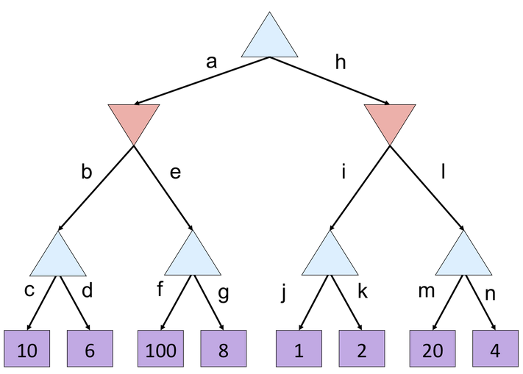
Alpha-Beta Practice
10
10
<=2
10
>=100
2
Notes:
Prune: g, k, l->(m,n)

Slide 34
Search Summary
Formulating search problems
Goal test, state space, successor function
Single-agent search
Uninformed approaches: BFS, DFS, UCS
Informed: Greedy, A*
Heuristic design
Adversarial multi-agent search
Minimax and alpha-beta pruning
Evaluation function design
Not the only kind of multi-agent search!

Slide 35
What problems can’t be formulated as search?

Slide 36
Next Time
Logical agents
(Propositional logic review)
Knowledge bases

