Slide 1

Classifying the Reported Ability in Clinical Mobility Descriptions
Denis Newman-Griffis*^{1,2}, Ayah Zirikly*¹, Guy Divita* ¹, and Bart Desmet ¹
¹National Institutes of Health, Clinical Center ²The Ohio State University *equal contributors
BioNLP 2019

Slide 2

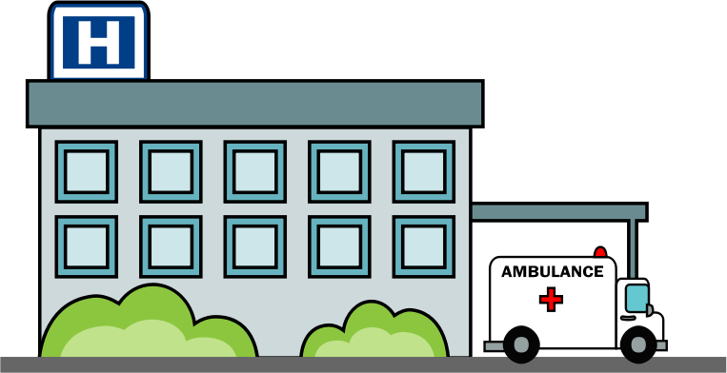



After coffee, is able to deliver conference talk.
Ability to perform a task is relevant to:
Measuring health outcomes
Assessing ability to meet work demands
Evaluating disability/functional impairment
!!

Slide 3
Our question:
Where do current classification methods succeed and fail at classifying ability to perform mobility-related actions?

Slide 4
Levels of performance (Polarity)
Able – activity could be completed in this environment
Unable – activity could not be completed in this environment
Unclear – some information, but not enough to decide
None – no information provided
Pt can walk 20 minutes in clinic
He is unable to walk
Includes goals, hypotheticals, etc
The cane makes it difficult to walk
tendency during gait to quickly extend the leg

Slide 5
Related work
Negation detection!
Identifying cues and scoping
General domain and clinical data
Early work on phrase-level semantic analysis
Wilson et al (2005, 2009)
General contextual feature detection
ConText (Chapman et al 2007)

Slide 6
Dataset
400 English-language Physical Therapy notes
Initial assessment/reassessment
From NIH Clinical Center
Annotated for
Descriptions of mobility status
Action in each description
Polarity of each action
Thieu et al (2017)
Train | 1,536 | 54 | 158 | 1,784
Test | 446 | 23 | 48 | 478

Slide 7
Study Design
Given an action in context, pick which of 4 Polarity labels applies.
Able | X
Unable
Unclear
None
Pt can walk 20 minutes in clinic
Rule-based methods
Machine learning baselines
CNN with embeddings

Slide 8
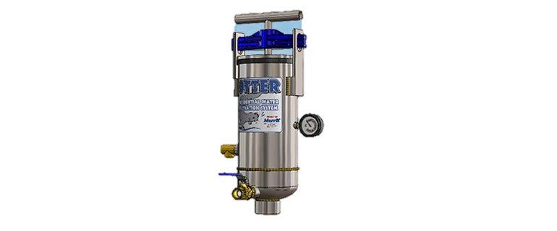

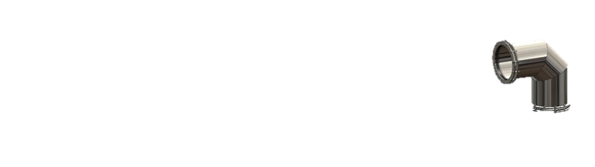
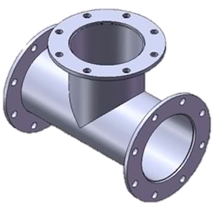
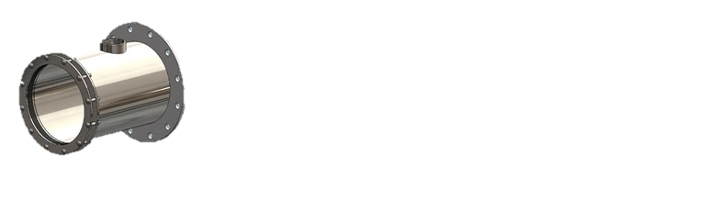

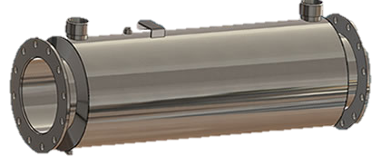
Rule-Based Polarity Pipeline
conTEXT Assertion Terms
Medical Terms
Polarity Assertion Terms
Medical Text
Dictionary Lookup
conTEXT
Question Identification
Mobility Annotator
Sentence
Sectionizer
Check Box
Regex Shapes
Line
Slot: Value
Tokenizer
Action Polarity

Slide 9
Action Polarity Annotator
Rule
Polarity [Unable]= Action + Negative Assertion Evidence
Negative Evidence Category
Sentence
Unable to walk up stairs
Unable | cannot| impossible | …
Clinical Text
Sentence
unable
to
walk
up
stairs
Slot:Value
Transfers: Unable
Slot: Value
Transfers
:
Unable
Rule
Polarity [Unable]= Slot contains Action + Value contains Negative Evidence

Slide 10
Machine learning models
Features
Bag of unigram indicators (binary)
Averaged word embeddings
Text of mobility description with/without Action text
Models
All equivalent; SVM absolute highest
Random Forest
Unigrams for context only
SVM
Unigrams and embeddings for context and Action
2-layer DNN
Unigrams and embeddings for context only

Slide 11
CNN Model
Mobility description
… Pt is not able to walk more than 50 feet ...
walk
Context window
prev
Unable
next
Pt
is
not
able
to
walk
full
walk
more
than
50
feet
Pt
is
not
able
to
walk
more
than
50
feet
Context representation
Convolutional layer with multiple filters
Max pooling
Fully connected layer with softmax

Slide 12
CNN Model
Mobility description
… Pt is not able to walk more than 50 feet ...
walk
Context window
prev
Unable
next
Pt
is
not
able
to
walk
full
walk
more
than
50
feet
Pt
is
not
able
to
walk
more
than
50
feet
Word embeddings
Character embeddings
Context representation
Convolutional layer with multiple filters
Max pooling
Fully connected layer with softmax

Slide 13
Ensembling Methods
DNN Chooser
Trained on disagreements to choose which model is right
All three systems
10-unit hidden layer
Voting
SVM and CNN only
When disagree, choose less frequent of the 2 labels

Slide 14
Results – F-1 on Test
Equivalent (p>0.001; Bonferroni-corrected bootstrapping)

Slide 15
Error Analysis
Lower performance for Unable and Unclear
Minority categories with fewer training instances
Unclear is ambiguous even for humans
None class false negatives: emotions, plans, recommendations
She is fearful to walk again
Assistive device can flip polarity from Unable to Able
She is unable to ambulate more than a few feet without support
Multiple action mentions with different polarities in one mobility description
Pt can walk but cannot run and he dislikes running
Able
Unable
None

Slide 16
Discussion: Failures
Assertion scoping algorithm is bounded by punctuation, conjunctions within a sentence
Scoping failures
Patient was unable to sit or stand
It was impossible for the patient to sit, stand, or transfer
Difficulty with home management(chores, shopping, driving) : No
Poor Section Segmentation
Stairs/Steps: needs assistance Walking : supervision w/cane
False Negative Negatives and Pertinent Negatives
Can walk with no assistance
No trouble walking
Mislabeled Sections
Goals\n\n Patient will stand without assist
Multiple slot values on a line
Multiple \n’s caused missed line in Goals section

Slide 17
Next Steps:
Rule evidences turned into feature vector
Emotion words, dependency structure
In Slot Value | In Section Zone | Section Name | In Sent | In Slot | In Value | Is Asserted | Is Negated | Is Conditional | Is Historical | Is Patient | Is Future Section | Is Patient reports … | Is Asserted Evidence before Mention
Yes | Yes | Goals | No | Yes | No | Yes | No | No | No | Yes | Yes | No | No

Slide 18

Thank you!
Ongoing research support comes from the Intramural Research Program of the National Institutes of Health, Clinical Research Center and through an Inter-Agency Agreement with the US Social Security Administration.

Slide 19
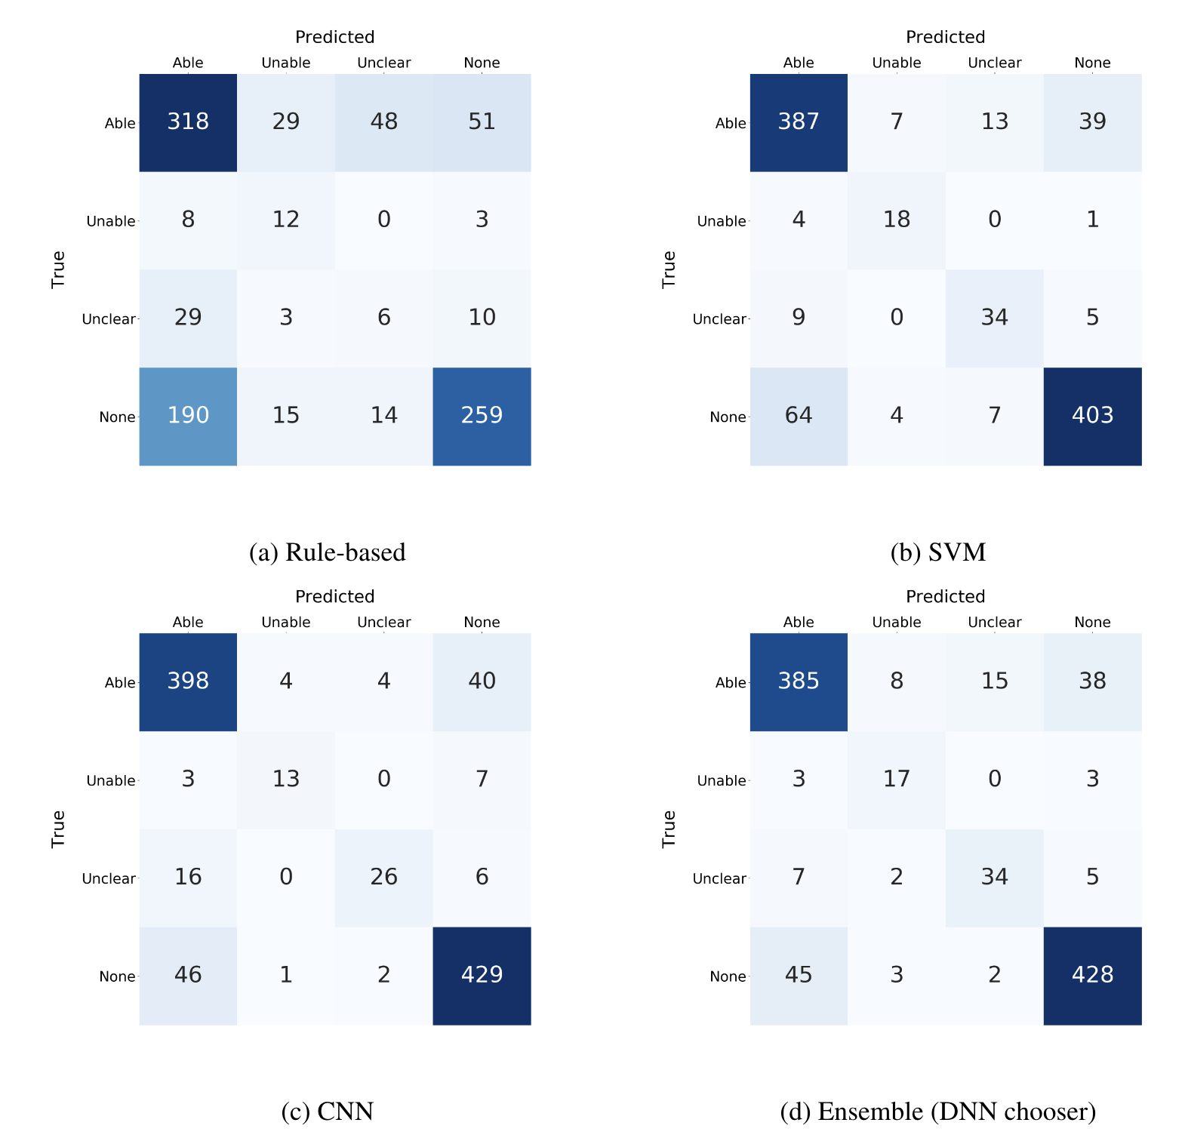

Slide 20
Pipeline Components Slot: Value
Content Heading
:
Content Value
Smoking
:
No
Concepts not looked for here
Concepts in content headings only asserted if content value contains positive evidence
Nursing Notes
Vitals
Slot:
Value

Slide 21
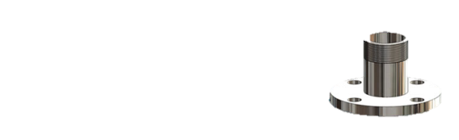
Pipeline Components: Question/Answer Identification
Content Heading
?
Content Value
Do you want to hurt others?
?
yes
(Answer)
(Question)
Negative Evidence sought out
Concepts in content headings only asserted if content value contains positive evidence
Question?
Answer

Slide 22
Pipeline Components: Checkboxes
Content Heading
Content Value
Smoking
Y [ ] N [x]
Concepts in content headings only asserted if content value contains positive evidence
Negative Evidence sought out
Check Boxes

Slide 23
After coffee, is able to deliver conference talk.
Our question:
Where do current methods succeed and fail at classifying ability to perform actions?
Ability to perform a task is relevant to:
Measuring health outcomes
Assessing ability to meet work demands
Evaluating disability/functional impairment

