Slide 1


Writing habits and telltale neighbors: analyzing clinical concept usage patterns with sublanguage embeddings
Denis Newman-Griffis^{1,2} and Eric Fosler-Lussier¹
LOUHI
November 2, 2019
1
2

Slide 2
Characterizing document types
Document/section structural patterns inform meaning
Field names vs observations
Temporality (future/past/recurrent)
Perceived importance (e.g. Chief Complaint)
Document types change priors for disambiguation
“Depression” in Psychiatric Consult vs GE Exam
Discharge summaries
!=
Nursing notes

Slide 3
Conceptual vs lexical analysis
Prior work used lexical content to describe clinical sublanguages
Feldman et al, 2016
Grön et al, 2019
Concepts (symptoms, diseases, procedures,
etc) are stock in trade of clinical language
Multiple surface forms
Ambiguity (“Cold”)
Tuberculosis
C0041327
Lung infection
C0876973
Infectious lung disease

Slide 4
Developing conceptual context profiles
Hypotheses
Context patterns around concept mentions (via embeddings)
Are clearly distinct between different document types
Capture relevant differences in surface form contexts
Applications
Document/section type classification
Descriptive analysis of clinical subcorpora

Slide 5
Getting concepts: MIMIC-III

Slide 6
MIMIC-III clinical dataset
Johnson et al, “MIMIC-III, a freely accessible critical care database.” Scientific Data, 2016.
2 million free-text notes
~50k individuals in Boston-area hospitals
Critical care admissions (11% mortality rate)
15 document types

Slide 7
Sub-corpus construction
For each document of a specific type:
Split at linebreaks (pseudo-“sentences”)
Tokenize with SpaCy
Lowercase all tokens
Concatenate all documents to a single (sub)corpus file

Slide 8
Learning concept embeddings
Using JET toolkit (Newman-Griffis et al, 2018)
Train word/term/concept embeddings jointly
Distant supervision using known terminology
Noisy, but good quality
Current word
Hx [ of lung infection and ] fever
Current term
Terminologies: SNOMED-CT and LOINC
[[C0876973]]
[[C0041327]]
Settings
Window size 5
Min freq 5
10 iterations

Slide 10
Identifying the profiling set

Slide 11
Mitigating random noise in embeddings
Problem
Nearest neighbors easiest/common way to compare embedding sets
But not reliable across replicates! (Wendlandt et al 2018)
Solution
Train 10 sets of embeddings for each subcorpus
Use all replicates in our analyses

Slide 12
Identifying high-confidence concepts
Per-concept consistency
Use all pairs of embedding sets across the 10 replicates
For each concept, calculate overlap in 5 nearest neighbors
Average overlaps across all pairs as consistency
Neighbors of Onion
Set A | Set B
Cucumber | Squash
Squash | Pumpkin
Beans | Pasta
Green | Beans
Pasta | Cheese
Concepts with >= 50% consistency are high-confidence

Slide 14
Comparing document types

Slide 15
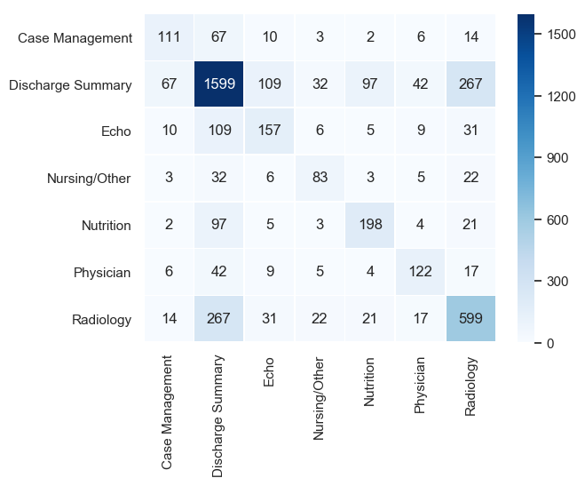
Using shared concepts
Identify concepts shared between doctypes
Compare using nearest neighbor consistency
Use intersection of high-confidence sets from Reference and Comparison as Super High-Confidence set (SHC)
Reference set
Comparison set

Slide 16
Consistency statistics
Reference self-consistency
NN overlap between pairs in the 10 reference replicates
Cross-set consistency
NN overlap between pairs in cross product of reference and comparison replicates
Comparison self-consistency
NN overlap between pairs in the 10 comparison replicates
Consistency deltas
Reference self-consistency minus cross-set consistency

Slide 17
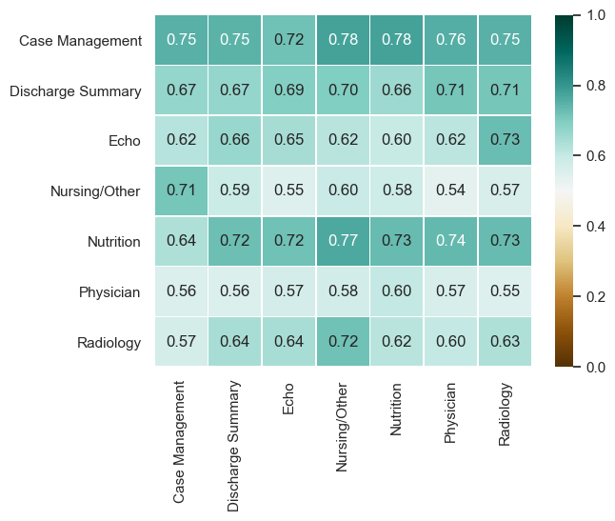
SHC: Self-consistency (symmetric)

Slide 18
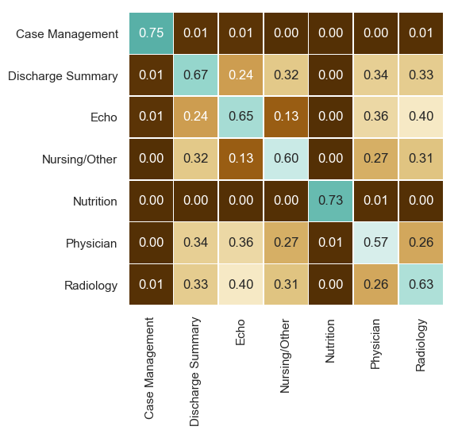
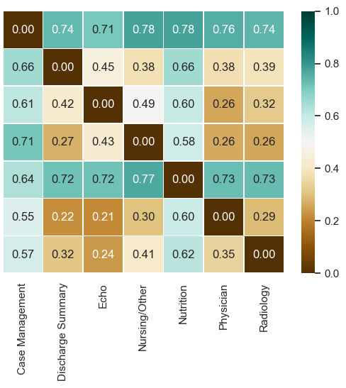
SHC: Cross-set consistency and deltas
Cross-set
Consistency deltas

Slide 19
What does it capture?

Slide 20
We’re hoping for non-spurious correlations
Two questions
Are we capturing clinically relevant differences in concept usage?
What do they reveal about context patterns?

Slide 21
NNs for qualitative review
Calculate qualitative nearest neighbors for a document type:
Get pairwise cosine distances in all 10 replicates
Take 5 neighbors with lowest average distance
Which to review?
Queries: high-confidence concepts
Neighbors: no filtering

Slide 22
Concept neighbors: Diabetes Mellitus (C0011849)
Discharge Summary | Nursing/Other | Radiology
Diabetes (C0011847) | Gestational Diabetes (C0085207) | Poorly controlled (C3853134)
Type 2 (C0441730) | A2 immunologic symbol (C1443036) | Insulin (C0021641)
Type 1 (C0441729) | Diabetes Mellitus, Insulin-Dependent (C0011854) | Diabetes Mellitus, Insulin-Dependent (C0011854)
Gestational Diabetes (C0085207) | Factor V (C0015498) | Diabetes Mellitus, Non-Insulin-Dependent (C0011860)
Diabetes Mellitus, Insulin-Dependent (C0011854) | A1 immunologic symbol (C1443035) | Stage level 5 (C0441777)
Strings: “diabetes mellitus”, “diabetes mellitus dm”

Slide 23
Concept neighbors: Mental state (C0278060)
Discharge Summary | Echo | Radiology
Coherent (C4068804) | Donor [LOINC] (C3263710) | Mental status changes (C0856054)
Confusion (C0009676) | Donor person (C0013018) | Abnormal mental state (C0278061)
Respiratory status [LOINC] (C2598168) | Respiratory arrest (C0162297) | Level of consciousness (C0234425)
Respiratory status (C1998827) | Organ donor [LOINC] (C1716004) | Level of consciousness [LOINC] (C4050479)
Abnormal mental state (C0278061) | Swallowing (C4281783) | Mississippi (C0026221)
Strings: “mental status”, “mental state”

Slide 24
Embeddings pick up template patterns
Mental status in Echo notes
PATIENT/TEST INFORMATION
Indication: Pt presents with reduced mental status
PATIENT/TEST INFORMATION
Indication: Pt presents in vegetative state, consider for organ donation

Slide 25
Surface form neighbors: Blood pressure (C0005823)
Discharge Summary | Nursing/Other | Radiology
Blood pressure | Blood pressure | Blood pressure
Heart rate | Heart rate | Heart rate
Pressure | Rate | Rate
Systolic blood pressure | Exercise | Method
Rate | Stress | Exercise

Slide 26
Surface form neighbors: Community (C0009462)
Discharge Summary | Nutrition | Case Management
Community | Dilute | Substance
Health center | Social work | Monitoring
Acquired | Surgical site | Somewhat
Residence | In situ | Hearing
Nursing facility | Nephritis | Speech

Slide 27
Now what?

Slide 28
Downstream applications
Document/section classification
Build predictive models with high-confidence concepts
Classify document and section types in multi-institution clinical data
Comparing self-reports and expert assessments
Self-reports and clinicians refer to some of the same concepts
Do they use them in different contexts?
Different correlations with other medical concepts?

Slide 29
Thanks!
newman-griffis.1@osu.edu
This research was supported by the Intramural Research Program of the National Institutes of Health and the US Social Security Administration

Slide 30
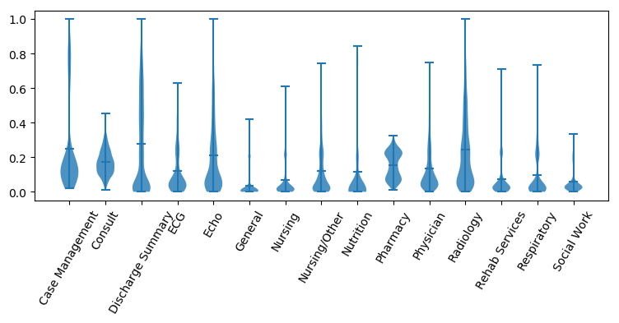
Per-concept confidence distributions

Slide 31
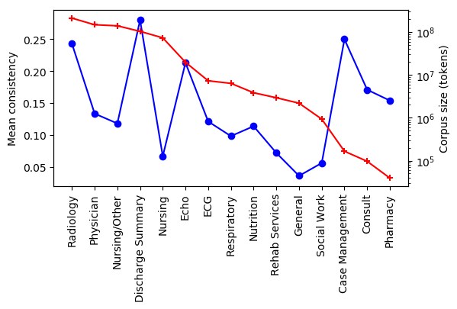
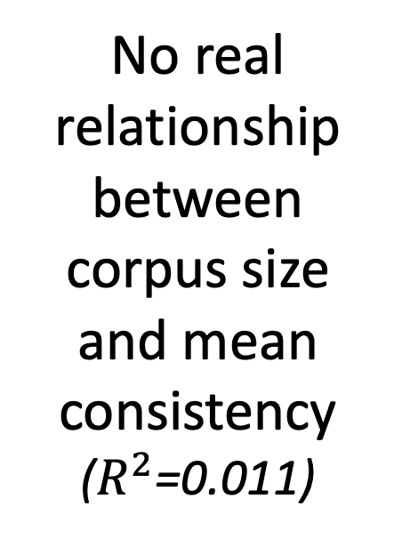
No real relationship between corpus size and mean consistency
($R^{2}$=0.011)

Slide 32
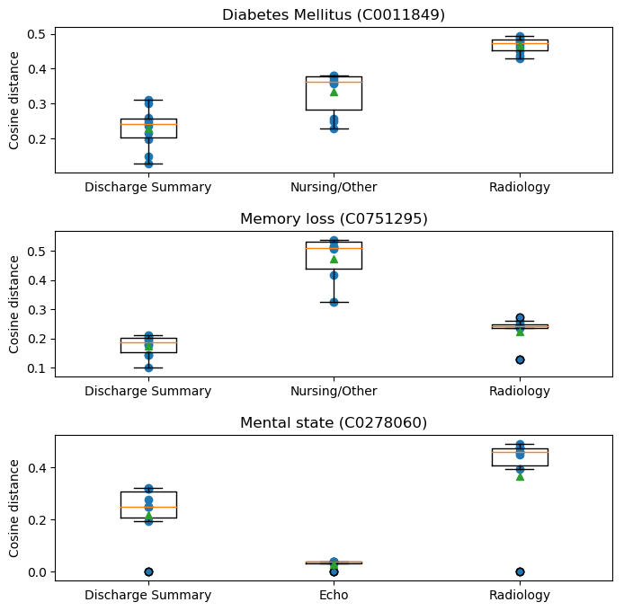
Cosine similarity to nearest neighbors varies widely

