Slide 1



Embedding Transfer for Low-Resource Medical Named Entity Recognition
A Case Study on Patient Mobility
Denis Newman-Griffis^{1,2} and Ayah Zirikly¹
¹ National Institutes of Health, Clinical Center ² The Ohio State University

Slide 2




Motivation: Applying for disability
Wolverine has chronic liver disease, and needs to apply for disability.
Step 1 – Sends application to Social Security Administration (SSA), with
Allegations (liver disease)
Info about work, etc.
Step 2 – SSA collects medical evidence from health providers
Images from openclipart.org

Slide 3
Motivation: Applying for disability
SSA has all necessary information!
BUT
!!
Hundreds of pages of records
Only a small subset are relevant!
(Broad) Research Question
How to effectively identify the relevant subset of documents for the decision?
Images from openclipart.org

Slide 4
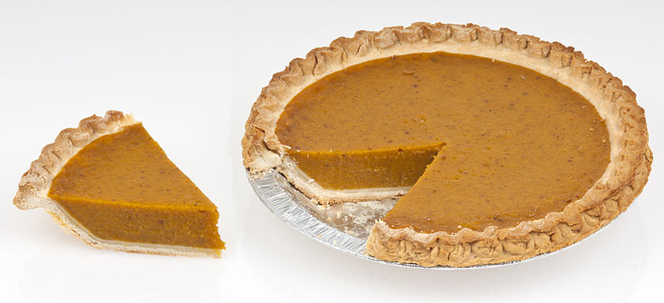
Functioning and Mobility
“Relevant” means describing patient functioning
Describing impact of health conditions
Functioning
Focus on Mobility
One aspect of functioning activity
Correlations with work disability
Describes different kinds of motion (changing position, walking, using transport, etc)
Mobility
Image from https://commons.wikimedia.org/wiki/User:Evan-Amos/Food

Slide 5
Mobility data examples
Example document content:
Observations:
Pt is weight bearing: [she ambulates independently w/o use of assistive device]_{Mobility}. Limited to very brief examination.
Evaluation:
[Scoring: 1=totally dependent, 2=requires assistance, 3=requires appliances, 4=totally independent]_{ScoreDefinition}.
[Ambulation: 4]_{Mobility}
Two kinds of information:
Mobility: descriptions of patient mobility status
ScoreDefinition: scales (with explanation) for measuring mobility
Here: formulate as NER
Task:
Given a new document, find every Mobility and ScoreDefinition description in it.

Slide 6
Annotated data
250 Physical Therapy notes
From NIH Clinical Center
Annotated for Mobility and ScoreDefinition mentions
Randomly split by document into train/dev/test
Entity | Train | Dev | Test
Mobility | 1,533 | 467 | 947
ScoreDefinition | 82 | 24 | 48

Slide 7
Our questions
How well do off-the-shelf neural models for NER work?
Where should we get pretrained embeddings from?
Can domain adaptation (of embeddings) help us use more information?

Slide 8
Model: bLSTM-CRF
CRF decoding
…
bearing
she
[ambulates]
Sequence bLSTM
Character bLSTM
(learned)
Word embeddings
(pretrained)
Pt is weight bearing: she ambulates independently
References: Lample et al. (2016); Dernoncourt et al. (2017)

Slide 9
Data sources
In-domain
Out-of-domain
BTRIS – 155k clinical documents, ~50% rehab medicine
PT-OT – 18k physical and occupational therapy docs
WikiNews – 16 billion miscellaneous documents (Wikipedia, web, news)
Pubmed – 15 million biomedical literature abstracts
MIMIC – 2 million critical care clinical notes
Used word2vec and FastText to learn embeddings

Slide 10
Domain Adaptation methods
Transform high-resource Source embeddings to look like low-resource Target
Simpler
Concatenation – concatenate Source and Target
Preinitialization – retrain Source embeddings on Target documents
Linear transform – learn linear projection f to minimize MSE between f(Source) and Target
Nonlinear transform – learn a deep neural net g to minimize MSE between g(Source) and Target
Complex

Slide 11
PT-OT > WikiNews; = PubMed
CoNLL exact match (Mobility only)
Token-level partial match 15-20% higher

Slide 12
Best Source results from mid-size clinical data (MIMIC)
CoNLL exact match (Mobility only)
Token-level partial match 15-20% higher

Slide 13
Side note: ScoreDefinitions basically solved
Exact match F1 values in low 90s
Token-level F1 above 97%
Evaluation:
[Scoring: 1=totally dependent, 2=requires assistance, 3=requires appliances, 4=totally independent]_{ScoreDefinition}.

Slide 14
Corpus effects
Out-of-domain corpora add symptomatic language, miss relevant language
Pubmed/MIMIC miss words like “fatigue” at end of Mobility mentions
Clinical corpora add things like “and chronic pain”
WikiNews oversensitive to common Mobility words, many irrelevant false positives

Slide 15
Domain adaptation methods vary in effect
Example results from BTRIS FastText -> MIMIC word2vec (Mobility exact match)
Nonlinear transforms give high precision, but drop recall
Preinit/Concat give high recall, but more susceptible to noise

Slide 16
Errors from domain adaptation
Preinitialization leads to long predictions
Gold:
…is healed [she is independent with wheelchair transfer]_{Mobility} and using her shower bench
…[is healed she is independent with wheelchair transfer and using her shower bench]_{Mobility}
Pred:

Slide 17
Errors from domain adaptation
Nonlinear mappings vary in effect
1-layer tanh mapping means fewer predicted entities
Difference disappears with 5-layer mapping
Generally reintroduce several errors of more general terminology (missing fatigue, etc)

Slide 18
NER formulation: square peg in a round hole
i2b2
Pros
Robust models/evaluation to use
Measures capturing exactly the desired text
There has been removal of [a swan-ganz catheter]_{Treatment} and placement of [a right internal jugular vascular catheter]_{Treatment}.
Mobility
Cons
Assumption mismatch with “normal” NER:
Syntactically complex info
Long descriptions
Don’t refer to canonical entities
[Ambulation: 4]_{Mobility}
Observations:
Pt is weight bearing: [she ambulates independently w/o use of assistive device]_{Mobility}. Limited to very brief examination.

Slide 19
Takeaways
Recurrent neural model works surprisingly well on Mobility data!
Evaluation:
[Scoring: 1=totally dependent, 2=requires assistance, 3=requires appliances, 4=totally independent]_{ScoreDefinition}.
[Ambulation: 4]_{Mobility}
Observations:
Pt is weight bearing: [she ambulates independently w/o use of assistive device]_{Mobility}. Limited to very brief examination.
Super low-resource in-domain embeddings match high-resource out-of-domain performance
Embedding adaptation qualitatively improves results, but needs to be combined with model adaptation

Slide 20
Ongoing research support comes from the Intramural Research Program of the National Institutes of Health, Clinical Research Center and through an Inter-Agency Agreement with the US Social Security Administration.
Thank you!
newman-griffis.1@osu.edu
ayah.zirikly@nih.gov
Nonlinear transform code at
https://github.com/drgriffis/NeuralVecmap

