Slide 1

Assessing the Low-Income Housing Tax Credit Using Machine Learning
David Grubman | General Assembly Data Science Spring 2017

Slide 2





Background of the Low-Income Housing Tax Credit
Created in 1986 under President Reagan to further the development of affordable housing (Section 42 of the 1986 Tax Reform Act).
Tax credits are exchanged on an open marketplace.
The allocation of tax credits is handled through each state agency, meaning the state decides which projects will be afforded tax credits.
The program allows for the leverage of private equity in previously underserved areas

Slide 3

38,365
Low-Income Housing Tax Credit Properties placed in service since 1987 scattered nationwide

Slide 4
Criticisms of the Program
Too much power is concentrated at the state agency level.
The developments are contributing to the concentration of poverty.
1.
2.

Slide 5

Question:
Does a LIHTC project have a negative impact on the neighborhood, in terms of income growth?
Can we predict a change in income based on the characteristics of a low-income housing project?

Slide 6
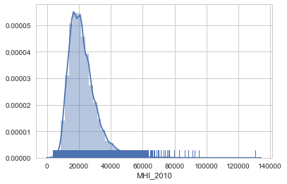
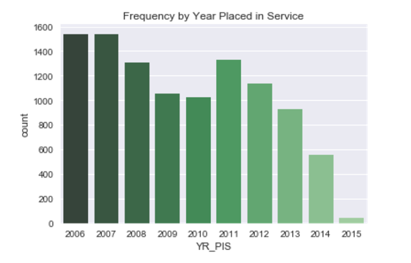
Data and Visualization
Provided by Housing And Urban Development and is geocoded. My subset included only data from 2006-2014, and was about 10,000 properties.
['FID', 'OBJECTID', 'HUD_ID', 'PROJECT', 'PROJ_ADD', 'PROJ_CTY', 'PROJ_ST', 'PROJ_ZIP', 'STATE_ID', 'CONTACT', 'COMPANY', 'CO_ADD', 'CO_CTY', 'CO_ST', 'CO_ZIP', 'CO_TEL', 'ALLOCAMT', 'N_UNITS', 'LI_UNITS', 'N_0BR', 'N_1BR', 'N_2BR', 'N_3BR', 'N_4BR', 'INC_CEIL', 'LOW_CEIL', 'CEILUNIT', 'YR_PIS', 'YR_ALLOC', 'NON_PROF', 'BASIS', 'BOND', 'MFF_RA', 'MFF_RA_ID', 'FMHA_514', 'RDNUM_514', 'FMHA_515', 'RDNUM_515', 'FMHA_538', 'RDNUM_538', 'HOME', 'HOME_AMT', 'HOME_IDISI', 'TCAP', 'TCAP_AMT', 'TCAP_IDISI', 'CDBG', 'CDBG_AMT', 'CDBG_IDISI', 'FHA', 'FHA_NUM', 'HOPEVI', 'HPVI_AMT', 'TCEP', 'TCEP_AMT', 'RENTASSIST', 'TRGT_POP', 'TRGT_FAM', 'TRGT_ELD', 'TRGT_DIS', 'TRGT_HML', 'TRGT_OTHER', 'TRGT_SPC', 'TYPE', 'CREDIT', 'N_UNITSR', 'LI_UNITR', 'DDA', 'QCT', 'NONPROG', 'DATANOTE', 'METRO_TRAC', 'STATE2KX', 'CNTY_NM2KX', 'CNTY2KX', 'TRACT2KX', 'BG2KX', 'BLOCK2KX', 'CURCNTY_NM', 'CURCNTY', 'CURCOSUB', 'CURCOSUB_N', 'PLACE2KX', 'PLACE_NM2K', 'PLACE_CC2K', 'PLACE_INC2', 'MSA_NM', 'CBSA_NM', 'NECTA', 'NECTA_NM', 'METRO', 'MICRO', 'FCD_FIPS91', 'HLC', 'DPV', 'DPVRC', 'STD_ADDR', 'URB_OUT', 'STD_CITY', 'STD_ST', 'STD_ZIP5', 'STD_ZIP9', 'ZIP_CLASS', 'ZCTA2KX', 'DPBC', 'DPBC_CKSUM', 'STD_ZIP11', 'ADDR_TYPE', 'APT_NO', 'APT_TYPE', 'C1PGRC', 'C1PPRB', 'C1PDRC', 'C1PSRC', 'C1PARC', 'C1PRC9', 'MSGUSPS', 'LAT', 'LON', 'RC2KX', 'STM2KX', 'LVL2KX', 'UR', 'MSG2KX', 'COUNTY_LEV', 'PLACE_LEVE', 'TRACT_LEVE', 'BLKGRP_LEV', 'MSA', 'CBSA']

Slide 7
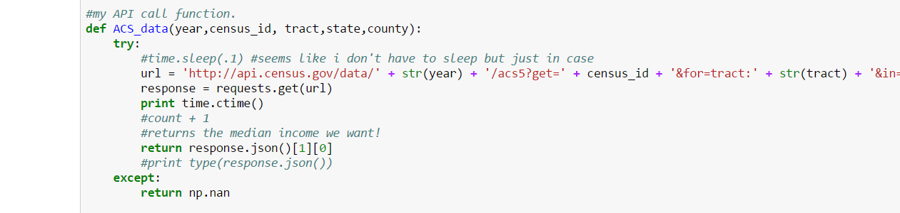
API
American Community Survey 5-Year Estimates are only available at Tract level
Used an API to append Census Data at the Tract Level.

Slide 8
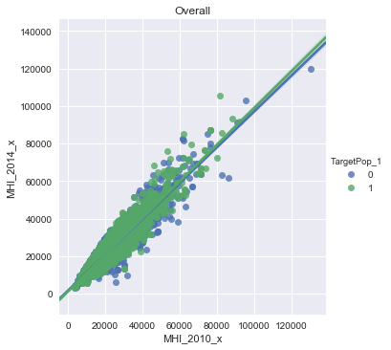
Data and Visualization
Model insight
Comparing 2010 and 2014 income, stratified by Targeted Population

Slide 9
Model Approach
Mine, clean, and visualize data from Housing and Urban Development.
Run and test linear regression model. Substitute variables as necessary.
Run through dummy projects nationwide and by state to interpret results.
Establish question and hypothesis.

Slide 10
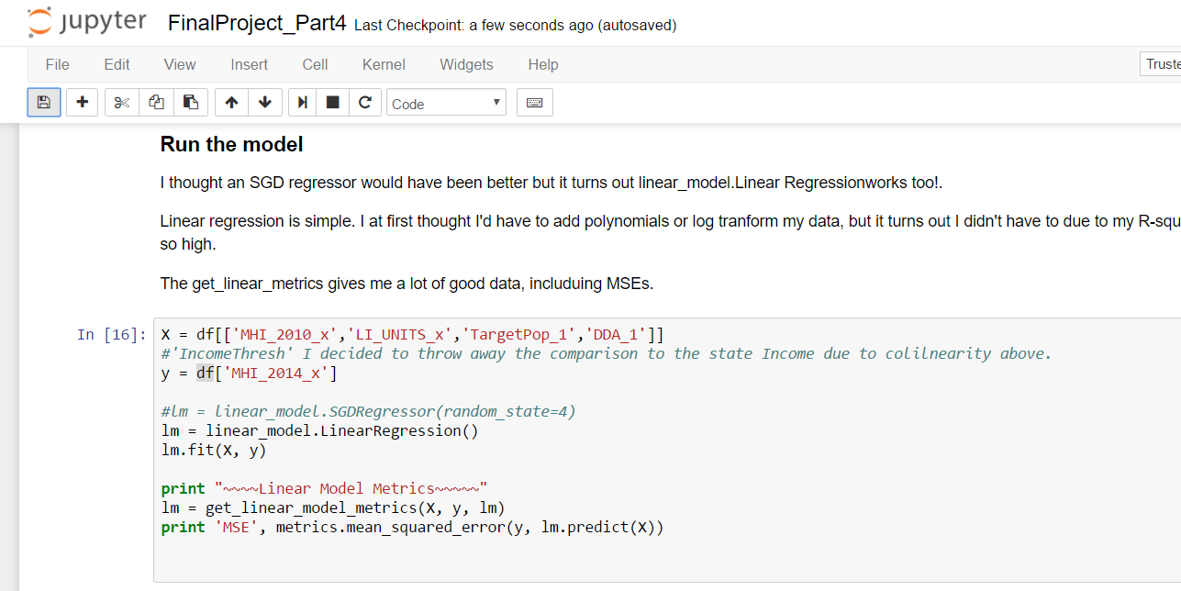
Modeling Approach
Linear Regression in sklearn
Optimize for R-squared
Test for MSE and P-Values
Cross validate with K-folds technique
Attempts at Lasso and Ridge, but not entirely necessary

Slide 11
Model Run and Results
For the nation overall, R-square of 86%
Cross validation produced the same R-Squared
Final Predictor variables:
Income in 2010,
Number of Low-Income Units,
Targeted Population, and
Difficult Development Area
~~~~~Linear Model Metrics~~~~~
P Values: [ 0. 0.40916979 0.05365917 0.20943458]
Coefficients: [ 0.96592574 -1.70825366 57.12010828 -180.70513562]
y-intercept: 1427.14184909
R-Squared: 0.865103832571

Slide 12
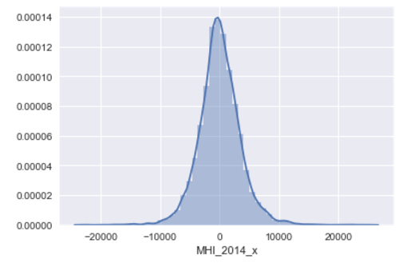
Residuals
Normally distributed residuals for predicted data

Slide 13

Best Variables
The best prediction on income in 2014, is income in 2010. Obvious, yes.
But interesting that a family project and a senior project has a meaningful coefficient….

Slide 14
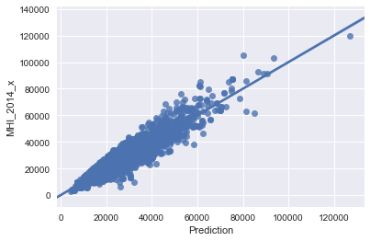
Prediction vs. Actual

Slide 15
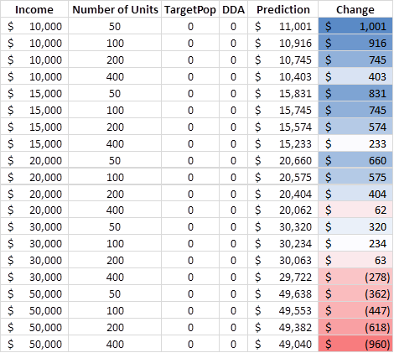
Nationwide Prediction
No Target Population or Difficult Development Area

Slide 16
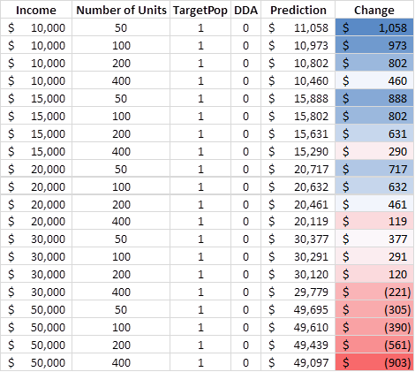
Nationwide Prediction
Targeted Population

Slide 17
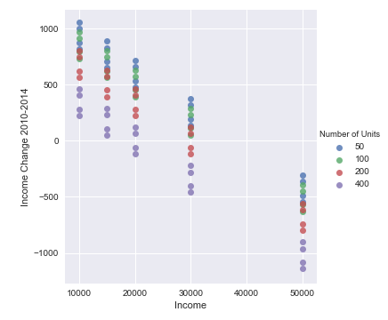
Nationwide Prediction

Slide 18
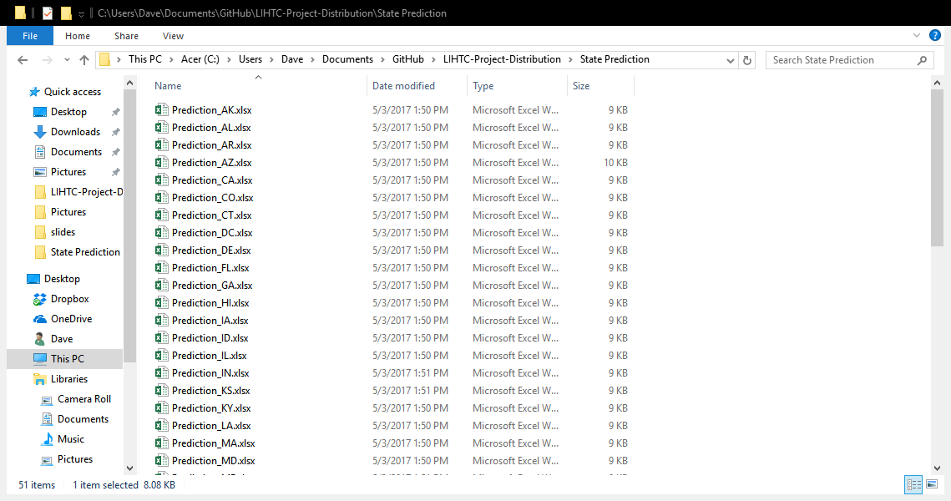
Results by State
~~~~~~RUNNING FOR NY ~~~~~~
<bound method LinearRegression.get_params of LinearRegression(copy_X=True, fit_intercept=True, n_jobs=1, normalize=False)>
[ 0.98125875 -3.00640495 391.27344875 426.05064422]
R-squared 0.8923228691
MSE 14901269.8204
~~~~~~RUNNING FOR NM ~~~~~~
<bound method LinearRegression.get_params of LinearRegression(copy_X=True, fit_intercept=True, n_jobs=1, normalize=False)>
[ 8.30867590e-01 -8.89398920e+00 -3.07435794e+03 0.00000000e+00]
R-squared 0.638055525286
MSE 12835158.2509
~~~~~~RUNNING FOR OH ~~~~~~
<bound method LinearRegression.get_params of LinearRegression(copy_X=True, fit_intercept=True, n_jobs=1, normalize=False)>
[ 0.92278446 -4.79071584 -181.14698245 0. ]
R-squared 0.783105539363
MSE 10128773.8414

Slide 19
Data Considerations
More up-to-date income statistics
Time to test every polynomial or log transformation of the data for the best result
Pull additional data from Census: educational attainment, employment by industry, etc.

Slide 20
Next Steps
Create a web app for planners to test the viability of the proposed development
Understand how to best place low income housing developments and use a tool for advocacy
1.
2.

Slide 21
Credits
HUDUser.org
US Census American Community Survey
Colleagues at Novogradac & Company LLP
General Assembly DC!

Slide 22
Thanks!
Any questions?
You can find me at:
David Grubman | drgrubman@gmail.com

