Slide 1


Slide 2
207731118
314761065
315823245
205799976
211566484
316576230

Slide 3


SAP cloud search engine
Based on google-collab and Firebase DB
Collab notebook
Firebase DB

Slide 4
NFR
Flexibility
Auditability and Control
Response Time
Privacy
Security
Accessibility
Scalability
Backup
Usability

Slide 5









crawler
code
write to
Search data
write to
Index changes and statistics
Updates user history
Indx. table
Index management
search
information
statistics
admin
user
chatbot

Slide 6
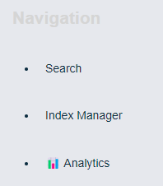
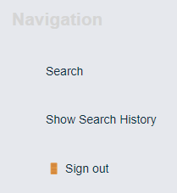
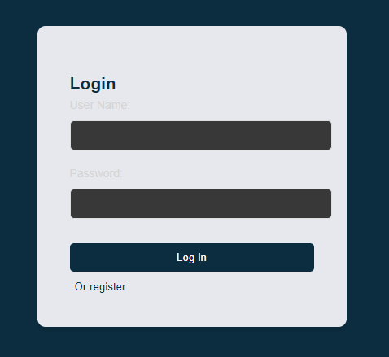
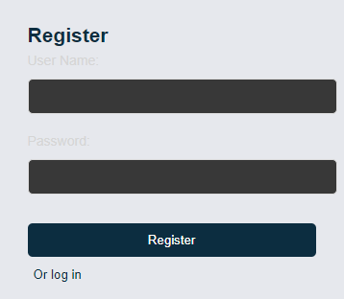
admin
user

Slide 7
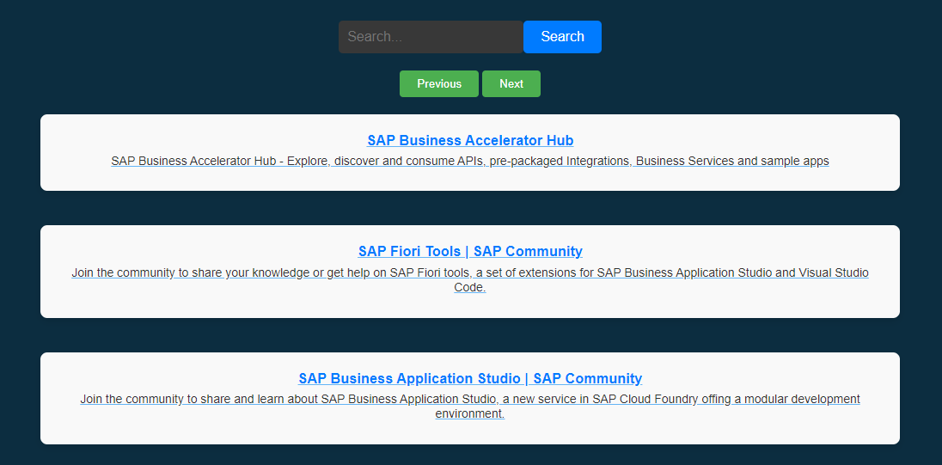

User search

Slide 8
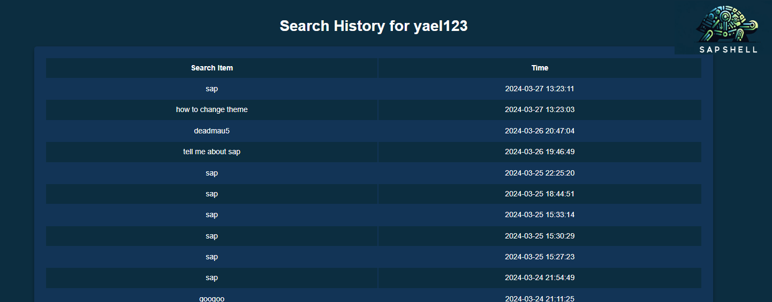
User history

Slide 9
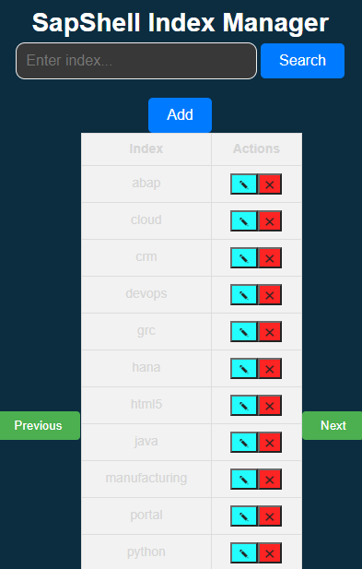
Index Manager

Slide 10
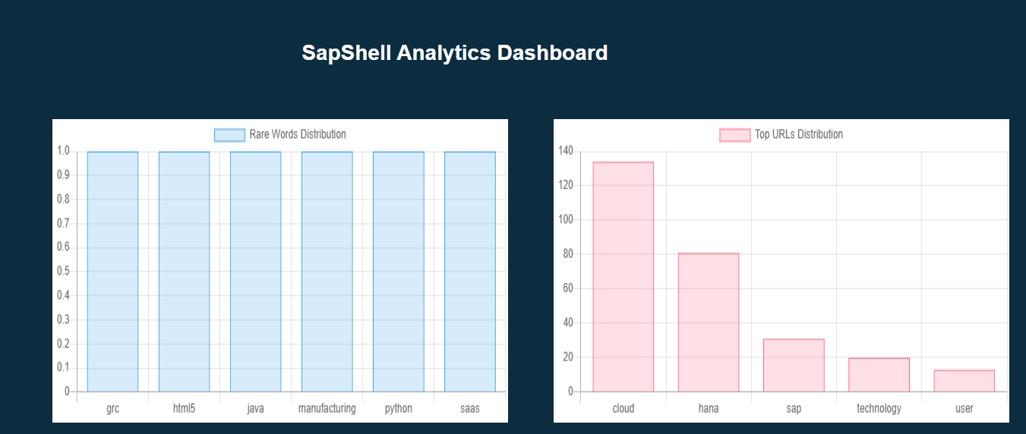
Index Statistics

Slide 11
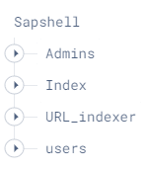

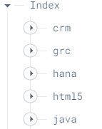
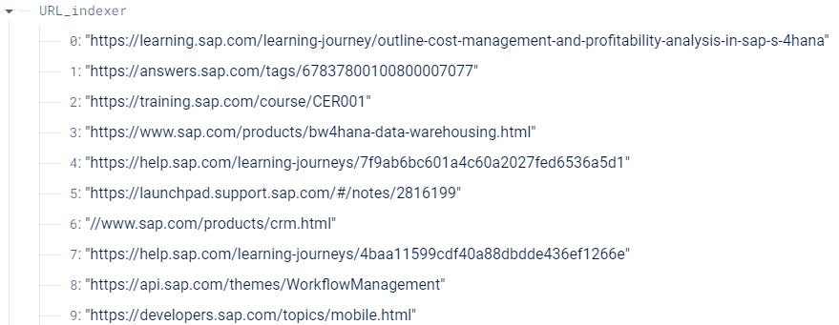
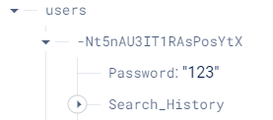
Firebase

Slide 12
Video presentation

