Slide 1



Gender Classification based on X (Twitter) Profile

Slide 2
Introduction
X (formerly known as Twitter) is a popular social networking platform for sharing 280-character messages known as tweets.
X has over 330 million monthly active users, with more than 66% being male and 34% female.
The project aims to classify X users' gender based on profile information and tweets.
Gender classification is valuable for marketing, election prediction, forensics, and cybercrime tracking.
Natural Language Processing (NLP) techniques play a crucial role in understanding user text data.
The project uses machine learning and NLP to train a gender classifier and create a labeled X dataset for research.

Slide 3
Research Objectives
Building a labeled X dataset is the primary research objective.
A Kaggle dataset with around twenty thousand users will be used as a starting point to fetch tweets and create a labeled dataset.
The primary motivation is to apply ML and NLP techniques to classify gender based on text features.
Such research has applications in psychological analysis and marketing.
Analyzing linguistic profiles of anonymous Twitter users is crucial for understanding their background and gender, especially in forensic investigations.
Marketing and recommendation systems benefit from gender classification for targeted advertising.
Detecting and understanding human authors on social media is essential to combat fake news, election manipulation, and bot activity.

Slide 4
Understanding the Dataset
Dataset Statistics:
The dataset is sourced from Kaggle and consists of 20,000 rows.
Each row includes various attributes, such as user name, a random tweet, account profile, image, location, link color, sidebar color, and more.
Key Attributes:
Target Variable "gender": At the heart of our classification task lies the "gender" attribute , with values male, female, or brand for non-human profiles.
This is the variable we aim to predict based on the information provided in the dataset.
Additional Attributes: Beyond gender, our dataset boasts an array of attributes, including user names, random tweets, account details, and more, each offering valuable insights into the Twitter users we're analyzing.

Slide 5
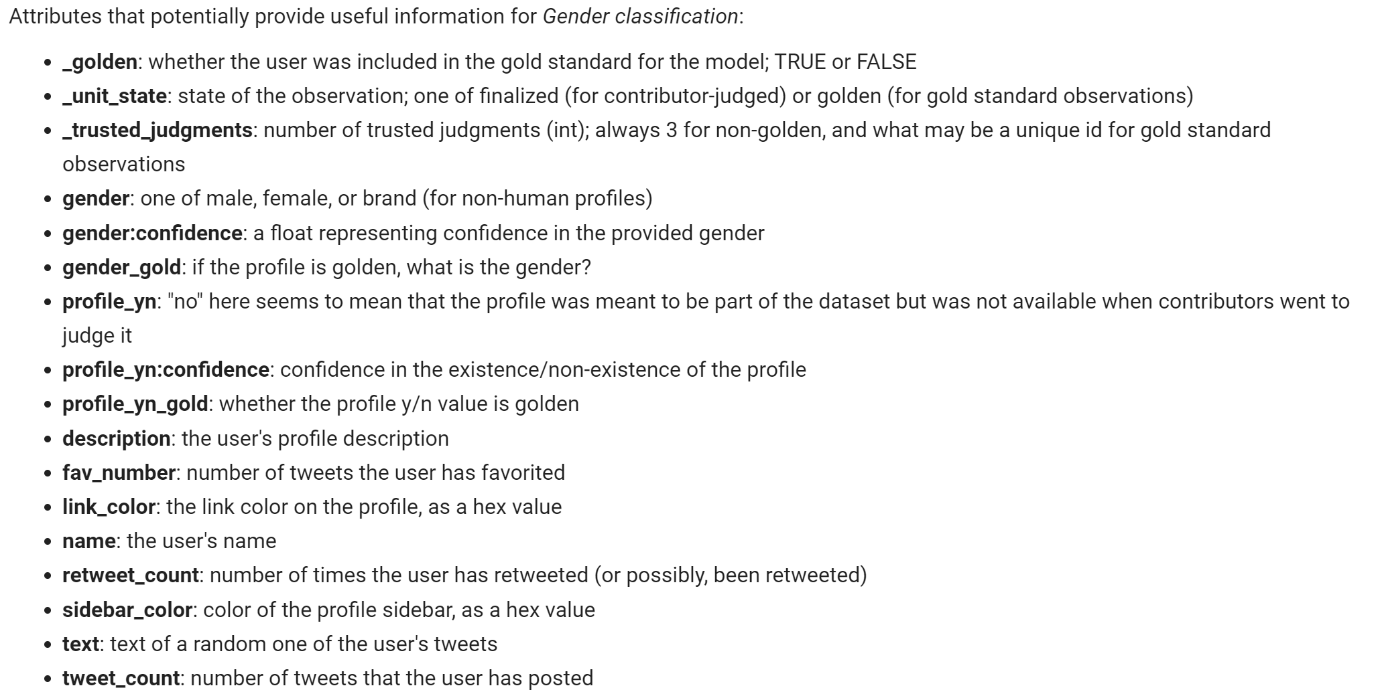
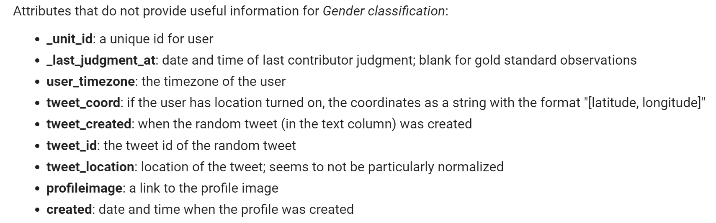

Slide 6
Data Cleaning
Importance of Data Cleaning:
Ensuring Accuracy: Data cleaning is like tidying up a room before decorating it. It ensures that our data is accurate and free from errors, setting the stage for reliable predictions.
Enhancing Model Performance: Clean data leads to robust models. By removing noise and inconsistencies, we're optimizing our models' potential for success.
Specific Data Cleaning Actions:
Irrelevant Columns: We've pruned our dataset by removing columns that don't contribute significantly to our gender classification goal. Attributes like "_unit_id," "user_timezone," and others, which don't hold substantial predictive power, have been gracefully retired.
Handling Missing Values: Missing data can be a stumbling block. We've addressed this by carefully handling missing values, ensuring they don't compromise the integrity of our analysis. For instance, instances with missing gender labels due to "profile_yn == 'no'" were thoughtfully eliminated.
Overview: With our dataset now cleaned and streamlined, we're well-prepared to embark on the journey of exploring, modeling, and predicting Twitter user gender.

Slide 7
Data Visualization
Importance of Data Visualization:
Unveiling Patterns: Data visualization serves as our magnifying glass, revealing hidden patterns, trends, and relationships within the data.
Enhancing Understanding: It goes beyond numbers, making complex information digestible and accessible to all.
Gender Distribution (Pie Chart):
A compelling pie chart showcases the distribution of genders within our dataset. It's a visual testament to the diversity of our Twitter users.
We see the proportions of male, female, and brand profiles, providing a clear snapshot of our data's composition.
Feature vs. Gender (Bar Charts):
Bar charts are our compass for exploring how specific attributes relate to gender.
We've visualized features like 'favorites,' 'retweets,' and 'tweets' to understand their gender-specific characteristics. These charts give us a glimpse of potential patterns.

Slide 8
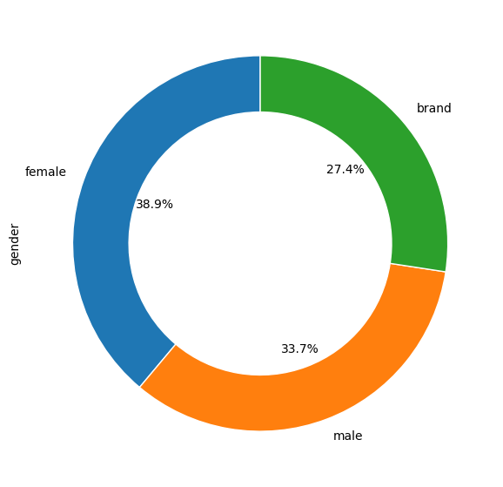
החלוקה של הטוויטים לפי מגדר

Slide 9
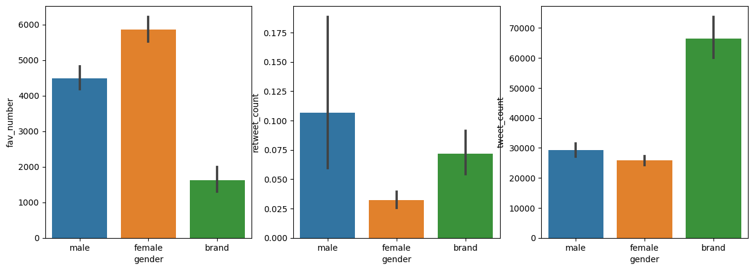
Favorites Lables
Tweets Lables
Retweets Labels

Slide 10
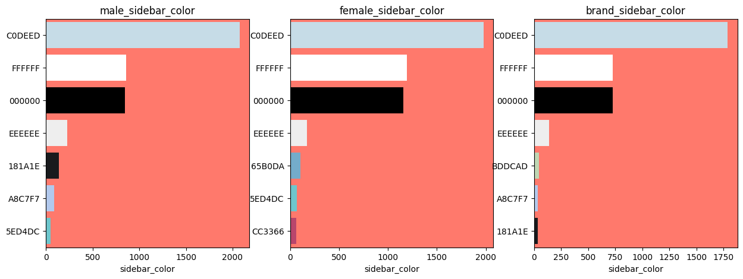

Slide 11
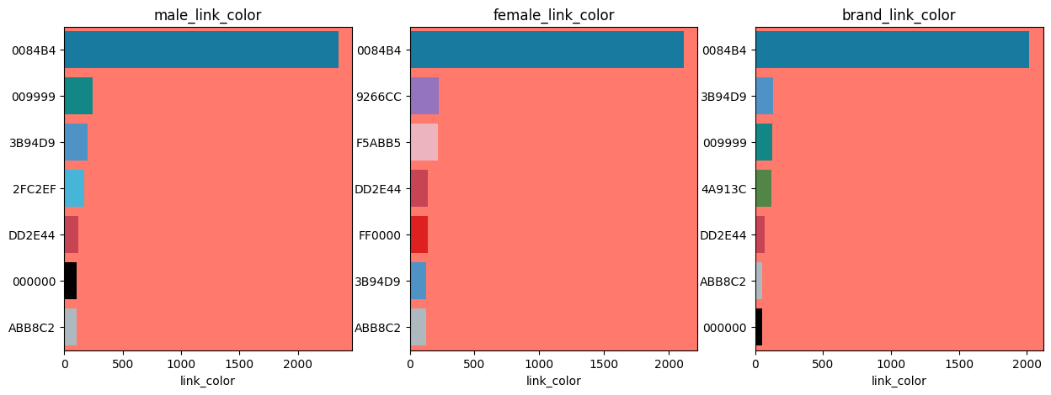

Slide 12
Feature Engineering
Concept of Feature Engineering:
Feature engineering is the process of creating new features or modifying existing ones to enhance the performance of machine learning models.
It's akin to sculpting, where we chisel away to reveal the most informative facets of our data.
Importance: Feature engineering can be the difference between a mediocre model and a top performer.
The "text_description" Feature:
In our project, we've conjured up a new feature called "text_description."
It's a fusion of two crucial pieces of information—tweet text and profile description.
Purpose: This amalgamation aims to capture more comprehensive insights about each Twitter user.
Combining the essence of what users share in their tweets with their profile descriptions enriches our dataset and equips us with a more potent tool for classification.

Slide 13
Handling Categorical Data
Challenges with Categorical Data:
Categorical features represent qualitative variables with no inherent order. They pose unique challenges in machine learning.
Our dataset includes attributes like "link_color" and "sidebar_color," which are prime examples of these categorical variables.
Label Encoding:
Label encoding is our tool of choice to tame categorical data.
It transforms categorical values into numerical format, allowing our machine learning models to process them.
How it Works: Each unique category is assigned a numerical label. For instance, different link colors get mapped to specific numerical values.
Use Case: We've employed label encoding to convert "link_color" and "sidebar_color" into numerical features, rendering them machine-friendly.

Slide 14
Text Data Preprocessing
Importance of Text Data Preprocessing:
Raw text data is often messy and unstructured. Preprocessing transforms it into a clean, organized, and analyzable format.
The significance lies in making the text data machine-readable, extracting meaningful patterns, and enhancing model performance.
Techniques Used:
Cleaning: We start by cleaning the text data, which involves removing HTML markup, URLs, and non-alphanumeric characters. This ensures that the text is free from noise and distractions.
Tokenization: Tokenization is the process of breaking text into individual words or tokens. This step forms the foundation for analyzing and understanding text data.
Stopword Removal: Stopwords are common words like "and," "the," and "is" that don't add significant meaning. Removing them reduces noise and focuses on content-carrying words.

Slide 15
Model Building
Introduction: Model building is where the magic of prediction happens. Let's embark on this pivotal phase.
Concept of Model Building:
Model building involves the creation of predictive algorithms that learn from our dataset to make informed predictions.
Our goal is to harness the power of these models to classify Twitter users' gender.
Our Arsenal of Models:
Logistic Regression: A classic model that works well for binary and multiclass classification. It's simple yet effective.
Random Forest: An ensemble model that combines multiple decision trees to improve accuracy and reduce overfitting.
Support Vector Machine (SVM): A powerful model that finds the best hyperplane to separate data points into different classes.
Complement Naive Bayes: A variation of Naive Bayes designed for imbalanced datasets. It's particularly useful when dealing with skewed class distributions.

Slide 16
Model Evaluation
The Need for Model Evaluation:
Model evaluation is essential to ensure that our predictions are not just guesses but accurate and reliable insights.
Without evaluation, we risk deploying models that may not perform well in real-world scenarios.
Evaluation Metrics:
Accuracy: A fundamental metric that measures the overall correctness of our predictions. It's the ratio of correctly predicted instances to the total instances.
Confusion Matrix: A visual representation that provides deeper insights into our model's performance, showing true positives, true negatives, false positives, and false negatives.
Classification Report: A comprehensive report that includes metrics like precision, recall, F1-score, and support for each class. It offers a more detailed view of our model's performance.

Slide 17
Model Comparison - Tweet-Text Only vs. Concatenating Description to Text vs. Non-Text Features
Tweet-Text Only:
Utilizes TF-IDF transformation on tweet text.
Focuses solely on textual content for classification.
Limited to linguistic patterns within tweets.
Concatenating Description to Text:
Combines tweet text with user descriptions.
Incorporates additional user information.
Enhances feature diversity for classification.
With Non-Text Features:
Includes non-text attributes from the dataset.
Utilizes label encoding for categorical labels.
Incorporates features like link_color and sidebar_color.
Key Differences:
Data Input:
Text-Only: Pure tweet text.
Concatenated: Merged tweet text and user descriptions.
Non-Text: Non-textual features from the dataset.
Information Utilization:
Text-Only: Linguistic patterns within tweets.
Concatenated: User-related information in addition to text.
Non-Text: Additional dataset attributes beyond text.
Model Comparison:
Analyzing the performance and highlighting differences:
Text-Only: Good for linguistic insights, but misses user context.
Concatenated: Captures both text and user information, balanced.
Non-Text: Incorporates diverse attributes but lacks text analysis.
Highlighting Advantages:
Text-Only: Efficient for pure text classification.
Concatenated: Enhanced user context, balanced performance.
Non-Text: Inclusion of various attributes, holistic understanding.
Trade-offs:
Text-Only: May overlook user-related cues.
Concatenated: Increased dimensionality, potential noise.
Non-Text: Ignores linguistic patterns, text context.

Slide 18

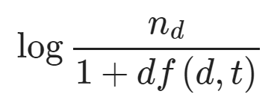
Classification Modeling - With Tweet-text Only
Understanding TF-IDF for Text Classification
Relevance of Words: TF-IDF (Term Frequency-Inverse Document Frequency) helps assess word importance.
Raw Term Frequencies: Initial scoring based on word frequency.
Challenge: Frequent words across all documents may not carry significant information.
Solution: TF-IDF reduces the score for frequently occurring words.
It is calculated like this:
tf(t,d) is the raw term frequency descrived above. idf(t,d) is the inverse document frequency, than can be calculated as follows:

Slide 19
Classification Modeling - With Tweet-text Only
n: Total number of documents (twits).
df(t,d): Number of documents with term t.
Adding 1: Prevents division by zero for terms in all documents.
Logarithm (log): Decreases weight for low-frequency terms.
IDF: Measures a term's importance across the entire corpus.
Weight Interpretation:
Higher TF-IDF weight = Rarer term.
Smaller TF-IDF weight = Common term.

Slide 20
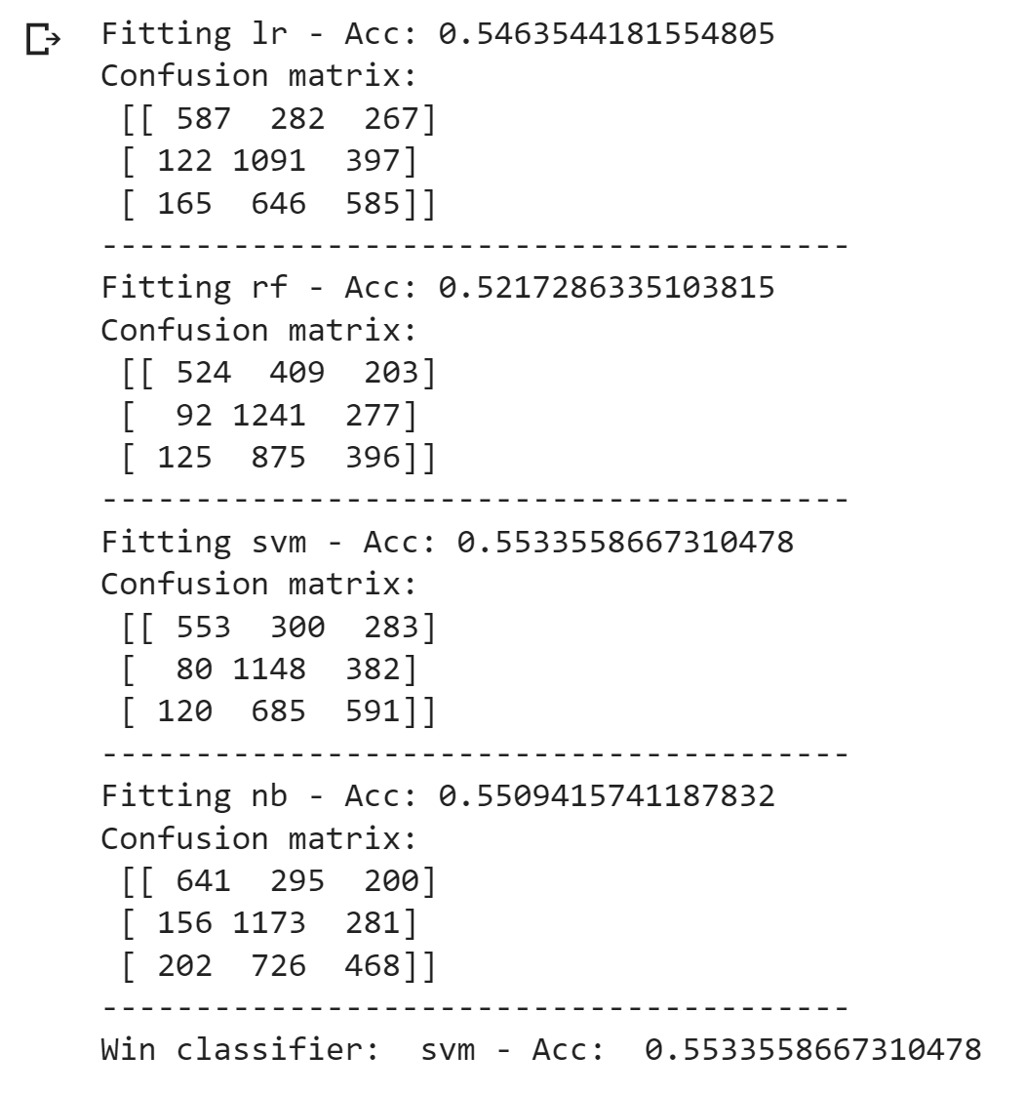

Slide 21
Classification Modeling - Concatenating description to text
Combining Text and Description: We merge tweet text and user descriptions by inserting whitespace between them. This maintains readability, separates content, and enhances feature interpretation.
Recreating Training Dataset: We update the dataset to include the concatenated feature, enriching it with additional user information.
Label Encoding for Categorical Labels: Transforming categorical gender labels into numerical values makes them suitable for machine learning algorithms.
Handling Categorical Features: Using the labelcount_encode method for link_color and sidebar_color assigns numerical values based on category frequency. This enhances feature representation without adding excessive dimensions.

Slide 22
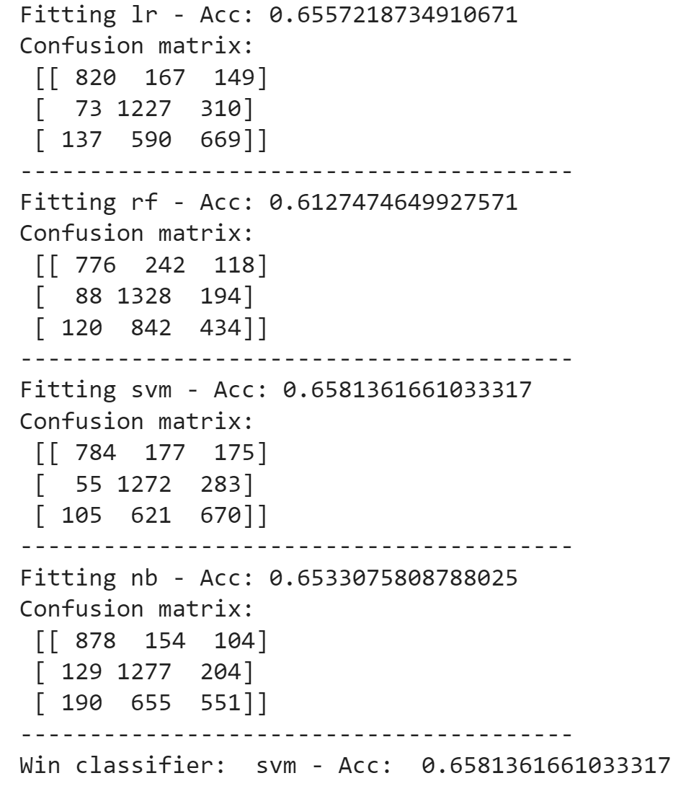

Slide 23
Classification Modeling - With Non-Text Features
Handling Non-Text Features:
In this phase, non-text features from the dataset are utilized in the classification model.
These non-text features provide additional information beyond the tweet text and user descriptions.
Label Encoding for Categorical Labels:
Transforming categorical gender labels (e.g., male, female, other) into numerical values.
Converts gender labels into a format suitable for machine learning algorithms.
Handling Categorical Features (link_color and sidebar_color):
Employing the labelcount_encode method to deal with these categorical features.
Assigning numerical values based on the frequency of each category.
Enhancing feature representation without introducing excessive dimensions.
Ensemble Classifier with Text and Non-Text Features:
Combining models trained with both text and non-text features.
Ensemble classifier leverages the strengths of individual models.
Accuracy Score of Ensemble Classifier:
Presenting the accuracy score achieved by the ensemble classifier.
Discussing the significance of this score in evaluating model performance.
Highlighting the effectiveness of combining text and non-text features for classification.

Slide 24
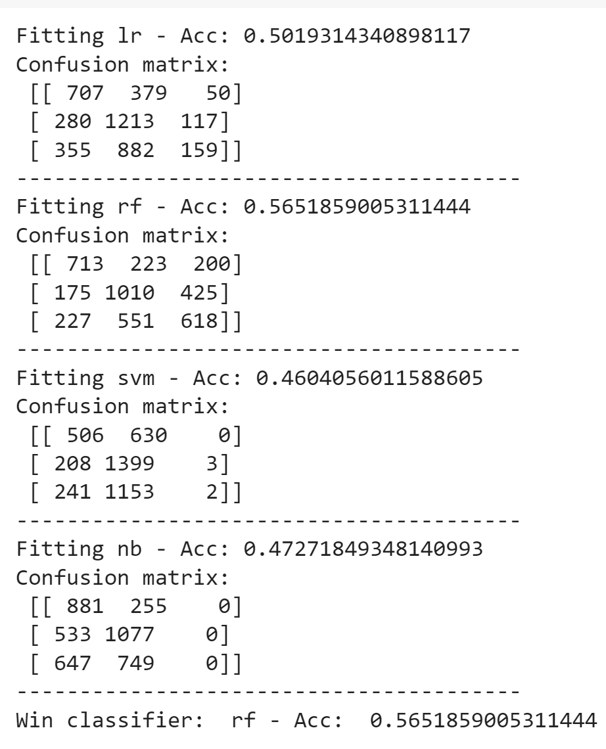

Slide 25
Ensembling: Combining Models for Improved Accuracy
The ensemble technique combines the predictions from different models to enhance overall accuracy.
In this project, we combined models trained on both text and non-text features.
Ensemble with Text and Non-Text Models
We used predictions from models trained on tweet text and non-text features.
Combined predictions with equal weights (0.5 each).
Achieved an ensemble accuracy of approximately 58.64%.
Ensemble with Text Models Only
Experimented with ensemble classifiers for textual data only.
Utilized a combination of Logistic Regression, Complement Naive Bayes, and Support Vector Machine classifiers.
Achieved an ensemble accuracy of approximately 66.27%.
Conclusion:
Ensembling techniques can significantly improve classification accuracy.
Combining models trained on different data sources or using different algorithms can lead to more robust predictions.
Further experimentation and fine-tuning may yield even better results.

Slide 26
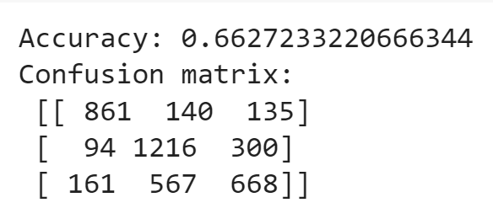

Slide 27
Conclusion
Baseline Model and Interesting Challenges:
We implemented a baseline model for gender classification using a Kaggle dataset.
Gender classification is an intriguing problem, often overshadowed by sentiment analysis.
Tweet Text vs. Description:
Tweet text alone yields moderate accuracy, with room for improvement.
Incorporating user descriptions significantly enhances classifier performance.
Other Features Require Attention:
Models trained on non-text features show limited success, with accuracy near random chance.
Further feature engineering and analysis needed, especially for "link_color" and "sidebar_color."
Ensemble Voting Experiment:
Experimented with majority voting for models trained on tweet text, leading to a slight accuracy boost (0.4%).
Combined models trained with text and non-text data for an ensemble approach.
Achieved an ensemble accuracy of 58.64%.

Slide 28
Future works
Explore advanced natural language processing techniques for better tweet text analysis.
Investigate deep learning models, such as neural networks, to capture complex patterns.
Incorporate additional user-related features like account creation date or follower count.
Conduct sentiment analysis in conjunction with gender classification for richer insights.

