Slide 1
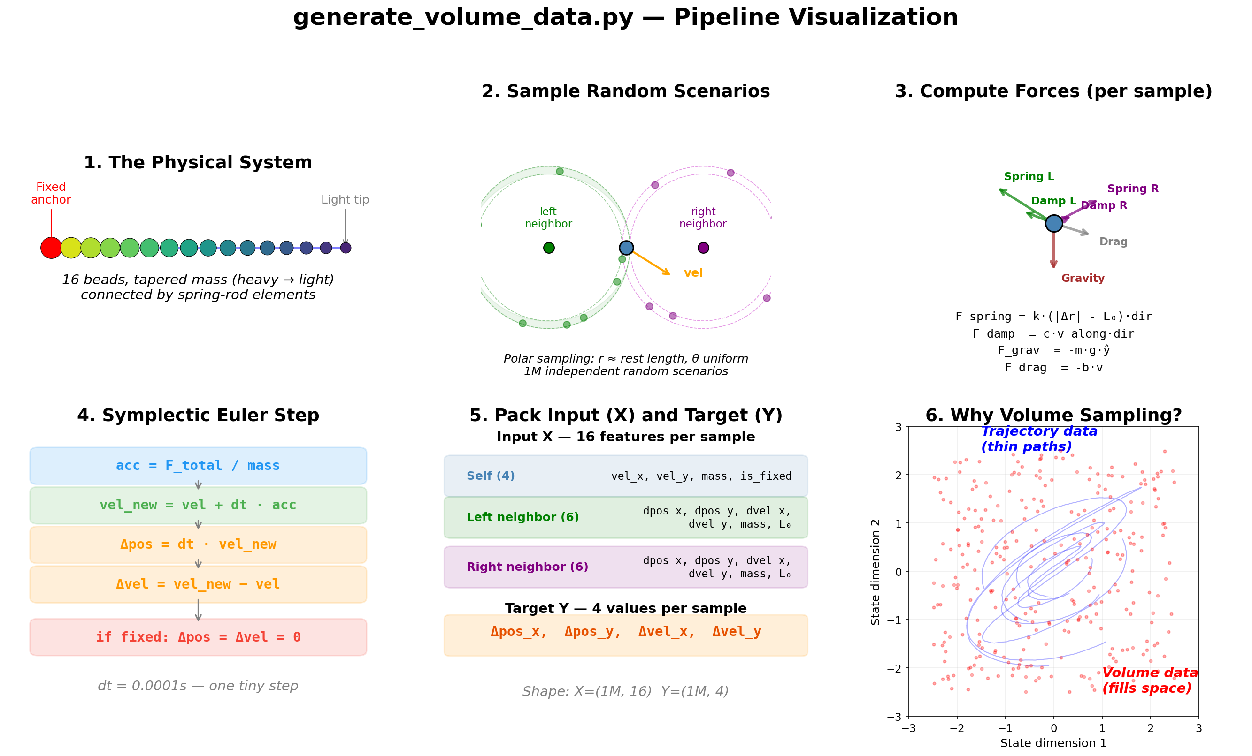
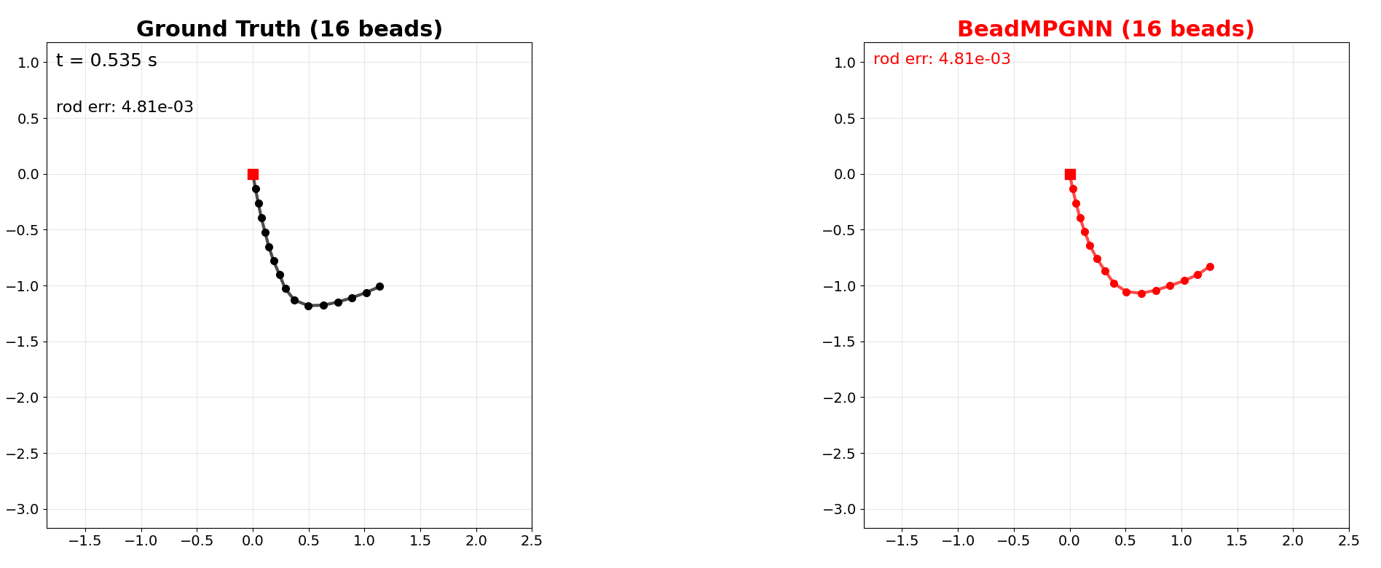
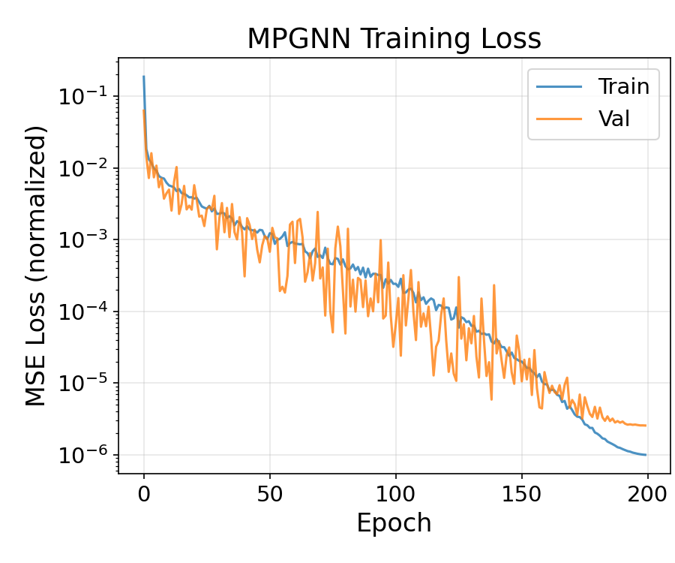
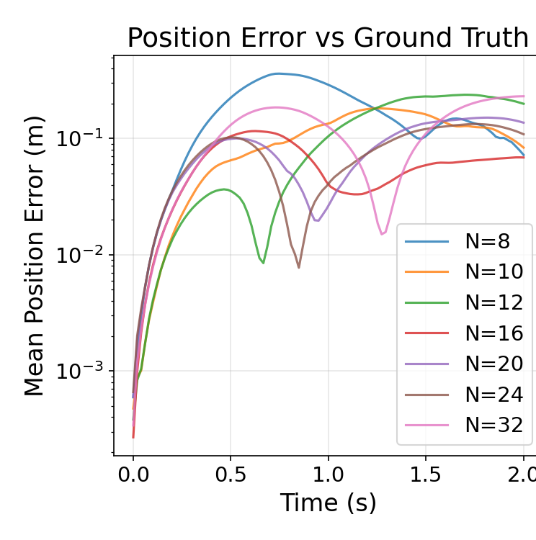
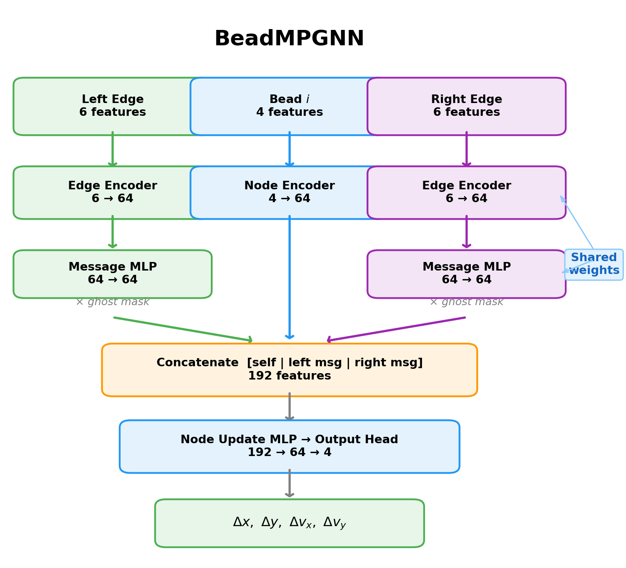
Message-Passing Graph Neural Network as a Surrogate for
Variable-Length 1D Finite Element Bead Chain Simulations
Grey L. Goodwin | Daniel L. Lau, PhD.
Department of Electrical and Computer Engineering · University of Kentucky · grey.goodwin@uky.edu · dllau@uky.edu
Abstract
Volume-Sampled Training Pipeline
Side-by-Side Rollout
We train a message-passing graph neural network (BeadMPGNN) as a per-timestep surrogate for a 1D finite element bead chain. A key finding: even a well-designed model fails without the right training data. Sampling neighbor positions in polar coordinates near the rest length was necessary for stable rollouts, while uniform Cartesian sampling produced models that diverged.
We restructure an initial fixed-size MLP as a true MPGNN with separate node and edge encoders, ghost masking for endpoints, and weight sharing across beads. One trained model runs on chains of any length. Trained on 1M volume-sampled per-bead scenarios spanning 8–32 beads and random tapers, it generalizes to chain lengths, orientations, and velocities unseen during training.
Reference solver (black, left) vs. BeadMPGNN (red, right) on a 16-bead chain released from horizontal. The GNN tracks the reference through fall, swing, and tip whip.
Problem Setup
Training Convergence
• Chain of N mass nodes connected by N−1 spring rod elements.
• Tapered mass distribution from heavy anchor to light tip (ratio r = m₀/m_{N−1}).
• Forces per bead: gravity, Hooke's-law spring forces from each connected neighbor, viscous rod damping, and a small global velocity drag.
• Reference solver uses symplectic Euler integration (Δt = 1e−4 s).
• Physics is strictly local: force on bead i depends only on i and its immediate neighbors i−1, i+1.
Each sample is an independent random bead-level scenario: random N ∈ [8, 32], taper ratio r ∈ [1, 10], polar-sampled neighbors near rest length. Physics solved analytically; no trajectories recorded. Dataset: 1,000,000 samples.
MPGNN Architecture
Why Volume Sampling
Train/validation MSE over 200 epochs. AdamW, lr = 1e−3 with cosine anneal, batch 512, 10% validation split, gradient clipping at norm 1.0.
Five learned components, all weight-shared across beads:
• Node encoder → 64-d hidden from 4-d node features
• Edge encoder → 64-d hidden from 6-d rel. edge features
• Message MLP → per-edge 64-d message
• Node update → [h_self ∥ m_left ∥ m_right] → 64-d
• Output head → 4-d Δstate (Δx, Δy, Δvx, Δvy)
Ghost masking zeros messages from absent endpoint neighbors. 80,324 params; the same model runs on any chain length.
Trajectory-recorded data traces a thin path through state space. During rollout, small prediction errors push the chain off this path into states the model has never seen — errors compound and the simulation diverges.
Volume sampling fills the reachable state space uniformly. Every training sample has a physically realistic rod length (±5% of ℓ₀), so the model learns force magnitudes matched to what it sees at inference.
• Cartesian uniform sampling → stable loss, diverging rollouts
• Polar near rest length → stable, accurate rollouts
Sampling strategy matters as much as architecture.
Generalization Across N
Mean position error vs. reference for N ∈ {8, 10, 12, 16, 20, 24, 32}. Short to medium chains track closely; longer chains show expected drift from compounding per-step errors.
Acknowledgements
Conclusions
This work was supported in part by the National Science Foundation under Grants CCF 2230161 and 2230162, and in part by AFOSR under Grant FA9550-22-1-0362.
• Sampling strategy is as important as architecture. Polar sampling near rest length is required; Cartesian uniform sampling fails.
• MPGNN with weight sharing + ghost masking enables one model across chain lengths.
• Volume sampling covers reachable state space — no trajectory recording needed.
• Model generalizes to unseen N, orientations, and velocities within sampling bounds.
• Future: rollout training to reduce drift; K > 1 message passing for longer-range effects.
ECE Symposium 2026 · Department of Electrical and Computer Engineering · University of Kentucky

