Slide 1
Introduction to SE300
Hao Zhong
Shanghai Jiao Tong University

Slide 2
About Me
Name
Hao Zhong
Email
zhonghao@sjtu.edu.cn
Website
http://www.cs.sjtu.edu.cn/~zhonghao
Experience
PhD, Peking University, 2009
Assistant Professor, IOS, Chinese Academy of Sciences, 2009-2011
Associate Professor, IOS, Chinese Academy of Sciences, 2011-2013
Associate Professor, Shanghai Jiao Tong University, 2013-
Research Interest
Empirical software engineering, program analysis, software maintenance, and mining software engineering data

Slide 3
Textbook
One of the following Software Engineering books
Pressman, “Software Engineering: A Practitioner’s approach”, 7th Edition, McGraw Hill, 2011.
软件工程：实践者的研究方法（原书第7版·本科教学版）作者:（美）普雷斯曼 著，郑人杰 等译出版社:机械工业出版社出版时间:2011年08月
Ian Sommerville, “Software Engineering”, 8th Edition, Addison-Wesley, 2006. (Or 9th Edition, Or 7th Edition)
Pfleeger and Atlee, “Software Engineering: Theory and Practice”, 4th Edition, 2010, Prentice Hall, 2006.

Slide 4
Grading Schema
Exam: 40%

Slide 5
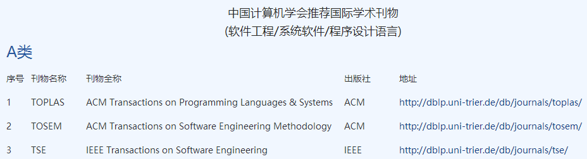
Grading Schema
Exam: 40%
Paper reading 10%
http://www.ccf.org.cn/xspj/rjgc/xtrj/cxsjyy/

Slide 6
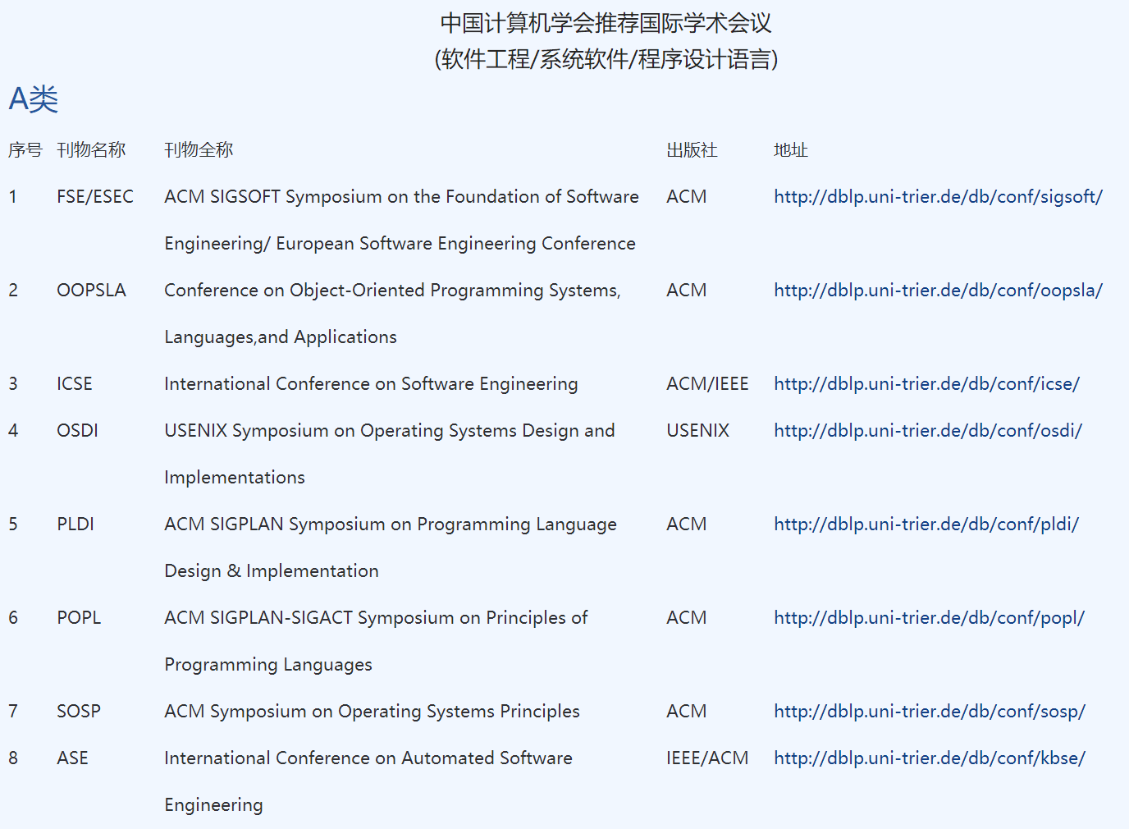
Grading Schema

Slide 7
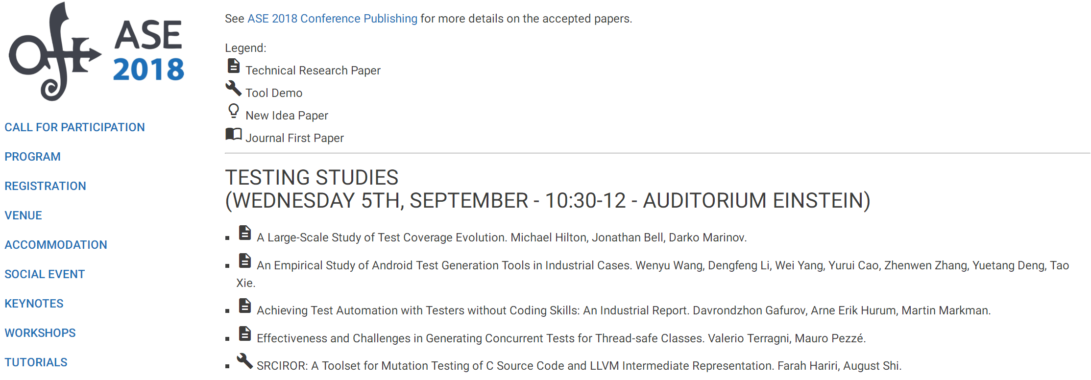
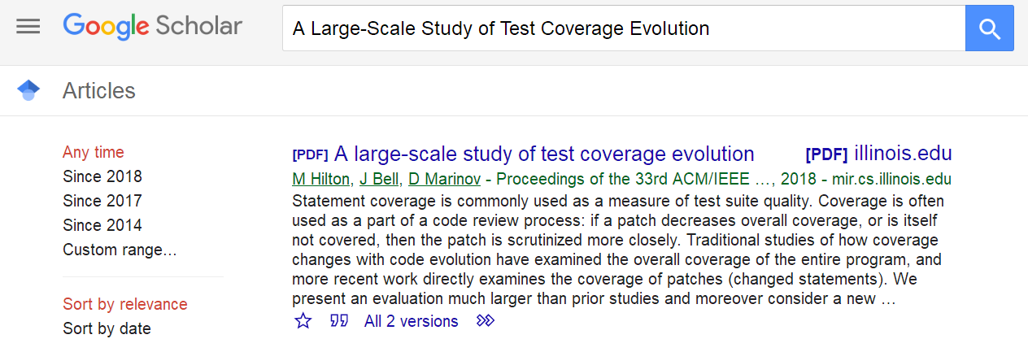
Grading Schema

Slide 8
Grading Schema
Exam: 40%
Paper reading 10%
Project: 50%
Midterm presentation 10%
Final term presentation 10%
Technical report 30%
http://2017.msrconf.org/#/challenge

Slide 9
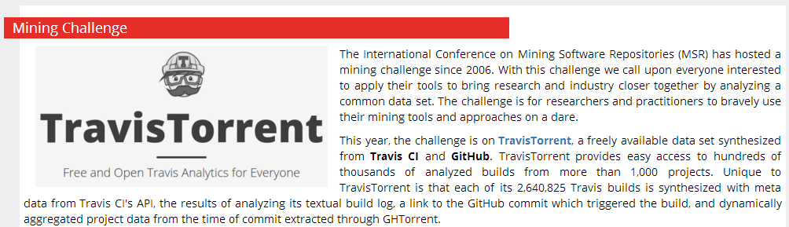
Grading Schema
Exam: 40%
Paper reading 10%
Project: 50%
A research topic on software engineering.
http://2017.msrconf.org/#/challenge

Slide 10





Grading Schema
Exam: 40%
Paper reading 10%
Project: 50%
A research topic on software engineering.

Slide 11
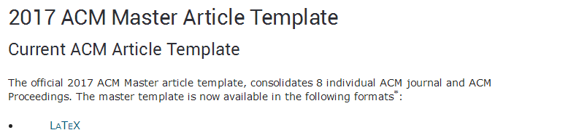
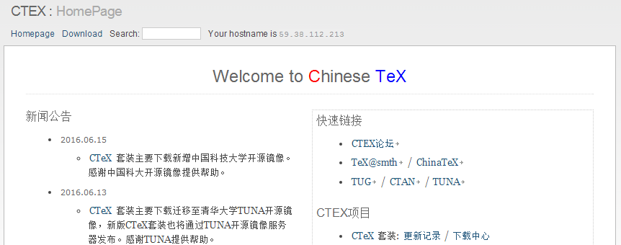
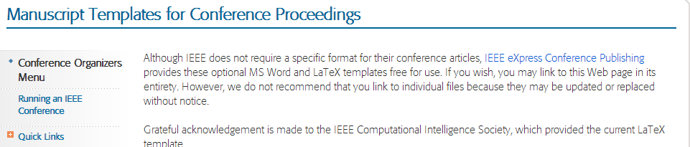
Grading Schema
Exam: 40%
Paper reading 10%
Project: 50%
A research topic on software engineering.
Working towards a published paper.
http://www.acm.org/publications/proceedings-template
http://www.ctex.org/HomePage
https://www.ieee.org/conferences_events/conferences/publishing/templates.html

Slide 12
Grading Schema
Exam: 40%
Paper reading 10%
Project: 50%
A research topic on software engineering.
Working towards a published paper.
Each group consists of no more than four students.
https://github.com/
drhaozhong

Slide 13
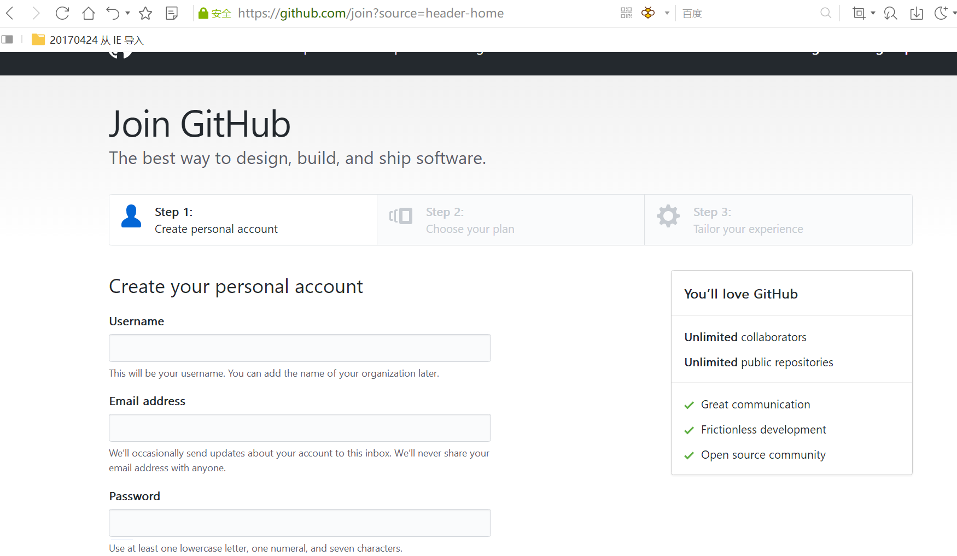
Development Enviroument
Java
https://blog.csdn.net/u012934325/article/details/73441617/
Eclipse
http://www.runoob.com/eclipse/eclipse-install.html
Github
https://blog.csdn.net/earl_yuan/article/details/60476938

Slide 14
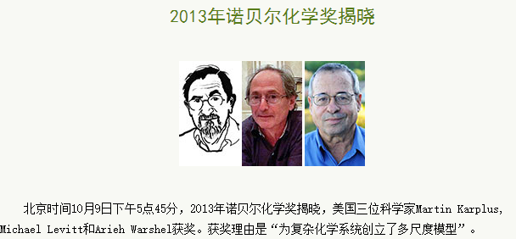
What is science?
数学是火，点亮物理的灯；物理是灯，照亮化学的路；化学是路，通向生物的坑；生物是坑，埋葬学理的人。
数学
物理
化学
生物
Science
Less science
matlab
computer science
math
physics
chemistry
…

Slide 15


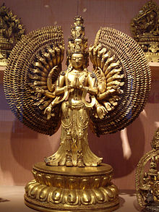
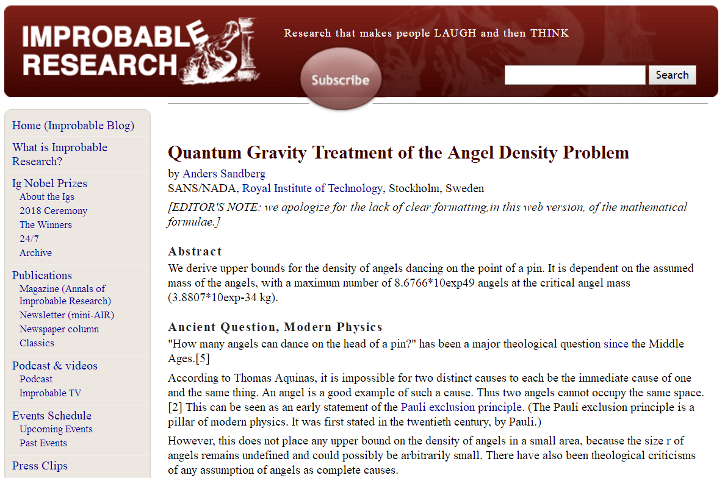
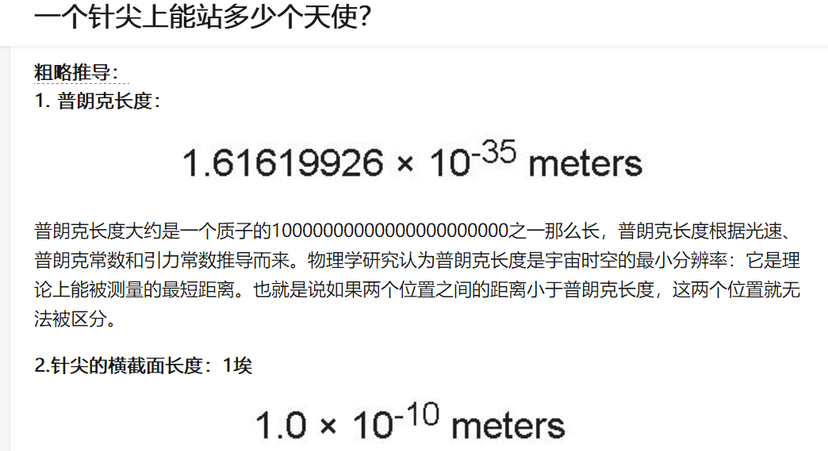
What is science?
Only theory: Science vs divinity
Newton
God
How many angels can dance on the head of a pin?

Slide 16
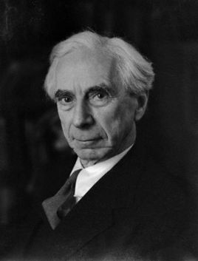
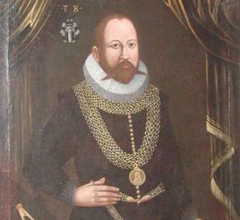

What is science?
Only evidence: too stupid?
Bertrand Arthur William Russell
Tycho Brahe
Johannes Kepler

Slide 17
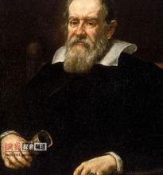
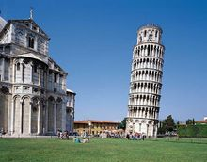



What is science?
Science = Theory + Evidence
Galileo Galilei
Albert Einstein
Experiment
Evidence

Slide 18



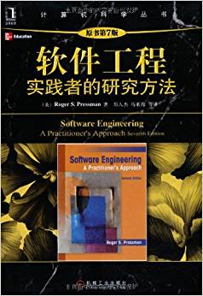
What is science?
Science = Theory + Evidence
Science and less science
Hawking
Empirical software engineering
Program analysis, software maintenance, and mining software engineering data…
Software engineering management
Best practice…

Slide 19
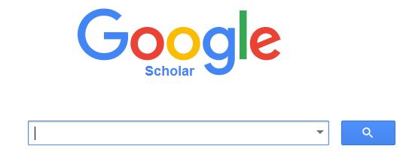
What is research?
Unknown
Engineering
Science
Challenges
Science
Known
Empirical studies
An empirical study on evolution of API documentation Lin Shi, Hao Zhong, Tao Xie, and Mingshu Li In Proc. Fundamental Approaches to Software Engineering (ETAPS/FASE), pages 416-431, 2011.
Detecting API documentation errors Hao Zhong and Zhengdong Su In Proc. Object-Oriented Programming, Systems, Languages & Applications (OOPSLA), pages 803-816, 2013.

Slide 20
The structure of a technical report
Role
Motivation
Related work
Contribution
Technical issues
Evaluation

Slide 21
What is a good research topic?
Novel or significantly better
Available inputs
Benefit (quantity)
Relevant
Implementation effort
…

Slide 22





What is open source
Open-source software (OSS) is computer software with its source code made available with a license in which the copyright holder provides the rights to study, change, and distribute the software to anyone and for any purpose.

Slide 23

Why open source
Individuals
learn about new tools, techniques, skills, etc.
have fun building software
exercise their technical skill
try out new kinds of systems to develop
interconnect multiple FOSSD projects

Slide 24


Why open source
Free Software (GPL)
license
Community versions (Mysql)
Corporate-Sponsored (IBM-Eclipse)

Slide 25
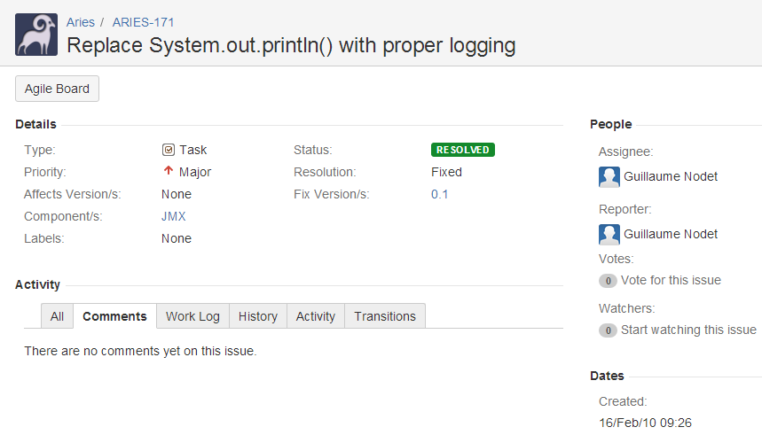
Characteristics
People come and go
Roles, but different from commercial software
No explicit requirements and no design
Refined incrementally
People locate in different places
SVN, GIT (Will introduce later)
Issue tracker

Slide 26
MSR 2017 challenge
This year, the challenge is on TravisTorrent, a freely available data set synthesized from Travis CI and GitHub. TravisTorrent provides easy access to hundreds of thousands of analyzed builds from more than 1,000 projects.
Data format https://travistorrent.testroots.org/page_dataformat/
API https://github.com/travis-ci/travis.rb
Dump https://travistorrent.testroots.org/page_access/
Column | Description
tr_build_id | The analyzed build id, as reported from Travis CI.
tr_job_id | The job id of the build job under analysis.
tr_build_number | The serial build number of the build under analysis for this project.
…

Slide 27
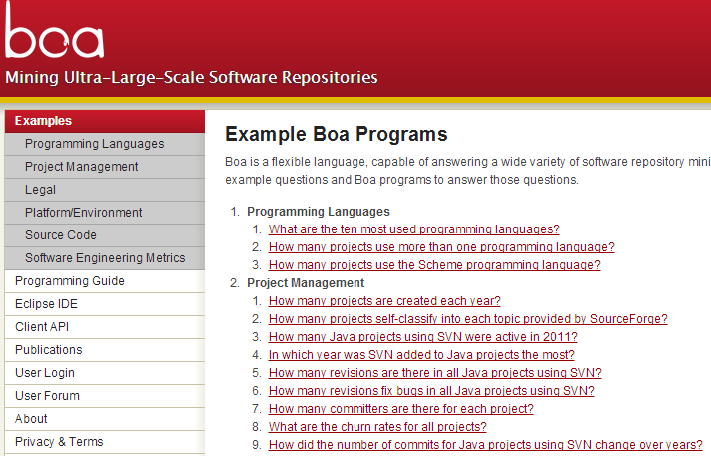
MSR 2016 challenge
We provide the data including the metadata for all projects/repositories and development histories for Java projects/repositories from SourceForge and GitHub up to September 2013.

Slide 28
MSR 2016 challenge
Dyer, Robert, Hridesh Rajan, Hoan Anh Nguyen, and Tien N. Nguyen. "Mining billions of AST nodes to study actual and potential usage of Java language features." In Proc. ICSE, pp. 779-790. 2014.
RQ1: Do Projects Use New Language Features Before Their Release?
RQ2: How Frequently Is Each Language Feature Used?
RQ3: How Did Committers Adopt and Use Language Features?
RQ4: Were There Missed Opportunities to Use Language Features?
RQ5: Was Old Code Converted to Use New Language Features?

Slide 29

MSR 2015 and 2013 challenges
This year's challenge is on comparing and combining different information sources, on theStack Overflow data set.
http://2015.msrconf.org/challenge_data/
http://data.stackexchange.com/ (Latest)

Slide 30
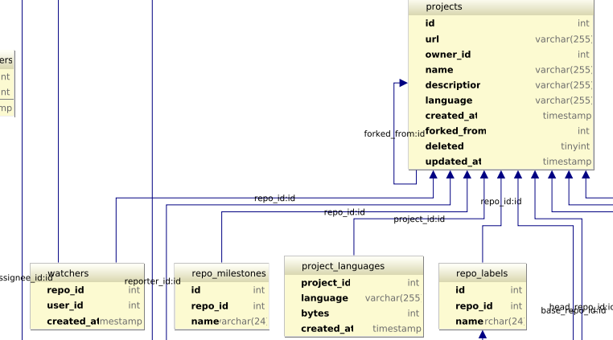
MSR 2014 challenge
This year, the challenge is on the GitHub data. We provide the data for the GitHub repository and you should use your brain, tools, computational power, and magic to uncover interesting findings related to it.
http://www.ghtorrent.org/ (Updated!!!)
http://www.ghtorrent.org/downloads.html

Slide 31
MSR 2012 and 2011 challenges
The focus of the challenge is the Android platform. We provide two sources of data: the Android changes (updated Dec. 6) and Android bug reports (updated Dec. 6).
This year the main theme of the challenge is on comparison of projects. We selected four open source projects, and you should use your brain, tools, computational power, and magic to compare them and uncover interesting similarities and differences. The projects are Eclipse and Netbeans, two popular IDEs written in Java (Group 1) and Firefox and Chrome,
Bug reports
SVN

Slide 32
Other data sources
FLOSSmole
http://flossmole.org/
PROMISE
http://openscience.us/repo/
Software-artifact Infrastructure Repository
http://sir.unl.edu/portal/index.php
Socorro
https://wiki.mozilla.org/Socorro
Mame (requirements)
http://softwareprocess.es/static/What's_in_a_Name.html
SeCold
https://sites.google.com/site/asegsecold/

Slide 33
Mining software engineering data
Tao Xie, UIUC
Software Mining and Software Datasets. Invited Tutorial. 2015 NSF Interdisciplinary Workshop on Statistical NLP and Software Engineering, Seattle, WA, October 2015. [Slides]
Towards Mining Software Repositories Research that Matters. Next Generation of Mining Software Repositories '14 (Pre-FSE 2014 Event), November 2014. [Slides]
Improving Software Reliability via Mining Software Engineering Data. Invited Talk, the Computer Science Department, Missouri University of Science and Technology, Rolla, Missouri, IEEE Computer Society Distinguished Visitors Program, April 2013. [Slides]
…

Slide 34
Code analysis
Compiler
Partial program analysis
More advanced analysis

Slide 35
Java model
Eclipse JDT
An open source compiler that is integrated with Eclipse
APIs to access, create, and manipulate Java projects’ source code

Slide 36
How do we use Java model?
https://www.programcreek.com/2011/01/best-java-development-tooling-jdt-and-astparser-tutorials/

Slide 37
Create New Java Elements

Slide 38
Abstract syntax tree
More details: http://www.vogella.com/tutorials/EclipseJDT/article.html

Slide 39
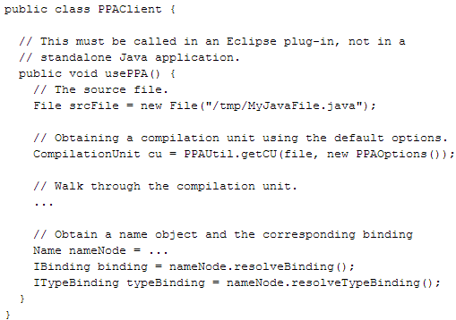
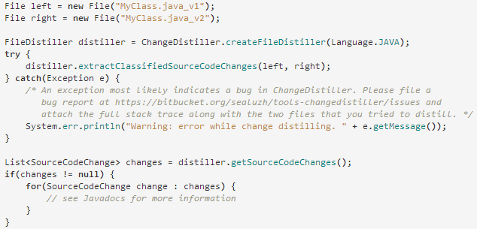
Partial program analysis
A partial program is a subset of a complete program.
PPA
http://www.sable.mcgill.ca/ppa/ppa_eclipse.html
Changedistiller
http://www.ifi.uzh.ch/en/seal/research/tools/changeDistiller.html

Slide 40
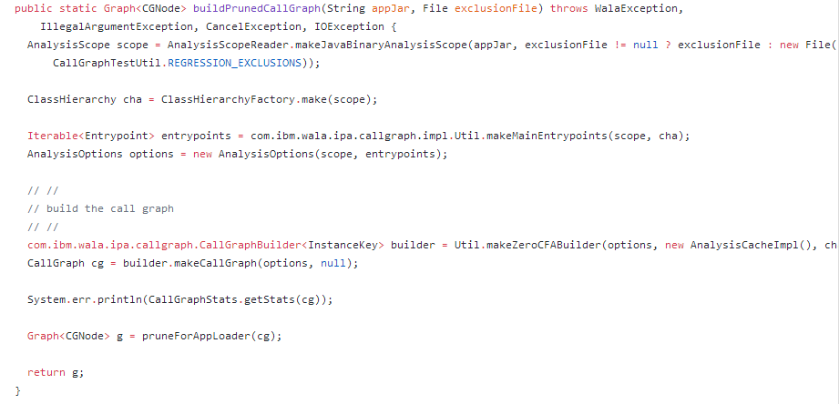
More advanced analysis
WALA
http://wala.sourceforge.net/wiki/index.php/Main_Page
Soot
https://sable.github.io/soot/

Slide 41
What is Software (engineering)?
Software is a collection of artifacts
Computer programs
Data
Documents
Characteristics of software
Software is complex
Software evolves
Software engineering is the establishment and use of sound engineering principles in order to obtain economically software that is reliable and works efficiently on real machines
by Prof. Fritz Bauer at the 1968 NATO conference on software technology, in Garmisch, Germany.
In short, software engineering is about developing quality software in a productive way.

Slide 42
Software Process Models
Requirements
engineering
Design
Implementation
Integration
The waterfall model

Slide 43
Software Process Models
Requirements
engineering
Design + build
prototype
Validate
prototype
Formalize
requirements
Design and
implementation
Integration
UTSA CS5103
The prototype model

Slide 44
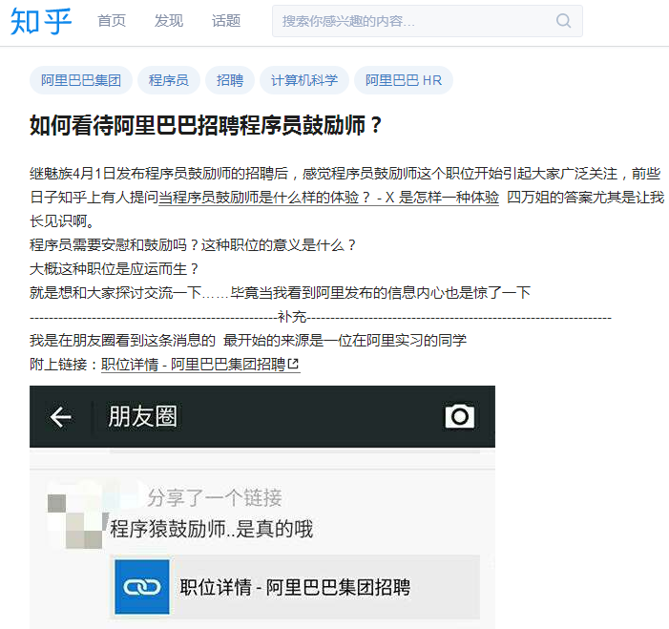
Roles
Domain expert
Architecture
Designer
Programmer
Quality engineer
Team manager

Slide 45
This class
Introduction
Science and research
Open source
Software engineering data
Code analysis
Compiler
Partial program analysis
WALA, SOOT

Slide 46

Next class
Domain Expert

