Slide 1
Welcome to CS250 Software Engineering
Hao Zhong
Shanghai Jiao Tong University

Slide 2
About Me
Hao Zhong
Email
zhonghao@sjtu.edu.cn
Website
http://www.cs.sjtu.edu.cn/~zhonghao
Research Interest
Empirical software engineering, program analysis, software maintenance, and mining software engineering data
Service PC
AAAI 2021
ICSE 2016 SEIP, ICSE 2020, ICSE 2020 doctor symposium
ESEC/FSE 2020
OOPSLA 2017
ASE 2018, ASE 2019 journal first track
ICSME 2017, ICSME 2018, ICSME 2019
MSR 2019, MSR 2020
COMPSAC 2018, COMPSAC2019,TASE 2015.

Slide 3
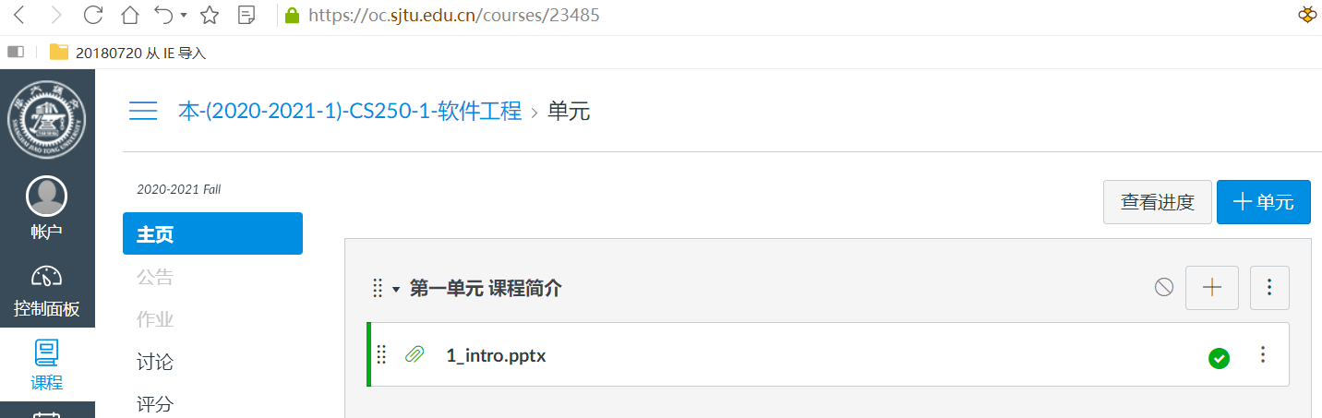
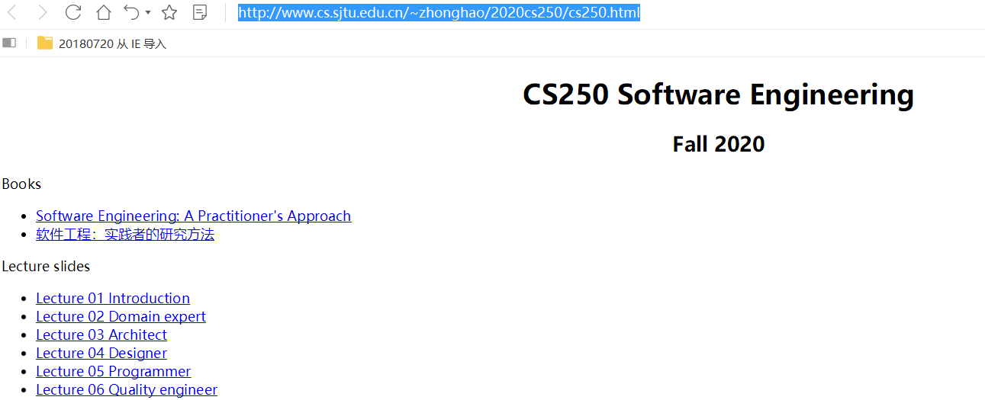
Website
https://oc.sjtu.edu.cn/courses/23485
http://www.cs.sjtu.edu.cn/~zhonghao/2020cs250/cs250.html

Slide 4
Textbook
One of the following Software Engineering books
Pressman, “Software Engineering: A Practitioner’s approach”, 7th Edition, McGraw Hill, 2011.
软件工程：实践者的研究方法（原书第7版·本科教学版）作者:（美）普雷斯曼 著，郑人杰 等译出版社:机械工业出版社出版时间:2011年08月
Ian Sommerville, “Software Engineering”, 8th Edition, Addison-Wesley, 2006. (Or 9th Edition, Or 7th Edition)
Pfleeger and Atlee, “Software Engineering: Theory and Practice”, 4th Edition, 2010, Prentice Hall, 2006.

Slide 5
Grading Schema
Exam: 50%

Slide 6
Grading Schema
Exam: 50%
Presentation 10%

Slide 7
Grading Schema
Exam: 50%
Presentation 10%
Project: 50%
Midterm presentation 10%
Final term presentation 10%
Technical report 30%

Slide 8
Empirical study
Purpose:
To deepen the knowledge
To explore new research directions
Methodology
How to do the analysis?
Automate, manual, semi-automate
Finding
New knowledge
New insights
Journals and conferences
Empirical software engineering, TSE, TOSEM, JSS…
ICSE, FSE, ASE, ESEM, MSR…

Slide 9
Approach/Tool
Purpose
New algorithms, new models, new problems
Better treatments, better variables
Methodology
inputs & outputs
technical details
Evaluation/Experiment
Feasibility/Effectiveness
Improvements
Journals and conferences
All

Slide 10
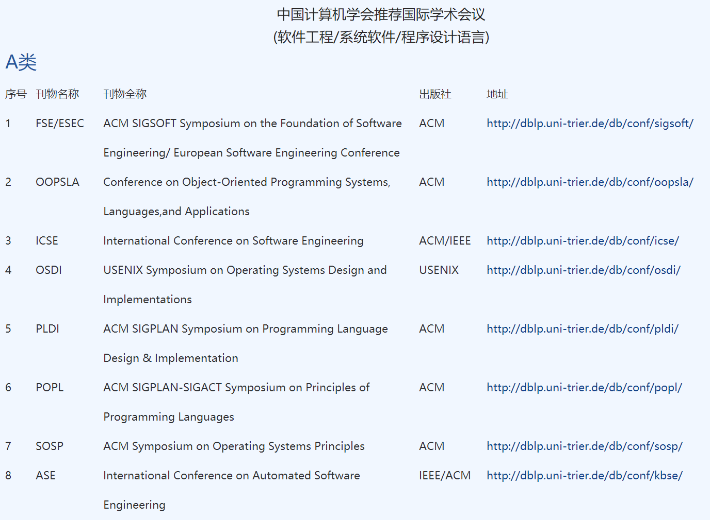
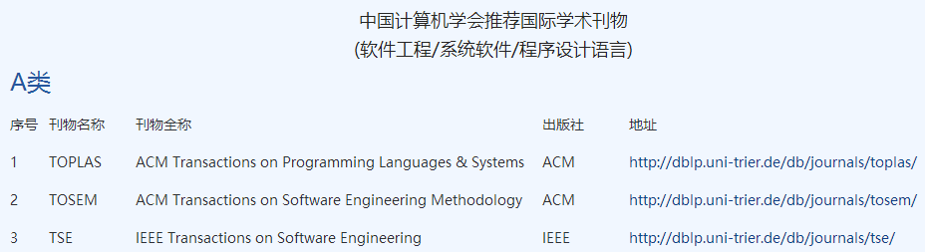
Journals and conferences

Slide 11





Dataset
Open-source software (OSS) is computer software with its source code made available with a license in which the copyright holder provides the rights to study, change, and distribute the software to anyone and for any purpose.

Slide 12
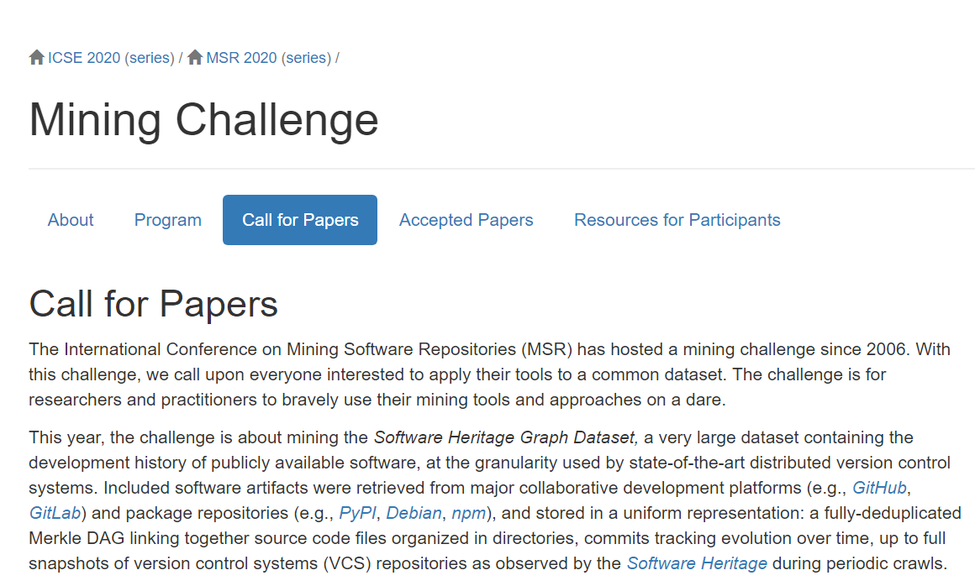
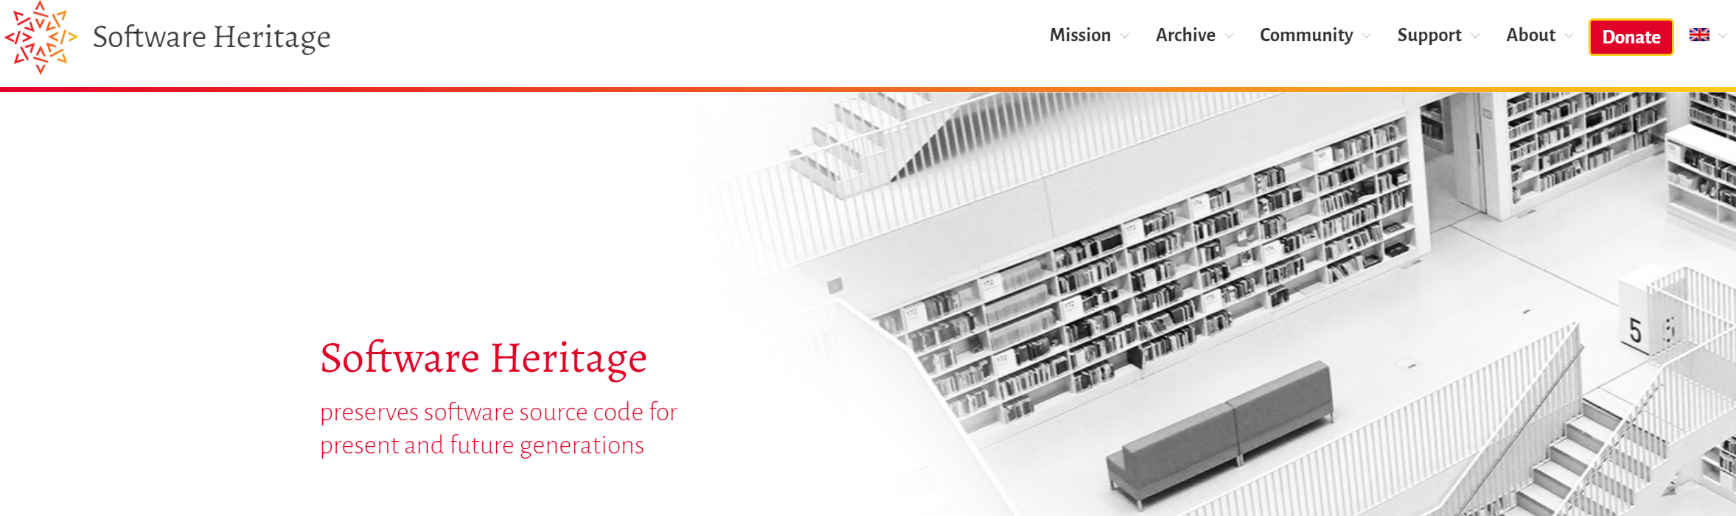
Dataset MSR 2020 challenge
https://2020.msrconf.org/track/msr-2020-mining-challenge
https://www.softwareheritage.org/

Slide 13
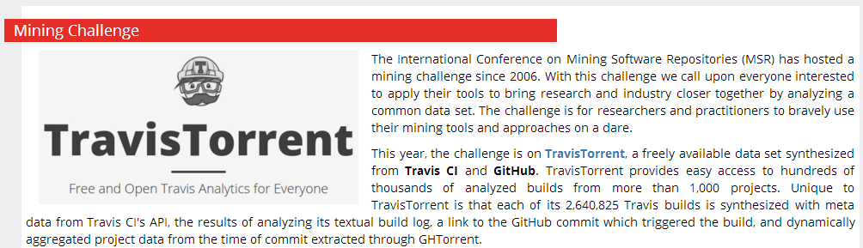
Dataset MSR 2017 challenge
http://2017.msrconf.org/#/challenge

Slide 14
Dataset MSR 2017 challenge
This year, the challenge is on TravisTorrent, a freely available data set synthesized from Travis CI and GitHub. TravisTorrent provides easy access to hundreds of thousands of analyzed builds from more than 1,000 projects.
Data format https://travistorrent.testroots.org/page_dataformat/
API https://github.com/travis-ci/travis.rb
Dump https://travistorrent.testroots.org/page_access/
Column | Description
tr_build_id | The analyzed build id, as reported from Travis CI.
tr_job_id | The job id of the build job under analysis.
tr_build_number | The serial build number of the build under analysis for this project.
…

Slide 15
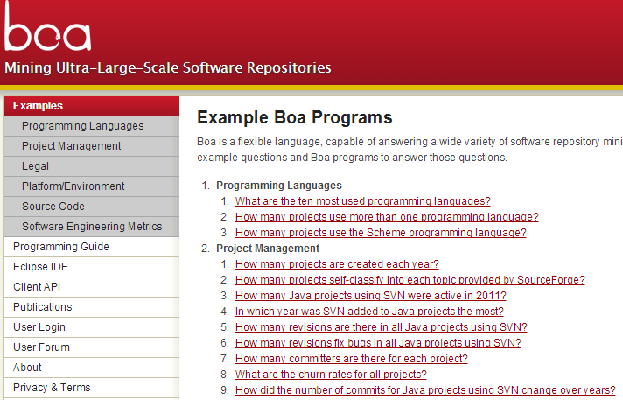
Dataset MSR 2016 challenge
We provide the data including the metadata for all projects/repositories and development histories for Java projects/repositories from SourceForge and GitHub up to September 2013.

Slide 16
Dataset MSR 2016 challenge
Dyer, Robert, Hridesh Rajan, Hoan Anh Nguyen, and Tien N. Nguyen. "Mining billions of AST nodes to study actual and potential usage of Java language features." In Proc. ICSE, pp. 779-790. 2014.
RQ1: Do Projects Use New Language Features Before Their Release?
RQ2: How Frequently Is Each Language Feature Used?
RQ3: How Did Committers Adopt and Use Language Features?
RQ4: Were There Missed Opportunities to Use Language Features?
RQ5: Was Old Code Converted to Use New Language Features?

Slide 17

Dataset MSR 2015/2013 challenges
This year's challenge is on comparing and combining different information sources, on theStack Overflow data set.
http://2015.msrconf.org/challenge_data/
http://data.stackexchange.com/ (Latest)

Slide 18
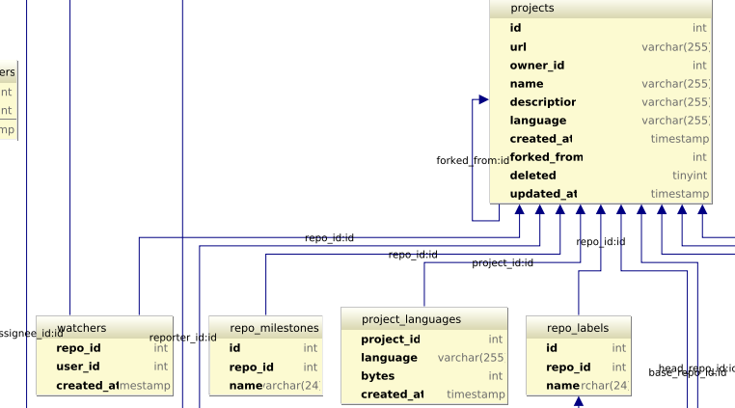
Dataset MSR 2014 challenge
This year, the challenge is on the GitHub data. We provide the data for the GitHub repository and you should use your brain, tools, computational power, and magic to uncover interesting findings related to it.
http://www.ghtorrent.org/ (Updated!!!)
http://www.ghtorrent.org/downloads.html

Slide 19
Dataset MSR 2012/2011 challenges
The focus of the challenge is the Android platform. We provide two sources of data: the Android changes (updated Dec. 6) and Android bug reports (updated Dec. 6).
This year the main theme of the challenge is on comparison of projects. We selected four open source projects, and you should use your brain, tools, computational power, and magic to compare them and uncover interesting similarities and differences. The projects are Eclipse and Netbeans, two popular IDEs written in Java (Group 1) and Firefox and Chrome,
Bug reports
SVN

Slide 20
Other data sources
FLOSSmole
http://flossmole.org/
PROMISE
http://openscience.us/repo/
Software-artifact Infrastructure Repository
http://sir.unl.edu/portal/index.php
Socorro
https://wiki.mozilla.org/Socorro
Mame (requirements)
http://softwareprocess.es/static/What's_in_a_Name.html
SeCold
https://sites.google.com/site/asegsecold/

Slide 21

Team
Each group consists of no more than four students.

Slide 22
What is software (engineering)?
Software is a collection of artifacts
Computer programs
Data
Documents
Characteristics of software
Software is complex
Software evolves
Software engineering is the establishment and use of sound engineering principles in order to obtain economically software that is reliable and works efficiently on real machines
by Prof. Fritz Bauer at the 1968 NATO conference on software technology, in Garmisch, Germany.
In short, software engineering is about developing quality software in a productive way.

Slide 23
Software Process Models
Requirements
engineering
Design
Implementation
Integration
The waterfall model

Slide 24
Software Process Models
Requirements
engineering
Design + build
prototype
Validate
prototype
Formalize
requirements
Design and
implementation
Integration
UTSA CS5103
The prototype model

Slide 25
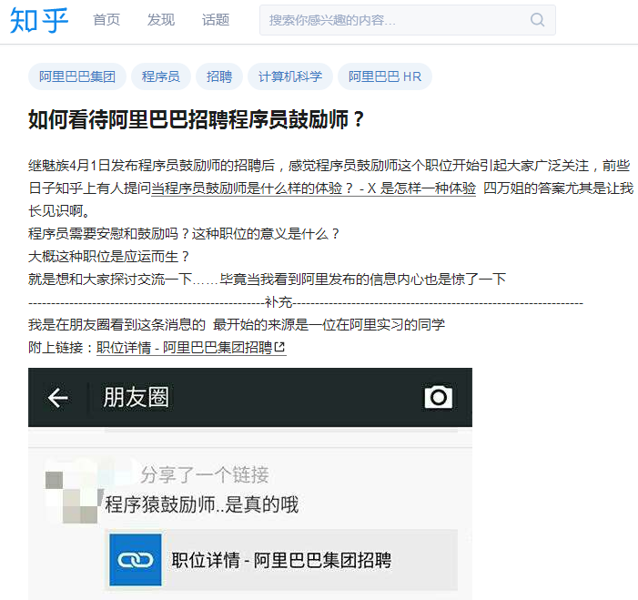
Roles
Domain expert
Architecture
Designer
Programmer
Quality engineer
Team manager

Slide 26
Projects
Controlled experiment
Evaluation
Empirical study
Potential estimation
Questionnaire and interview
Incremental approach
Novel approach

Slide 27




Underlying techniques

Slide 28
Code analysis- Java model
Eclipse JDT
An open source compiler that is integrated with Eclipse
APIs to access, create, and manipulate Java projects’ source code

Slide 29
How do we use Java model?
https://www.programcreek.com/2011/01/best-java-development-tooling-jdt-and-astparser-tutorials/

Slide 30
Create New Java Elements

Slide 31
Abstract syntax tree
More details: http://www.vogella.com/tutorials/EclipseJDT/article.html

Slide 32
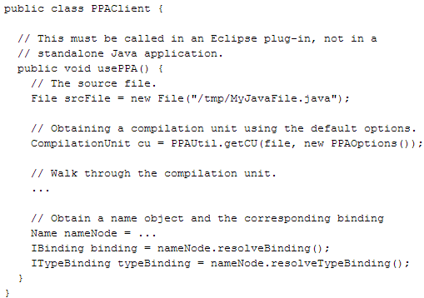
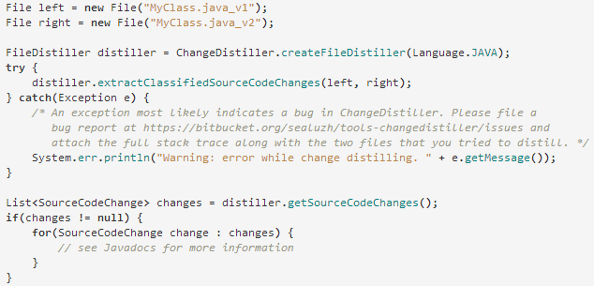
Partial program analysis
A partial program is a subset of a complete program.
PPA
http://www.sable.mcgill.ca/ppa/ppa_eclipse.html
Changedistiller
http://www.ifi.uzh.ch/en/seal/research/tools/changeDistiller.html

Slide 33
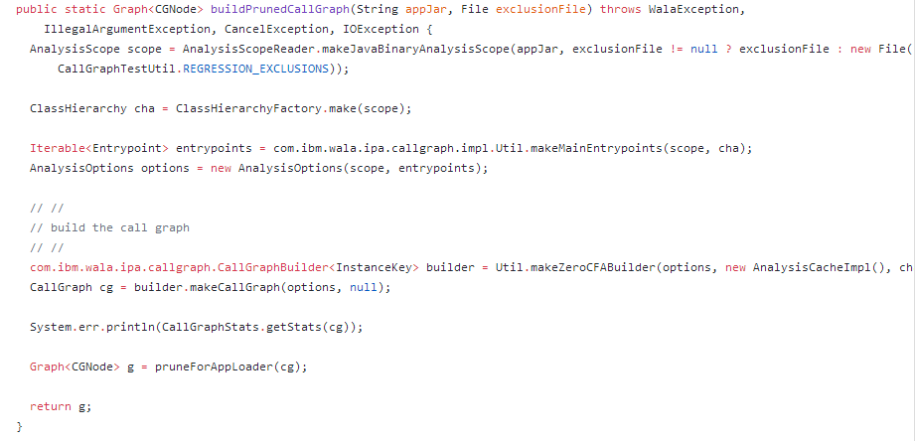
More advanced analysis
WALA
http://wala.sourceforge.net/wiki/index.php/Main_Page
Soot
https://sable.github.io/soot/

Slide 34
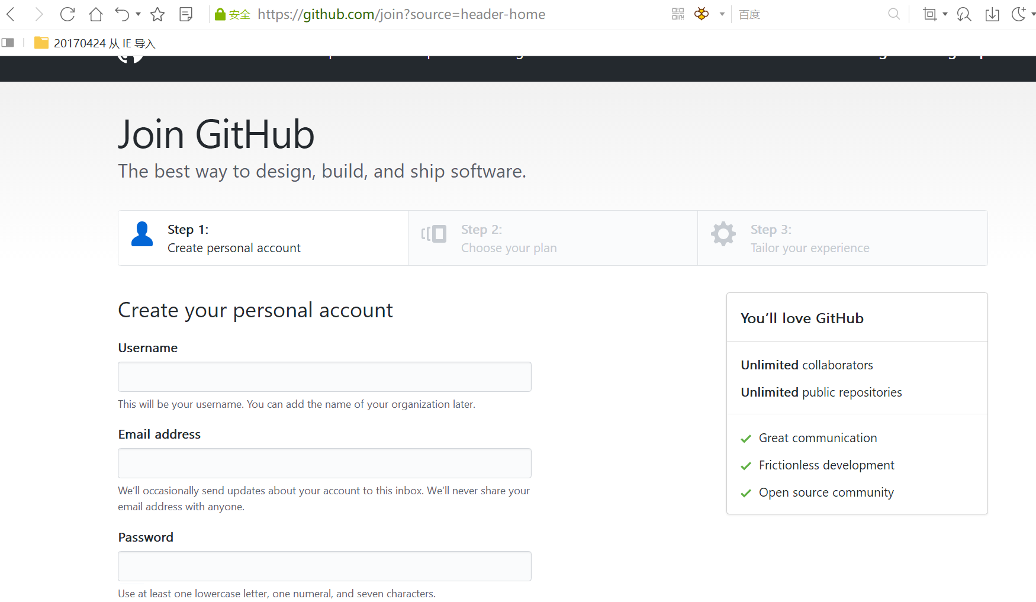
Development environment
Java
https://blog.csdn.net/u012934325/article/details/73441617/
Eclipse
http://www.runoob.com/eclipse/eclipse-install.html
Github
https://blog.csdn.net/earl_yuan/article/details/60476938
My account: zhonghao@pku.org.cn

Slide 35
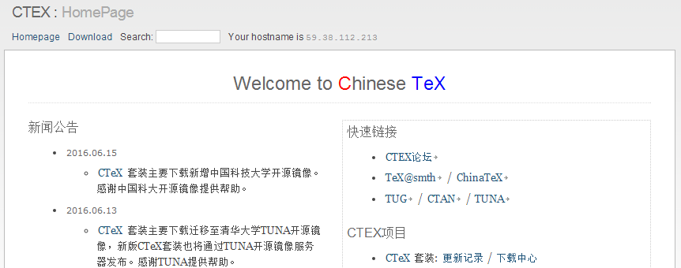
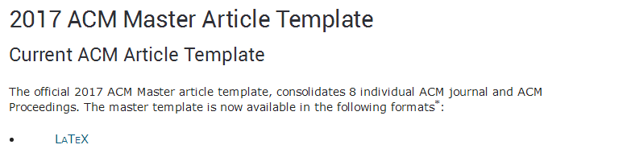
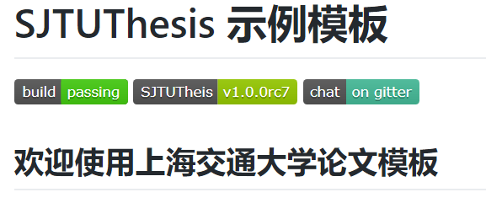

Writing report
http://www.acm.org/publications/proceedings-template
http://www.ctex.org/HomePage
http://tug.org/texlive/
https://github.com/sjtug/SJTUThesis

Slide 36
This class
Introduction
Science and research
Open source
Software engineering data
Code analysis
Compiler
Partial program analysis
WALA, SOOT

Slide 37

Next class
Domain Expert

