Slide 1
Domain Expert
Hao Zhong
Shanghai Jiao Tong University

Slide 2
Grading Schema
Exam: 50%
Paper reading 10%
Project: 50%
Midterm presentation 10%
Final term presentation 10%
Technical report 30%

Slide 3
Empirical study vs approach
Empirical study
Research questions
Interesting
Their answers are unknown
Analysis methodology
Tool support
Manual inspection
Result
Interesting? Important?
Approach
Tool
Novel
Useful
Evaluation
Research questions
Setup
Results
An empirical study on evolution of API documentation Lin Shi, Hao Zhong, Tao Xie, and Mingshu Li In Proc. Fundamental Approaches to Software Engineering (ETAPS/FASE), pages 416-431, 2011.
Detecting API documentation errors Hao Zhong and Zhengdong Su In Proc. Object-Oriented Programming, Systems, Languages & Applications (OOPSLA), pages 803-816, 2013.

Slide 4
What is Software (engineering)?
Software is a collection of artifacts
Characteristics of software
Software engineering is the establishment and use of sound engineering principles in order to obtain economically software that is reliable and works efficiently on real machines
by Prof. Fritz Bauer at the 1968 NATO conference on software technology, in Garmisch, Germany.
In short, software engineering is about developing quality software in a productive way.

Slide 5
What is Software (engineering)?
Software is a collection of artifacts
Computer programs
Data
Documents
Characteristics of software
Software is complex
Software evolves
Software engineering is the establishment and use of sound engineering principles in order to obtain economically software that is reliable and works efficiently on real machines
by Prof. Fritz Bauer at the 1968 NATO conference on software technology, in Garmisch, Germany.
In short, software engineering is about developing quality software in a productive way.

Slide 6
Software Process Models
Requirements
engineering
Design
Implementation
Integration
The waterfall model

Slide 7
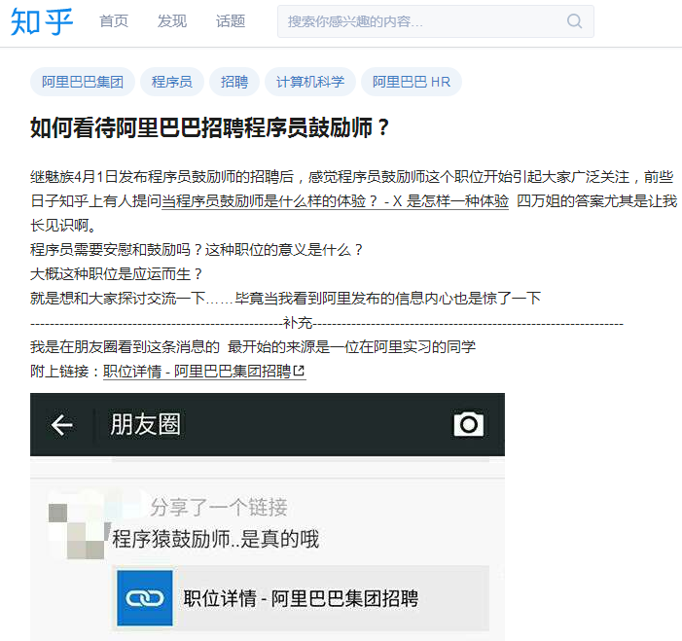
Roles
Domain expert
Architecture
Designer
Programmer
Quality engineer
Team manager

Slide 8

Role
The term domain expert is frequently used in expert systems software development, and there the term always refers to the domain other than the software domain. A domain expert is a person with special knowledge or skills in a particular area of endeavor. (An accountant is an expert in the domain of accountancy, for example.)
Requirements
engineering
Design
Implementation
Integration
The waterfall model

Slide 9
Requirement
RUP: A requirement describes a condition or capability to which a system must conform; either derived directly from user needs, or stated in a contract, standard, specification, or other formally imposed document.
UML: A desired feature, property or behavior of the system.

Slide 10
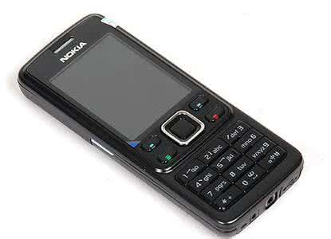
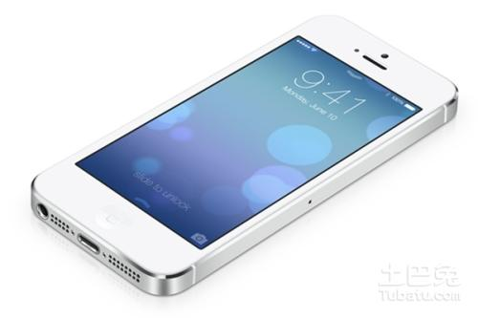
Requirement analysis is hard
Major causes of project failures
Incomplete requirements
Changing requirements
Poor user input

Slide 11
The cost to fix a problem
Stage
.5 - 1
Requirements Time
2.5
Design
Stage discovered | Relative repair cost (p.day)
Requirements | 0.1 – 0.2
Design | 0.5
Coding | 1
Unit test | 2
Acceptance test | 5
Maintenance | 20
5
Coding
10
Unit Test
25
Acceptance Test
100
Maintenance

Slide 12
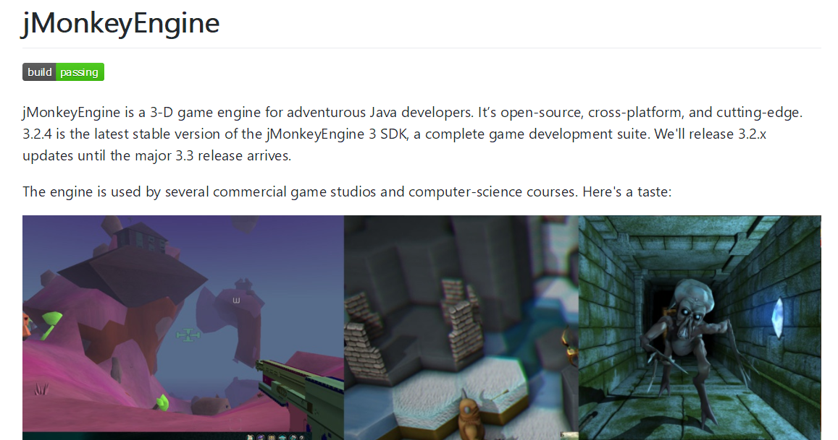
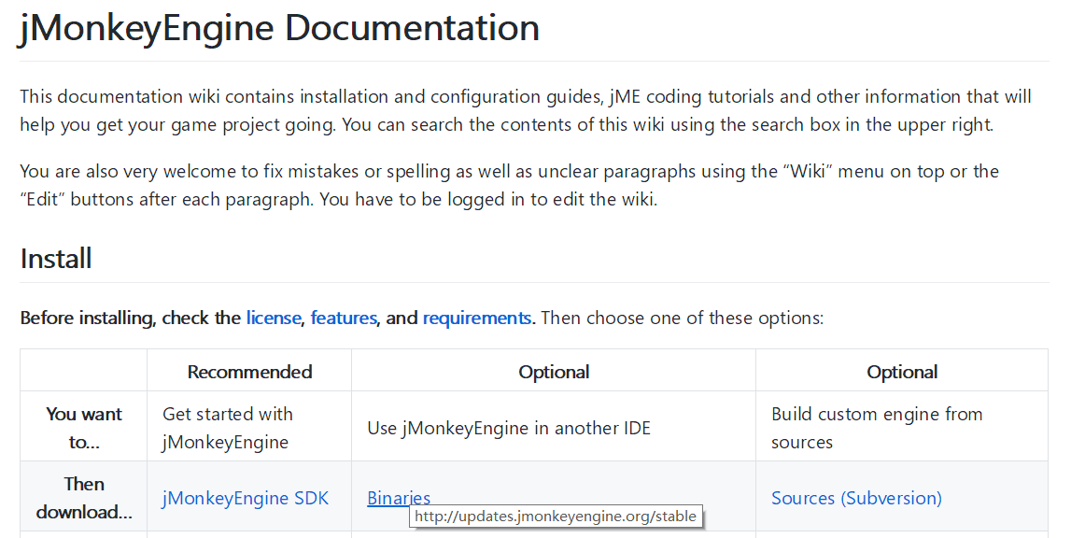
Open source
Company and organizations
Requirement documents are not provided.
Design documents are not provided
Individual
No requirement documents

Slide 13



Do we need requirements?

Slide 14



Outsourcing

Slide 15
Requirements engineering
First stage of software life cycle
Produces a document, software requirements specification (SRS)
Customers provide a high level ideas
Software developers need a more detailed specification
Requirements are bridging the gap between the minds of customers and developers
Customers “know” what the system shall do
Developers “know” what they are going to build
“Requirements are means of communication with customer and many other stakeholders”
-- by Helene Wong, PhD thesis, 1994

Slide 16
Types of requirements
Functional
What is the system supposed to do
Mapping from inputs to outputs
Non-functional (quality)
Performance
Resource Consumption
Usability
Reliability
Robustness
Portability
…

Slide 17
Stakeholders
People who support, benefit from, or affected by a software project
Stakeholders may include
Customers
Users
Final beneficiaries
System administrators
Supervisors

Slide 18
Stakeholders (example)
Name | Represents | Role
IT Executive | IT Department and Wylie College as whole. | Responsible for project funding approval. Monitors project progress.
Registrar | The office of the registrar, administrative and data entry personnel. | Ensures that the system will meet the needs of the registrar, who has to manage the course registration data, including professor and student databases.
Student | Students | Ensures that the system will meet the needs of students.
Professor | Professors | Represents the interests of the faculty (professors).

Slide 19
Requirements engineering process
Elicitation
Analysis
Specification
Validation

Slide 20


Requirements elicitation
Elicitation is to gather
Functions that the system should perform
Non-functional requirements that the system should exhibit
Elicitation is critical but difficult
Customers are not good at describing what they want
Software engineers are not good at understanding what customers want
Customers and software engineers speak different languages

Slide 21
Elicitation approaches
Brainstorming
Gather stakeholders, collect ideas and prune
Interviewing
Formal or informal interviews with stakeholders
Prototype
GUI, flow charts of UIs
Testable User Story
…

Slide 22
Requirements analysis, Why?
Requirements analysts have to understand the system from each stakeholder's point of view
Stakeholders have different views of the system
Requirements analysts resolve conflicting views

Slide 23
Requirements analysis
Goal
Determine the scope of the software
Categorization, negotiation, and decision:
Few established fixed approaches
Large amount of mental work based on domain knowledge
Requirements analysts prioritize requirements
Essential requirements
Desirable requirements
Optional requirements

Slide 24
Requirements specification
Document what is required of the system to be developed
State the requirements from the perspective of the developers
Natural Language Specification
Structure Specification
Graph Notation Specification
Mathematical Specification
Formal

Slide 25
Glossary (Conceptual models)
Course
A class offered by the university.
Course Offering
A specific offering for a course, including days of the week and times.
Course Catalog
Unabridged catalog of all courses offered by the university.
Grade
The grade for the student in a course.
Report Card
All the grades for all courses taken by a student in a given semester.
Roster
All the students enrolled in a particular course offering.
Transcript
The history of the grades for all courses for a particular student.

Slide 26
Natural language specification
The requirements are written using numbered sentences in natural language.
Each sentence should express one requirement.
Diagrams and tables can be used for better understanding of the specification

Slide 27
Natural language specification
Formatting
Invent a standard format and use it for all requirements
Font, size, indentation, …
Use text highlighting to identify key parts of the requirement.
Wording
Use language in a consistent way.
E.g. always use shall for mandatory requirements, should for desirable requirements
Avoid the use of computer jargon
Contents
Avoid ambiguity in expression
Add as much details as you can (think as a developer)

Slide 28
An example of natural language specification
1.1 If sales for current month are below target sales, then report is to be printed, unless the difference between target sales and actual sales for the current month is under 5%.
Any problems with this specification?
Ambiguity: 5% of actual sales or target sales?
Potential term inconsistency: sales & actual sales
What are contents in the report?
When and how to print?

Slide 29
Natural language specification
Pros
Expressive, can express almost any concepts, although not precisely
Can be understood by users, customers, developers, etc.
Easy to write
Cons
Ambiguity, imprecision
Contradictions can happen
Functional and non-functional requirements tend to be mixed-up
Several different requirements may be expressed together

Slide 30
Structured specifications
The structure of a requirement is predefined
The freedom of the requirements writer is limited
Some common structures:
Forms
Tables

Slide 31
Form-based specifications
Definition
Definition of the function or entity
Description of the action to be taken
Input & Output
Description of inputs and where they come from.
Description of outputs and where they go to
Pre and post conditions (if any)
Dependencies
Information needed & other entities used
The side effects (if any) of the function
E.g., reduced credit score when you query it

Slide 32
Example: Insulin pump for blood sugar control
Insulin Pump/Control Software/SRS/3.3.2
Function
Compute insulin dose: safe sugar level.
Description
Computes the dose of insulin to be delivered when the current measured sugar level is in the safe zone between 3 and 7 units.
Inputs
Current sugar reading (r2); the previous two readings (r0 and r1).
Source
Current sugar reading from sensor. Other readings from memory.
Outputs
CompDose—the dose in insulin to be delivered.
Destination
Main control loop.

Slide 33
Example: Insulin pump
Action
CompDose is zero if the sugar level is stable or falling or if the level is increasing but the rate of increase is decreasing. If the level is increasing and the rate of increase is increasing, then CompDose is computed by dividing the difference between the current sugar level and the previous level by 4 and rounding the result. If the result, is rounded to zero then CompDose is set to the minimum dose that can be delivered.
Requirements
Two previous readings so that the rate of change of sugar level can be computed.
Pre-condition
The insulin reservoir contains at least the maximum allowed single dose of insulin.
Post-condition
r0 is replaced by r1 then r1 is replaced by r2.
Side effects
None.

Slide 34
Table specification
A map from inputs to outputs in the form of a table
Each line corresponds to a case in inputs
The corresponding action is filled in
Particularly useful when you have to define a number of possible alternative courses of action.

Slide 35
Example: Insulin pump
Condition | Action
Sugar level falling (r2 < r1) | CompDose = 0
Sugar level stable (r2 = r1) | CompDose = 0
Sugar level increasing and rate of increase decreasing ((r2 – r1) < (r1 – r0)) | CompDose = 0
Sugar level increasing and rate of increase stable or increasing ((r2 – r1) ≥ (r1 – r0)) | CompDose = round ((r2 – r1)/4) If rounded result = 0 then CompDose = MinimumDose

Slide 36
Structured specifications
Pros
Easier to control quality compared with pure natural language
Still easy to write and understand
Reduce imprecision and missing of details
Cons
The form of structure has strong impact on the quality of specification, and is not easy to design
Less expressiveness due to the rigid structures
Still has the problem of natural language expression, such as ambiguity, missing term definitions, etc.

Slide 37
Graph notation specification
Predefined graphical models
Supplemented by text annotations
Existing techniques:
UML: Use case diagram

Slide 38
Use case diagram
Used as a graphics notation for requirement engineering
System: drawn as a box
Actors: outside the system
Use cases: inside the system
Relations among use cases

Slide 39
Actors
Actors are external to the system
An actor specifies a role
Users that operate the system directly
Other software systems or hardware pieces that interact with the system
One person or thing may play many roles in relation to the system simultaneously or over time

Slide 40
Use case
Use cases are usages of the system
Use cases capture the functional requirements
Use cases provide the high-level descriptions of the system’s functionality in terms of interactions
Use cases show inputs and outputs between the system and the environment
Use cases are from the user’s point of view

Slide 41
Use case diagram
Actor: an entity in the environment that initiates
and interacts with the system
Use case: usage of system
a set of sequences of actions
Association: relation between actor and use cases
Includes dependency: a sub use case
Extends dependency: a subtype of use cases
<<include>>
<<extend>>

Slide 42
Use case – an example
ATM system
Withdraw cash
Check account balance
Maintain usage statistics
…

Slide 43
Initial Use Case Diagram for ATM

Slide 44
Elaborated Use Case Diagram for ATM

Slide 45
Mathematic specification
Write specification using predefined formal languages
Define all concepts, inputs, and corresponding outputs /actions formally
Some popular specification languages:
Z language
Alloy
…

Slide 46
Example: word split with Z language
Textual Description
Purpose: Breaking a text into words
A text is a sequence of characters.
Certain characters are blanks: spaces, line breaks, and tabs
A word is a sequence of non-blank characters
A separator is a sequence of blank characters.
Concept Definition:
char == [CHAR] (CHAR is defined as all characters)
blank == [space, line break, tab]
TEXT == seq char (seq is a predefined function, meaning a sequence of elements from its set-type argument)
SEPARATOR == seq1 blank
WORD == seq1 (char \ blank)
Note: TEXT includes the empty sequence, but SPACE and WORD must have at least one character, so we declare them to be seq1 (non-empty sequences).

Slide 47
Mathematic specification
Pros
Precise, little ambiguity (almost pseudo code)
Computer readable, so correctness can be checked with automatic tools (e.g. model checker)
Easy to write test case based on the specification (providing oracles)
Cons
Hard to understand
Hard to write, costly to find people writing it and using it
Expressiveness depending on the specification language (often not expressive enough)

Slide 48
In practice
Natural language
Widely used, especially for small projects
Structure
Often used as a supplement to natural language
Graph Notation
Widely used in industry, outsourcing
Mathematics
Compilers (programming language)
Model checker

Slide 49
Requirements validation
Review
Systematic manual analysis of the requirements
Regular reviews should be held while the requirements definition is being formulated
Both client and contractor staff should be involved in reviews
Reviews may be formal (with completed documents) or informal
Prototyping
Using an executable model of the system to check requirements. Covered in previous lectures
Test-case generation
Developing tests for requirements to check testability
Used in extreme programming, also used as a validation technique

Slide 50
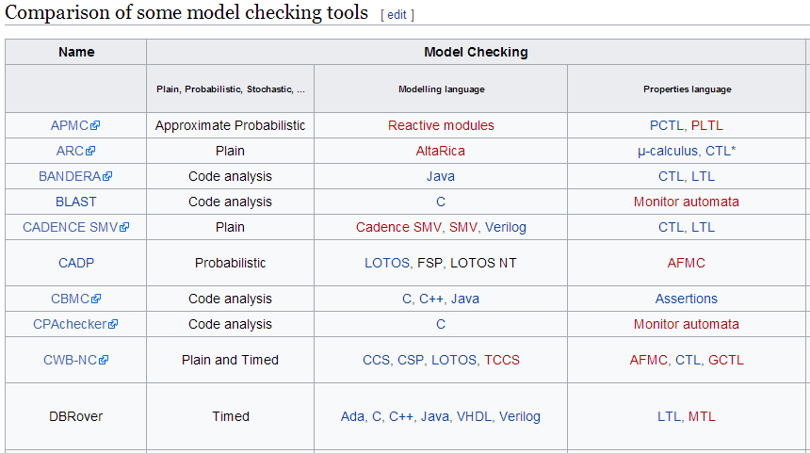
Requirements validation
Verification
Consistency checking (No contradictions)
Completeness checking (All concepts are well defined)
Usually require mathematical specification

Slide 51
This class
Requirement Engineering
Concepts
Definition
Stakeholders
Types of requirements
Process
Elicitation
Analysis
Specification
Validation

Slide 52
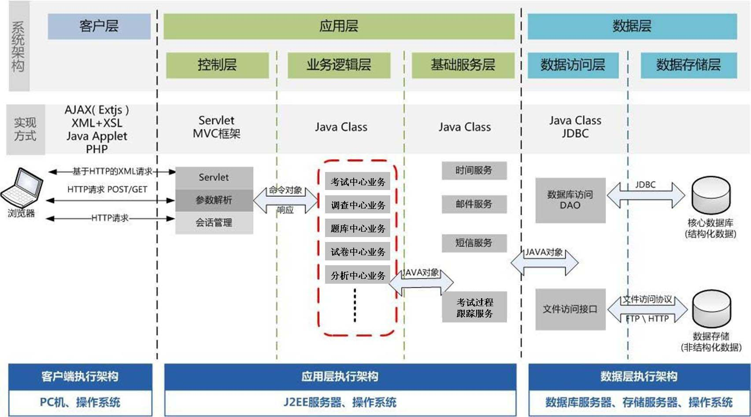
Next class
Software architect

